Slide 1
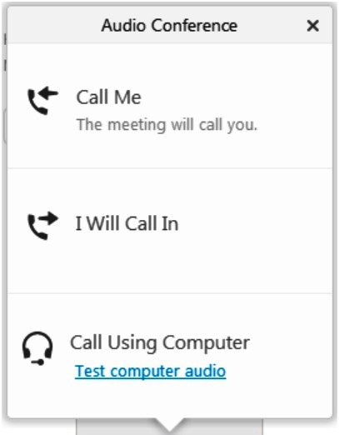
W.WA Municipal Stormwater Permit Reissuance Webinar Will Begin Soon
Connecting to Audio: 3 Options
Phone (for best sound quality)
Select “Call Me”
Enter your phone number
You will be called
Or select “I Will Call In” and dial the number provided
Computer microphone and speakers
Select “Call Using Computer”
and follow directions

Slide 2
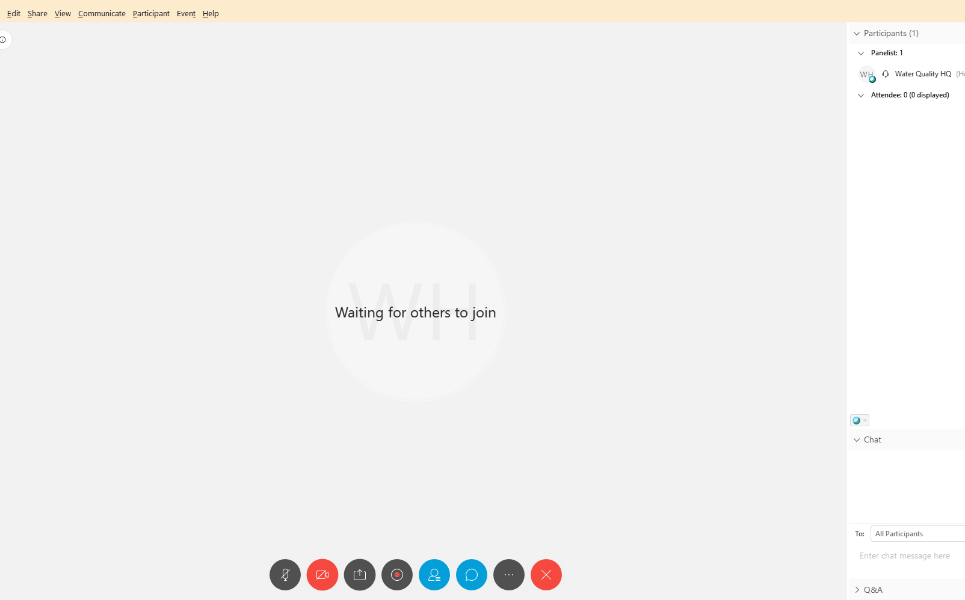
The webinar is starting– you should be able to hear us now! HOUSEKEEPING
For technical assistance or Q&A,
type in the white box below Chat.
Turn chat on/off here.
Notes:
Lucienne will quickly go over WebEx facilitation details and pass the baton to Emma to open the presentation

Slide 3
Structural SW Controls (SSC) Science Synthesis Project
Webinar on Thursday, November 21, 2019, from 10:00-11:30
Notes:
Emma: Welcome to our webinar. We’re going to move through some information in a presentation fashion and then take questions at the end, through the chat feature.

Slide 4
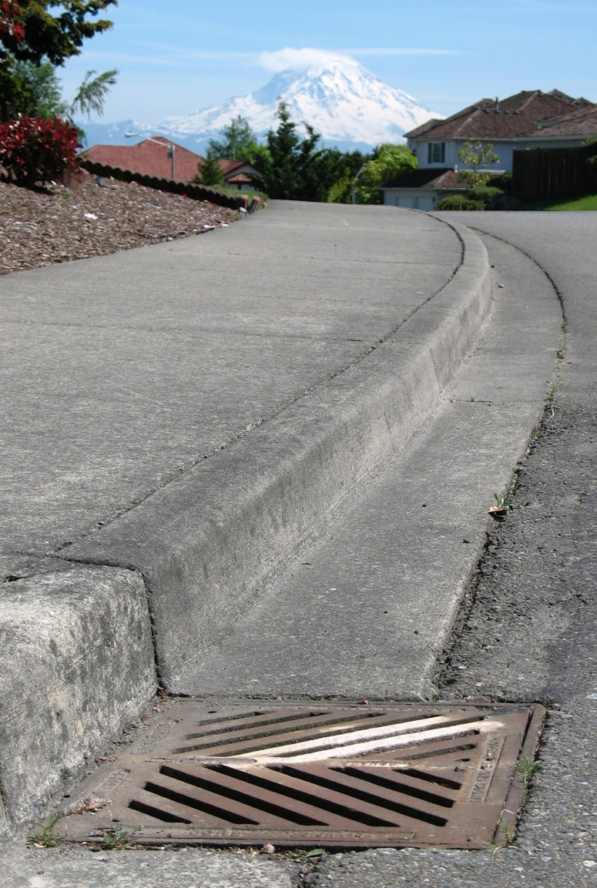
Introduction
What are we talking about today?
Why SSC is important
A science synthesis will help support future conversations about policy
Photo by Dan Smith, Federal Way
Notes:
Emma –We know stormwater is a major source of pollution in our surface waters, and treating stormwater from existing areas is an important step in solving the problem. The SSC program is the retrofit program currently required in the PH I Municipal Stormwater Permits, that works towards just that.
Today we’re talking about the Structural SW Science Synthesis Project, and how this project will help support future conversations about policy.

Slide 5
Purpose of this webinar
Provide background and context to orient participants to the Structural Stormwater Control (SSC) science synthesis project and help participants understand:
Phase I permit SSC requirement
Relevance to Phase II permittees’ planning requirement
Purpose and sideboards for the SSC science synthesis project
Who, what, where, when, why, and how of the project
Timeline and opportunities to participate in the process
Next steps (policy discussions) following this project
Notes:
Emma
For folks who were unable to attend the discussion on October 31, this is a repeat of the background and context information shared at recent meetings as well as a summary of the input Ecology has received in the last month or so.
So to give a roadmap of the next 30 minutes:

Slide 6
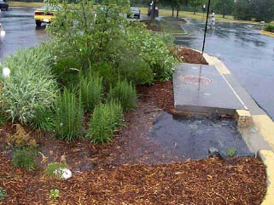
What is SSC?
Structural Stormwater Controls requirement in Phase I permit
S5.C.7 and Appendix 12: Address stormwater impacts not otherwise adequately controlled by other areas of the Permit.
Disturbances to watershed hydrology and discharges of pollutants
In areas of existing development, including roadways
In areas of new development to prevent anticipated future impacts
Introduces a defined LOE
Requires a prioritization process
Applied in a wide variety of geographic and receiving water conditions
Notes:
Emma – What is the SSC Program?
Applies to Phase I cities & counties, currently not a PH II requirement
Purpose is to prevent or reduce negative impacts from MS4 discharges not otherwise adequately controlled
It’s going to be helpful to know a bit of the history of the requirement, to understand how we got here today.
The program itself stems from a Federal requirement for these Phase I municipal stormwater permits to have a retrofit program.
SSC Program History
2007 – 2012 Permit, two permit cycles ago, we started to get more focused
Required a project planning process
Identified qualifying and non-qualifying project types
Required annual reporting of a project list
Permit was appealed to the Pollution Control Hearings Board (PCHB), and as a result, the PCHB told us we needed to set a level of effort for the SSC program
2013 – 2018 Permit, our goal was to collect information to be able to figure out how we wanted to go about setting a level of effort
Added reporting format as an appendix
Introduced 3 potential metrics to be calculated and reported:
Hydrologic benefit
Water quality benefit (i.e., treatment)
Retrofit incentive point (SSC program point)
Adjusted qualifying and non-qualifying project types
And added a prioritization process as a requirement
Current Permit- moving on to the current permit
Introduced a defined level of effort in the form of retrofit incentive points, now called SSC program points. So, PH I permittees now have to achieve a certain number of these points, that they get by designing and implementing qualifying project types, to be in compliance with the Permit
Added to, and adjusted qualifying project types
Further clarified and adjusted the SSC point calculation process

Slide 7
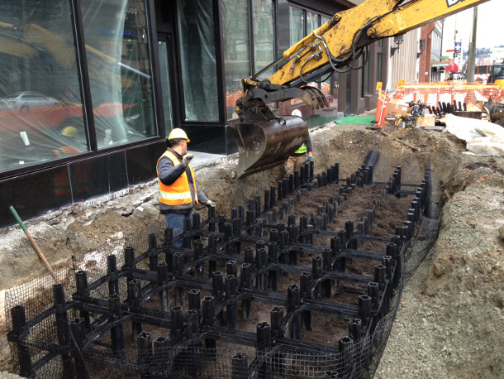
Eligible SSC projects/activities:
New flow control facility
New runoff treatment
New LID BMPs
Retrofit of existing facility
Property acquisition
Maintenance with high costs
Restoration of riparian buffer
Restoration of forest cover
Floodplain reconnection
Removal of impervious surfaces
Other actions
Notes:
Emma
The details are given in Appendix 12 of the Phase I permit. Mix of things people traditionally think of as retrofits, and things that aren’t directly related, but have a stormwater benefit. I also want to note that projects can be a combination of different project types, for example you can have a facility that does flow control and treatment and get points for both project types.
Also, ‘other actions’ is limited this permit cycle to include street sweeping and line cleaning, not otherwise used to comply with other permit requirements

Slide 8
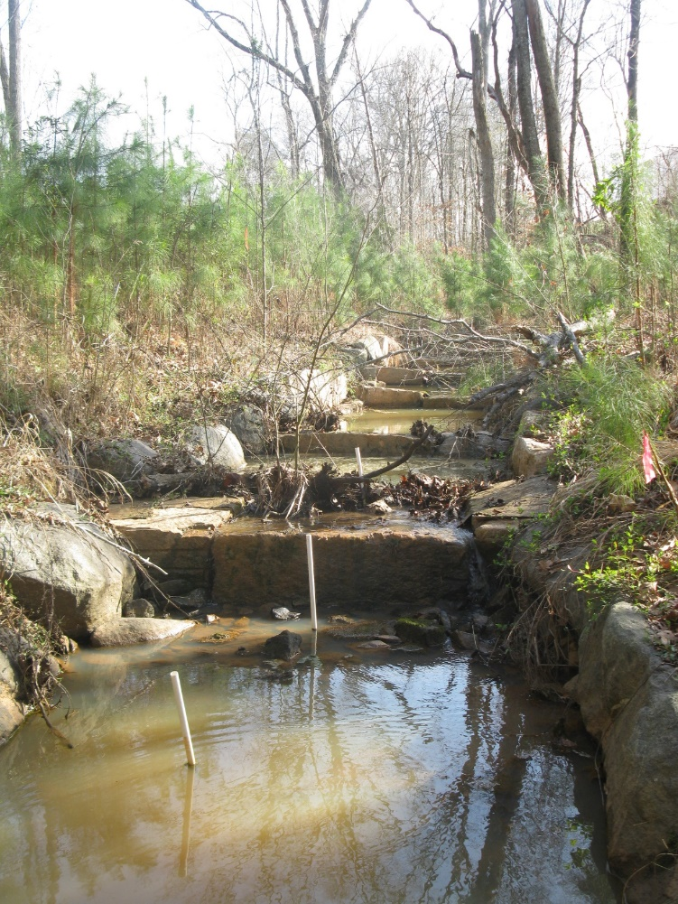
Non-qualifying projects/activities:
In-channel habitat and stream restoration
Fish barrier removal
Stabilization of down cutting
In-stream culvert replacement
Mitigation projects otherwise required
Notes:
Emma- These are also listed in Appendix 12
Non qualifying projects include
Projects that don’t have a nexus with the current MS4
Projects that occur in the receiving water.

Slide 9
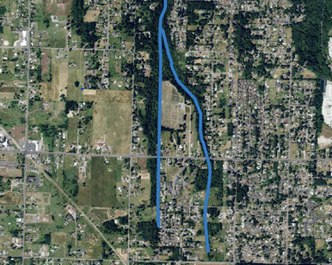
Why should Phase II permittees care about this project?
Stormwater Management Action Plan (SMAP) permit requirement
Inform permittee’s selection of short-term and long-term actions to address:
Disturbances to watershed hydrology and discharges of pollutants
In areas of existing development, including roadways, and/or
In areas of new development to prevent anticipated future impacts
Support the prioritization process
Inform 2024 permit conditions
Notes:
Emma
PH II permittees have a new Stormwater Management Action Plan requirement this permit cycle. Phase IIs must conduct planning to identify stormwater retrofits and other actions needed to protect/improve WQ and habitat. Ecology has not determined how Phase IIs will be required to implement their plans, but the information we learn from this process may be used to inform 2024 permit conditions.

Slide 10
SSC Program Point Structure
Goal to have calculations for Permittees requiring limited effort by identifying simple metric for each category of project
Allows for comparisons of
A variety of project types
Differing project benefits
Urban/rural projects
Standardizes quantification of qualifying projects
Notes:
Doug - Make it as easy as possible for jurisdictions to determine how many points they earned
Be able to compare environmental benefit between very different types of projects

Slide 11
SSC Program Point Structure
Emphasizes
Reducing negative impacts from existing MS4 discharges
Project effectiveness as compared to minimum technical requirements
Addressing water quality impairments
Preventing future negative impacts from future MS4s
Implementing basin or watershed plans
Notes:
Doug -

Slide 12
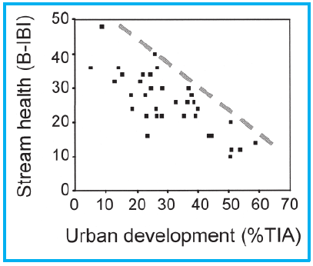
Right tool in the right place
Protect
Restore
Steward
Notes:
Doug – this requirement is applied in a wide variety of land uses and geographic settings. The Permittees need to prioritize their projects, and they should be taking receiving water needs into account
There are project types that address all of these categories- permittees can select from the full range

Slide 13
Sideboards on this Science Synthesis Project:
Science, not policy
The point system and level of effort questions will be undertaken in a stakeholder process that will be launched following the PCHB ruling
This project is intended to support that process
Goal is a common description of relative stormwater benefit of eligible SSC projects
Start with metrics
Consider land uses and broader settings
Notes:
Karen
Ecology has made a commitment to review the current permit point system with input from all stakeholders and, if needed, make refinements for the 2024 permit
Ecology sees this science synthesis project – the topic of this webinar - as providing a broadly accepted foundation for informing the 2024 permit requirements and refinements to the point system. We want everyone at the table to have a common understanding of the environmental benefits of the stormwater projects that are eligible for SSC points.

Slide 14
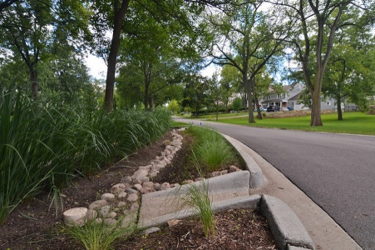
What is the proposed SSC science synthesis project?
Desired outcome:
An objective articulation of our collective knowledge and understanding of the stormwater benefits of the eligible SSC project types as applied in various settings, and definition of how best to measure those benefits in various settings
First requested by permittees, as a SAM project
Will be funded by Ecology to get results sooner, but still overseen by stakeholders
No new data collection: review and synthesis of available info to connect BMP effectiveness to environmental benefit
Anticipated completion in fall 2020
Notes:
Karen

Slide 15
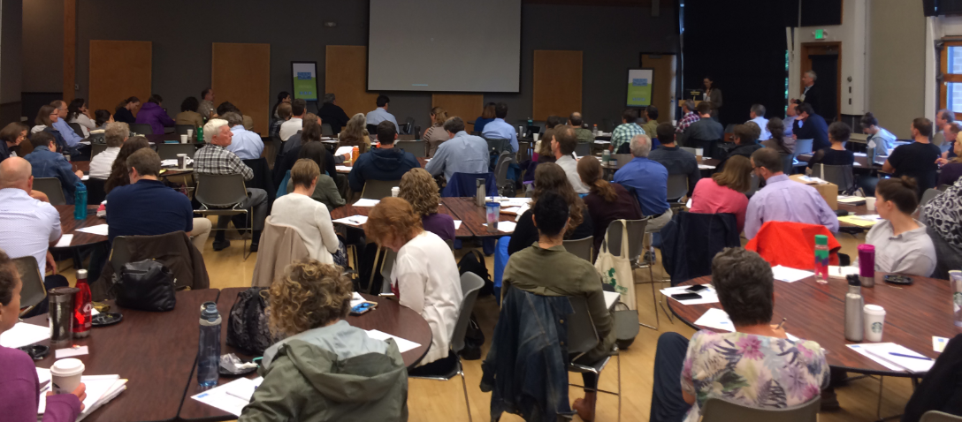
Draft proposed research questions
What are the most useful definitions of “environmental benefit” for various project/activity types?
What is the best metric for measuring the environmental benefit of each project/activity type?
What are the limitations of the metric across the gradient of urbanization and receiving water conditions/goals?
Are there project/activity types that are better suited for receiving waters that need to be protected versus restored versus stewarded?
How does land use play a factor in determining which BMPs will be most effective for these various purposes?
Within a project/activity type, are there more and less effective BMPs or combinations of BMPs?
What are other limitations or considerations for the most beneficial application of a specific SSC project or activity?
Notes:
Karen – This is the list of questions that are currently proposed for this science synthesis project. In addition to discussing these draft questions, the Ecology has asked the group to recommend an appropriate amount of funding for this project.
Some of the feedback so far:
The concept of environmental benefit is linked to the impact of the project. The first question seems broad – but we do need a clear understanding of the value of each project type – and so far the group generally agrees that we should cover all of the eligible project types. Since we have good metrics for some but not for others
We might consider making some of these questions specific to certain eligible project types
Need to articulate what assumptions are we going to be making
We also hope to look to the Phase I stormwater scenario modeling studies to further inform these questions and the process

Slide 16
Stormwater Work Group’s Effectiveness Subgroup
Who is defining this project?
This subgroup has been meeting since 2008 to identify, prioritize, scope, evaluate, and recommend permittee-funded effectiveness studies for the regional stormwater monitoring program, now called Stormwater Action Monitoring (SAM)
Membership in the subgroup is open to all interested parties
The subgroup met on October 31, 2019 to begin to discuss this project and recommend a solicitation and evaluation process, the science/research questions, and a recommended funding amount to the Stormwater Work Group
Stormwater Work Group
Notes:
Karen – I’ve been talking about “the group” and want to make sure everyone understands who is working on defining these research questions.
Ecology is using the Stormwater Work Group’s existing (open, transparent) stakeholder process for the science discussions that will be held in advance of the policy discussions on this topic. Some of you know that Ecology has about $250K available for stormwater work, some of which we intend to use to fund this project. We are interested in the subgroup’s recommendation for the appropriate level of effort, or funding amount, for the science synthesis.
Please let me know if you want to join the discussion and provide your input. My email and phone number will be on the last slide of the presentation

Slide 17
Proposed timeline for SSC science synthesis project and ensuing policy discussions
Who | When | What
SWG Effectiveness Subgroup | October 31, 2019 | First discussion of science questions
SWG | November 13, 2019 | General discussion of RFP process
Ecology | November 21, 2019 | Webinar to expand communication
SWG Effectiveness Subgroup | December 9, 2019 | Second discussion of science questions
SWG Effectiveness Subgroup | TBD January 2020 | Another meeting if needed
SWG | January 15, 2020 | Approve RFP process
Ecology and project proponents | January 15, 2020 | RFP goes out, proposals due on February 6
SWG Effectiveness Subgroup | February 7 to March 11, 2020 | Proposal reviews: evaluation and scoring
SWG | March 18, 2020 | Approval of successful SSC proposal(s)
Ecology | March-April 2020 | Contracting process
SSC project proponent(s) | April-May 2020 | Form a technical advisory committee (TAC)
SSC project proponent(s) | Summer-fall 2020 | Deliver draft findings to Ecology
SSC project TAC | Summer-fall 2020 | Review draft deliverables
SSC project proponent(s) | Fall 2020 | Deliver final science review products
PCHB | October 2020 | Hearing of appeal issues
PCHB | 3-6 months > hearing | Ruling on appeal issues
Ecology | After PCHB ruling | Launch stakeholder process on SSC policies
Ecology | 2022 | Begin permit reissuance process
Notes:
Karen – this is the proposed timeline for the Science Synthesis project and the ensuing policy discussions about the point system and level of effort. If the group decides more time is needed, then we might be able to extend it a couple of months. But the goal is to complete this project in time for it to produce a valuable synthesis of information to inform those policy discussions.

Slide 18
Proposed timeline for SSC science synthesis project and ensuing policy discussions
Who | When | What
SWG Effectiveness Subgroup | October 31, 2019 | First discussion of science questions
SWG | November 13, 2019 | General discussion of RFP process
Ecology | November 21, 2019 | Webinar to expand communication
SWG Effectiveness Subgroup | December 9, 2019 | Second discussion of science questions
SWG Effectiveness Subgroup | TBD January 2020 | Another meeting if needed
SWG | January 15, 2020 | Approve RFP process
Ecology and project proponents | January 15, 2020 | RFP goes out, proposals due on February 6
SWG Effectiveness Subgroup | February 7 to March 11, 2020 | Proposal reviews: evaluation and scoring
SWG | March 18, 2020 | Approval of successful SSC proposal(s)
Ecology | March-April 2020 | Contracting process
SSC project proponent(s) | April-May 2020 | Form a technical advisory committee (TAC)
SSC project proponent(s) | Summer-fall 2020 | Deliver draft findings to Ecology
SSC project TAC | Summer-fall 2020 | Review draft deliverables
SSC project proponent(s) | Fall 2020 | Deliver final science review products
PCHB | October 2020 | Hearing of appeal issues
PCHB | 3-6 months > hearing | Ruling on appeal issues
Ecology | After PCHB ruling | Launch stakeholder process on SSC policies
Ecology | 2022 | Begin permit reissuance process
Notes:
Karen –The next conversation about these questions is scheduled for December 9. Send me an email if you want to be included in the list for getting information about the December 9 meeting and subsequent discussions.

Slide 19
Questions?
Emma Trewhitt Phase I Permit Writer (360) 407-7428 emma.trewhitt@ecy.wa.gov
Abbey Stockwell Phase II Permit Writer (360) 407-7221 abbey.stockwell@ecy.wa.gov
Karen Dinicola Senior Policy Lead (360) 407-6550 karen.dinicola@ecy.wa.gov
Doug Howie Senior Stormwater Engineer (360) 407-6444 douglas.howie@ecy.wa.gov
Notes:
Emma – open up Q&A. Please type your questions into the chat box and we will answer them in the order we receive them.
Sideboards: not discussing the science questions today. But we want everyone to understand the purpose, sideboards, and process of the permit.
For future questions: this is the project team. Emma is the project lead; Karen is running the stakeholder process for this SSC project.

