Slide 1
UTC Rate Setting for Recycling Collection
Mike Young
Section Supervisor, Water and Transportation
Regulatory Services Division
Washington Utilities and Transportation Commission

Slide 2
Legislative Authority
RCW 81.77.030: The Commission shall supervise and regulate every solid waste collection company in this state,
(1) by fixing and altering its rates, charges, classifications, rules, and regulations.
(5) By requiring compliance with local solid waste management plans and related implementation ordinances
RCW 81.77.130 and 81.77.020-do not apply to cities that undertake themselves, or contract for, the collection of garbage and/or recyclable materials.

Slide 3
Rate Setting Concepts
Rates are set on a “cost plus return” basis
Utilizing the Lurito-Gallagher methodology
Garbage rates cannot subsidize recycling rates
Recycling must pay for itself
Cost causer bears the burden
Person generating the solid waste or recycling is responsible for the cost to collect, process and/or dispose of the material
Revenue generated from the material belongs to the customer
RCW 81.77.185 - companies may retain up to 50% under revenue sharing; what is not retained must be returned to the customer

Slide 4
Traditional Rate Setting
Cost of collection is reflected in the (Tariff) rate billed to customers.
Rates adjusted through a General Rate Case
Audit of company-wide financial data
Determination of rate base-value of assets used in collection process
Calculation of rate of return
Price-out to apportion costs to appropriate lines of service
Typical costs include:
Driver and labor hours
Truck operating and repair costs
Recovery of capital equipment costs
Processing or disposal of material costs
Commodity Credit is amount returned to customers reflecting the value of the commodities when sold at market
Monthly bill “credit” that off-sets collection costs
Adjusted yearly in a filing with the commission
Utilizes simple tracker formula with true-up for regulatory lag

Slide 5
Recycling Markets-the New Norm
Little or no revenue received for sale of commodities
commodity credits go to zero, or
Company continues to give customers credits while receiving zero revenue
Increased processing costs for contamination reduction, storage, transportation, or even disposal
Increased processing charges passed to collection company
Disposal costs increase as more contaminates removed
Transportation, storage and disposal costs increase for materials not marketable
Netting any revenue received, and processing costs incurred, now results in additional cost to the collection company

Slide 6
How can UTC alleviate the cost burden?
General Rate case
Company can file to update costs for recycling collection and change tariff rates
Commodity adjustment (formerly known as “credits”)
Adjusted to include additional processing costs
Surcharges
Customers receive an additional charge on their bill for processing recyclable commodities

Slide 7
Commodity Adjustments
“Commodity Credits” become “Commodity Debits”
Monthly charge to customers in addition to collection rate
Can be calculated using same tracker methodology already in place
Can alter the projection period for commodity adjustments
Allows the company to be more reactive to market changes
Prevents overpayment of credits
Requires the company to file more often

Slide 8
Surcharges
Surcharges to recover the incremental changes in processing cost
Applicable to collection companies utilizing affiliate-owned MRFs
Based on previously audited costs from a general rate case
Only covers variable operating costs affected by market volatility
Surcharge is a temporary monthly charge to customers appearing on their bill as a separate line item
Commission is currently allowing 90 day surcharges;
Separate from commodity adjustment and collection rate; now 3 lines on billing for recycling
Based on costs incurred by affiliated MRF to reduce contamination until longer-term solutions can be sought.

Slide 9
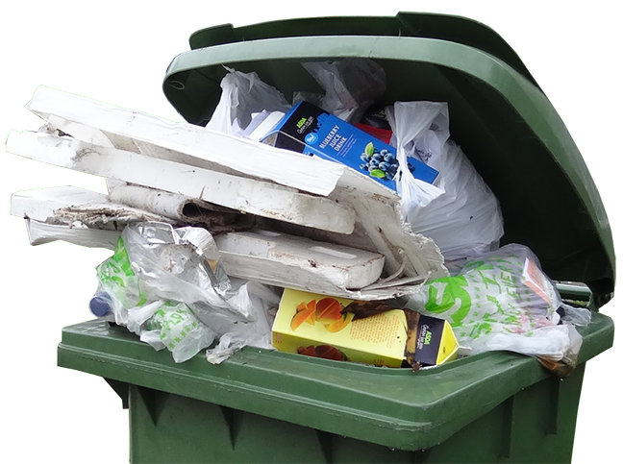
Surcharges
Types of costs allowed:
Increase in labor to operate MRFs
Increase in maintenance costs to keep facility running
Increase in utility costs to keep facility running
Increase in disposal costs of contaminants
Costs not allowed:
Capital costs for new equipment
Increased overhead or managerial costs
Other costs not directly associated with processing material

Slide 10
So far
Commodity adjustments
All regulated companies that offer curbside recycling are utilizing alternate projection periods for calculation
Most credits have become debits, but costs are starting to stabilize
Commission requiring outreach via one-time customer notices
Surcharges
The largest operations (Spokane, King and Snohomish Counties) utilize affiliate MRFs and have requested surcharges
Now that costs have stabilized somewhat, the commission is looking at ways of rolling these costs into normal service rates; simplify customer bills

Slide 11
What’s Next?
Commission working with companies to incorporate additional or new costs into collection rates
Commission reviewing Revenue Sharing programs in light of little or no revenue
Commission initiating an additional step in review of County Comprehensive Solid Waste Plans

Slide 12
Incorporating Costs
Encouraging companies to file tariff revisions to include all costs associated with curbside collection, processing, marketing, and disposition of recycling material
Winding down the use of surcharges by extending the effective period (stabilizing the cost to customers) or requiring a tariff filing
Changing from “commodity credits” to “commodity adjustments” to allow for continued fluctuations of markets, changes in transportation and disposition of commodities
Requiring more support for additional processing costs, market prices, etc.

Slide 13
Revenue Sharing
RCW 81.77.185 allows companies to retain revenue from sale of recyclable commodities
County revenue sharing initiatives may no longer have a funding source if there is no market for commodities, or if the revenues are eaten up by additional processing costs
Should customers continue to pay (more) to continue these programs?
Should these programs be funded by other sources-tipping fees or county taxes for example?

Slide 14
County Solid Waste Plan Review
Commission reviews plans for additional costs to customers
Currently involves mostly tip fee increases
Cost Assessment Questionnaire has not been updated to reflect recent changes to recycling markets
Commission will review plans for “other” cost impacts to customers, such as continuing to require collection of materials that have no value or markets
More efficient to dispose of material in garbage than take the roundabout way to the landfill via recycling processors
Counties have more direct impact (through SWMP and ordinances) on consumer behavior than collection companies
Counties manage the full solid waste stream; regulated haulers are only one link in that chain, and are responsive to county requirements enforced by commission

Slide 15
New Norm
It is unlikely that recycling markets will return to the way they were 5 years ago
The commission seeks to partner with Ecology, Regulated Haulers, local governments, and stakeholders to educate customers and change behaviors to adapt to the new recycling market situations
It will take a holistic approach to adjust to the new norm
My contact information
Mike.young@utc.wa.gov
360 664-1155

