Slide 1
Waste Reduction Recycling & Education 2019-2021
Kelsey Dunne
Grants Technical Assistance Lead
& WRRED Program Coordinator

Slide 2
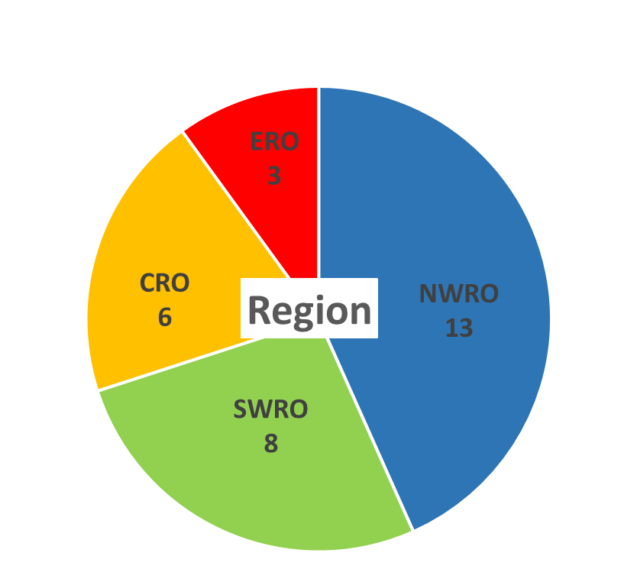
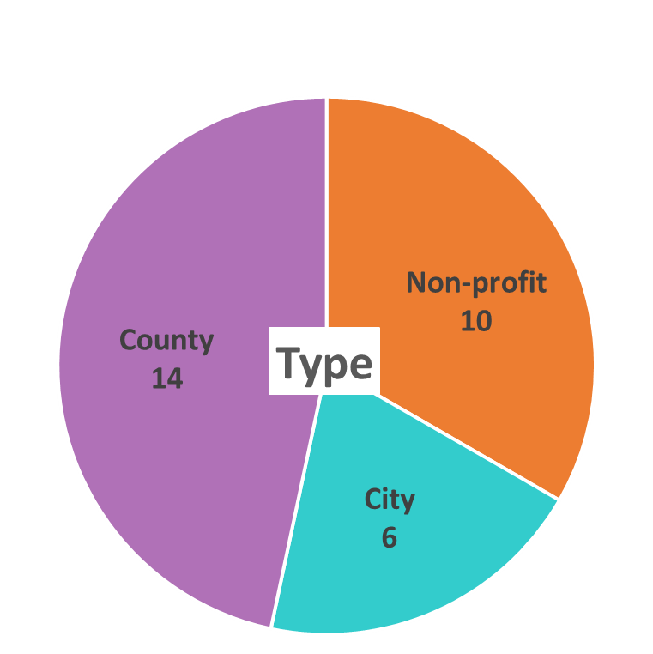
30 Applicants

Slide 3
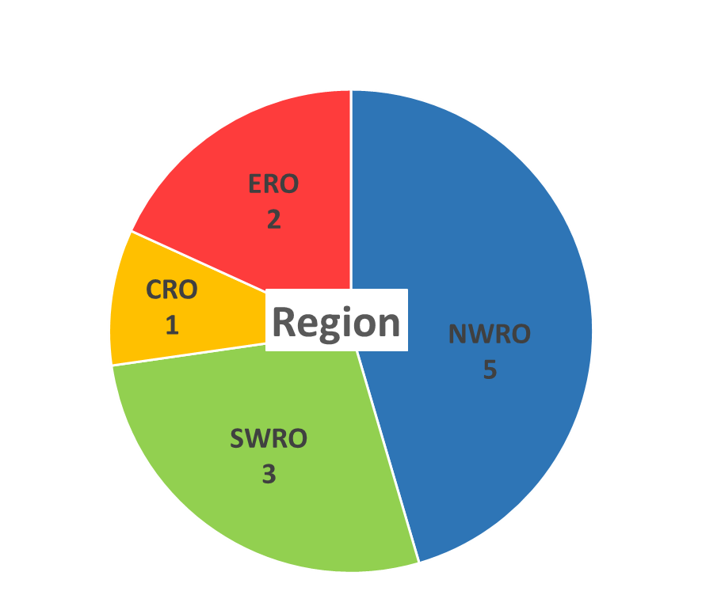
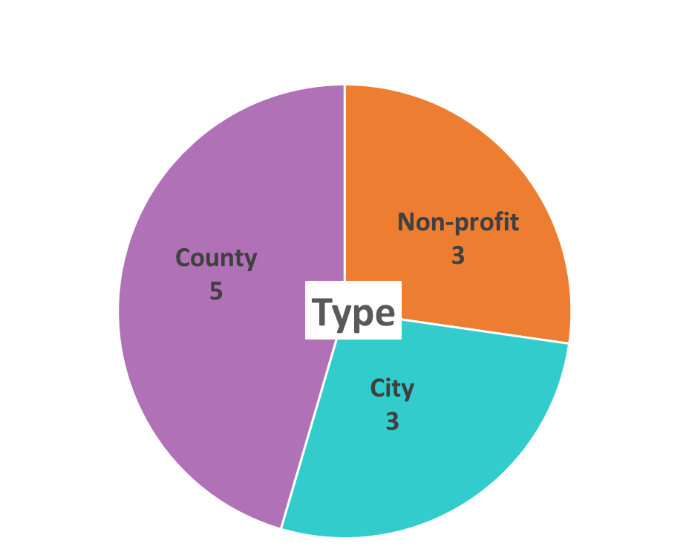
11 Funded Applications
Notes:
Follow along in the handout (copy of Rule) or on the screen.
We will be looking at our framework as it is laid out in rule, starting with Section 010. This is the backbone of the rule.
This section identifies our statutory authority; our foundation – RCW 70.105D.070(3).
We won’t go over this statute in detail today, but it is a something you will want to review and be aware of.

Slide 4
Funded Projects
Clark Co PH
Lewis Co SW
City of SeaTac
Klickitat Co SW
Clallam Co PW
City of Marysville
Snohomish Co PW
City of Walla Walla
Spokane River Forum
Zero Waste Washington
HopeWorks Social Enterprises

Slide 5
Funded Projects
All contamination reduction
½ CROP implementation
1/3 CROP development
1/3 Business outreach
¼ Targeting multi-family dwellings

Slide 6
Other Funded Projects
Classes
Translation
Newspaper
Cart tagging
Event tabling
Event recycling
Educational videos
Online outreach

