Slide 1
Solid Waste Advisory Committee Meeting July 18, 2018
Emergency Management of Debris and Carcasses from Natural Disaster or Foreign Animal Disease Event
Chuck Matthews, Southwest Regional Office

Slide 2
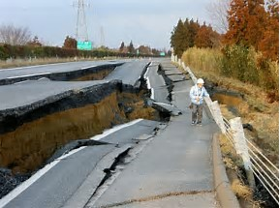
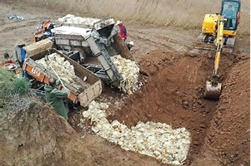
Focus…planning for debris management resulting from…
Natural disaster such as earthquake, flood, other events,
Carcass management resulting from foreign animal disease.

Slide 3
Disaster Debris v. FAD
Natural Disaster Bottom Up Structure Stafford Act National Incident Command Structure Public Assistance, Response & Recovery | Foreign Animal Disease State and Federal Response Not Stafford Act Event Uses Incident Command Structure but not part of ESF structure Biosecurity and protection of trade & commerce

Slide 4
Natural Disaster Debris Management Planning Partners (Local)
Emergency Planning Departments (not necessarily the same as Emergency Planning Committee required by EPCRA)
City and County Public Works Departments
Jurisdictional Health Departments
Public and Private Waste Handling Facilities
Waste Haulers

Slide 5
Local Planning
Value in connecting County Solid Waste Control Plans to Local Emergency Management Plans

Slide 6
Natural Disaster Debris Management Planning Partners (State)
Military Department, Emergency Management Div.
State Emergency Operations Center
Ecology
Washington Conservation Corp
Spills
Department of Enterprise Services
Contracts and Procurement
Utilities and Transportation Commission
Debris Hauling Issues
Notes:
Provides Washington Conservation Corps (WCC) support to state agencies and
local jurisdictions for disaster relief efforts such as flood response, debris clearing, wildland
fire operations, Volunteer Reception Center (VRC) set-up and operation, and post-disaster
environmental rehabilitation.

Slide 7
Natural Disaster Debris Management Planning
Washington State Emergency Management Division (WA Military Dept.)
Houses the State Emergency Operations Center
Maintains the “Washington State Comprehensive Emergency Management Plan” (mirrors the National Response Framework)
Primary Coordinators between State/local govt. and FEMA during emergencies
Coordinates State Agency Responses (not necessarily in lead)
Review of Local Plans (Hazard Mitigation, Hazardous Emergency Response Plans)
Houses State Emergency Management Council

Slide 8
State Emergency Management Council RCW 38.52
Members Include:
Representatives of City and County Government
Local and State Law Enforcement
State Military Department
Department of Ecology
State and Local Fire Chiefs
Seismology Safety Experts
State and Local Emergency Management Directors
Emergency Medical Care Professionals
Search and Rescue Volunteers
Building Officials
Private Sector (Haz. Materials and Emergency Mgt. Expertise)
Advises the Governor on emergency preparedness matters
Subcommittee functions as the “Intrastate Mutual Aid Committee”
Statute requires the State Emergency Management Council (or a subcommittee) to meet as the State Emergency Response Commissions required by the Federal “Emergency Planning and Right-to-Know Act”
Reviews local emergency response plans (hazardous materials)
Report to the Governor and Legislature on statewide compliance with EPCRA

Slide 9
Natural Disaster Debris Management Planning Partners (Federal)
Federal Emergency Management Agency (Dept. of Homeland Security)
Hazard Mitigation Planning
Public Assistance Program
Environmental Protection Agency
U.S. Army Corp of Engineers
U.S Coast Guard
Notes:
Moreover, a FEMA-approved hazard mitigation plan is a condition for receiving certain types of non-emergency disaster assistance, including funding for mitigation projects. Ultimately, hazard mitigation planning enables action to reduce loss of life and property, lessening the impact of disasters.

Slide 10
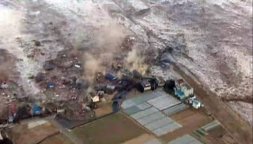
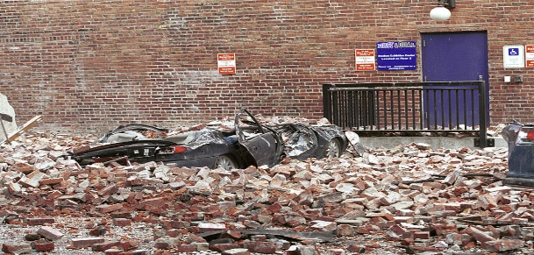
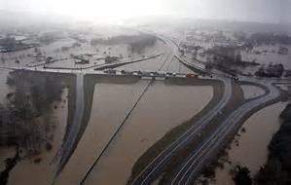
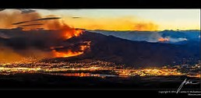
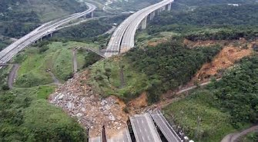
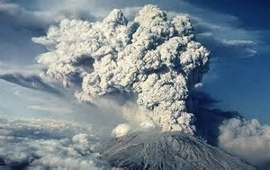
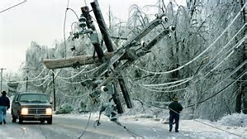
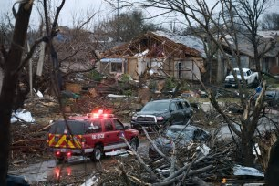
Potential Major Natural Disaster Debris-Causing Events

Slide 11
Debris Types from Natural Disaster
Structural debris (lumber, roofing, ACM, brick, concrete, asphalt, sheetrock, other)
Furniture and appliances
Electronics
Rotted food and other putrescible materials
Hazardous materials (HHW, Business waste, orphaned hazardous materials)
Natural debris (downed or damaged trees, log jams)
Vehicles and similar equipment
Earthen materials (slides and flood deposits, dam and levy failure)
Animal carcasses

Slide 12
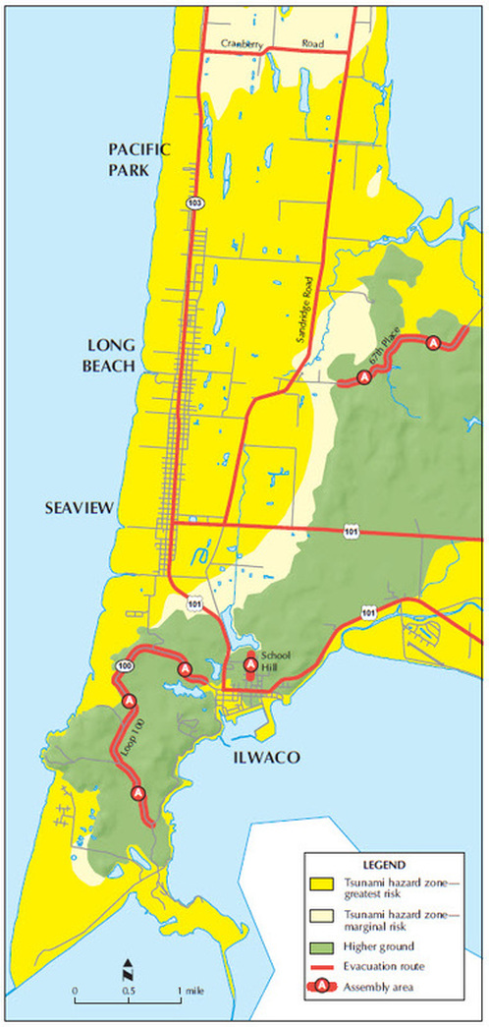
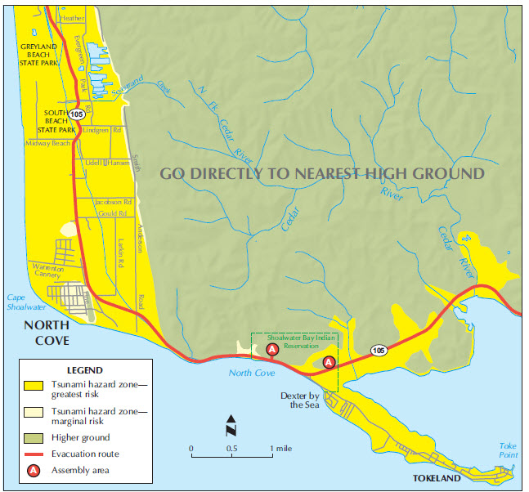
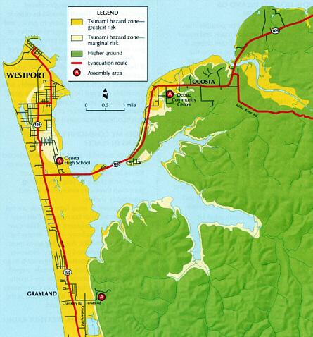
Modeled Coastal Inundation Zones

Slide 13
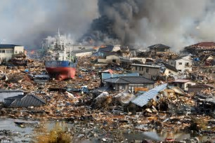
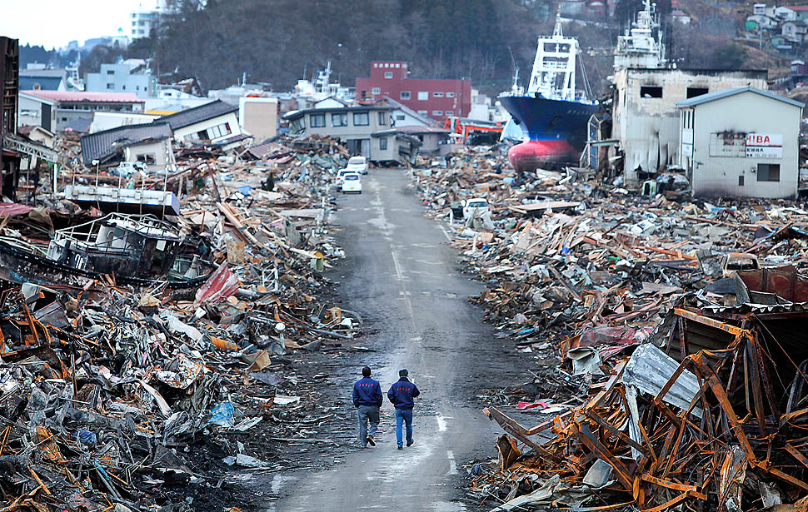
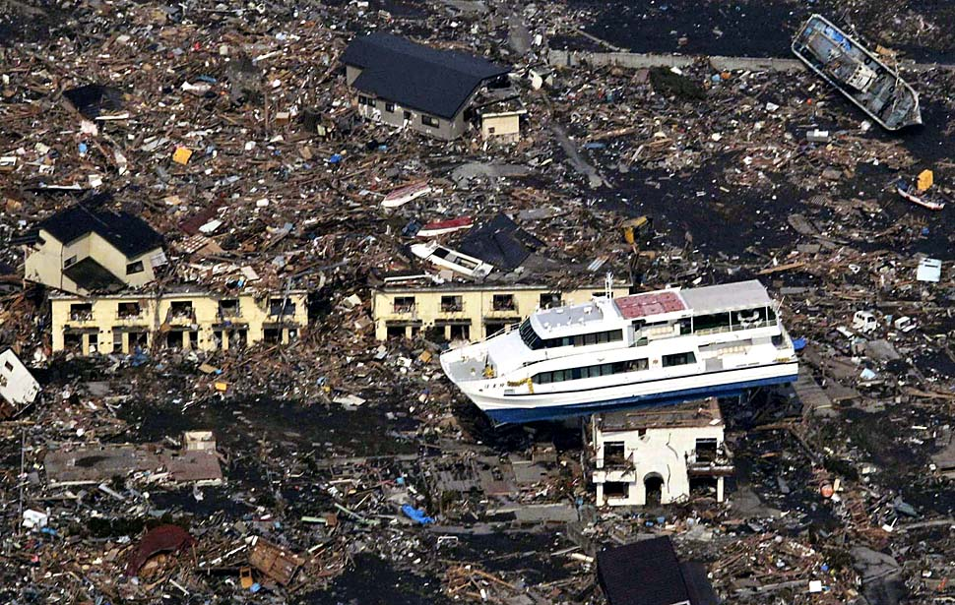
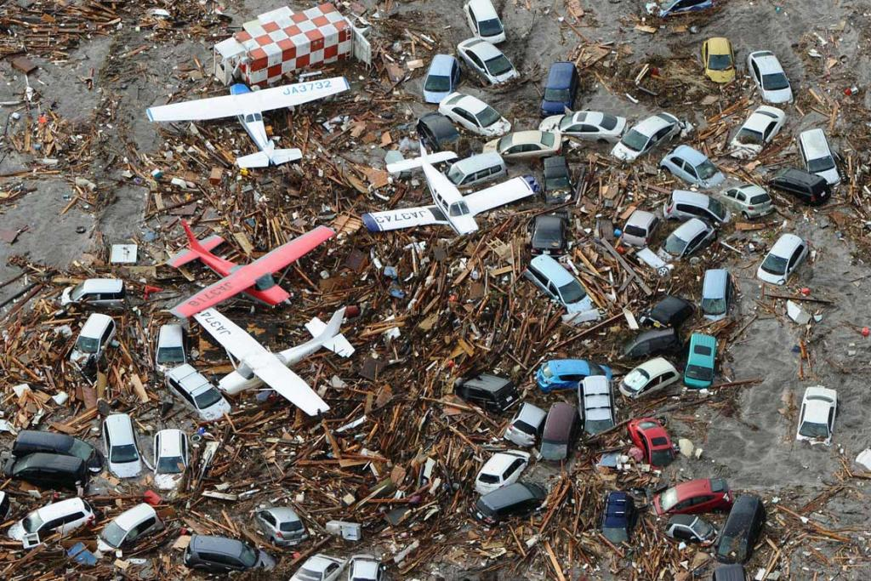
2011 Tōhoku Earthquake and Tsunami

Slide 14
Cascadia Earthquake

Slide 15
2007 Chehalis River Flood
Source:
Lewis County Flood Disaster Recovery: January 2009

Slide 16
Debris Management
ESF 3 – Public Works and Engineering
• Infrastructure protection and emergency repair
• Infrastructure restoration
• Engineering services and construction management
• Emergency contracting support for life-saving/sustaining services
• Debris removal and disposal coordination
• Infrastructure Systems; Critical Transportation; Logistics and Supply Chain Management; Environmental Response/Health and Safety

Slide 17
Ecology Planning Involvement for Debris Management
Program Regional Planners work with CSWMP Update to include element on debris management
Work with local emergency management departments to ensure debris management sufficiently addressed (Current FEMA $ Incentives)
Work with State Planners from EMD, UTC, others

Slide 18
Foreign Animal Disease in Agriculture
High Pathogenic Avian Influenza
Foot and Mouth Disease
There are others but today, these are of most visible concern

Slide 19
Foreign Animal Disease in Agriculture
Biosecurity
Maintaining access to international markets
Both HPAI and F&M are very virulent diseases and rapid containment is a priority
Risk to human health from either disease in North America is extremely limited
HPAI has caused human disease in Asia but different strain

Slide 20
Disposal Planning Partners Include…
WSDA/USDA
Ecology
State Department of Health
Local Health
Local Emergency Response
Law enforcement to help enforce quarantine.
Producers and Trade Assns.

Slide 21
USDA/Animal and Plant Health Inspection Service
Under the Animal Health Protection Act (AHPA; 7 U.S.C. §8301 et seq.), APHIS, in cooperation with state and local animal health officials, has the authority to take extraordinary measures, such as seizing, restricting movement, or euthanizing animals to protect the health of other animals.

Slide 22
Highly Pathogenic Avian Influenza
Primary carriers are migrating waterfowl.
Often test positive for the virus but not susceptible to the disease
Typically highly contagious and fatal in domestic poultry flocks

Slide 23
HPAI 2014-15
During the 2014-15 outbreak, APHIS paid to:
Euthanize poultry
Clean and disinfect poultry premises and equipment
Test for the AI virus to ensure poultry farms can be safely repopulated.
Indemnify poultry owners for euthanized poultry (Over $190 Million)

Slide 24
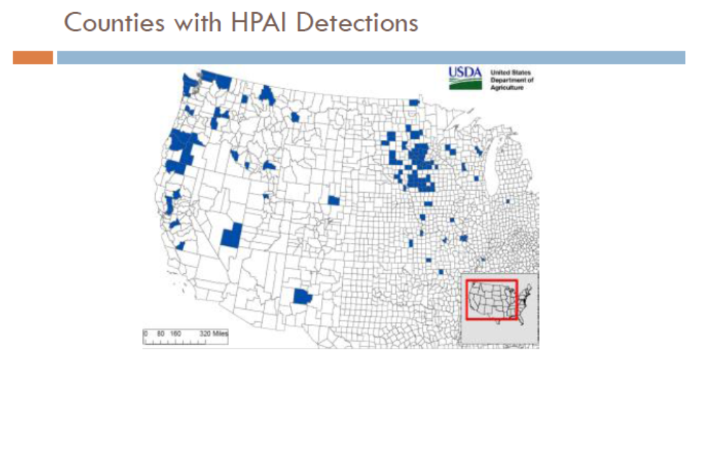
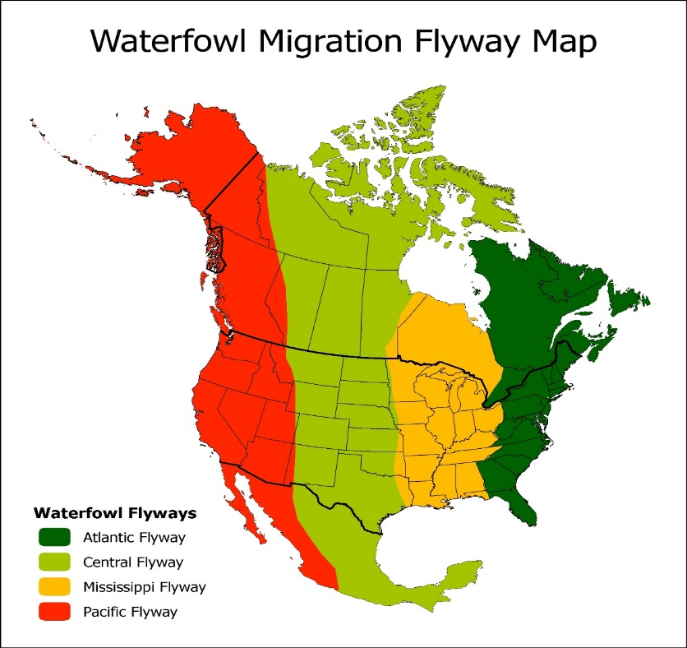
High Pathogenic Avian Influenza

Slide 25
2014-15 HPAI Outbreak
The cost of the HPAI outbreak to the poultry industry was high.
The value of turkey and laying hen losses is estimated at nearly $1.6 billion. Economy-wide losses are estimated at $3.3 billion.
18 U.S. trading partners imposed bans on all shipments of U.S. poultry and products
38 trading partners imposed partial, or regional bans on shipments from states or parts of states with HPAI cases.
China, Russia, and South Korea, 3 of the top 10 destinations for U.S. poultry meat in 2014, banned all imports of U.S.

Slide 26
Highly Pathogenic Avian Influenza
When a production facility tests positive for the HPAI virus…
All birds are immediately destroyed
Zone of quarantine and zone of observation are established and expanded as needed
Disposal requirements include
All birds
All feed
All manure and litter
All eggs
All cartons and similar products

Slide 27
Highly Pathogenic Avian Influenza
Current preferred method is composting as most bio-secure.
Other methods discussed include:
Landfilling
Burial
Incineration
Alkaline Hydrolysis

Slide 28
Foot and Mouth Disease
Viral disease affecting:
Cattle
Swine
Sheep
Goats

Slide 29
Foot and Mouth Disease
In the U.S., the most recent occurrence was in 1929
Three outbreaks between 1914 and 1929 but been disease free since
Deliberate infection is major concern for potential source of the disease
Partners include:
WSDA
USDA/APHIS
F.B.I.
Ecology
Dept. of Health
Local Health

Slide 30
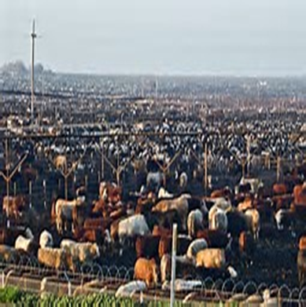
Significant Disposal Dilma

Slide 31
2001 United Kingdom Outbreak
Took 221 days to eradicate
Direct economic impact ~$14 billion or 0.2% of the GDP
Tourism and related industries impact between $6.3 and 7.5 billion
4.5 Million Sheep 10 %
751,000 Cattle 7 %
5% of total Swine

Slide 32
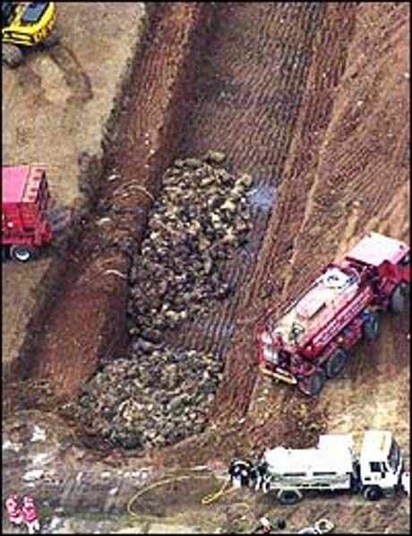
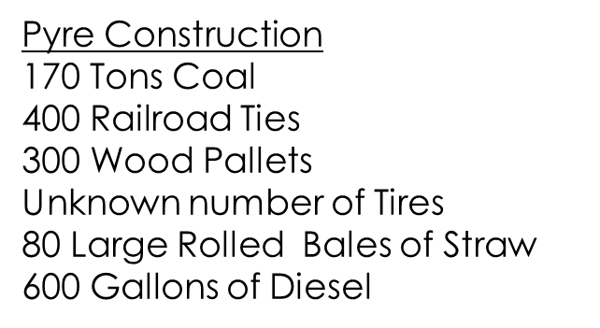
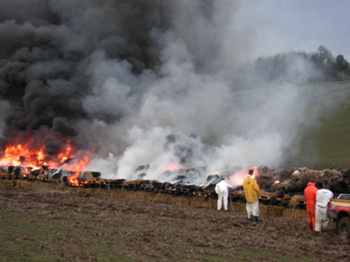
2001 United Kingdom Outbreak
Relied primarily on burial and pyres for disposal

Slide 33
Foot and Mouth Disease
Feedlot in Eastern Washington has ~85,000 animals on-sight
Average weight at roughly 1,250 lbs
Means 53,125 tons needing disposal
Disposal options under consideration…
Bury and walk away
Depopulation method is also a mystery

