Slide 1
Welcome!
Please keep your video off unless you are presenting – this will help with internet connectivity.
We are conducting sound tests before 9:30 am, if you cannot hear us, please connect your audio.
If you have technical issues, please use the chat box and we will help you troubleshoot.
Solid Waste Advisory Committee Meeting

Slide 2
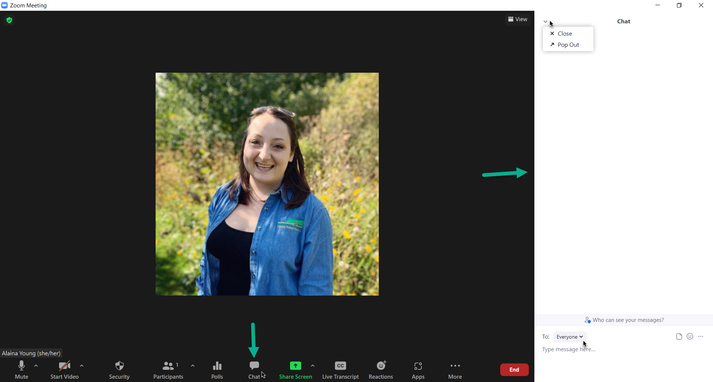
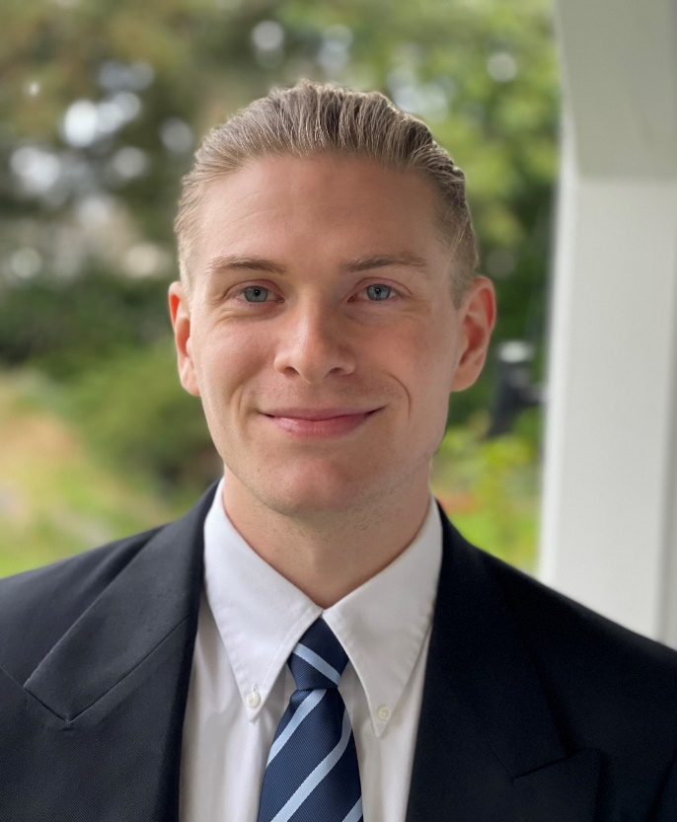
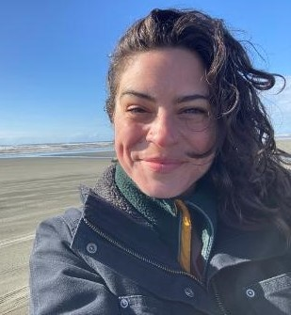
Assisting with this meeting:
Please use the chat box to ask questions or make comments.
To ask the presenter questions, select
Everyone in the drop-down.
For technical help, select Molly McNutt in the drop-down.
Caleb Carlson
Molly McNutt

Slide 3
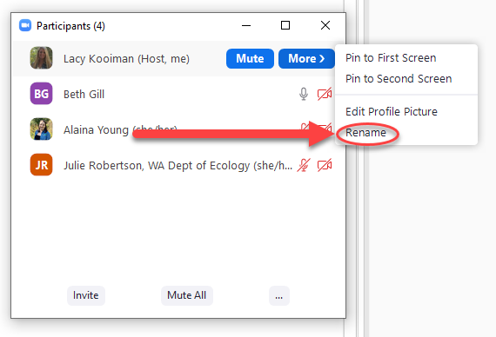
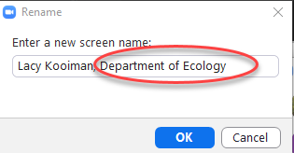
Zoom Functions: Rename to Add Your Affiliation

Slide 4
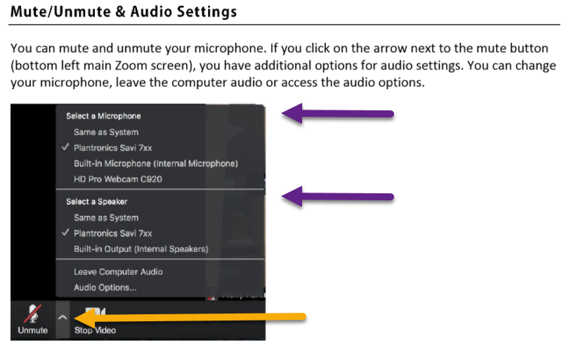
Zoom Functions: Audio Settings

Slide 5
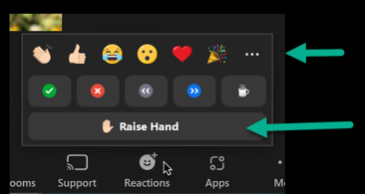
Zoom Functions: Raising Your Hand

Slide 6
Solid Waste Advisory Committee Meeting
March 13, 2024
Notes:
REVISED 11/16/22 - AJ

Slide 7
Agenda Solid Waste Advisory Committee Meeting March 13, 2024 | 9:30 a.m. – 11:25 a.m.
Call to Order & Zoom Meeting Instructions
9:30 a.m. | 5 minutes | Troy Lautenbach (Chair)
SWAC Election Update
9:35 a.m. | 5 minutes | Troy Lautenbach (Chair), Jay Blazey (Vice Chair)
Ecology Legislative Updates
9:40 a.m. |20 minutes | Peter Lyon and Julie Robertson, Dept. of Ecology SWM
Zero Waste Washington Legislative Update
10:00 a.m. |20 Minutes | Heather Trim, Zero Waste Washington
Food Waste Prevention Campaign and Food Waste Prevention Week
10:20 a.m. |15 Minutes | Jade Monroe, Dept. of Ecology SWM
Waste in Washington
10:35 a.m. | 20 minutes | Gretchen Newman, Dept. of Ecology SWM
Wood Waste Regulations
10:55 a.m. | 15 minutes | Dawn Marie Maurer, Dept. of Ecology SWM
Member Updates & Roundtable
11:10 a.m. | 15 minutes | Troy Lautenbach (Chair)
Adjourn
11:25 a.m.

Slide 8
SWAC Election Update
Troy Lautenbach (Chair), Jay Blazey (Vice Chair)

Slide 9
Ecology Legislative Updates
Peter Lyon and Julie Robertson, Dept. of Ecology SWM
Notes:
A legislative proviso directed Ecology to hire a contractor to do a Full Emissions Life Cycle Assessment comparing emissions from managing Spokane’s 250,000 tons per year of waste through their Waste to Energy Facility to emissions from other available technologies to manage that waste should Waste to Energy cease operating.
The other available technologies are landfills in the region. The contractor will compare Waste to Energy emissions to those from emissions expected at Roosevelt Regional Landfill, Greater Wenatchee Landfill, and Finley-Buttes Landfill for the tonnage from Spokane that could go to them.
The proviso stems from a clause in the Clean Energy Transformation Act that will allow energy produced from Spokane Waste to Energy to continue to be used by the local utility in the future if the Dept. of Commerce and Ecology determines that greenhouse gas impacts from Waste to Energy compared to other options has less of an impact. This determination must be based on an emissions life cycle assessment of greenhouse gases.
Recycling, green waste, and household hazardous waste services provided in the Spokane area are presumed to continue under all scenarios so are not factored into the assessment.
The report must be completed by year’s end. The contractor (CDM Smith Inc.) was awarded $160,000, under the budget proviso of $200,000.
The City of Spokane, Solid Waste Program staff with life cycle assessment experience, an Ecology greenhouse gas person from Air Quality, and the Dept of Commerce are part of the team working with the contractor.

Slide 10
Agenda Solid Waste Advisory Committee Meeting March 13, 2024 | 9:30 a.m. – 11:25 a.m.
Call to Order & Zoom Meeting Instructions
9:30 a.m. | 5 minutes | Troy Lautenbach (Chair)
SWAC Election Update
9:35 a.m. | 5 minutes | Troy Lautenbach (Chair), Jay Blazey (Vice Chair)
Ecology Legislative Updates
9:40 a.m. |20 minutes | Peter Lyon and Julie Robertson, Dept. of Ecology SWM
Zero Waste Washington Legislative Update
10:00 a.m. |20 Minutes | Heather Trim, Zero Waste Washington
Food Waste Prevention Campaign and Food Waste Prevention Week
10:20 a.m. |15 Minutes | Jade Monroe, Dept. of Ecology SWM
Waste in Washington
10:35 a.m. | 20 minutes | Gretchen Newman, Dept. of Ecology SWM
Wood Waste Regulations
10:55 a.m. | 15 minutes | Dawn Marie Maurer, Dept. of Ecology SWM
Member Updates & Roundtable
11:10 a.m. | 15 minutes | Troy Lautenbach (Chair)
Adjourn
11:25 a.m.

Slide 11
Zero Waste Washington Legislative Update
March 13, 2024

Slide 12
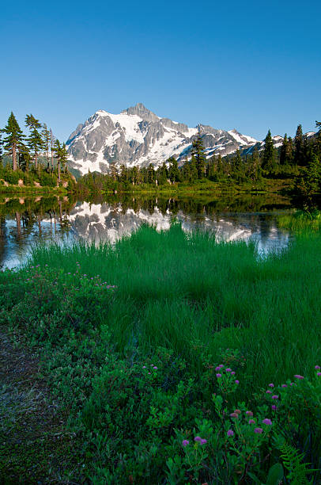
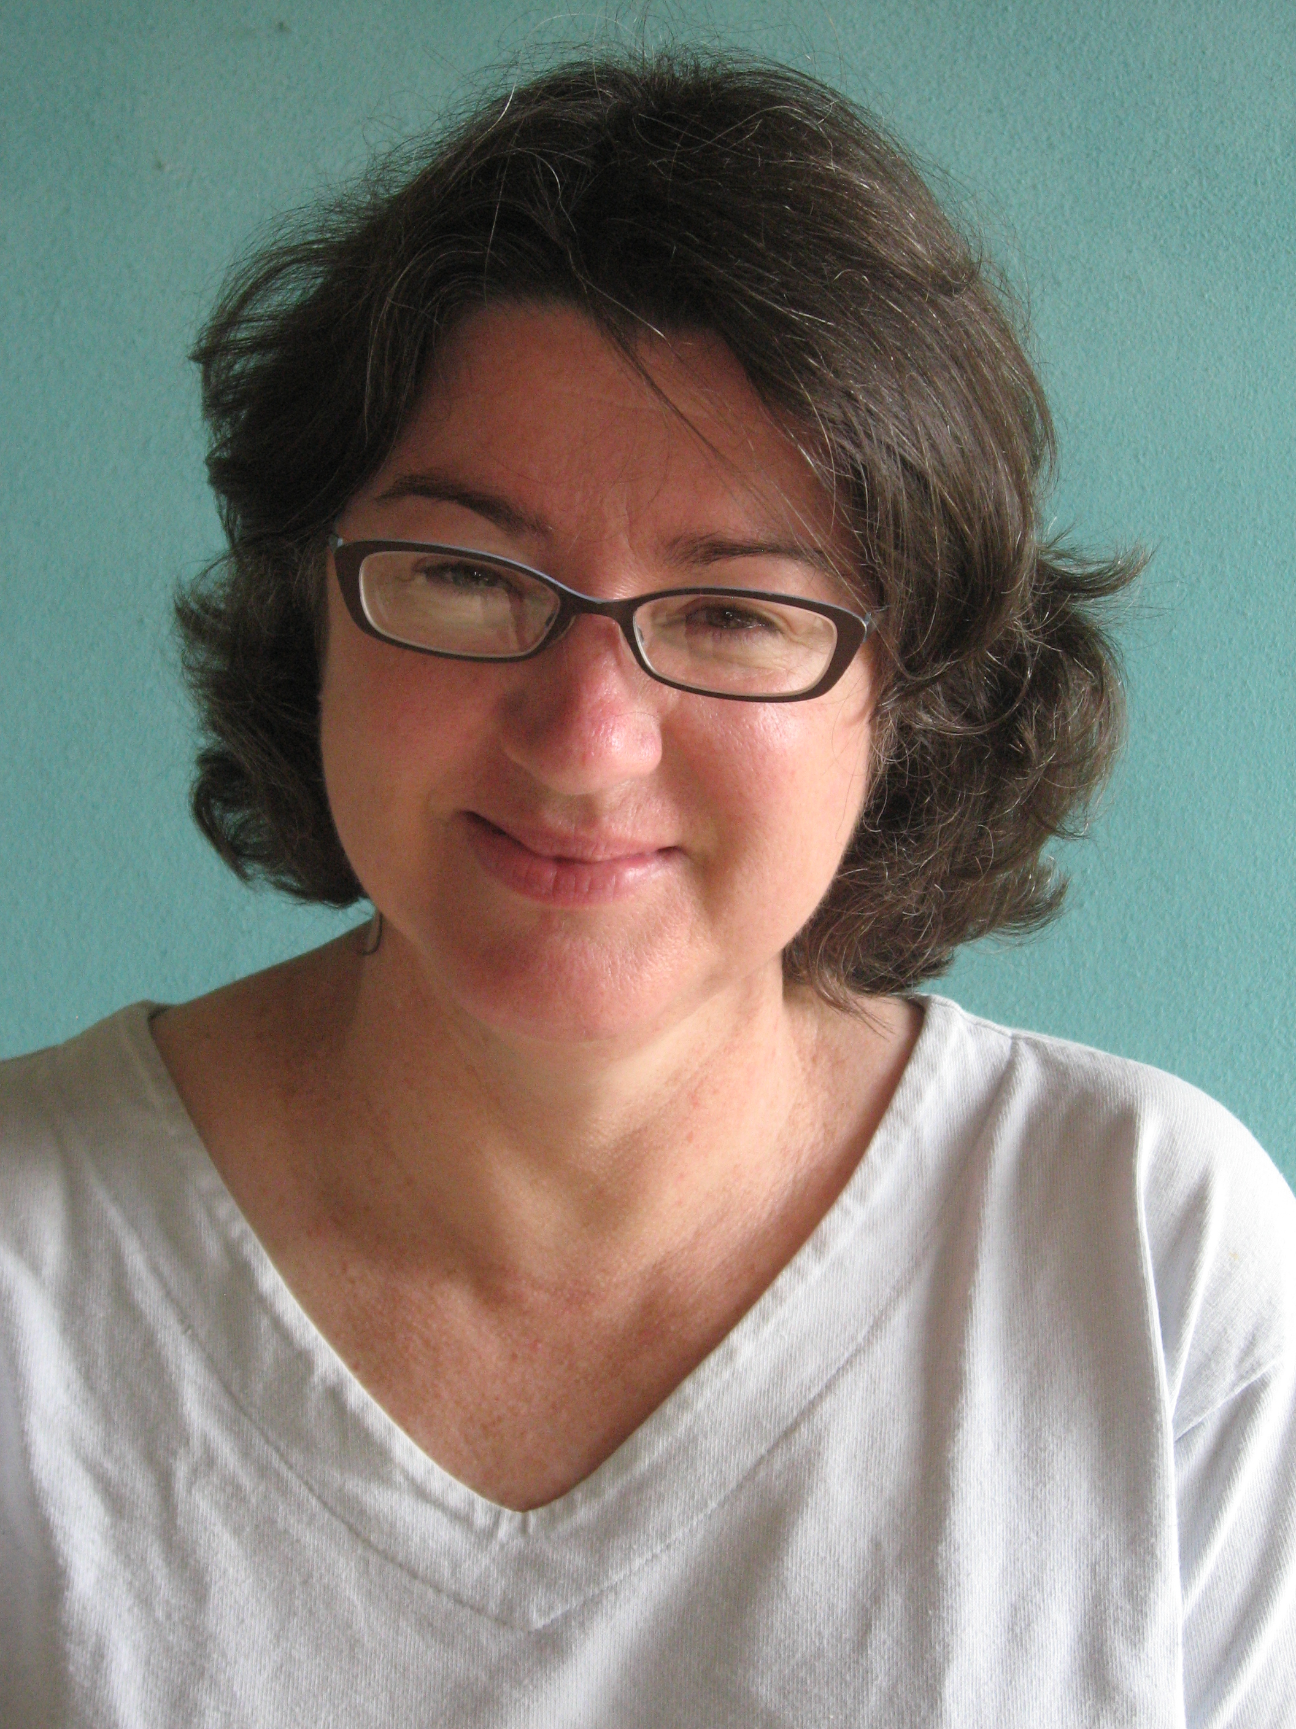
Zero Waste Washington Legislative Update
Heather Trim, Executive Director, Zero Waste Washington
March 13, 2024

Slide 13
2024 Legislative Action
Zero waste policy
Ecology SWAC
Zero Waste Washington
March 13, 2024

Slide 14
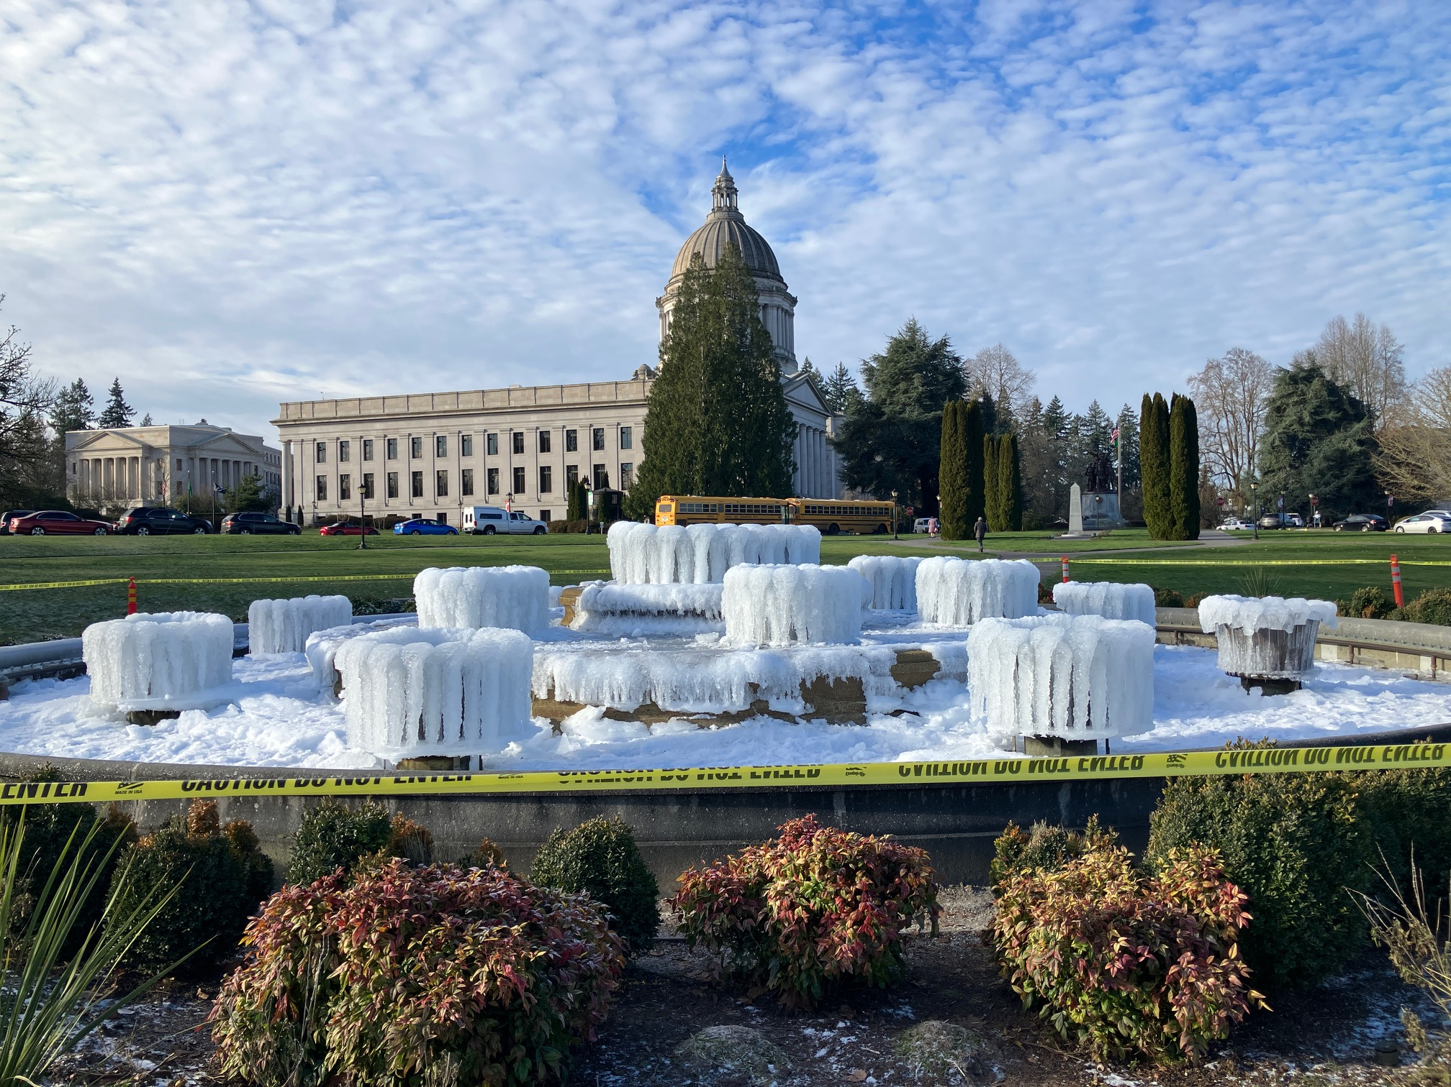
Legislative update
2024

Slide 15
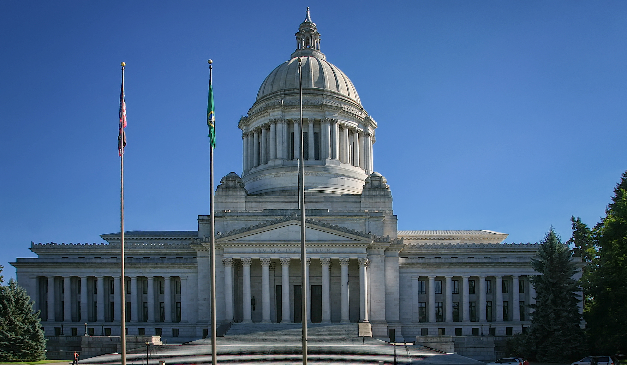
Legislative update
2024

Slide 16
2024
Organics (food and yard waste) (HB 2301)
Mercury light bulbs (HB 1185)
Cannabis waste (SB 5376)
Lead in cookware (HB 1551)
Tires: 6ppd (SB 5931)
Illegal dumping (HB 2207)
ReWRAP Act (HB 2049) - died
DRS for Beverage Containers (bottle bill) (HB 2144) – died
Right to repair (HB 1933) - died
Refrigerant gases (HB 2401) - died
PFAs in biosolids (SB 5245) - died
Tires: resistance (SB 6304) – died
EV Battery recycling (SB 6319 / HB 2501 – late entry
Legislative update
2024

Slide 17
Resignations & Retirements
Senators - Billig, Mullet, L Wilson, Hunt, Van de Wege, Keiser
Reps - Wilcox, Maycumber, Kretz, Chambers, Hutchins
Reps Running for Senate - Riccelli (Billig), Ramos (Mullet), Bateman (Hunt), Chapman (VDW), Harris (L Wilson), Orwall or Gregerson (Keiser)
Senators Running for Higher Office But NOT Up for Reelection
Randall (Kilmer), MacEwan (Kilmer), Saldana (CPL), Dhingra (AG), Kuderer (OIC)

Slide 18
Stripped out of Organics bill
Multi family – requirements and building design
Stickers – study
Date labeling
More work to do
Compostable products
Permitting and air quality

Slide 19
Standardize bin colors
Notes:
To help reduce confusion and contamination, require black/grey bins for landfill bins, blue for recycling and green/brown for organics bins. New bins by July 1, 2024 and all bins by Jan 1, 2030

Slide 22
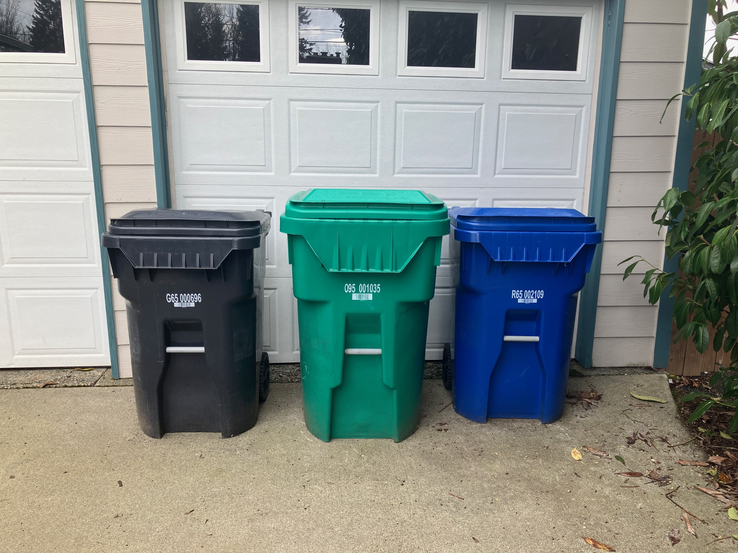

Slide 24
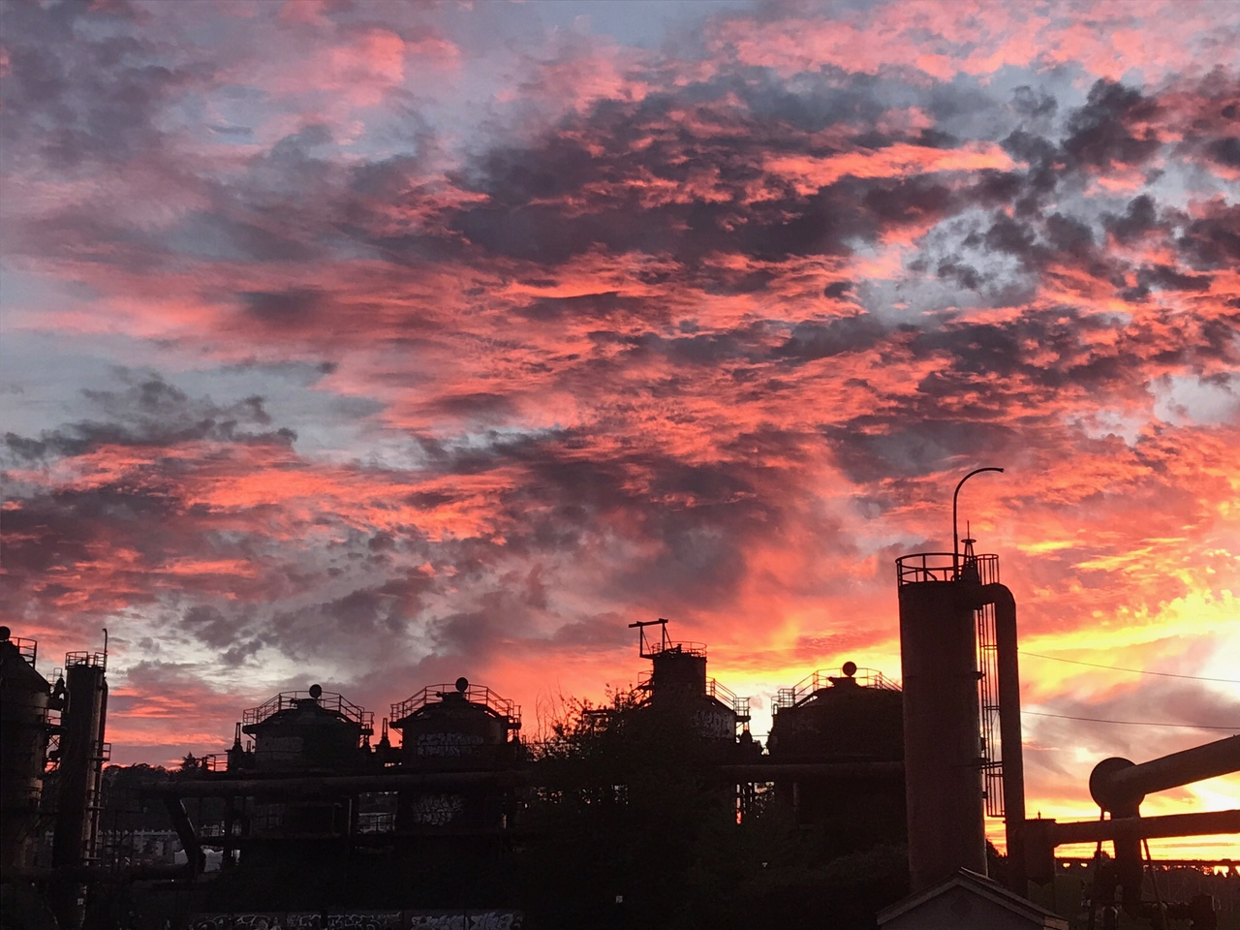
Thank You!
Heather Trim
heather@zerowastewashington.org
Zero Waste Washington
www.zerowastewashington.org

Slide 25
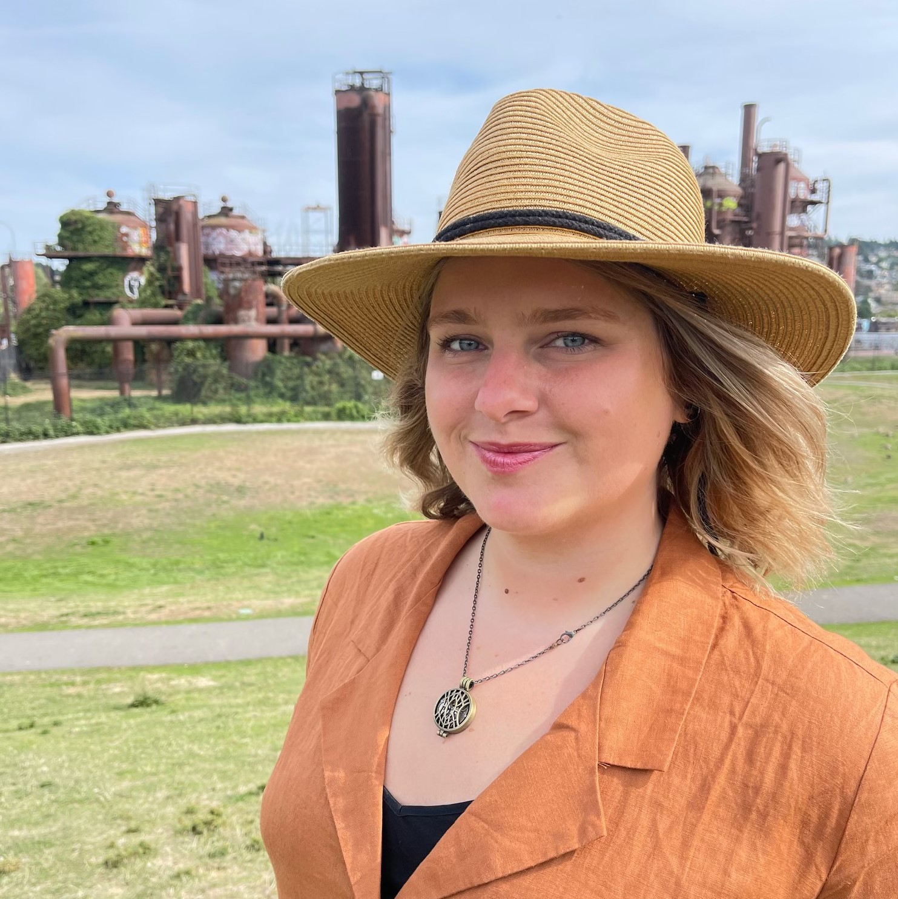
Food Waste Prevention Campaign & Food Waste Prevention Week
Jade Monroe, Food Center Lead,
Dept. of Ecology
March 13, 2024

Slide 26
Food Waste Prevention Week Use Food Well Campaign Launch
Jade Monroe, Food Center Lead Solid Waste Advisory Committee
March 13, 2024

Slide 27
So much wasted food!
500,000 tons of edible food end up in Washington’s landfills every year
Enough to make 105 meals for every resident in Washington
Cost the average family $1500 every year
About $125 every month

Slide 28
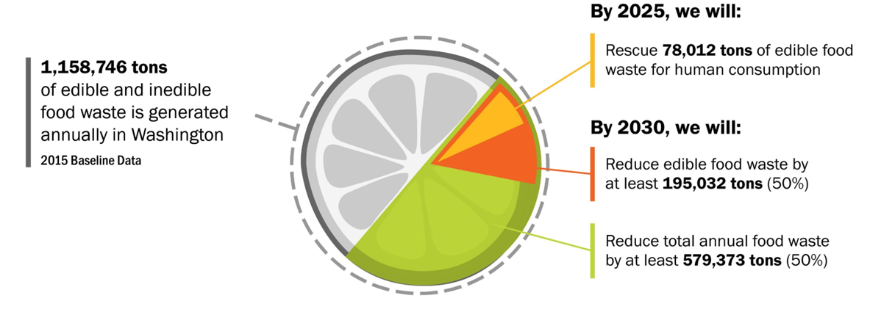
Washington’s Food Waste Reduction Goals

Slide 29
Authorized by the 2022 Organics Management Law
Recommended by Use Food Well Washington Plan
Dedicated staff and resources to meet Washington’s food waste reduction goals
Works within Solid Waste Management program and alongside the Recycling Development Center
“The Food Center” (FoodCenter@ecy.wa.gov)

Slide 30
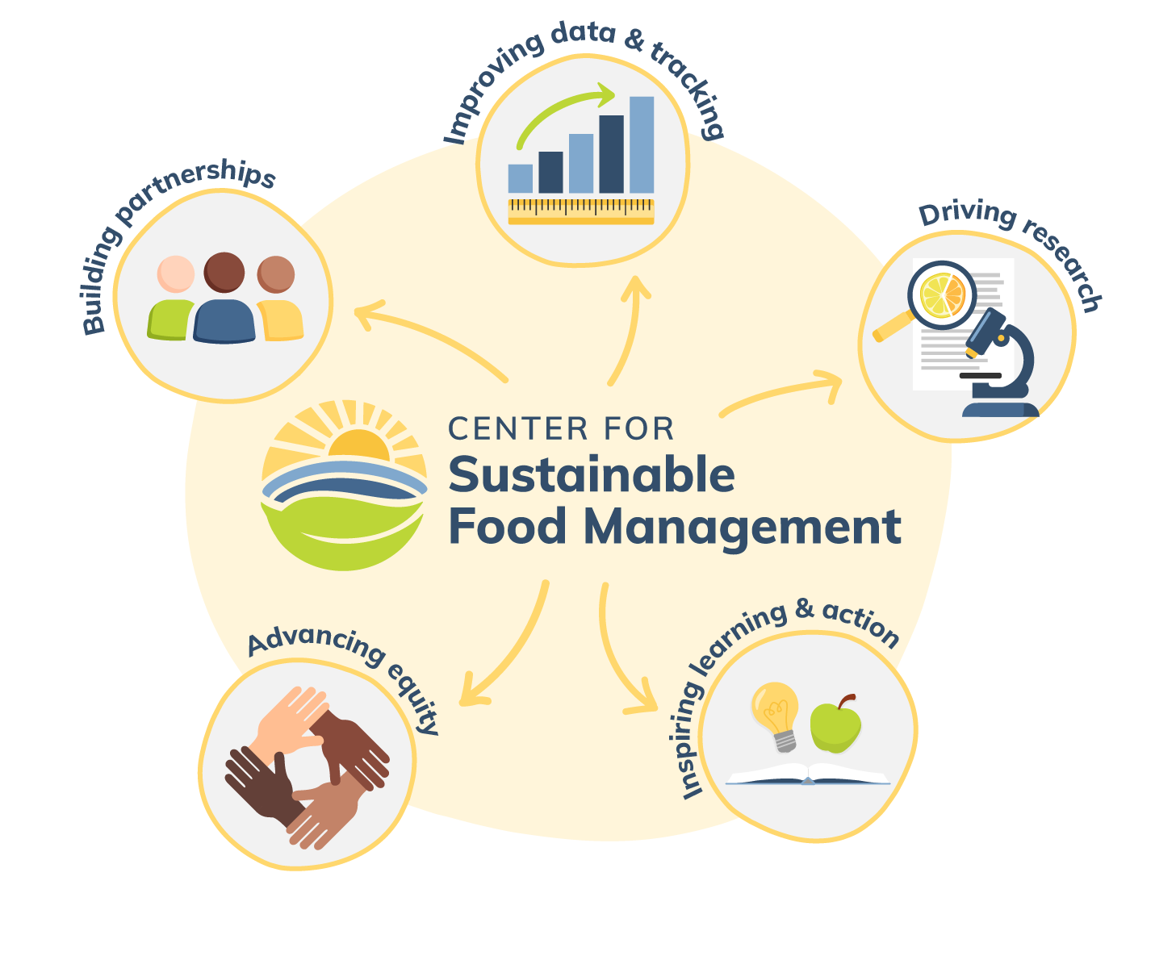

Slide 31
Represent Washington
FWP Week April 1-7, 2024
Free and fast registration
Promotional toolkit
Social media posts, etc.
Information sessions
Little to no commitment
Over 60 WA partners already! Let’s get to 100!

Slide 32
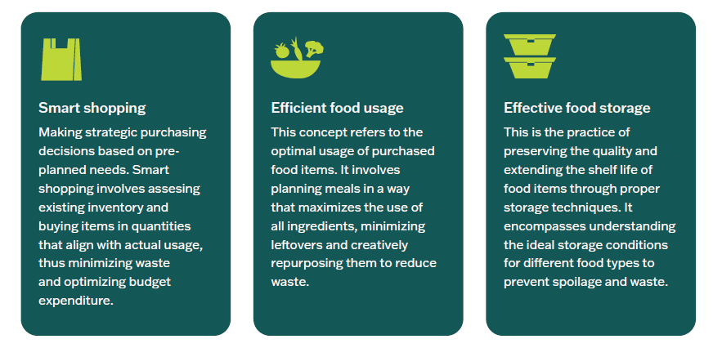
Washington’s Use Food Well Campaign
Register for preview on March 25, 1:15pm
Statewide resources to use and complement local work

Slide 33
Action Items
1
Subscribe to our email list
2
Register for Food Waste Prevention Week
3
Help recruit FWP Week Partners!
4
Attend the March 25 Campaign Preview Meeting
5
Food Waste Prevention Week April 1-7, 2024
6
Future Collaboration and Work Groups

Slide 34
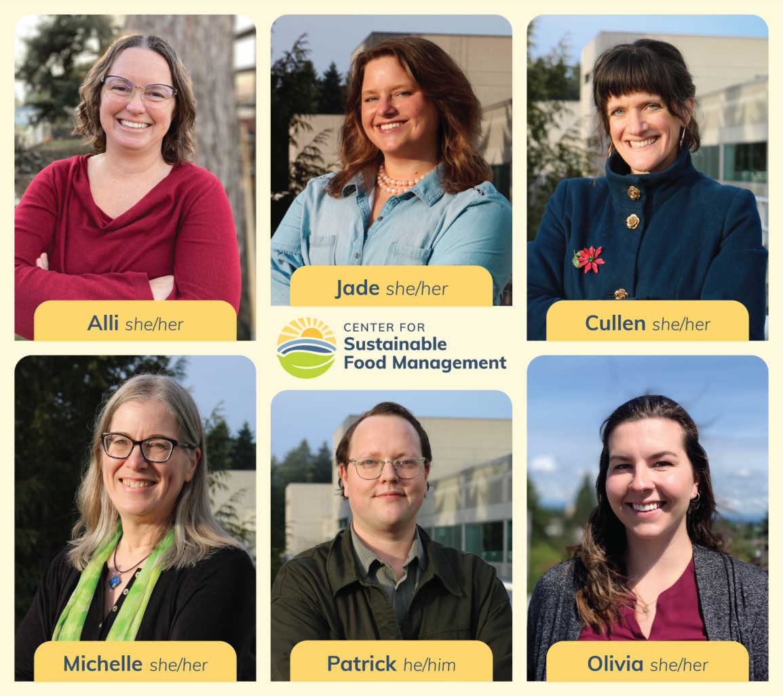
Thank you
FoodCenter@ecy.wa.gov

Slide 35
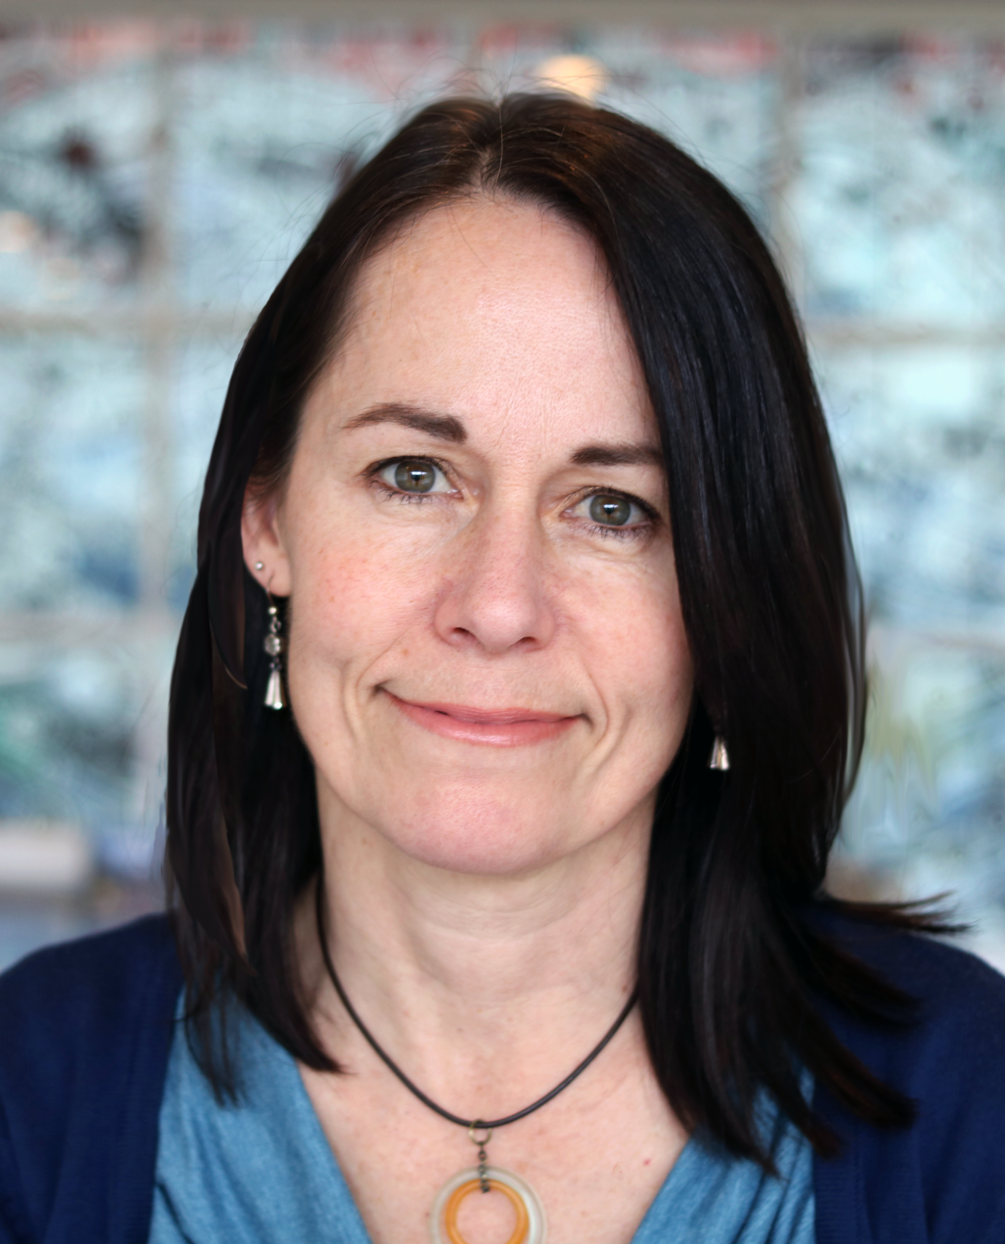
Waste in Washington
Gretchen Newman, Lead Data Analyst, Dept. of Ecology
March 13, 2024

Slide 36
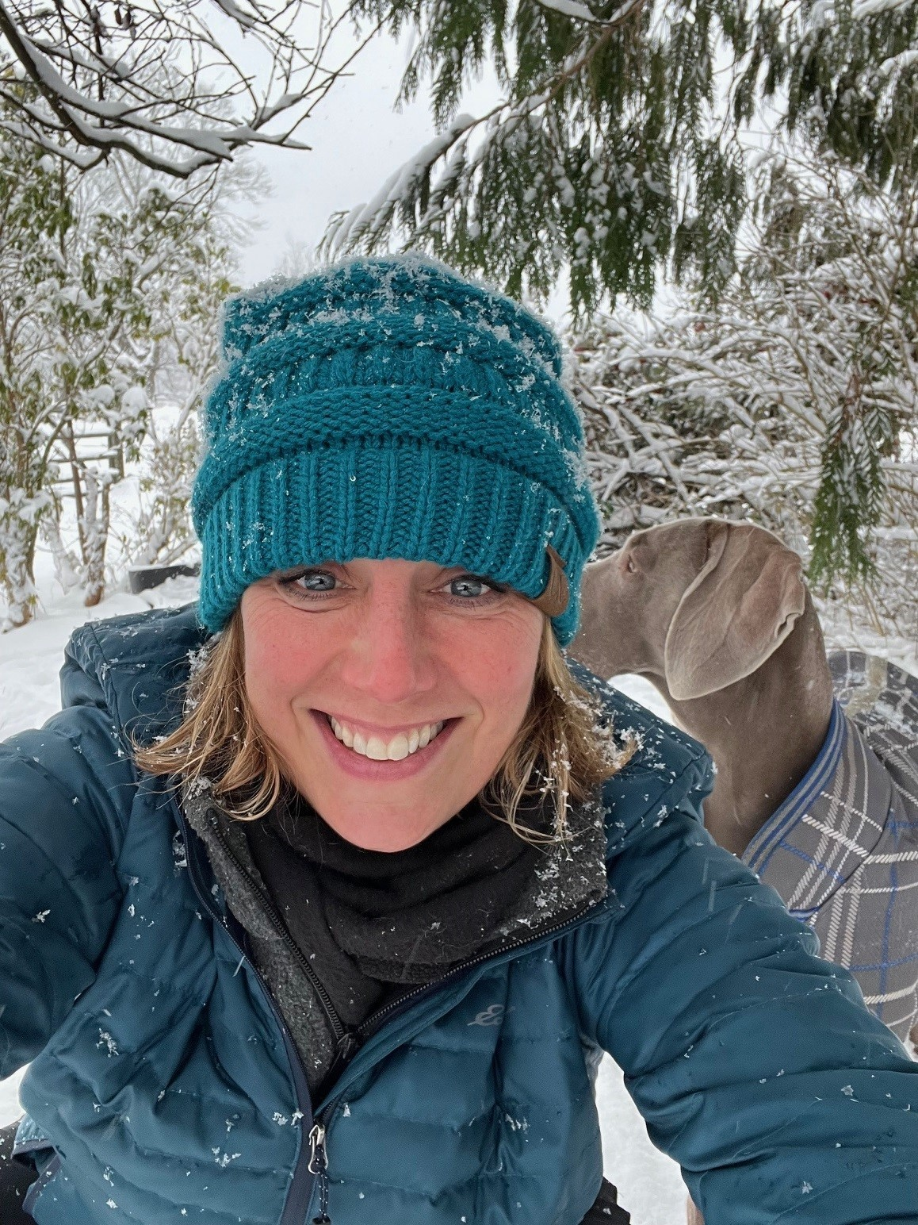
Wood Waste Regulations
Dawn Marie Maurer, Facilities Specialist,
Dept. of Ecology
March 13, 2024

Slide 37
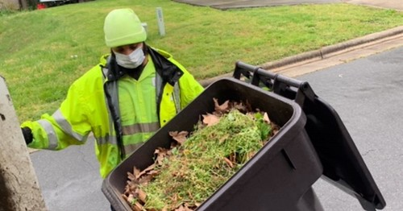
Yard Debris and Wood Waste
This Photo by Unknown Author is licensed under CC BY-NC
Dawn Marie Maurer – Facilities Specialist
Notes:
Thank you for inviting me, my name is Alli Kingfisher, I’m the Lead for Ecology’s Organics Team and the Director of the Washington Center for Sustainable Food Management. My team is part of the Policy sections of Ecology’s Solid Waste Management Program.
This morning I will be discussing some of the major parts and implementation of the 2022 OML.
For the August 16 OML Part 2 presentation we will cover:
Ecology's support of reducing methane emissions:
State of Organics in Washington (Content developed by: Dawn Marie and Mary; Presented by: Mary)
Finance Study (Janine -- how much time do you need?)
1799 section-by-section:
Section of law,
Intent of section
Overview of Implementation
Challenges of implementation
Opportunities for improvement
Wrap-up--summary?

Slide 38
Quick comparison
Yard debris
Wood waste
Comes from gardens, landscaping, horticulture
Commonly managed through composting
May contain brush, branches, and other woody material
The presence or absence of grass is not a defining characteristic
Comes from forest practices, lumber yards, tree services, construction
Commonly managed through recycling into mulch or fuel
Contains mostly stumps, trees, dimensional lumber
Grass and weeds may not be present
Both yard debris and wood waste are defined in the solid waste handling standards under the Washington Administrative Code (WAC), chapter 173-350-100

Slide 39
Yard debris
"Yard debris" means plant material commonly created in the course of maintaining yards and gardens and through horticulture, gardening, landscaping or similar activities. Yard debris includes, but is not limited to, grass clippings, leaves, branches, brush, weeds, flowers, roots, windfall fruit, and vegetable garden debris.

Slide 40
Wood waste
"Wood waste" means wood pieces or particles determined to be solid waste per WAC 173-350-021 generated from construction, demolition, handling and storage of raw materials, trees, stumps, and manufacturing of wood products. This may include, but is not limited to, sawdust, chips, shavings, bark, pulp, and log sort yard waste, but does not include wood pieces or particles containing paint, laminates, bonding agents, or chemical preservatives such as creosote, pentachlorophenol, or copper-chrome-arsenate.
This Photo by Unknown Author is licensed under CC BY-NC-ND

Slide 41
Urban wood
The largest source of wood waste isn’t forest practices or tree services – it’s construction and demolition debris, and other forms of urban wood.
Some clean urban wood meets the definition of wood waste, but some painted or treated wood may not.
Another category of wood that can be recycled is wood derived fuel.

Slide 42
Wood derived fuel
"Wood derived fuel" means wood pieces or particles used as a fuel for energy recovery, which contain paint, bonding agents, or creosote. Wood derived fuel does not include wood pieces or particles coated with paint that contains lead or mercury, or wood treated with other chemical preservatives such as pentachlorophenol, copper naphthenate, or copper-chrome-arsenate.

Slide 43
Brush, branches, leaves
Brush, branches and leaves are all listed in the definition of yard debris
Wood waste trees are expected to have branches and de minimis leaves, however brush, fallen leaves and other carbon-rich materials generated in the course of maintaining yards and gardens fall into the definition of yard debris.
The presence grass or weeds is not the defining characteristic of yard debris.
This Photo by Unknown Author is licensed under CC BY

Slide 44
Regulatory implications – wood waste
The solid waste handling regulations under WAC 173-350-320 provide permit exemptions for storage piles of wood waste prior to recycling.
This section does not have any similar permit exemptions for storage of yard debris.
WAC 173-350-202 also provides a regulatory out for wood waste used as much:
(2) This chapter does not apply to the following: (b) Wood waste used for ornamental, animal bedding, mulch and plant bedding, or road building purposes;
This section does not exclude wood waste that is collected or processed, only the end use. It does not include yard debris.
This Photo by Unknown Author is licensed under CC BY

Slide 45
Regulatory implications – yard debris
Yard debris could theoretically be anaerobically digested in a dry fermentation system, processed though gasification, combusted for energy recovery, or landfilled, but most commonly it is managed through composting.
WAC 173-350-220 provides four permit exemptions for composting yard debris at various volumes.
Volumes and feedstocks combinations not covered by a permit conditional exemption require coverage under a solid waste handling permit.
Most commercial composters operate under permit.
Unlike wood waste, no exemption or exclusion exists for mulching yard debris.
Facilities managing yard debris, even high carbon content yard debris, normally need to operate under a composing permit or permit exemption.

Slide 46
Facilities, local governments and the public
In general, wood waste recyclers are expected to maintain the conditions for their exemption by avoiding acceptance of yard debris.
Companies wishing to manage yard debris commercially to create soil amendments and garden enrichment products should do so through a composting permit or permit exemption.
Municipalities, counties, landscaping companies and homeowners should be certain the facilities they are contracting with or self-hauling to are operating under a composting permit or permit exemption if they are accepting yard debris.

Slide 47
Thank you!
Dawn Marie Maurer
Department of Ecology
Northwest Region
dmau461@ecy.wa.gov

Slide 48
Agenda Solid Waste Advisory Committee Meeting March 13, 2024 | 9:30 a.m. – 11:25 a.m.
Call to Order & Zoom Meeting Instructions
9:30 a.m. | 5 minutes | Troy Lautenbach (Chair)
SWAC Election Update
9:35 a.m. | 5 minutes | Troy Lautenbach (Chair), Jay Blazey (Vice Chair)
Ecology Legislative Updates
9:40 a.m. |20 minutes | Peter Lyon and Julie Robertson, Dept. of Ecology SWM
Zero Waste Washington Legislative Update
10:00 a.m. |20 Minutes | Heather Trim, Zero Waste Washington
Food Waste Prevention Campaign and Food Waste Prevention Week
10:20 a.m. |15 Minutes | Jade Monroe, Dept. of Ecology SWM
Waste in Washington
10:35 a.m. | 20 minutes | Gretchen Newman, Dept. of Ecology SWM
Wood Waste Regulations
10:55 a.m. | 15 minutes | Dawn Marie Maurer, Dept. of Ecology SWM
Member Updates & Roundtable
11:10 a.m. | 15 minutes | Troy Lautenbach (Chair)
Adjourn
11:25 a.m.

Slide 49
Member Updates & Roundtable
We want to hear from you!
If you would like to provide comments, please write your name in the chat or raise your hand.
We will call on you to speak in the order that we see names in the chat or hands raised.
Please turn on your camera and unmute yourself when it’s your turn.
You may also write your comment in the chat and we will read it for you.

Slide 50
Thank you for joining us today!
Notes:
REVISED 11/16/22 - AJ

