Slide 1

2019 Legislative Session
Solid Waste Advisory Committee
Laurie Davies
Department of Ecology
May 15

Slide 2
2019 Bills related to solid waste
HB 1543 Sustainable Recycling
SB 5397 Plastic Packaging
HB 1114 Food Waste
HB 1652 Paint Stewardship
HB 1569 Marketing Degradability of Products
Notes:
5397 delivered to the gov
1114 both chambers signed
1543 delivered to the gov

Slide 3
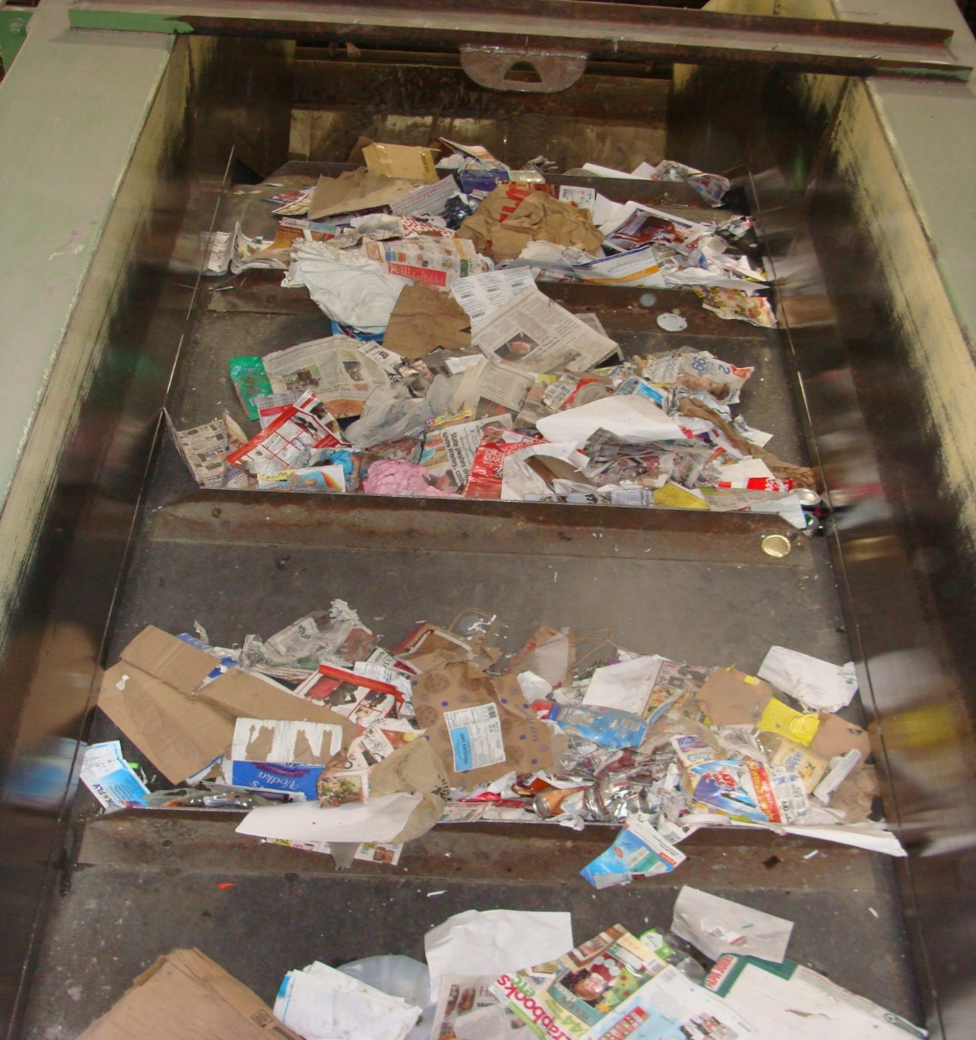
HB 1543 Sustainable Recycling
Agency Request Legislation
Recycling Development Center
Contamination Reduction and Outreach Plans (CROPs)

Slide 4
HB 1543 Sustainable Recycling
Recycling Development Center
…to research, incentivize,
and develop new markets and
expand existing markets for
recycled commodities and recycling facilities
Notes:
it is the policy of the state to create the recycling development center to research, incentivize, and develop new markets and expand existing markets for recycled commodities and recycling facilities.

Slide 5
Waste Reduction, Recycling, and
Litter Control Account (WRRLCA)
Litter tax created in 1971 to prevent and pick up litter
0.015-percent tax on retail sales of commonly littered items
Supports litter prevention and pickup and waste reduction and recycling programs

Slide 6
Waste Reduction, Recycling, and Litter Control Account (WRRLCA)
40 percent to Ecology and other agencies for litter pick up and prevention
40 percent to Ecology for waste reduction and recycling programs, education, outreach
20 percent to local governments for litter pick up on city and county roads and WRRED grants

Slide 7
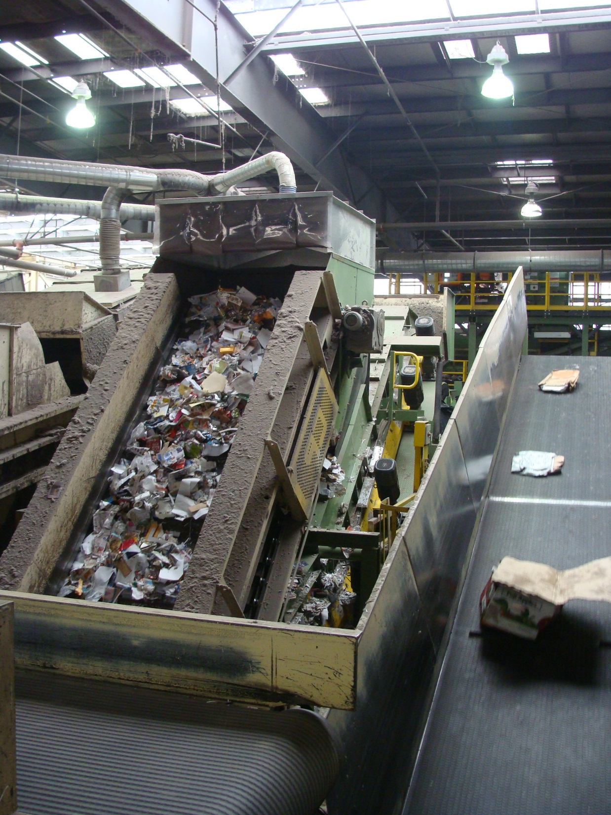
Recycling Development Center
Ecology & the Department of Commerce collaboration
Advisory board of public and private sector stakeholders
Interagency Agreement with Commerce

Slide 8
Recycling Development Center
Implementation
Advisory Board
  Cities
  Eastside counties
  Westside counties
  Public interest groups
  Three members from universities or state and federal research institutions
  Up to seven private sector members to represent the recycling materials system, including:
    manufacturing and packaging
    solid waste management
    At least one not-for-profit organization familiar with innovative recycling solutions used internationally in Scandinavia, China, and other countries
  UTC chair or designee (nonvoting)

Slide 9
Contamination Reduction and Outreach Plans
State and Local CROPs
  Statewide by July 1, 2020
  State to create guidance for local plans
  Local CROPs due in plans by July 1, 2021
    Locals can use state plan
    Counties under 25,000 exempt
  Can fund Local CROPS via
    Local Solid Waste Financial Assistance Grants
    Competitive WRRED grants
Notes:
State plans July 1, 2020
Local plans July 1 2021
Financial Assistance for Local Jurisdictions
The development and implementation of CROPs is an eligible cost for financial assistance under Local Solid Waste Financial Assistance.
The bill expands the eligibility of the matching fund competitive grant program under the Waste Reduction, Recycling, and Litter Control Account, twenty percent share to local.
CROPs will be added to the grant guidelines for both of these grant programs, and assistance will be provided by our grant officers.
Counties with populations less than 25,000 are exempted from the CROP inclusion

Slide 10
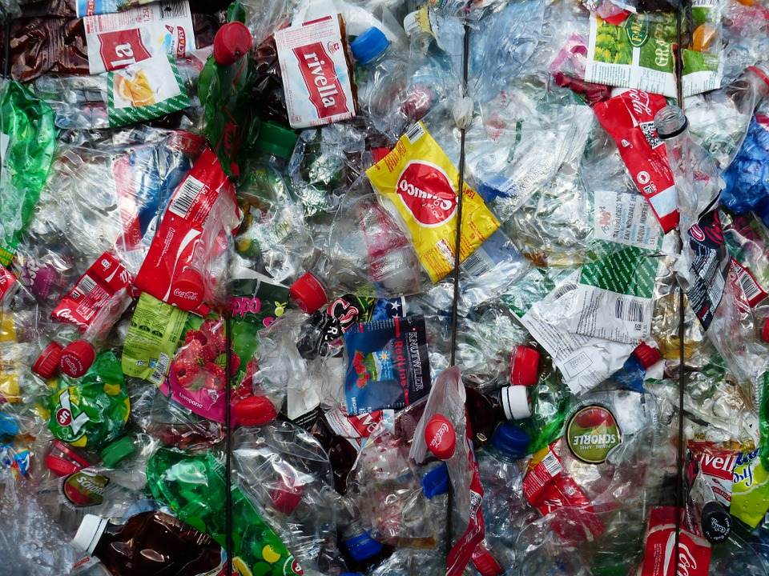
SB 5397 Plastic Packaging
…through design & innovation, industry should strive to achieve the goals of:
recycling 100% of packaging,
using at least 20% postconsumer recycled content, &
reducing plastic packaging when possible

Slide 11
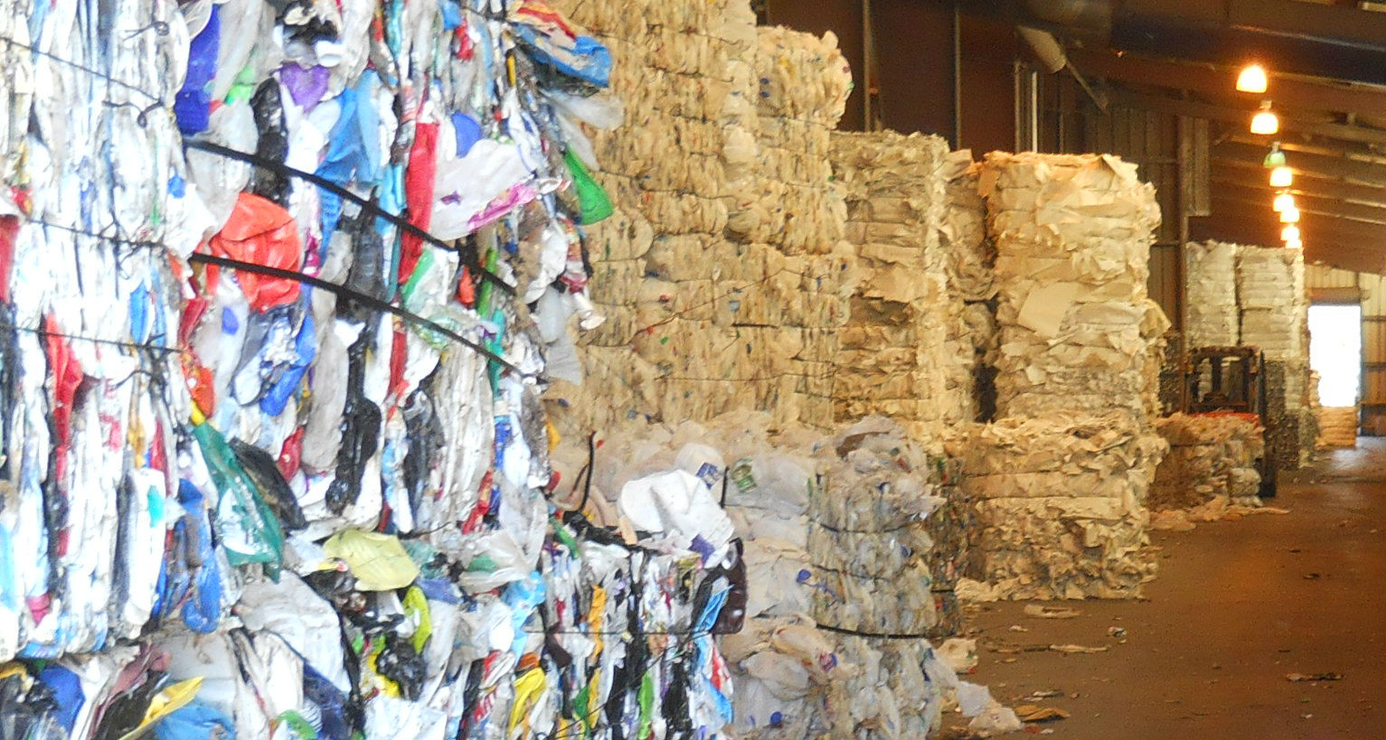
SB 5397 Plastic Packaging
Ecology, through consultation
with industry and consumer interests,
will develop options to reduce plastic
packaging in the waste stream for
implementation by January 1, 2022.

Slide 12
Plastic Packaging - Implementation
Evaluate and assess the amount and types of plastic packaging sold into Washington, and the management and disposal
Contract for a third-party study for the evaluation and assessment

Slide 13
Plastic Packaging - Implementation
RFP for the third-party independent consultant
Stakeholder input
Study
Legislative Report with findings and recommendations: Due October 31, 2020

Slide 14
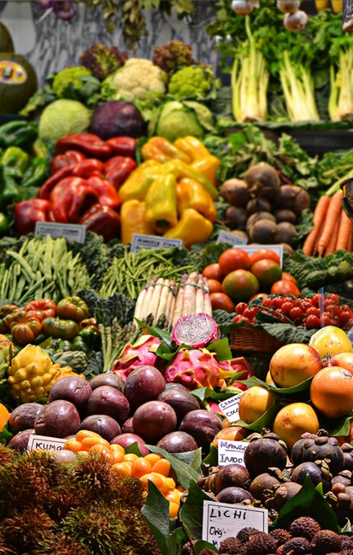
HB 1114 Food Waste
Purpose: Reduce the wasting of food in order to fight hunger and reduce environmental impacts.
Goal: Establishes a goal for the state to reduce by fifty percent the amount of food waste generated annually by 2030.
Ecology must adopt standardized metrics and processes for measuring wasted food and food waste generated.
Notes:
This bill is to reduce the wasting of food in order to fight hunger and reduce environmental impacts.
This bill establishes a goal for the state to reduce by 50% the amount of food waste generated annually by 2030.
Ecology must adopt standardized metrics and processes for measuring wasted food and food waste generated.

Slide 15
State Wasted Food Reduction and
Food Waste Diversion Plan
October 1, 2020 - Ecology will partner with the Departments of Health and Agriculture to develop and adopt a state wasted food reduction and food waste diversion plan
Notes:
Ecology will partner with the Department of Health and the Department of Agriculture to develop and adopt a state wasted food reduction and food waste diversion plan

Slide 16
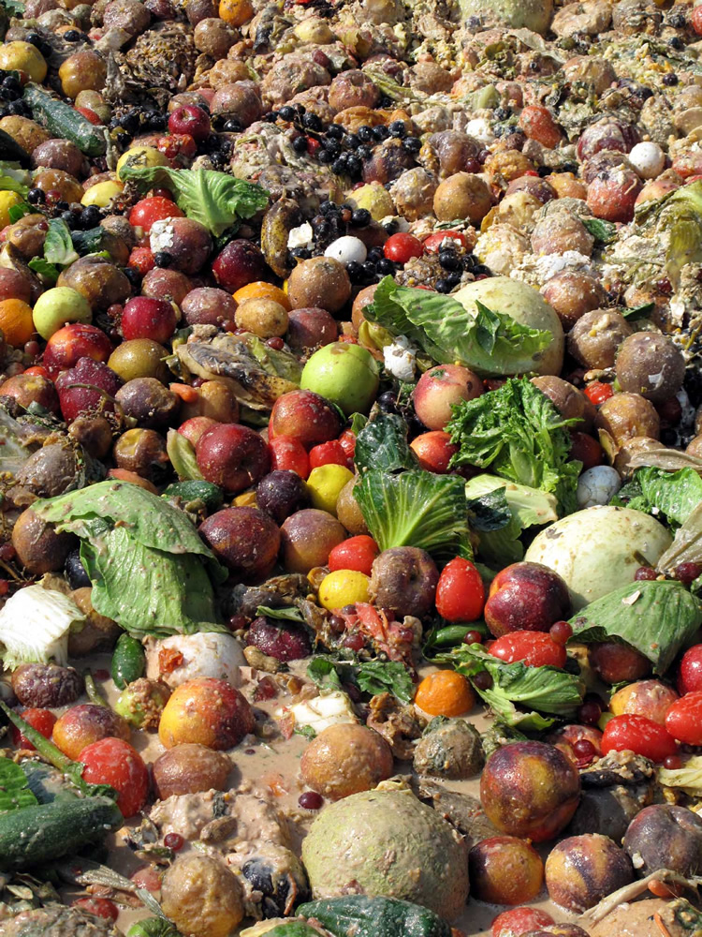
Food Waste - Implementation
Contract process
Assemble a stakeholder and interested parties group and solicit feedback
Study – Commerce independent evaluation of the state’s food waste and wasted food management system
Develop and implement the plan
Legislative report

Slide 17
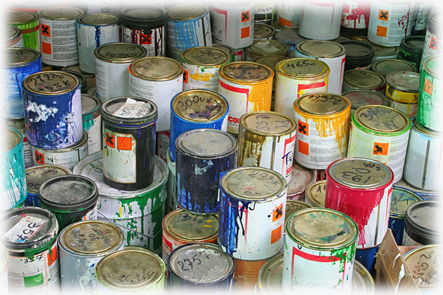
HB 1652 Paint Product Stewardship
Requires paint producers selling in or into Washington to participate in a state paint stewardship plan
A paint stewardship organization will implement this bill with Ecology providing oversight

Slide 18
HB 1569 Marketing
Degradability of Products
Requires environmental marketing claims for plastic products to follow specific standards for compostability and biodegradability
Prohibits the sale of packaging with misleading terms
In effect July 1, 2020
100% Biodegradable & Compostable

