Slide 1
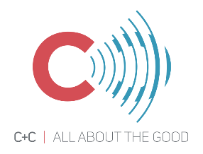
Reducing recycling contamination in WA
March 28, 2019
Notes:
The Department of Ecology is currently working with Media Group C+C to launch a statewide education and outreach campaign focused on reducing contamination through the messaging “Empty, Clean, and Dry”.

Slide 2
Recycle Right Campaign Foundation
Awareness | Desired Behavior | Barriers | Motivator
Audience is receptive: people in King County want to recycle, believe it is important and that it is the right thing to do | Keep recyclables empty, clean and dry | Believe I’m already do a good job recycling – no reason to pay attention Unaware that liquid or food left in containers or on paper can spoil a whole load of recyclables. | I don’t want to spoil/ruin recyclables for everyone
2
Notes:
C+C has been creating King County’s “Recycle Right” campaign since 2018 where they have been working with King County Solid Waste to generate messaging to inform King County Residents how to “recycle right”. Because this process was well underway when the Department of Ecology secured the funding to launch a statewide campaign, we decided to build on King County’s Recycle Right campaign to ensure continuity throughout the state. That being said, Ecology is ensuring that the messaging and materials being developed for the Statewide campaign will be applicable throughout the state and it’s varied demographics.

Slide 3
We Want the Audience To…
THINK: | Recycling is important. I need to do it right, because doing it wrong can ruin/spoil a whole load of recyclables.
FEEL: | By recycling right (empty, clean and dry), I feel good that I’m helping ensure materials can be recycled into new products.
DO: | Put only empty, clean and dry recyclables in my recycling bin
3

Slide 4
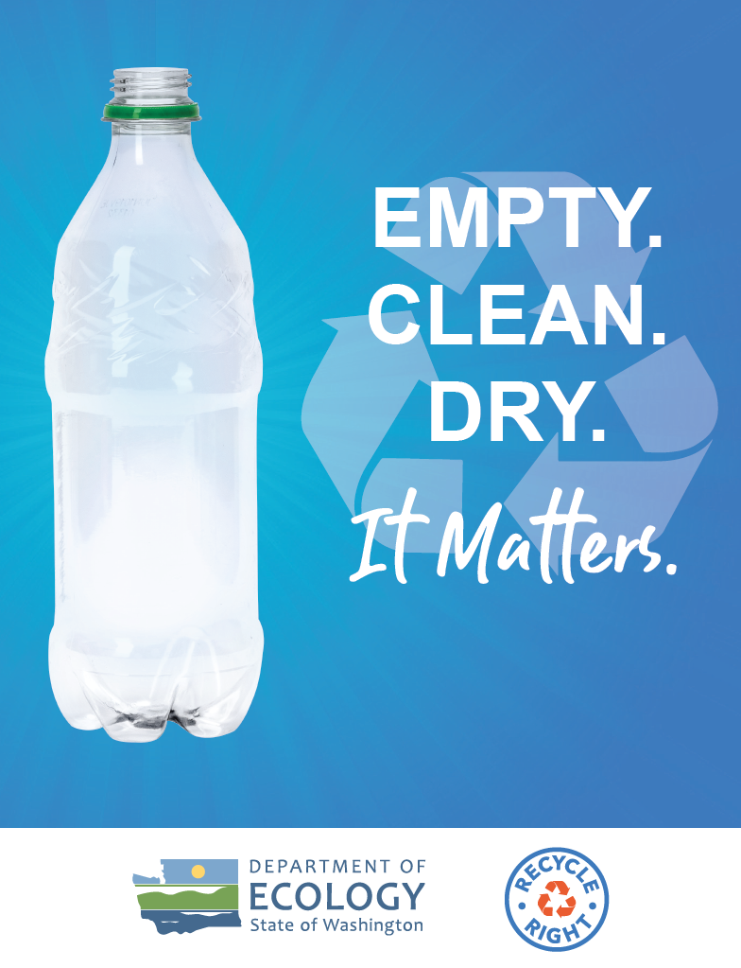

Slide 5
Ecology Media Plan
Audience: Residents statewide who recycle at home
Geography: statewide with more focus outside King County
Message and Creative:
Focus on “Empty, Clean and Dry”
Leverage Recycle Right/Recicla bien mark and “Empty. Clean. Dry. It Matters” messaging and creative look and feel
Expand creative assets for Ecology’s campaign – new video and radio spots
Languages: English and Spanish
In future, campaign can extend to other behaviors (over-recycling, bagging recyclables, etc.)

Slide 6
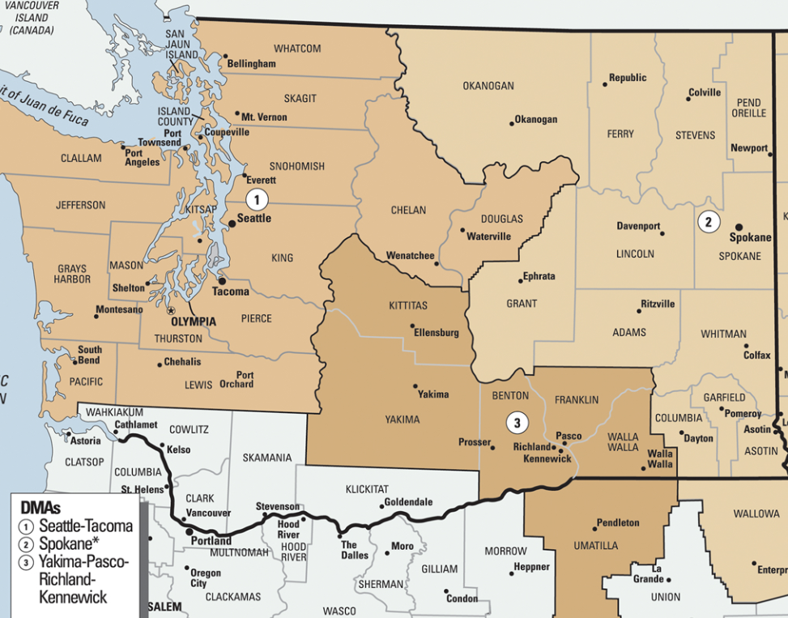
Washington Media Coverage
Online Market Coverage
TV Market Coverage
Radio Market Coverage
Zoned Cable TV only to avoid PDX market

Slide 7
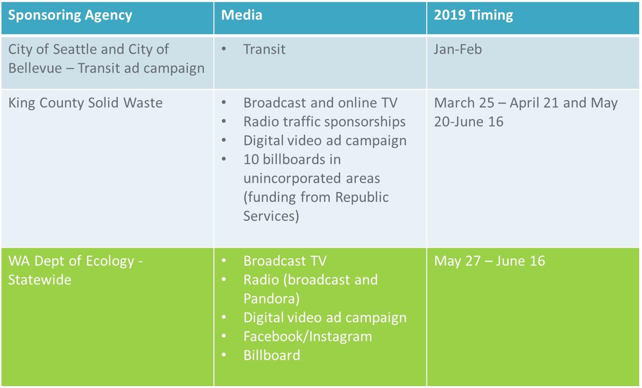
2019 Recycle Right Media

Slide 8
Other Campaign Materials
Customizable outreach toolkit for local government agencies
Social marketing plan for local program implementation and future statewide efforts
Evaluation plan
Notes:
Additionally, and what I am more excited for, C+C will be developing outreach toolkits for local municipalities to use and customize to their areas. This will include a social marketing plan for local program implementation and future statewide efforts.

Slide 9
Recycle Right Partner Toolkit Preliminary survey results
Relative priority
Notes:
As part of the recycle right outreach campaign, Ecology and its marketing firm are producing a toolkit for local government partners to download and customize for their own use. The toolkit will include several items already produced for the campaign including 30-second videos, 30-second radio spots, billboard artwork and digital banner ads.
To figure out what other items to include in the toolkit, we’re asking for your feedback. We’ve heard from 23 of you so far, and here are the preliminary results. This graph shows the relative priority of the potential toolkit items based on the prioritization exercise in the survey. A higher bar means higher priority.
While all the items are pretty close, the top items right now are:
A half-page or postcard handout for events
Website content (graphics and copy)
Static social media graphics and copy
If you’d like to provide your feedback, please complete the survey by Monday, April 29. I’ll resend the link out later today. We need to get rolling on producing these items, so your prompt feedback is appreciated!

