Slide 1

Recycling Development Center
Kara Steward
Solid Waste Advisory Committee
October 3, 2019

Slide 2
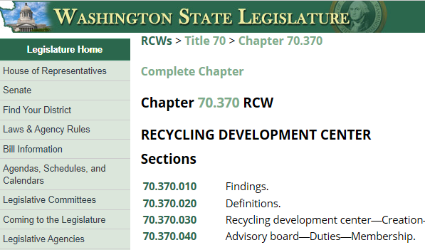



House Bill 5135
14 member Advisory Board
1 City
2 County
1 Public interest
3 Research
7 Private sector

Slide 3












https://ecology.wa.gov/DOE/files/3e/3e036fc2-2e55-4e4a-ba87-673654c28019.pdf
https://www.ezview.wa.gov/Portals/_1962/Documents/Water2Resources/SWAC19RecyclingDevelopmentCenterPresentation.pdf

Slide 4

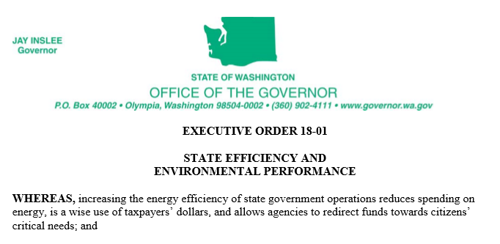




Recycling Development Center
What’s next?
RDC

Slide 5
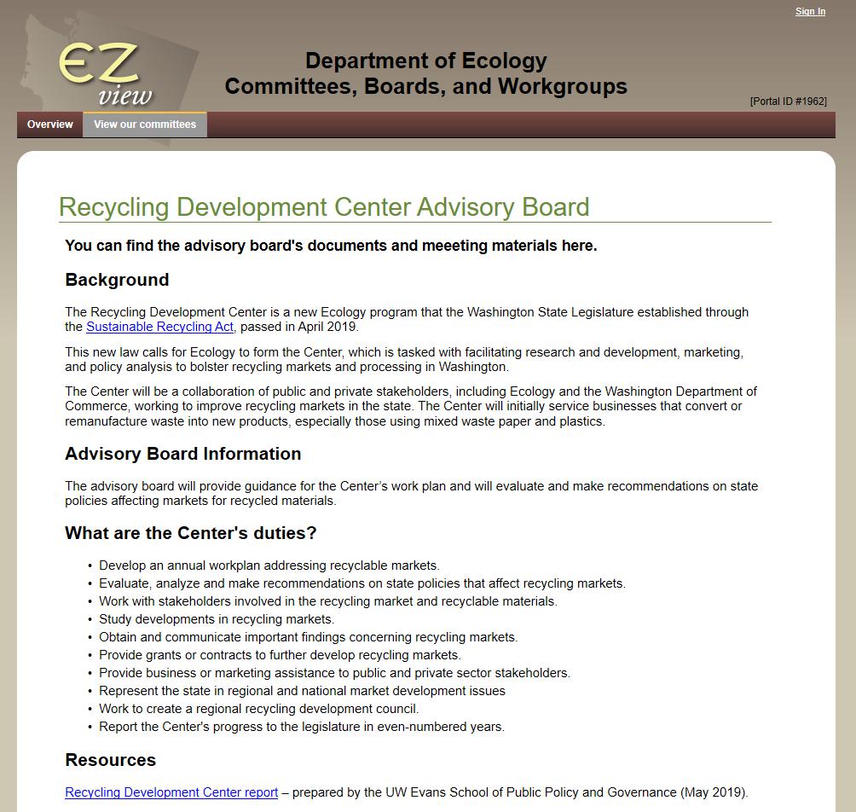
Kara Steward
Kara.steward@ecy.wa.gov
360-407-7643 work
564-999-5550 cell
https://www.ezview.wa.gov/site/alias__1962/37596/recycling_development_center_advisory_board.aspx

