Slide 1
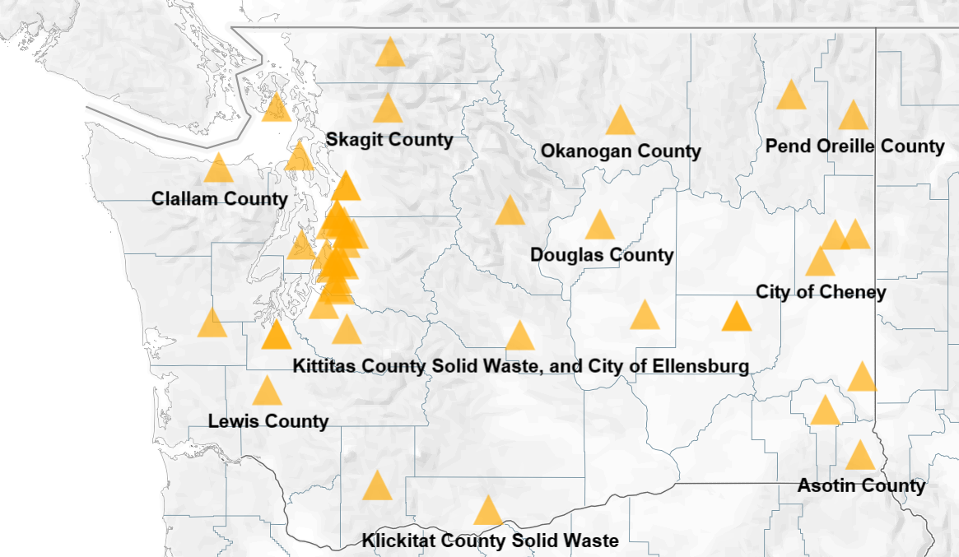
Recycling Markets Impacts Survey 2019
Heather Church

Slide 2
We Heard You!
“What are other municipalities doing?”
Created a survey that launched in June and closed end of July 2019
Survey looked a little something like this…

Slide 3
59 Responding Jurisdictions
Counties
Cities and Other Jurisdictions
Adams County
Asotin County
Chelan County
Clallam County
Douglas County
Garfield County
Grant County
Grays Harbor County
Island County
Jefferson County (2)
Kitsap County
Kittitas County and City of Ellensburg
Klickitat County
Lewis County
Lincoln County
Lopez Island
Okanogan County
Pierce County
Pond Oreille County
Skagit County
Skamania County
Snohomish County
Spokane County (2)
Stevens County
Thurston County
Whatcom County
Whitman County
Yakima County (3)
City of Auburn
City of Bellevue
City of Bothell
City of Cheney
City of Edmonds
City of Everett
City of Federal Way
City of Kenmore
City of Kent
City of Kirkland (2)
City of Lynnwood
City of Normandy Park and Bruien
City of North Bend
City of Olympia
City of Pacific
City of Redmond
City of Renton
Seattle Public Utilities City of SeaTac
City of Sedro Woolley (2)
City of Shoreline
City of Spokane Valley
City of Spokane
City of Tacoma
City of Vancouver
City of Walla Walla (2)

Slide 4
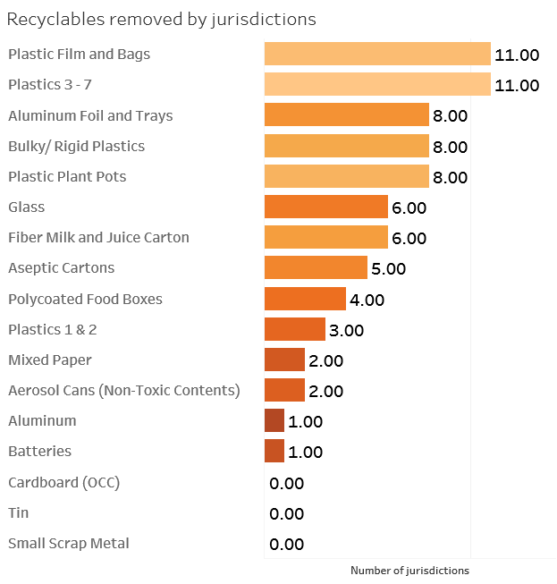
Getting Somewhere…
View initial results and visuals from data

Slide 5
What’s Next?
Getting the Existing Data on Ecology.wa.gov
- Summary of Data and Trends
- Access to
- Merge information with that which has historically been collected.
Continuing the Data Collection- Survey 2020
- Revise Questions
- Continue/ Increase Participation Rates

Slide 6
Questions?
Heather Church
Eastern Washington Materials Management Coordinator
Heather.Church@ecy.wa.gov
Desk: (509) 329-3564
Cell: (509) 202-6946

