Slide 1
Water Rights Primer January 19, 2023
Noah Wentzel
Water Resources Program Washington State Department of Ecology

Slide 2
Overview
Introduction to water rights
Relevant case law – Postema, Swinomish, Foster, Hirst

Slide 3
Water Management Doctrines
Prior Appropriation
Riparian
Private Property

Slide 4
Early Water Law – Era of Appropriations
1917 Water Code (RCW 90.03)
Established prior appropriation for surface water rights.
1945 Groundwater Code (RCW 90.44)
Expanded prior appropriation to groundwater rights.
Established permit-exempt groundwater withdrawals.

Slide 5
Establishing a water right
Water rights can be established through:
A “claim,”
A permit application submitted to the Dept. of Ecology, or
A permit-exempt use
Prior Appropriation
“First in time, first in right”
Seniority based on priority date established by initial use
Four-part test for new appropriations

Slide 6
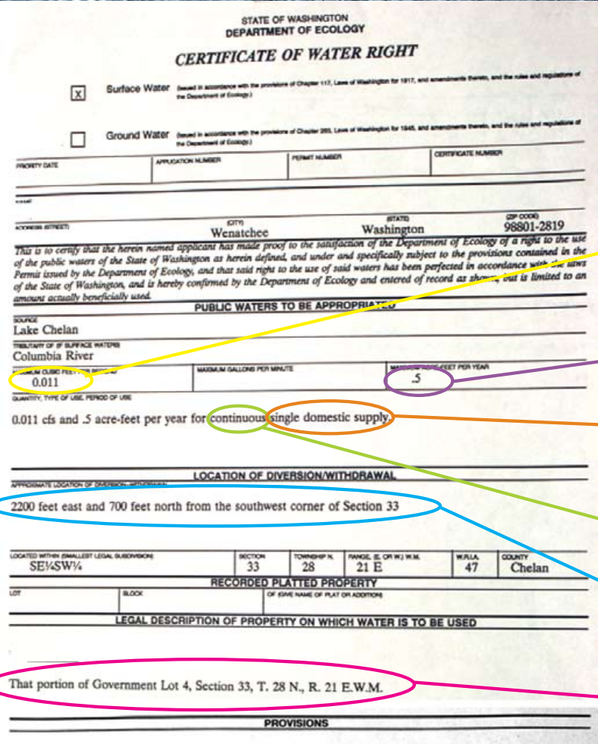
What is a water right?
The right to use water:
For a specific beneficial use.
For a specific quantity.
During a specified season.
From a specific point of diversion or withdrawal.
At a specific place.

Slide 7
Maintaining a water right
Water rights are only valid to the extent that they are beneficially used.
Abandonment: failure to use your water for an extended period of time and intention to give up the right.
Relinquishment: failure to beneficially use your water for a period of 5 years or longer and failure to qualify for a “sufficient cause” of nonuse. See RCW 90.14.140.

Slide 8
Changing a water right
To change a quality of a right, have to submit a change application to Ecology.
Ecology must do an evaluation of “extent and validity” of the right on all change applications.
Examine whether the right has been relinquished via failure to beneficially use the right for a period of 5-years or more (or qualify for a sufficient cause for exemption/exception).
Could result in a reduction of the right or finding that the entire right was relinquished.

Slide 9
Permit-exempt wells
For certain groundwater uses, landowners may drill a well (and use the water) without first getting a water right permit from Ecology.
Permit-exempt wells are still a water right and cannot impair senior users.
Under RCW 90.44.050, permit-exempt uses include:
A single home or groups of homes (up to 5,000 gpd);
Livestock (no gallon per day limit);
A non-commercial lawn or garden one-half acre in size or less (limited to reasonable use); and
Industrial purposes, including irrigation (up to 5,000 gpd).

Slide 10
Instream Flow Protection
1969 Minimum Instream Flow Law (RCW 90.22)
1971 Water Resources Act (RCW 90.54)
Source: Dave Nielsen, Flickr

Slide 11
Minimum Instream Flow Law (1969)
“The department of ecology may establish minimum water flows or levels for streams, lakes or other public waters for the purposes of protecting fish, game, birds or other wildlife resources, or recreational or aesthetic values of said public waters whenever it appears to be in the public interest to establish the same” (RCW 90.22.010).
Instream flow rules have a priority date of the rule’s adoption.
Ecology shall not grant rights that would conflict with instream flow rules.

Slide 12
Water Resources Act (1971)
“Uses of water for domestic, stock watering, industrial, commercial, agricultural, irrigation, hydroelectric power production, mining, fish and wildlife maintenance and enhancement, recreational, and thermal power production purposes, and preservation of environmental and aesthetic values, and all other uses compatible with the enjoyment of the public waters of the state, are declared to be beneficial” (RCW 90.54.020(1)).
“The quality of the natural environment shall be protected and, where possible, enhanced as follows: (a) Perennial rivers and streams of the state shall be retained with base flows necessary to provide for preservation of wildlife, fish, scenic, aesthetic and other environmental values, and navigational values…” (RCW 90.54.020(3)).

Slide 14
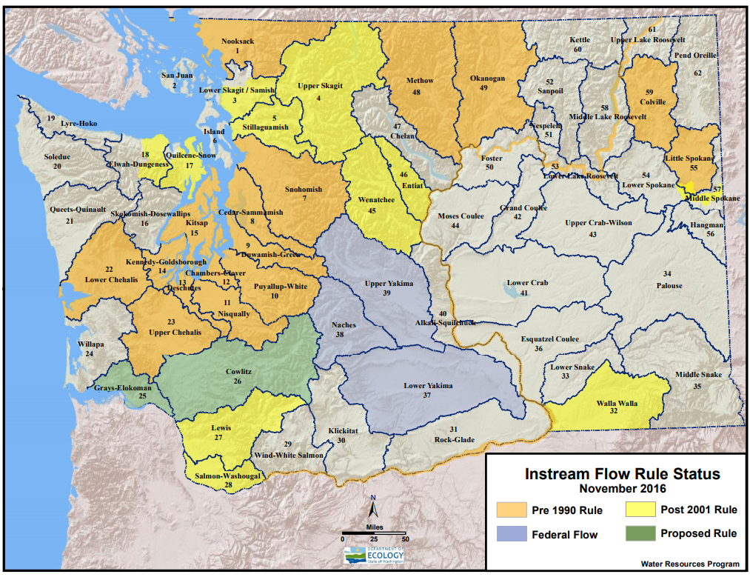

Slide 15
Ecology’s Role
Statute
Case Law
Rules
Policy
Legislature
Courts
Ecology
Guidance
Forms

Slide 16
Water Resource Program Role
Legislature
Courts
Ecology
Water Resources
Fish & Wildlife
DNR
OCR
Water Quality

Slide 17
Case Law

Slide 18
Postema, et al. v. PCHB,et al. (2001)
Appeal of a batch denial of applications to withdraw groundwater in hydraulic continuity with “closed” surface water sources.
Rulings:
Instream flow rights are rights subject to the same protection as any other water right.
No impairment to existing rights are permissible, even de minimis impairment.
“Any effect on the flow or level of the surface water” in closed streams would mean impairment.

Slide 19
Swinomish v. Ecology (2013)
Appeal of Ecology’s amendment to the Skagit Instream Flow Rule that created a “reservation” of water for domestic use. Ecology justified the reservation based off a finding of “overriding consideration of the public interest “ (OCPI).
Rulings:
Ecology cannot use OCPI to justify water use that impairs existing instream flows.
OCPI is a narrow exception and requires extraordinary circumstances before the minimum flow water right can be impaired.

Slide 20
Foster v. Ecology, et al. (2015)
Appeal of a water right permit granted to a local city. Ecology had conditioned the permit on mitigation, including “water for water” and “out-of-kind” measures. We used OCPI to approve the application.
Rulings:
No impairment of instream flows are permissible, regardless of magnitude or ecological impact (reaffirming Postema).
We cannot use out-of-kind mitigation, such as habitat improvements, to address impairment of instream flows.
Legal vs. ecological impairment.
Ecology cannot use OCPI to justify permanent allocations of water.

Slide 21
Whatcom County v. Hirst, et al. (2016)
Appeal of Whatcom County’s Comprehensive Plan.
Rulings:
The plan failed to sufficiently protect water resources under the GMA.
Counties have an independent responsibility to ensure that new permit-exempt uses do not impair senior uses, including instream flows.
Counties cannot allow even de minimis impairment to instream flows.

Slide 22
Legislative Response: Streamflow Restoration (2018)
In affected “Hirst basins”:
People can build homes using a permit-exempt well; potential impacts to instream flows authorized. Includes a $500 fee and water use restrictions.
Planning groups are convened to identify actions necessary to offset the consumptive impact from new permit-exempt wells.
Plans must prioritize “in-time and in-place” mitigation.
Plans must meet a “net ecological benefit” standard.
Appropriated $300 million over 15 years for streamflow restoration projects statewide.
Convened a Legislative task force to study the WA Supreme Court’s Foster decision. Authorized 5 pilot projects.

Slide 23
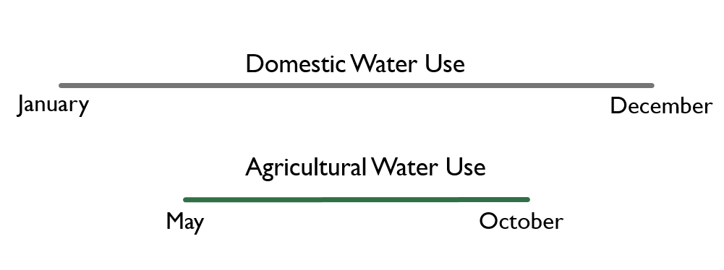
The “perfect mitigation” standard
1. In-place
2. In-time
3. In-kind
“water for water”

