Slide 1
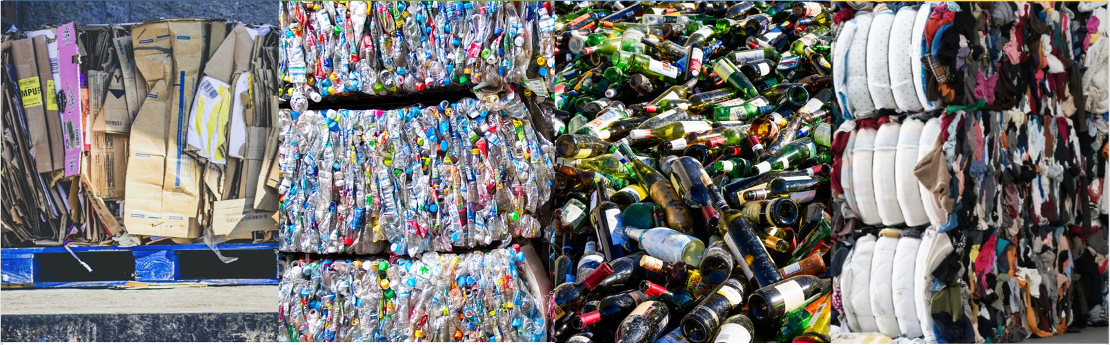
Recycling Development Center Advisory Board Meeting
June 14, 2023 | 9am – 12pm (Pacific time)

Slide 2


AGENDA
9:00 am Welcome
9:10 am Board and Agency Updates
10:00 am Dan Weston-Recycle Right Campaign
10:15 am Break
10:30 am Presentations
11:45 am Wrap-up

Slide 3
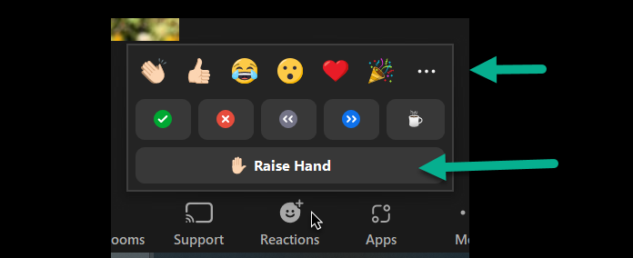
Participating in this meeting:
Roles
Host-Caleb
Facilitator-Mya
Note taker/chat monitor-Tina
Rules
Cameras On
Board members and presenters may unmute themselves.
Questions, please raise your hand or type them in the chat box.
I will call on you or I can read your question from the chat.
Use reactions to keep it interactive
Note: we are not recording this meeting, meeting notes will be posted on the Advisory Board website.
Notes:
Roles
Caleb is running the Zoom and slides
Mya is facilitating
Tina is taking notes and monitoring the chat
Rules
Please turn your cameras
Board members and presenters may unmute themselves.
For questions, please raise your hand or type them in the chat box. I will call on you or I can read your question from the chat.
Participants may use reactions throughout.

Slide 4
AGENDA
9:00 am Welcome
9:10 am Board and Agency Updates
10:00 am Dan Weston-Recycle Right Campaign
10:15 am Break
10:30 am Presentations
11:45 am Wrap-up

Slide 5


Center updates
Board members
Commerce
Ecology
NextCycle Washington
UW Study, WWU Reports

Slide 6
Board roundtable:
Are you able to recycle polystyrene in your community?
What’s the best concert you’ve been to lately?
Notes:
If you have an update on your work great and pick one of these to tells us about.

Slide 7













Board roundtable:
Natalie Caulkins
Corinne Drennan
Karl Englund
Kyla Fisher
Allen Langdon
Kris Major
Scott Morgan
Chris Piercy
Mike Range
Tim Shestek
Jay Simmons
Heather Trim
Jon Smieja

Slide 8



Agency Updates
Rob Duff
Kara Steward
Notes:
Random thoughts on Ecology Updates
Work comes/goes on active legislation
How about a budget update? What we’ve done in 21-25 – coming up to the end of the biennium, looking forward into next biennium (why we want the subcommittee to prioritize/UW study)

Slide 9
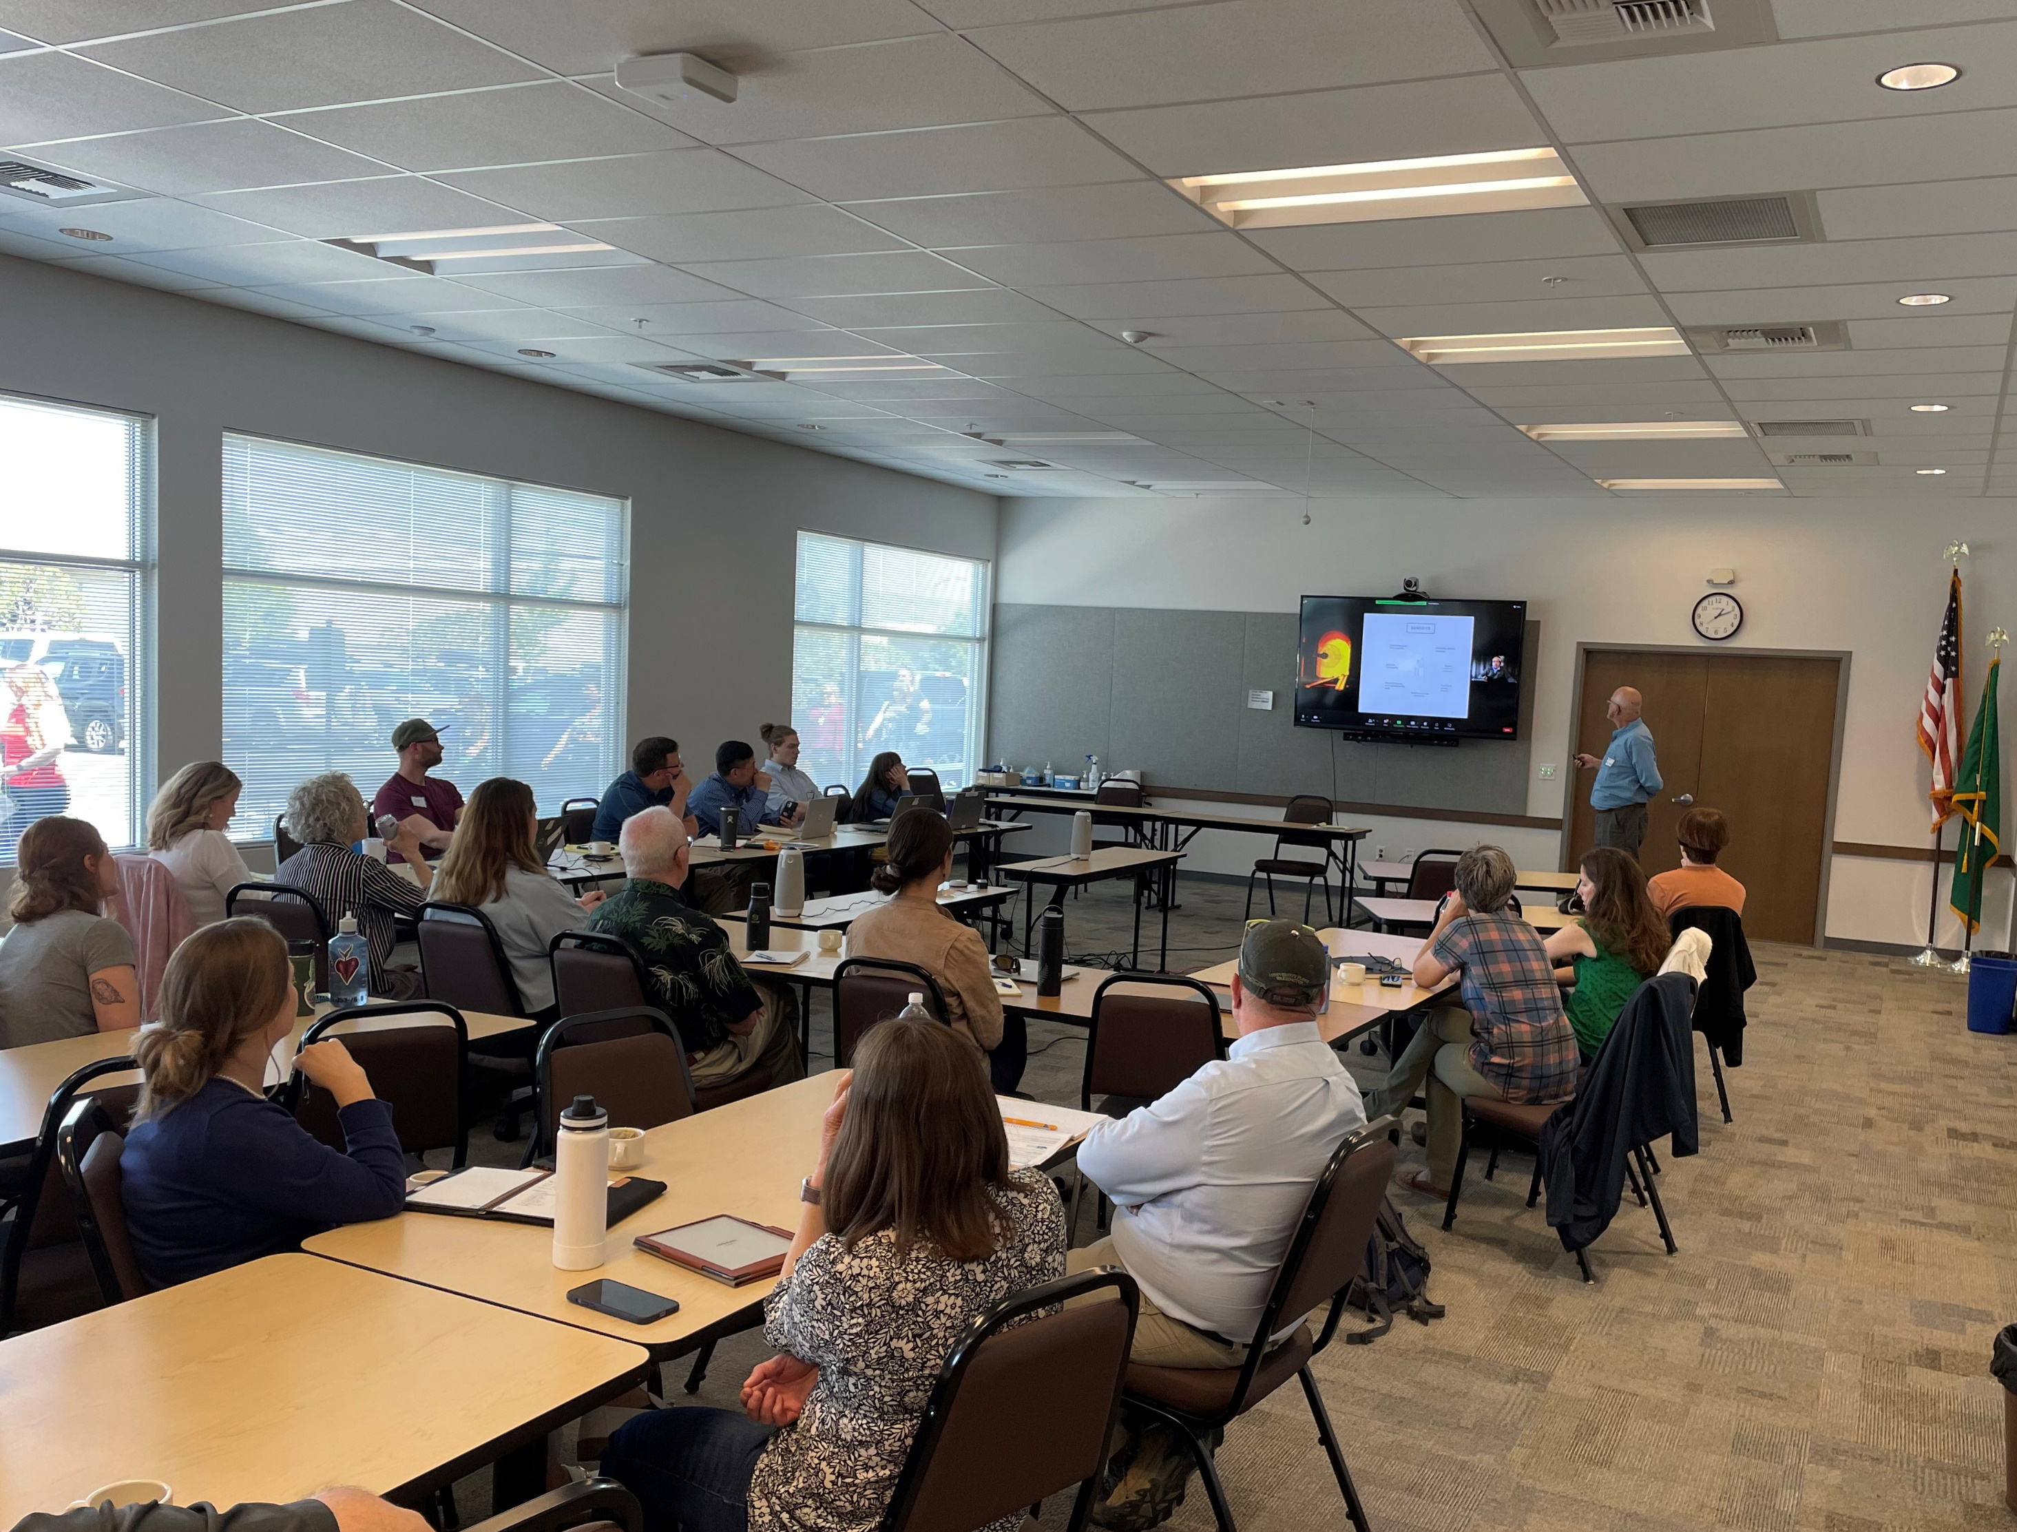
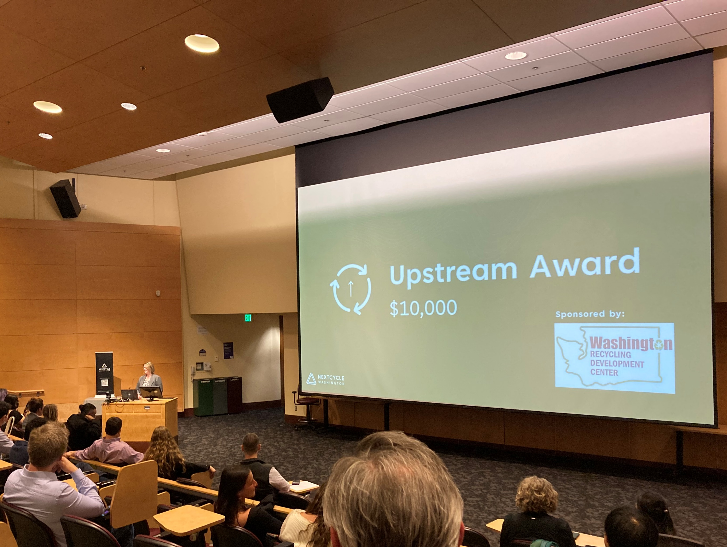
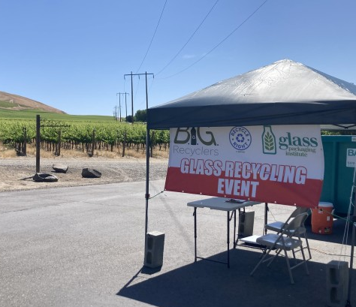
Updates:
June 6, Eastern Washington Hub and Spoke, Walla Walla and Benton City
March 23, NextCycle Washington Pitch Competition, UW Campus
May 4, Eastern Washington Glass Summit, Ecology office in Union Gap

Slide 10
What’s next:
NextCycle Washington
Market Development RFP
RFP 2364 SWM out for bid
Gap analysis
Accelerator outcomes
Resilience, risk, and circularity maps
Circular funding resource guide
Bids due July 20
EPA SWIFR grant funded
Ecology/Commerce
Priority matrix
Market map
Research
Topic summits

Slide 11

Highlights from Western Washington University’s Center for Economic & Business Research report
Mya Keyzers
Notes:
This three-part comprehensive report was a search and analysis of the businesses that sort and refine Washington’s recyclable materials into sellable commodities, and the intermediate and end-users that use recyclable materials in manufacturing.

Slide 12
Scope: Analysis of the businesses that sort and refine Washington’s recyclable materials into sellable commodities and the intermediate and end-users that use recyclable materials in manufacturing.
WWU Economic Study
Part one: Recycling Companies and Revenue
Part three: Equity Analysis of Recycling
Part two: Economic Impact of Recycling
Notes:
Part one: Recycling Companies and Revenue, provides economic data related to management of recyclable materials in Washington state and their principal processors.
Part two: Economic Impact of Recycling, examines economic contribution of the recycling industry, identifying direct, indirect, and induced economic impacts of potential expansion within the recycling industry.
Part three: Equity Analysis of Recycling, examines environmental justice and equity concerns within the solid waste and recycling system, mapping health and environmental hazard variables to facility locations.

Slide 13
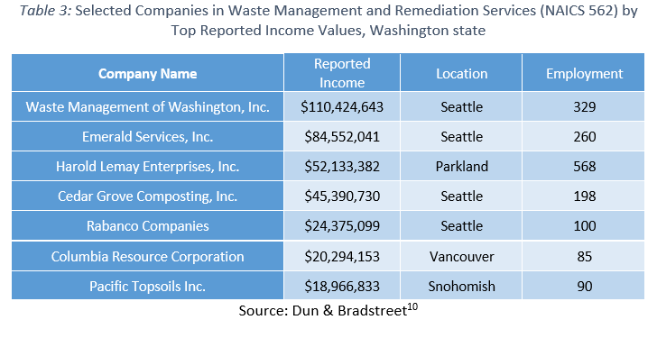
Recycling Companies/Revenue
Waste Management and Remediation Services sector (NAICS 562)
NAICS 562 in 2019:
585 establishments
15,632 employees
$77,095 avg wage

Slide 14
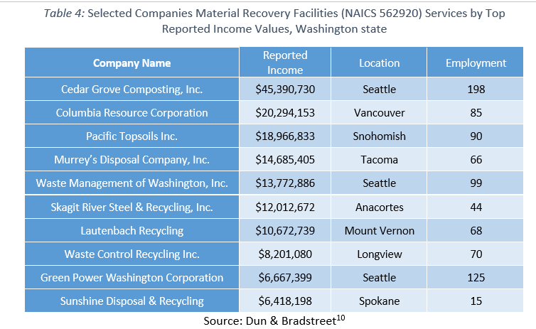
Recycling Companies/Revenue
Material Recovery Facilities (NAICS 562920)
NAICS 562920 in 2019:
32 establishments
963 employees
$56,649 avg wage

Slide 15
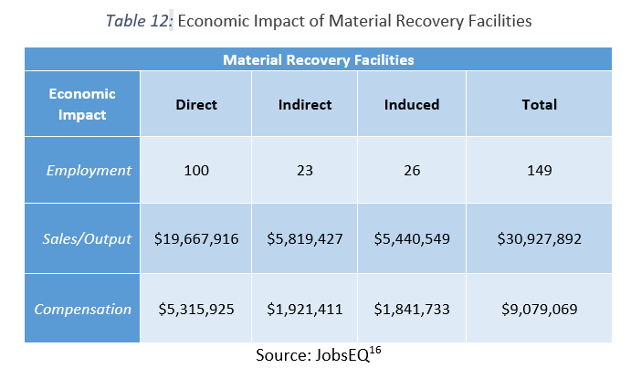
Economic Impact of Recycling
The table shows the economic impact of adding 100 new employees to the material recovery facilities industry.
There are currently 963 employees in the MRF industry in Washington.
Direct – Initial change in demand (spending and jobs supported)
Indirect – Changes in spending throughout the supply chain due to a change in demand
Induced – Changes in spending that result when households see a change in their income

Slide 16
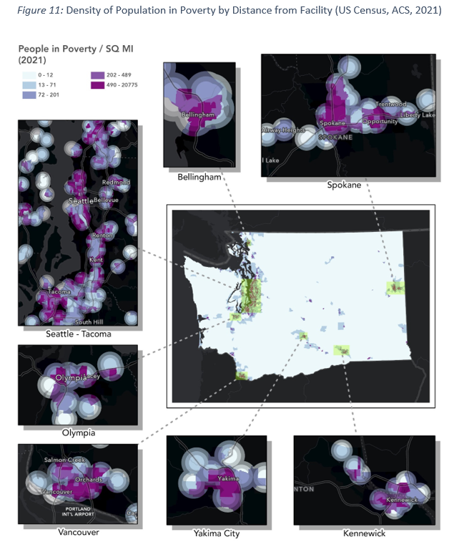
Equity Analysis of Recycling
This first dataset (Figure 10) is from the American Community Survey (ACS) 2015-2019, using census tracts from before the 2020 redistricting. While the second (Figure 11) is from the ACS 2017-2021, using census tracts post 2020 redistricting. Determining exact changes between these datasets is difficult due to the change in census tracts, maps of both sets are provided to help illustrate these changes. Highlighted areas on the maps are within a 2-mile radius of facilities that take part in recycling activities.
While this should not be expected to reliably express the relationship between recycling industry workers and poverty, it aims to reveal any notable relationship between recycling activity and the potential impact on the surrounding economic conditions. Namely asking; do recycling activities and facilities primarily occur within lower income areas? Do they occur mainly within densely populated areas? Are there any potential opportunities that could be provided to these communities that live in such proximity?
Bureau, US Census. “American Community Survey 2019 & 2021”. Census.gov. 2019, 2021.
https://data.census.gov/table?q=washington+census+tracts+poverty&g=0400000US53$1400000&tid=ACSST1Y2021.S1701

Slide 17
WWU Economic Study - links
Part one: Recycling Companies and Revenue
https://apps.ecology.wa.gov/publications/SummaryPages/2307013.html
Part two: Economic Impact of Recycling
Part three: Equity Analysis of Recycling
https://apps.ecology.wa.gov/publications/SummaryPages/2307011.html
https://apps.ecology.wa.gov/publications/SummaryPages/2307012.html
Notes:
Part one: Recycling Companies and Revenue, provides economic data related to management of recyclable materials in Washington state and their principal processors.
Part two: Economic Impact of Recycling, examines economic contribution of the recycling industry, identifying direct, indirect, and induced economic impacts of potential expansion within the recycling industry.
Part three: Equity Analysis of Recycling, examines environmental justice and equity concerns within the solid waste and recycling system, mapping health and environmental hazard variables to facility locations.

Slide 18
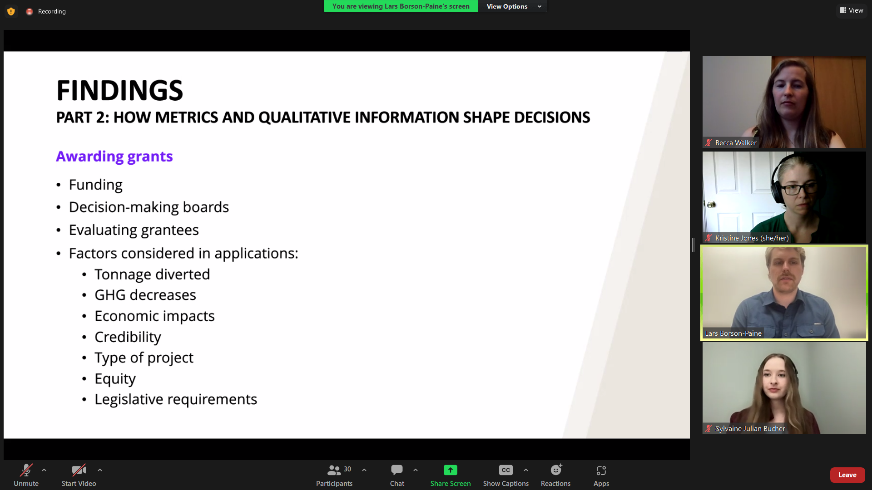
University of Washington Evans School of Public Policy & Governance
Scope: Help the Recycling Development Center shape an approach to using quantitative and qualitative data and metrics to inform the Center’s contributions to recycling market development.
Deliverables
A final written report including the information set forth in the project description-publication in process, will share when it is available.
A virtual presentation to was completed on June 2, 2023 a recording of the Zoom presentation is on our EZ Advisory Board webpage.

Slide 19
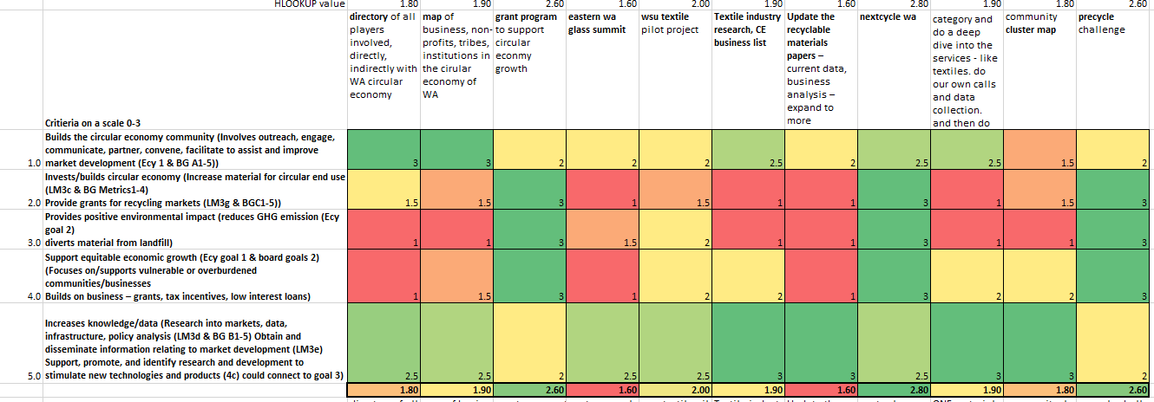
Matrix Subcommittee
We will use the UW Evans recommendations and the NextCycle gap analysis data to inform the next iteration of the prioritization tool. The subcommittee will reconvene later this summer to discuss.

Slide 20
AGENDA
9:00 am Welcome
9:10 am Board and Agency Updates
10:00 am Dan Weston-Recycle Right Campaign
10:15 am Break
10:30 am Presentations
11:45 am Wrap-up

Slide 21

Legislative Update
Dan Weston– Ecology – Solid Waste Management Program Statewide Recycling Coordinator

Slide 22


Questions?

Slide 23

Let’s take a 10 minute break

Slide 24
AGENDA
9:00 am Welcome & review meeting goals
9:10 am Board and Agency Updates
10:00 am Dan Weston-Recycle Right Campaign
10:15 Break
10:30 am Presentations
11:45 am Wrap-up

Slide 25

Presentations &
Discussion
Scott Morgan–Evergreen State College
Lexi Brewer–University of Puget Sound
Shannon Britton–Seattle University
Karl Englund–Washington State University
Marilyn Lauderdale–Styro Recycle
Notes:
Scott Morgan is the Director of Sustainability at The Evergreen State College, and has coordinated the Washington Higher Education Sustainability Coalition (WAHESC) for over a decade. ‘Sustainability’ encompasses a very broad scope of work in higher education, including waste mitigation and diversion for recycling. Scott is joined in this presentation by two WAHESC colleagues from the University of Puget Sound and Seattle University to provide an overview of the nature and scale of the waste diversion and recycling systems and challenges on college and university campuses.

Slide 26
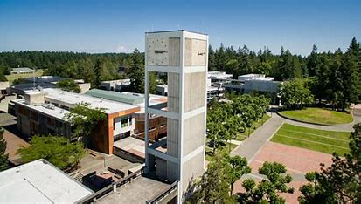
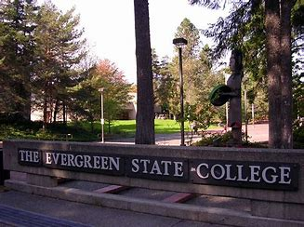
College Sustainability
Scott Morgan–Evergreen State College
Lexi Brewer–University of Puget Sound
Shannon Britton–Seattle University
Notes:
Scott Morgan is the Director of Sustainability at The Evergreen State College, and has coordinated the Washington Higher Education Sustainability Coalition (WAHESC) for over a decade. ‘Sustainability’ encompasses a very broad scope of work in higher education, including waste mitigation and diversion for recycling. Scott is joined in this presentation by two WAHESC colleagues from the University of Puget Sound and Seattle University to provide an overview of the nature and scale of the waste diversion and recycling systems and challenges on college and university campuses.

Slide 27
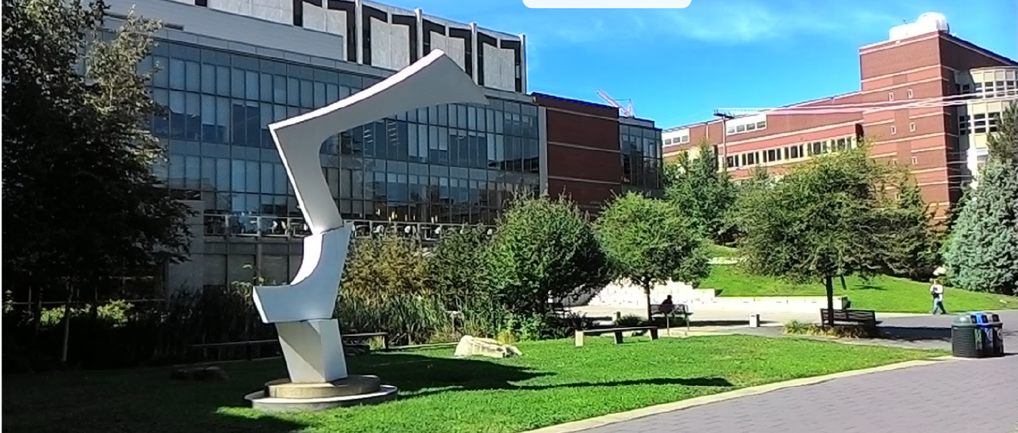
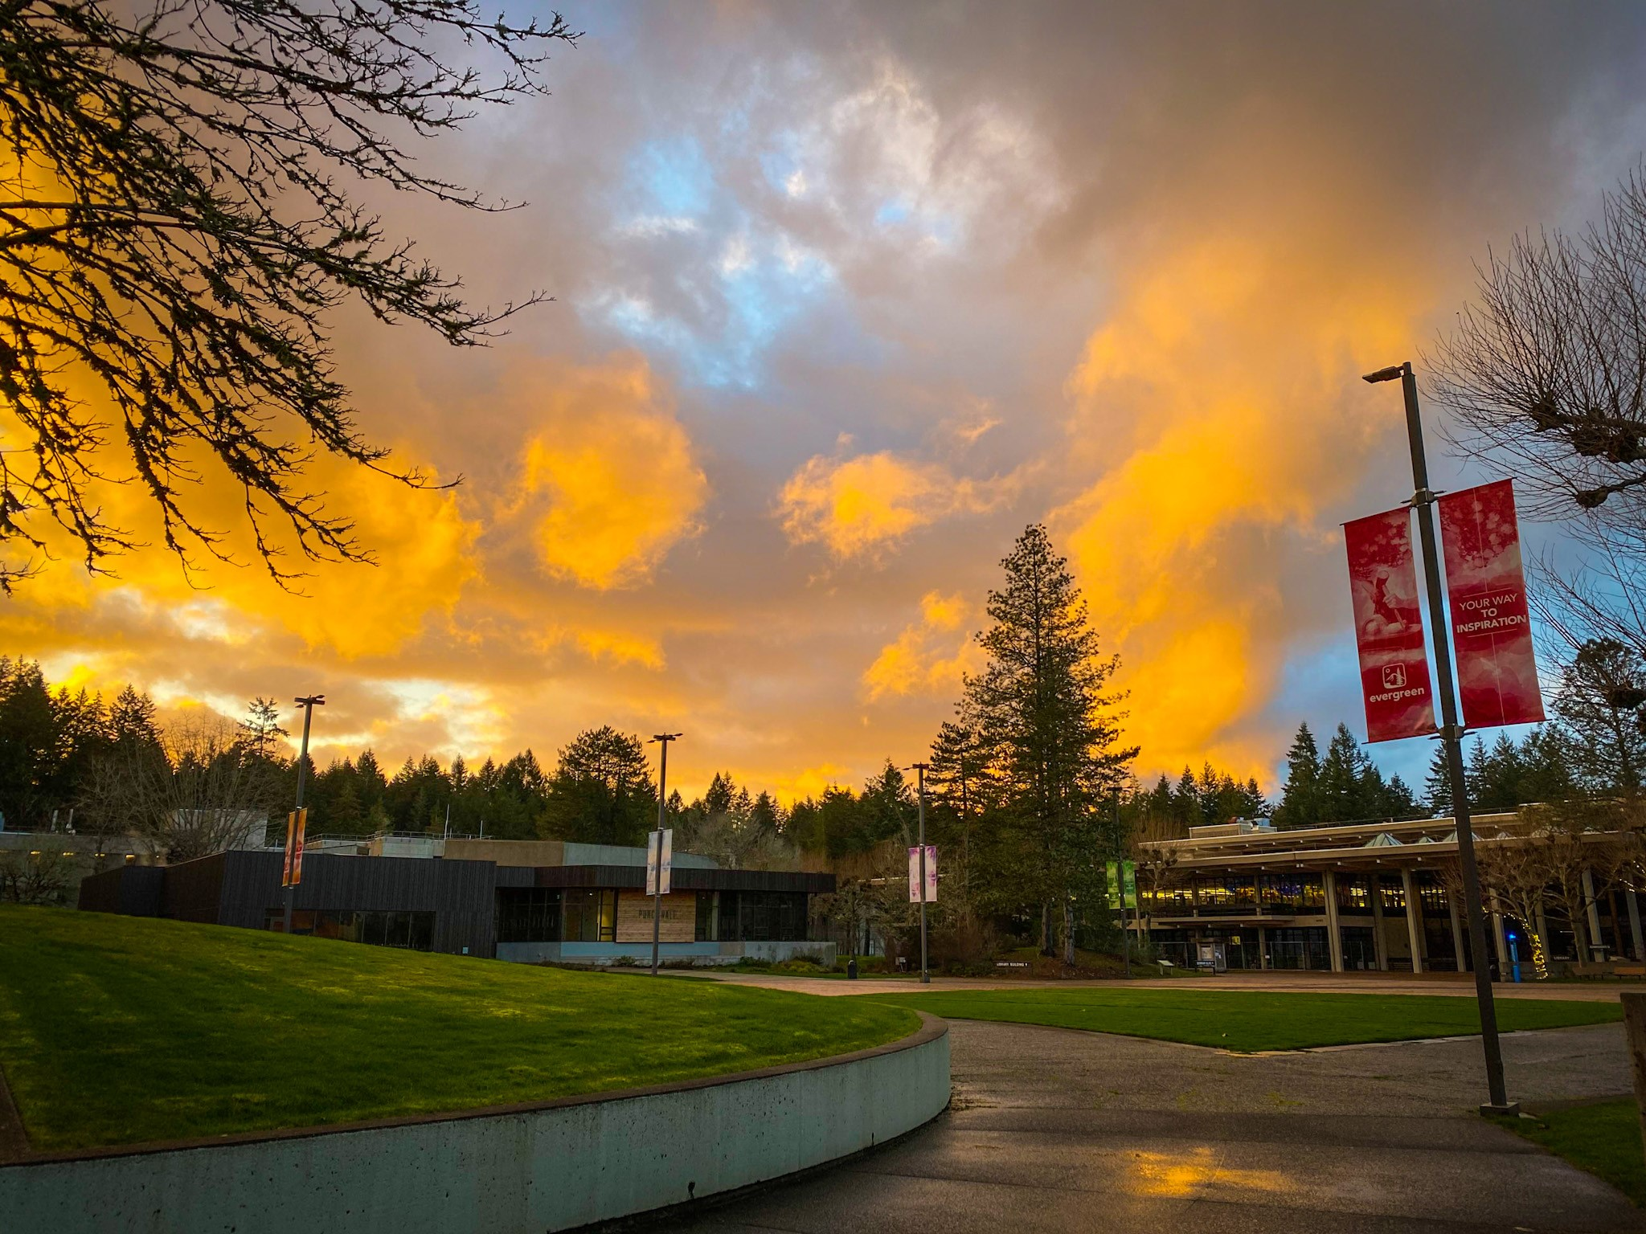
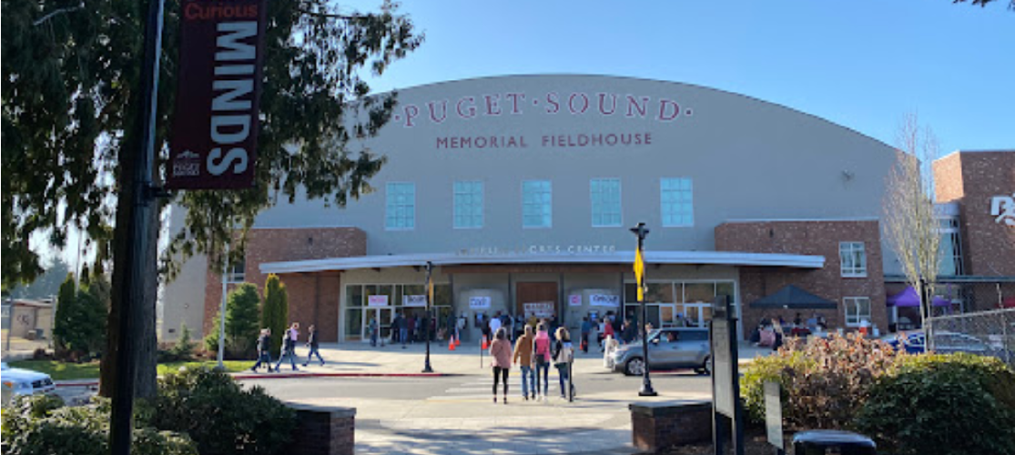
College & University Recycling
Scott Morgan, The Evergreen State College
Lexi Brewer, University of Puget Sound
Shannon Britton, Seattle University
Notes:
SCOTT
Our institutions are representative of colleges and universities across the state.
We all face high expectations, multiple challenges, and limited capacity to maximize diversion of campus wastes to recycling.

Slide 28
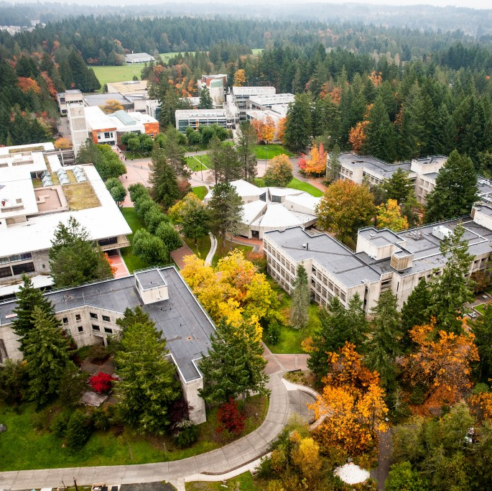
College campuses are like small towns.
Office buildings
Classroom buildings
Labs of many kinds
Community centers
Multi-family housing
Utility services and shops
Retail operations
Food service
Libraries
…and more.
Notes:
SCOTT

Slide 29
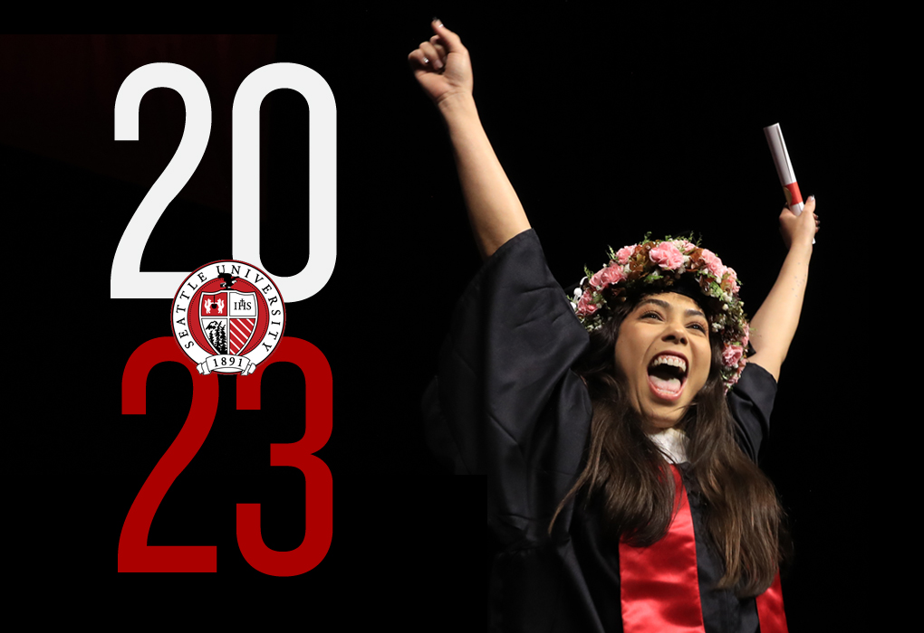

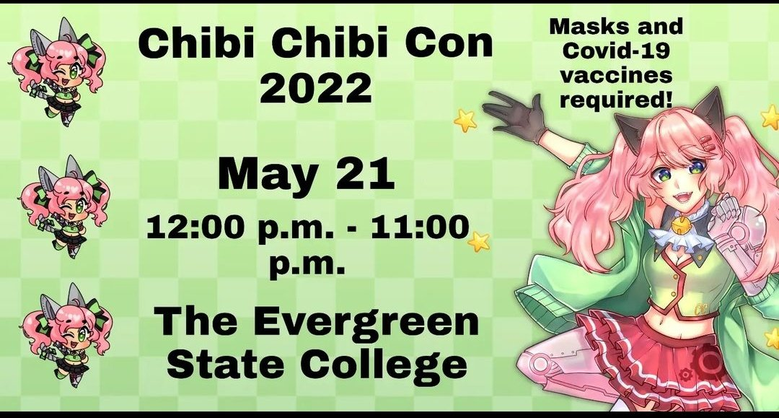
We are also event destinations.
Graduations, alumni celebrations, concerts, theatre, athletics, community gatherings, lectures, conferences, summer camps…
Holiday events
Student fairs
Socials & Parties
Notes:
SCOTT

Slide 30
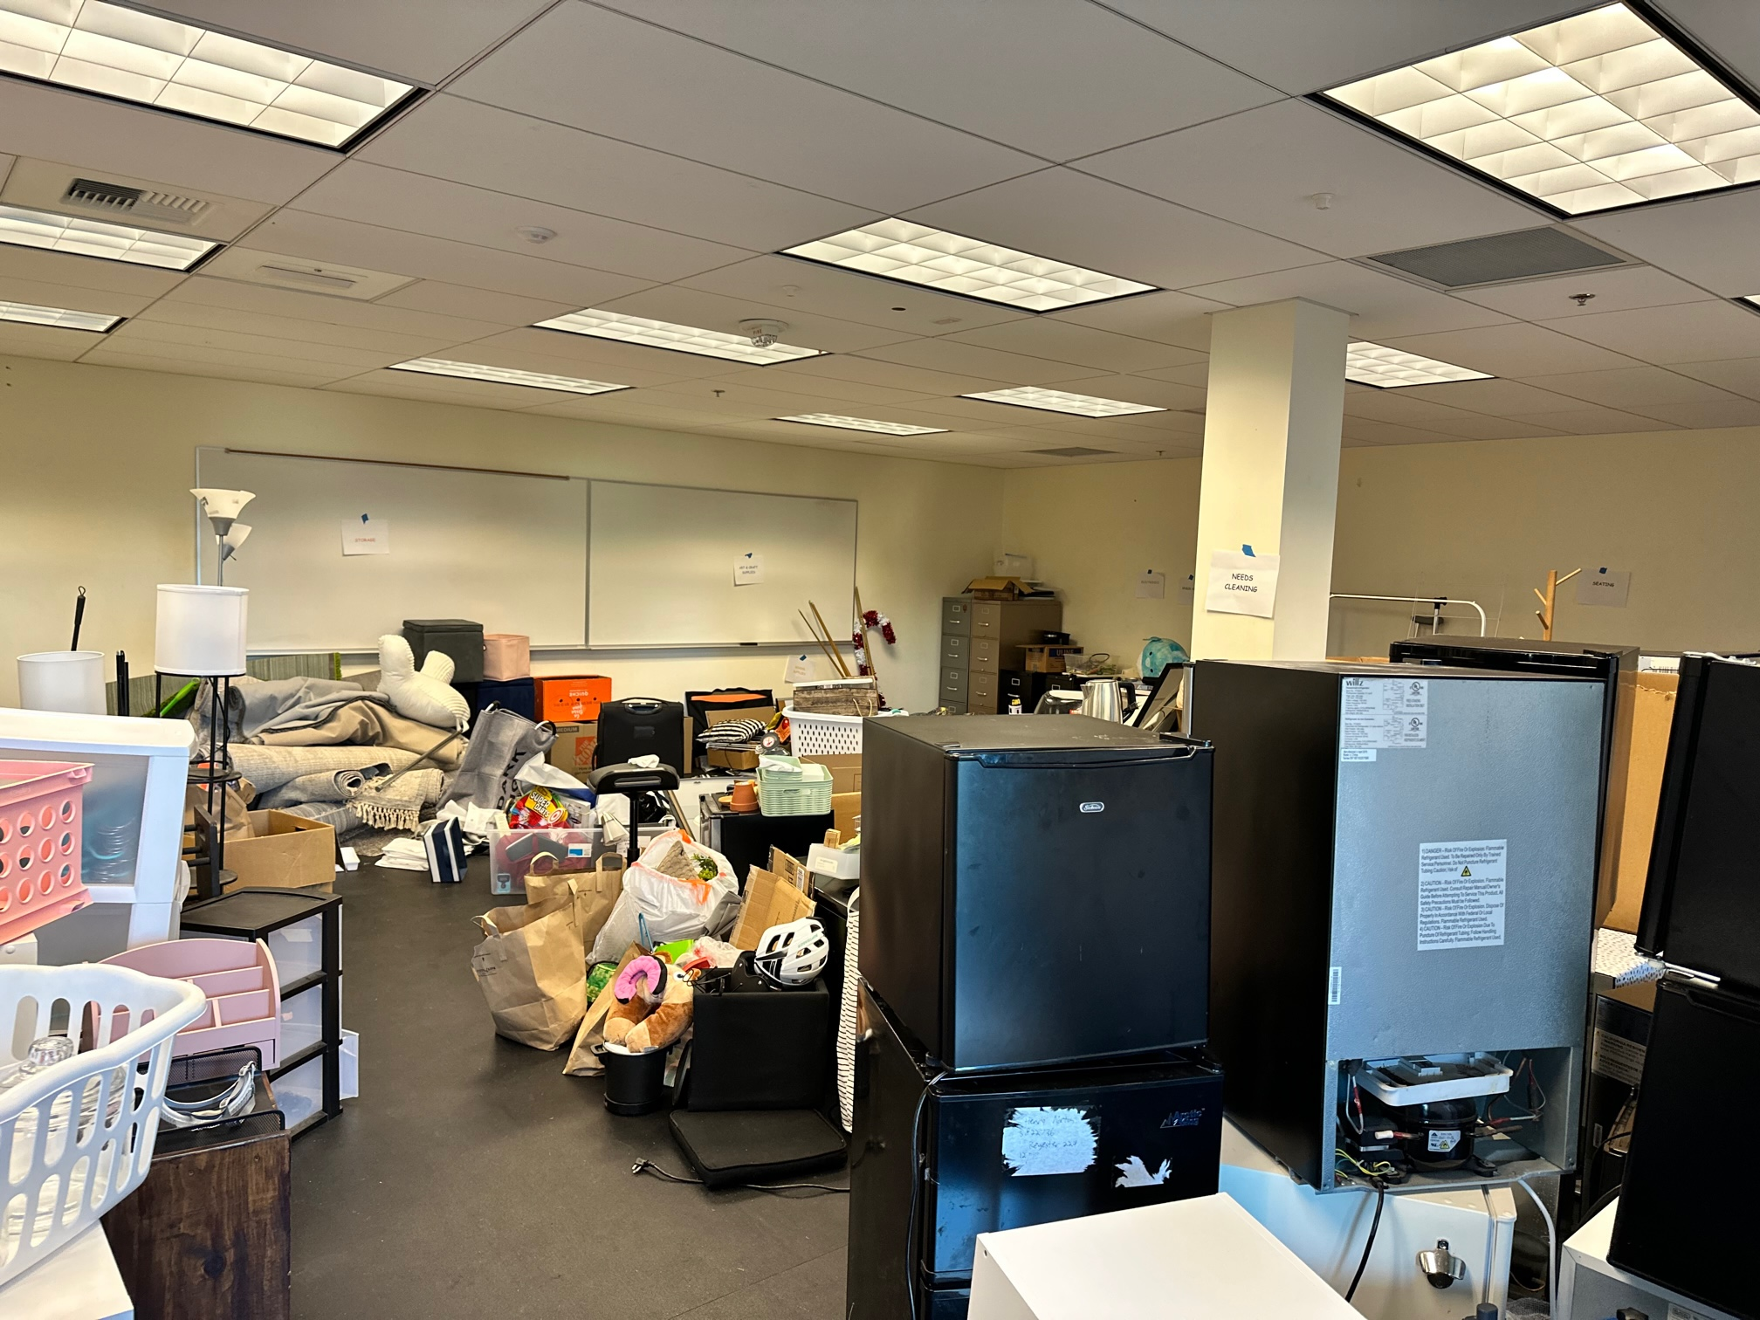
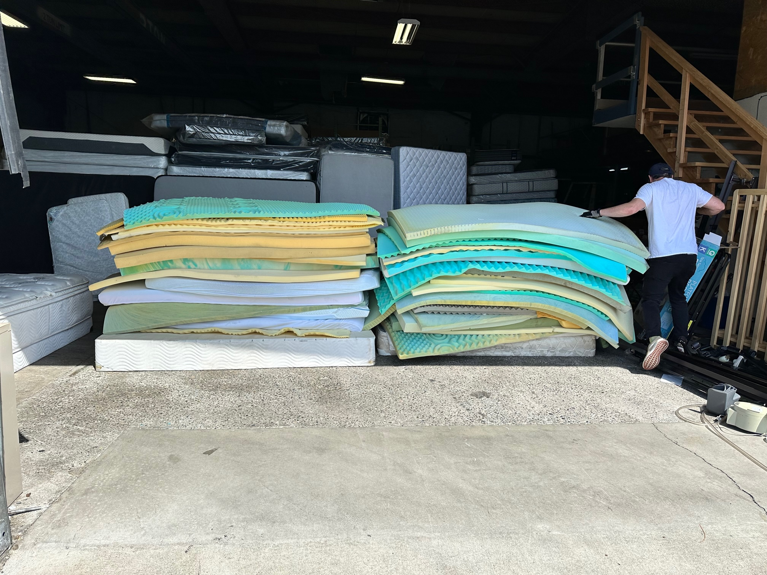
And people move…
Each year we see a complete change of residents in student housing.
Everyone moves in each fall, then they move out the following spring.
All within the space of a few days.
Notes:
LEXI
Move in is often associated with large quantities of packaging waste.
Move out is associated with large quantities of small appliances, bedding, furniture, electronics, clothing, and everything else the student doesn’t care to carry back home with them.

Slide 31
Common challenges include:
Our campus recycle needs are cyclical, and often unpredictable
External partners for these needs are often better than individual contracts
Time constraints limit diverting and recycling items that are technically recyclable
Notes:
LEXI
Our campus recycle needs are cyclical, and while some are predictable (we will have a lot of foam mattress toppers to offload at move-out), some are one-time needs of a large volume of hard to recycle materials (ex. we re-did the rock gym and had a whole bunch of crash mats there was no market for that needed to be trashed).
For these one-time and even cyclical needs, a model where we can turn to an external partner is needed, rather than having individual contracts with servicers for individual items. One thing that comes to mind is access to a textile recycler at move-out would have been helpful.
We also often are operating within a time crunch - from the time someone contacts me with something they need to get rid of, to when they expect it to be gone is often less than a week, and we don't have the space to store materials waiting for a recycler or external market/partner to appear. Sometimes things that *could* have a second life, don't because we don't have the time to find an appropriate place for them to go.
I've attached some photos from move-out; one anecdote that might be valuable, of the three 20-yard DOBs that I ordered to be recycling, only one of them remained recycling despite being closed at night, and that one took us popping open the back and fishing out plastic bags, a mattress, and other things to keep it recycling. You can see in one of the photos all the plastic that is mixed in with recyclables that needed to be fished out. The photo of the room is us halfway through move-out, and all the materials that we recovered from our donation stations.

Slide 32
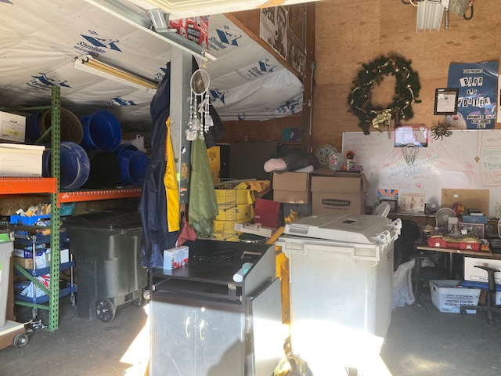
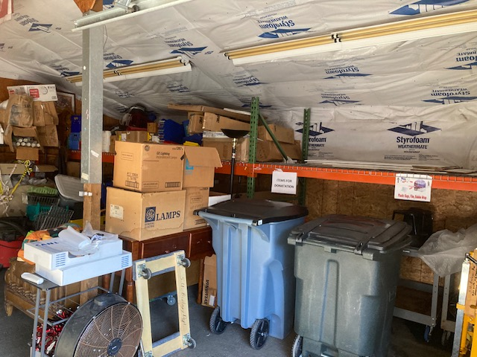
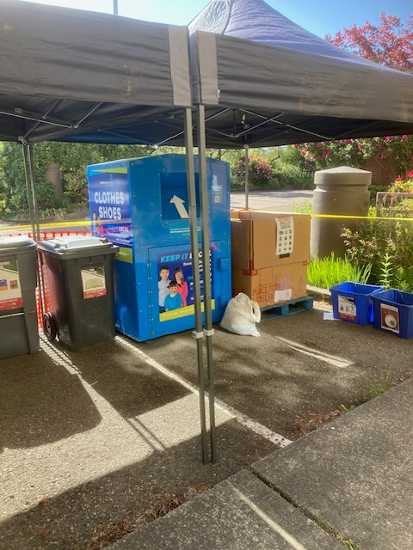
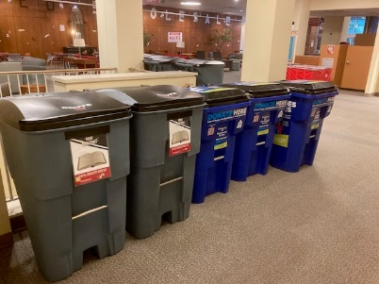
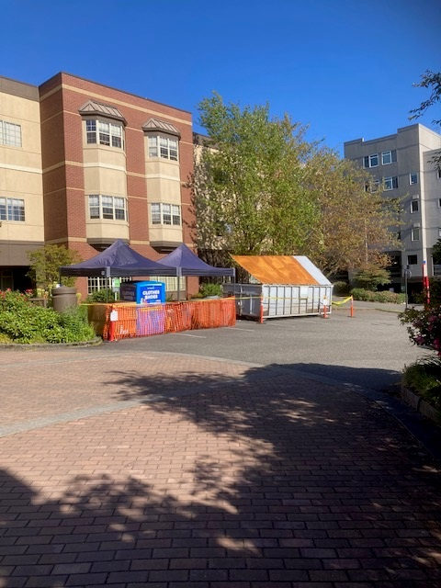
Move In/Move Out = Organized Chaos
Seattle U Residence Halls are zoned residential in a commercial setting. This makes it really fun when ordering roll off dumpsters separate from Seattle Public Utilities our usual provider – improve service pathways city to vendor
SU’s small campus has limited space for storage and sorting.
Rely on haulers schedules and quick turnaround to free up precious operations space.
Recycle Barn staging & sorting Res Hall outdoor recycle stations
Notes:
SHANNON;
Recycle Barn is 30’10” x 20’, likely bigger than a tiny house, but its multi-purpose and function are small and limited for routine rotation of all unwanted items on campus,
SU Lead Recycle Coordinator and 2+ student employees handle collection, sorting and schedule frequent recycling pick ups with vendors.
Student employees and interns learn the value of zero waste by handling and sorting university waste

Slide 33
Internal Education Outreach
Recycle Operations and Regular Campaign Programs made visible
Connect staff faculty to processes, timelines and work order system
Allows Facilities staff to set the schedule
Prevent curb dumping and last-minute demands for removal
Personalize problem solving
Invite campus community to tour the Recycle yard
Improve relations across campus
Notes:
SHANNON;
Integrate throughout university community our common home
Integral ecology - Back of house becomes front of house

Slide 34
Campuses have multiple waste streams.
OPERATIONS
Wood, cardboard, & plastic packaging
Construction wood, metals, concrete, glass, and other debris
Maintenance parts and materials
Electronics
Furniture and equipment
Abandoned print jobs
Old files, books, and office materials
SERVICES
Food & Dining
Residential waste from student housing
Public receptacles used by everyone who comes to campus
Notes:
SCOTT
In terms of waste diversion, the Operations streams are more controllable, Service area streams are only marginally controllable.
All waste diversion is ultimately defined by our local haulers and/or jurisdictional procedures.

Slide 35
Our users arrive with many different habits and expectations.
Sorting behaviors are not consistent across state and municipal boundaries.
College cultures idealize what could be done, and don’t like to be limited to current practices.
Signage isn’t enough to train disposal habits, but other training is nearly impossible, given the frequent changes among our populations.
Notes:
SCOTT
Most students and some employees come from municipalities that sort differently than our campus system(s).
Their habits at home don’t always translate to habits they need on campus.
Many students and employees expect that we will be more diligent in our recycling practices than local jurisdictions, and subsequently insist on more recycling.
A significant portion of our population is only on campus for 2 – 4 years, and a new ‘generation’ arrives every year.

Slide 36
Recycling is collaborative work.
Our haulers and local jurisdictions are key partners, but
  Hauler labor staffing is limited for large waste events
  Hauler’s capacities and supplies are limited
  Meetings for problem solving are often less than satisfactory
Building relationships is more critical than ever.
  Despite the normal cycles of college/university operations, we don’t fit the mold of ‘normal’ customers.
  Regional support seems uncertain due to staffing inconsistencies.
  We need to develop stronger collaborative relationships with our haulers and municipal waste/recycling centers.
Notes:
LEXI & SHANNON;
Govt and municipal Help with vendors and contacts for building relationships meaningful in support of day to day recycling ops and planning for the future
Amplify and escalate the critical need for regular collaborations for zero waste that are routine and looking to the future
Recruit all businesses especially investment business to reimagine and invest in current and future systems making zero waste culture possible
Invest in developing higher education curriculums with the power to create a zero waste future

Slide 37
Questions?

Slide 38
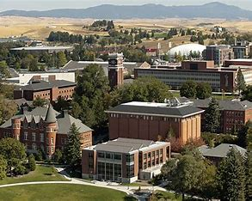
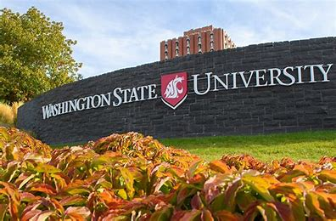
Washington State University
Karl Englund–Composite Materials and Engineering Center (CMEC)
Notes:
Karl Englund is a research professor at Washington State University’s Composite Materials and Engineering Center (CMEC). His work is heavily focused on developing viably option to utilize waste streams as feedstocks for next generation products. His presentation will focus on the work that is being done at WSU’s CMEC related to recycling thermoset based composites.

Slide 39
Recycling Thermosets – What WSU has done for us lately
Karl Englund
Hui Li
Zhenghao Chen
Jinwen Zhang
Washington State University
WA Recycling Development Center
Board Meeting – 6/14/23

Slide 40
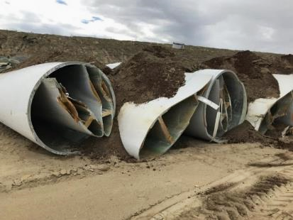

Presentation overview
Motivation
  Recycling strategies for thermosets
Recycling of SFC
Managing the supply chain
  Getting the right materials
  Accessing materials
Processing into filler/fibers
  Milling synthetic fiber composites
  Classifying fillers/fibers
Initial testing and results
  Compounding and IM
  Tensile and flex
Markets and next steps
oilcity.news
www.thisiscolossal.com

Slide 41
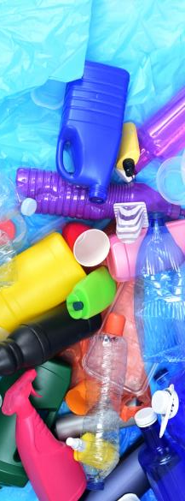
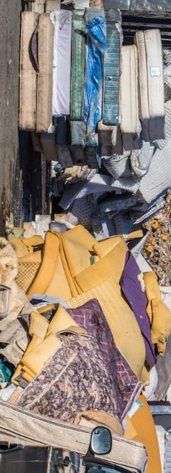
Thermoplastics vs Thermosets
Thermoplastics (PP, PE, PS, PA…..)
  Reversible
  Thick viscosity
  Not extensively used in continuous synthetic fiber composites
  Compliant and ductile – mostly
  Long shelf life
Thermosets (Epoxy, PU, Acrylics, …)
  Non reversible
  Low viscosity
  Used extensively in composites
    Great stress transfer and permeability
  Limited shelf life
clearonplastics.com
utech-polyurethane.com

Slide 42


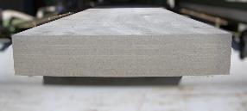
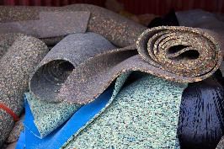
Thermoset Resin Recycling
Polyurethanes
  Pyrolysis
    Fuels and heat
  Mechanical
    Most common (Post Industrial)
  Chemical
    In the lab
Epoxies, other resins
  Not many options
    Not as prolific as PU
    Mainly as binders
  Academic
  Development of new recyclable epoxys

Slide 43
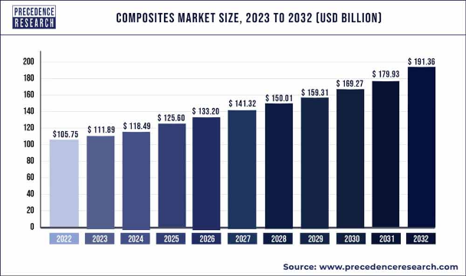
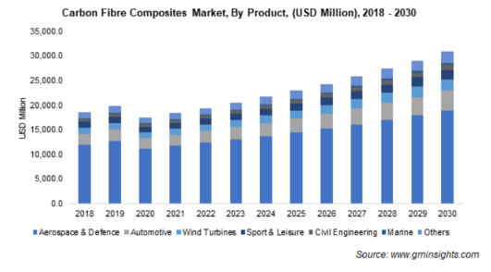
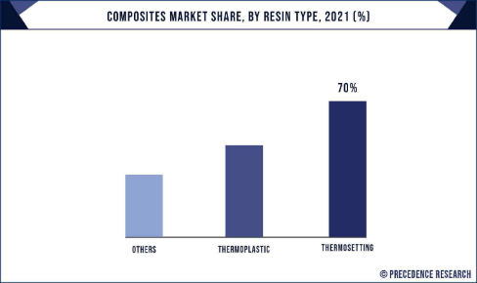
Synthetic Fiber composite inventory
Projection ($)
  FRP 2027 – $38+ B
  CFC 2030 - $30+ B
Volume
  FRP 18-20x CFC
Predominately thermoset

Slide 44
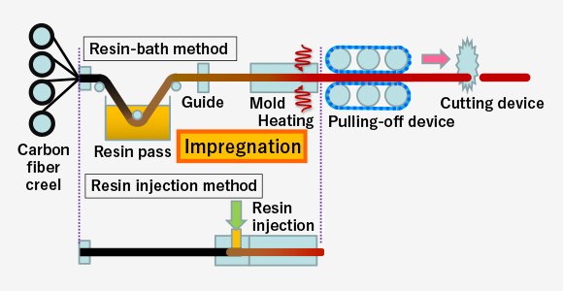
Continuous Fiber Composites - Thermosets
Stages of SFC process
Orientation and design
Layered
Often in prepreg
  Resin impregnated
  Refrigerated storage
Lay-up
Cured
  Heat or solvent loss
Prepreg
Post-cured
Dry Fiber
www.m-chemical.co.jp

Slide 45







Recycling Thermoset SFC
Two types
  Pre-preg or pre-cured
    Industrial scraps or expired resin
  Post-cured
    Cured composites
      Post industrial or EOL
Primarily in CF
  Cost
  Want the fiber
Different than dry fiber recyclers
  No resin applied

Slide 46
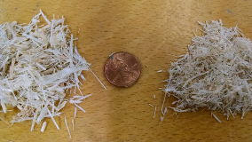
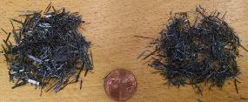
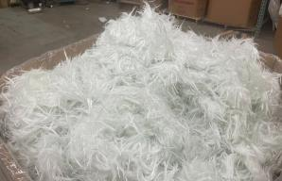
SFC Recycling
Recycling platforms
  Mechanical
    Use mechanical means to reduce SFC size
    Target size and profile – Fractionization
      Fibers generally not liberated from matrix resin
  Advanced
    Fibers liberated from resin via heat or chemicals or bio-based enzymes (or combination)
      Chopped fiber with lower quality than virgin
    Resin is reduced/cleaved/?? to a lower Mw
      Hard to build back up
      Infancy for uses
    Still need to mechanically breakdown
Carbon Rivers

Slide 47
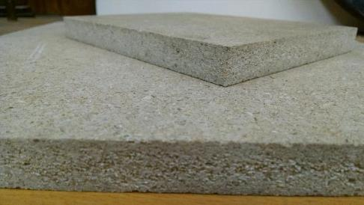
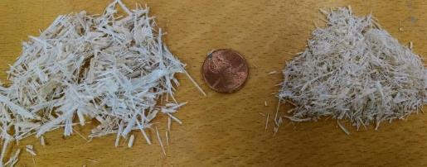
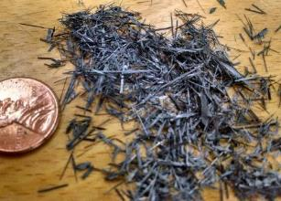
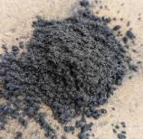
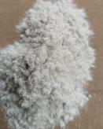
WSU - Mechanical recycling
Recycling platforms (cont.)
  Mechanical
    Breakdown to desired sizes
    Fibers not generally liberated from matrix resin
    Macrofiber bundles
      Panels, pavements, etc..
    Fines
      Filler/reinforcement for polymers
Synthetic Composite Fillers (SCF)

Slide 48
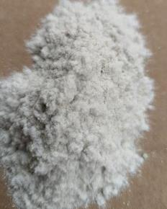
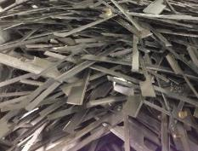
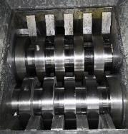
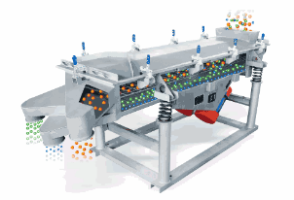
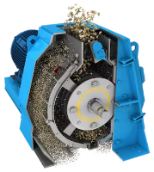



Breakdown Process
Received Material
Size Reduction
Fractionization
processingmagazine.com
beidoou.com
carbosystem.com
Things to consider
End use
PSD
Optimal yield
  Size reduction methods
Things to consider
Options/pathways
Wear
Amounts
Contaminates
End product specific
Many…
Shapes and sizes
Locations
Amounts
Contaminates

Slide 49



Resulting distribution
Coarse/Macrofiber bundles
Fillers/fines

Slide 50




WSU - Panel Process
Using Coarse/Macrofiber bundles
Polyurethane adhesive (pMDI)
Air-atomized resin
Mat Former
* Similar to conventional particleboard and fiberboard manufacturing
Cured with time and heat
Heated Press
(Sanded, cut to size)

Slide 51


Panel Performance
Advantages
  Moisture resistance
    Dimensional and bio - stability
  Hard smooth surface
    Rolling resistance and overlays
    Structural properties
  Recyclable

Slide 52


Fillers Market Potential
Global Polymer Filler Market Will Reach $62.54 Billion By 2024.
US Market Only
grandviewresearch.com/press-release/global-polymer-filler-market
sites.google.com/site/advancedmaterialsreport/polymer-filler-market-1

Slide 53

Who uses Fillers
Fillers
  Usually inorganic minerals
    Calcium carbonate, talc, mica, clays, etc…
    Some organics
      Wood, ag-fiber residue
Extensively used
  Most plastic products have some fillers in them
Why are they used
  Cost – lower plastic used
  Property changes
Used often in concrete and other cementitious materials
businesswire.com/news/home/20170413005138/en/Global-Polymer-Fillers-Market-Projected-to-be-Worth-USD-58.52-Billion-by-2021-Technavio

Slide 54




Pellet compounding and Injection Molding
Compounding
  Dry blend
    Base level (highest filler amount) (70/30)
      Weighed SCF and polymer
        Rotary blend
  Extrusion compounding
    35mm twin-screw conical
    Strand profile
  Pellet granulation
    Nelmor granulator
Injection Molding (IM)
  Aggregated pellets
    Direct feed into IM (70/30)
    Polymer added to base for lower filler levels.
  Tension dog-bone and flex bar output

Slide 55



Formulations
SCF
  CF/Epoxy composites
    P 20 mesh
    P 70 mesh
  GF/Epoxy composites – WTB
    P 32 mesh
Polymer
  vHDPE – Fractional melt
  vPP
  rLDPE – Recycled ag mulch film
SCF | Polymer | Filler Amt (%)
P20M CF | HDPE | 30 | 20 | 10 | 0
P70M CF | PP | 30 | 20 | 10 | 0
P70M CF | rLDPE | 30 | 20 | 10 | 0
P32M GF | PP | 30 | 20 | 10 | 0
P32M GF | rLDPE | 30 | 20 | 10 | 0
Performance metrics
  Tensile (ASTM D638)
    UTS and E_{t}
  Flexure (ASTM D790)
    MOR and MOE

Slide 56



Tensile properties - P20MCF
vHDPE resin
20 mesh rCF
  More longer fibers bundles
Maleated PE coupling agent utilized

Slide 57



Flexure Properties - P20MCF

Slide 58


Tensile properties - PP
Carbon Fiber
P-70 mesh
P70M rCF
P32M rGF
Glass Fiber
P-32 mesh

Slide 59
Flexure properties - PP
Carbon Fiber
P-70 mesh
P70M rCF
P32M rGF
Glass Fiber
P-32 mesh

Slide 60
Tensile properties - rLDPE
Carbon Fiber
P-70 mesh
P70M rCF
P32M rGF
Glass Fiber
P-32 mesh

Slide 61
Flexure properties - rLDPE
Carbon Fiber
P-70 mesh
P70M rCF
P32M rGF
Glass Fiber
P-32 mesh

Slide 62

WSU - Pavements
WSU-Boeing
  Pervious concrete and asphalt
  Mechanically Recycled CFC
  Increase durability, strength and ductility

Slide 63





WSU – Chemical Recycling of CFC
zinc acetate/acetic acid buffer, pH 4.8
wash with acetone
reclaimed carbon fiber
(rCF)
220 °C, within 6 h
CFRP with an amine-cured epoxy matrix
carbon fiber + decomposed matrix polymer
Limitations of the aqueous buffer system:
Requires a pressure reactor
High catalyst concentration
Not very efficient
The catalyst solution can be reused repeatedly.
Dr Jinwen Zhang
jwzhang@wsu.edu

Slide 64



At atmospheric Pressures
New method:
Recovered Fibers
190 °C
water
3 h
Shredded CFEP
Degraded Polymers
High boiling point (~ 300 C) enables chemical recycling at atmospheric pressure.
No pressure reactor needed!

Slide 65
Points to consider
Volume
  rProcess needs to consider how much is out there and impact
Robust enough for diverse feedstocks
  Lots of different CFC and GFC used everywhere
Logistics, supply chain
  Need to develop a supply chain to make this all happen and have pathways for EOL and post-industrial materials

Slide 66
Contact and Questions??
englund@wsu.edu

Slide 67

Acknowledgements
Some of this work is supported by Specialty Crops Research Initiative Award 2022-51181-38325 from the USDA National Institute of Food and Agriculture. Any opinions, findings, conclusions, or recommendations expressed in this publication are those of the author(s) and do not necessarily reflect the view of the U.S. Department of Agriculture.

Slide 68

Mechanically Recycled Fibers Research
Nassiri S, Al Shareedah O, Rodin, H. and KR Englund. 2021. Mechanical and Durability Characteristics of Pervious Concrete Reinforced with Mechanically Recycled Carbon Fiber Composite Materials. Materials and Structures. 54(107):30p
Seyed HM*, Li H, Tavousi A and KR Englund. 2021. Heterogeneous thermoset/thermoplastic recycled carbon fiber composite materials for second-generation composites. Waste and Biomass Valorization 38. doi.org/10.1007/s12649-021-01341-0.
Zhang K, Liu Y, Nassiri S, Li H, and KR Englund. 2021. Performance Evaluation of Porous Asphalt Mixture Enhanced with High Dosages of Cured Carbon Fiber Composite Materials. Construction and Building Materials 274(2):122066.
Haider MM, Nassiri S, Englund KR, Li H, and Z Chen. 2021. Exploratory Study of Flexural Performance of Mechanically Recycled Glass Fiber Reinforced Polymer Shreds as Reinforcement in Cement Mortar. J. of the Transportation Research Board. doi.org/10.1177%2F03611981211015246.
Rangelov M, Nassiri S, and KR Englund. 2020. Life cycle assessment of pervious concrete pavements reinforced by recycled carbon fiber composite elements. Pavement, Roadway, and Bridge Life Cycle Assessment 2020. Proceedings of the International Symposium on Pavement. Roadway, and Bridge Life Cycle Assessment 2020. 11pp. (Peer-reviewed). Sacramento, CA, June 3-6.
Zhang K, Lim J, Nassiri S, Al Shareedah O, Li H, and KR Englund. 2020. Field pilot study of porous asphalt pavement reinforced by cured carbon fiber composite materials (CCFCMs). International Journal of Pavement Engineering. DOI:10.1080/10298436.2020.1774765.
Zhang K, Lim J, Nassiri S, Englund KR, and H Li. 2019 Reuse of Carbon Fiber Composite Materials in Porous Hot Mix Asphalt to Enhance Strength and Durability. Construction & Building Materials. 11:e00260.
Seyed HM*, Li H, Englund KR, and A Tavousi. 2019. Extruded fiber-reinforced composites manufactured from recycled wind turbine blade material. Waste and Biomass Valorization. 11:3853-3862.
Nassiri S, Li H, Englund KR, Al Shareedah O, Chen Z. 2019. Field Performance Evaluation of Pervious Concrete Pavement Reinforced with Novel Discrete Reinforcement. Case Studies in Construction Materials 10(open access).
Rodin H G, Nassiri S, Englund KR, Li H, and OM Fakran. 2018. Recycled Glass Fiber Reinforced Polymer Composites Incorporated in Mortar for Improved Mechanical Performance Construction & Building Materials. Construction & Building Materials 187:738-751
Seyed HM*, Li H, Englund KR, and A Tavousi. 2018. Recycled wind turbine blades as a feedstock for second generation composites. Waste Management. 76:708-714.
Rodin H, Rangelov M, Nassiri S, and KR Englund. 2018. Enhancing mechanical properties of pervious concrete using carbon fiber composite reinforcement. J of Materials in Civil Engineering. 30(3).

Slide 69

Styro Recycle, LLC
Marilyn Lauderdale–Owner
Notes:
Welcome Marilyn Lauderdale, founder, and owner of Styro Recycle based in Kent Washington. Styro Recycle is an expanded polystyrene (EPS) foam recycling center that provides a place for the public and businesses to recycle their used EPS foam.

Slide 70

Styro Recycle LLC
Recycling Center in Kent - Styro Recycle

Slide 71





Slide 72
AGENDA
9:00 am Welcome & review meeting goals
9:10 am Board and Agency Updates
10:00 am Dan Weston-Recycle Right Campaign
10:15 am Break
10:30 am Presentations
11:45 am Wrap-up

Slide 73

Wrap up
Next meeting:
Wednesday, September 13th, 2023
Location: to be determined
Tour: to be determined
Tasks from today:
Notes and slides from today will be posted to the EZ page next week.
Links to the UW and NextCycle reports will be shared via GovDelivery message.

Slide 74

See you all at the September 13th board meeting!

