Slide 1
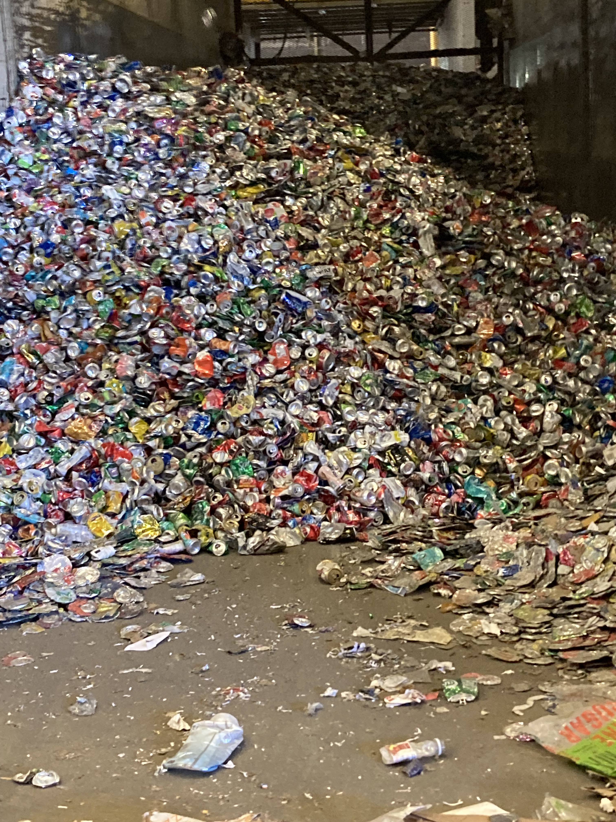
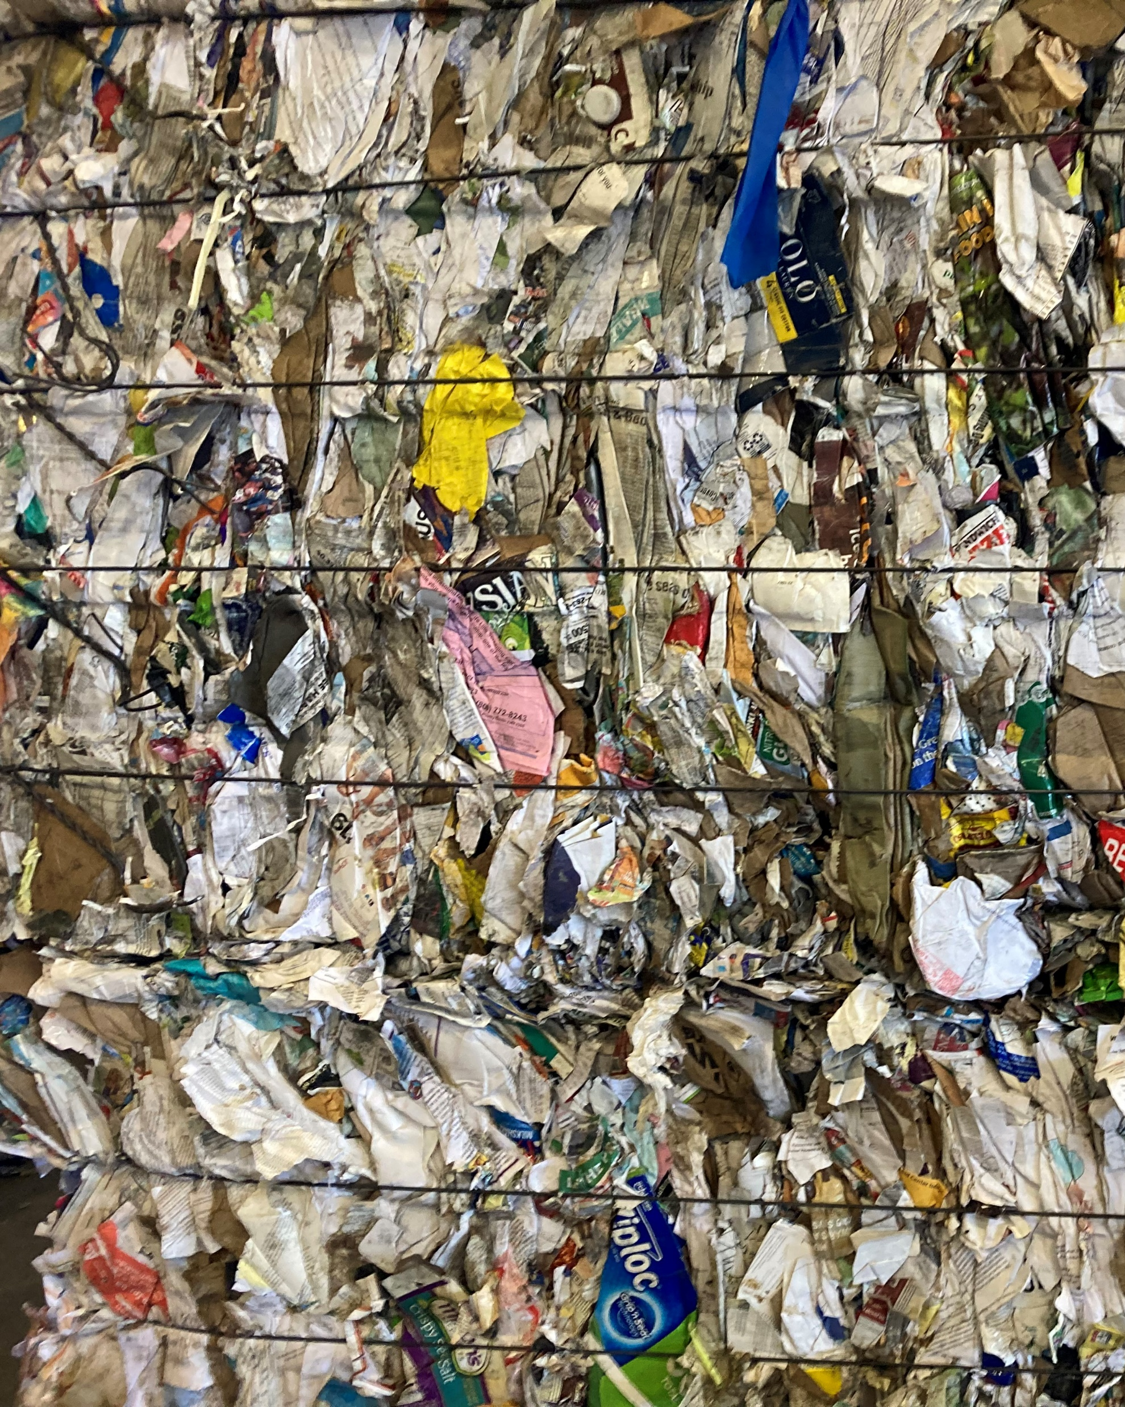
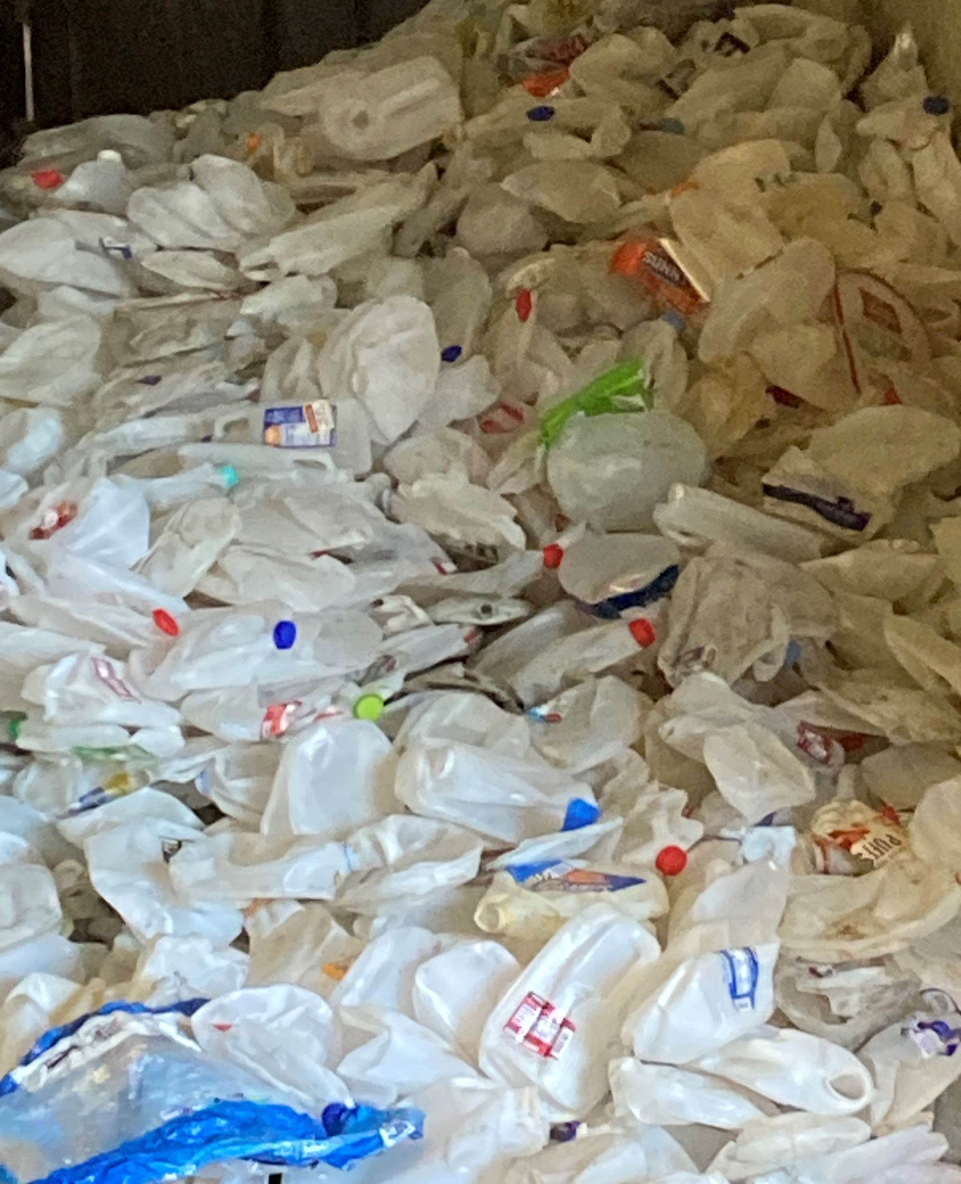
Recycling Development Center Advisory Board Meeting
October 11, 2023 | 9am – 11pm (Pacific time)

Slide 2
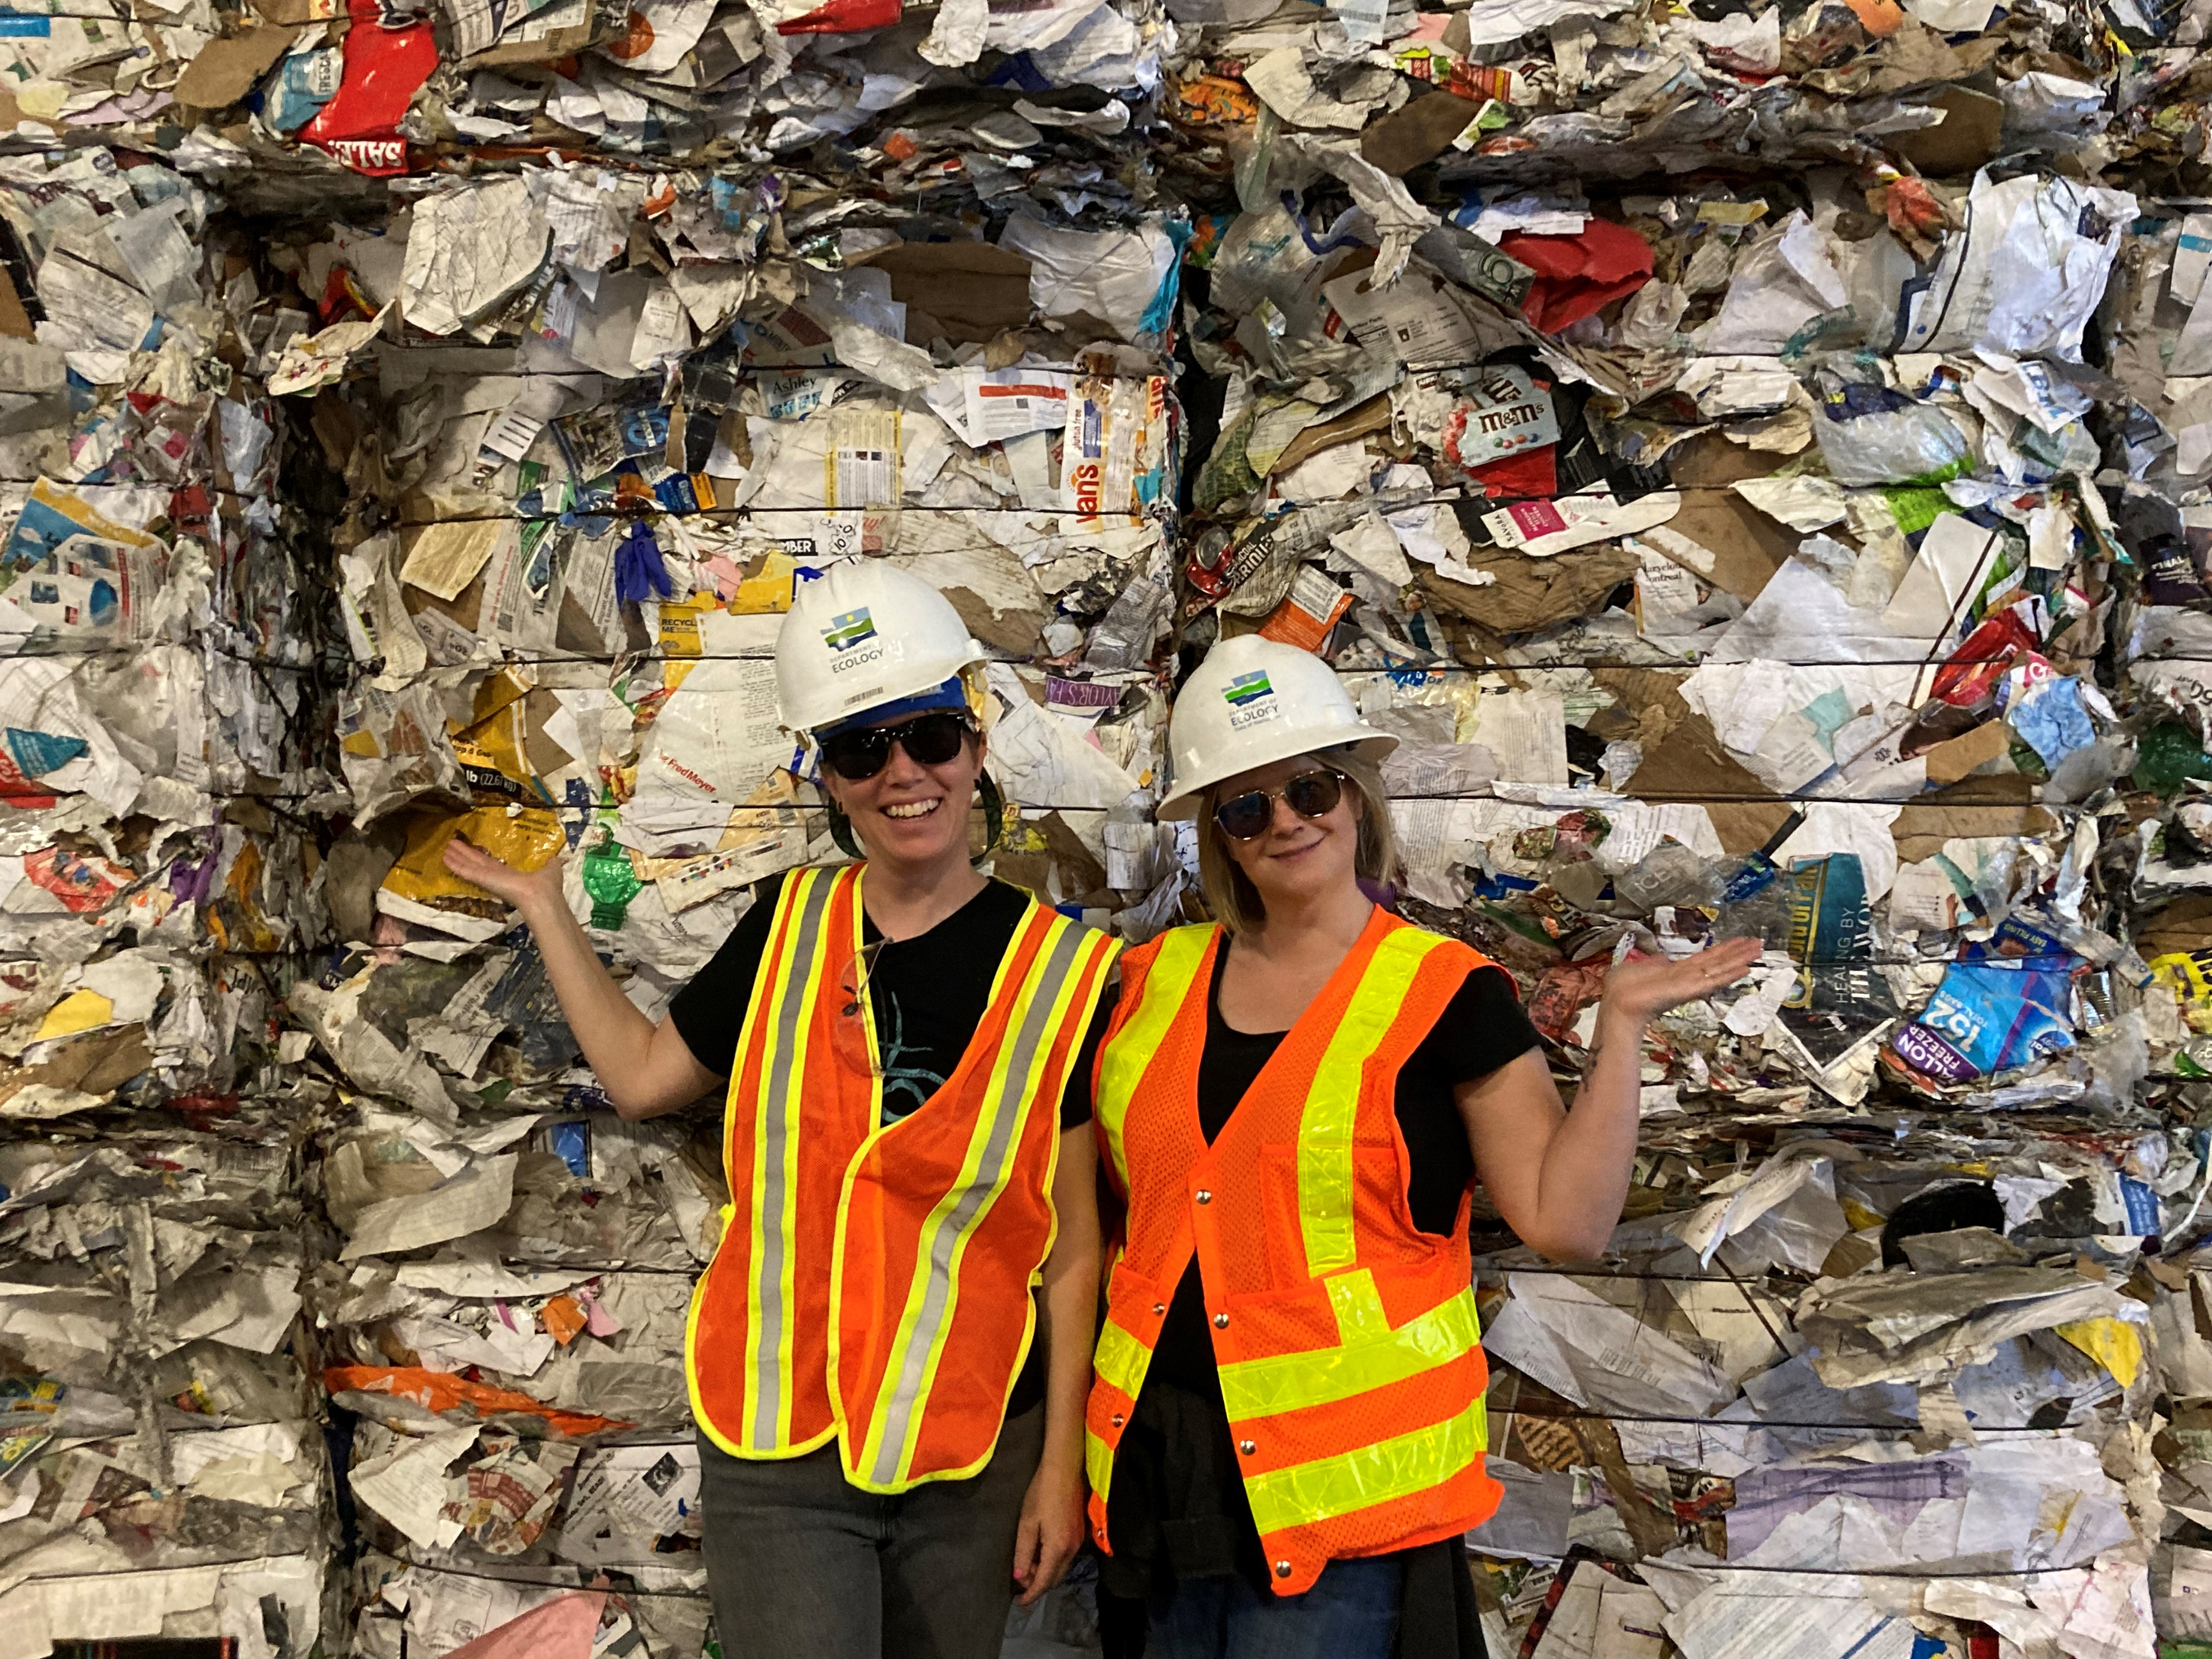
AGENDA
9:00 am Welcome
9:10 am Board roundtable
9:15 am Commerce and Ecology updates
9:25 am Tina Schaefer – NextCycle WA update
9:30 am Chery Sullivan – Organics Presentation
9:50 am Bio break
10:00 am Kara Steward - Past, present, future
10:15 am Mya Keyzers - Priority decision metrics
10:25 am Strategic planning
11:00 am Wrap-up

Slide 3
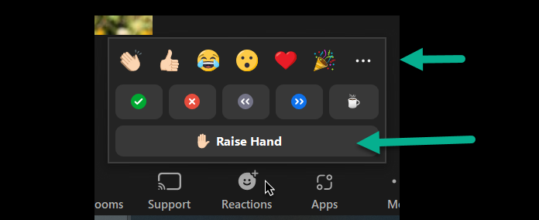
Participating in this meeting:
Roles
Host-Caleb
Facilitator-Mya
Note taker/chat monitor-Tina
Rules
Cameras On
Board members and presenters may unmute themselves.
Questions, please raise your hand or type them in the chat box.
I will call on you or I can read your question from the chat.
Use reactions to keep it interactive
Note: we are not recording this meeting, meeting notes will be posted on the Advisory Board website.
Notes:
Roles
Caleb is running the Zoom and slides
Mya is facilitating
Tina is taking notes and monitoring the chat
Rules
Please turn your cameras
Board members and presenters may unmute themselves.
For questions, please raise your hand or type them in the chat box. I will call on you or I can read your question from the chat.
Participants may use reactions throughout.

Slide 4
AGENDA
9:00 am Welcome
9:10 am Board roundtable
9:15 am Commerce and Ecology updates
9:25 am Tina Schaefer – NextCycle WA update
9:30 am Chery Sullivan – Organics Presentation
9:50 am Bio break
10:00 am Kara Steward - Past, present, future
10:15 am Mya Keyzers - Priority decision metrics
10:25 am Strategic planning
11:00 am Wrap-up

Slide 5
Center updates
Board members
Commerce
Ecology
NextCycle Washington

Slide 6
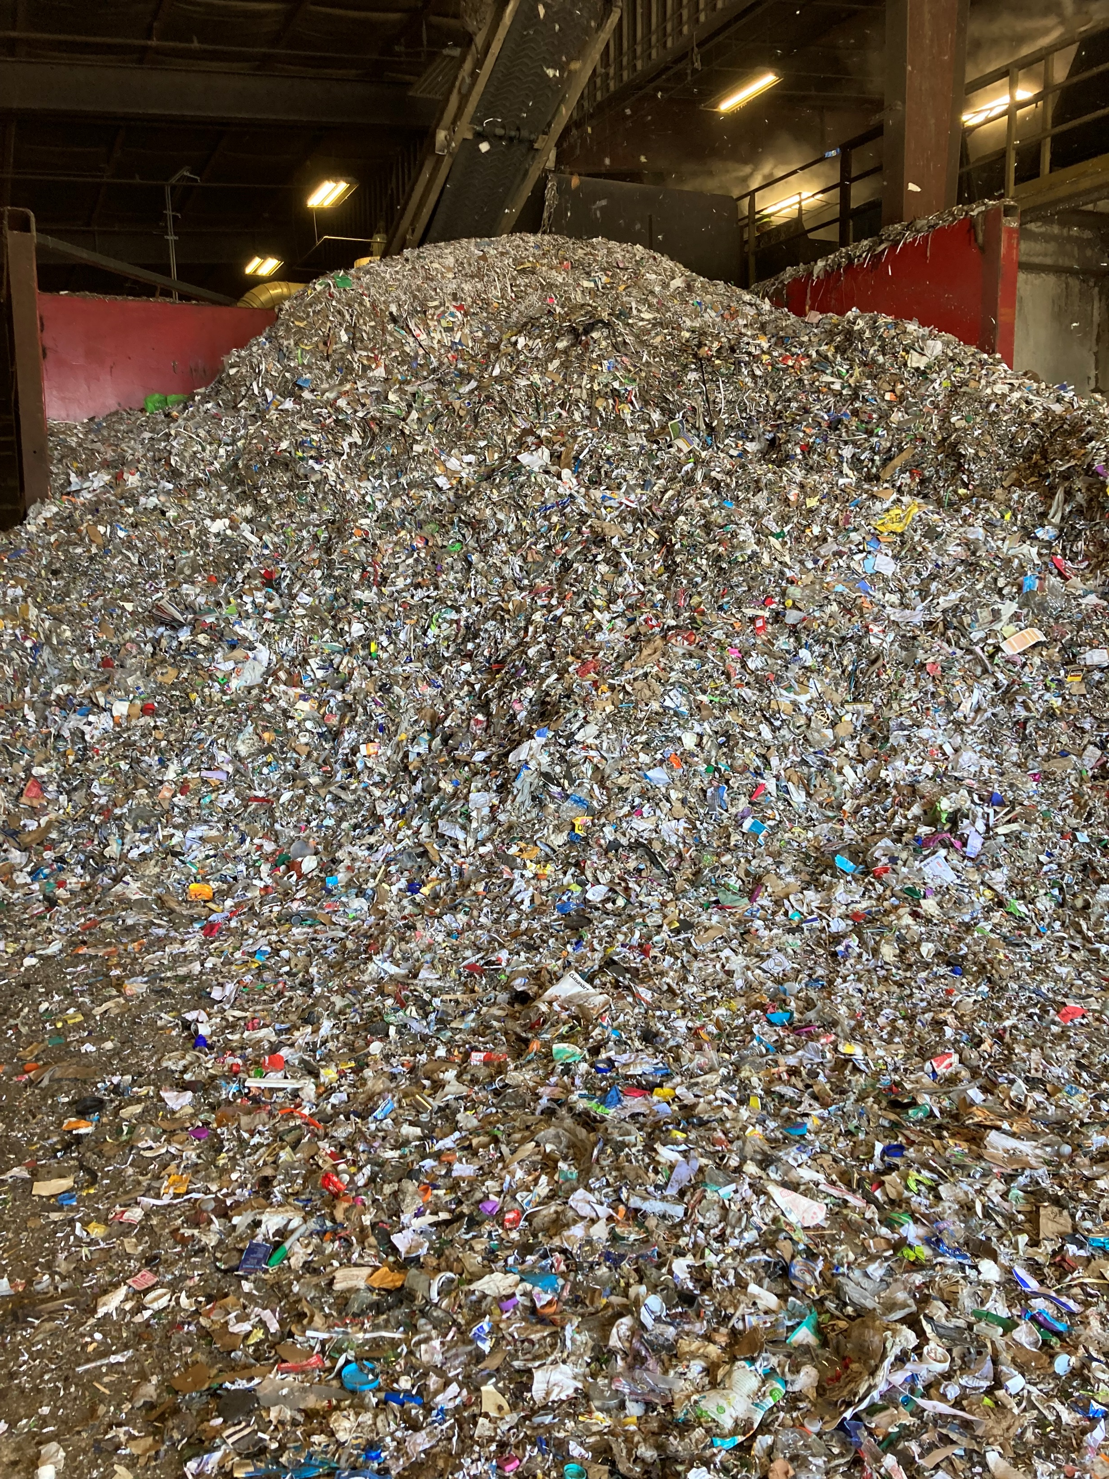
Board roundtable:
What material pile is this?
How would you describe your job to a 5-year-old?
Notes:
If you have an update on your work great if not let’s hear your answers to these questions. This pile is a picture from the Pioneer MRF facility tour me and Tina took recently.

Slide 7
Board roundtable:
Natalie Caulkins
Corinne Drennan
Karl Englund
Kyla Fisher
Allen Langdon
Kris Major
Scott Morgan
Chris Piercy
Mike Range
Tim Shestek
Jay Simmons
Heather Trim
Jon Smieja

Slide 8
Agency Updates
Kirk Esmond
Kara Steward
Notes:
Since our last board meeting in June 2024
UW Evans report is published – focused on market development efforts in the US – they provide 5 recommendations for the RDC
NextCycle contract – Tina will cover this next
Wrap up of nextcycle year 1 – several reports prepared by the consultants
New website is live Recycling Development Center - Washington State Department of Ecology
Random thoughts on Ecology Updates
Work comes/goes on active legislation
How about a budget update?

Slide 9
Washington State Circular Economy
Recycling Development Center, Advisory Board meeting
— commerce Updates –
October 11, 2023
Kirk Esmond| Sustainable Business Development Director
Office of Economic Development & Competitiveness | Washington State Department of Commerce

Slide 10
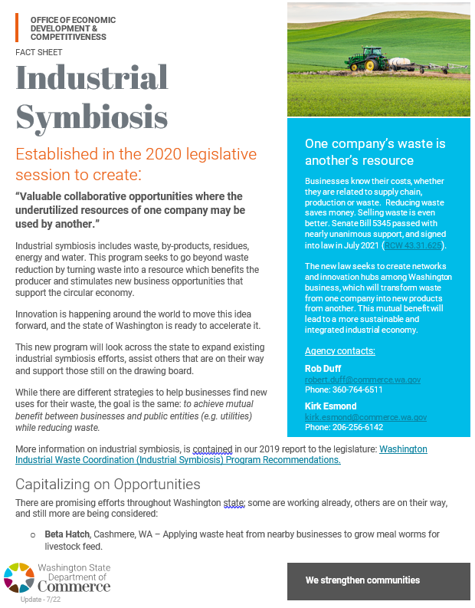
High-level Updates Industrial Symbiosis Program – 2022
Completed projects (FY23)
Inland Empire Paper, Spokane – Transforming fly ash for delivery as a soil amendment using conventional farm equipment ($250,000)
Qualterra Inc., Spangle – Biochar production from ag/forest waste biomass while creating renewable energy ($245,416)
Myno Carbon, Kettle Falls – Combine waste CO₂ with crushed basalt to create a liming agent beneficial to soil health ($250,000)
Chomp, formerly Impact Bioenergy, Vashon Island – Waste heat capture, dry fertilizer and RNG development ($104,584)

Slide 11
High-level Updates Industrial Symbiosis Program – 2023
New projects underway (FY24)
Cascadia Produce, Auburn – Food waste diversion. Establishing a retail rejection hub, distribution center and online marketplace ($250,000)
Qualterra Inc., Cheney – Biochar to renewable energy. Furthering biomass conversion and generating renewable energy ($206,857)
Waste Loop, Leavenworth – Landfill diversion. Circular economy of materials and establishment of Reuse Innovation Center ($157,326)
Washington State University, Pullman – Biochar in concrete. Diverting waste biomass to develop a durable, carbon-negative alternative for the construction industry ($235,817)

Slide 12
High-level Updates Circular Economy Acceleration
Key takeaways:
Grant funding – scaled to better meet industry demand and opportunities
Eco-industrial Parks – framework for circularity-focused industrial areas
Market Development Program – e.g. NextCycle WA
DP-PL-CK-Circular Economy Acceleration.pdf

Slide 13
High-level Updates Industry Connections
Recent and ongoing conversations:
Creative Energy
Ebb Carbon
Advanced Lewis County Recycling (ALCR)
SAI Tech
PNW Renewables
Aero Aggregates
Carbon Robotics
Lamb Weston
Pacific Ag
Framatome
OCOchem
Allegheny Technologies (ATI)
TwispWorks
Collaboration with related programs, divisions and agencies (PWB, CERB, Energy Office, PNNL, ADO’s, Dept. of Ag.)
Evergreen Recycling
Mura Tech
RMP Eco
Cedar Grove
Sierra Pacific Industries
[more]

Slide 14
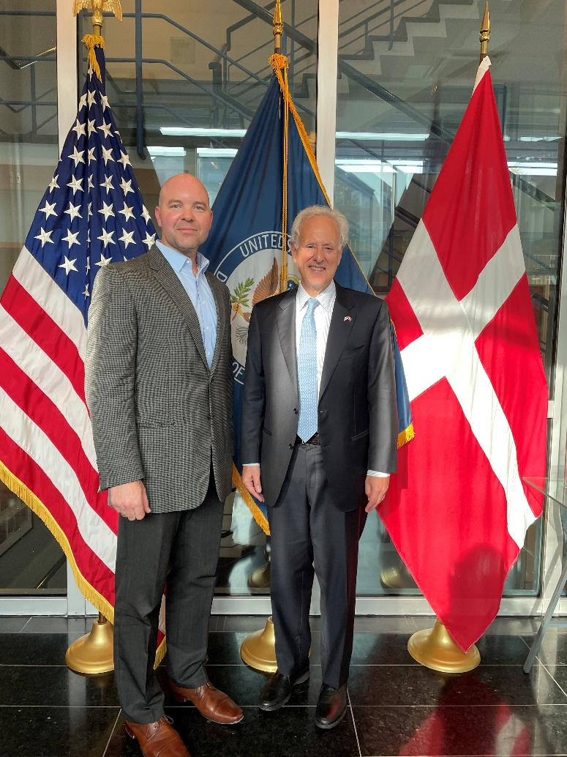
High-level Updates Conferences and Training
Recent conferences, presentations and training:
Divert groundbreaking event – Longview
Agricultural Symbiosis Study Tour – Denmark
United States Embassy in Denmark – Copenhagen
Systemic Approach to Clean Industry (SACI) – Portland/Tri-Cities
Northwest Bioenergy Summit – Kennewick
Center for Advanced Manufacturing Conference – Bellevue
Biochar Innovation Summit – Spokane
In-person meeting with Ambassador Alan Leventhal, US Embassy in Denmark

Slide 15
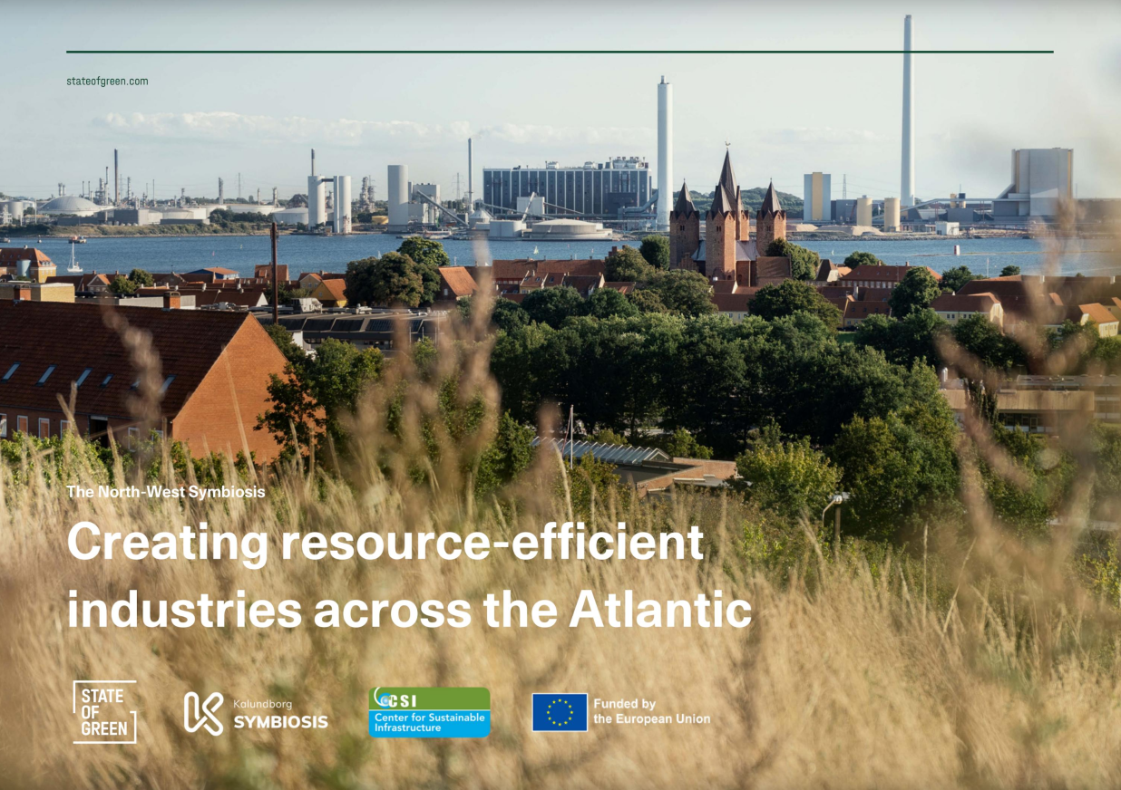
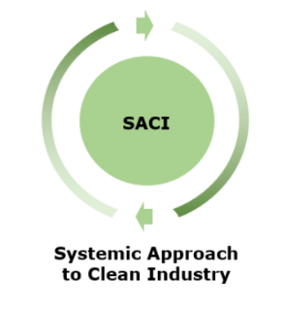
High-level Updates Other Cool Stuff
The North-West Symbiosis: Creating resource-efficient industries across the Atlantic by stateofgreen - Issuu

Slide 16
Thank you.
Kirk Esmond
Sustainable Business Development Director
kirk.esmond@commerce.wa.gov
206-837-2622
www.choosewashington.com

Slide 17
Agency Updates
Kirk Esmond
Kara Steward
Notes:
Since our last board meeting in June 2024
UW Evans report is published – focused on market development efforts in the US – they provide 5 recommendations for the RDC
NextCycle contract – Tina will cover this next
Wrap up of nextcycle year 1 – several reports prepared by the consultants
New website is live Recycling Development Center - Washington State Department of Ecology

Slide 18
NextCycle Washington Reports
Year End Report
https://www.nextcyclewashington.com/s/NCWA-Year-End-Report.pdf
Gap Analysis
www.nextcyclewashington.com/resources1/nextcycle-washington-gap-analysis
Circular funding resource guide
www.nextcyclewashington.com/resources1/nextcycle-washington-circular-funding-resource-guide
Resilience Maps
www.equityanalyticsgroup.com/resilience-networks

Slide 19
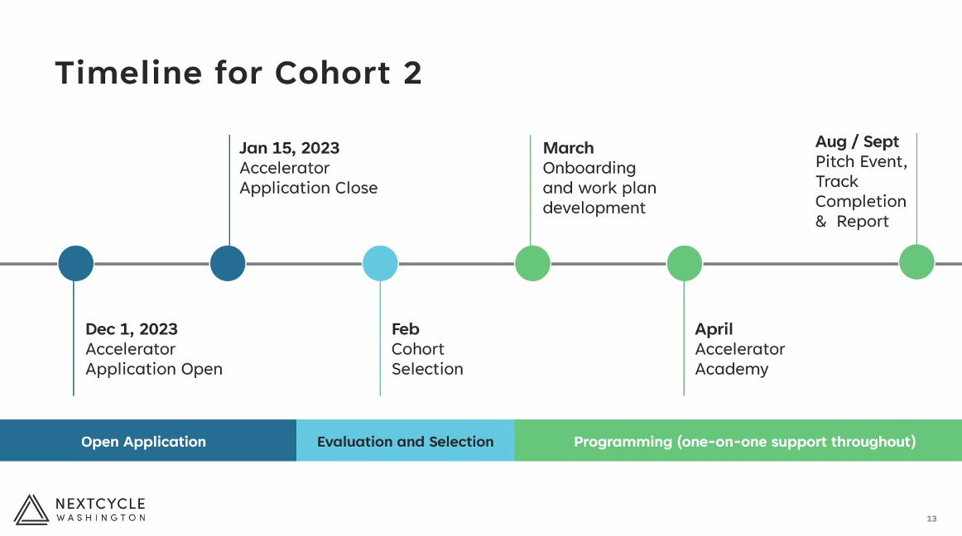
NextCycle WA Updates
New state-wide contract with Ecology
Networking/Year 1 event September 28 in Seattle
Notes:
Tina’s slide for updates

Slide 20
Advisory Board Business
Thank you to all our board members.
Board members up for renewal:
Let us know by November 30 if you choose to vacate your seat or renew for another 2-year term.
Kris Major | Scott Morgan
Heather Trim | Kyla Fisher
Corinne Drennan | Tim Shestek
Karl Englund | Allen Langdon
Notes:
These are all the board members up for renewal: Kris Major, Heather Trim, Corinne Drennan, Karl Englund, Scott Morgan, Kyla Fisher, Tim Shestek, Allen Langdon. We would love to have everyone stay but this is the time to make a change if you choose. This would also be the time to confirm the chair and co-chair positions.
Here is the language from the statute:
(4) The initial appointments of the seven private sector members are as follows: Three members with three-year terms and four members with two-year terms. Thereafter, members serve two-year renewable terms.

Slide 21
Board meetings
Value: What do you find most valuable?
Content: Do you want presentations? What topics or content?
Material experts
Innovative businesses
Legislative updates
Ecology or Commerce work
Remote: Do you prefer in person/hybrid meetings or all virtual?
Tours: Is there interest in arranging facility tours?
Duration: 1 hour or 3 hours?
Notes:
Board member roundtable and agency updates could be completed in under an hour.

Slide 22
AGENDA
9:00 am Welcome
9:10 am Board roundtable
9:15 am Commerce and Ecology updates
9:25 am Tina Schaefer – NextCycle WA update
9:30 am Chery Sullivan – Organics Presentation
9:50 am Bio break
10:00 am Kara Steward - Past, present, future
10:15 am Mya Keyzers - Priority decision metrics
10:25 am Strategic planning
11:00 am Wrap-up
Notes:
Chery Sullivan (she/her)
Policy Section Manager
Solid Waste Management Program

Slide 23
2022 Organics Management Law Recycling Development Center Food Center
October 11, 2023

Slide 24
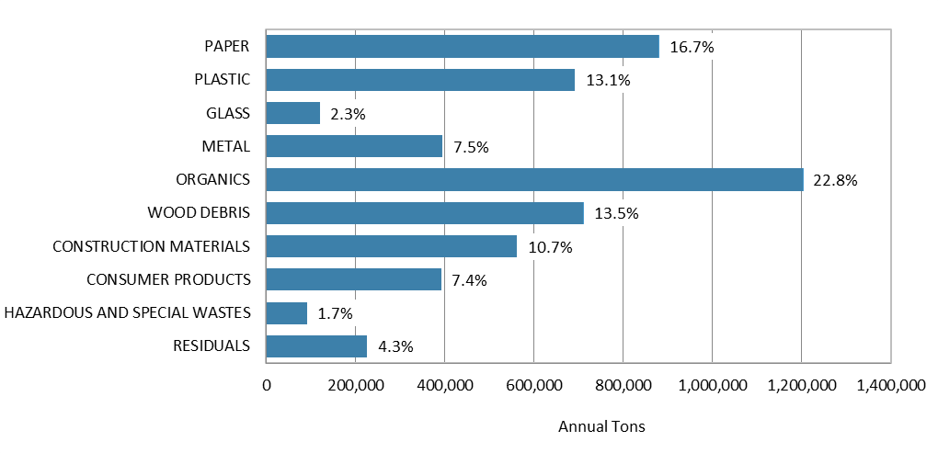
Overall Waste Stream by Material 2020-21
Notes:
The first question to address is WHY ORGANICS
NOTE: This is Washington State Disposal
The 2020-2021 Waste Characterization study reveals that OM make up THE LARGEST PERCENTAGE of the OVERALL STATEWIDE DISPOSED WASTE STREAM, at 22.8 percent, or about 1.2 MILLION TONS in one year.
If you add in the compostable paper to the organics, wood and C&D, it is over half the disposed waste stream (about 52%).
In terms of GHGs, these are important materials since the organics degrade faster than other materials causing more GHGs emissions.

Slide 25
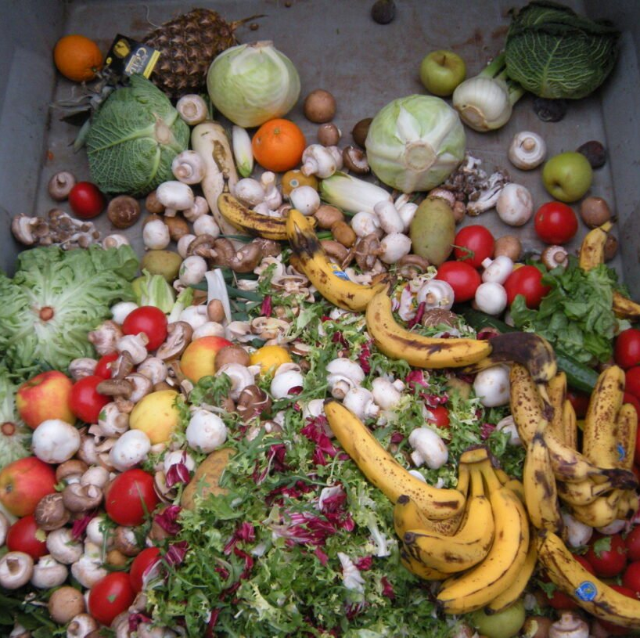
Organics Management Law (OML) Reduce methane emissions by diverting organics from landfills
Formerly known as HB1799
9 Parts
Added or amended more than 20 Revised Code of Washington (RCW) laws
Many impacts to state and local governments, and businesses
This Photo by Unknown Author is licensed under CC BY
Notes:
As a refreshed The Organics management law that was passed in 2022 ESTABLISHED OR AMENDED more than 20 RCWs. It is divided into 9 parts and IMPACTS GOVERNMENT at all levels as well as BUSINESS and RESIDENTS and the DIVERSE ORGANICS INDUSTRY

Slide 26
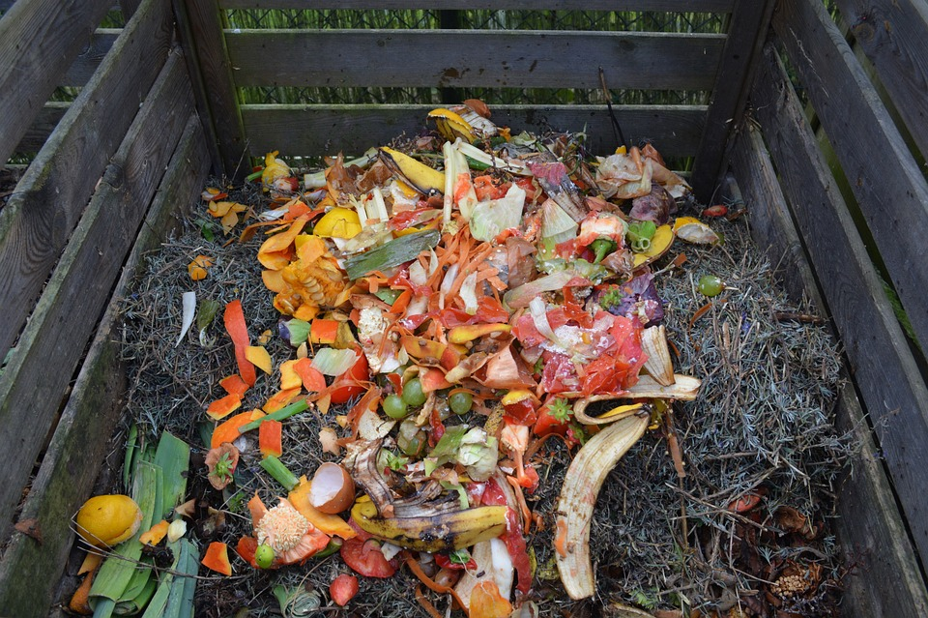
OML sections
Research
Adequacy of funding for local solid waste management
Collection
Business organics collection
Residential and non-residential collection
Processing
Recycled organics facility siting
Compostable product labeling
Markets
Compost procurement and reporting
Agricultural organic material purchases
Prevention
Good Samaritan laws
Washington Center for Sustainable Food Management
Notes:
The 9 PARTS of the law UTILIZE 5 STRATEGIES: RESEARCH, COLLECTION & MANAGEMENT, PROCESSING, MARKETS and PREVEVTION
Janine shared the major research item in the law and for each of the other items that Ecology has some role in implementing – whether that is primary role or something more tangent, I will provide a brief review of our implementation efforts to date. Where appropriate, I will also note challenges related to implementation and where we have identified opportunities to improve.
I want to emphasize that we are talking about the challenges and the gaps so that as we move forward in future meetings, I want encourage this group to discuss policy tools where we can work together to identify solutions that address the challenges and close the gaps.
Research
Adequacy of funding for local solid waste management
Collection & management
Business organics material management
Residential and non-residential collection
Processing
Recycled organics facility siting
Compostable product labeling
Markets
Compost procurement and reporting
Agricultural organic material purchases
Prevention
Good Samaritan laws
Washington Center for Sustainable Food Management

Slide 27
Doing the work
Businesses with food waste
2024 - Arrange for collection service
Jurisdictions
2023 - Purchase compost
2024 - Report diversion
2025 - Plan for and approve facility siting
2027 - Provide collection service
Ongoing - Enforcement
Producers
2024 - Label and certify compostable packaging
State
2023 - Research
2024 - Food Center
2024 - Build user portals for tracking diversion and compliance
Ongoing - Enforcement

Slide 28
Food Center & Use Food Well WA
Prevention: Prevent and reduce the amount of food wasted.
Rescue: Rescue edible food that would otherwise be wasted and ensure the food reaches those who need it.
Recovery: Support productive uses of inedible food materials, including using it for animal feed, energy production, and nutrient recovery through anaerobic digestion, and for off-site or on-site management systems including composting, vermicomposting, or other biological systems.

Slide 29
Use Food Well Washington Update
Federal policy (4)
State policy (9)
Funding (4)
Public education (2)
Infrastructure Development (11)
In action
Roadblock
Food Center support
No progress
Complete

Slide 30
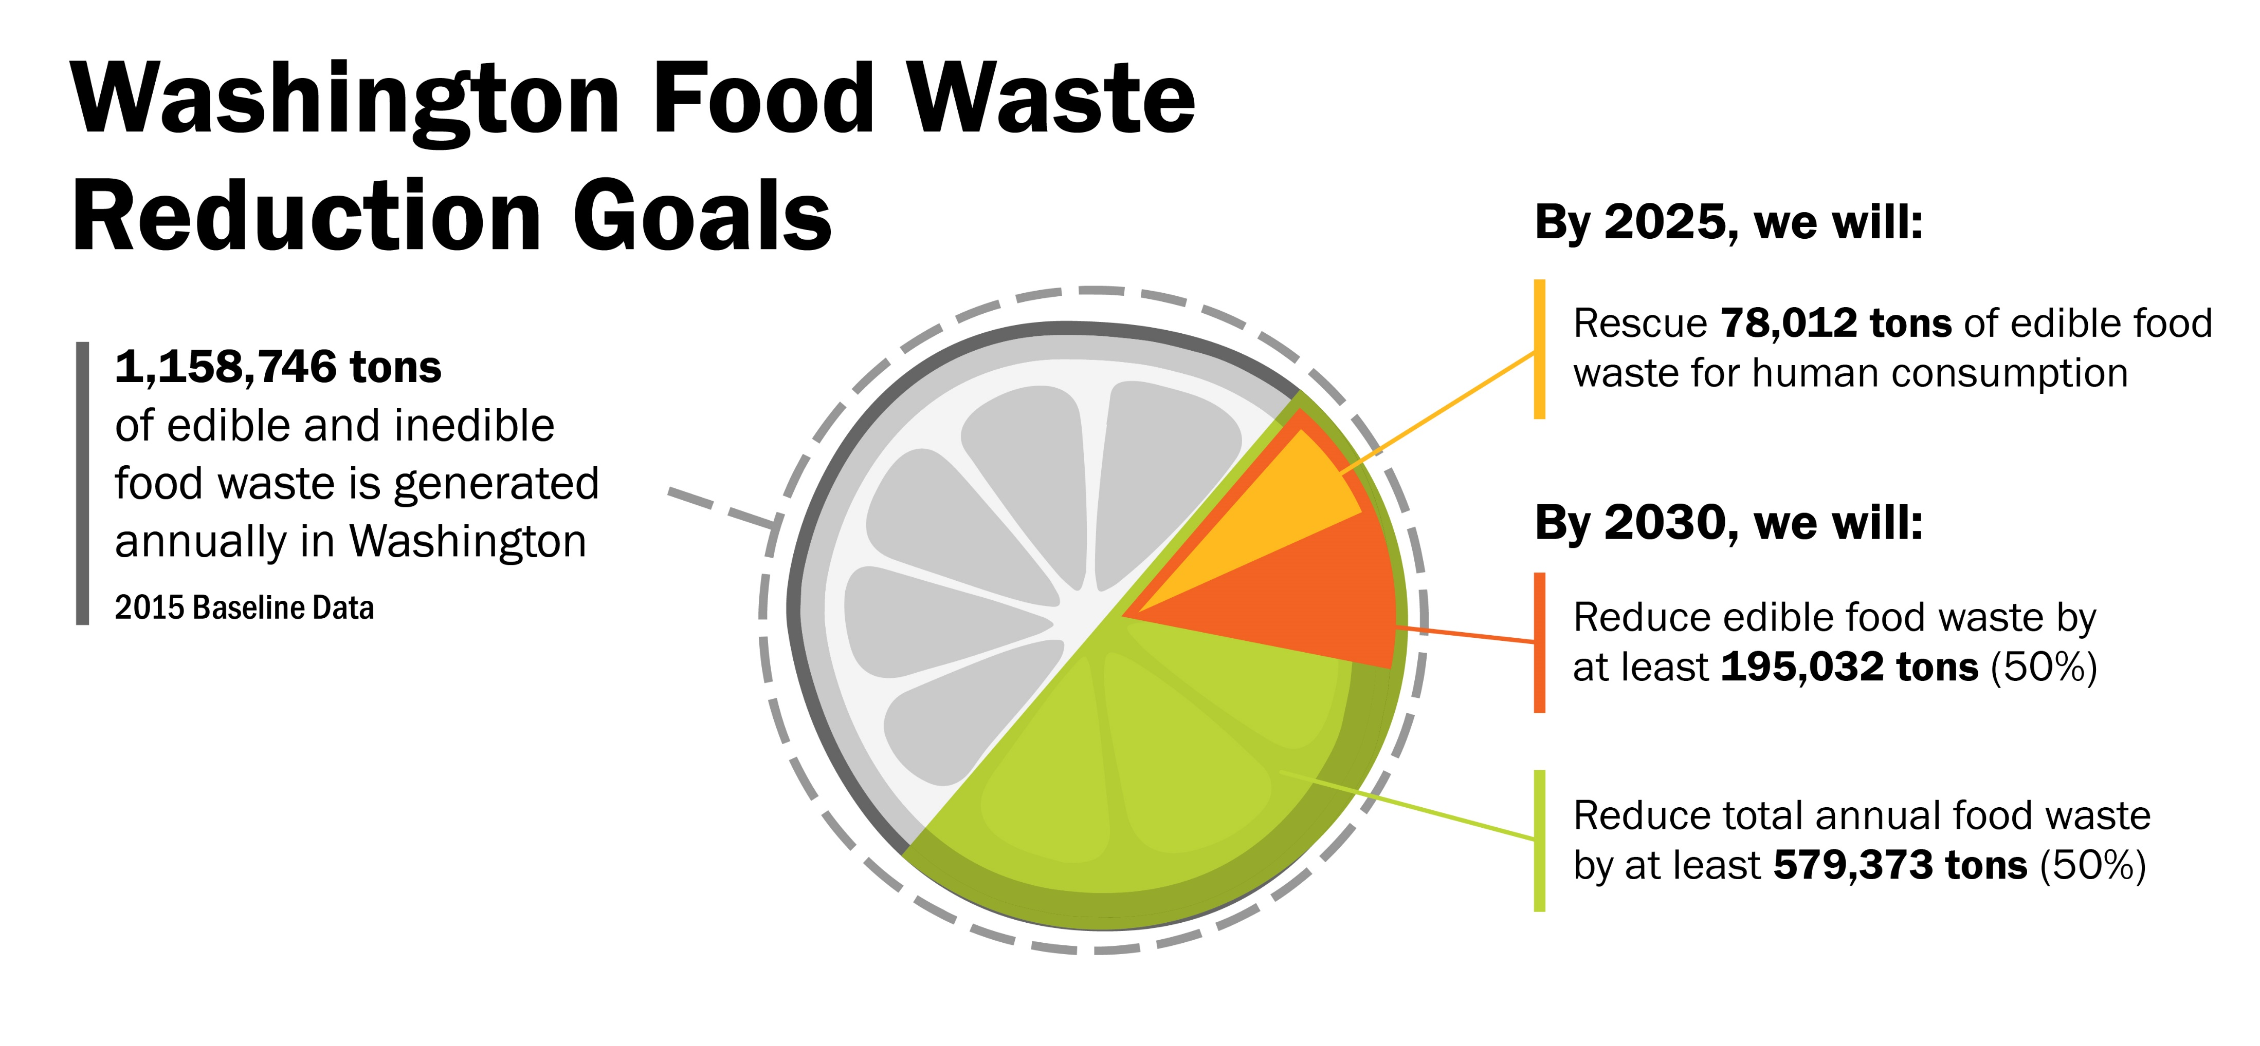

Slide 31
Thank you!
Chery Sullivan
Policy Section Manager
Chery.Sullivan@ecy.wa.gov
360.425.2724
Alli Kingfisher
Organics and Food Center Supervisor
Alli.Kingfisher@ecy.wa.gov
509.960.1290
Jade Monroe
Food Center Lead
Jade.Monroe@ecy.wa.gov
360.628.4031

Slide 32
Let’s take a 10 minute break

Slide 33
AGENDA
9:00 am Welcome
9:10 am Board roundtable
9:15 am Commerce and Ecology updates
9:25 am Tina Schaefer – NextCycle WA update
9:30 am Chery Sullivan – Organics Presentation
9:50 am Bio break
10:00 am Kara Steward - Past, present, future
10:15 am Mya Keyzers - Priority decision metrics
10:25 am Strategic planning
11:00 am Wrap-up

Slide 34
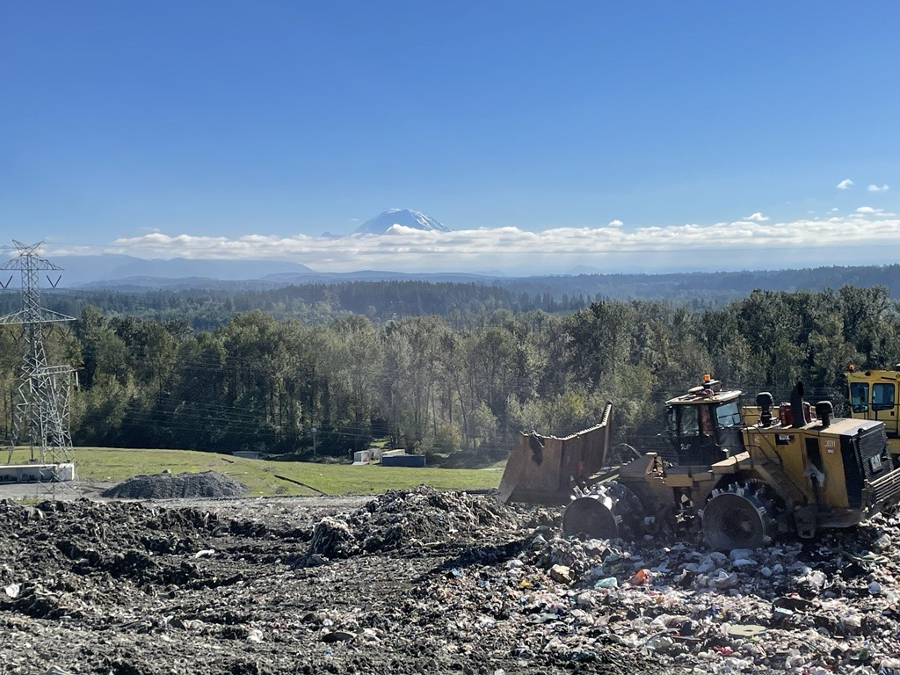
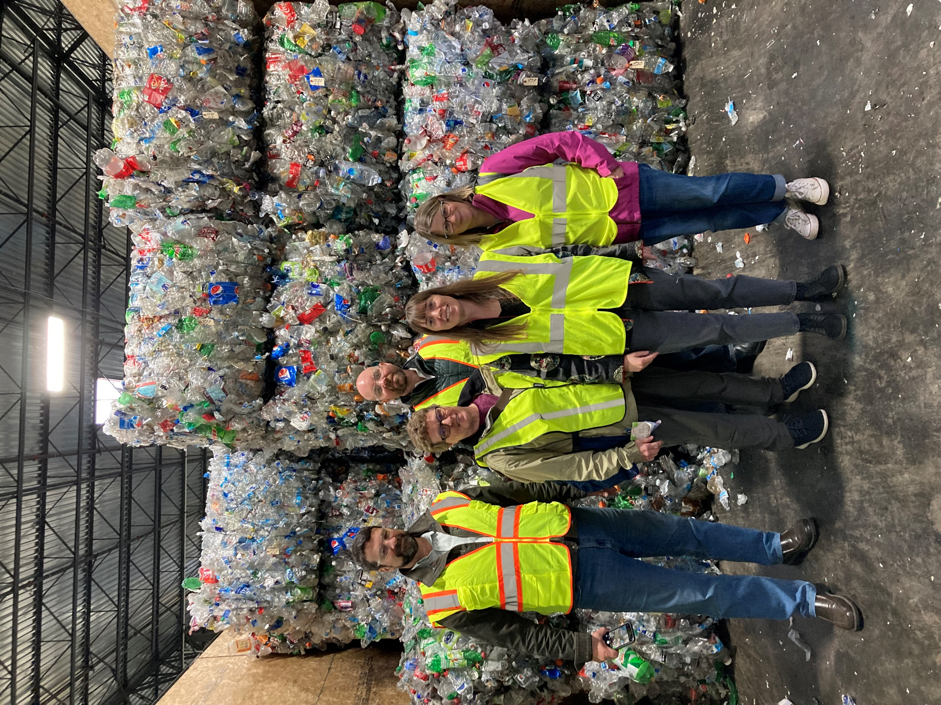
2022-2023 Years in Review
Notes:
Play movie now, with sound
https://clipchamp.com/watch/oHzUpu8f0Zg

Slide 35
RDC North Stars for 2023-2024
CONVENE
Tours
INNOVATE
NextCycle
RESEARCH
Material papers
ASSISTANCE
Grants
Summits
Meetings
Studies
Commerce
Conferences
Outreach
Pilot projects
Pilot projects
Outreach
Material papers
Notes:
The RDC Team met in August to go over the work we have completed – mostly the past year plus. We found our work fell into four general areas – listed on the slide.

Slide 36
What’s coming July 2023 – June 2024
Future Work
Ag plastics summit
Update material papers
Community database and map
Commercial cardboard collection research
Other ideas?
Winter 2024 NextCycle accelerator application
Spring 2024 PreCycle
Draft legislative report Spring 2024
Fall 2024 NextCycle Pitch event, track completion
May glass summit #2 May 2024
Jan 2024 Board Meeting
April 2024 Board Meeting
July 2024 Board Meeting
October 2024 Board Meeting

Slide 37
AGENDA
9:00 am Welcome
9:10 am Board roundtable
9:15 am Commerce and Ecology updates
9:25 am Tina Schaefer – NextCycle WA update
9:30 am Chery Sullivan – Organics Presentation
9:50 am Bio break
10:00 am Kara Steward - Past, present, future
10:15 am Mya Keyzers - Priority decision metrics
10:25 am Strategic planning
11:00 am Wrap-up

Slide 38
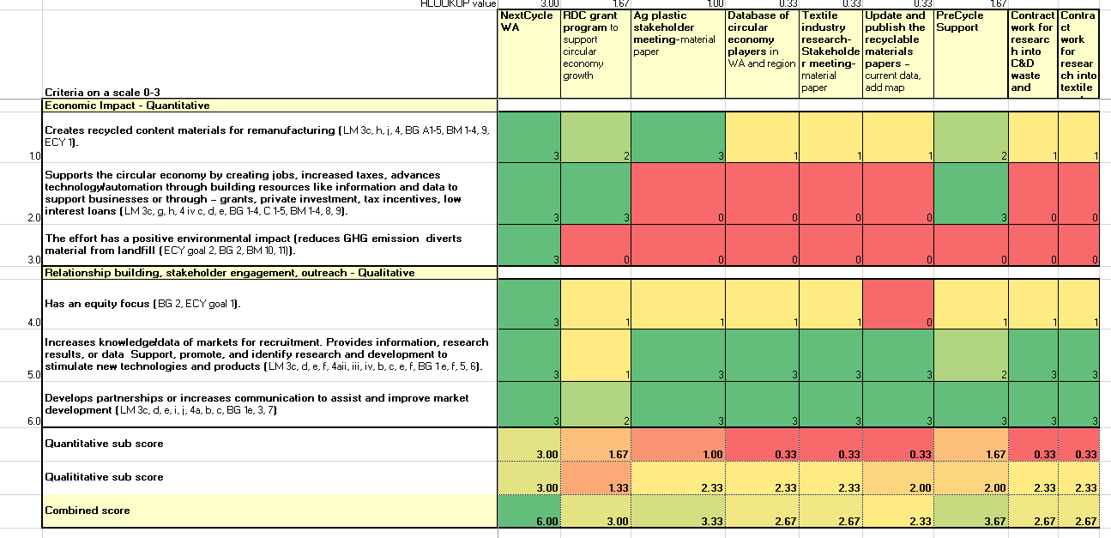
Project prioritization tool
Split criteria into quantitative and qualitative
Added data tab
Added project details tab
We know this isn’t the only way we will determine what to work on it, but one tool to lean on.
Notes:
EZpage-CenterProjectPrioritizationToolSept2023.xlsx (live.com)
BACKGROUND
This quasi quantitative tool was developed to give the Center a way to rank project ideas against the legislative mandate, the Center work plan, Ecology's agency goals, board goals, and Commerce's.
This will give us place to start when new project ideas are introduced. It will facilitate discussion in the context of the goals and directives of the Center. This will also help with consistency through time and staff changes.
Why do we need a priority tool: RDC resources are thin, our financial resources will be committed in the coming year to NextCycle (including Tina’s time and available contracting resources ($$). The remaining RDC resources are staff time – Kara, Mya, some of Kirk.
Why we need a screening process: with the number of areas where we can focus our resources, we’d like to make strategic choices in the use of resources. It can also provide a consistency through time.
HOW TO
Find your tab and fill in all cells in the scoring table.
The grid cells are controlled by a drop down 0-3, no decimals allowed or other numbers.
The criteria is separated into quantitative and qualitative, with 3 criteria each. The idea was to give projects with less connection to hard data (qualitative) an equal evaluation. We made the choice to limit the criterial to 6 total. Each was given equal weight with a range of 0-3 has the scoring option.
Each criterial was mostly taken directly from the legislative mandate. In () after is an acronym referencing what goal it relates to. For example LM3a means it came from the legislative mandate 3a.
The top columns are a list of projects we have plans to continue doing or would like to do. For more details on the projects see the Project ideas details tab.
As scores are filled in the conditional formatting showing high values in green and low values in yellow. Once all the cells are filled in the scores will autofill in the ranking results table below, the project titles will not auto fill, you have to copy/paste them below or don't worry about it and I will do it.
Once you are done, email it back to Mya and she will compile everyone's results and share back with the group. You can see an example from our internal test group on the All Scores tab.
These results would be used to direct what projects and the order of priority the RDC should work on.

Slide 39
AGENDA
9:00 am Welcome
9:10 am Board roundtable
9:15 am Commerce and Ecology updates
9:25 am Tina Schaefer – NextCycle WA update
9:30 am Chery Sullivan – Organics Presentation
9:50 am Bio break
10:00 am Kara Steward - Past, present, future
10:15 am Mya Keyzers - Priority decision metrics
10:25 am Strategic planning
11:00 am Wrap-up

Slide 40
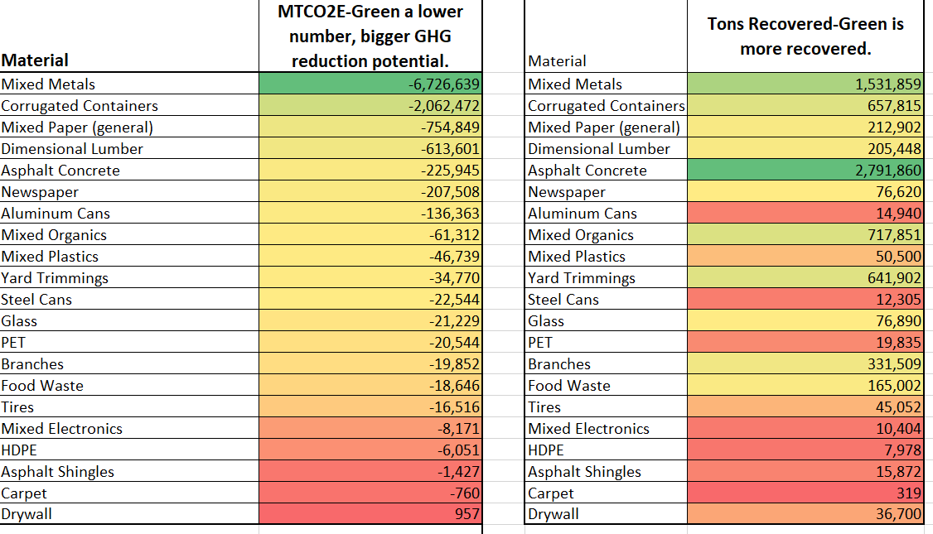
Center strategic planning by material type

Slide 41
Questions?

Slide 42
Wrap up
Next meeting:
Wednesday, January 10th, 2024
Location: to be determined
Tour: to be determined
Tasks from today:
Notes and slides from today will be posted to the EZ page next week.
Links to the XXXXX.

Slide 43
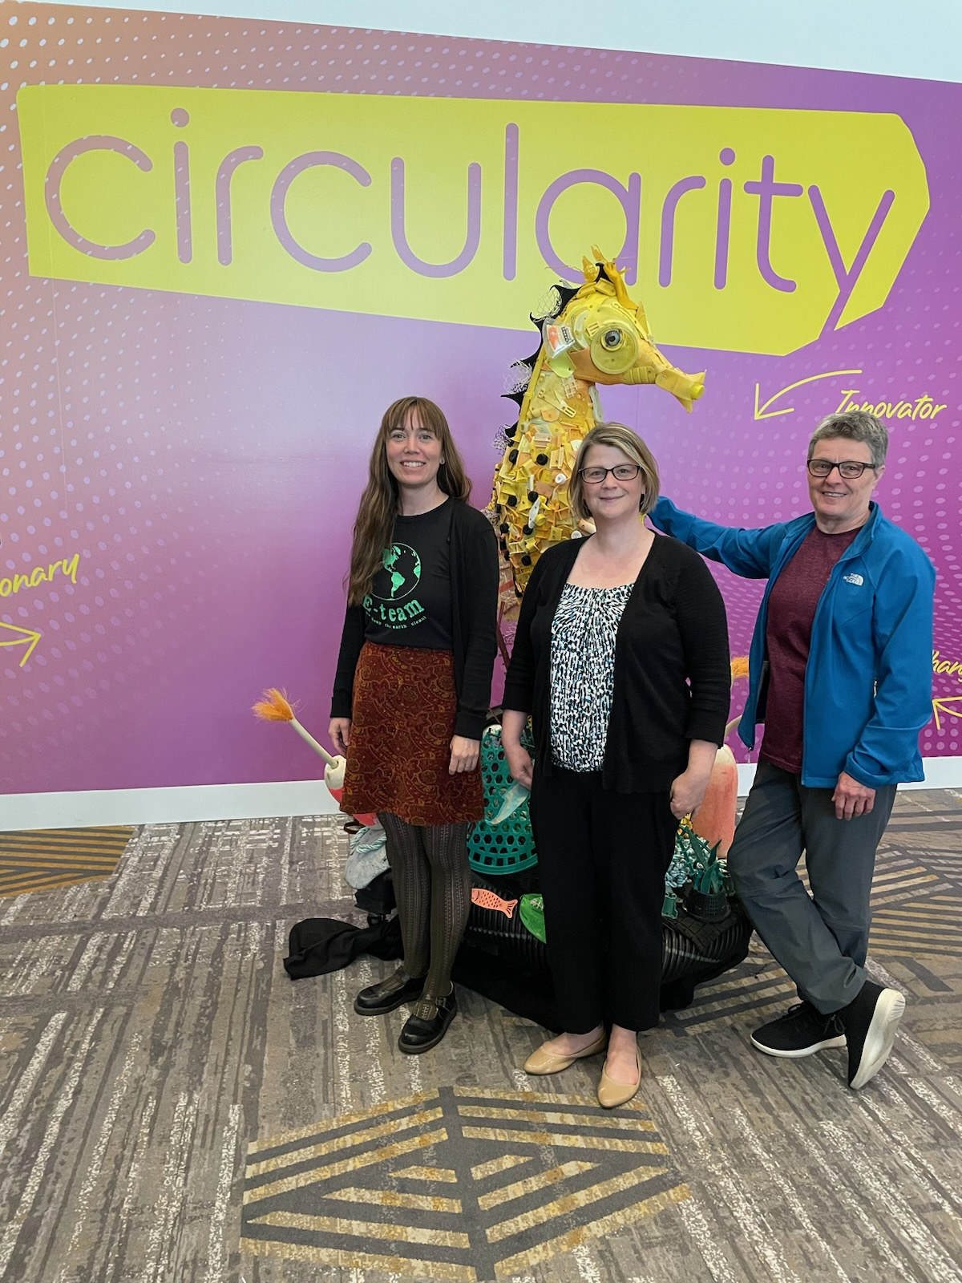
See you all at the January 10th board meeting!

