Slide 1
Styro Recycle tour
Recycling Development Center June 14, 2023

Slide 2
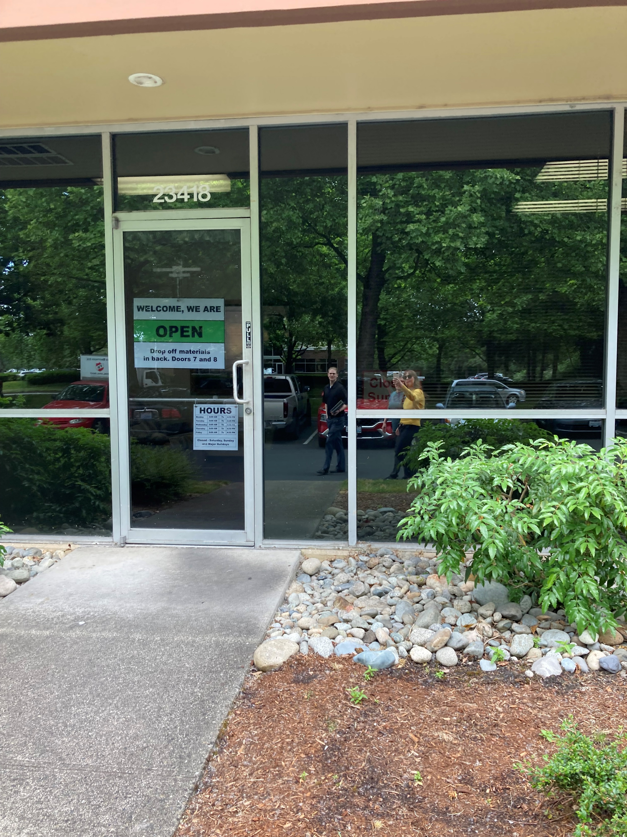
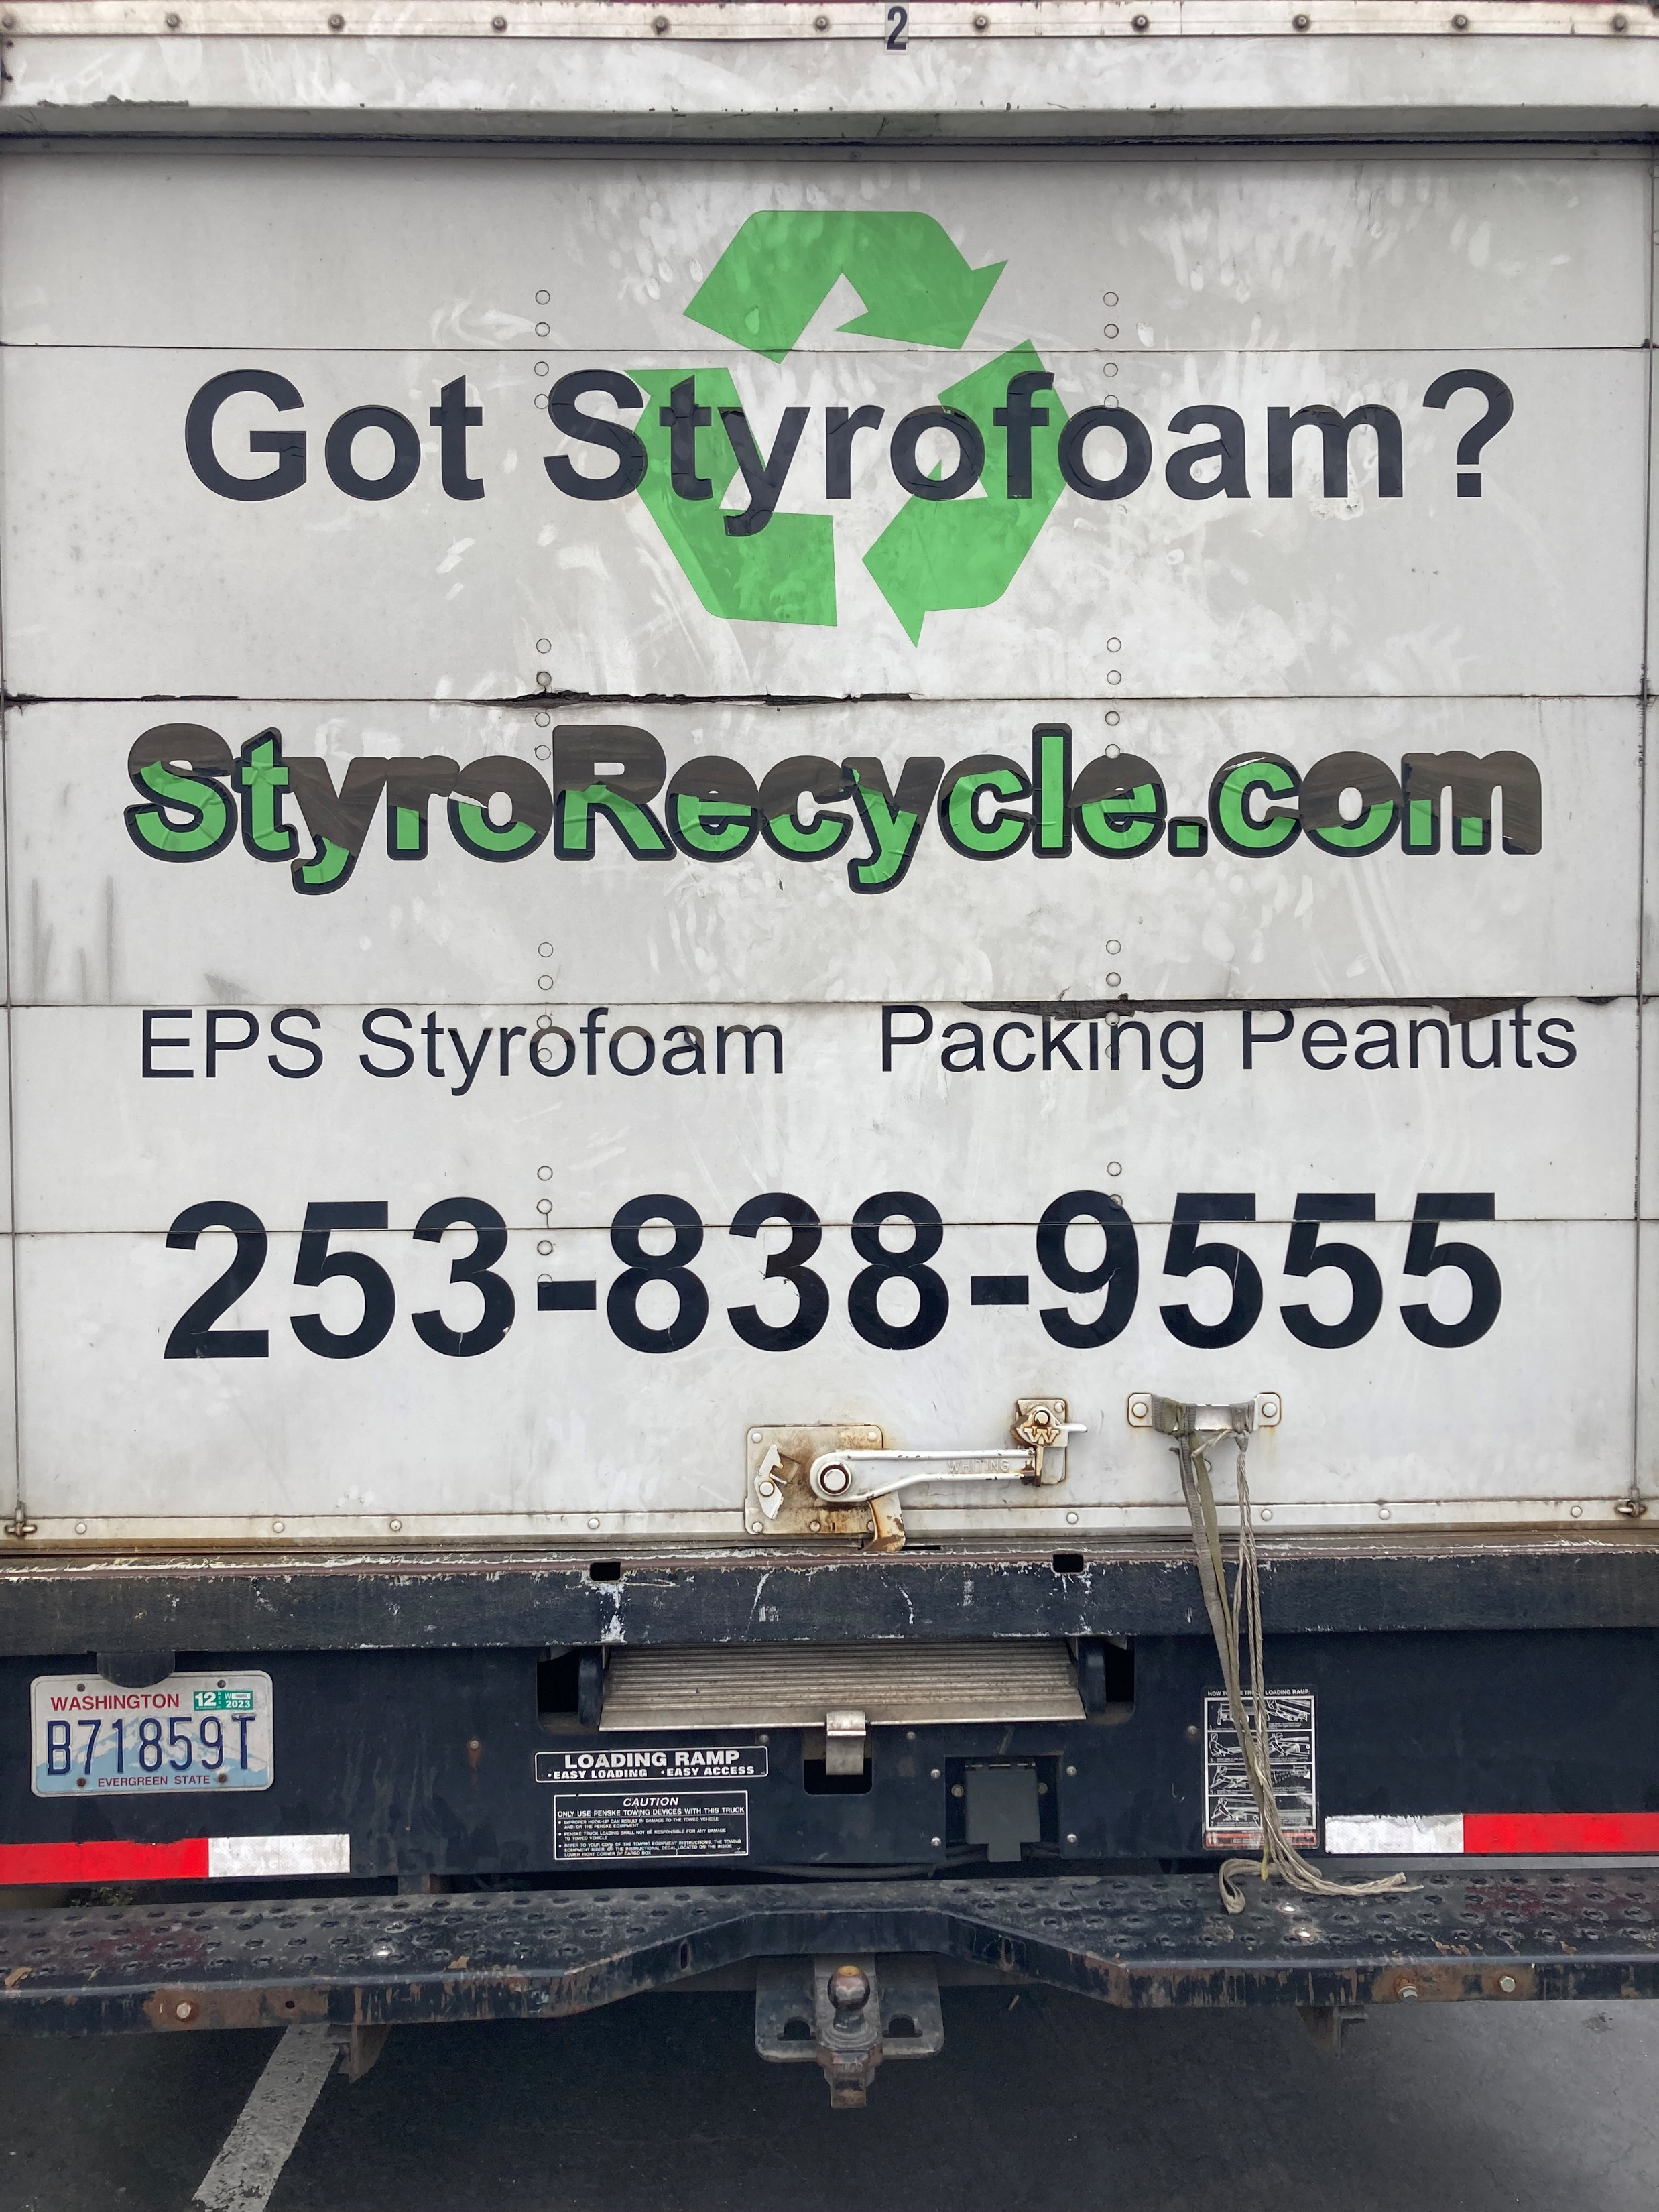
Stryo Recycle Free Drop off at 23418 68th Ave., S. Kent, WA 98032

Slide 3
Public access to drop off the different materials they accept.

Slide 4
Public access to drop off the materials they accept.

Slide 5
Angel loading polystyrene into the densifier machine.
The condensed polystyrene coming out of the machine.

Slide 6
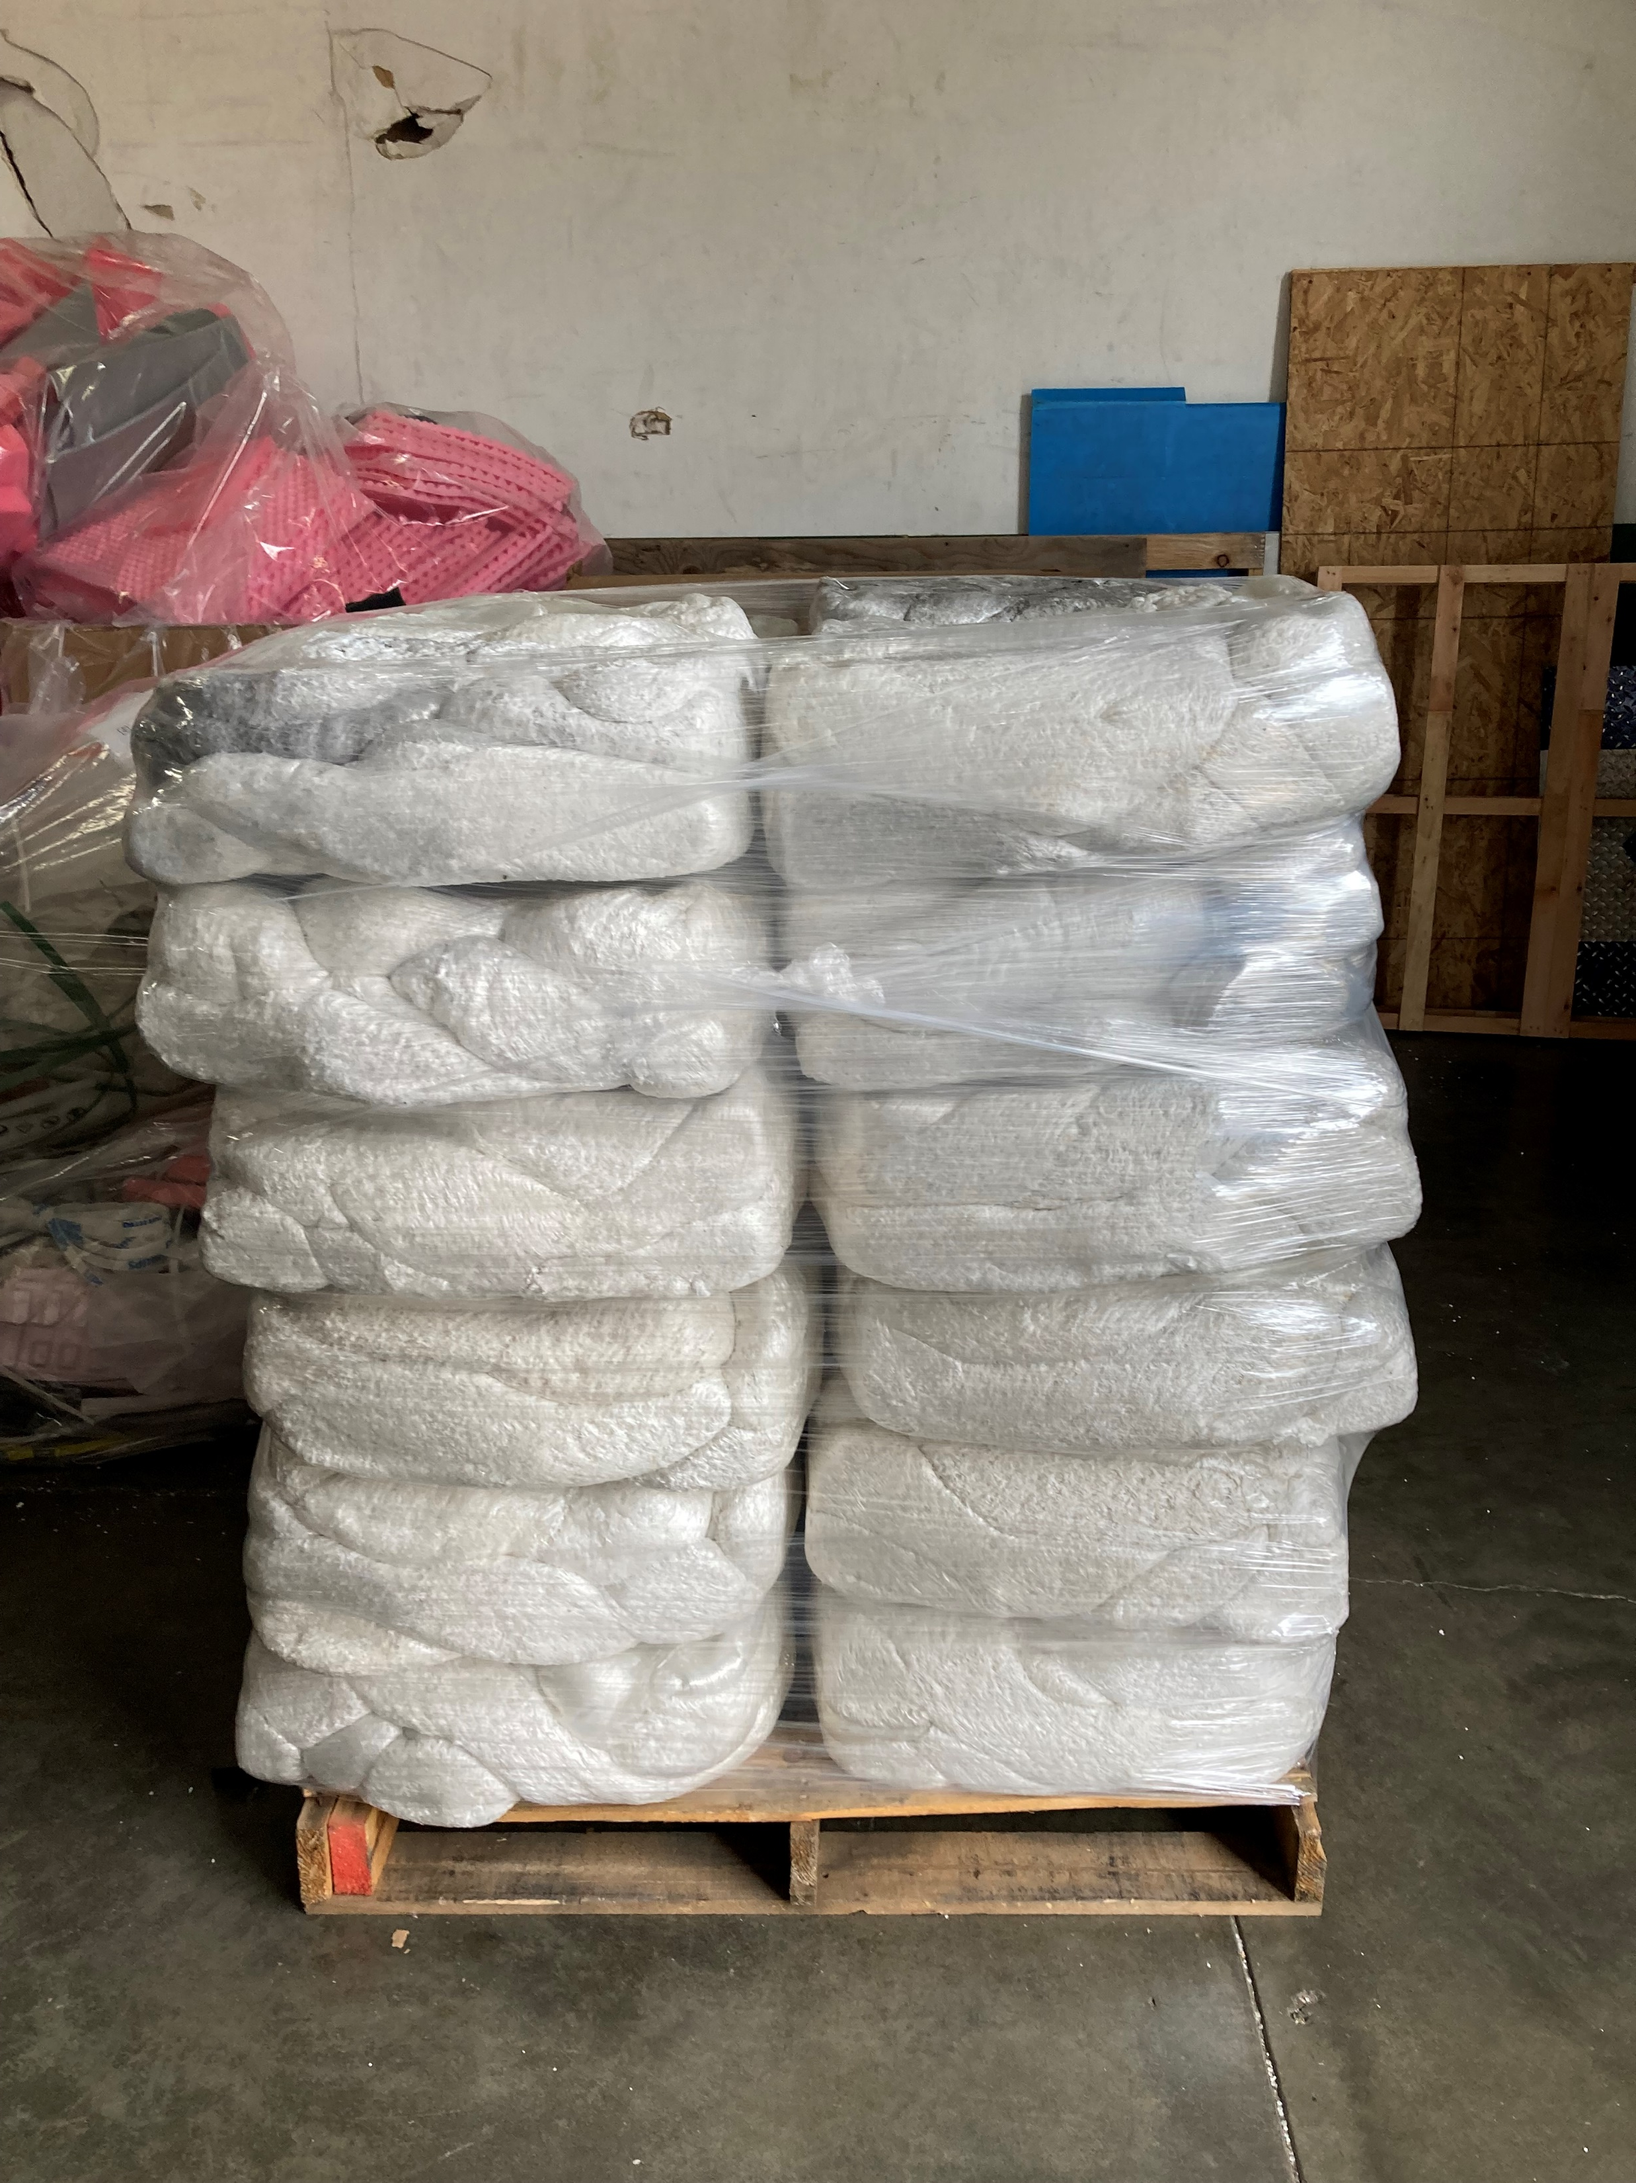
Condensed polystyrene bales, grade A is white, lower grades are gray, and black.

Slide 7
Marilyn’s Hub Brainchild

Slide 8
Thank you Marilyn and styro recycling
Recycling Center in Kent - Styro Recycle
Free Drop Off Center Located at 23418 68th Ave., S. (West Valley Hwy.) Kent, WA 98032
Caleb, Natalie, Marilyn, Kara, Mya, Polly.

