Slide 1
HFC End-of-life Management Program
Stakeholder Input Webinar
June 30, 2021
Notes:
Good afternoon! Thank you for joining us for this presentation today. We’re looking forward to sharing this work and hearing your questions and feedback.
We’ll start by reviewing some logistics for the meeting to make sure everyone can participate.

Slide 2
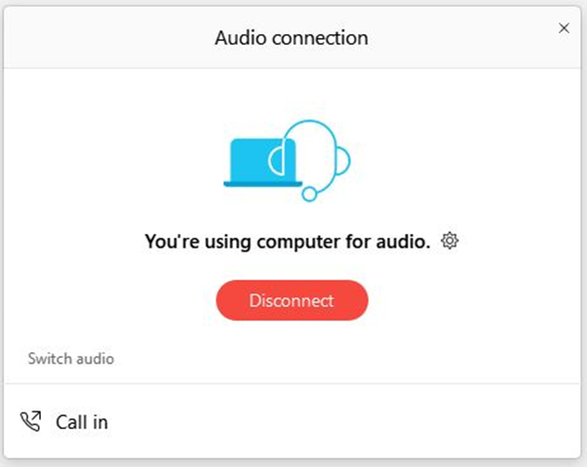
Audio connection logistics
For audio connection, we recommend using your computer speaker
If you are unable to join using computer audio, use “Call In” to access dial-in information
To open the audio options, select the three dots icon in the menu at the bottom of your screen
Notes:
We recommend joining WebEx using your computer audio. Our participants seem to have the best results using that audio option.
If you need to adjust your audio selection, click the three dots in the menu at the bottom of your screen, and select “switch audio.”
This will bring up a menu where you can choose to enter your phone number and have the WebEx system call you, or you can access call-in information and use audio via your phone.

Slide 3
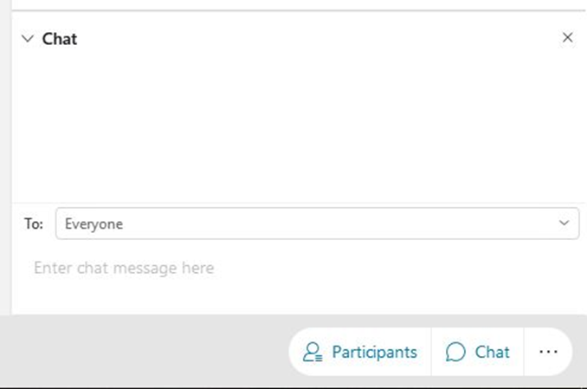
Webinar logistics
All lines are muted
Questions and input go in the Q&A box
Technical difficulty issues go in the chat box
To open the chat box, select the chat button at the lower right hand side of your screen
In the event of major technical difficulties, we will reschedule
Notes:
Please direct any technical difficulty issues to the host in the chat box. We’ll do our best to help you address the problem.
Right now, your line is muted. But because we will have an interactive discussion, you are able to unmute yourself throughout the presentation, so be mindful of that.
If we hear background noise before the discussion portion, we’ll just mute your line from our end until we get to that part.
Questions are welcome anytime throughout the presentation, but we will address them during the discussion. We encourage you to ask your question in the chat as soon as you have it so you don’t forget!

Slide 4
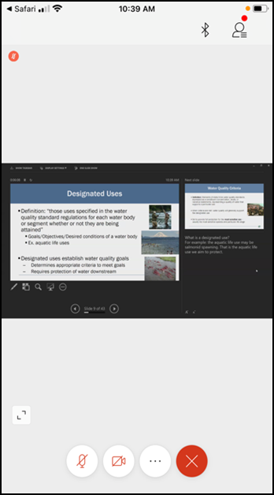
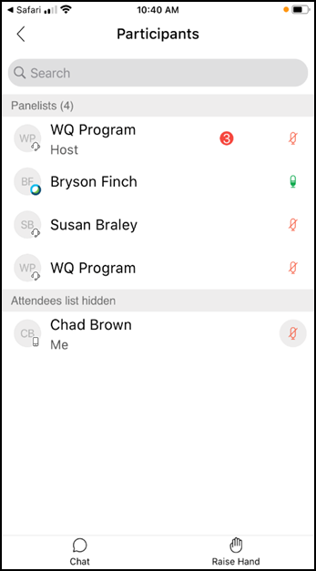

If you are joining by mobile device
Notes:
If you are joining WebEx using your phone or tablet, click on the participant icon on the upper right of your screen to show the participant list. At the bottom of the participant list screen, you should see the option to chat and raise your hand.

Slide 5
Agenda
Introductions
Legislative directive
Project timeline
Stakeholder questions and input
Wrap-up
Notes:
Here’s today’s agenda. We will not be recording today’s event, but we will be posting the final slides, including the summary of comments, on our EZView web page.

Slide 6
Introductions
Notes:
Introductions: to start, I’m Kimberly Goetz and I’m coordinating this cross-programmatic team as part of the agency’s climate change efforts. I’m the Legislative Coordinator for the Hazardous Waste and Toxics Reduction program and I’ll be taking the lead on writing the legislative report and recommendations..
Megan Warfield from our Solid Waste Management Program. ***Megan can introduce herself***
From the Air Quality Program, Abbey Brown is our technical lead for HFCs. ***Abbey can introduce herself***
And also from Air Quality is Linda Kildahl, who is leading Ecology’s efforts for another section of the same legislation. ***Linda can introduce herself”””
OPTIONAL IF BILL ATTENDS: And our Air Quality Program Climate and Energy Specialist Bill Drumheller. ***Bill can introduce himself.***
Also joining us today behind the scenes are Margaret Plummer and Tina Maurer who will handle the technological part of the presentation.

Slide 7
Legislative Directive
E2SHB 1050: Reducing greenhouse gas emissions from fluorinated gases
Notes:
Next we’ll talk about what Ecology has been directed to accomplish. There were a number of bills passed during the last legislative session, but the one we’re talking about today is House Bill 1050.
There are a number of sections of the underlying legislation, and our current efforts are only focused on one small section.
And before we get into what we’ve been directed to do, we want to make it very clear that we are NOT talking about the large-scale rulemaking that’s is related to section 9 of the legislation. Ecology will be getting to that section, but that’s not what we’re talking about today.

Slide 8
E2SHB 1050 – Section 14 (1)
Ecology must make recommendations for “optimal design” of program to address “end-of-life management and disposal of refrigerants”
Ecology must solicit feedback from “potentially impacted parties and the public”
Ecology must consider actions taken by other states and governments
Ecology may include draft legislation with recommendations, but isn’t required
Due by December 1, 2021, which means our team must finish our work much earlier
Notes:
Instead, the relevant section of the bill for today’s discussion is section 14. It requires Ecology to prepare a report summarizing our recommendations for the “optimal design” of an end-of-life management program for HFCs and other refrigerants.
We’re specifically directed to engage in activities like this webinar where we ask for input and feedback from affected stakeholders and other members of the public.
And we’re directed to research what other jurisdictions have done to address the issue of end-of-life refrigerant management.
We may, but are not required to, develop draft legislation. That decision has not yet been made but is on the calendar for management to address.
All of this is due to the legislature no later than December 1st. So you can see that a lot has to happen in a short amount of time.

Slide 9
E2SHB 1050 – Section 14 (2)
Recommendations must specifically include:
  Legal and financial obligations to support or participate in the program
    Refrigerant manufacturers
    Importers
    Distributors
    Retailers
    Owners, operators, and servicers of refrigerant-using equipment
    Others
  Funding mechanism for refrigerant recovery and disposal activities
    Must provide a financial incentive for recovery and management
  Performance goals and operational standards
Notes:
The recommendations we are required to address include:
How to structure the program to legally obligate participation both in the program and any associated financial support by the listed parties
How the program should be funded and who should pay
How to provide a financial incentive for recovery of old refrigerants so they can be properly managed at the end of their useful life
And what performance measures should be applicable to the program

Slide 10
Work to date
Focused on identifying and engaging with stakeholders
Reviewing similar programs in other jurisdictions
  NYC Dept. of Sanitation
  British Columbia
  California
  Australia
Now collecting input and feedback from affected stakeholders and other interested parties
Notes:
So what have we done so far?
Our primary work has been related to assembling a team to do the work and identifying stakeholders. We have engaged with some stakeholders one-on-one. If you would also like to have a one-on-one discussion with our team, please reach out to us and let us know. My contact information will be at the end of this presentation.
Megan has been hard at work researching programs in other jurisdictions, and I’m going to turn it over to her to explain what she’s been investigating.
So far I’ve begun to research how refrigerant containing consumer appliances are currently being managed in-state – and programs in 3 other jurisdictions: NYC, British Columbia, and California. If you know of other successful programs that you feel we should be investigating, please let us know! Australia has also been mentioned to us, and we’d like to know more about that if you can provide additional information.
We’re now collecting your input so we can incorporate it into our recommendations and program design work.

Slide 11
Current schedule
Bill passed Legislature | April 19
Governor signed | May 17
Program development | May 17 – August 13
Stakeholder engagement | Now – July 21
Writing report and recommendations | August 2 – August 13
First round of peer review | August 16 – August 27
First round revisions | August 30 – September 3
Program Manager reviews | September 7 – September 17
Second round revisions | September 20 – October 1
“Fatal flaw only” program review | October 4 – October 8
Government Relations and Executive review | October 11 – November 29
Final edits | November 29 – November 30
Submission of final report and recommendations | December 1
On-going stakeholder engagement | December 1 – January 10
2022 Legislative Session begins | January 10
Notes:
You can see we have a very compressed timeline to complete our work – just a few months. The most important date for you to be aware of is July 21st – the last date available for you to submit your feedback. While we recognize that’s not very far away, you can see that only gives us about three weeks to consider your feedback, design the program recommendations, and write the legislative report.

Slide 12
Stakeholder Questions and Input
Notes:
Now it’s time for you to contribute to the discussion. Again, we are seeking input about program design and funding, especially if you have experience with similar programs in other jurisdictions. We really want to hear what works well and what doesn’t work well and any ideas you have that could help a Washington program succeed.
If you think Washington should not have a program, that’s a great comment also. However, please remember Ecology has been directed to design a program, not necessarily make recommendations whether a program should be developed. So even if you don’t support having a program, we encourage you to give us comments about how a program could be designed to minimize your concerns. Ultimately, whether or not a program is adopted is a decision for the Legislature to make.
We ask that you to identify not only yourself but any organization you represent. We are trying to ensure a broad scope of interests are represented and this will help us do that. We also ask that you keep your comments to around 3 minutes. If you need more time, reach out to us and we can schedule some time to talk with you.

Slide 13

Type your question or raise your hand
Notes:
Again, if you would like to make a comment, we ask that you either type your comment in the chat box or raise your hand. If you don’t see the raise hand feature, try clicking on the three dots to open the options menu. To lower your hand, just repeat the same steps.
If you are calling in from a phone and aren’t able to select one of those options, you can press star 3 to raise and lower your hand.
If you’re attending on a mobile device, you should see chat and raise hand icons at the bottom of the participants list screen.
We’ll call on folks in order of when you raised your hand and we’ll unmute your line at that time.
If you do not want to make a comment at this time, you still have other options to submit written comments that we’ll cover in a minute.

Slide 14
Suggested topics
What role should various stakeholders have in the program?
Who incurs costs and who should pay those costs?
What incentives are needed and where should the money come from?
What would be important to your organization to see in a program?
What should be included in program scope?
What metrics should be used to measure success?
Should reclamation/reuse be prioritized or should they be disposed?
Who should administer/oversee a program?
What education and outreach is needed?
Are you aware of successful programs we should examine?
Notes:
We’re here today to hear whatever feedback you’d like to provide. To help guide our discussions today, we encourage you to comment on the topics listed here. You don’t have to talk about these topics, but they are probably the most important issues for us right now.
We are going to post a longer list of detailed questions on our EZView page. We encourage all of you to take a look at that list and contribute any additional comments you have after looking at it.
If you want to come back to this screen when it’s your turn to comment, just let us know.

Slide 15
Comments and feedback – page 1
What role… Aspirationally, we want stuff to remain in the pipe. Careful reclamation can lead to successful reuse. | Costs… Should be EPR – traditional approach starting with brand owners and then on down the line. Don’t have a strong opinion yet on ref manufacturers vs. appliance manufacturers. Just throwing out a second call for a producer responsibility approach to this problem, one has producers and distributors of refrigerants "take back" recovered refrigerant and utilize incentives to do so. An 'eco fee' in refrigerant sales would be an ideal way to fund costs of such a program. It will be very important to get at the large HFC410A banks in household unitary AC and commercial AC systems. EPR program would be great because folks think it should be fee. | Incentives… Do we need to offer incentives for lower GWP refrigerants? It might speed up the process of changing to a more carbon-neutral environment? Yes we should! Heat pump technology is good. Less CO2 emissions. Next phase is moving to lower GWP no O2 damaging options. New R32 refrigerant is much lower GWP and no O2 harm. We could encourage folks to change. Applies to both homes and commercial. Cooling is going to part of the NW going forward. Should prioritize recovery of refrigerants Australia has a deposit/fee program. People just don’t bring refrigerant back, so look at other approaches with better track record. Maybe utilities could get/give incentives for customers to switch to low GWP refrigerants Incentives are good idea and EPA is working to move to lower GWP in compliance with Kigali Amendment
Important elements… Public purchasing requirements Need to update codes to allow for use of refrigerants like R32 or else it will result in increase emissions | Program scope… We’re trying to get to a more carbon-neutral environment, should we include lower GWP refrigerants, Should the management program include lower-GWP refrigerants in the EOL program? It’s both end of life of the refrigerant as well as end of life of the stuff that uses the refrigerant – proper reclamation goes hand in hand with using better refrigerants | Metrics and performance measures…
Notes:
We’re going to keep track of comments in real time here on the screen. We ask that if you are going to make a comment, please help us make sure that we’ve correctly summarized your comment. Please feel free to correct us or add more details so we get an accurate summary on the list.
Also, just to make sure it’s clear, you do not need to comment today, and if you do comment today, you are welcome to follow up with additional written comments, keeping in mind the July 21st deadline.
We ask that you try to keep your comments to about three minutes. Again, if you feel like you need more than that, we encourage you to reach out and schedule some time for a one-on-one chat.

Slide 16
Comments and feedback – page 2
Reuse vs. disposal… NRDC – reclamation is key and should be mandatory. Important to focus on maximizing recovery of refrigerant (both residential and commercial). Important part of phase-down. Competition among HFC users is going to increase due to decreasing supply. Systems have long life but leak so need recharging. Will reduce need for virgin refrigerants. Many of the newer refrigerants are impossible to reclaim because they are mixes of various refrigerants, which leak at different rates. At EOL it is no longer the correct mixture. Have to be sent for incineration and there’s no value to help offset the cost of recovery. Incineration very expensive. Some reclaimers are able to reclaim blends, but not all do. Refrigerants don’t change chemically – may need to be cleaned up but they halon itself doesn’t change chemically | Program administration… Utilities incentives and procurement provisions might affect program administration Rebate program? Reclaimed refrigerant instead you get money back? Creative ideas will be needed to move it forward. Private entity maybe doing the administration? Maybe like arrangement Product Care has for light recycling program Maybe could be role for encouraging EOL for higher high GWP – maybe don’t wait but encourage through rebates, etc. | Education and outreach… Customers expect recycling to be free and some people won’t recycle when they find out the cost
Other successful programs… EU has an expansive program. Several utilities have programs even though they tend to be focused on energy efficiency. EPA’s RAD – responsible disposal program. They offer some services for residential products. Look to CA’s life cycle emissions calculator – including the social cost of carbon. Can help ECY come up with the inventory and can help give utilities help to customers to estimate their emissions. Want to be successful … baby steps may be appropriate. A bounty-type system might be helpful, especially for carbon credits. | Other program comments… DW regs will treat refrigerants as DW, and some of the new ones will be RCRA waste because of flammability. CFCs and HCFC rule doesn’t cover HFCs. What’s up with potential changes? Would be good to also apply to alternatives like ammonia. Fire code only allows so many hazardous materials based on occupancy rating. Might be limited to a small(ish) amount of material. Very expensive to upgrade a building to allow for greater materials storage.150 pounds per unit. Proposals for up to under 10,000 lbs under new IFC. UN estimates about half of HFCs are used for recharge Offsetting dangers – GWP vs. human health hazards Remember different refrigerants have different pressures and may not be interchangeable (different coils, tubing, thickness of coils, etc.) | Bike rack Is there any data about how many appliances or how much refrigerant is out there that needs to be addressed? Procurement policies for public buildings Hazard classification is a hurdle that needs addressing Maybe Washington can be a testing ground for innovative ideas that can be revised or abandoned if they don’t work Some refrigerants have active patents so may be restricted

Slide 17
Wrap-up
Notes:
Thanks for that input and feedback. We will definitely be using these comments, as well as others we receive before the July 21st deadline, as part of our program development.

Slide 18
We also invite further written feedback
Additional comments and feedback can be submitted at our eComments page at https://aq.ecology.commentinput.com/?id=Q6945
  You can type in your comment or upload a PDF/Word file
Also access eComments at www.ecology.wa.gov
  Select the “More public input & events” link towards the bottom of the page
All comment letters received will be posted on our EZView web page at https://www.ecology.wa.gov/HFC-EndOfLife
All comments due no later than July 21, 2021
Notes:
We strongly encourage submission of written comments. They help us make sure we don’t miss comments and suggestion. The best way to submit comments is at our eComments page at the address listed here.
You might find it easier to access eComments by going to our website at www.ecology.wa.gov and scrolling down to the “More public input and events” link at the bottom of the screen, Then just open one of the days listed, choose this project, and it will open our listing. A link to the comment submission page is listed there.
We will be posting this presentation on our EZView page, so you’ll be able to access these web links there if you like.
Please remember all comments must be received by July 21, 2021. Due to the compressed timeline we summarized earlier, we do not have an option to extend the comment period. If you want us to consider your suggestions, concerns, and other comments, we must have your feedback no later than July 21st.

Slide 19
For more information
Kimberly Goetz
(360) 819-7080 – mobile
Kimberly.Goetz@ecy.wa.gov
EZView bit.ly/hfc-end-of-life
HFC Listserv Signup
Notes:
And you can see we also have a bit.ly address for our EZView page if you’re going to type it in. Just visit bit.ly/hfc-end-of-life. That will take you to the same place as the full address that we listed on the previous screen. We’ll be posting these slides, including the notes we took, on that page.
You’ll find lots of info on the EZView page including a link to sign up for our HFC Listserv. This listserv will also be a good source about Ecology’s work as we continue to implement other portions of the bill, including future rulemaking activities.
This is my contact information and we encourage you to reach out to me or other members of the team. I’m happy to talk with any of you about your ideas, feedback, and other input you have for our project. And as I mentioned earlier, we are happy to have one-on-one chats with interested stakeholders and other parties.
Thanks so much for joining us.

