Slide 1
HFC End-of-life Management Program
Stakeholder Input Webinar
July 8, 2021
Notes:
Good morning! Thank you for joining us for this presentation today. We’re looking forward to sharing this work and hearing your questions and feedback.
We’ll start by reviewing some logistics for the meeting to make sure everyone can participate.

Slide 2
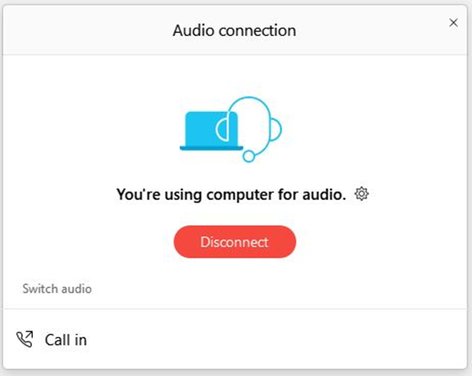
Audio connection logistics
For audio connection, we recommend using your computer speaker
If you are unable to join using computer audio, use “Call In” to access dial-in information
To open the audio options, select the three dots icon in the menu at the bottom of your screen
Notes:
We recommend joining WebEx using your computer audio. Our participants seem to have the best results using that audio option.
If you need to adjust your audio selection, click the three dots in the menu at the bottom of your screen, and select “switch audio.”
This will bring up a menu where you can choose to enter your phone number and have the WebEx system call you, or you can access call-in information and use audio via your phone.

Slide 3
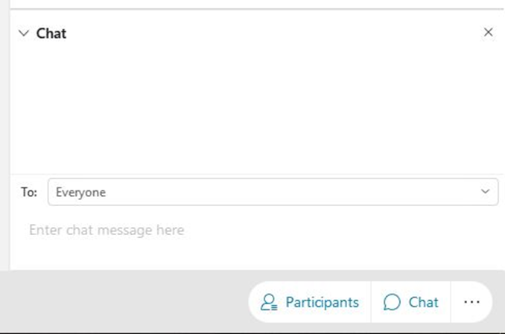
Webinar logistics
All lines are muted
Questions and input go in the Q&A box
Technical difficulty issues go in the chat box
To open the chat box, select the chat button at the lower right hand side of your screen
In the event of major technical difficulties, we will reschedule
Notes:
Please direct any technical difficulty issues to the host in the chat box. We’ll do our best to help you address the problem.
Because we will have an interactive discussion, you are able to mute and unmute yourself throughout the presentation, so be mindful of that. So if you would all please mute yourself now, I’d really appreciate that.
If we hear background noise before the discussion portion, we’ll just mute your line from our end until we get to that part.
Questions are welcome anytime throughout the presentation, but we will address them during the discussion. We encourage you to ask your question in the chat as soon as you have it so you don’t forget!

Slide 4
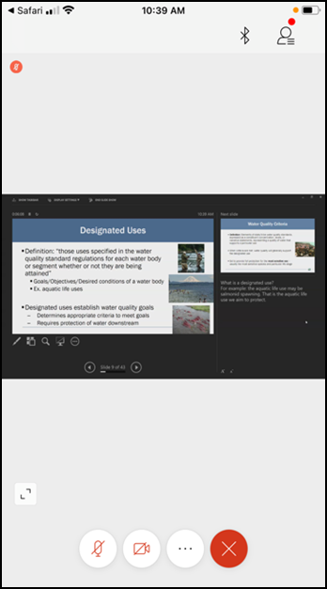
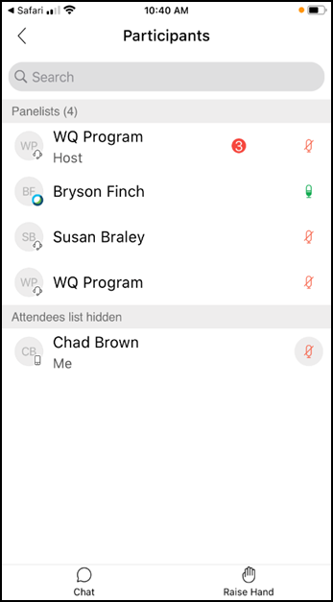

If you are joining by mobile device
Notes:
If you are joining WebEx using your phone or tablet, click on the participant icon on the upper right of your screen to show the participant list. At the bottom of the participant list screen, you should see the option to chat and raise your hand.

Slide 5
Agenda
Introductions
Legislative directive
Project timeline
Stakeholder questions and input
Wrap-up
Notes:
Here’s today’s agenda. We will not be recording today’s event, but we will be posting the final slides, including the summary of comments, on our EZView web page.

Slide 6
Introductions
Notes:
Introductions: to start, I’m Kimberly Goetz and I’m coordinating this cross-programmatic team as part of the agency’s climate change efforts. I’m the Legislative Coordinator for the Hazardous Waste and Toxics Reduction program and I’ll be taking the lead on writing the legislative report and recommendations..
Megan Warfield from our Solid Waste Management Program. ***Megan can introduce herself***
From the Air Quality Program, Abbey Brown is our technical lead for HFCs. ***Abbey can introduce herself***
And also from Air Quality is Linda Kildahl, who is leading Ecology’s efforts for another section of the same legislation. ***Linda can introduce herself”””
Also joining us today behind the scenes are Margaret Plummer and Tina Maurer who will handle the technological part of the presentation.

Slide 7
Legislative Directive
E2SHB 1050: Reducing greenhouse gas emissions from fluorinated gases
Notes:
Next we’ll talk about what Ecology has been directed to accomplish. There were a number of bills passed during the last legislative session, but the one we’re talking about today is House Bill 1050.
There are a number of sections of the underlying legislation, and our current efforts are only focused on one small section.
And before we get into what we’ve been directed to do, we want to make it very clear that we are NOT talking about the large-scale rulemaking that’s is related to section 9 of the legislation. Ecology will be getting to that section, but that’s not what we’re talking about today.

Slide 8
E2SHB 1050 – Section 14 (1)
Ecology must make recommendations for “optimal design” of program to address “end-of-life management and disposal of refrigerants”
Ecology must solicit feedback from “potentially impacted parties and the public”
Ecology must consider actions taken by other states and governments
Ecology may include draft legislation with recommendations, but isn’t required
Due by December 1, 2021, which means our team must finish our work much earlier
Notes:
Instead, the relevant section of the bill for today’s discussion is section 14. It requires Ecology to prepare a report summarizing our recommendations for the “optimal design” of an end-of-life management program for HFCs and other refrigerants.
We’re specifically directed to engage in activities like this webinar where we ask for input and feedback from affected stakeholders and other members of the public.
And we’re directed to research what other jurisdictions have done to address the issue of end-of-life refrigerant management.
We may, but are not required to, develop draft legislation. That decision has not yet been made but is on the calendar for management to address.
All of this is due to the legislature no later than December 1st. So you can see that a lot has to happen in a short amount of time.

Slide 9
E2SHB 1050 – Section 14 (2)
Recommendations must specifically include:
  Legal and financial obligations to support or participate in the program
    Refrigerant manufacturers
    Importers
    Distributors
    Retailers
    Owners, operators, and servicers of refrigerant-using equipment
    Others
  Funding mechanism for refrigerant recovery and disposal activities
    Must provide a financial incentive for recovery and management
  Performance goals and operational standards
Notes:
The recommendations we are required to address include:
How to structure the program to legally obligate participation both in the program and any associated financial support by the listed parties
How the program should be funded and who should pay
How to provide a financial incentive for recovery of old refrigerants so they can be properly managed at the end of their useful life
And what performance measures should be applicable to the program

Slide 10
Work to date
Focused on identifying and engaging with stakeholders
Reviewing similar programs in other jurisdictions
  NYC Dept. of Sanitation
  British Columbia
  California
  Australia
Now collecting input and feedback from affected stakeholders and other interested parties
Notes:
So what have we done so far?
Our primary work has been related to assembling a team to do the work and identifying stakeholders. We have engaged with some stakeholders one-on-one. If you would also like to have a one-on-one discussion with our team, please reach out to us and let us know. My contact information will be at the end of this presentation.
Megan has been hard at work researching programs in other jurisdictions, and I’m going to turn it over to her to explain what she’s been investigating.
So far I’ve begun to research how refrigerant containing consumer appliances are currently being managed in-state – and programs in 3 other jurisdictions: NYC, British Columbia, and California. If you know of other successful programs that you feel we should be investigating, please let us know! Australia has also been mentioned to us, and we’d like to know more about that if you can provide additional information.
We’re now collecting your input so we can incorporate it into our recommendations and program design work.

Slide 11
Current schedule
Bill passed Legislature | April 19
Governor signed | May 17
Program development | May 17 – August 13
Stakeholder engagement | Now – July 21
Writing report and recommendations | August 2 – August 13
First round of peer review | August 16 – August 27
First round revisions | August 30 – September 3
Program Manager reviews | September 7 – September 17
Second round revisions | September 20 – October 1
“Fatal flaw only” program review | October 4 – October 8
Government Relations and Executive review | October 11 – November 29
Final edits | November 29 – November 30
Submission of final report and recommendations | December 1
On-going stakeholder engagement | December 1 – January 10
2022 Legislative Session begins | January 10
Notes:
You can see we have a very compressed timeline to complete our work – just a few months. The most important date for you to be aware of is July 21st – the last date available for you to submit your feedback. While we recognize that’s not very far away, you can see that only gives us about three weeks to consider your feedback, design the program recommendations, and write the legislative report.

Slide 12
Stakeholder Questions and Input
Notes:
Now it’s time for you to contribute to the discussion. Again, we are seeking input about program design and funding, especially if you have experience with similar programs in other jurisdictions. We really want to hear what works well and what doesn’t work well and any ideas you have that could help a Washington program succeed.
If you think Washington should not have a program, that’s a great comment also. However, please remember Ecology has been directed to design a program, not necessarily make recommendations whether a program should be developed. So even if you don’t support having a program, we encourage you to give us comments about how a program could be designed to minimize your concerns. Ultimately, whether or not a program is adopted is a decision for the Legislature to make.
We ask that you to identify not only yourself but any organization you represent. We are trying to ensure a broad scope of interests are represented and this will help us do that. We also ask that you keep your comments to around 3 minutes. If you need more time, reach out to us and we can schedule some time to talk with you.

Slide 13

Type your question or raise your hand
Notes:
Again, if you would like to make a comment, we ask that you either type your comment in the chat box or raise your hand. If you don’t see the raise hand feature, try clicking on the three dots to open the options menu. To lower your hand, just repeat the same steps.
If you are calling in from a phone and aren’t able to select one of those options, you can press star 3 to raise and lower your hand.
If you’re attending on a mobile device, you should see chat and raise hand icons at the bottom of the participants list screen.
We’ll call on folks in order of when you raised your hand and we’ll unmute your line at that time.
If you do not want to make a comment at this time, you still have other options to submit written comments that we’ll cover in a minute.

Slide 14
Suggested topics
What role should various stakeholders have in the program?
Who incurs costs and who should pay those costs?
What incentives are needed and where should the money come from?
What would be important to your organization to see in a program?
What should be included in program scope?
What metrics should be used to measure success?
Should reclamation/reuse be prioritized or should they be disposed?
Who should administer/oversee a program?
What education and outreach is needed?
Are you aware of successful programs we should examine?
Notes:
We’re here today to hear whatever feedback you’d like to provide. To help guide our discussions today, we encourage you to comment on the topics listed here. You don’t have to talk about these topics, but they are probably the most important issues for us right now.
We are going to post a longer list of detailed questions on our EZView page. We encourage all of you to take a look at that list and contribute any additional comments you have after looking at it.
If you want to come back to this screen when it’s your turn to comment, just let us know.

Slide 15
Comments and feedback – page 1
What role… EPR with fee on sale of refrigerants to cover costs Distributors to offer takeback program | Costs… Make sure not to double up on costs – consider existing fees related to DW/HW This is going to cost someone somewhere. With HFCs, there’s no big incentive for HFCs to be recycled because there’s no limitations. No scarcity. The feds won’t create that anytime soon. There will need to be money pumped into the system for a while. It’s hard to put a value on dirty HFC when you can still easily buy virgin HFC. Establishing licensing would be a funding source also | Incentives… State institutes cap and trade, and dirty HFCs get burned and get a carbon credit from state, which they auction off to generate funds
Important elements… Where can contractors take their refrigerants. Sometimes easier to just vent and recycle coil. Need to encourage keeping system whole and taken for recycling properly Maybe variation on 811 system for folks to use No real enforcement – maybe there’s a license that’s needed – City of Seattle has something similar Auto is issue – anyone can buy from local auto parts store. Maybe need to prove you fixed the leak before you can buy more refrigerant WA building codes have been updated to allow A2Ls IFC and ICC considering allowing additional storage capacity | Program scope… Opportunity biggest in motor vehicle sector and residential and commercial HVAC sector L&I registration of out-of-state contractors? Broader scope helps prevent free riders and helps folks know what is covered by program Amount of gas from refrigerators is small compared to HVAC uses. See if we can engage with contractors – what is their pinch point? Generally recovery from communities is almost a community service – amount of gas is so much less. Very labor intensive for the amount of gas you get from small AC unit vs large chillers. “Who wants my dirty gas?” Commercial shops do a good job of recovery, far exceeds small sources | Metrics and performance measures… Set targets for recovery rate of refrigerants (other program have achieved 50-80% recovery rate) Don’t just tackle HFCs – all high GWP Public awareness goals – push outreach and education
Notes:
We’re going to keep track of comments in real time here on the screen. We ask that if you are going to make a comment, please help us make sure that we’ve correctly summarized your comment. Please feel free to correct us or add more details so we get an accurate summary on the list.
Also, just to make sure it’s clear, you do not need to comment today, and if you do comment today, you are welcome to follow up with additional written comments, keeping in mind the July 21st deadline.
We ask that you try to keep your comments to about three minutes. Again, if you feel like you need more than that, we encourage you to reach out and schedule some time for a one-on-one chat.

Slide 16
Comments and feedback – page 2
Reuse vs. disposal… Recoverable HFCs growing from 15k tons to 25k tons projected up to 40k tons Focus on both, probably now focused on reclamation of HFCs, but will still be high demand Whole thing is circle – from installation to leak detection to recovery to reclamation to eventual destruction Reuse can keep equipment refrigeration – that determines lifespan of refrigerants Venting is the negative side of recovery – how do you get people to do the right thing and not vent and not see it as a nuisance. Create a stream from equipment to bottle to reclaimer to new equipment Might need to break down by sectors – which sectors will be most impactful on recovery rates | Program administration Need to make sure that reverse supply chain actually works. How do we ensure Lowes, etc. actually recycles it Some do but not all ensure proper recovery Typically free to drop off pure refrigerants, but if it’s been mixed you have to pay. People will pay for R-22 HCFC because it’s no longer manufactured If you know when you go back with a cylinder, if you know they’ll take it back at no cost or pay you, that’s best for contractors. Make it part of the regular procurement process. For reclaimers and wholesalers to take back material without restrictions shifts burden downstream. Handling mixed refrigerants isn’t free. Recognize contractors aren’t always servicing the same piece of equipment. Trying to shift that doesn’t actually solve the problem. | Education and outreach… Homeowners don’t actually know it’s illegal to vent and just get rid of their appliance. Get the word out is really important – don’t top off systems because they don’t know Do a refrigerant license like electrical license with number – that creates accountability, which then leads to participation Maybe set up educational opportunity for Ecology and other stakeholders
Other successful programs… California requires proof that your system is leak free before going online. Make sure they aren’t leaking at the beginning of life. Look for lessons learned from other WA State EPR programs NYC program: well intentioned program, has appliance mfgs pay city for proper disposal. But what happens is that appliances get picked up when replaced, which is excluded to the program and unclear what happens to those appliances. Building supers aren’t necessarily aware of the program. Waste haulers aren’t supposed to pick up without a tag, but that doesn’t always happen. Maybe something at state level could be more effective on reporting recovery, etc. | Other program comments… Enforcement is really important Once we get gas recovered, then you can figure out what to do with it. No way to evaluate what is actually in the unit – you can’t tell that it isn’t pure until you take it to the reclaimer Need a way to track – have individual technicians be responsible | Bike rack Propane is one of alternatives coming and can be dangerous if you don’t know what you’re doing. Heavier than air, so less suffocation danger, but is flammable and explosive. Currently isn’t used in large enough quantities to pose significant harm. Ammonia is more dangerous to inhale. Probably won’t be allowed to be used inside systems. Small enough quantity won’t be problem if there’s a leak. A2Ls are mixtures and less hazardous. But no IFC rule yet. Reach out to National Fire Protection Agency (NFPA) who is responsible for creating code re A2Ls.

Slide 17
Wrap-up
Notes:
Thanks for that input and feedback. We will definitely be using these comments, as well as others we receive before the July 21st deadline, as part of our program development.

Slide 18
We also invite further written feedback
Additional comments and feedback can be submitted at our eComments page at https://aq.ecology.commentinput.com/?id=Q6945
  You can type in your comment or upload a PDF/Word file
Also access eComments at www.ecology.wa.gov
  Select the “More public input & events” link towards the bottom of the page
All comment letters received will be posted on our EZView web page at https://www.ecology.wa.gov/HFC-EndOfLife
All comments due no later than July 21, 2021
Notes:
We strongly encourage submission of written comments. They help us make sure we don’t miss comments and suggestion. The best way to submit comments is at our eComments page at the address listed here.
You might find it easier to access eComments by going to our website at www.ecology.wa.gov and scrolling down to the “More public input and events” link at the bottom of the screen, Then just open one of the days listed, choose this project, and it will open our listing. A link to the comment submission page is listed there.
We will be posting this presentation on our EZView page, so you’ll be able to access these web links there if you like.
Please remember all comments must be received by July 21, 2021. Due to the compressed timeline we summarized earlier, we do not have an option to extend the comment period. If you want us to consider your suggestions, concerns, and other comments, we must have your feedback no later than July 21st.

Slide 19
For more information
Kimberly Goetz
(360) 819-7080 – mobile
Kimberly.Goetz@ecy.wa.gov
EZView bit.ly/hfc-end-of-life
HFC Listserv Signup
Notes:
And you can see we also have a bit.ly address for our EZView page if you’re going to type it in. Just visit bit.ly/hfc-end-of-life. That will take you to the same place as the full address that we listed on the previous screen. We’ll be posting these slides, including the notes we took, on that page.
You’ll find lots of info on the EZView page including a link to sign up for our HFC Listserv. This listserv will also be a good source about Ecology’s work as we continue to implement other portions of the bill, including future rulemaking activities.
This is my contact information and we encourage you to reach out to me or other members of the team. I’m happy to talk with any of you about your ideas, feedback, and other input you have for our project. And as I mentioned earlier, we are happy to have one-on-one chats with interested stakeholders and other parties.
Thanks so much for joining us.

