Slide 1
Vape Waste Management
MRW Statewide Coordinator Meeting – June 5, 2025
Jenny Yoo | Toxics Reduction Engineer
Notes:
Toxics Reduction Engineer. Working with Hospitals and health care facilities, including pharmaceutical waste management, for about 25 years.
This is not a WA State only issue. Disposal and management of vape devices is a National issue.
It is important to know how waste regulations apply to this waste stream. There are lot of nuances and details.
I am going to cover a lot of material in a short period of time so I will go fast. To save time can we hold questions to the end?

Slide 2
Vape Devices
Photo Credit: https://www.fda.gov/tobacco-products/products-ingredients-components/e-cigarettes-vapes-and-other-electronic-nicotine-delivery-systems-ends
Notes:
Photo Credit: https://www.fda.gov/tobacco-products/products-ingredients-components/e-cigarettes-vapes-and-other-electronic-nicotine-delivery-systems-ends

Slide 3
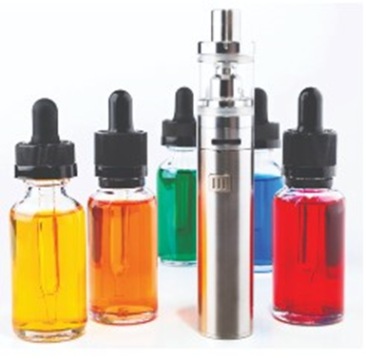
Anatomy of a Vape device
Refillable
Remove the tank or cartridge and manage as DW.
Remove the battery, if removable.
Manage as universal waste.
https://pinellas.gov/guide-to-electronic-nicotine-delivery-system-disposal/
Notes:
These are often a two or three component set-up and can be easily disassembled.

Slide 4
Anatomy of a Vape device
Refillable
Remove the tank or cartridge and manage as DW.
Remove the battery, if removable.
Manage as universal waste.
https://pinellas.gov/guide-to-electronic-nicotine-delivery-system-disposal/
Notes:
The top is a glass tank and a coil. All of this would designate as nicotine dangerous waste.
The bottom in the red oval is the battery compartment. The entire housing can be sent out as a universal waste battery.
Or you can remove the battery from the housing, if there is a battery compartment, and dispose it as UW.

Slide 5
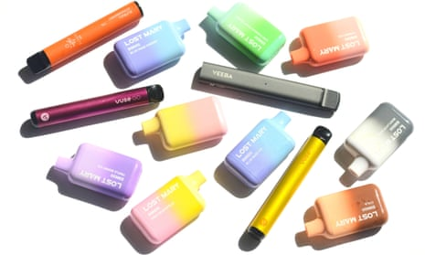
Anatomy of a Vape device
Disposable devices
Device – A housing that contains a lithium-ion battery and nicotine e-liquid as one unit.
Photo Credit: https://i.guim.co.uk/img/media/6e4a38025a7cca7f7c8b1e9b57bcc810b5545d0c/0_200_5200_3120/master/5200.jpg?width=465&dpr=1&s=none
Notes:
Disposable units are typically one piece and cannot easily be disassembled.

Slide 6
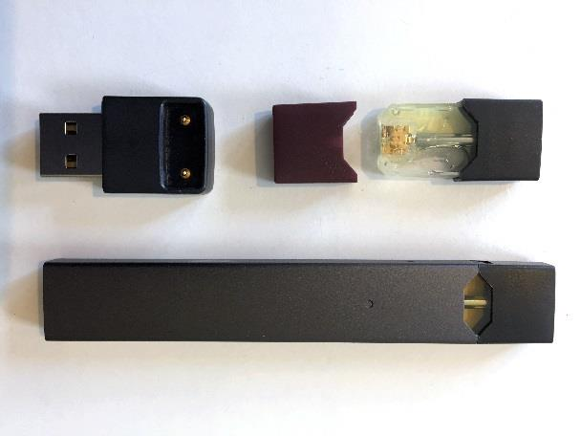
Reusable Vapes
Photo Credit: https://www.massgeneral.org/assets/MGH/images/children/juul-vape-pen.jpg
Notes:
Juul was the most popular vape product with youth in the 2020 survey. But these have fallen out of favor in recent years.
These are easy to hide at school and home since they look like USB drives and fit in a pocket. The Juul vapes have a nicotine cartridge that can be removed from the battery and electronics.
*************************
Juul photo credit: https://www.massgeneral.org/assets/MGH/images/children/juul-vape-pen.jpg

Slide 7
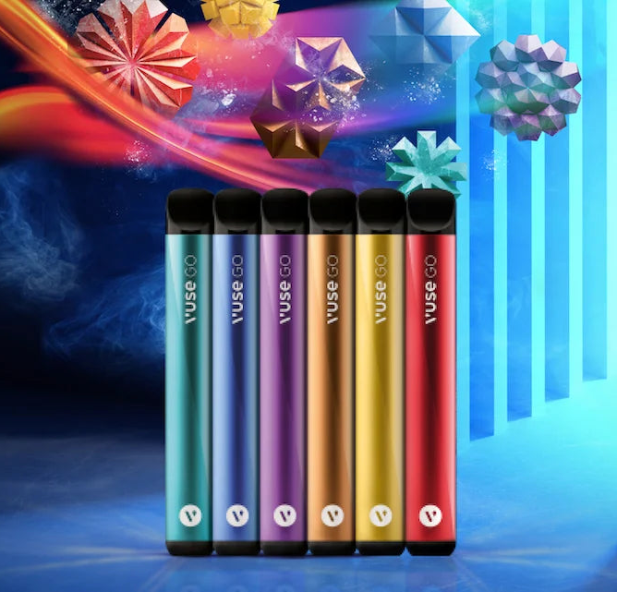
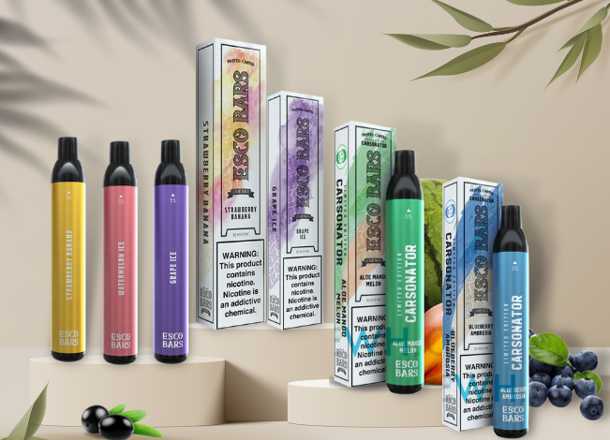
Popular Disposable Vapes
Photo Credit: https://escobarsdirect.com/esco-bar-flavors/
Photo Credit: https://vuse.co.nz/cdn/shop/articles/Introducing_Vuse_Go_Disposable_Vape_Pens_-_Header_Image_900x.webp?v=1686236131
Notes:
Now these larger and brighter and more colorful vape products are most popular with youth.
Here we have Esco Bars on the left and Vuse on the right
*************************
Esco Bars Photo Credit: https://escobarsdirect.com/esco-bar-flavors/
VUSE photo credit: https://vuse.co.nz/cdn/shop/articles/Introducing_Vuse_Go_Disposable_Vape_Pens_-_Header_Image_900x.webp?v=1686236131

Slide 8
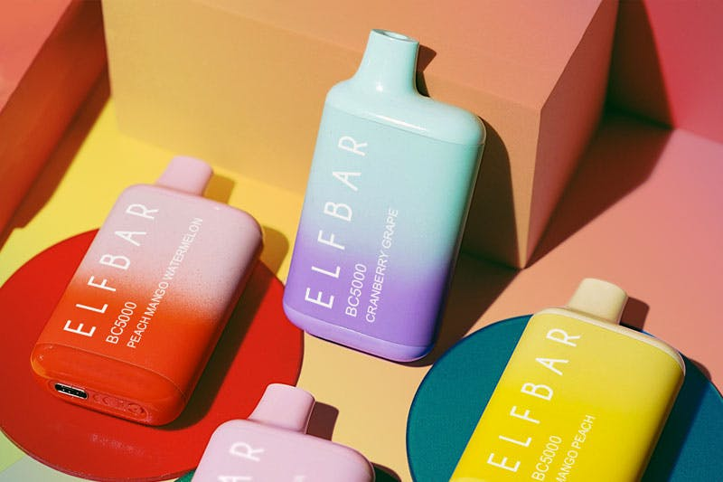
Popular Disposable Vapes
https://a1.vaping360.com/wp-content/uploads/2022/10/elf-bar-3_review-image-template_800x533.jpg?auto=compress,format
Notes:
The most popular disposable vape products with youth in late 2022 was the Elf Bar.
These disposables are larger, more colorful, and come in many different flavors like “peach mango watermelon” or “cranberry grape” or “Mango peach” as pictured here. Now celebrities are seen with a vape product that matches their outfit.
They are no longer trying to hide their vapes, they are flaunting them.
FDA blocked the import of the Elf Bars in summer of 2023 since they appear aimed at a youth population due to the colors and flavors. But Elf Bar has bypassed this ban by changing their name first to EB Design and now to EB Create.
*************************
Elf Bar photo credit: https://a1.vaping360.com/wp-content/uploads/2022/10/elf-bar-3_review-image-template_800x533.jpg?auto=compress,format

Slide 9
Popular Disposable Vapes
Photo Credit: https://www.ebcreate.com/product/EBCREATE-BC5000-Disposable-Pod-Device.html
Notes:
Here you can see that the vapes look exactly the same, just a new name.
These flavors are “lemon mint,” “strawberry mango,” “tropical rinbo” and “cranberry grape”
*************************
EBCreate photo credit: https://www.ebcreate.com/product/EBCREATE-BC5000-Disposable-Pod-Device.html

Slide 10
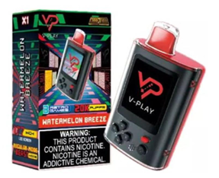
Popular Disposable Vapes
Notes:
These vapes are now “gamified”…
…More puffs you take the higher level you achieve.

Slide 11
Vape Information
January 2020
15.5 million e-cigarettes sold
24.7% are disposable → 3.8 million units/month
Annual estimate: over 186 million units sold in retail stores*
September 2023
22.9 million e-cigarettes sold
57.2% are disposable → 13.1 million units/month
Annual estimate: over 309 million vape units sold in retail stores.*
*Online and tobacco specialty stores not included.
https://www.cdc.gov/media/releases/2023/p0622-ecigarettes-sales.html#:~:text=A%20study%20released%20today%20found,from%20184%20to%20269%20brands
Source PSI Webinar: Addressing Vape Product Waste: Management Challenges and Policy Solutions, October 2024
Notes:
Now we are going to shift gears completely and just talk about Vapes. We will come back to the waste management later.
Eric mentioned how this is a nationwide problem. We do not have good solutions or pathways in place to manage these as wastes. To illustrate how big of a problem this is, I extrapolated some sales numbers from a CDC report.
Back in 2020, there were 15.5 million e-cigarettes sold in the month of January.
This extrapolates to 186 million e-cigarettes sold in the year
In 2020,the disposable vapes were only a quarter of those sales so 46 million for the year.
Data Source:
https://www.cdc.gov/media/releases/2023/p0622-ecigarettes-sales.html#:~:text=A%20study%20released%20today%20found,from%20184%20to%20269%20brands

Slide 12
Dangerous Waste Management Overview (Vape specific)

Slide 13
Regulatory structure
DW Regulations – Chapter 173-303 WAC
New management standards for HW Pharmaceuticals
RCRA – Subpart P
WAC 173-303-555
Health care facilities are required to follow either Subpart P or WAC 173-303-555 (in WA), if applicable
Notes:
Vape wastes must be managed according to our Dangerous Waste Regulations (Chapter 173-303 Washington Administrative Code)
EPA classified vapes as pharmaceuticals so now the new management standards for hazardous waste pharmaceuticals must be followed as well.
Subpart P is the federal Management Standards for HW Pharmaceuticals
WA’s DW Regulations adopted in Subpart P as WAC 173-303-555, or -555 as we call it, in 2020.
Health Care Facilities are required to follow -555 in WA.

Slide 14
How the regulations apply to waste
Residential
Household Hazardous Waste
Moderate Risk Waste Facility
* If the MRW can accept the waste
Waste Identified
Solid Waste
(not DW)
Permitted
Treatment,
Storage, &
Disposal Facility
SQG
Business/ Organization
Waste Designation
Notifying HCF
MQGs
LQGs
Notes:
(Walk through this)
Keep this diagram in mind as we talk about generator category and Health Care facilities. This is the general pathway for waste, but it gets complicated with pharmaceuticals and, in particular, vapes.

Slide 15
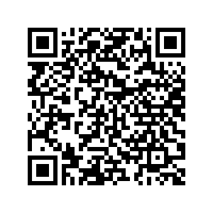
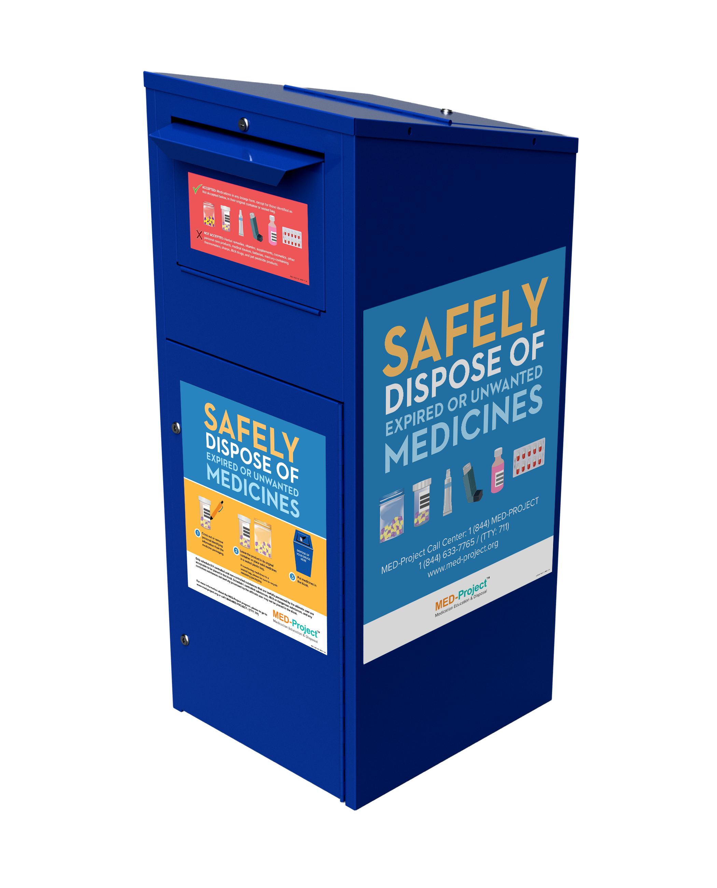
Household Hazardous Waste
Exempted from the DW Regulations
Safe Medication Return Kiosks and Mail-back
No batteries allowed
Includes disposable vapes
No illicit drugs allowed
Includes cannabis vapes and products
https://medtakebackwashington.org/
Notes:
HHW is exempted from DW regs
Usually, the HHW can go through your MRW facilities as authorized through your permitting
HHW Pharmaceuticals kiosks can accept residential HW medications. There also exists a mail-back option. accept waste batteries cannot go to these kiosks.
Since disposable vapes are not allowed in the medicine tack back programs, this leaves MRWs as safest option for management of these disposable vape devices.
We do not want to see these going into the regular solid waste or sewer system.

Slide 16
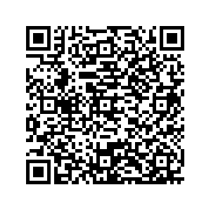
Universal Waste – Vapes
Specific wastes with recycling requirements
Batteries
Alkaline
Lithium-ion
Nickel metal hydride
Cannot be mixed with other Dangerous Waste
Notes:
Going to fly through some of the regulations as they apply to vapes…
We have three types of universal waste streams in WA’s regulations.
Batteries,
Lamps which includes fluorescent tubes and CFLs,
And Mercury-containing equipment, like thermometers and thermostats.
Disposable vapes have a rechargeable lithium-ion battery inside.
If the vape liquid can be separated from the battery, the battery and electronics can be managed as Universal Waste and the vape liquid managed as DW
If the battery cannot be removed, it cannot be managed as universal waste

Slide 17
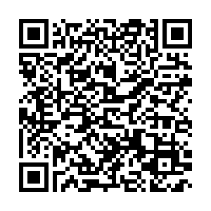
Dangerous Waste Designation – Vapes
Listed Waste – P-listed & U-listed
> 2.2 lbs of P-listed waste in one month makes a facility an LQG.
Nicotine is P075.
Characteristic Waste – D001 through D043 waste codes
Not commonly seen in vape liquids.
Lithium batteries could cause device to be D001 and D003
State Criteria Waste – WT0x, WP0x, and WSC2codes
Cannabis >10% THC can be WT02.
QR code to Designation Webpage:

Slide 18
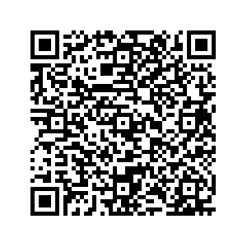
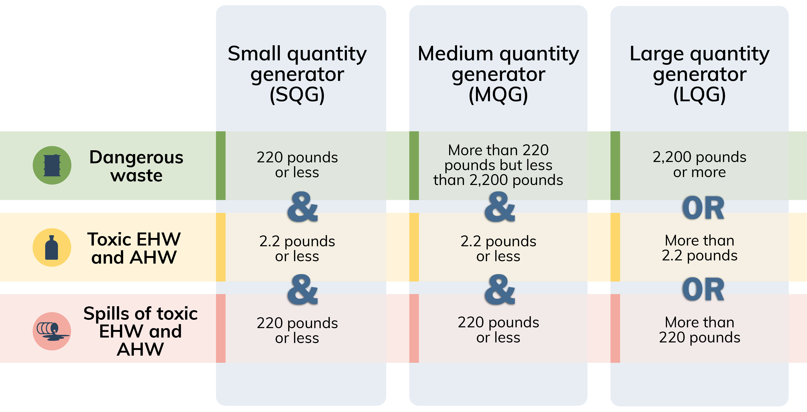
Generator Categories
Notes:
Generator Category – small, medium, and large (SQG, MQG, LQG)
Management requirements increase with monthly generation
SQG = Up to 220 lbs DW or up to 2.2 lbs of acute HW
Equivalent to federal vSQG
MQG = more than 220 lbs and less than 2200 lbs DW or up to 2.2 lbs of acute HW.
Equivalent to federal SQG
LQG = more than 2200 lbs DW or more than 2.2 lbs acute HW.

Slide 19
Generator Categories
Notes:
SQG = Up to 220 lbs DW or up to 2.2 lbs of acute HW
Equivalent to federal vSQG
SQGs have the least amount of management and disposal regulations to meet. They also have transportation and disposal options. So remaining an SQG is important to many facilities.
Some of the disposal options include consolidation at an LQG under the same ownership.
BUT an SQG can over-accumulate dangerous waste and become an LQG.
If an SQG generates 200 lbs of DW monthly and keeps it on-site for 11 months they would become an LQG through over accumulation.
Over-accumulation also applies to acute hazardous waste with a QEL of 2.2 pounds. IF an SQG accumulates half a pound of AHW monthly they would be an LQG for over-accumulation in FIVE months.

Slide 20
Pharmaceutical Waste Management
Notes:
You might be wondering why I’m talking about waste pharmaceuticals. Vape waste is considered a pharmaceutical under dangerous waste regulations.
And Health Care Facilities must determine if these new management requirements apply to them or now.

Slide 21
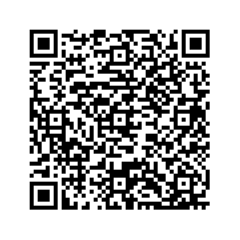
Dangerous Waste Pharmaceuticals
Health care facility is any person that is lawfully authorized to:
Provide preventative palliative care, and counseling with respect to the physical or mental condition, or functional status, of a human or animal.
Distribute, sell, or dispense pharmaceuticals
Schools that administer medications to students are health care facilities.
→ Most leftover medications are business generated dangerous waste pharmaceuticals.
Notes:
EPA came out with Subpart P in 2019. Basically they carved out RCRA to place some specific requirements around pharmaceuticals. Ecology adopted the new rules in section -555 of the DW regulations in late 2020.
Follow the QR code in the top right of the slides to go to our webpage that has more information, links to guidance, and links to more in-depth training videos we provided in early 2021.
For now, we will try to provide an overview of how -555 differs from the rest of the DW regulations.
EPA defined a health care facility under Subpart P. and to paraphrase, a HCF is any facility that provides care to a human or animal. or a facility that distributes/sells/dispenses pharmaceuticals.
This obviously covers hospitals and clinics, and retail pharmacies, but also includes grocery stores, and gas station convenience marts.
…And schools that help administer a student’s medications during the day. That’s right, a school can be considered a HCF and subject to -555
Now those leftover medications that the parents forget to pick-up…are considered business generated wastes.
And those vape pens you are so diligently confiscating from students or find in the playground or parking lot…are considered business generated dangerous waste pharmaceuticals.

Slide 22
Dangerous Waste Pharmaceuticals
When counting ALL dangerous waste every month, health care facilities are “True SQGs” if they generate:
≤ 2.2 lbs of AHW or WT01 EHW, and
≤ 220 lbs of all other dangerous waste
≤ 220 lbs of spill cleanup of AHW or WT02 EHW
“True SQGs” and have 2 management options
Not required to use the Special Requirements for Management of DW Pharmaceuticals (WAC 173-303-555)
Notes:
-555 has specific applicability requirements. A health care facility must count all their dangerous waste. This includes both their dangerous waste pharmaceuticals and non pharmaceutical dangerous wastes.
Now counting ALL of their dangerous waste, if a health care facility generates less than or equal to amounts listed here in a calendar month, they are eligible for the management options.
Any HCF that exceeds any of the thresholds are required to manage DW pharmaceuticals under -555.

Slide 23
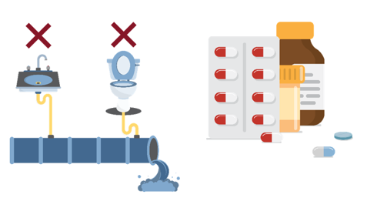
Required for All Health Care Facilities
All health care facilities must follow:
Sewer prohibition in -555(6)
Residues of dangerous waste pharmaceuticals in empty containers found in -555(8)
Notes:
All health care facilities that generate dangerous waste pharmaceuticals MUST adhere to the following subsections of -555, regardless of generation amounts:
The sewer prohibition in -555(6).
There is no disposal of dangerous waste pharmaceuticals to the sewer. This sewer prohibition includes state-only dangerous waste pharmaceuticals.
HCFs must also follow -555(8) regarding the residues of dangerous waste pharmaceuticals in empty containers found in -555(8).

Slide 24
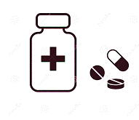
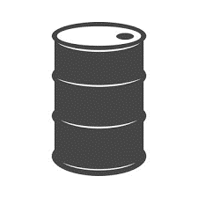
Management Options for “True SQGs”
Option 1
Manage all dangerous waste pharmaceuticals under -555
Manage nonpharmaceutical dangerous wastes under SQG requirements
WAC 173-303-170(2)(a)(i)
WAC 173-303-171
Option 2
Manage all dangerous waste under SQG requirements
WAC 173-303-170(2)(a)(i)
WAC 173-303-171
Under this option they can still use:
-555(5) for SQG health care facilities
-555(7) for conditional exemption for controlled substances.
Notes:
“True SQG” is not a term you will see in the regulations, but we have started using it to differentiate HCFs that are truly SQG after counting all their DW, including pharmaceuticals, vs those HCFs that are SQG because they are using -555 to manage their DW pharmaceuticals.
These health care facilities have two main options.
They can choose to manage their dangerous waste pharmaceuticals under -555 (option 1).
Or
They can choose to manage them under the SQG dangerous waste regulations (option 2).
Depending on the management option they choose, how they determine their generator category can be different.
“True SQGs” that choose to manage under -555 (option 1):
- do not count their dangerous waste pharmaceuticals towards their generator category. Since they were already below the SQG thresholds, this will not change, but for some hospitals and clinics, this may change the generator category for the facility.
- must follow all the management requirements outlines in -555 for DW pharmaceuticals
If they choose to manage under the SQG DW regulations (option 2)”
- they must count all their dangerous waste to determine their generator category. This includes both dangerous waste pharmaceuticals and nonpharmaceutical dangerous waste.

Slide 25
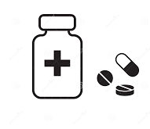
Option 1 Manage under Special Requirements WAC 173-303-555
Generator category: Only count nonpharmaceutical dangerous waste.
___________
DW Pharmaceutical Management:
1 year accumulation
Ship on Manifest to TSD
Notify Ecology
Can consolidate DW pharmaceuticals from affiliated HCFs under Option 2
Notes:
Under Option 1, HCFs must follow all the requirements in -555 including:
Notification
Manifest offsite to a permitted TSD
Use a HW Transporter
1 year accumulation – there is no Satellite Accumulation.
Why would a “True SQG” select Option 1?
the “True SQG” facilities do not need to count their dangerous waste pharmaceuticals when determining their generator category.
If they are close to the thresholds we discussed earlier then opting in can be easier than changing onsite management requirements
a HCW under -555 can consolidate DW Pharmaceuticals from affiliated “true SQGs” under Option 2

Slide 26
Option 1 Manage under Special Requirements WAC 173-303-555
Generator category: Only count nonpharmaceutical dangerous waste.
___________
DW Pharmaceutical Management:
Must be shipped using:
Licensed HW Transporter
Uniform Hazardous Waste Manifest
Onsite Accumulation ≤ 1 year
Container labeling
Notify Ecology
Recordkeeping
Keep manifests and profiles for 5 years
Can consolidate DW pharmaceuticals from affiliated HCFs
Notes:
These are just a few of the specific management requirements under -555.
Under Option 1, HCFs must follow all the requirements in -555 including:
Sen DW pharmaceuticals to a Permitted TSDF
Shipped on a Uniform Hazardous Waste Manifest
Using a licensed HW Transporter
Accumulate up to a year (No Satellite Accumulation)
You must Notify Ecology that you are a HCF using -555
And all profiles and manifests and other shipping papers must be kept available onsite for 5 year.
Be sure to reference the regulations (section -555), our Pharmaceutical webpage and guidance for more details.
Why would a “True SQG” select Option 1?
the “True SQG” facilities do not need to count their dangerous waste pharmaceuticals when determining their generator category.
If they are close to the thresholds we discussed earlier then opting in can be easier than changing onsite management requirements
a HCW under -555 can consolidate DW Pharmaceuticals from affiliated “true SQGs” under Option 2

Slide 27
Option 2 Manage under SQG Requirements WAC 173-303-170(2)(a)(i) WAC 173-303-171
Generator category: count all dangerous waste, including pharmaceuticals.
___________
Manage DW Pharmaceuticals as DW
No time limit
Stay under total accumulation amount limit
Manage DW Pharmaceuticals offsite at:
MRW Facility
Affiliated LQG
Affiliated HCF under -555/ Subpart P
+
Notes:
Under Option 2, the DW management may be simplified because all DW follow the same management requirements
However, they must count all their dangerous waste each month to confirm that they still have this option. If they exceed the thresholds, the facility must start managing DW pharmaceuticals under -555.
The “True SQG” under Option 2 can take advantage of the SQG waste management requirements including:
No accumulation time limit
While there is not clock on getting the waste offsite, the SQG must stay below a total accumulation limit.
If they exceed onsite accumulation limits, they must follow LQG requirements until the waste is off-site
Can consolidate their DW Pharmaceuticals at either:
An affiliated HCF managing under -555 (or Subpart P or equivalent if out of state)
An affiliated facility under WAC 173-303-
May be able to send waste to an MRW - but I do not believe any will accept business generated DW pharmaceuticals
Under Option 2, the “True SQG” follows the SQG requirements
Again no accumulation time limit, but there is a total accumulation amount limit you will want to stay under or start following LQG management requirements
On paper, the “True SQGs” under Option 2 have a few more management options for their DW pharmaceuticals, but in reality it is pretty limited. Mostly limited to sending a permitted facility or consolidating at an affiliated facility

Slide 28
SQG Waste Management Options
Moderate Risk Waste (MRW) Facilities
Only 40% of counties accept SQG business DW
Most do not accept business generated pharmaceutical waste or vape waste
Permitted TSDF
Use a licensed HW Vendor
HCFs under -555 must use a HW Vendor and ship on a manifest
May send to a destination facility on a shipping paper
Only for “True SQGs” managing under Option 2
Consolidation at affiliated facility
Notes:
I was told that only 40% of MRWs accept business waste
Even if the MRW will accept SQG dangerous waste, most will not accept vape waste or pharmaceuticals
Sending DW to a permitted TSDF is expensive. Even if you do not need to ship the waste on a Manifest.

Slide 29
SQG Waste Management Consolidation
Consolidate at affiliated LQG
Same company/owner
WAC 173-303-171(1)(e)(ix) and WAC 173-303-200(15)
Consolidate at affiliated HCF under Special Requirements (-555) or EPA Subpart P
Same company/owner or have contractual relationship to provide pharmaceuticals
WAC 173-303-555(5)(b)
Notes:
2 options that are viable and potentially cost-effective are the consolidation options.
SQGs have the option to consolidate at an LQG that is part of the same company.
This consolidation option is available to all their DW, not just the pharmaceuticals
So for example, if the school district has a facilities/maintenance location that is a Large Quantity Generator (based on monthly waste generation), all the other “true SQGs” in the district could send all their DW to the LQG location for management. The LQG must follow the requirements under section -200.
“True SQGs” under Option 2 also have the ability to consolidate DW pharmaceuticals at an affiliated HCF that is managing under -555 (or if that facility is outside of WA, managing under Subpart P or the other state’s equivalent regulations).
This consolidation is open to facilities that are part of the same company or have a contractual relationship to provide pharmaceuticals (for example a LTC facility could consolidate their pharmaceutical waste at a pharmacy that provides their resident’s medications.
This consolidation option is only available to DW pharmaceuticals.
So in this example - if a school district wanted to have 1 school manage DW Pharmaceuticals under the Special Requirements of -555. all the other “True SQG” schools in that district could consolidate their DW pharmaceuticals at that school. This way the School district only has to incur 1 HW pick-up and shipment fee.

Slide 30
Summary of the Challenges
Many marketed as “disposable”
P-listed & characteristic hazardous wastes cannot be separated
Notes:
In summary of the challenges of vape wastes.
Disposable is more like simply one-time-use.
Most people think they can just throw in regular trash
The hazardous waste codes associated with the combination of waste nicotine (P075) and the batteries (D001 and D003) makes these devices difficult to dispose of.
What counts towards the 2.2 lb threshold?
What counts towards the 220 lb threshold?
EPA guidance

Slide 31
Summary of the Challenges
Many marketed as “disposable”
P-listed & characteristic hazardous wastes cannot be separated
Increased generator category
MRW acceptance policies
Notes:
The weight of P-listed waste can easily throw a small quantity generator straight into LQG status
And SQG facilities that can normally manage DW at MRW facilities are hampered by limited acceptance of this waste stream.

Slide 32
Summary of the Challenges
Many marketed as “disposable”
P-listed & characteristic hazardous wastes cannot be separated
Increased generator category
MRW acceptance policies
Increased disposal costs
Confusion with regulatory requirements
Notes:
Disposable vape waste management is expensive due to the combination of hazards.
Many small facilities, like our schools, do not have the money to dispose of this growing waste stream. Especially if they need to have a waste vendor ship small quantities directly several times a year.
Pharmaceutical waste management regulations are confusing and the smaller facilities are limited by staff not familiar in managing dangerous wastes.

Slide 33
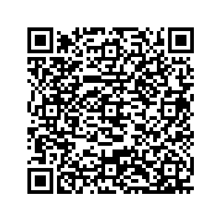
Proper Vape Waste Management
Business Generated (e.g. schools, youth organizations, clinics)
If the battery can be removed:
Manage batteries as universal waste
BMP: Tape terminal ends or segregate into separate containers
Manage vape cartridge as dangerous waste (or DW Pharmaceutical)
Residue remaining in cartridge is still a P075 (nicotine) listed AHW
If the battery cannot be removed:
Manage entire vape device as dangerous waste
Universal waste is not an option due to nicotine dangerous waste
Notes:
If the battery cannot be removed, the entire vape pen is considered a DW and likely have the waste codes P075, D001 (ignitable) and D003 (reactive)
EPA has provided verbal guidance that would allow the nicotine liquid to be counted towards the 2.2 QEL and the remainder of the batter and device weight to be counted towards the 220 lb QEL
Schools and other HCFs do not need to count the DW vapes if they are managing pharmaceuticals under -555
“True SQG” HCFs managing under Option 2 must count the weight of the entire vape pen towards their generator category.
Youth organizations are not HCFs unless they are administering medications.
-555 is not an option for facilities that are not considered a HCF.

Slide 34
Vape Waste Best Management Practices
Do not crush or crack the vape devices
If vape device is leaking nicotine, place in a plastic bag before placing in accumulation container
If the vape battery case is crushed, cracked, or bulging, consider storing separately in sand or other inert media to prevent fire
Send to a disposal facility sooner rather than later
Recycle the nicotine
If nicotine is recycled into new nicotine products, this is legitimate recycling and not a P075 acute hazardous waste
Easiest with cartridges that can be separated from the battery/electronics
Notes:
Cannabis vapes will be a challenge
Known Cannabis vapes may be WT02
If not known, our recommendation has been assume they are nicotine (only) since the 2.2 lb QEL puts into a higher level of DW management
If known to be cannabis, the accumulation, transportation, and disposal are tricky since it is still a Schedule 1 narcotic per DEA.
We do not recommend using tests to determine if an unknown vape is cannabis or not. Kind of a don’t ask, don’t tell.
These test kits will also generate a DW for solvent wastes.

Slide 35
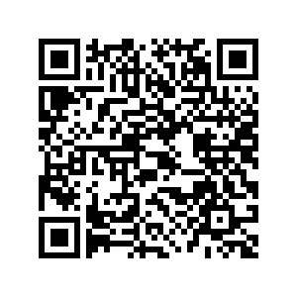
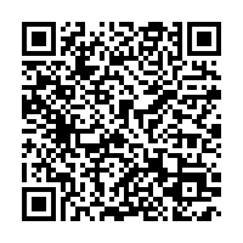
Questions? Jenny Yoo jenny.yoo@ecy.wa.gov Eric McConnell eric.mcconnell@ecy.wa.gov
QR codes for more information
Waste Designation Webpage
DW Guidance Webpage
Guide to Universal Waste
Shoptalk Newsletter
Pharma Webpage
Notes:
Now that I’ve sent your heads all spinning, This is good place for questions
We included QR codes for immediate access to Ecology’s guidance on key information.

Slide 36
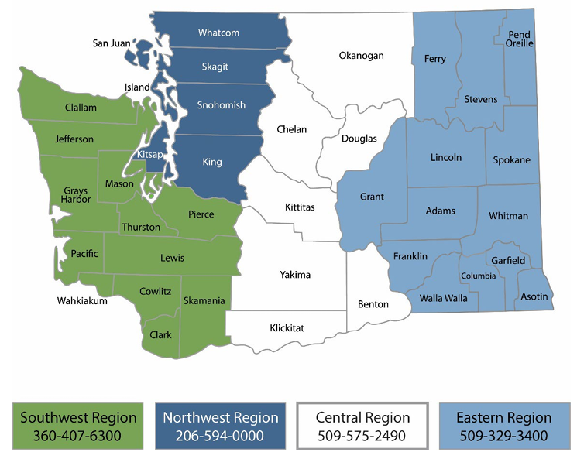
Questions?
Notes:
I will leave you with this map of our regional office numbers.

Slide 37
What would influence your generator category?
You consistently generate 0.3 lbs of P-listed pharmaceuticals each month.
Option 1 – Using the Special Requirements:
No change to generator category – Remain SQG
DW pharmaceuticals do not count towards monthly generator category
Option 2 – Managing as an SQG:
No change to generator category – Remain SQG
Monthly generation is below the SQG thresholds
School will exceed the 2.2 lbs total accumulation limit for AHW/EHW in 7 months.
Accumulated waste is subject to LQG management requirements
Notes:
Now we are going to look at a couple of scenarios to see how the school’s status might change. We are going to assume that the previous monthly generation numbers stay consistent from month to month. I know these may be unrealistic, but it helps us illustrate some of the regulatory bounds over the next few slides. There is a lot of information to take in but we can walk through them together.
Would their options change if the school consistently generates 0.3 lbs of P-listed vape waste each month?
Under Option 1 – there is no change to generator category
the DW Pharmaceuticals managed under the Special Requirements are not counted towards generator category
And under -555 there is a 1 year accumulation time limit, but no accumulation amount limit for DW Pharmaceuticals.
Under Option 2 – there is no change to the generator category but there is a potential change to the management requirements
The generator category is based on monthly generation so if the waste volumes stay the same at 0.3 lb/month, the school will not change generator category.
But SQGs have a total onsite accumulation amount limit. If they exceed 2.2 lbs of AHW stored or accumulated onsite, they now must manage all their DW under the LQG requirements until that waste is off-site.
At a consistent generation rate of 0.3 lbs/month, the school will exceed 2.2 lbs before the end of the school year.

Slide 38
What would influence your generator category?
School generates an additional 2 lbs of vape pens in one month
Option 1 – Using the Special Requirements:
Generator category changes – Remain an SQG
DW: 10 lbs + 5 lbs + 200 lbs = 215 lbs
AHW/EHW: 0.3 lbs + 2 lbs = 2.3 lbs (all pharmaceuticals)
Option 2 – Managing as an SQG:
Generator category changes – Become an LQG
DW: 10 lbs + 5 lbs + 0.2 lbs + 200 lbs = 215.2 lbs
AHW/EHW: 0.3 lbs + 2 lbs = 2.3 lbs
School now required to use the Special Requirements (WAC 173-303-555) to manage DW Pharmaceuticals
Actual generator category remains SQG since -555 does not count pharmaceuticals
Notes:
Now let’s explore what happens if the school has a one-time spike of P-listed waste and they generate an additional 2 lbs of vape pens this month.
Under Option 1:
All the AHW is epinephrine and nicotine. And under -555 the DW pharmaceuticals are not counted towards the generator category so the school remains an SQG
Under Option 2:
The extra 2 lbs of Vape pens in addition to the regular monthly generation of 0.3 lbs pushes the school over the 2.2 QEL limit for AHW.
The school is now a Large Quantity Generator and required to use -555
Once -555 is applied though the actual generator category would still remain a SQG since, you’ve got it, the DW pharmaceuticals do not count towards generator category.
Ok I hope you are still with me – a couple of more examples.

Slide 39
What would influence your generator category?
Chemical spill that generates 200 lbs of dangerous waste
Option 1 – Using the Special Requirements:
No change to generator category – Remain SQG
DW: 10 lbs + 5 lbs + 200 lbs = 215 lbs
AHW/EHW: 0.3 lbs
Option 2 – Managing as an SQG:
No change to generator category – Remain SQG
DW: 10 lbs + 5 lbs + 0.2 lbs + 200 lbs = 215.2 lbs
AHW/EHW: 0.3 lbs
Notes:
Now let’s explore what happens if the school has a one-time chemical spill in their science labs. The spilled material and all the cleanup media generates 200 lbs of dangerous waste. The spilled material was not a P-listed compound.
Under Option 1 – there is no change to generator category:
The spilled media is a DW so is added to the usual 10 lbs of chemical waste and 5 lbs or hand sanitizer and wipes. This totals 215 lbs which is below the 220 lbs QEL for DW
Again the pharmaceuticals are not counted towards the generator category under -555 so the school remains an SQG
Under Option 2 – there is also no change to generator category:
The spilled media is a DW so is added to the usual 10 lbs of chemical waste,5 lbs or hand sanitizer and wipes, and the 0.2 lbs or DW pills. This totals 215.2 lbs which is still below the 220 lbs QEL for DW
All the AHW combined is 0.3 lbs and well below the 2.2 lb QEL

Slide 40
What would influence your generator category?
5 lbs of DW abandoned on campus and a chemical spill that generates 200 lbs of dangerous waste and spill cleanup media
Option 1 – Using the Special Requirements:
No change to generator category – Remain SQG
DW: 10 lbs + 5 lbs + 5 lbs + 200 lbs = 220 lbs
AHW/EHW: 0.3 lb = 0.3 lbs
Option 2 – Managing as an SQG:
Generator category changes – Become an MQG
DW: 10 lbs + 5 lbs + 0.2 lbs + 5 lbs + 200 lbs = 220.2 lbs
AHW/EHW: 0.3 lb = 0.3 lbs
School now required to use the Special Requirements (WAC 173-303-555) to manage DW Pharmaceuticals
Actual generator category remains SQG since -555 does not count pharmaceuticals
Notes:
OK – here’s our last example.
What happens to your school if you had a one-time chemical spill in the science labs and you found 5 lbs of DW on your campus.
Under Option 1 – there is no change to generator category:
The 200 lbs of spilled media and the 5 lbs of found waste is added to the usual 10 lbs of chemical waste and 5 lbs or hand sanitizer and wipes. This totals 220 lbs which equals the 220 lbs QEL for DW. SQG must generate 220 lbs or less.
Again the pharmaceuticals are managed under -555 so no count.
The school is still an SQG…but just barely.
Under Option 2 – there is a change to generator category:
The spilled media and found waste are added to the usual 10 lbs of chemical waste, 5 lbs of hand sanitizer and wipes, and the 0.2 lbs of DW pills. This totals 220.2 lbs which is above the 220 lbs QEL for DW
All the AHW combined is 0.3 lbs and well below the 2.2 lb QEL
The school would be a Medium Quantity Generator and required to use the Special Requirements for DW Pharmaceuticals
But once you remove the pharmaceuticals, the DW total is 220 lbs exactly again and the actual generator category is a SQG

Slide 41
What would influence your generator category?
End of school-year laboratory clean-out generates 300 lbs
Uses Episodic Waste:
No change to generator category – Remain SQG
Does not use Episodic Waste:
DW: 10 lbs + 5 lbs + 0.2 lbs + 300 lbs = 315.2 lbs
AHW/EHW: 0.3 lb = 0.3 lbs
Option 1: Generator category changes – Become an MQG
Option 2: Generator category changes – Become an MQG
School now required to use the Special Requirements (WAC 173-303-555) to manage DW Pharmaceuticals
Notes:
You consistently generate 0.3 lbs of P-listed pharmaceuticals each month.
You will exceed 2.2 lbs in 7 ½ months
Under Option 1 there is no impact to generator category As a SQG
Consider if you added one lb of disposable vape waste per month.
Addition of two lbs of disposable vape waste?
A closet clean out once a year?
1 kg = 2.2 lb
1 lb = 16 oz
0.5 lb = 8 oz
0.3 lb = 4.8 oz
0.1 lb = 1.6 oz

