Slide 1
Duwamish and green River Watershed Model Development & Calibration
February 19, 2020
Ecology NWRO
Bo Li, Washington State Department of Ecology
Yi Xiong, Washington State Department of Ecology
Jeff Burkey, King County, Water and Land Resources Division

Slide 2


Slide 3
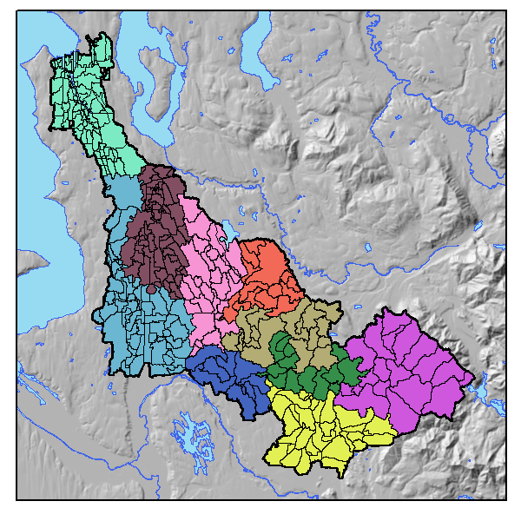
Model Domains
Segmented into 10 domains (was 4)
Duwamish
Lower Green
Black River
Covington
Jenkins
Soos
Newaukum
Middle Green 1
Middle Green 2
Middle Green 3

Slide 4
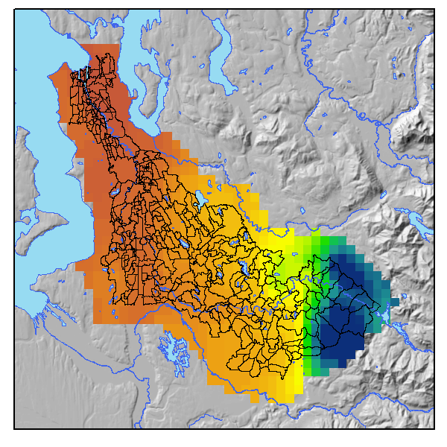
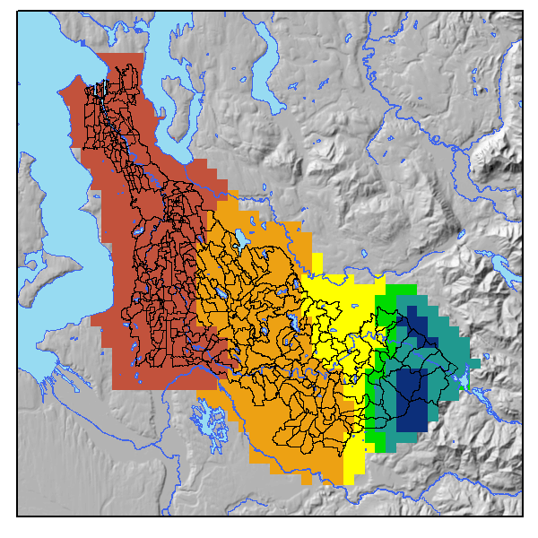
rainfall
Modeled Resolution
Up to 30 zones
Up to 3 Zones per domain
Full Resolution
> 80 zones

Slide 5
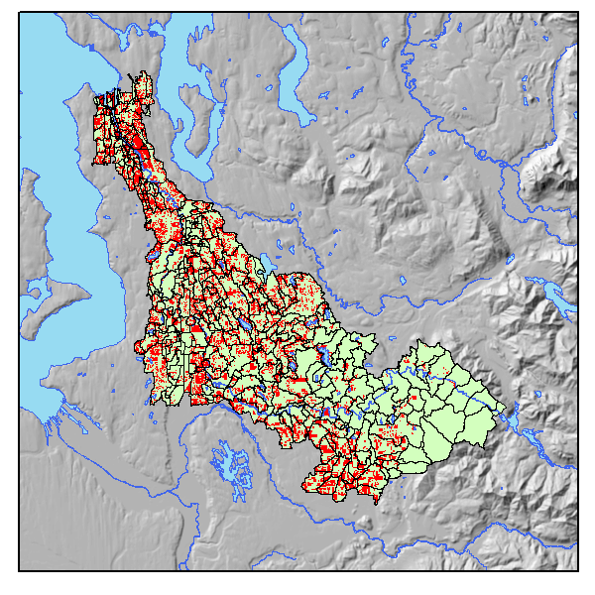
Age of Structure
Using King County Assessors database
Structures permitted:
Before 1980 (Red) will generate more PCB loads
After 1980 (Green) will generate less PCB loads

Slide 6
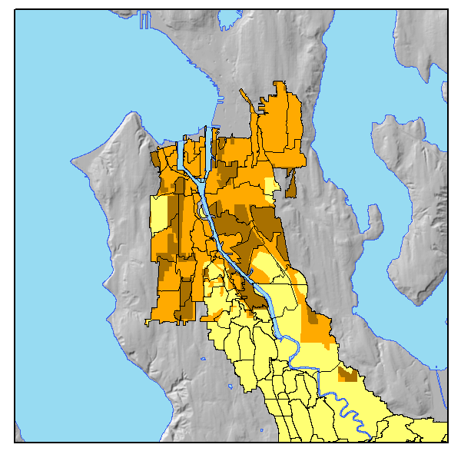
Sewer Basins
Variable by catchment
  Fully combined (Dark Brown)
  Partially combined (Orange)
  Fully separated (Yellow)
To Do:
  Converse with SPU and finalize segmentations/definitions

Slide 7
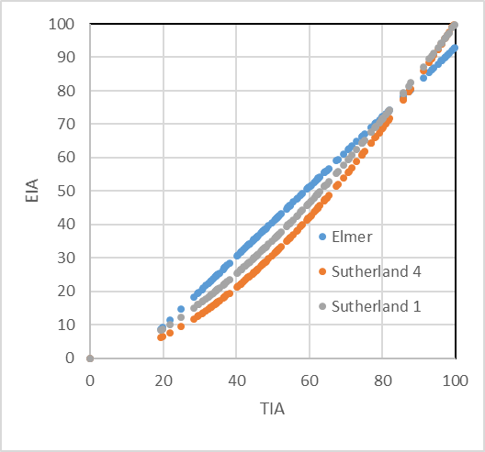
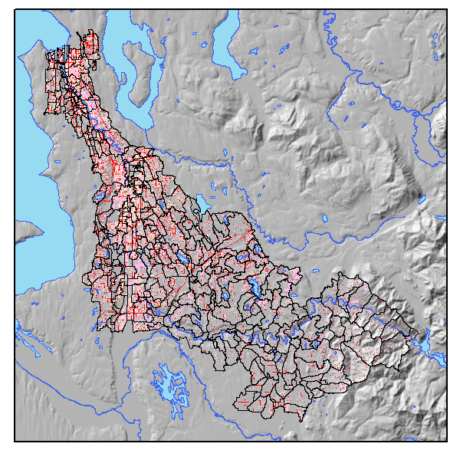
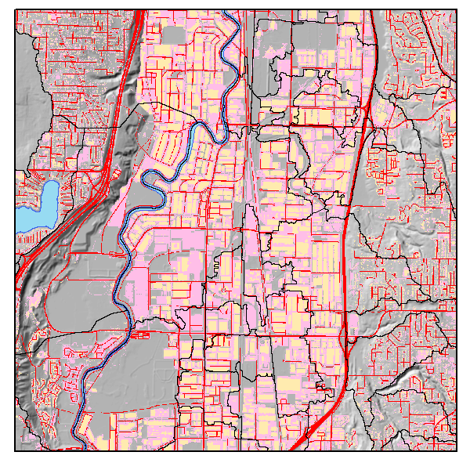
Impervious surface
Previous 3 Types
Roofs (orange)
Ground Level Developed
(Pink & Red)
Ground Level (other)
New 3 Types
Roads (red)
Roofs (orange)
Ground Level Developed (pink)

Slide 8
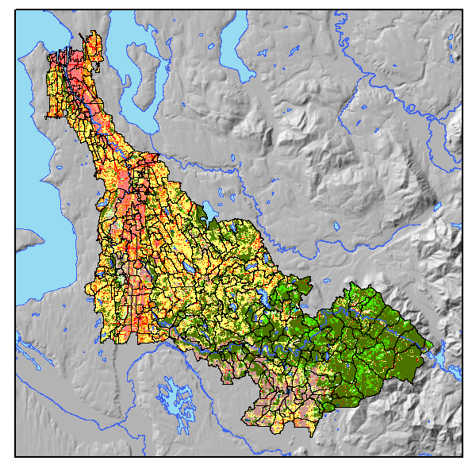
Land use / Land cover
11 Categories
Open water
Low Intensity Residential
High intensity residential
Commercial & Industrial
Barren
Scrub/shrub
Forest
Grasslands
Agriculture
Wetlands
Roads (added)

Slide 9
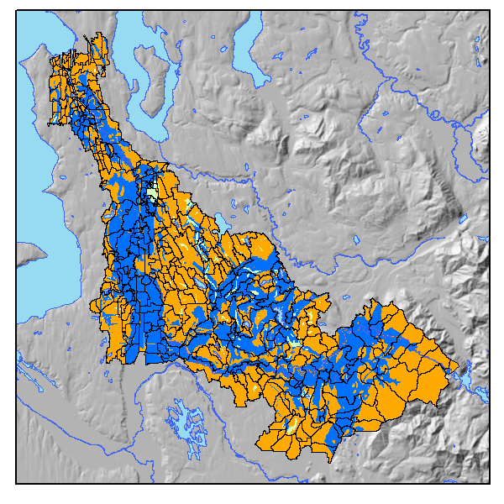
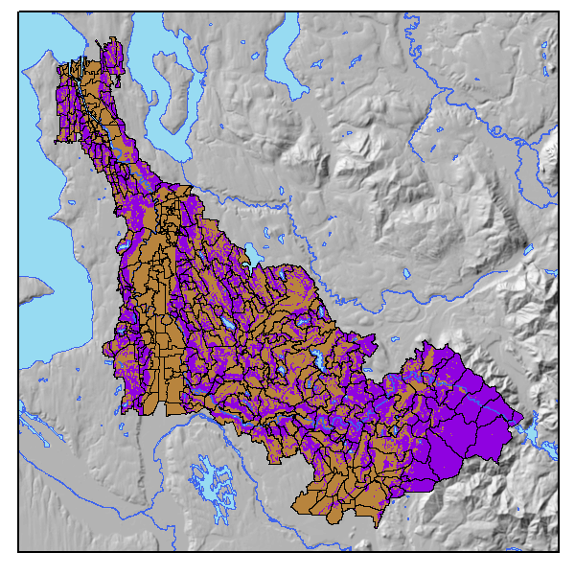
Soils and slope
(no changes)
3 soils types
Till, Outwash, Saturated
2 slopes
< 5% > 5%

Slide 10
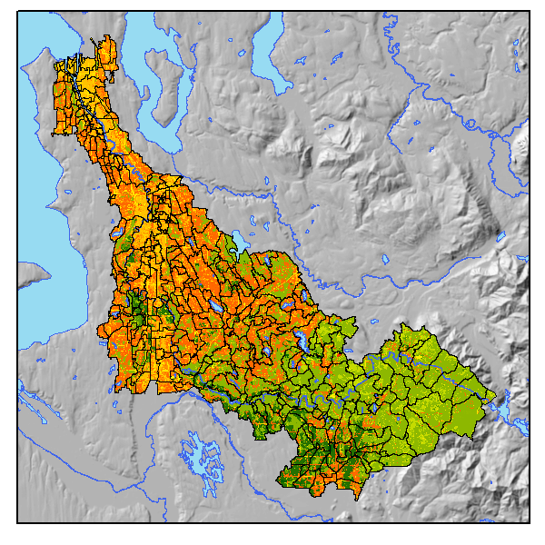
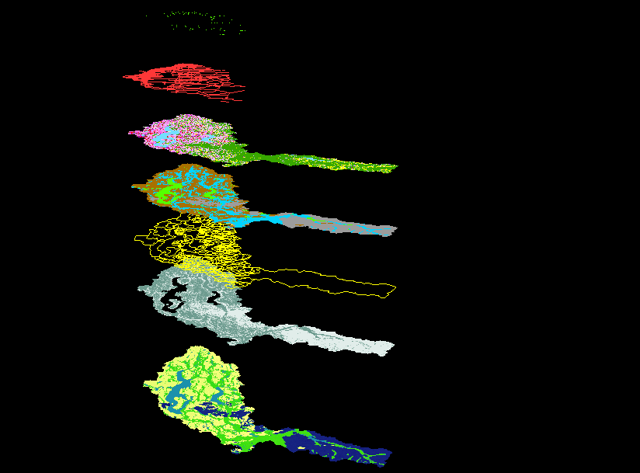
Hydrologic response units (HRU)
Merging (soils, sewer, age, land use, land cover, slope) generates 1728 unique combinations per rainfall zone
Simplified (☺) into 293 HRUs per rainfall zone
Previously ~ 1000 HRUS (for all zones)

Slide 11
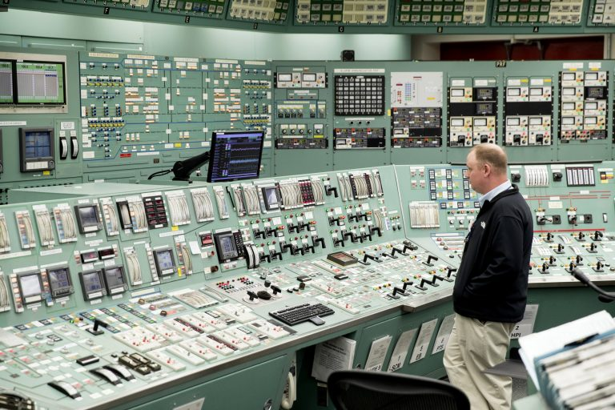
Calibration processes

Slide 12
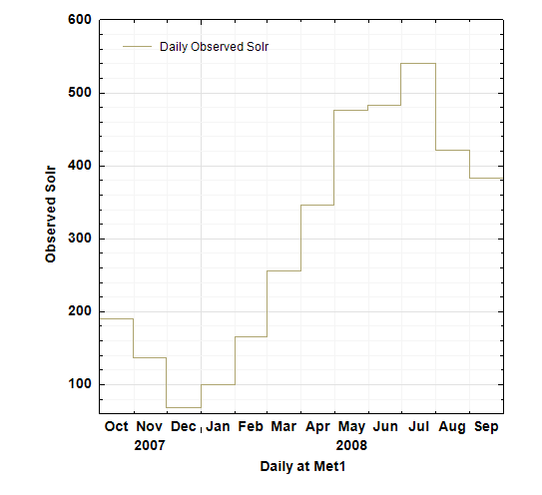
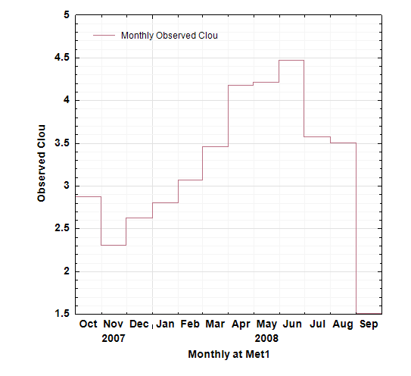
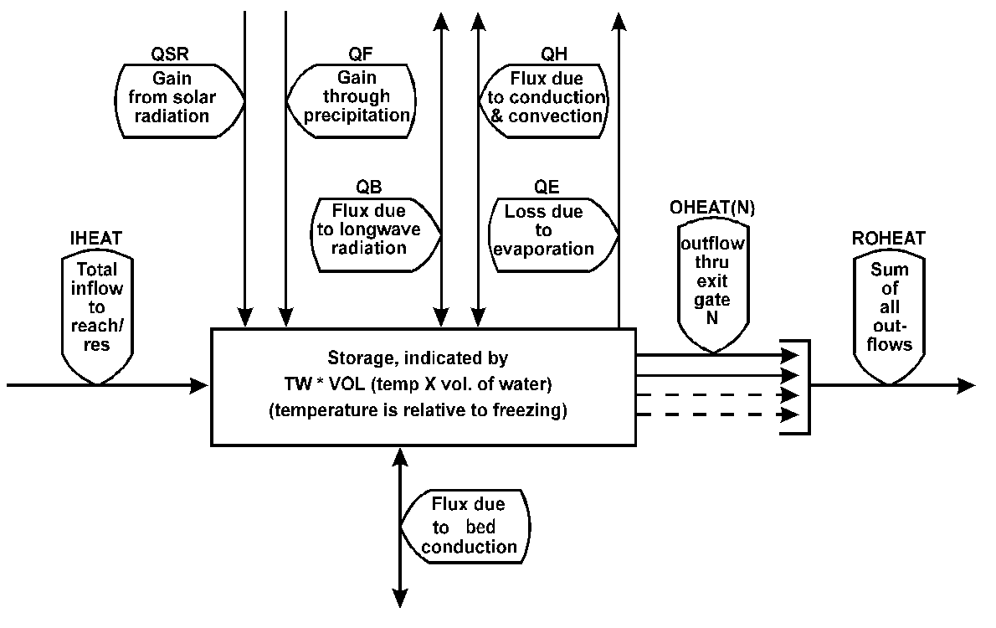
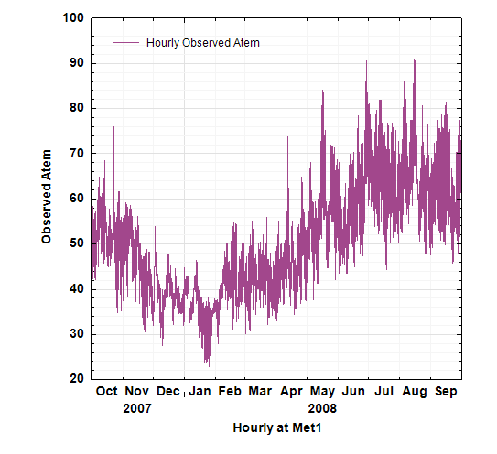
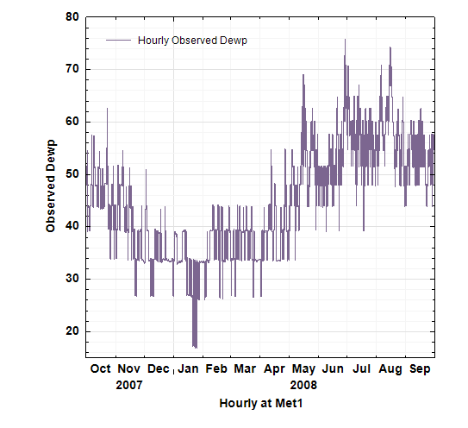
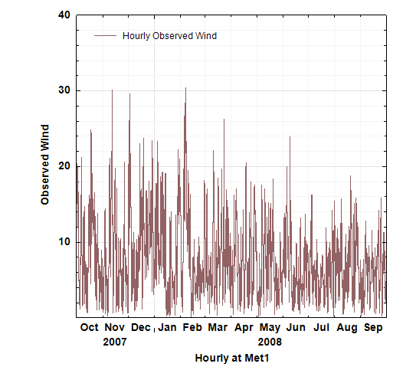
Water temperature calibration
Atmospheric Inputs for Each Zone
  Shortwave solar
  Cloud cover
  Air temperature
  Dewpoint
  Wind speed

Slide 13
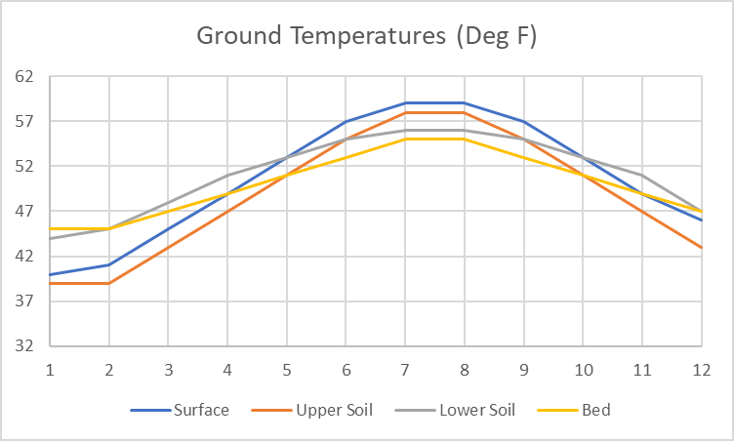
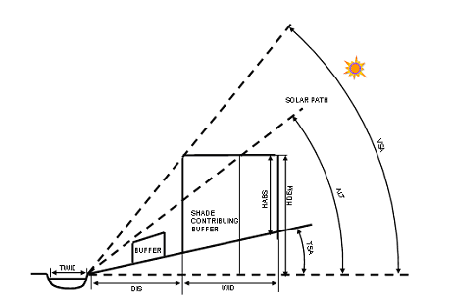
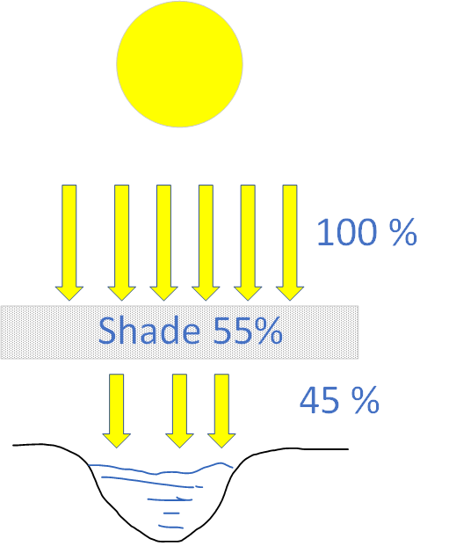
Water temperature calibration
Initial Models setups
Ground temperatures
  all hru soils (surface, shallow) set to same monthly temperatures
  All hru Groundwater (Lower) temperatures set to same monthly temperatures
Channel temperatures
  All reaches set to same thermal conductivity values
  All reaches set to same stream bed temperatures
Channel Shade
  Constant for all reaches (55%)
Continue to individualize and refine parameters

Slide 14
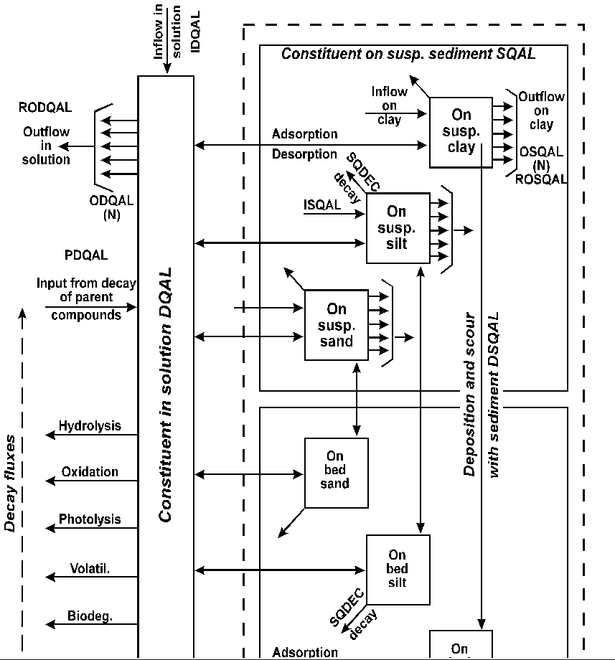
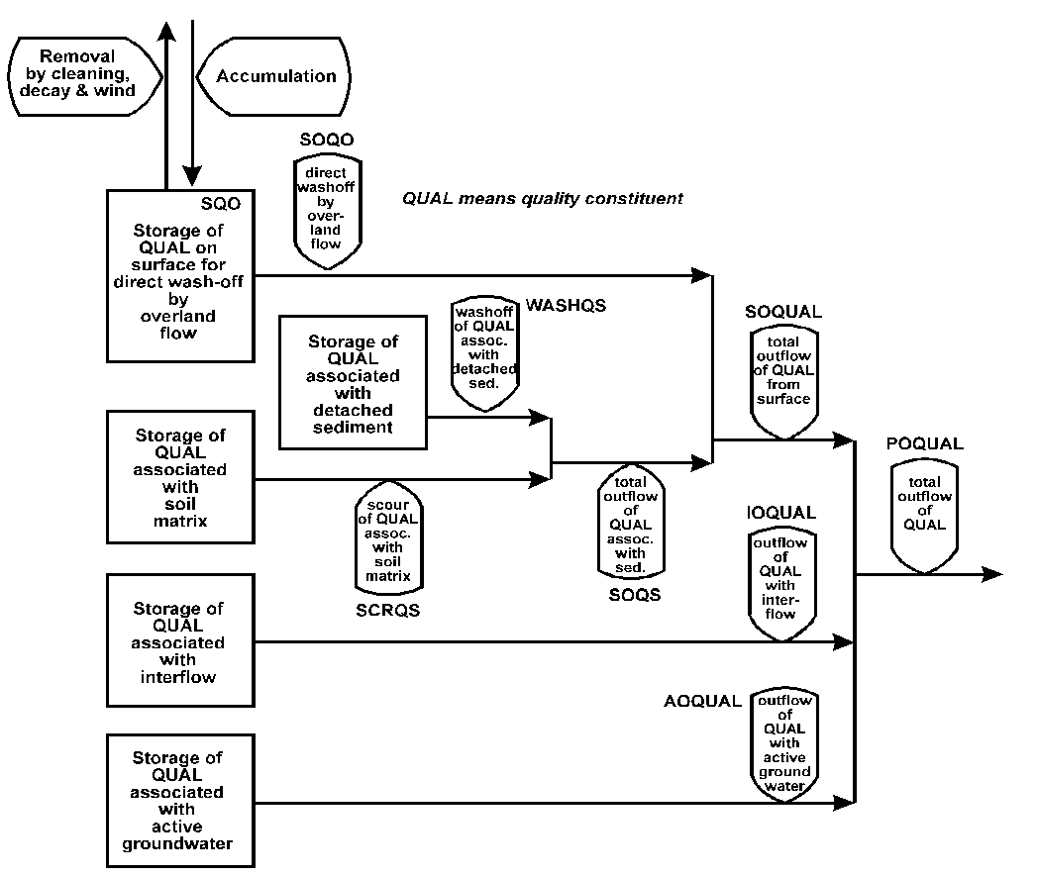
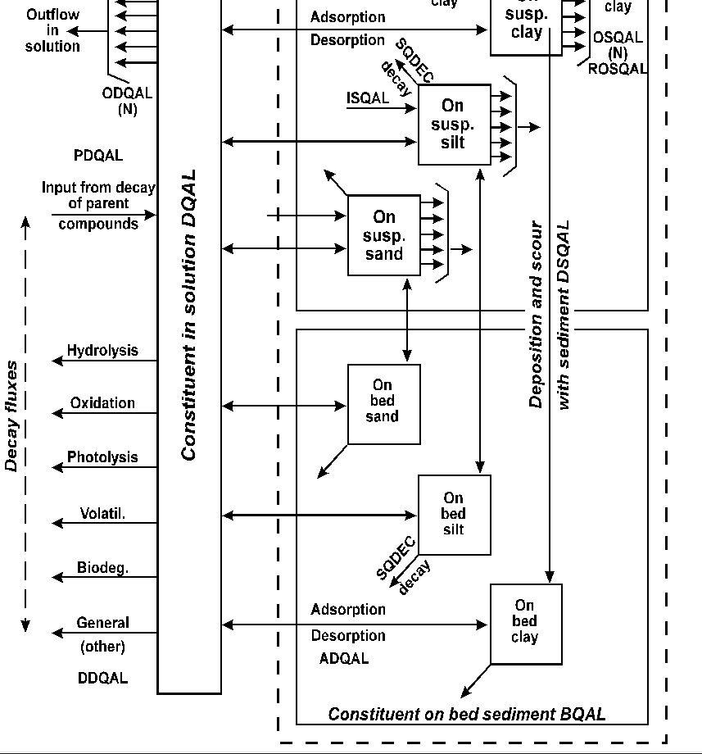
Modeling Pathways
channel pathways
overLand pathways

Slide 15
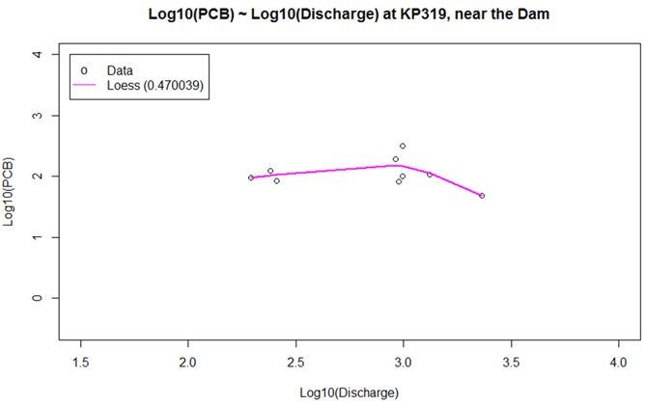
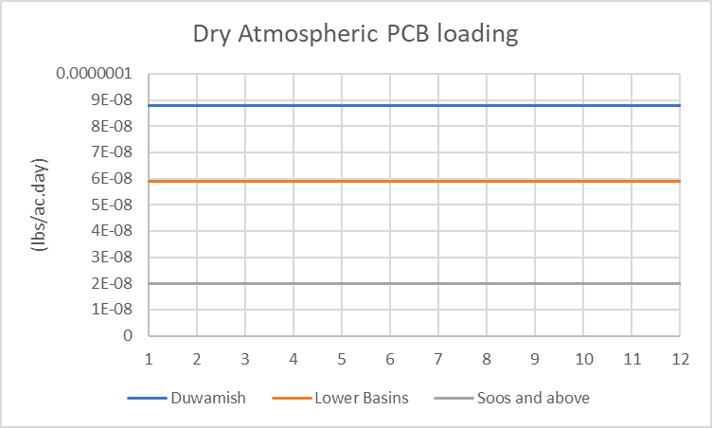
Watershed PCB calibration
sequence
  Define boundary conditions
  Define atmospheric deposition
  Define groundwater concentrations
  Define bed sediment concentrations
  Define land use
    accumulation rates
    Wash-off rates
    Storage limits
  Repeat
Groundwater Concentrations
Initial Bed Sediment Concentrations

Slide 16
Watershed PCB calibration
Initial Atmospheric deposition on Land & Water
  Dry deposition
  Constantly monthly values
  3 zones of loading rates (Duwamish, Lower/Middle, Soos and upper)

Slide 17
Watershed PCB calibration
Initial Landscape parameterization
  Land use accumulation not set yet (build-up is atmospheric only for now)
  Interflow/groundwater concentrations
  Duwamish/Black
    9.8E-12 lbs/CF ≈ 167 pg/l
  Others
    5.8E-12 lbs/cf ≈ 100 pg/L
Initial channel parameterization all reaches same
  Initial dissolved concentration (100 pg/L)
  Volitization ratio (0.49)
  First order Decay (.00007/Day) in water column
  No Decay in bed sediments
  Adsorption/desorption coefficients (5E-2 L/mg) & rates (0.01/day) are same for sand, silt, clay
  Initial bed sediment (3 pg/mg), same for sand, silt, clay
Continue to individualize and refine parameters

Slide 18
Modeling progress

