Slide 1
PLA HSPF
Water Temperature Modeling

Slide 2
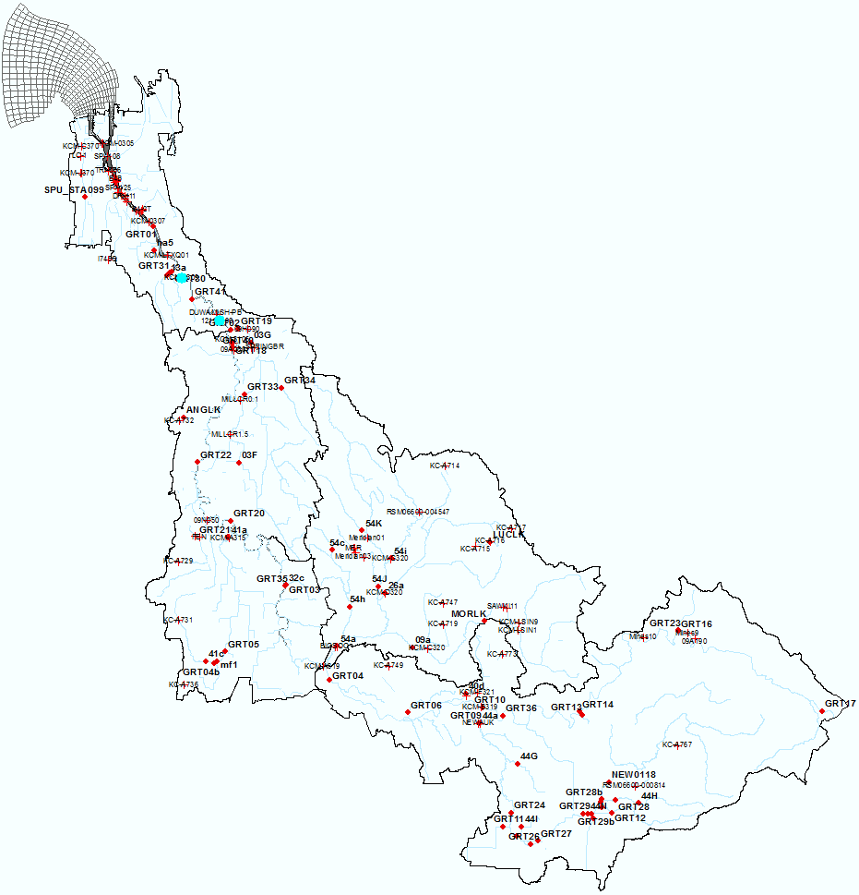
Water Temperature Data
Points:
- Surface water temperature stations
King County https://green2.kingcounty.gov/hydrology/GaugeMap.aspx
Leidos Database
2 USGS Stations
USGS 12113415 Duwamish River at E Marginal Way Bridge at Duwamish, WA
~RM6.3
USGS 12113390 Duwamish River at Golf Course at Tukwila, WA
downstream of Black River inflow to Green River
RM9.8
Duwamish
USGS12113390
Lake Young
41a
Black River
RSM06600-004547
Lower Green
Soos
54i
26a
09a
GRT35
GRT16
09A190
Upper Green
GRT17
Howard Hansen Dam (HHD)

Slide 3
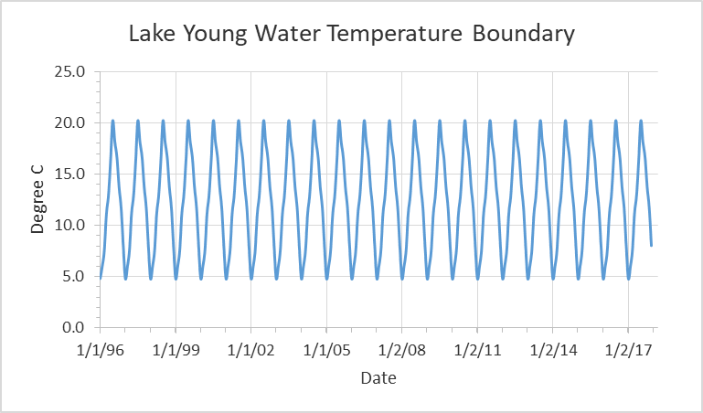
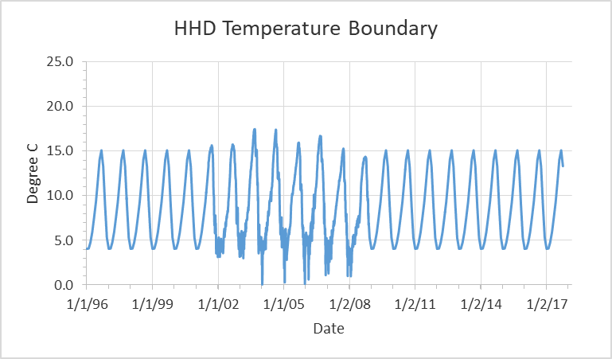
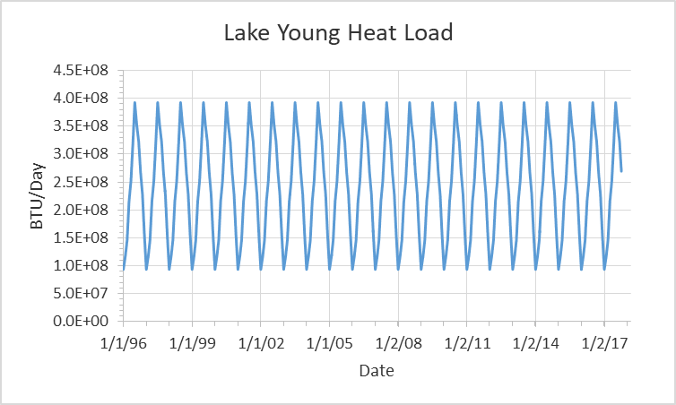
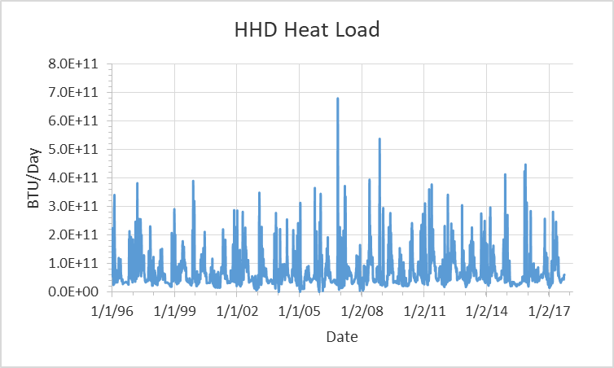
Water Temperature Boundary Conditions
Lake Young boundary
based on Station – RSM06600-004547, < 2 miles downstream of Lake Young
Howard Hansen Dam (HHD) upstream boundary
based on Station – GRT17, < 1 mile away from the DAM
Groundwater temperature:
55 degree F (or ~13 degree C)
Solar factor (CFSAEX):
set to 0.45 for all streams
Lake Young
Howard Hansen Dam (HHD)

Slide 4
Statistical Calibration Targets
General calibration targets for HSPF water temperature and toxic simulations (magnitude of Relative Average Error (RE, %)) (Donigian, 2000)
Model Component | Very Good | Good | Fair | Poor
Water Temperature | < 7% | 8 – 12% | 13 – 18% | > 18%
Toxics | < 20% | 20 – 30% | 30 – 40% | > 40%
where RE = relative average error in percent, O_{i} represents the time series observations and P_{i} is the time series of model predictions, n is the number of data pairs. The relative error is the ratio of the absolute mean error to the mean of the observations and is expressed as a percent (%).
$$RE=\frac{\sum_{i=1}^{n}{\left|O_{i}−P_{i}\right|}}{\sum_{i=1}^{n}{O_{i}}}×100\%,$$
Reference:
Donigian, A. S., Jr. 2000. Lecture 19: Calibration and verification issues, Slide L19-22. HSPF training workshop handbook and CD. Presented and prepared for the U.S. EPA Office of Water and Office of Science and Technology, Washington, D.C.

Slide 5
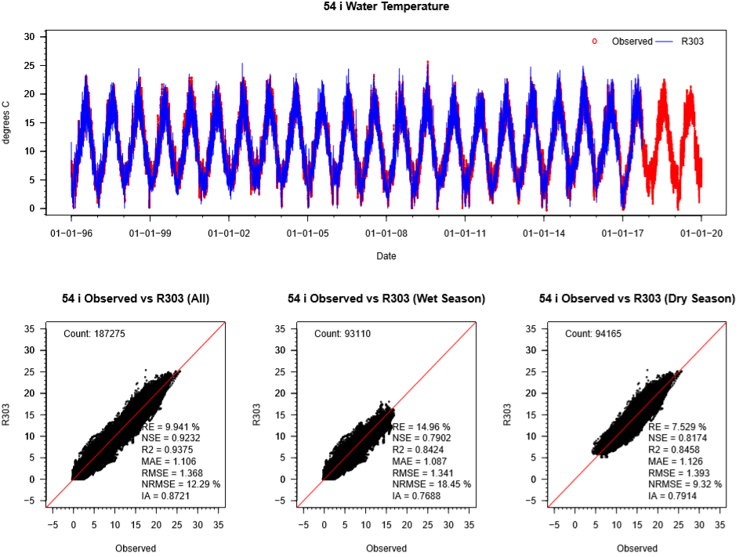
Temperature – 54i (Soos)
54i is ~5 miles downstream of Lake Young
RE=9.941 %,
Good

Slide 6
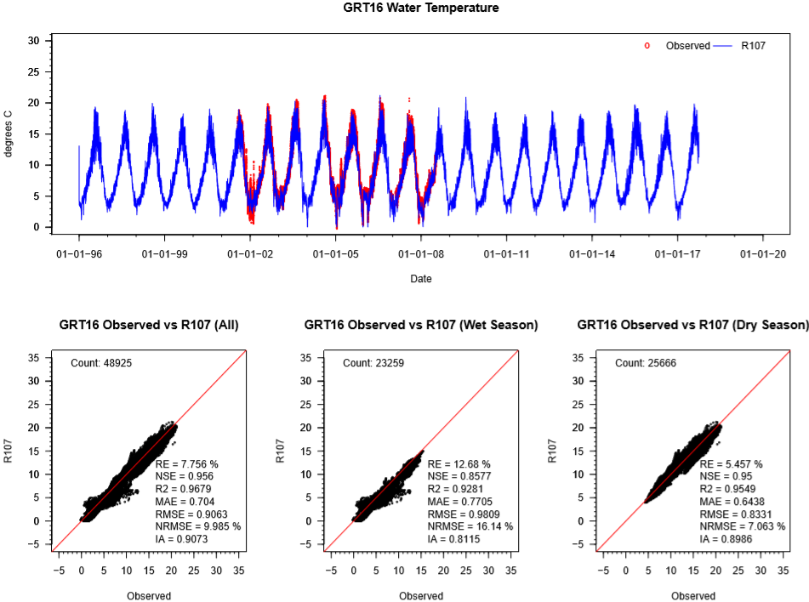
Temperature – GRT16 (Upper Green)
GRT16 is <10 miles from the HHD
RE=7.756 %,
Good

Slide 7
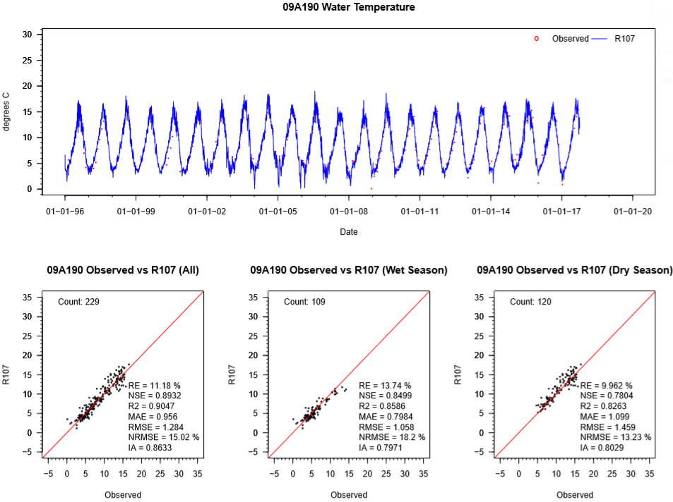
Temperature – 09A190 (Upper Green)
09A190 is ~8 miles from the HHD
RE=11.18 %,
Good

Slide 8
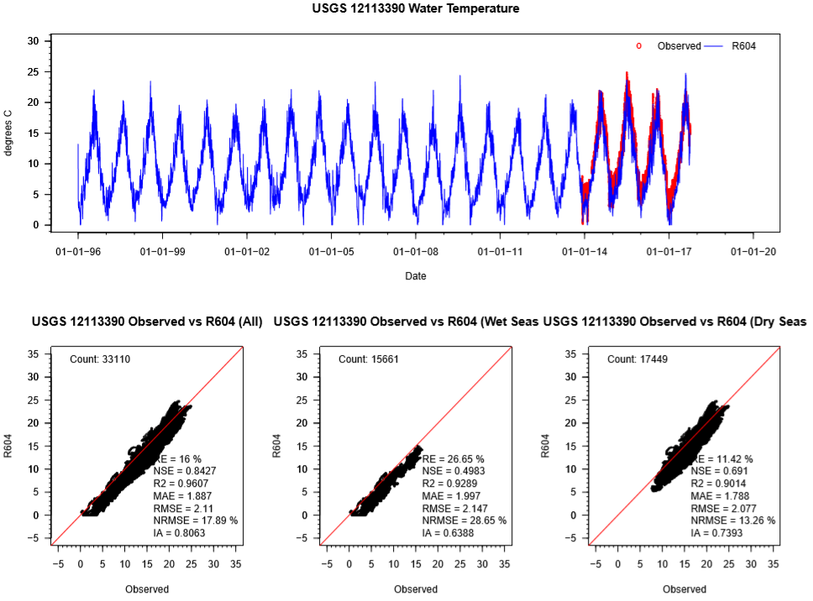
Temperature –12113390 (Duwamish)
USGS12113390: Duwamish River at Golf Course at Tukwila, WA
RE=16 %,
Fair

Slide 9
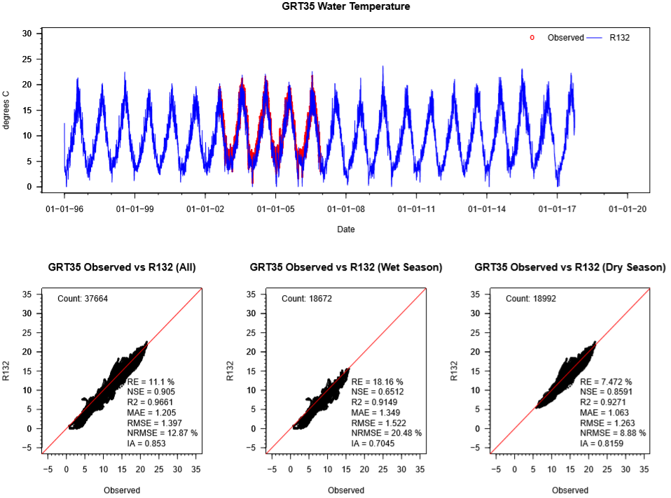
Temperature – GRT35 (Lower Green)
GRT35: Green River @ North Green River Park
RE=11.1 %,
Good

Slide 10
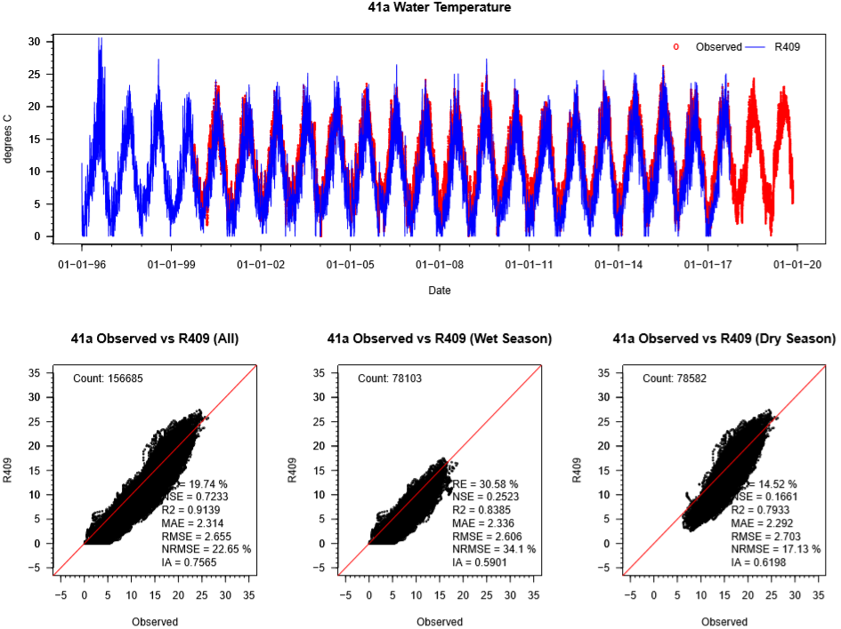
Temperature – 41a (Lower Green)
41a: Mill Creek at SR 181
RE=19.74 %,
Poor

Slide 11
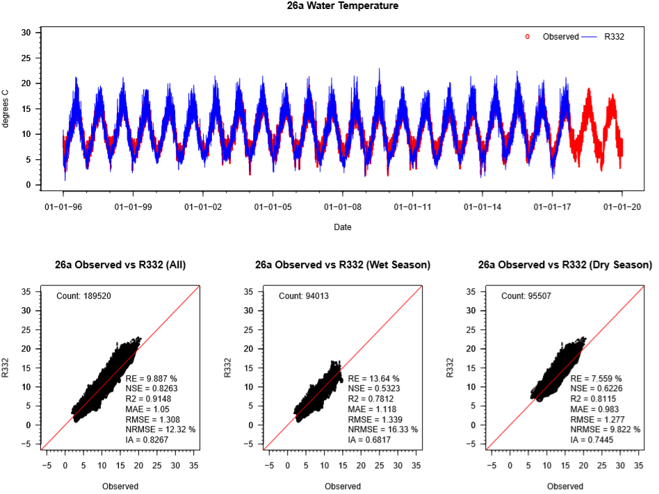
Temperature – 26a (Soos)
26a:
Jenkins Creek near Mouth - Soos Creek Sub-watershed
RE=9.887 %,
Good

Slide 12
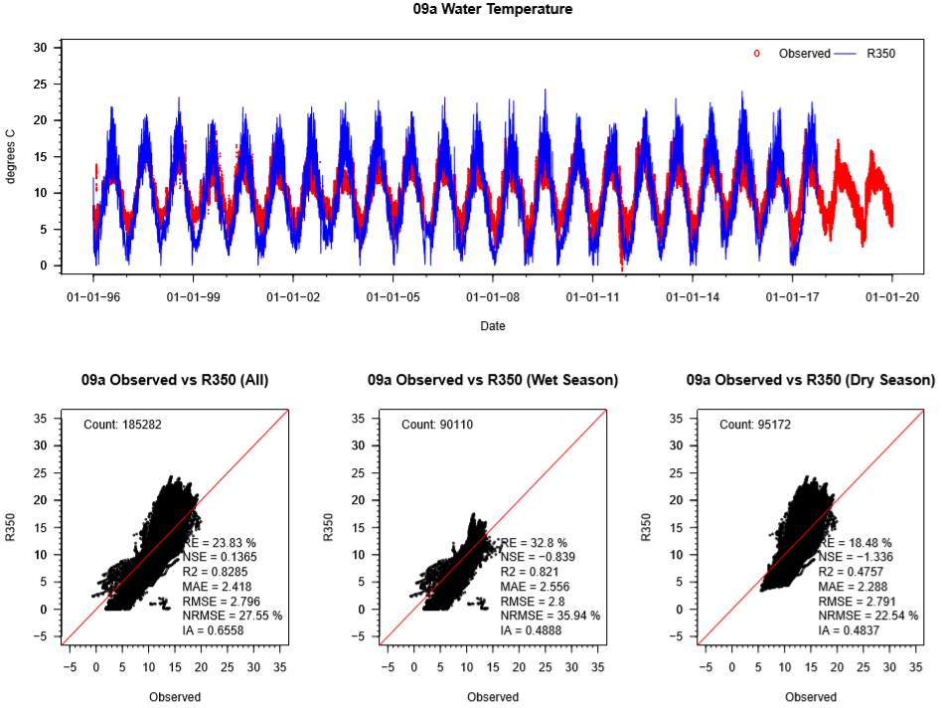
Temperature – 09a (Soos)
09a:
Covington Creek
near Mouth, Soos Creek Sub-watershed
RE=23.83 %,
Poor

Slide 13
PLA Preliminary HSPF
PCBs Modeling Demo

Slide 14
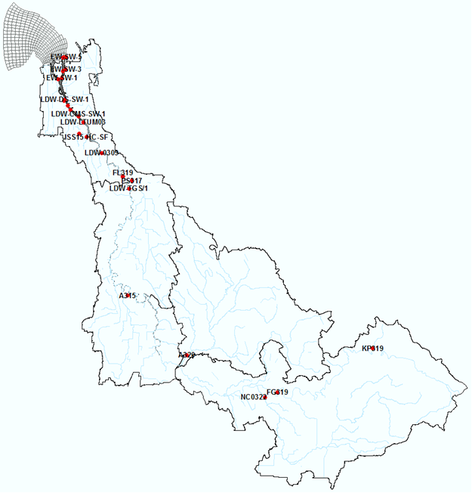
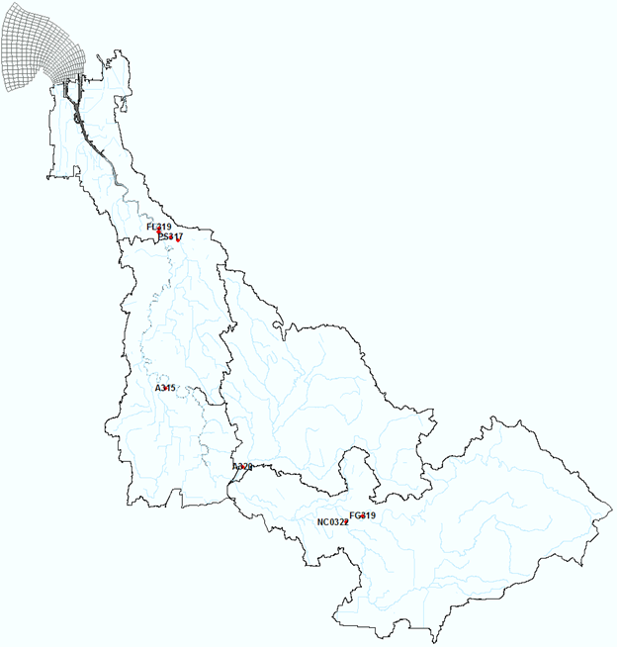
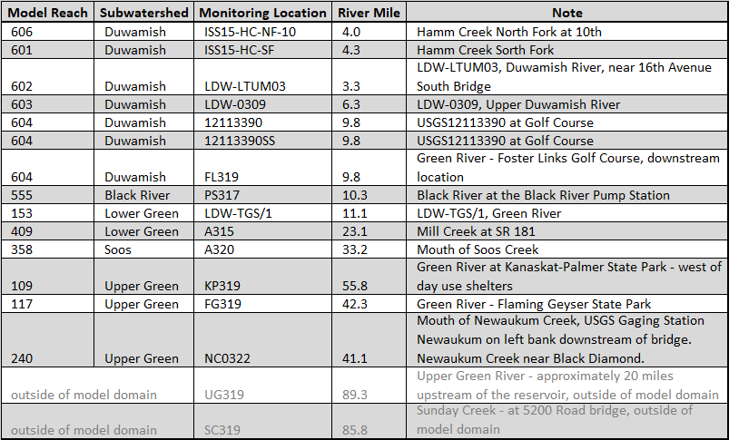
Existing PCBs Data – Water Column
Surface water PCB Data Stations
USGS12113390
12113390SS
A315
A320
KP319
Whole water PCB Concentration (pg/L)
Particulate PCB Concentration (ng/kg)

Slide 15
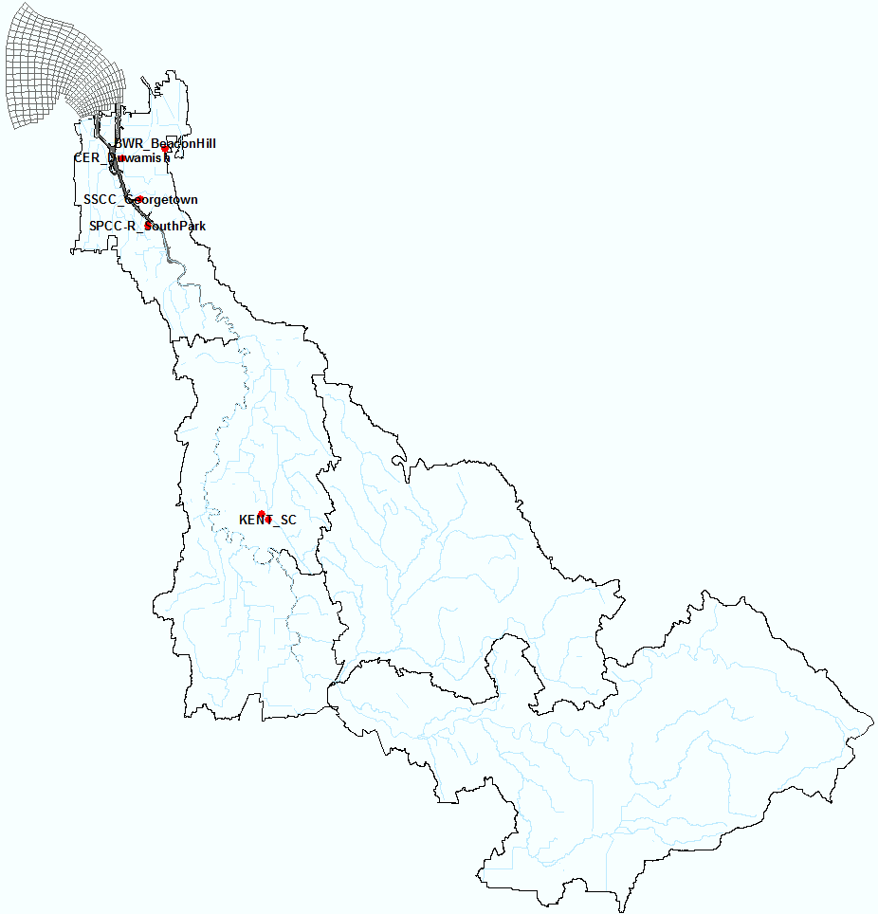
Existing PCBs Data – Air Deposition
Green/Duwamish watershed is divided into three zones:
and each Zone is assigned a value (ng/m²/day):
Zone 1. Duwamish: 9.82
Zone 2. Black River/Lower Green: 6.60
Zone 3. Soos/Upper Green: 2.25
Atmospheric PCB Flux (ng/m²/day)
Reference:
King County, 2019. Potential PCB Atmospheric Loading to the Green/Duwamish Basin.

Slide 16
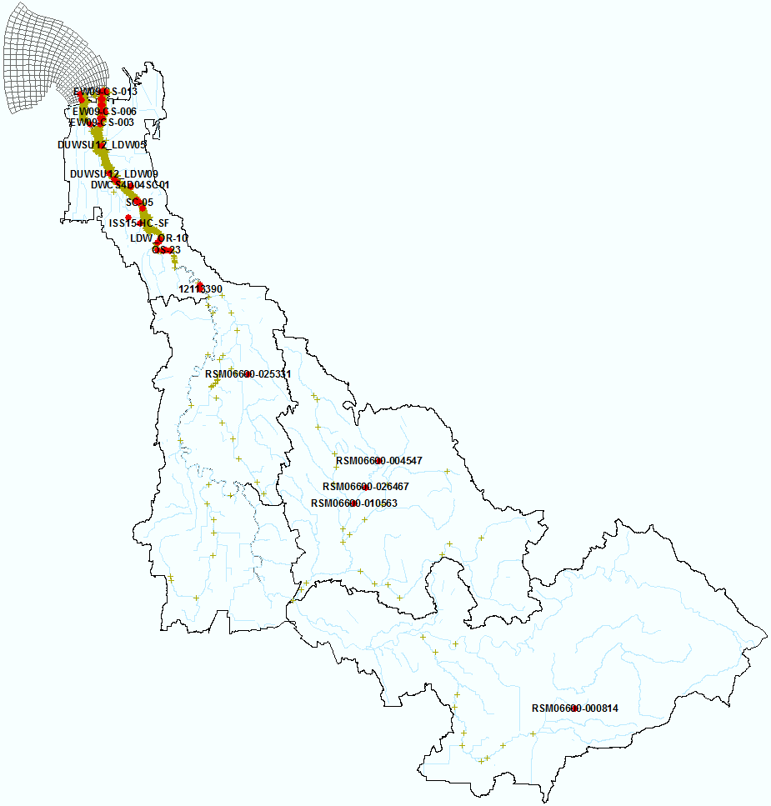
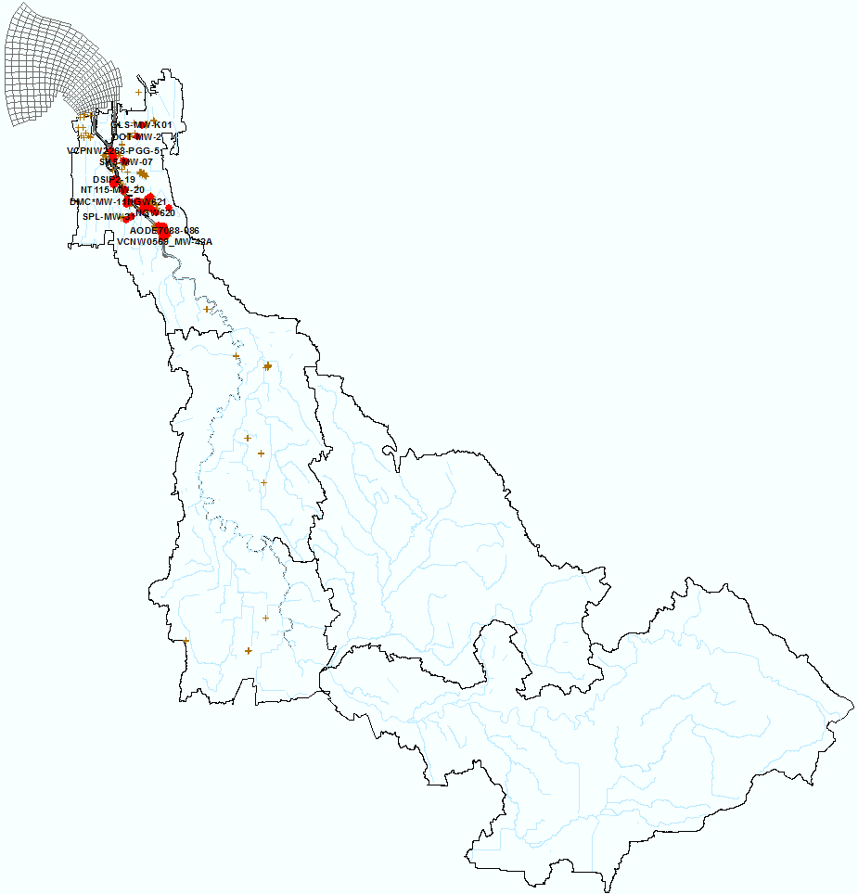
Existing PCBs Data – Bed and Groundwater
Congeners (ng/kg)
Aroclors (µg/kg )
Congeners (pg/L)
Aroclors (µg/L)
Sediment bed PCB Concentration
Groundwater PCB Concentration

Slide 17
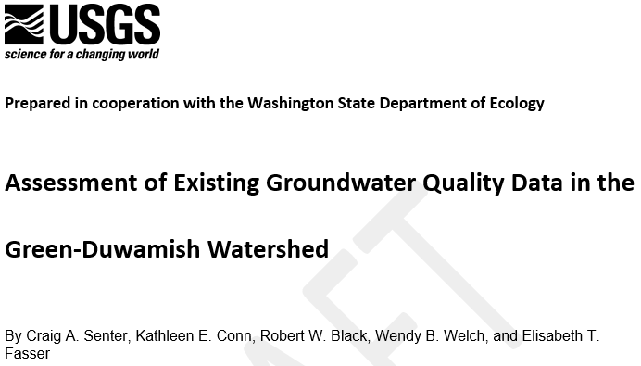
USGS 2019 Green/Duwamish
Groundwater PCB Data Assessment
- Aroclors
PCB Concentration, as a sum of Aroclors (µg/L)

Slide 18
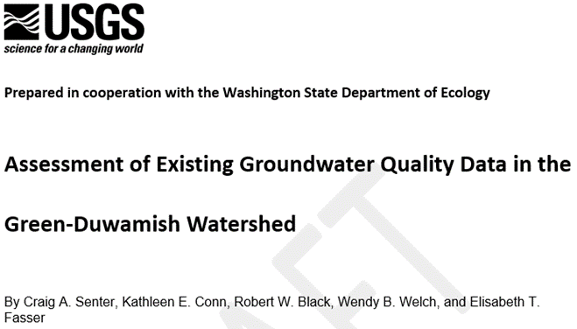
USGS 2019 Green/Duwamish
Groundwater PCB Data Assessment
- Congeners
PCB Concentration, as a sum of 209 Congeners (pg/L)

Slide 19
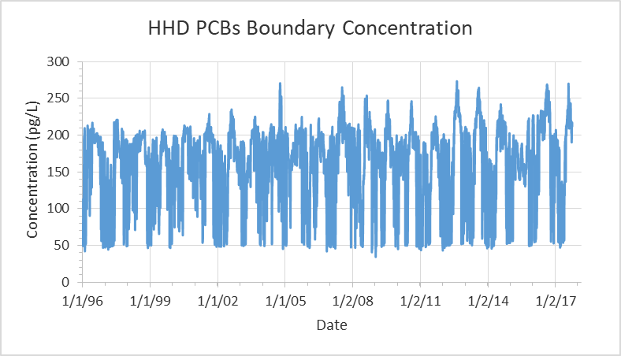
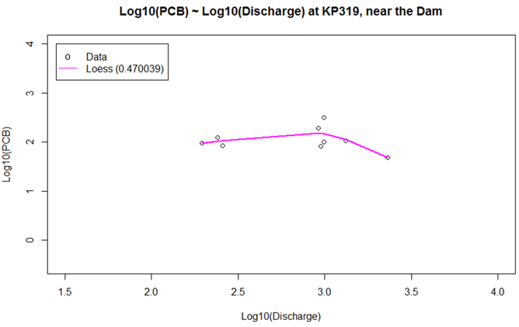
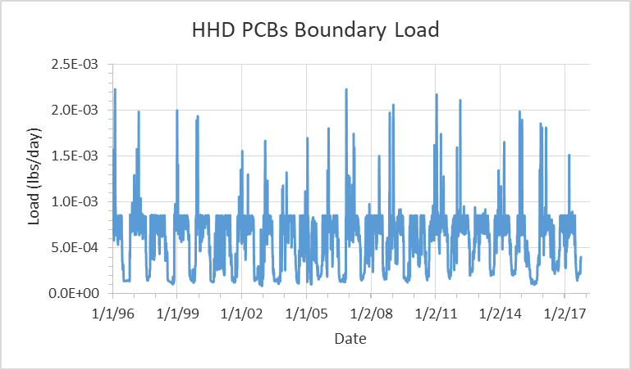
PCBs Boundary Conditions
Whole water PCBs regression: Log10(PCB)~Log10(Discharge)
First Groundwater conc.:
Duwamish/Black River: 167 pg/L
Other subwatersheds: 100 pg/L
Lake Young constant boundary:
1.08×10⁻⁶ lbs/day; 100 pg/L

Slide 20
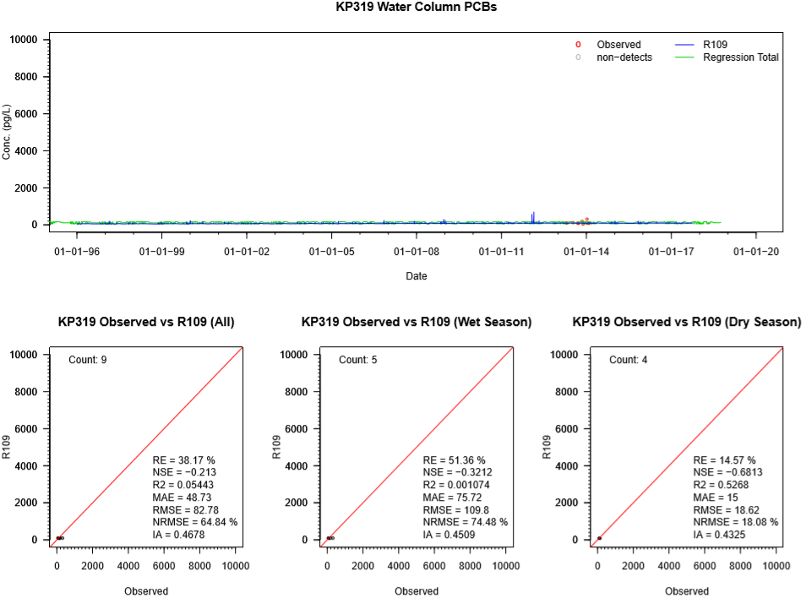
Whole water PCBs (pg/L) – KP319 (Upper Green)
KP319:
Green River at Kanaskat-Palmer State Park

Slide 21
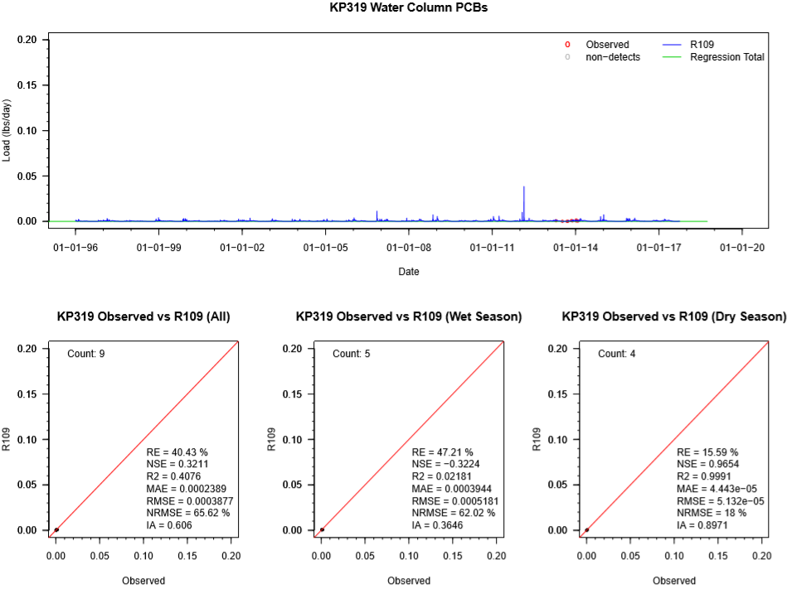
PCBs Load (lbs/day) – KP319 (Upper Green)

Slide 22
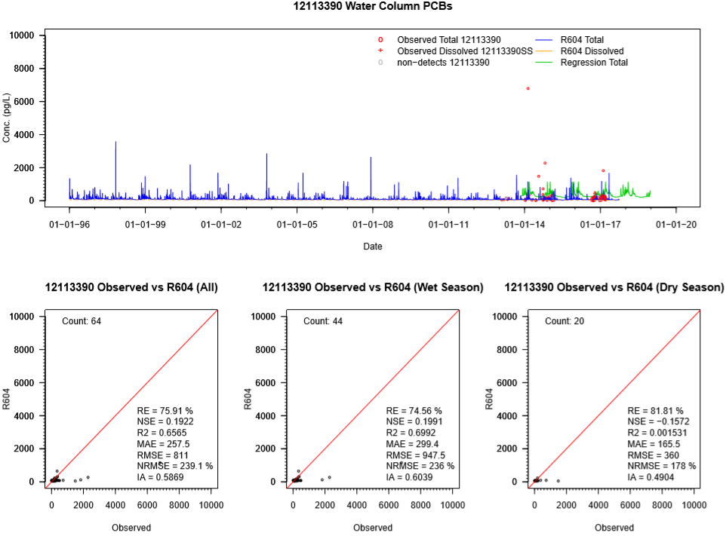
Whole water PCBs (pg/L) – 12113390 (Duwamish)
USGS12113390: Duwamish River at Golf Course at Tukwila, WA

Slide 23
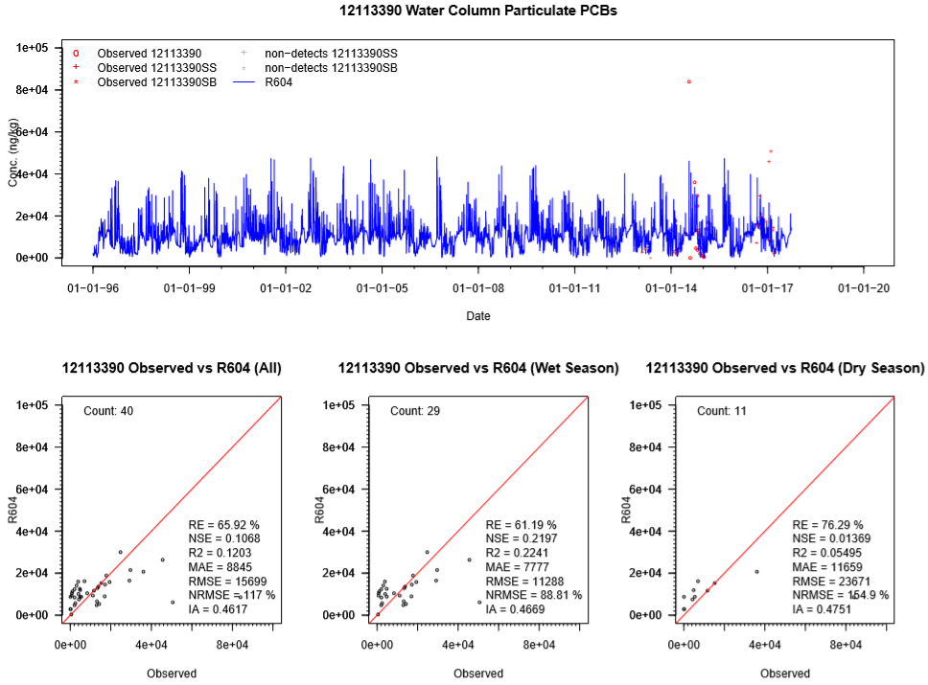
Particulate PCBs (ng/kg) – 12113390 (Duwamish)

Slide 24
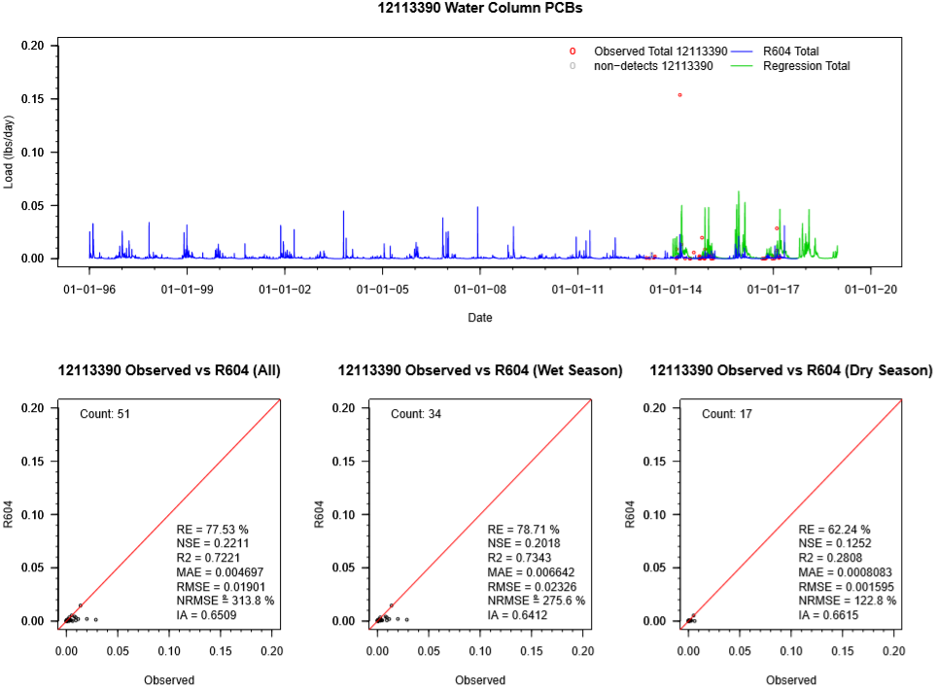
PCBs Load (lbs/day) – 12113390 (Duwamish)

Slide 25
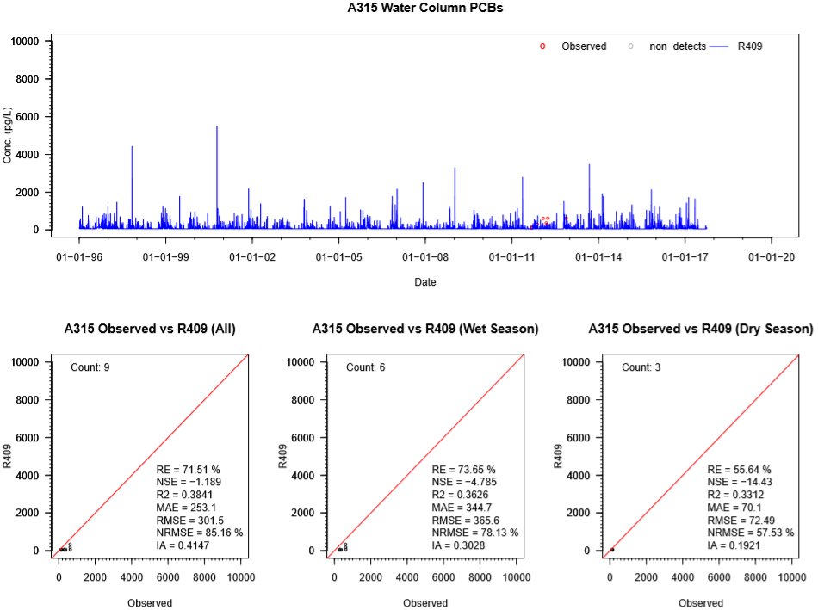
Whole water PCBs (pg/L) – A315 (Lower Green)
A315: Mill Creek at the bridge at 68th Ave and South 261st Street

Slide 26
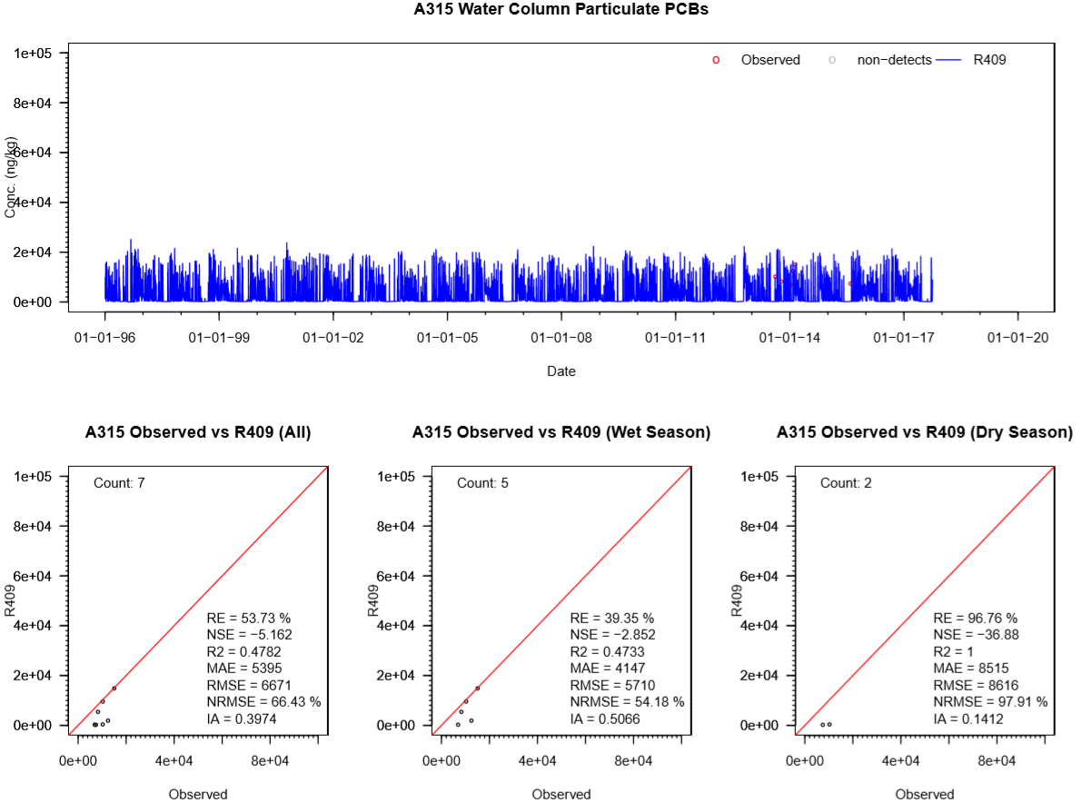
Particulate PCBs (ng/kg) – A315 (Lower Green)

Slide 27
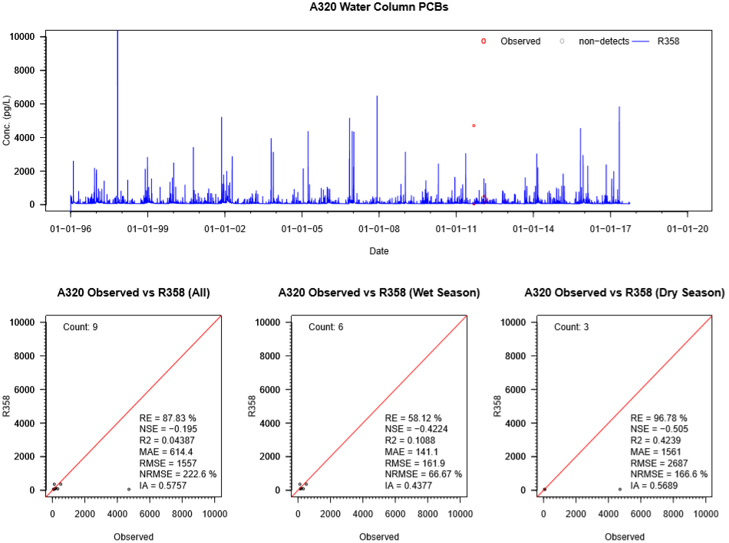
Whole water PCBs (pg/L) – A320 (Soos)
A320: Roughly 300 feet upstream of the hatchery near the mouth of the Soos Creek.

Slide 28
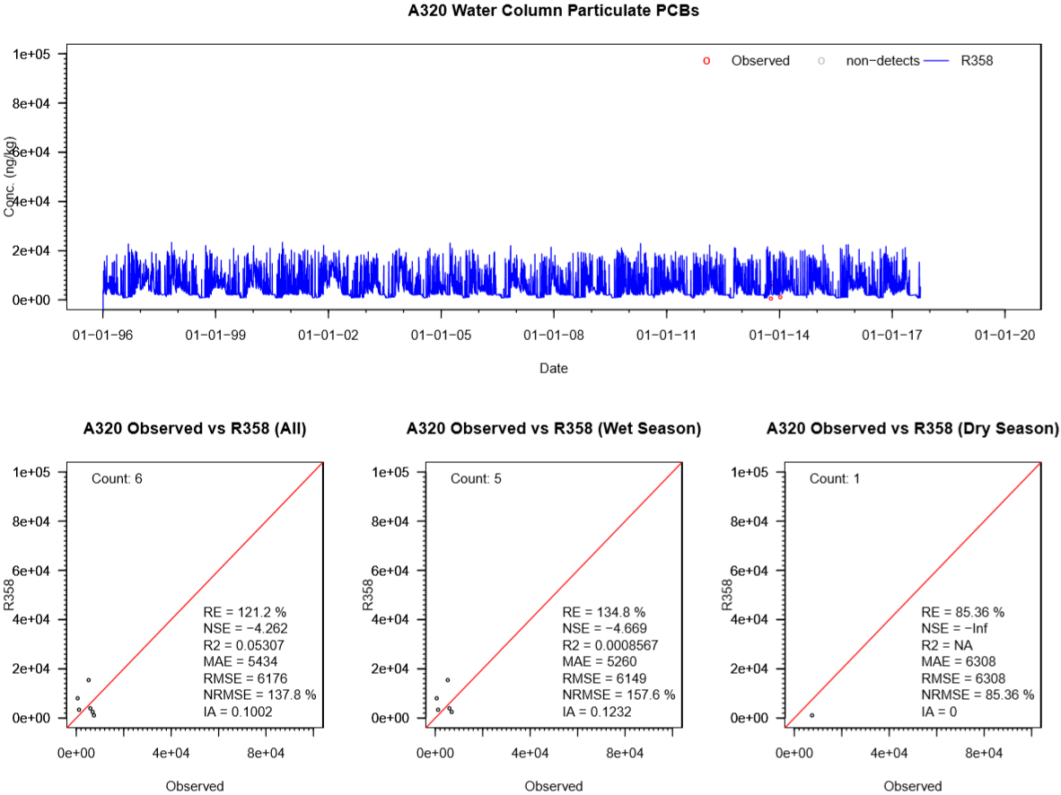
Particulate PCBs (ng/kg) – A320 (Soos)

Slide 29
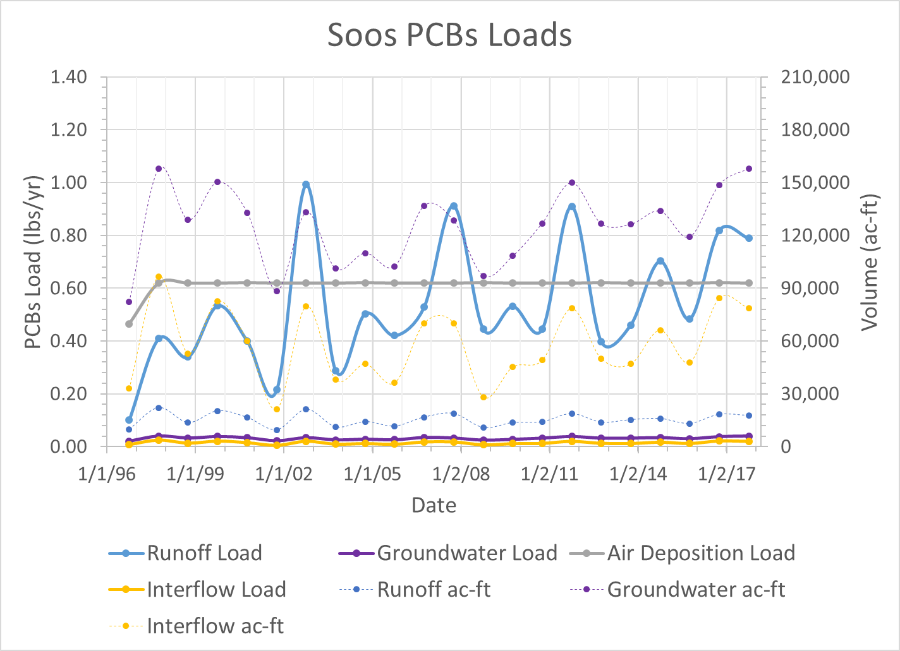
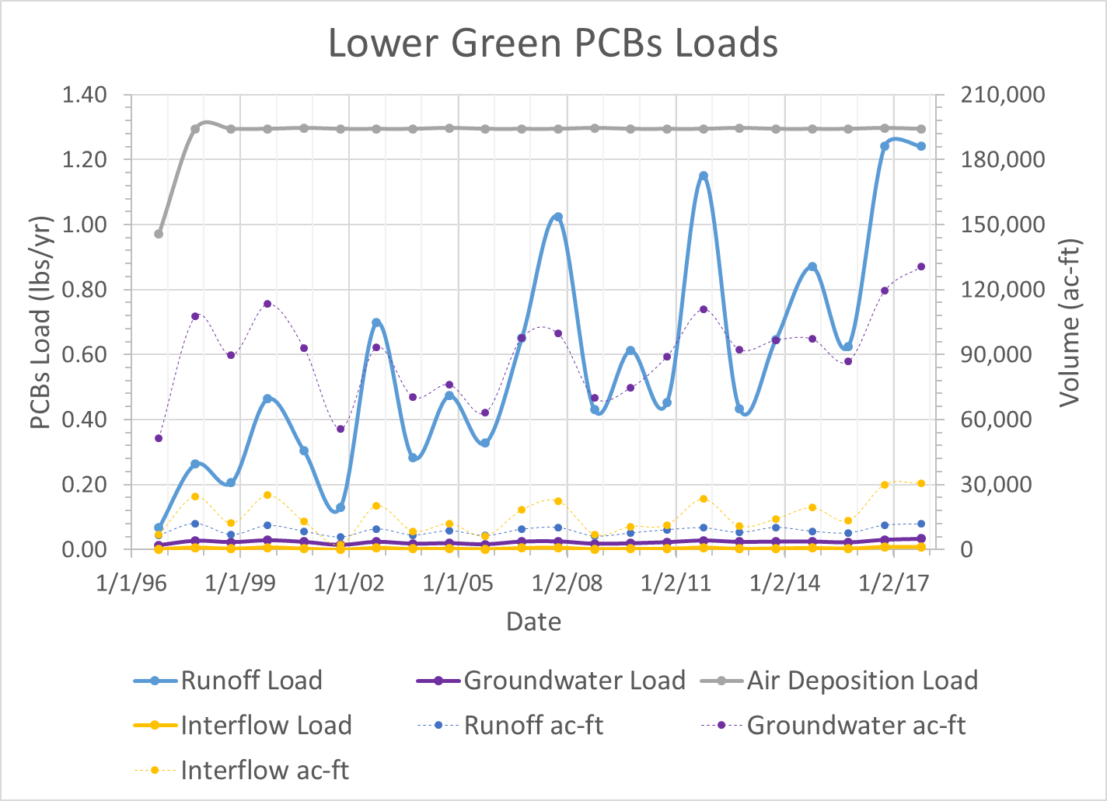
Soos and Lower Green PCBs Loads (lbs/yr)
Soos Subwatershed
Lower Green Subwatershed

Slide 30
Next Steps
Double check PCBs and sediment data.
If applicable, specify spatial and temporal variation
groundwater and bed concentration
potency factor
partition coefficients
adsorption/desorption rate, and etc.
Meanwhile, examine sediment transport calibration as needed.
Add seasonal PCBs concentration and load comparisons.
Continue the temperature calibration for streams:
include water temperature data from Leidos database
mainly monthly and seasonal data
specify spatially varying parameters in HSPF Module RCHRES (Channel):
solar radiations
conduction-convection
Evaporation, and etc.
Work on other toxics following the same procedures as PCBs.

