Slide 1
Welcome to the 16th Green-Duwamish Watershed
Pollutant Loading Assessment (PLA)
Technical Advisory Committee (TAC) Meeting
We will begin shortly
If you’re having audio problems, you may dial in:
Dial 564-999-2000, Enter Conference ID: 823 330 222#
Use chat for technical issues and we will try to help 7/14/2021

Slide 2
PLA TAC #16 Agenda
Introductions and project goals
Watershed model updates and Q&A
BREAK (10 mins)
Management scenarios (background, break-out, open discussion)
BREAK (10 mins)
Watershed model calibration results

Slide 3
Reminder of Project Goals
Pollutant Loading Assessment
  Address LDW impairments and protect cleanup
Watershed Model
  Assess effectiveness of potential management scenarios
Technical Advisory Committee
  Review technical issues and provide input to technical decision points

Slide 4
Updates - Outreach
Developing Communication Plan
Scheduled Outreach:
  Our Green Duwamish (OGD)
  WRIA 9 Salmon Recovery Group

Slide 5
Watershed Model Q&A

Slide 6
Q: Land Use & HRU?
HRU = Hydrologic Response Unit

Slide 7
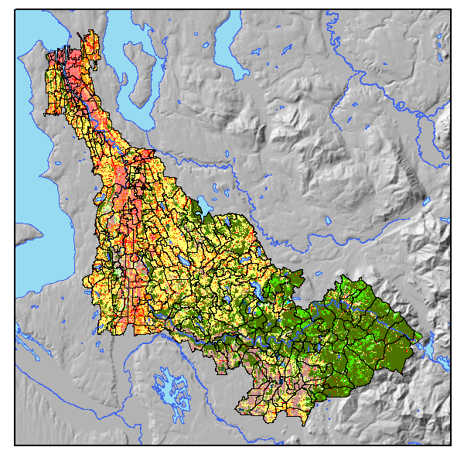
Land use / Land cover
High Intensity Residential
Low Intensity Residential
Commercial & Industrial
Agriculture
Barren
Forest
Grasslands
Scrub/shrub
Open Water
Wetlands

Slide 8
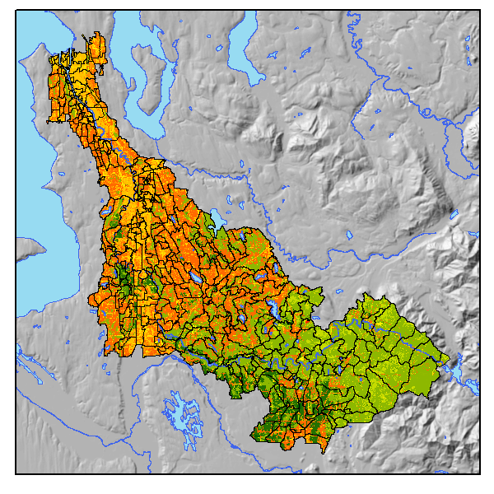
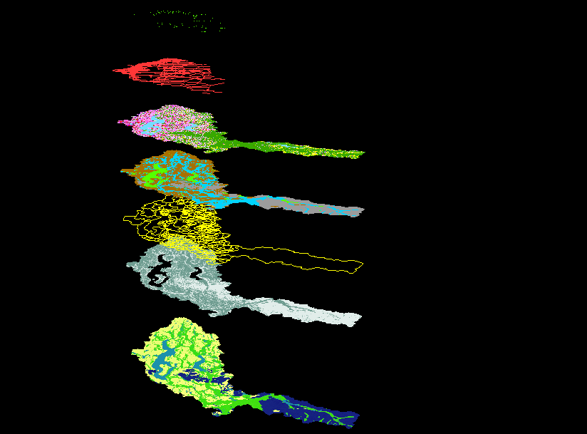
Hydrologic response units (HRU)
Merging (soils, sewer, land use, land cover, slope) generates 1,728 unique combinations per rainfall zone
Simplified (☺) into 293 HRUs per rainfall zone
Previously ~ 1,000 HRUs (for all zones)

Slide 9
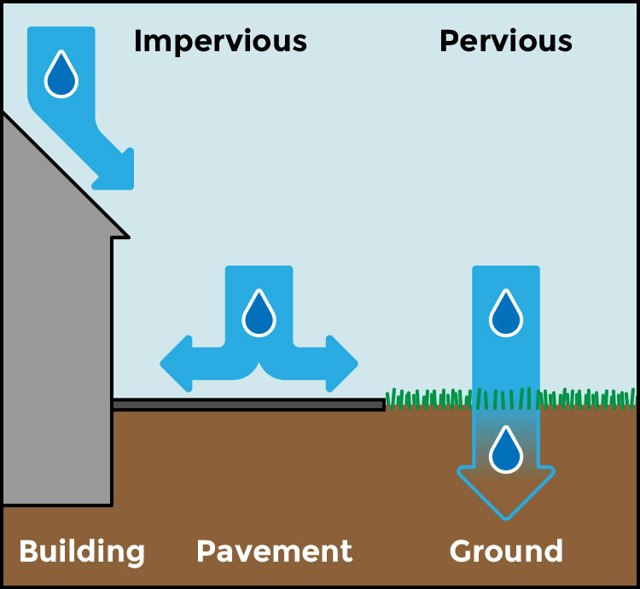
Effective Impervious Area
Commercial & Industrial
  Commercial & Industrial (Pervious area)
  Commercial & Industrial (Impervious area)
    Impervious area drained to pervious area
    EIA_Commercial *
Residential
  Residential (Pervious area)
  Residential (Impervious area)
    Impervious area drained to pervious area
    EIA_Residential *
EIA_NonDev *
EIA_Roof *
*EIA-Effective Impervious Area

Slide 10
Q: Air Deposition & Stormwater Runoff?

Slide 11
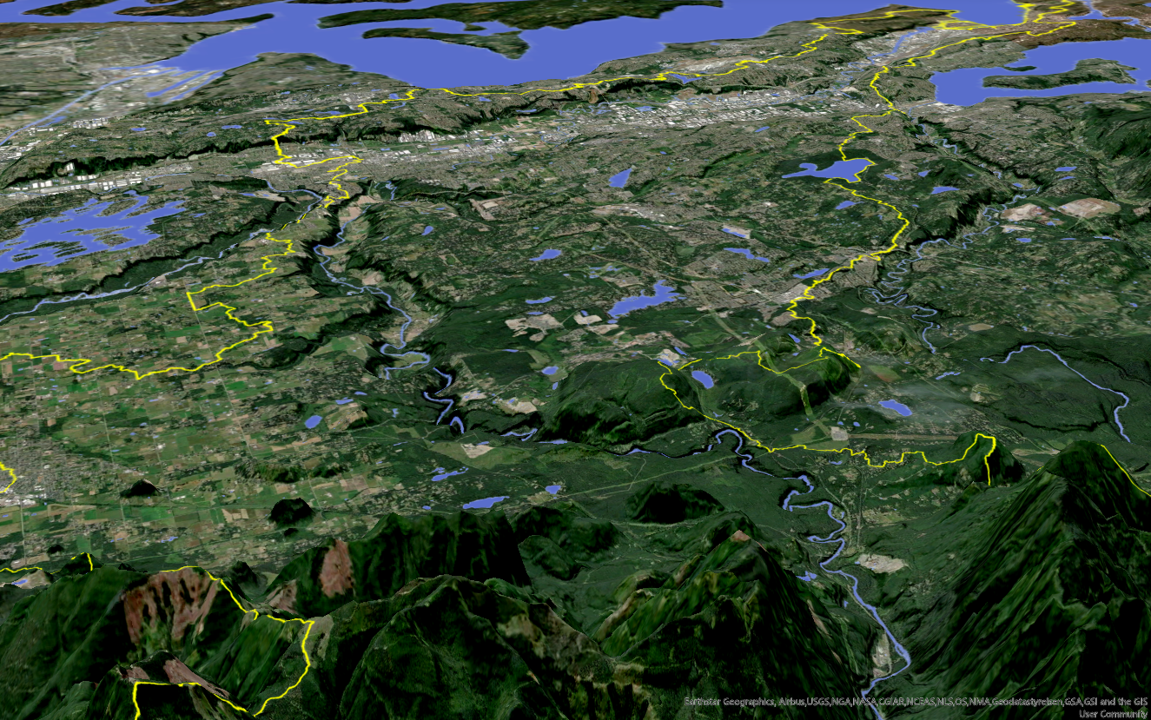

Atmospheric deposition

Slide 12
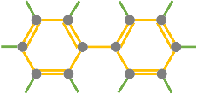
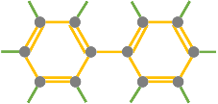












Modeling Simplifications
Atmospheric Deposition
Land use generation
Stormwater surface
Stormwater scour
Subsurface loads
Receiving
Waterbody
(dissolved + particulate)
Wash-off
Build-up
Interflow (dissolved)
Groundwater (dissolved)

Slide 13
Atmospheric & Stormwater loadings
Atmospheric deposition (dissolved) – set by monthly loading rates
        +
Land use deposition (dissolved) – set by build-up rate
        +
Mobilization by rainfall and overland runoff (particulate + dissolved)
particulate proportion based on sediment generation
        +
Mobilization by stormwater runoff scours soils (particulate)
particulate proportion based on sediment generation
        =
Total loads (dissolved + particulate, atmospheric + stormwater)
Finite
Unlimited

Slide 14
Q: Load vs. Load Rate?

Slide 15
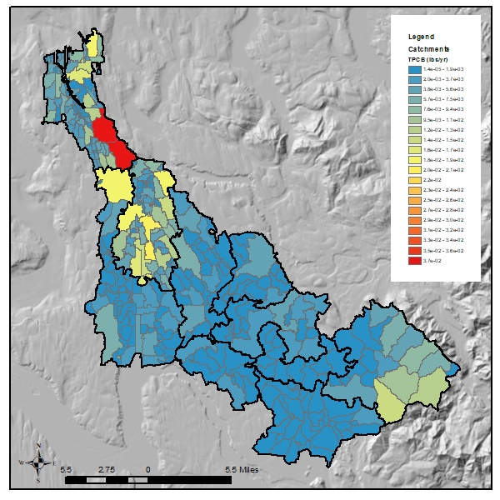
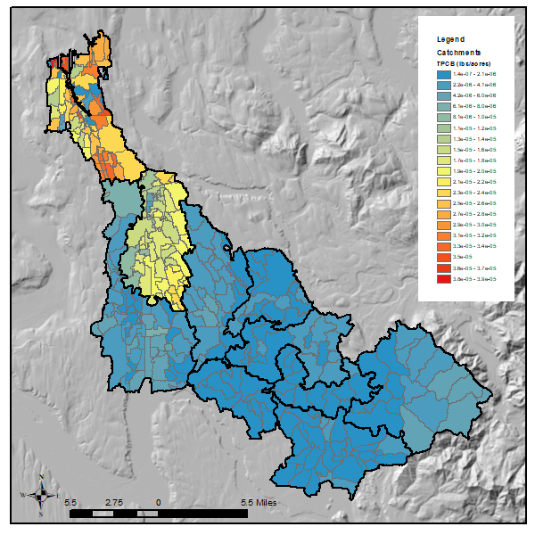
Load vs. Load Rate
Load Rate: Unit Area Load Rate = Load / Area
Example - PCBs
Total Load by catchment (lbs/yr)
Total Load Rate by catchment (lbs/acre/yr)

Slide 16
Other questions?
Let us know by raising your hand
We’ll call on you to unmute yourself

Slide 17
Break 1 (10 mins)
Please mute yourself during the break

Slide 18
Management Scenarios
Update and Examples

Slide 19
Stormwater Management
Solids Removal: enhanced stormwater conveyance maintenance
TSS Removal: Watershed-specific storm solids reduction targets
Stormwater/discharge treatment: structural/engineered treatment BMPs
Source Removal/Bioretention BMPs: widespread installation of infiltration BMPs
Building Material Removal
Removal of PCBs in building materials
Removal of PAHs in building supplies
Upland Site Cleanup
Comprehensive contaminated site cleanup throughout watershed

Slide 20
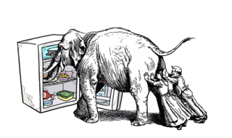
Example 1: Removal of PCBs in building materials
Identify the location of the building material removal activities
Find the subbasin/RCHRES that the building materials removal will be implemented;
Apply the % reduction of the soil/sediment potency factor in those HRUs;
Run the simulation based on revised HRU loading.

Slide 21
Example 2: Bioretention BMPs
Identify the locations and BMP area of the source removal/biotreatment;
Find the subbasins/RCHRES;
Apply the biotreatment to the subbasin, and determine the BMP location in each HRU;
Modify HRU to represent BMP, it could mean:
  reduction of effective impervious area
  Impervious → Pervious; and/or
  Moderate → Flat;
  ComInd, HDRes and LDRes → Grass or others.
Figure out the BMP removal efficiency based on information available;
Run the simulation with the updated HRU setting and removal efficiency.

Slide 22
Management Scenarios
What other questions do you have?
What needs clarification?

Slide 23
Management Scenarios
Break Out Session

Slide 24
Break Out Session Prompts
Which scenarios will be important for your organization?
What challenges can you identify with these scenarios?
Any information or resource that you can provide?
What might you need from PLA Team to help you share this information or gain input from your organization?

Slide 25
Break 2 (10 mins)
Please mute yourself during the break

Slide 26
Watershed Model Calibration Results
Re-cap and discussion

Slide 27
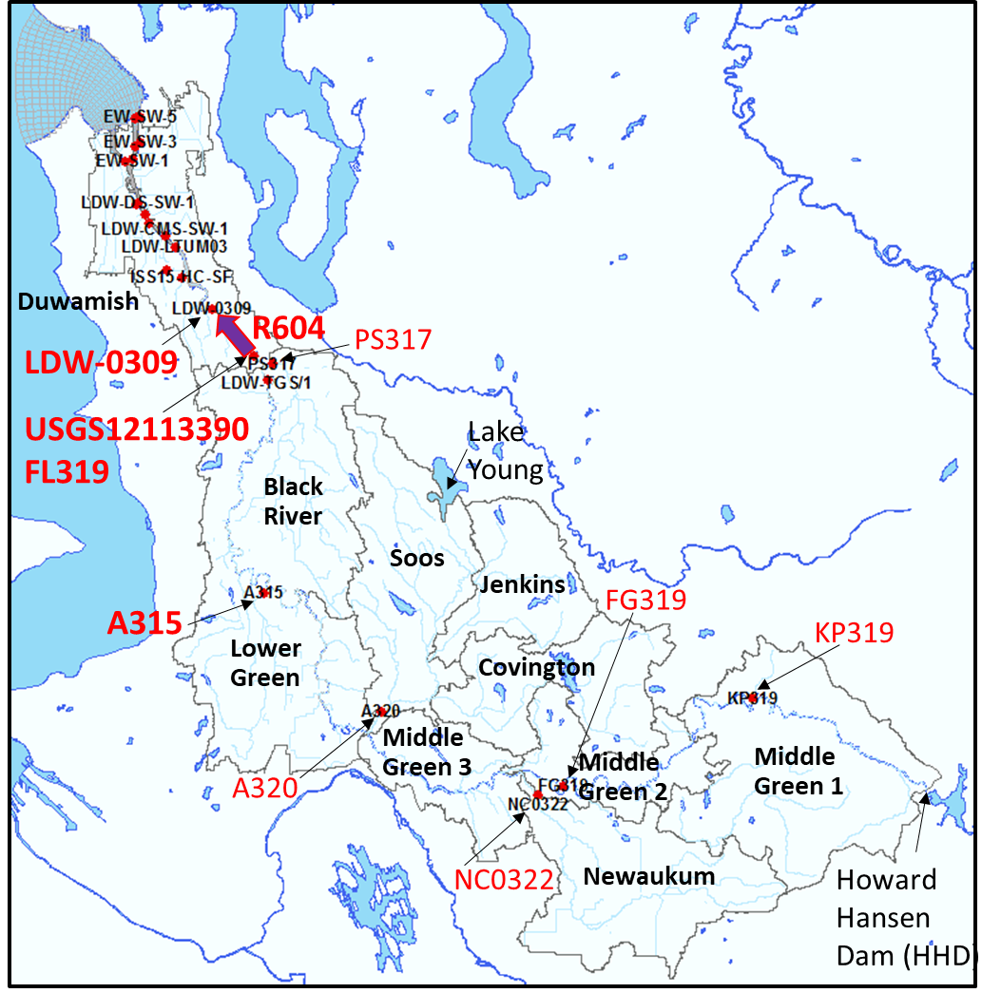
Calibration Sequence
Flow rates
HHD Dam
Tributaries & River
Hourly & Daily
Water Quality
(setup)
Develop HHD Loads
Initial State
(conc. & mass)
Sensitivities
Atmospheric Dep.
Groundwater
Variables
- define potency - adjust washoff
Particulate &
Soil
Dissolved &
Sorbed (conc.)
Adjust
Bed Sediments
(conc.)
Notes:
Both visual and statistics are used to evaluate the toxic concentration result. Also, we look at the total load to LDW.

Slide 28
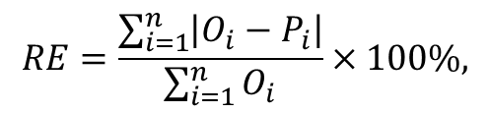
Statistical Calibration Targets for Reference
1. Visual inspection from the graph
2. General calibration targets for HSPF toxic simulations (magnitude of Relative Average Error (RE, %)) (Donigian, 2000)
Model Component | Very Good | Good | Fair | Poor
Toxics | < 20% | 20 – 30% | 30 – 40% | > 40%
$$RE=\frac{\sum_{i=1}^{n}{\left|O_{i}−P_{i}\right|}}{\sum_{i=1}^{n}{O_{i}}}×100\%,$$
where RE = relative average error in percent, O_{i} represents the time series observations and P_{i} is the time series of model predictions, n is the number of data pairs. The relative error is the ratio of the absolute mean error to the mean of the observations and is expressed as a percent (%).

Slide 29
Calibration Status
C = Complete
I = In progress
< = Complete, but sample Size is less than 12
Notes:
Duwamish – Hamm Creek, a lot of tributaries.
Upstream stations, tidal influenced.
1st round toxic calibration is complete. still rooms for the improvements. We found it necessary to go back to repeat the process.

Slide 30
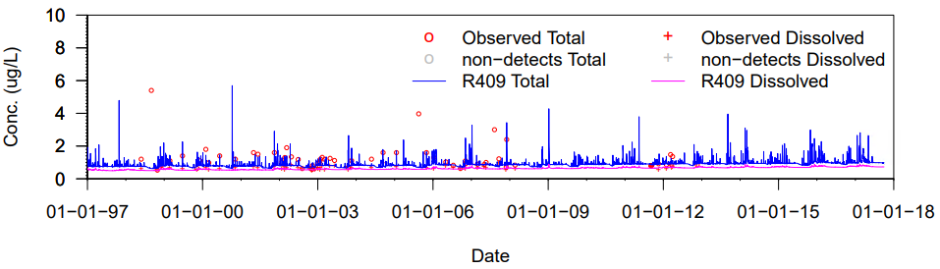
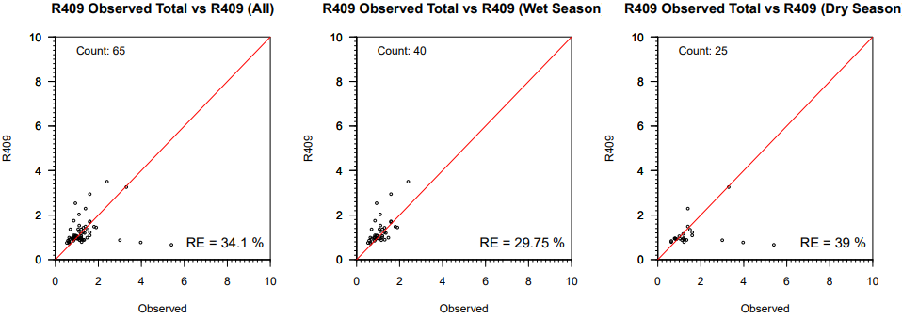
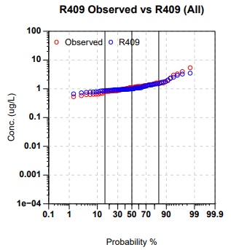
Arsenic
Location: Mill Creek at the bridge at 68th Ave and South 261st Street
Time Series
Cross Plot
Probability
All data
Wet Season
Dry Season
Notes:
Meaning of the plots

Slide 31
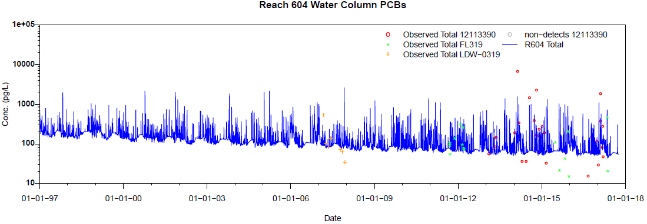
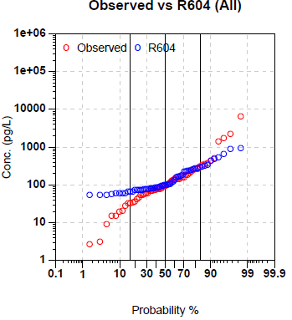
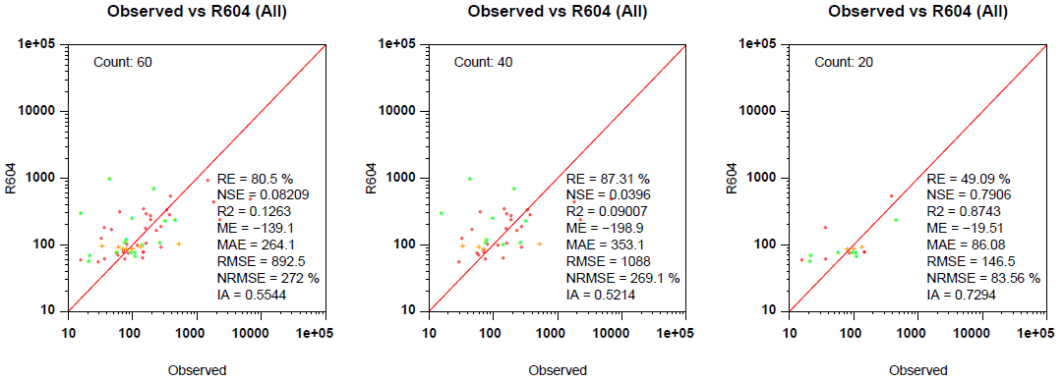
PCBs
12113390
FL319
LDW-0309
Time Series
Cross Plot
Probability
All data
Wet Season
Dry Season
Notes:
Improve, start from a Table.

Slide 32
Next
Continue calibrating:
  Spatial pattern
  Sediment bed concentration
  adsorption/desorption rate
  partition coefficient
  groundwater concentration
Improve upstream toxic boundary condition at HH Dam when applicable

Slide 33
Wrap Up
Next steps
Contact Bo Li, PLA Project Manager
  bo.li@ecy.wa.gov

