Slide 1
Model Development Process
Calibration
Scenarios
Integration
Compare loading pathways
Adjust parameters
Develop scenarios
(examples shown)
Evaluate results
Couple to EFDC
Atmospheric
Verify model
Update land use
Achieve targets
Translate model outputs
Surface
Until Bo says “STOP!”
Apply climate change
Integrate point sources
Sub-surface
Develop actions
(e.g., BMPs)
Achieve targets

Slide 2
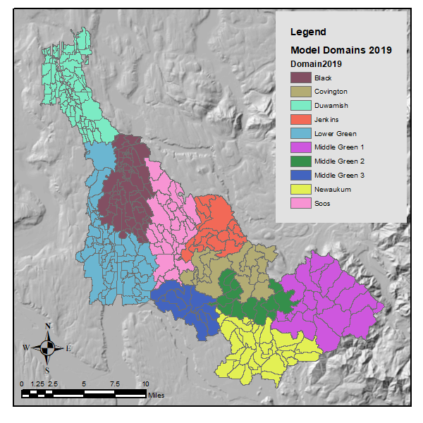
Model Domains

Slide 3
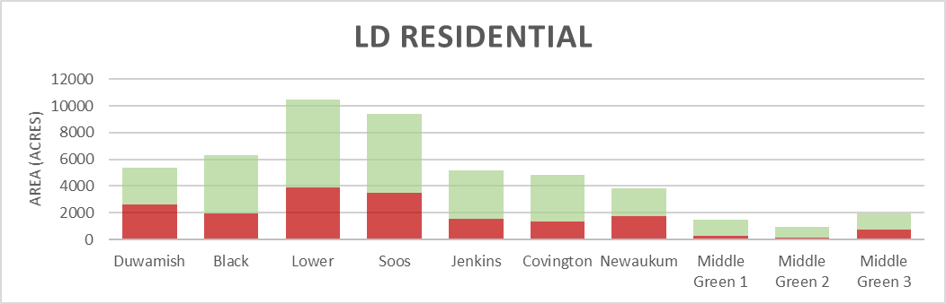
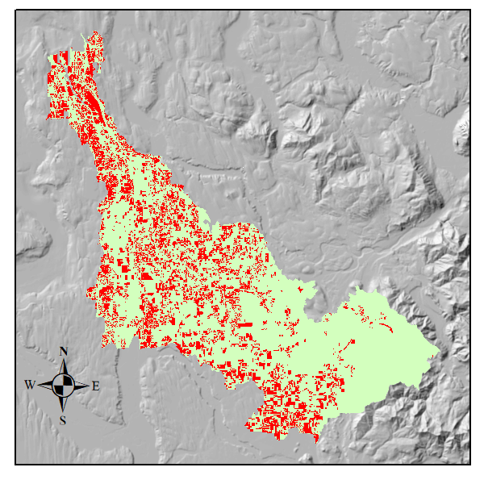
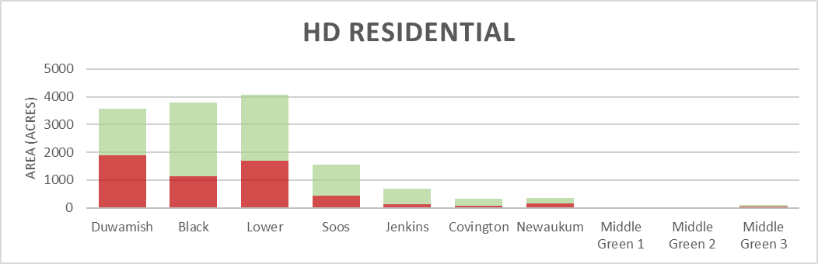
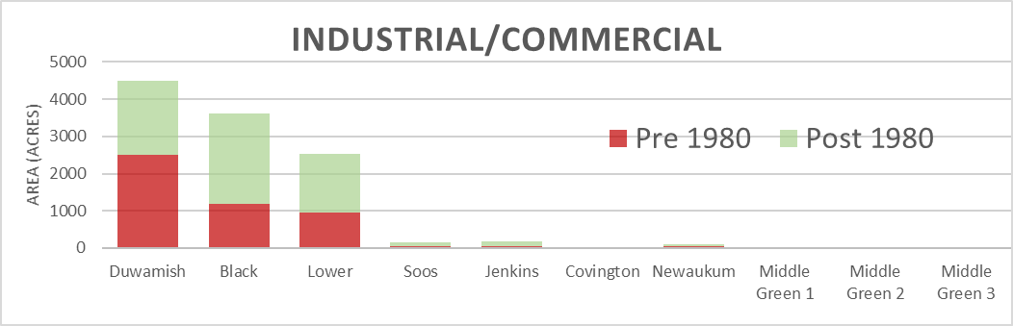
Age of development
Notes:
Provide table of percentages

Slide 4
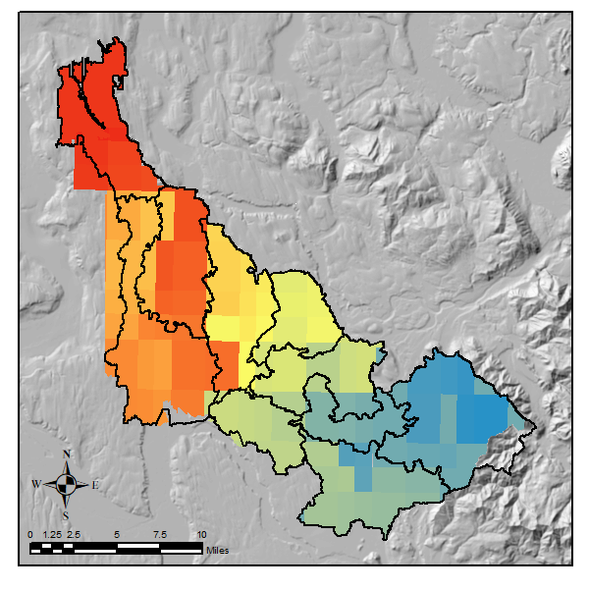
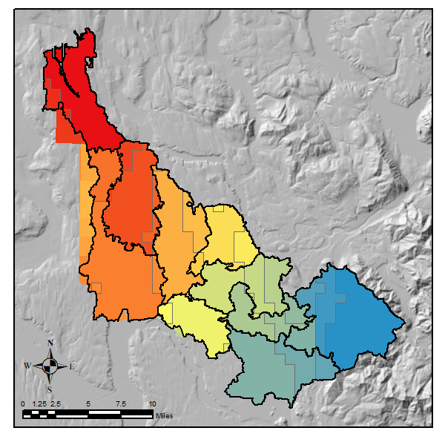
Rainfall Zones
Original (83 zones)
Revised (30 zones)

Slide 5
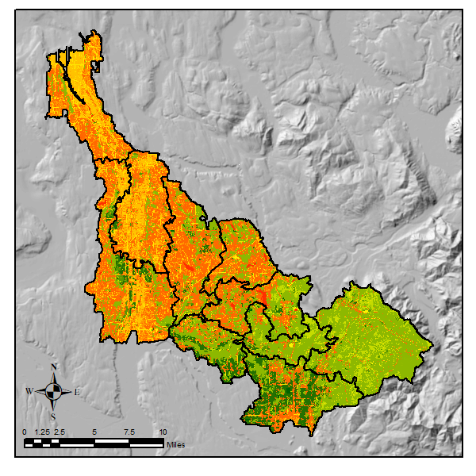
Hydrologic Response Units (HRUs)
30

Slide 6
Compare and Adjust HRU assumptions
Impervious Surfaces

Slide 7
Model Development Process
Calibration
Scenarios
Integration
Compare loading pathways
Adjust parameters
Develop scenarios
(examples shown)
Evaluate results
Couple to EFDC
Atmospheric
Verify model
Update land use
Achieve targets
Translate model outputs
Surface
Until Bo says “STOP!”
Apply climate change?
Integrate point sources
Sub-surface
Develop actions
(e.g., BMPs)
Achieve targets

