Slide 1
PLA HSPF Watershed Toxic Model Calibration Results
Notes:
We need to calibrate the model to minimize the simulated and observed differences by adjusting the toxic parameters so that the calibrated model can be used for decision-making, prediction, and etc.

Slide 2
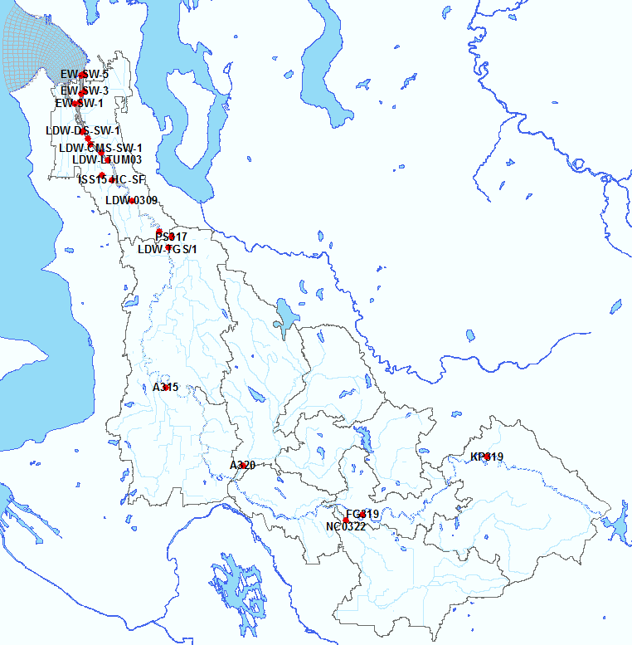
Green/Duwamish River Sub-Watersheds, and Estimated Load to LDW
Toxic Load → Reach 604 → LDW
20-year HSPF simulation order:
1) Jenkins → 2) Covington → 3) Soos → 4) Newaukum → 5) Middle Green 1 → 6) Middle Green 2 → 7) Middle Green 3 → 8) Lower Green → 9) Black River → 10) Duwamish
Duwamish
R604
PS317
LDW-0309
USGS12113390
FL319
Lake Young
Toxic Load to Lower Duwamish Waterway (LDW)
Black River
Soos
Jenkins
FG319
A315
KP319
Lower Green
Covington
Middle Green 3
Middle Green 1
A320
Middle Green 2
Reference:
Lower Duwamish Waterway Air Deposition Scoping Study, Data Gaps Report. December, 2013.
NC0322
Newaukum
Howard Hansen Dam (HHD)
Notes:
20 year average, snapshot of data analyses.

Slide 3
Statistical Calibration Targets for Reference
General calibration targets for HSPF toxic simulations (magnitude of Relative Average Error (RE, %)) (Donigian, 2000)
Model Component | Very Good | Good | Fair | Poor
Toxics | < 20% | 20 – 30% | 30 – 40% | > 40%
where RE = relative average error in percent, O_{i} represents the time series observations and P_{i} is the time series of model predictions, n is the number of data pairs. The relative error is the ratio of the absolute mean error to the mean of the observations and is expressed as a percent (%).
$$RE=\frac{\sum_{i=1}^{n}{\left|O_{i}−P_{i}\right|}}{\sum_{i=1}^{n}{O_{i}}}×100\%,$$
Reference:
Donigian, A. S., Jr. 2000. Lecture 19: Calibration and verification issues, Slide L19-22. HSPF training workshop handbook and CD. Presented and prepared for the U.S. EPA Office of Water and Office of Science and Technology, Washington, D.C.

Slide 4
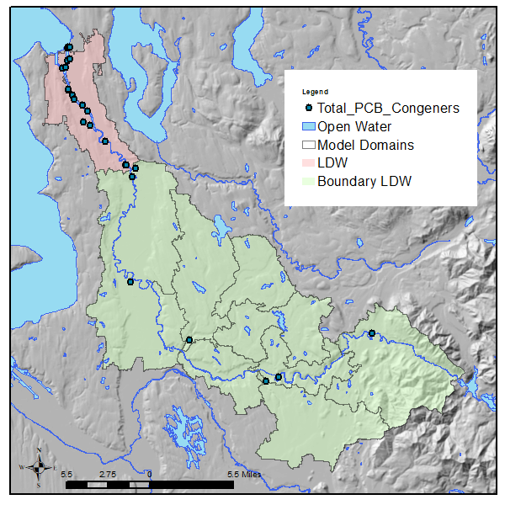
Calibration Method
Calibration Sequence
Flow rates
HHD Dam
Tributaries & River
Hourly & Daily
Water Quality
(setup)
Develop HHD Loads
Initial State
(conc. & mass)
Sensitivities
Atmospheric Dep.
Groundwater
Variables
- define potency - adjust washoff
Particulate &
Soil
Dissolved &
Sorbed (conc.)
Adjust
Bed Sediments
(conc.)
Notes:
Both visual and statistics are used to evaluate the toxic concentration result. Also, we look at the total load to LDW.

Slide 5
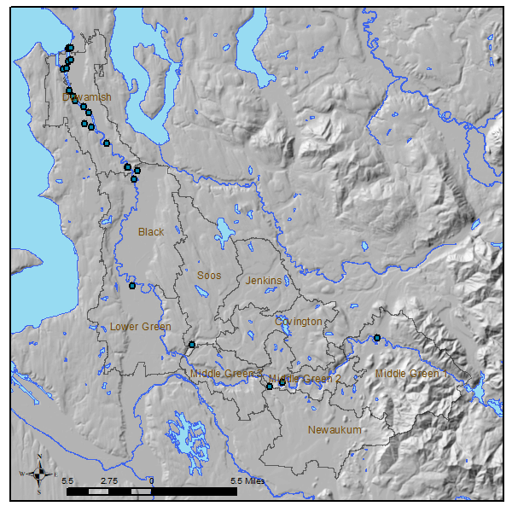
Calibration Table
Model Status
LDW (Black + Lower Green)
Reach 604
Notes:
Duwamish – Hamm Creek, a lot of tributaries.
Upstream stations, tidal influenced.
1st round toxic calibration is complete. still rooms for the improvements. We found it necessary to go back to repeat the process.

Slide 6
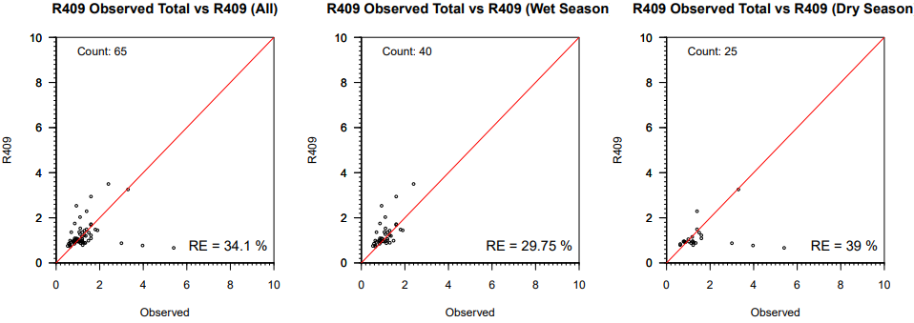
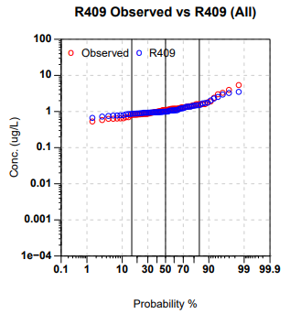
Whole water Total Arsenic (µg/L) – A315 (Lower Green)
Arsenic Time Series
Time Series
A315: Mill Creek at the bridge at 68th Ave and South 261st Street
Total Arsenic
All data
Wet Season
Dry Season
Cross Plot
Probability
Notes:
Meaning of the plots

Slide 7
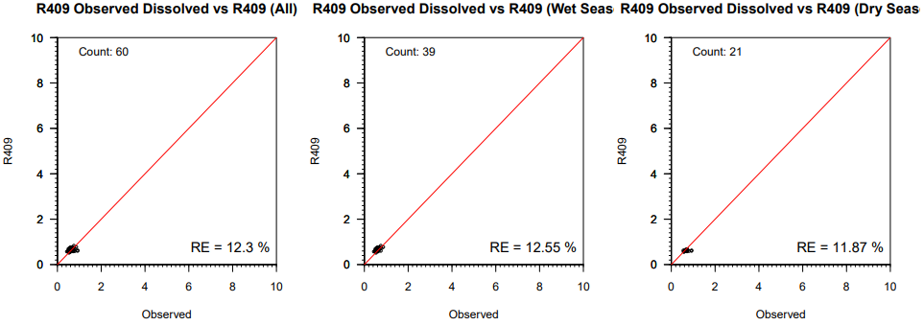
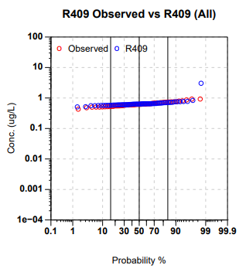
Dissolved Arsenic (µg/L) – A315 (Lower Green)
Arsenic Time Series
A315: Mill Creek at the bridge at 68th Ave and South 261st Street
Dissolved Arsenic

Slide 8
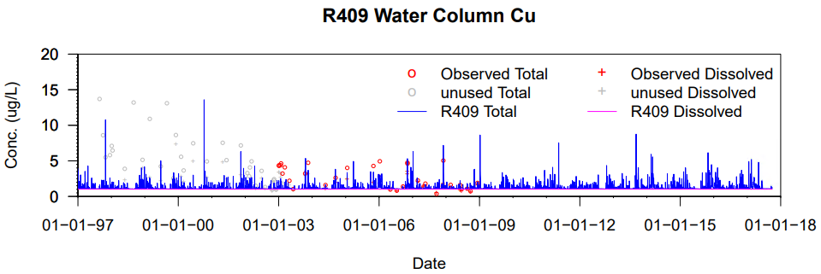
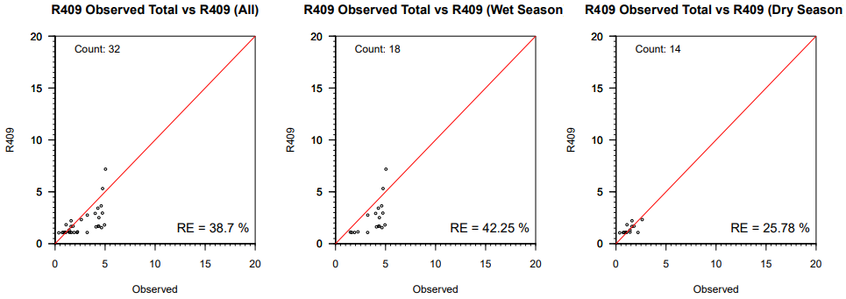
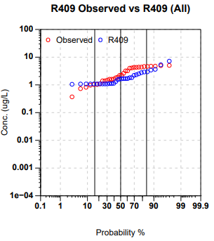
Revised Whole water Total Copper (µg/L) – A315 (Lower Green)
Copper Time Series
Copper Time Series
A315: Mill Creek at the bridge at 68th Ave and South 261st Street
Hard to fit
Total Copper
Notes:
Scatter plots to five years.

Slide 9
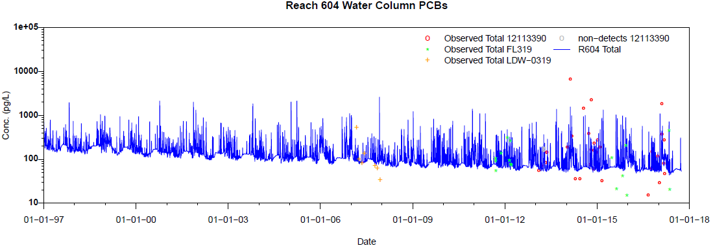
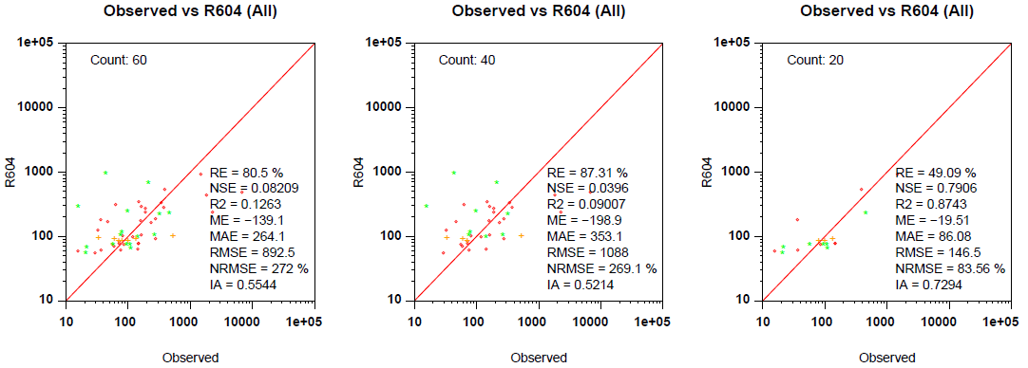
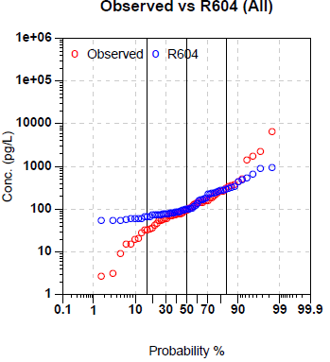
Whole water Total PCB (pg/L) to LDW – Reach 604
12113390
FL319
LDW-0309
Notes:
Improve, start from a Table.

Slide 10
Next
Further optimize model parameters by
reconsidering the spatial difference
double-checking the spatial pattern, and
readjusting the spatial parameters
Continue adjust and/or modify
sediment bed concentration
adsorption/desorption rate
partition coefficient
groundwater concentration
Improve upstream toxic boundary condition at HH Dam, if applicable
Apply building age to the parameterization

