Slide 1
Things to Consider based on WRIA 1 Experience
April 11, 2019
Andrew B. Dunn

Slide 2
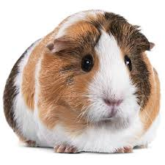
Background
WRIA 1 – Nooksack
Whatcom and Skagit Counties
Watershed Staff Team
Ecology, Whatcom County, Lummi Nation and Nooksack Tribe, Whatcom PUD, City of Bellingham
Watershed Planning Unit
Larger, more diverse group
RH2 – provided technical assistance
Extremely tight timeline (<1 year)

Slide 3
WRIA 1 - Work Order
Define Subbasins
Calculate Per-Home Use and Consumptive Use
Determine Anticipated Future Growth Served by Permit-Exempt Wells (5 Options)
Calculate Anticipated Future Consumptive Use (7 Scenarios)
Identify Projects and Actions (100+)
Select Preferred Projects and Actions (45-20)
Evaluate Net Ecological Benefit
Policies (not completed)

Slide 4
Define Subbasins
Balancing Act
Too Big – Not enough detail on impacts
Too Small – Too many of them
Regardless, water for water mitigation will be easy in some and impossible in others

Slide 5
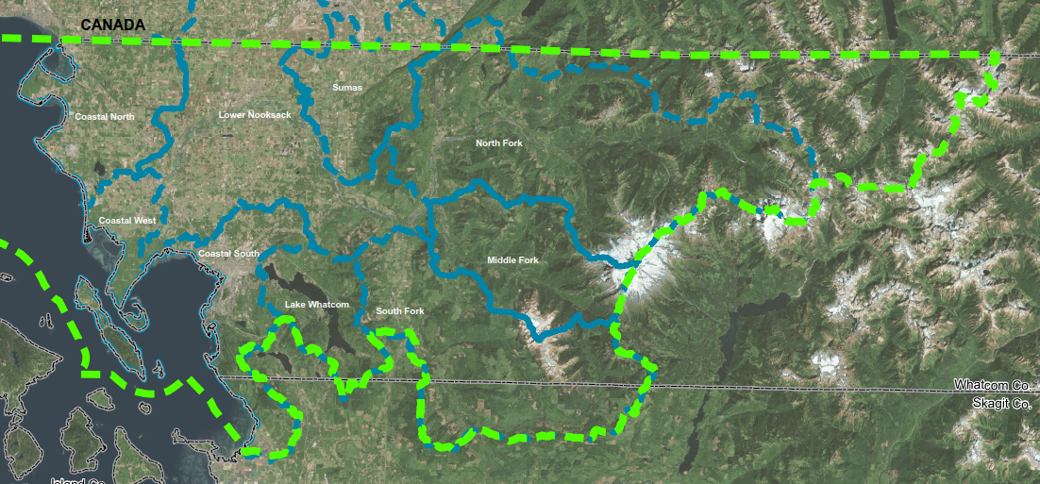
Define Subbasins

Slide 6
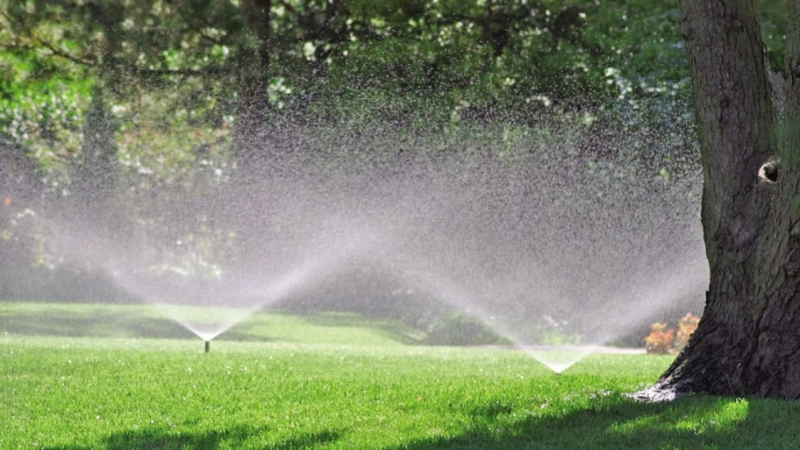
Consumptive Use Per home
Variable or fixed number of people per home?
Variable or fixed irrigated area?
Variable or fixed crop irrigation requirement?
Grass CIR:
Everett - 14.89”
Snoqualmie Falls - 14.32”
Monroe - 13.59”
Use Ecology’s numbers, or others?
Annual average or peak pumping?

Slide 7
Population Projections
2 Counties
Standard population projections look at inside and outside of UGA.
Is the growth data spatial?
What about Public Water Systems outside of UGAs?

Slide 8
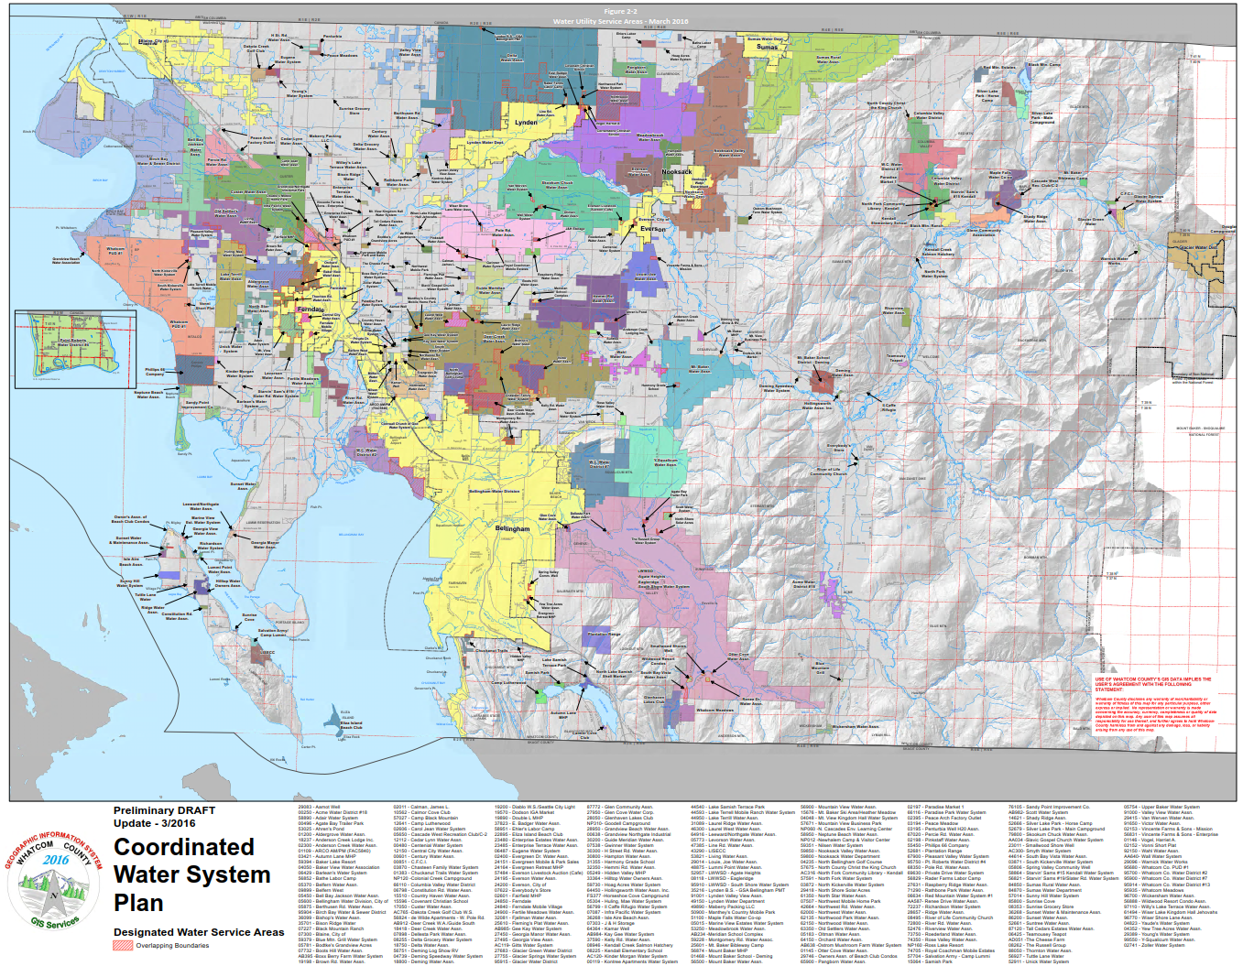
Population Projections

Slide 9
Interconnection
Future Consumptive Water Use
Policies
Consumptive Use Offset Projects/Actions

Slide 10
Suggestions
Don’t lose sight of the overall goal.
Accept that there will be uncertainty in everything.
Agree up-front on the level of detail necessary for different aspects of the work and stick with them.

Slide 11
WRIA 1 Documents – for Reference
https://wria1project.whatcomcounty.org/resources/draft-working-and-planning-documents/streamflow-restoration-act-planning-documents
Growth Projections (BERK Consulting)
Consumptive Use Impact Calculations (RH2)
Projects and Actions (RH2)
Net Ecological Benefit (Lummi Nation and Nooksack Tribe)

