Slide 1

Intro to subbasins- Wria 7
Streamflow Restoration
Water Resources Program
Washington State Department of Ecology

Slide 2
Why do we need subbasins for this process?
In RCW 90.94.030: The highest priority recommendations must include replacing the quantity of consumptive water use during the same time as the impact and in the same basin or tributary.
Population projection scenarios
Project identification and development
Notes:
Ingria:
RCW 90.94.030(3)(b) says plans must include actions to offset new consumptive use impacts in either 1) the same subbasin (higher priority projects) or 2) not in the same subbasin or only during critical flow periods (lower priority projects).
The fewer the number of subbasins, the more likely you’ll have more higher priority projects.
Key for NEB evaluation- highest priority given to water for water projects in the same place as the projected water use. We can include other projects, but will need to justify why a project in another part of the watershed should be counted towards offsetting water use on a stream in another part of the watershed.
Will support organization of population projections and scenarios and project ID

Slide 3
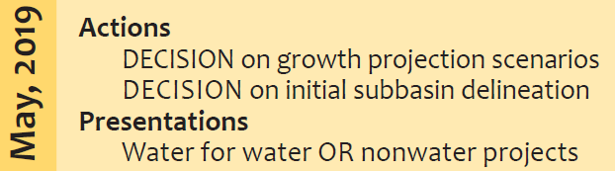
Timeline for Decision
February-April 2019: Discussion with committee to identify options and seek input
February-May 2019: Workgroup discusses subbasins and proposes options and recommendations
May 2019: Committee decision on initial subbasins
Fall 2019-Spring 2020: Revisit initial subbasin delineation to revise as necessary to align with project proposals
Notes:
Revisiting the handout from last meeting
Consultants and workgroup to support, but options will come to this committee for a decision

Slide 4
Options and Recommendations
Develop initial subbasin delineation now (as begin growth projections)
Revisit as we develop projects to refine as necessary
Identify a manageable number of subbasins
Support from technical consultant, ECY technical staff, workgroup
No right answer
Notes:
Too many subbasins will make project id difficult

Slide 5
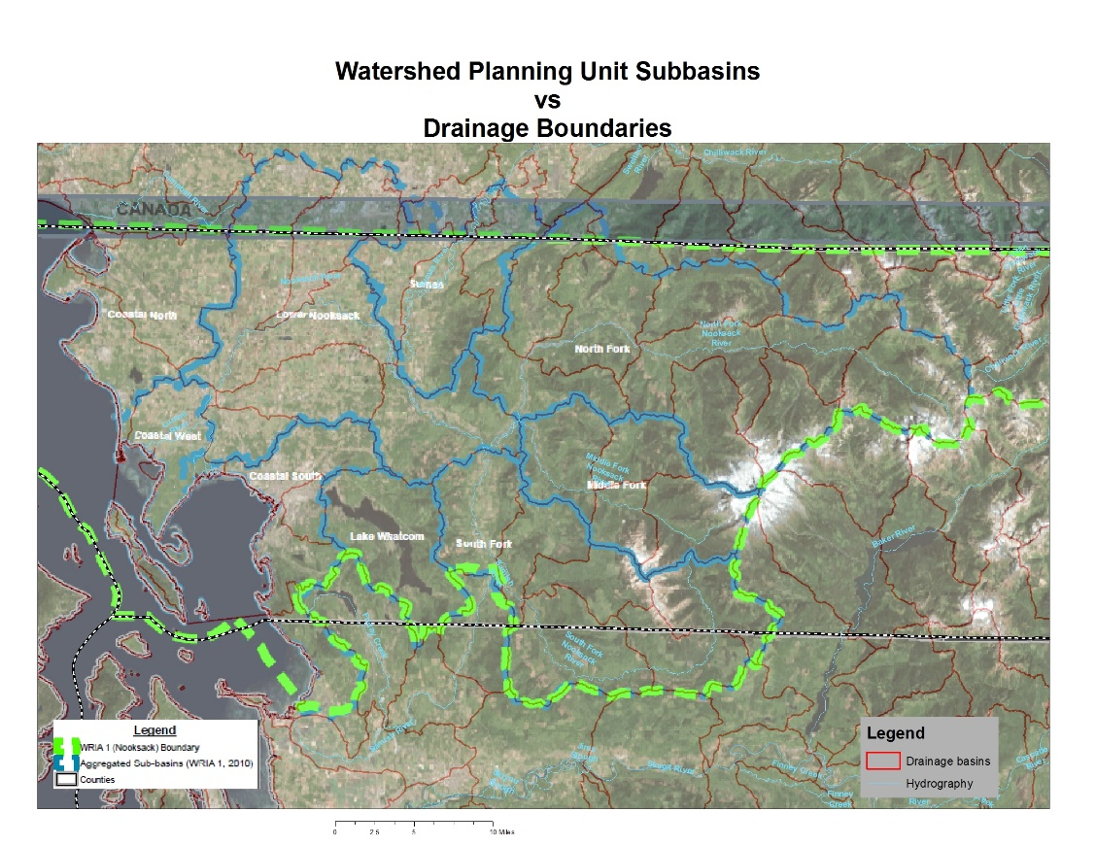
Introduction to Subbasin Delineation for Watershed Restoration and Enhancement Plans
Planning groups must delineate subbasins within WRIAs, and these must be suitably sized to allow meaningful determinations of whether offset projects are in-time and in same subbasin, without being so small that they are unwieldly.
In some instances, subbasins may not correspond with hydrologic basin delineations (i.e. watershed divides).
WRIA 01 has 49 USGS HUC12 subwatersheds and
9 Planning Unit subbasins
Notes:
John Covert:
Sub-basins are required to meet NEB and will help the Committee to plan and prioritize.
Remember that highest priority recommendations must include replacing the quantity of consumptive water use during the same time as the impact and in the same basin or tributary.
Lower priority projects include projects not in the same basin or tributary and projects that replace consumptive water supply impacts only during critical flow periods.

Slide 6
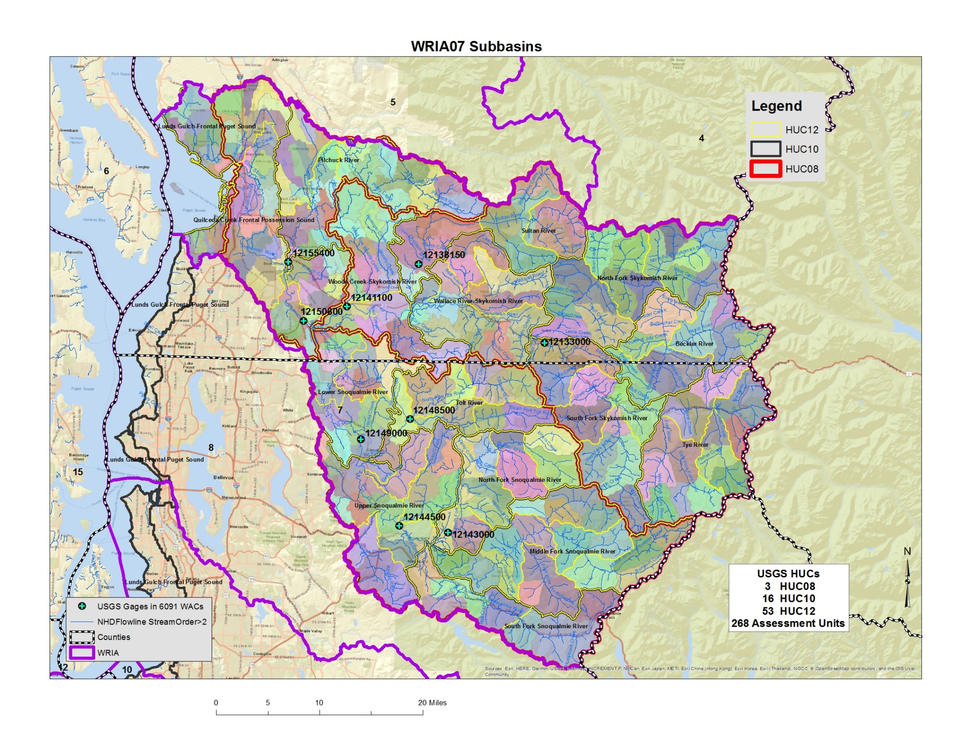

Subbasin Delineations by Hydrologic Unit Code (HUC) and Assessment Units
Too few of subbasins reduces our understanding of the relationships between where pumping effects will be and where benefits of offset projects will occur.
Too many subbasins can make it unwieldly to evaluate all of the offset projects needed to achieve a net ecological benefit for the WRIA.
Lower Snohomish Basin
Skykomish Basin
Snoqualmie Basin
Notes:
I developed an example map for you, using the USGS HUC (Hydrologic Unit Codes) are various scales: HUC08-subbasin; HUC10-watershed; HUC12-subwatersheds and overlaid them for WRIA 7. I also added even smaller Assessment Units that Ecology had developed several years ago.
There are three HUC08s in WRIA07; there are sixteen HUC10s; and fifty three HUC12s. There are 268 AUs as well.
While at some level all 268 drainages deserve some attention, it is important to keep in mind the purpose of this delineation process, which is to support estimating the consumptive impacts of new domestic exempt well uses in the WRIA. If no new wells are going to be constructed in a specific drainage, then there won’t be new impacts caused by new domestic wells in that area.

Slide 7
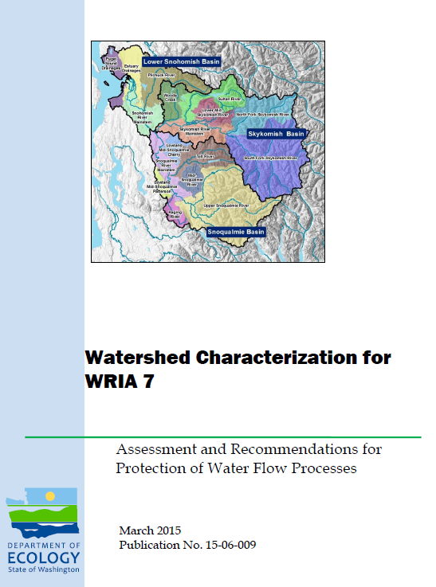
Salmon Recovery Forum Subbasin Delineations
2015 Work broke the basin into 17 subbasins
Source: https://fortress.wa.gov/ecy/publications/documents/1506009.pdf
Notes:
Previous planning efforts and studies have delineated sub-basins, for a variety of criteria.
This report was developed to support the efforts of the Snohomish Basin Salmon Recovery Forum in the development of an addition to their Salmon Conservation Plan for the Snohomish basin (Water Resources Inventory Area/WRIA 7).
The 2015 Watershed Characterization work broke the basin into 17 subbasins, using measures of water flow importance, water flow degradation, sediment process degradation, and salmon habitat importance (Give credit to authors, Colin Hume and others).
What was important for their planning effort drove the decision on what to measure and how to sub-divide the basin.

Slide 8
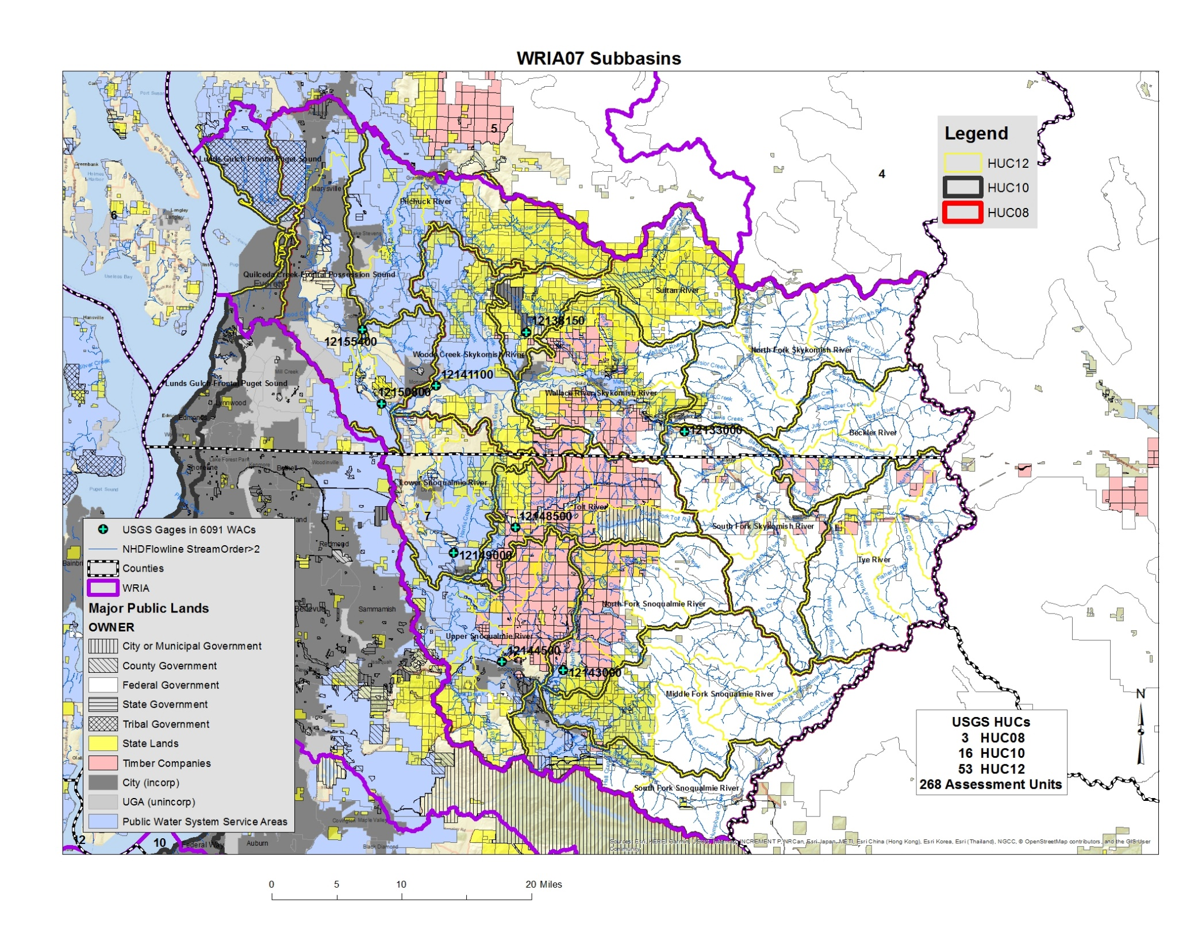
Location of New Domestic Exempt Wells Considerations
Where can new domestic exempt wells be drilled in the WRIA?
Notes:
The Committee will want to consider where growth is most likely to occur as it delineates sub-basins. In areas where very little growth is expected, the Committee may want to make sub-basins larger.
To make this map, I overlaid major public lands, parcels obviously owned by major timber companies (missing all the smaller ones), water system service area maps and the incorporated/UGA boundaries. Most of the polygons I added preclude domestic well new uses because the land is publicly owned or in commercial timber.
This shows that virtually the entire upper watershed isn’t likely to experience much new domestic exempt use in the coming decades. Much of the watershed seems to be unlikely to experience a lot of new, rural, domestic exempt well use. There isn’t that much real estate that isn’t either inside a water service area, or public land, or timber property.
Other considerations include hookup policies within UGAs and water service areas and whether water service areas have the capacity to serve new uses (‘blue’ areas on this map.)
Your Committee’s technical team and technical support will dive into the consumptive use estimates further.

Slide 9
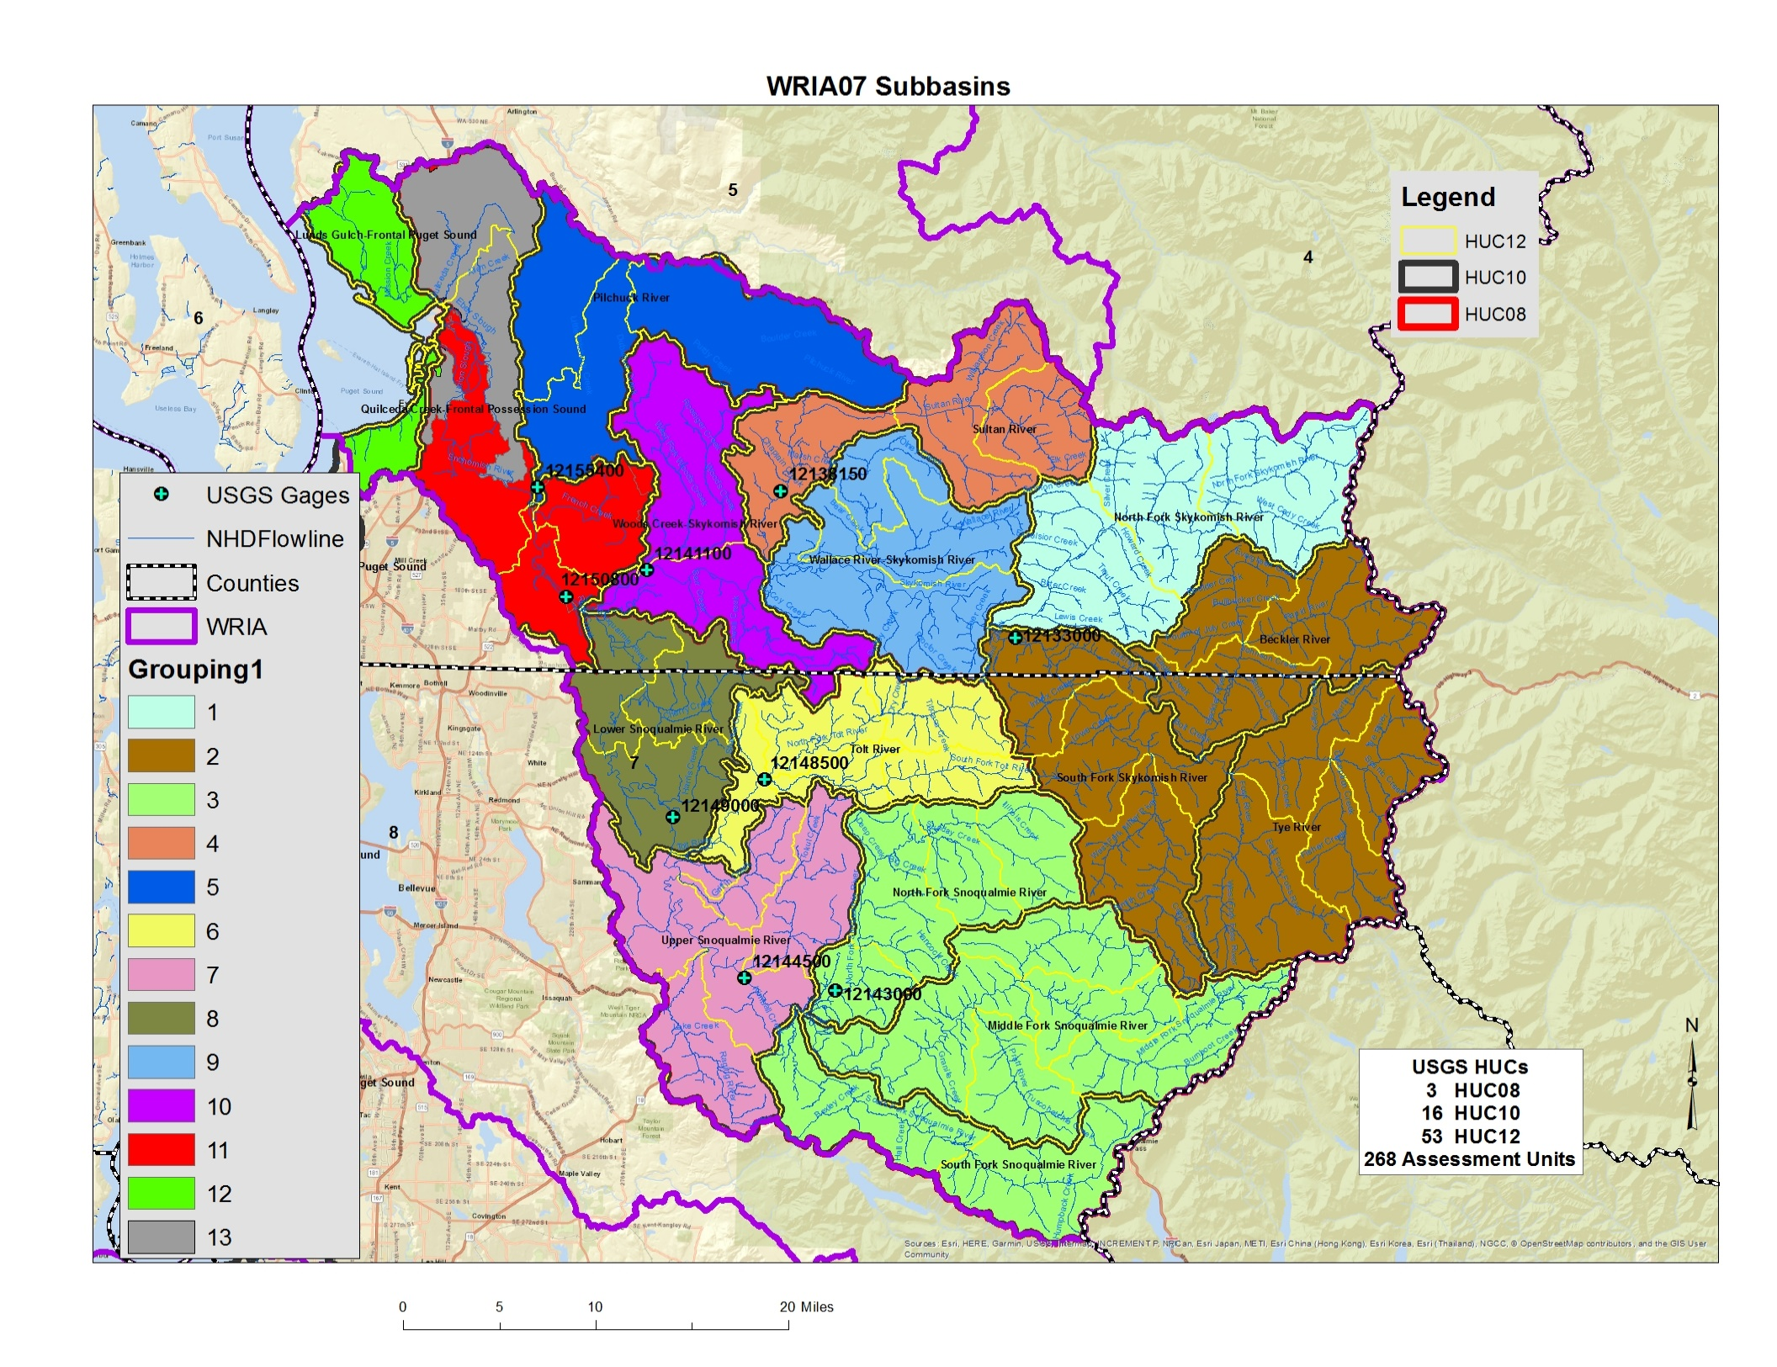
Example Subbasin Delineations by HUC Groupings
I ended up with 13 subbasins
Notes:
I created an example subbasin delineation for the Committee by combining the HUC10s together to arrive at 13 subbasins.
Since much of the upper watershed is federally owned, I combined these drainages. I’m quite certain that I have oversimplified the process and ignored very important information that I’m not aware of given my inexperience in the watershed.
I offer this as a strawman to start the conversation about how to do it correctly. “Ecology” is not proposing this as ‘the’ way to partition out the WRIA, it’s just someplace to start the conversation.

Slide 10
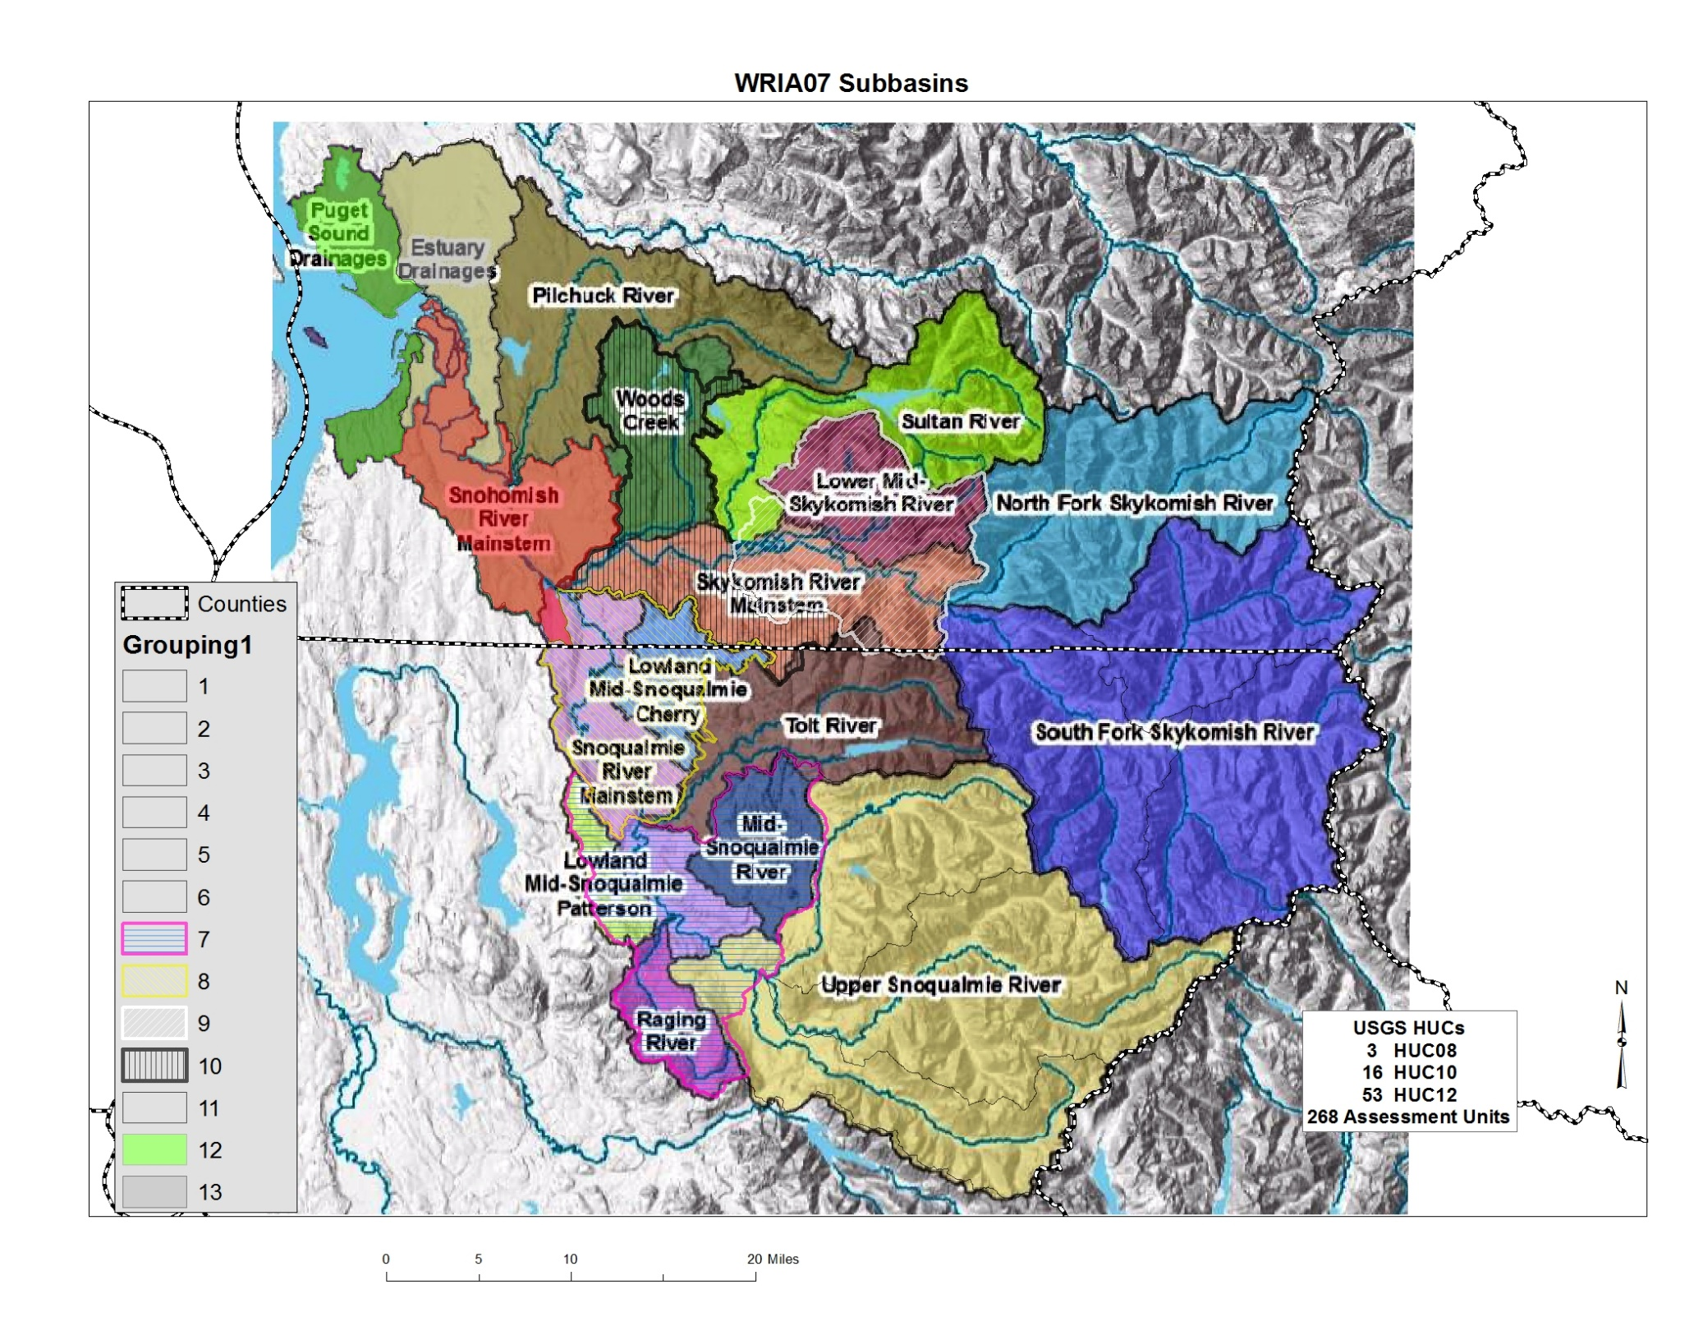
Comparison: Salmon Recovery Subbasins and Example HUC Groupings
.
2 HUCs [9&10] vs
3 shaded Drainages
2 HUCs [7&8] vs
5 shaded Drainages
Notes:
The salmon recovery subbasins and example draft map I created share the same 9 subbasins.
My map has four additional subbasins, the previous work uses eight different basins.
There are undoubtedly other layouts that make sense to the group.

Slide 11
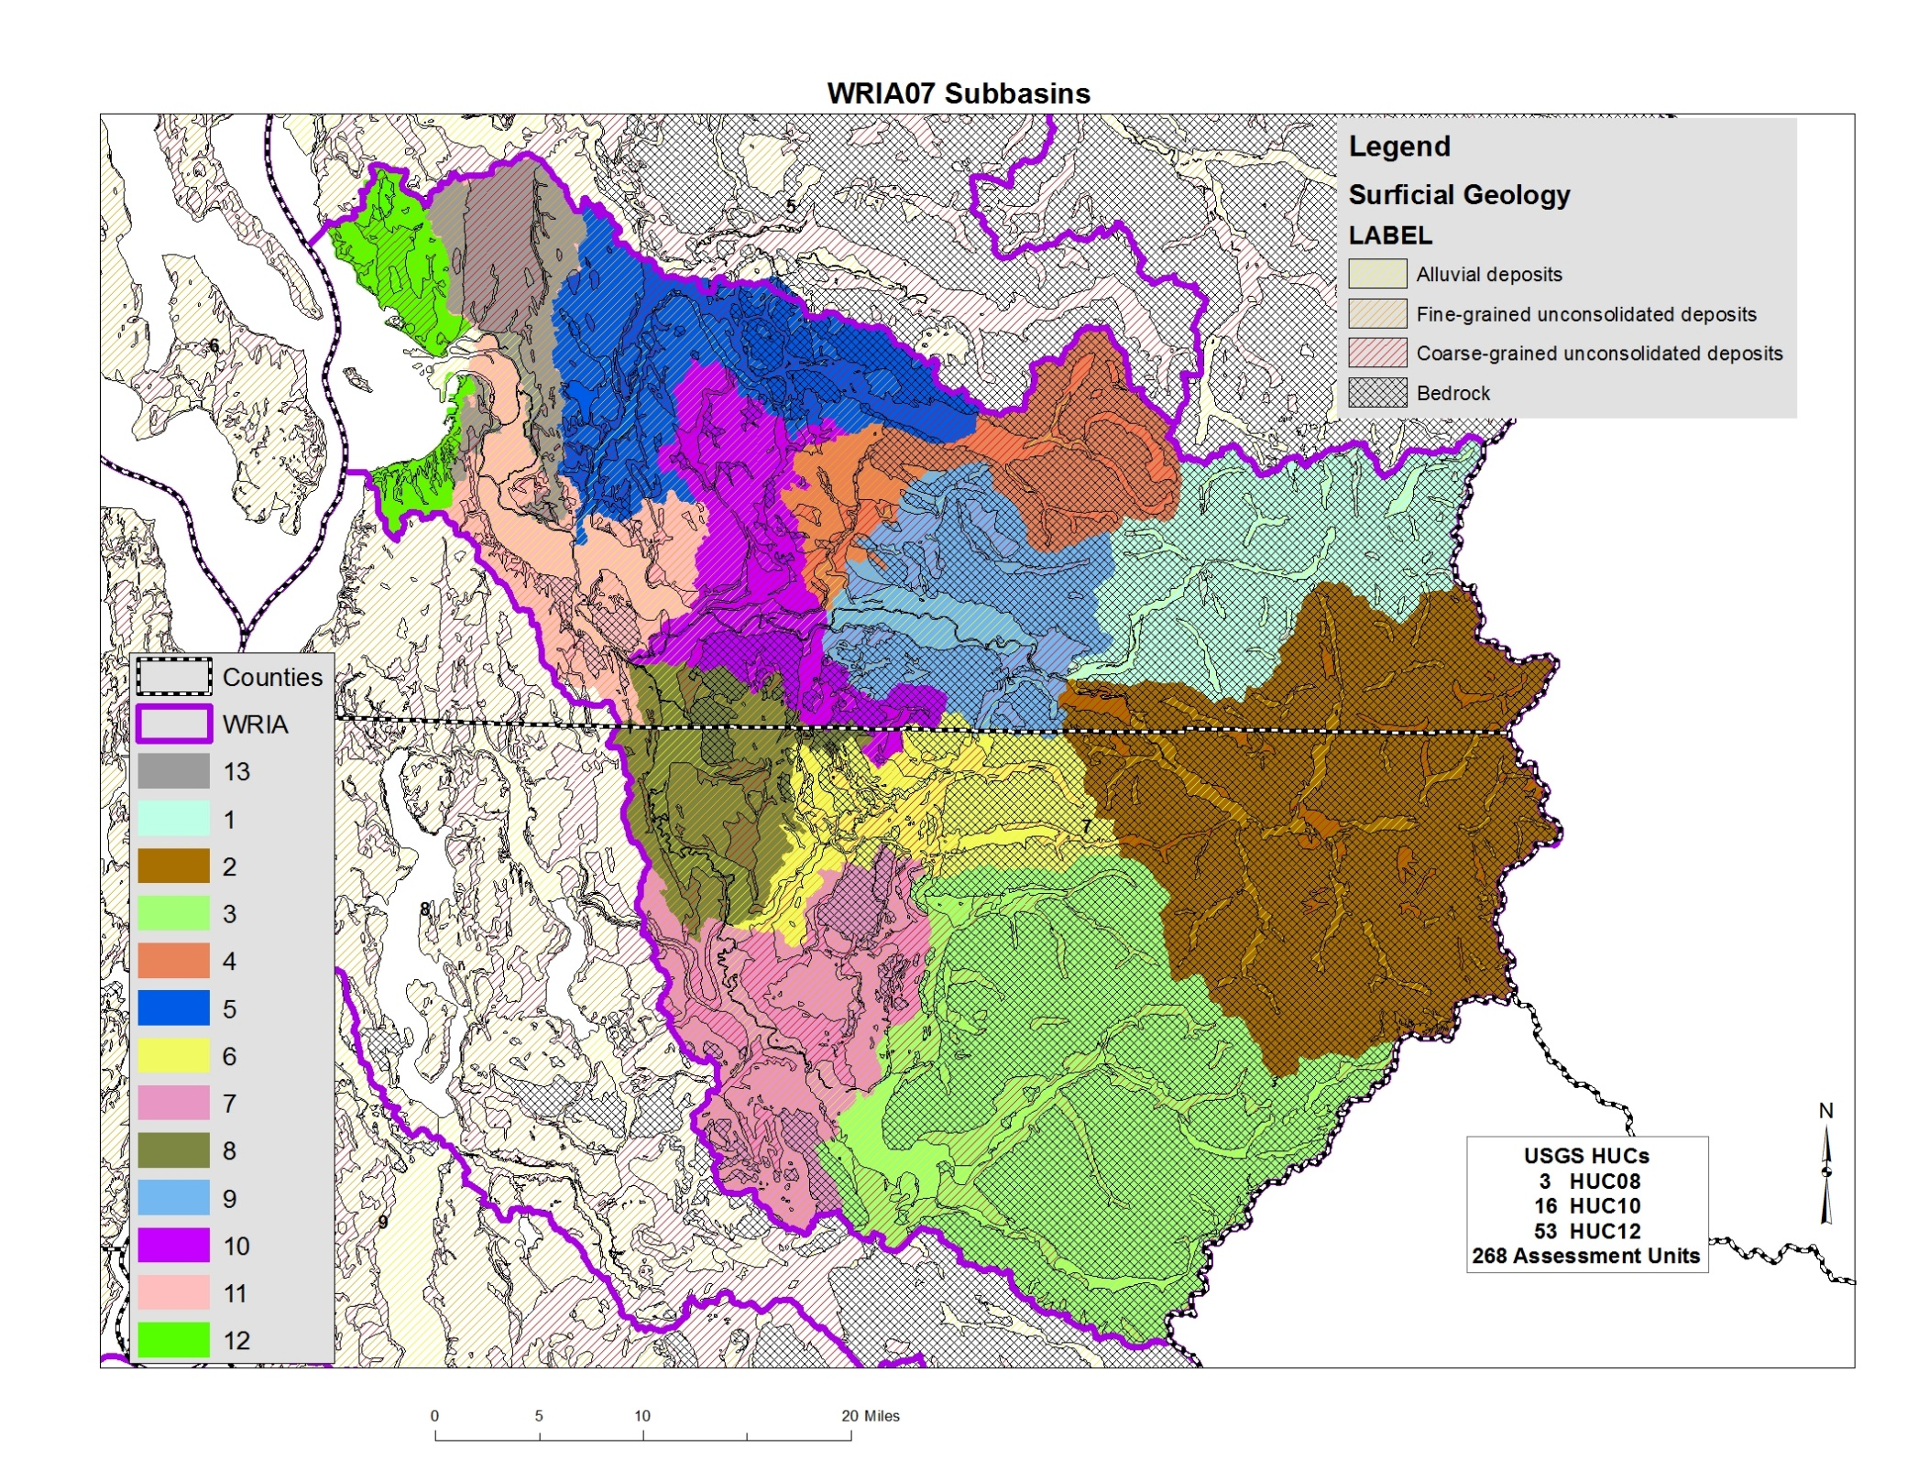
Hydrogeology Considerations
Notes:
The Committee may want to consider geology/hydrogeology
Bedrock geology is not likely to be a major concern in WRIA 7, unlike some WRIAs where the bedrock geology affected decisions about subbasin delineations.

Slide 12
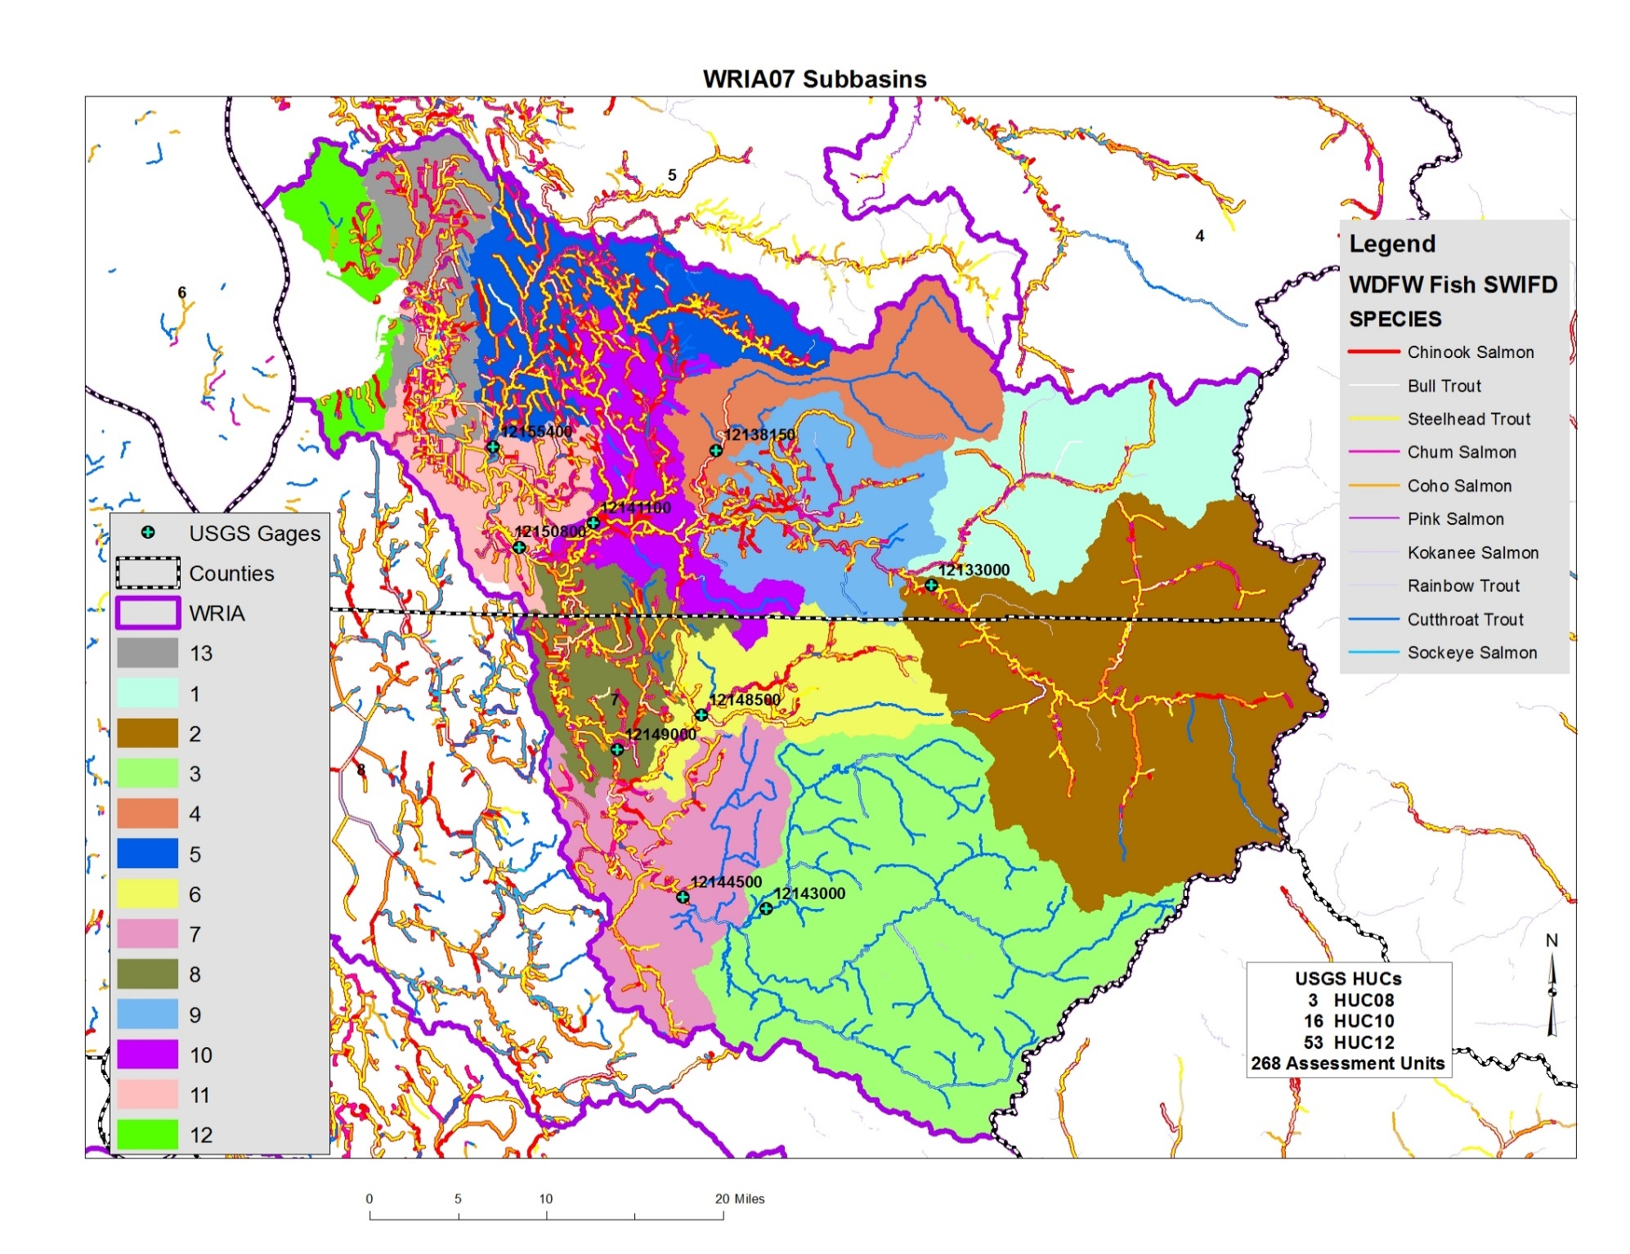
Salmon Distribution Considerations
Source: https://gispublic.dfw.wa.gov/arcgis/rest/services/MapServices/SWIFD/MapServer
Notes:
Committee may want to consider unique salmon habitat and species distribution

Slide 13

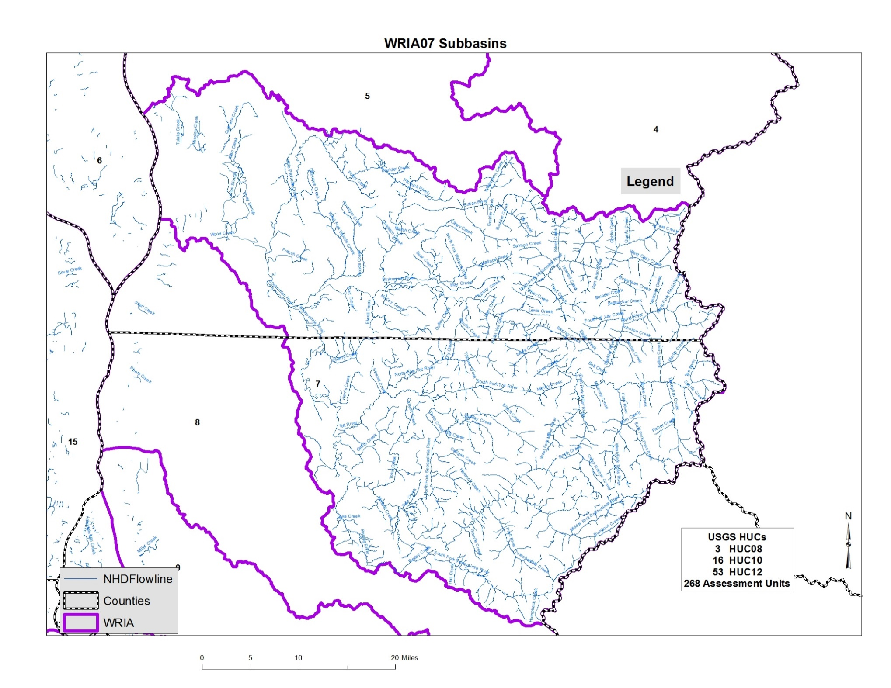
Notes:
The WRIA 7 Committee can choose how it will delineate sub-basins, taking into consideration the need to meet net ecological benefit.
Ecology is here to help. John Covert will try to make a few of our Committee meetings each year and assist where he can.

Slide 14
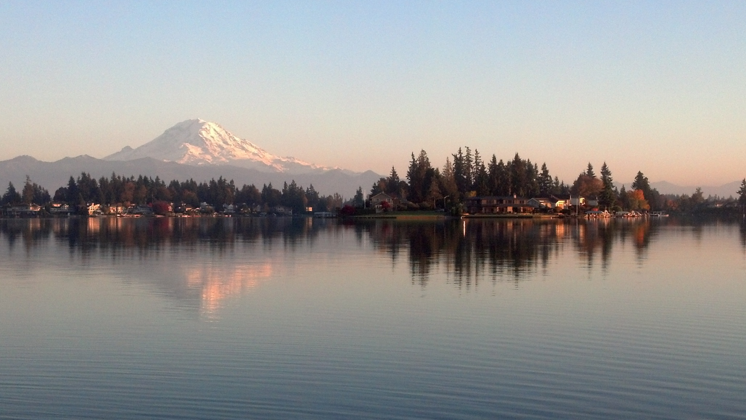

Department of Ecology
Water Resources Program
Notes:
Next steps:
Work with technical consultant and workgroup to begin teeing up ideas/options to bring back to the committee for input. Continue discussion next month, working towards decision in May.

