Slide 1
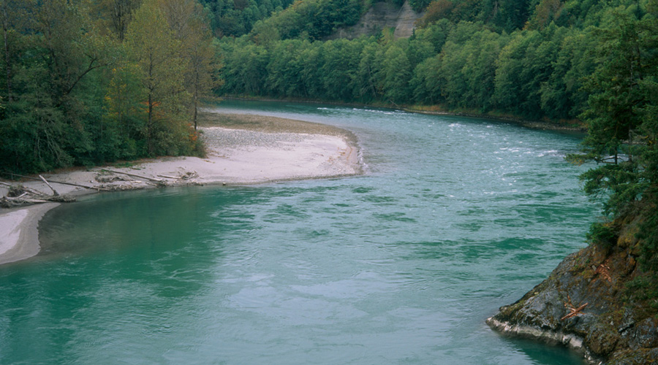

Hydrogeology for Streamflow Restoration,
RCW 90.94
John Covert
WDOE Bellingham
john.covert@ecy.wa.gov
February 14, 2019

Slide 2
3 Messages from Today:
Hydrogeologic Principles that demonstrate that groundwater and surface water are connected.
  (pumping domestic exempt wells does have an impact on streamflows)
Talk about the hydrology and geology of the Snohomish Basin.
Talk about Our Planning Group’s To Do List

Slide 3
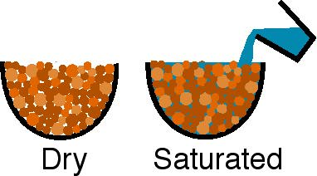
Place aquifer material (sand or gravel) in a bowl
Is the bowl full?
It appears to be full up to the brim.

Slide 4
There are holes (pore spaces) between the grains that can be filled with water

Slide 5
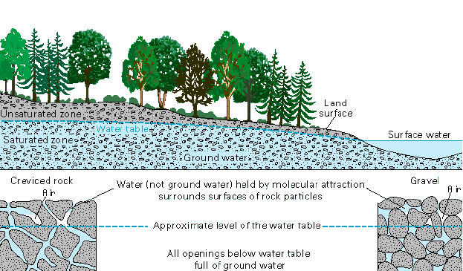
All pore spaces (openings) below the water table are full of groundwater

Slide 6
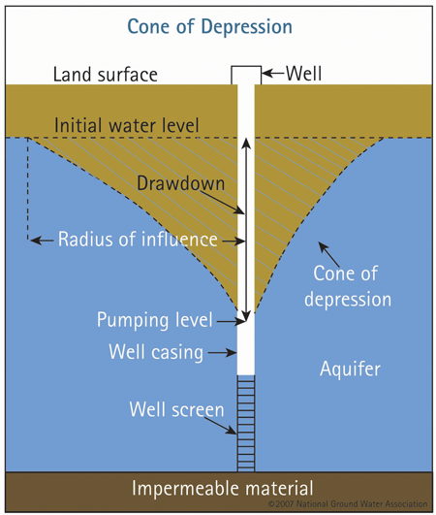
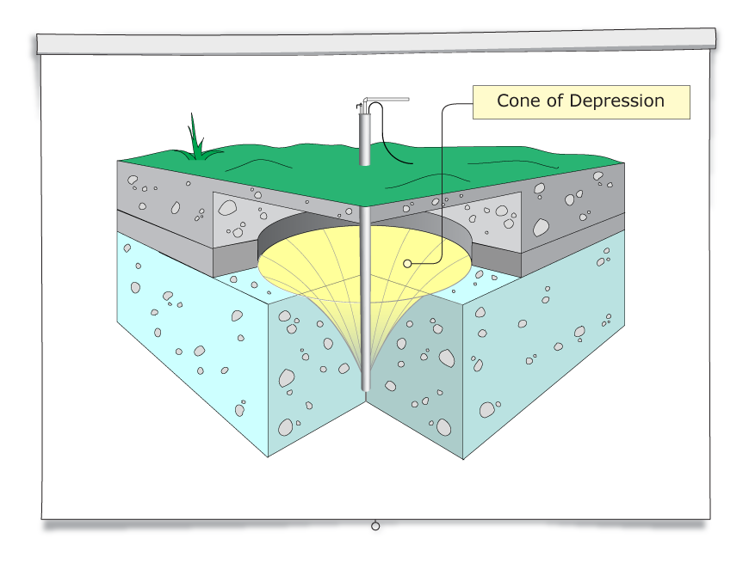

Slide 7
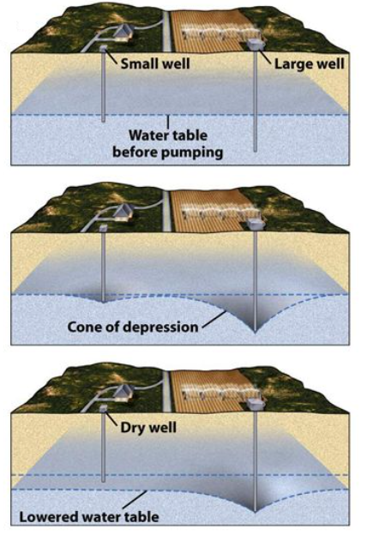
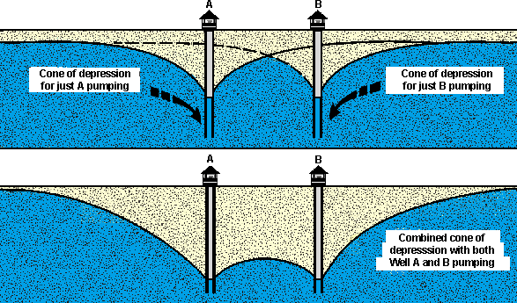
Well interference can lower the water table to the point where it leads to a dry well.
Notes:
INTERFERENCE OVERHEAD

Slide 8
Aquifers
Aquifer -- saturated earth material permeable enough to transmit useful quantities of water to a well
Aquitard -- saturated geologic material with low permeability; well yields low; also called “confining layer”
Confined Aquifer -- saturated geologic material below an aquitard
The water in the well rises above the bottom of the confining layer.

Slide 10
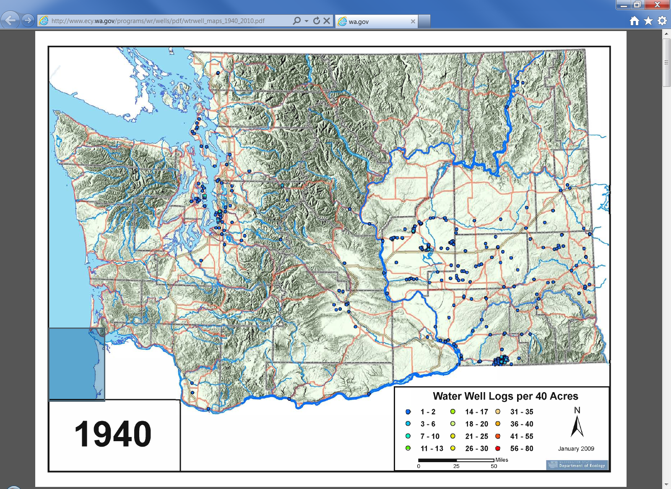
These are the pre-1940 wells that are listed in our well log database. There were more wells than this in the state (just not in our database).

Slide 11
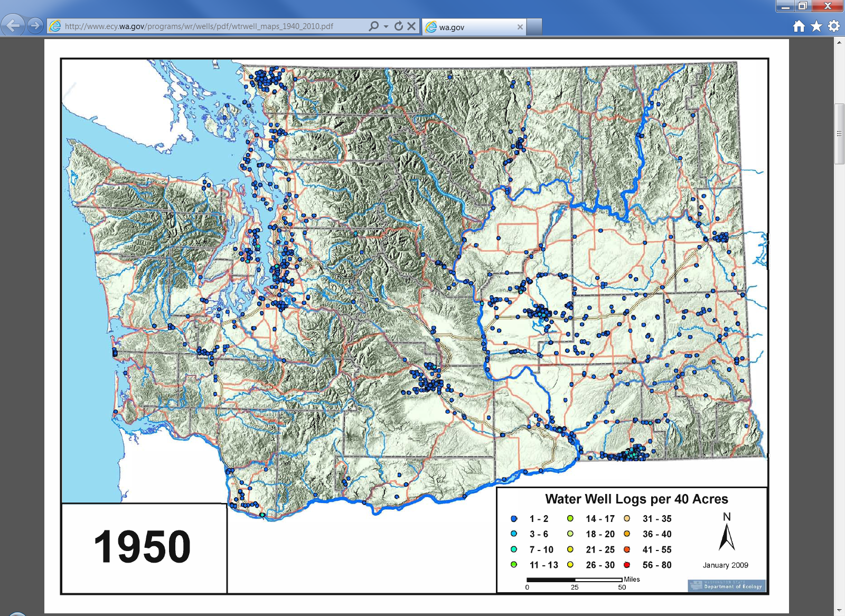

Slide 12
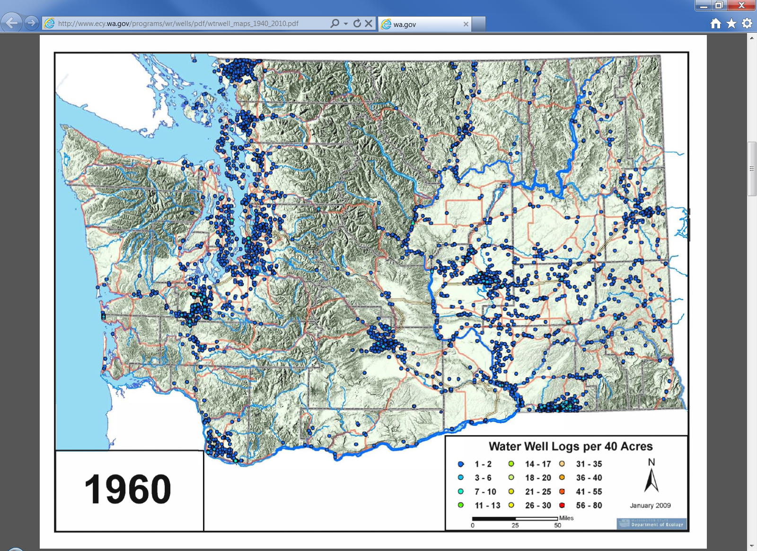

Slide 13
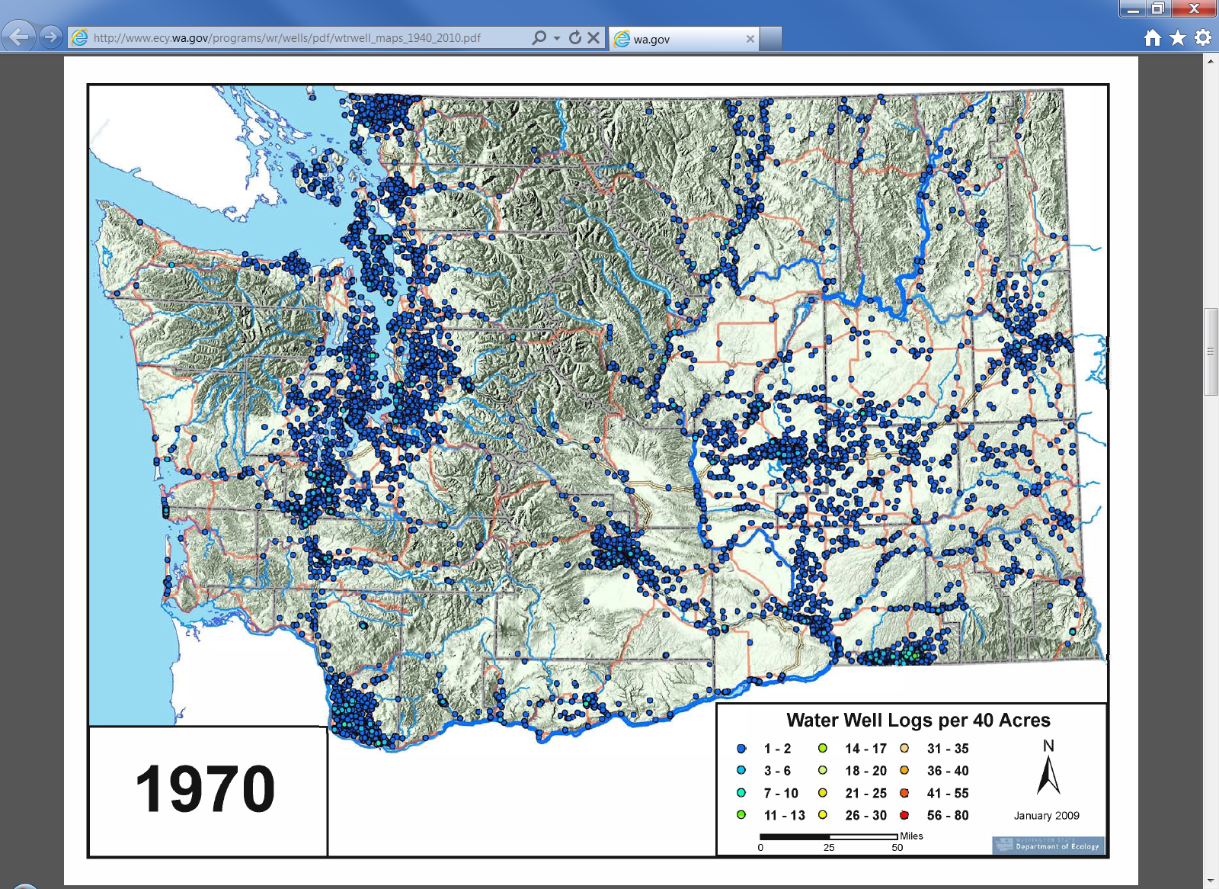

Slide 14
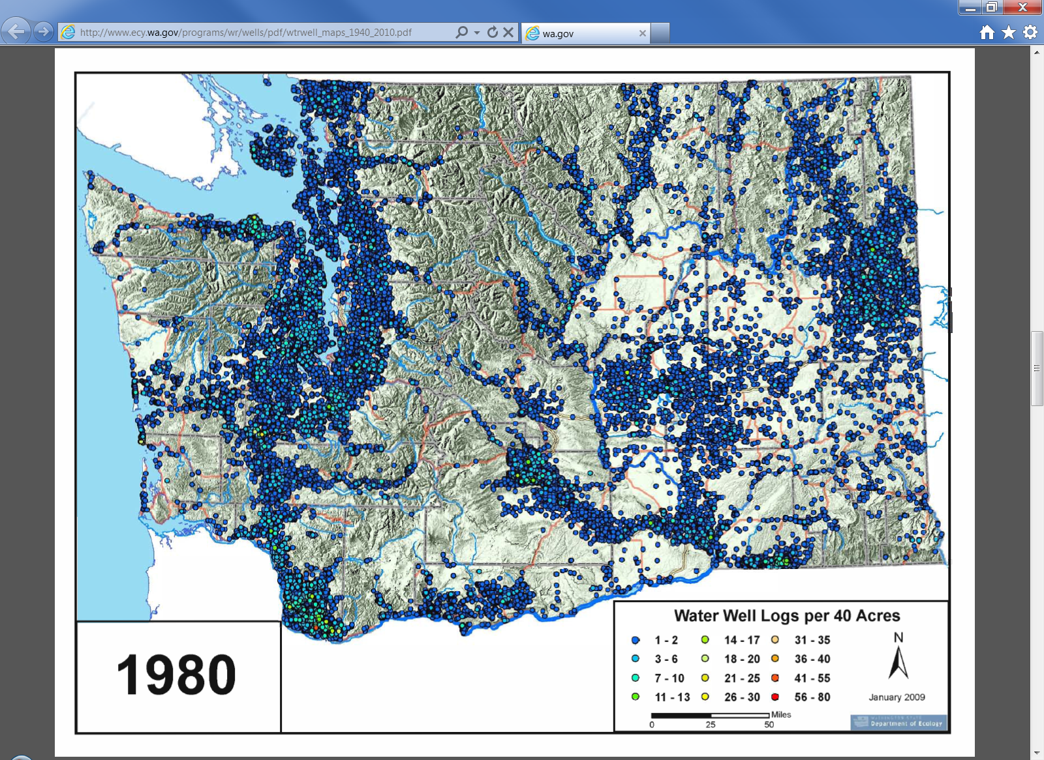

Slide 15
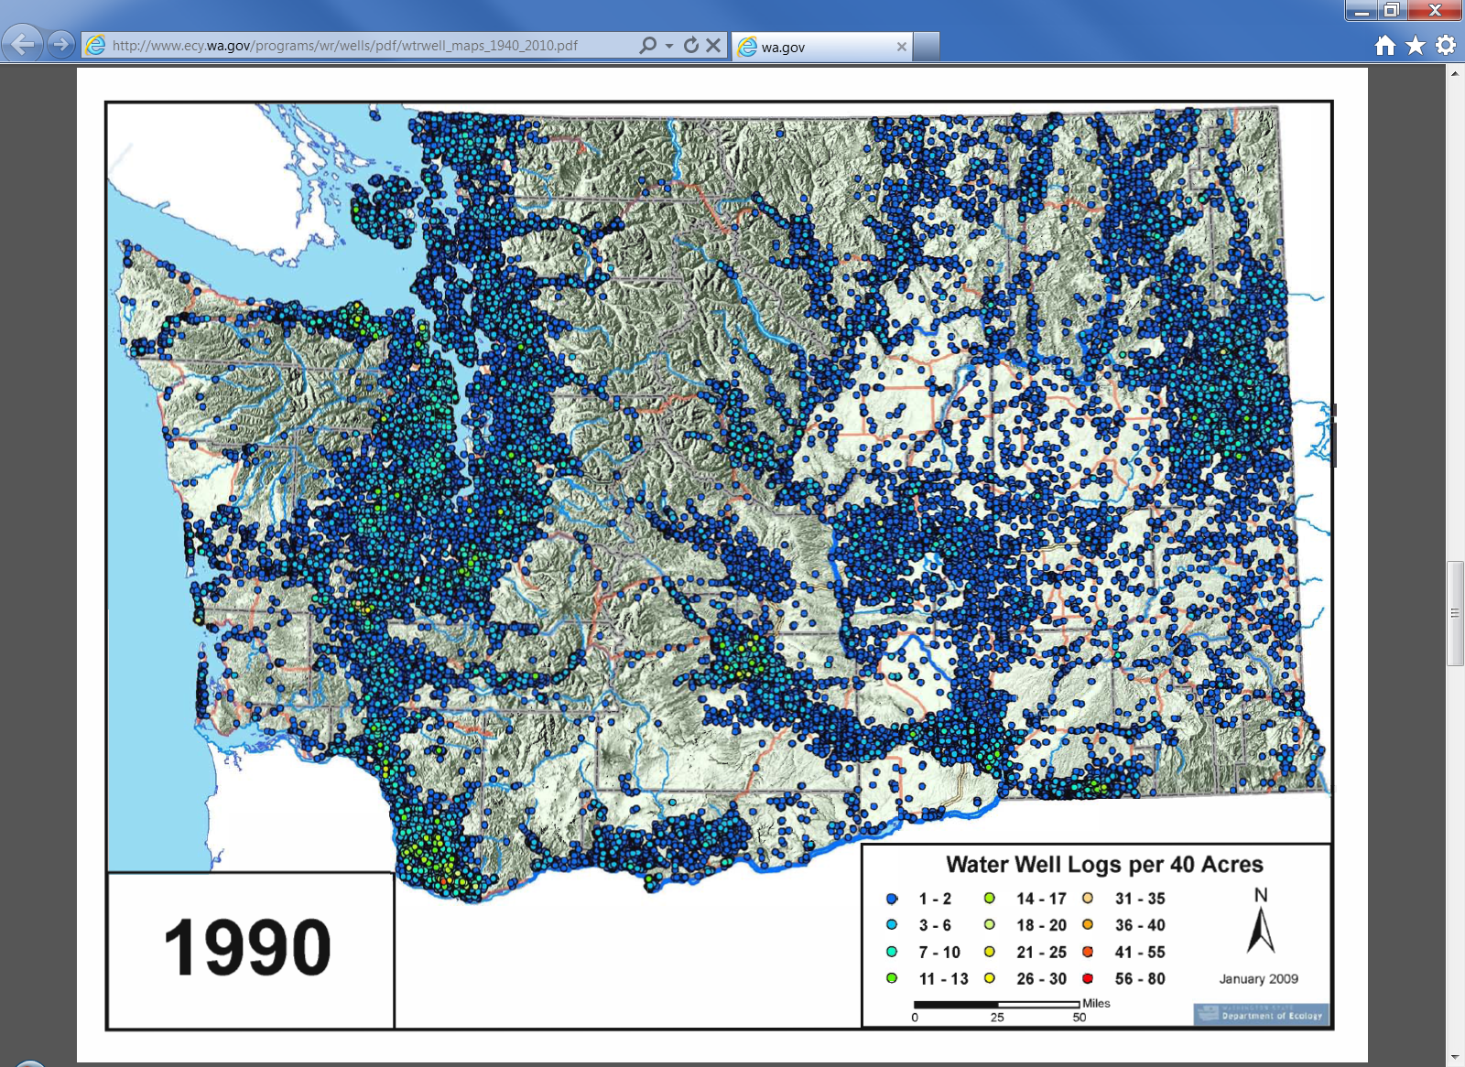

Slide 16
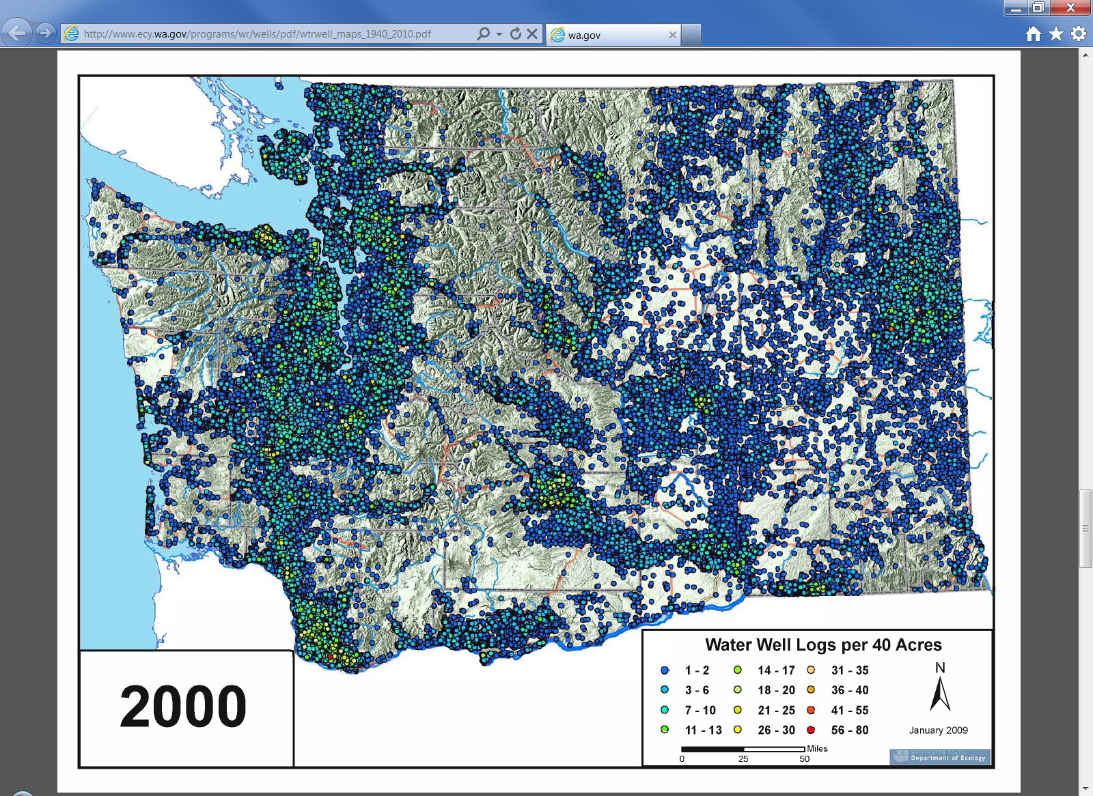

Slide 17
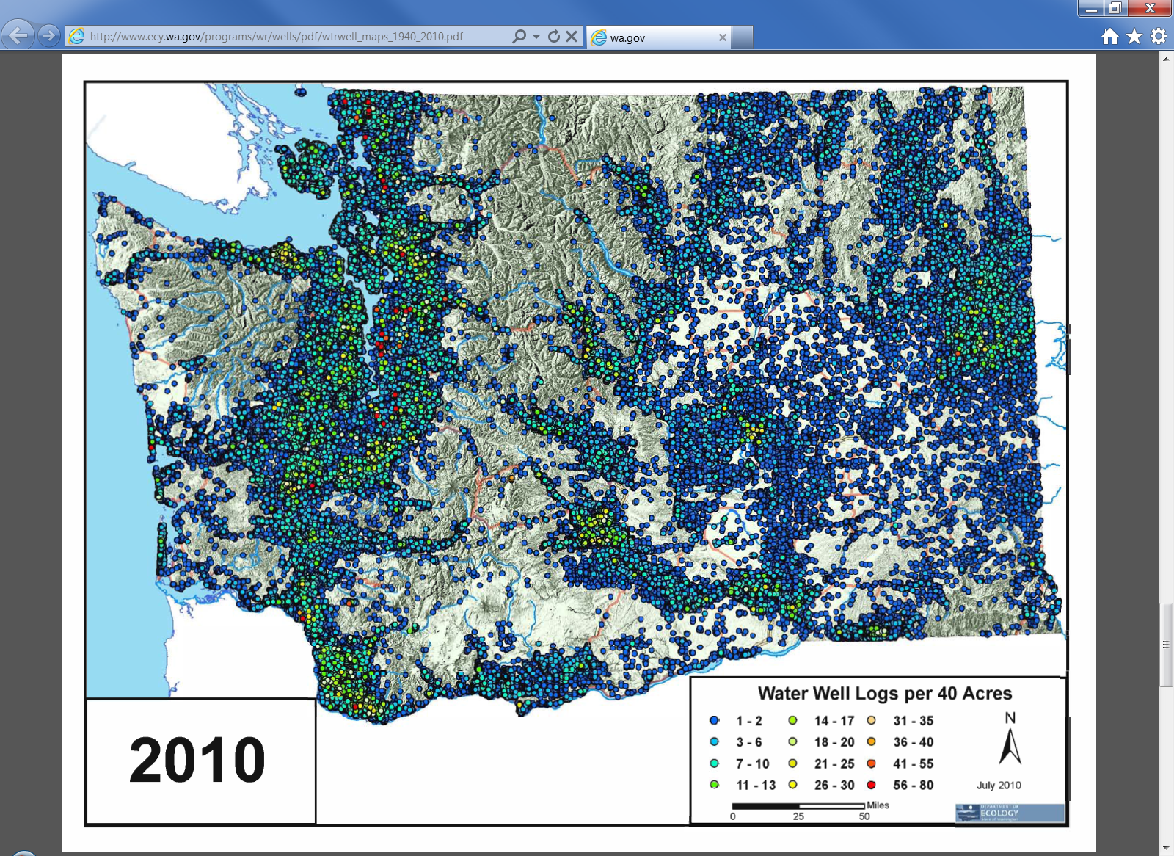

Slide 18
Example of an aquifer being mined by overpumping
Groundwater pumping for irrigation uses exceeds annual recharge in the basin and has resulted in declining groundwater levels for more than 70 years.
Numerous, shallow, hand dug wells in the Walla Walla Gravel aquifer have gone dry over the decades.

Slide 19
In addition to well interference issues, groundwater use can change the dynamics between an aquifer and its connected surface water body.
Groundwater flows from areas of recharge to it’s natural discharge area in a connected stream.

Slide 20
“Streams interact with ground water in three basic ways:
streams gain water from inflow of ground water through the streambed (gaining stream),
they lose water to ground water by outflow through the streambed (losing stream),
or they do both,
gaining in some reaches and losing in other reaches”
USGS Circular 1139, Winter et. al. 1998

Slide 21
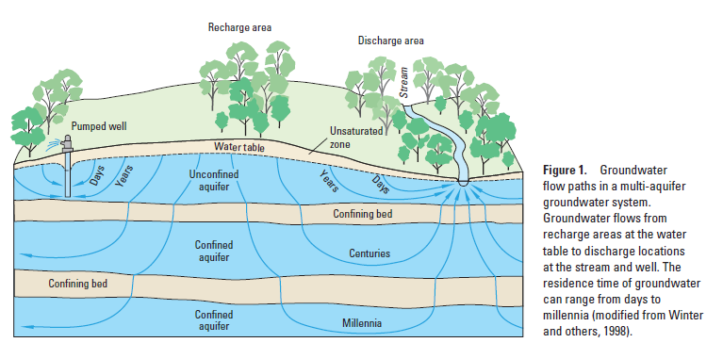

Slide 22
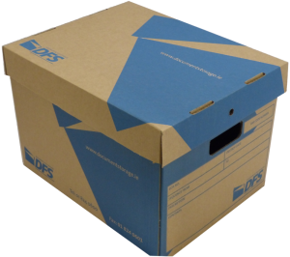

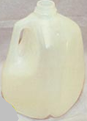
We measure streamflow in cubic feet per second (cfs). One cubic foot is the size of a standard archive box. It takes 7.5 gallons of water to fill one cubic foot.

Slide 23
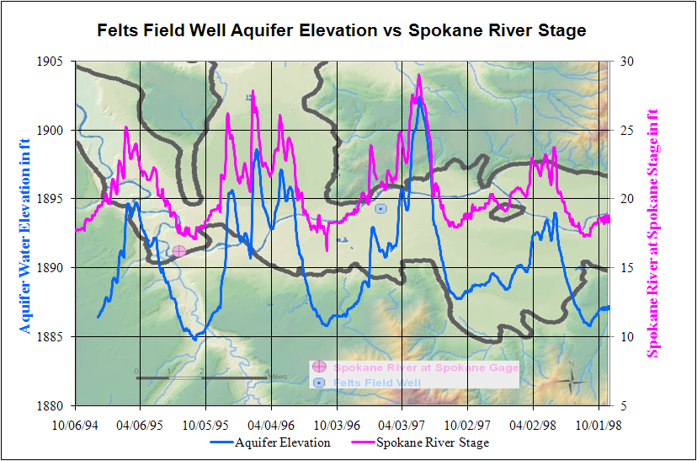

Slide 24
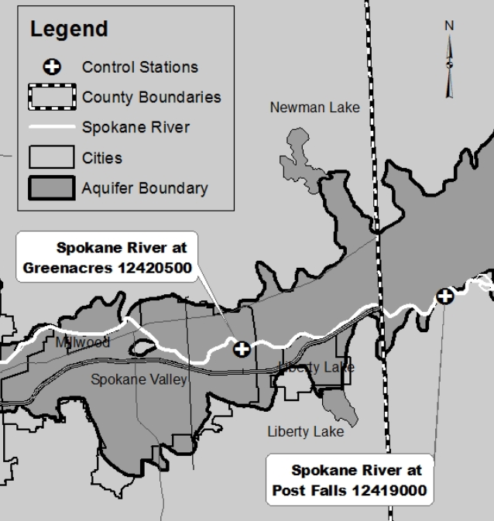
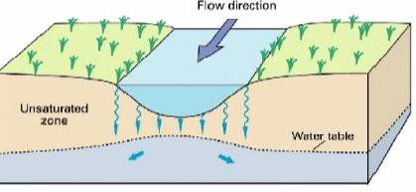
This portion of the Spokane River is an example of a losing river

Slide 25
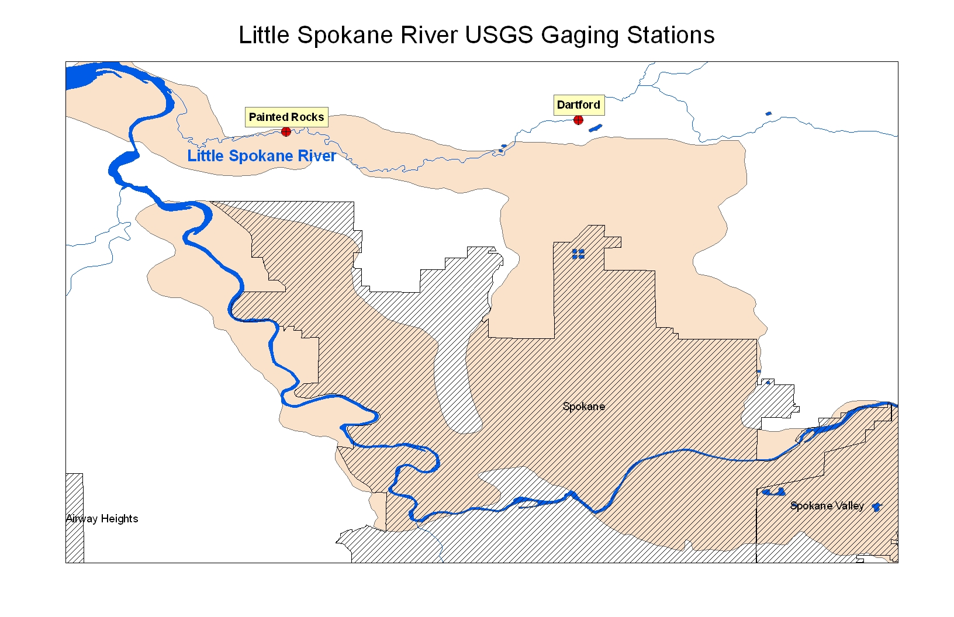
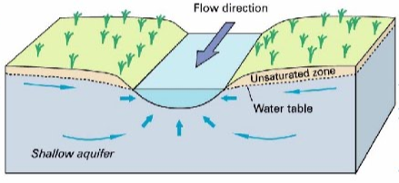
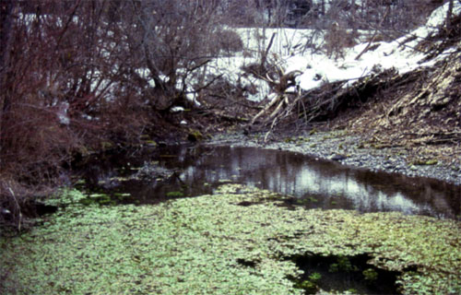
The Little Spokane River is an example of a gaining river
Griffith Spring

Slide 26
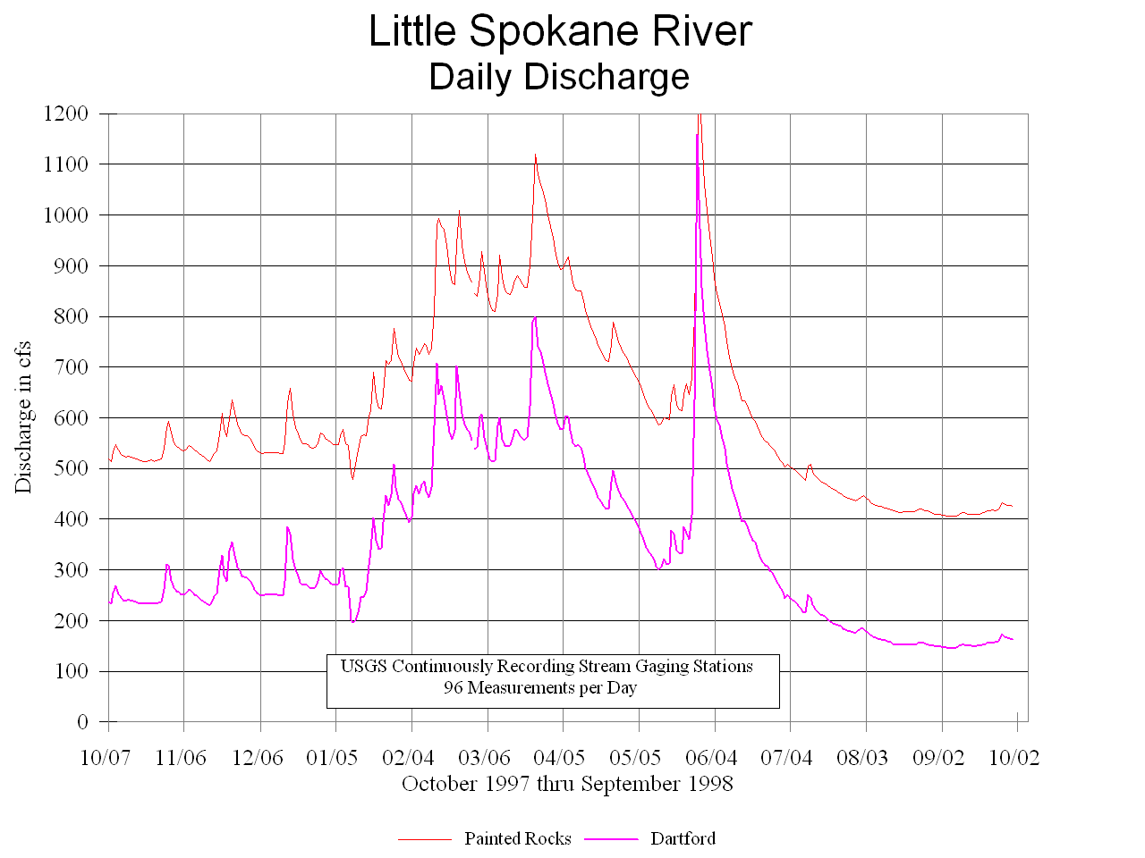
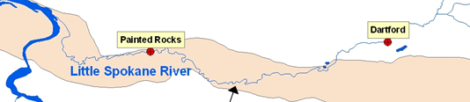
Spokane Aquifer discharges ~ 250 cfs to the Little Spokane River between Dartford and Painted Rocks

Slide 27
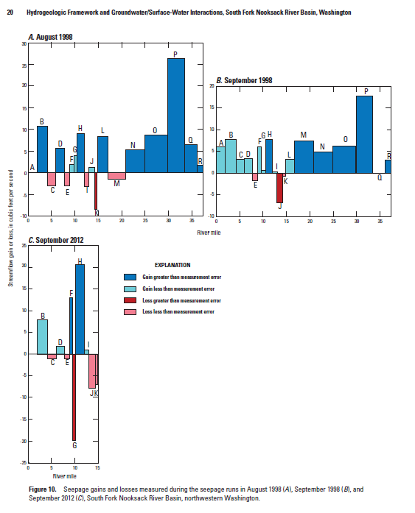
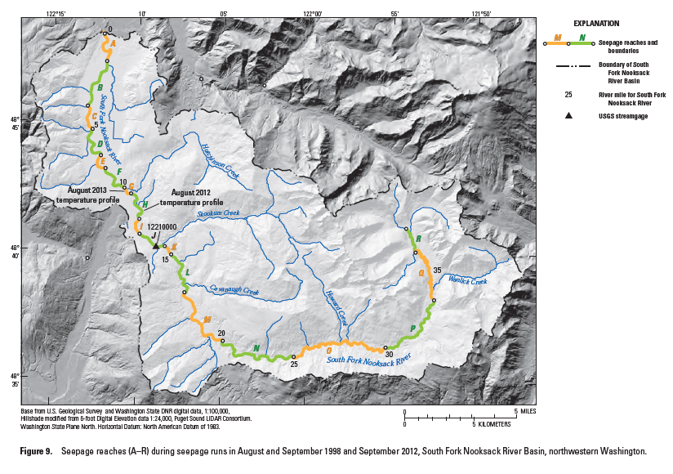

Gains and losses in flow can be within the measurement error of individual flow measurements making it harder to interpret.

Slide 28
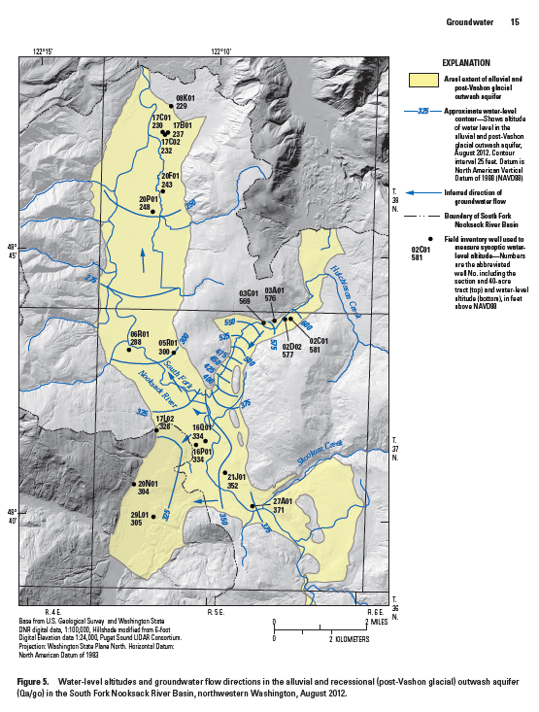
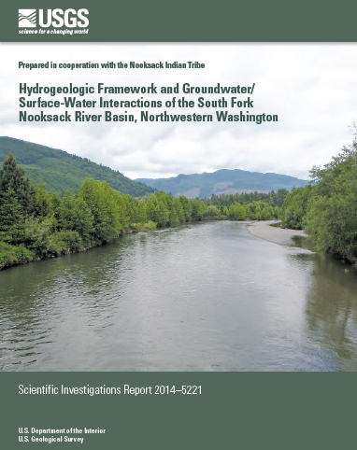
In valley aquifers, the groundwater flows parallel to streamflow for both the tributary and mainstem valleys.

Slide 29
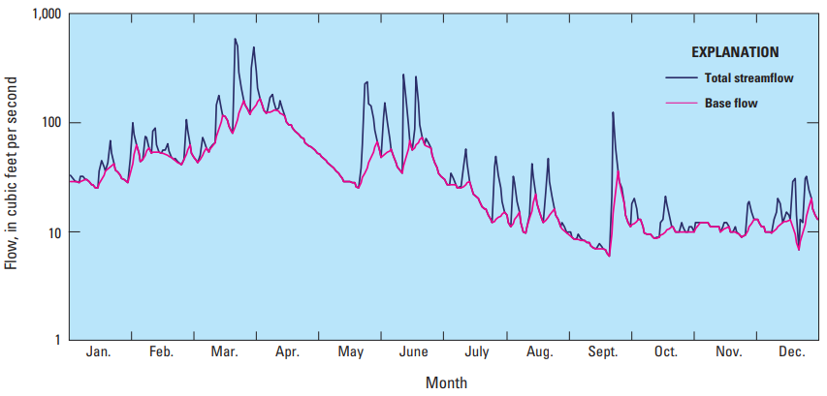
Given the interconnectedness of groundwater and surface water, it’s not surprising that a stream’s total flow is often comprised mostly of groundwater baseflow.
In WA state, groundwater baseflow contributes 68% of the total annual flow for 594 studied gages (WSB 60)
USGS’s 2012 Circular 1376

Slide 30
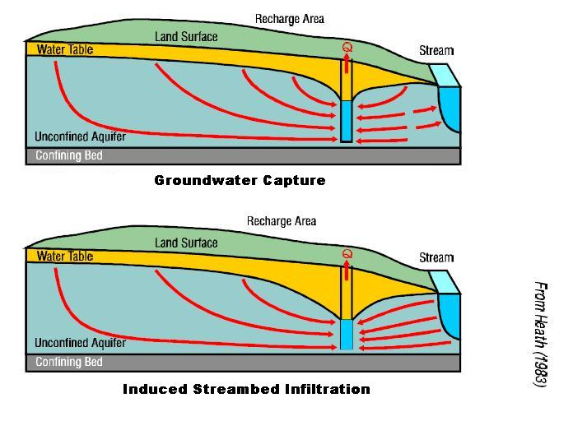
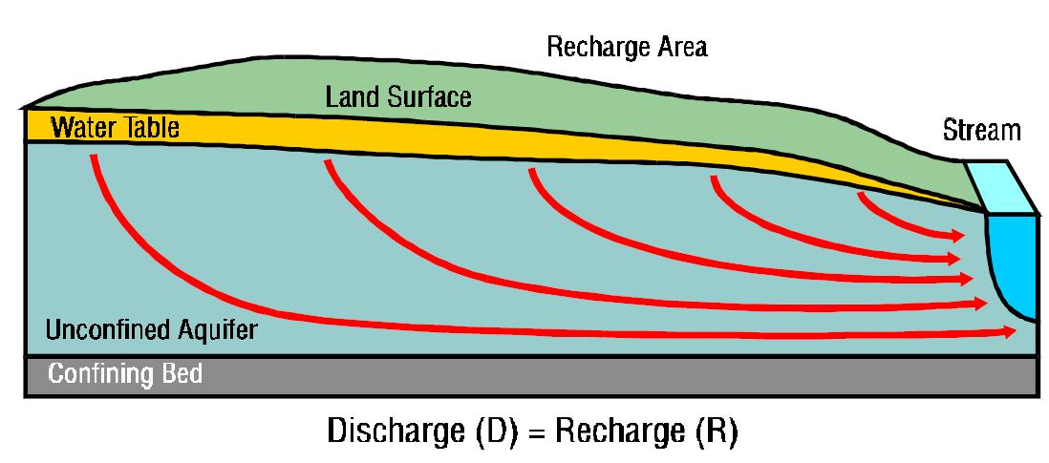
Groundwater pumping produces two separate components that contribute to total streamflow depletion:
The first component, groundwater capture, is the interception of groundwater flow tributary to the stream. This ultimately reduces the hydraulic gradient near the stream and baseflow to the stream. Streamflow depletion from groundwater capture usually continues after pumping ends and may require long periods of time to recover.
The second component, induced streambed infiltration, occurs when the pumping causes surface water to be pulled from the stream toward the well.

Slide 31
Groundwater declines have led to diminished discharge
Springs and seeps within the watershed that used to be fed by this aquifer have slowly dried up as the head in the aquifer declined.

Slide 32
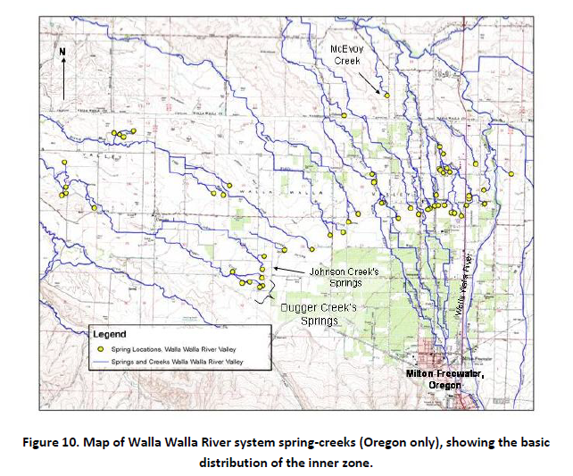

Slide 33
Groundwater and Surface Water are interconnected. Pumping aquifers affects streamflow (or Puget Sound).
As more wells get drilled in your watershed, they will have an impact on streamflow.
Let’s look at the Snohomish Basin Hydrology and Geology.

Slide 34
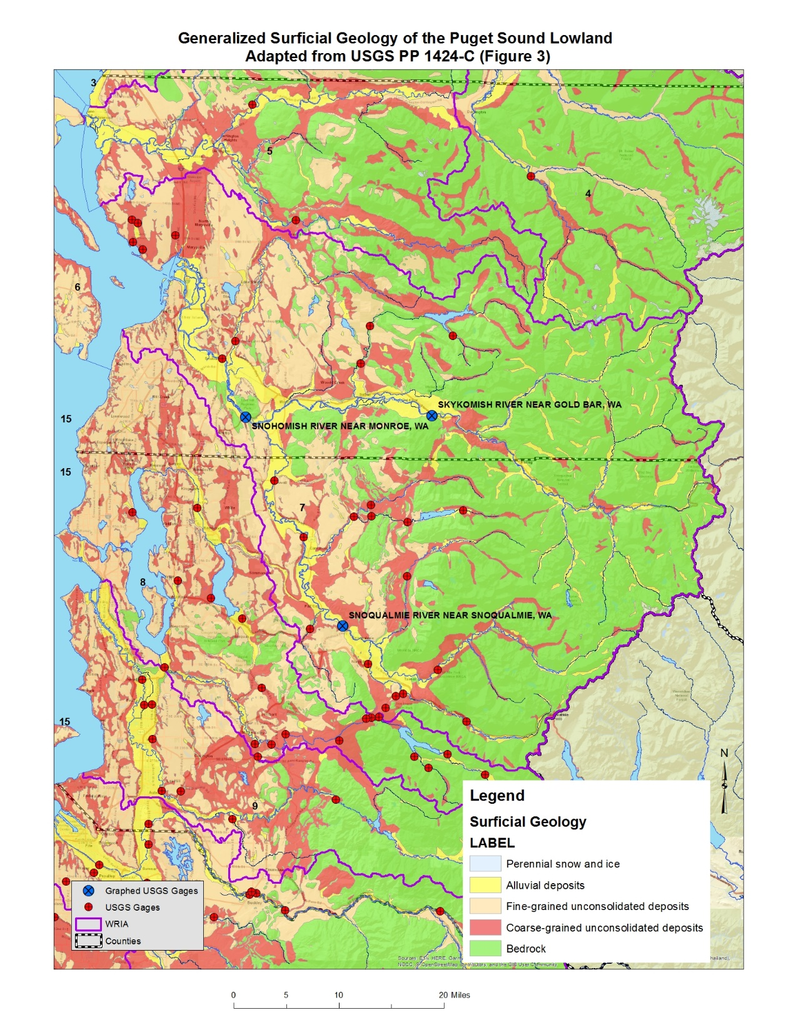
In WRIA 7, the USGS has measured streamflow at numerous sites over the years. We’re going to look at streamflow data from two of the gaging stations to get a sense of flow conditions within the WRIA over time:
  Snohomish River near Monroe;
  Skykomish River near Gold Bar.

Slide 37
Rainfall (Winter) and Snowmelt (late Spring) system

Slide 41
Only long-term groundwater data with measurements into the 2010s I can find.
Near Lake Goodwin.

Slide 42
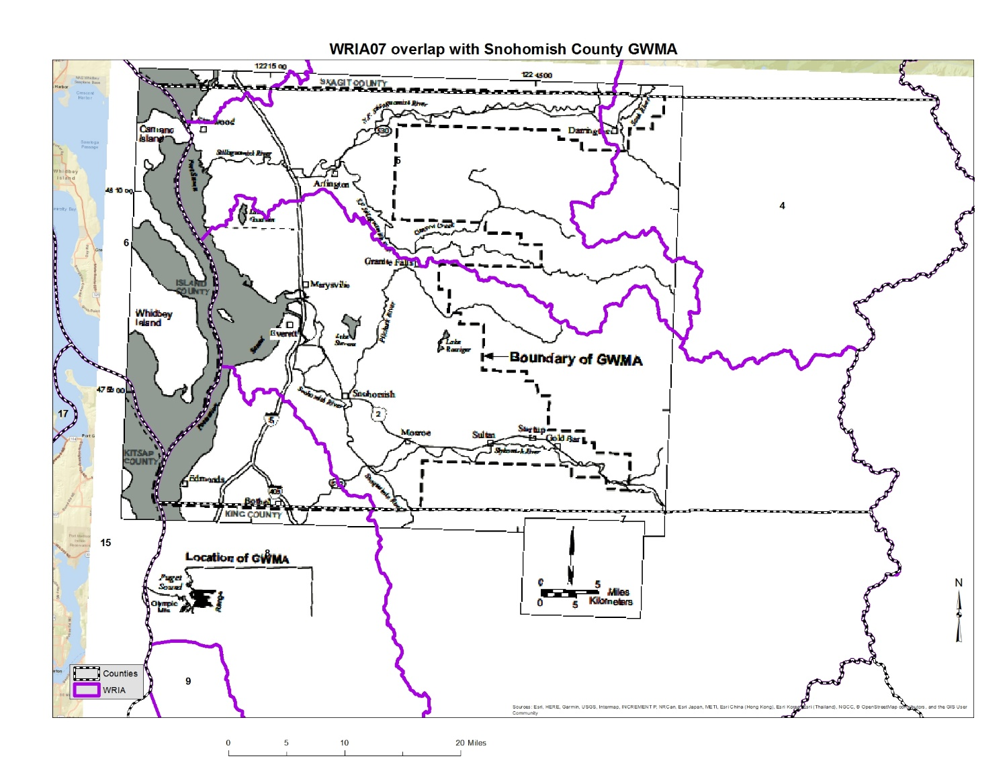
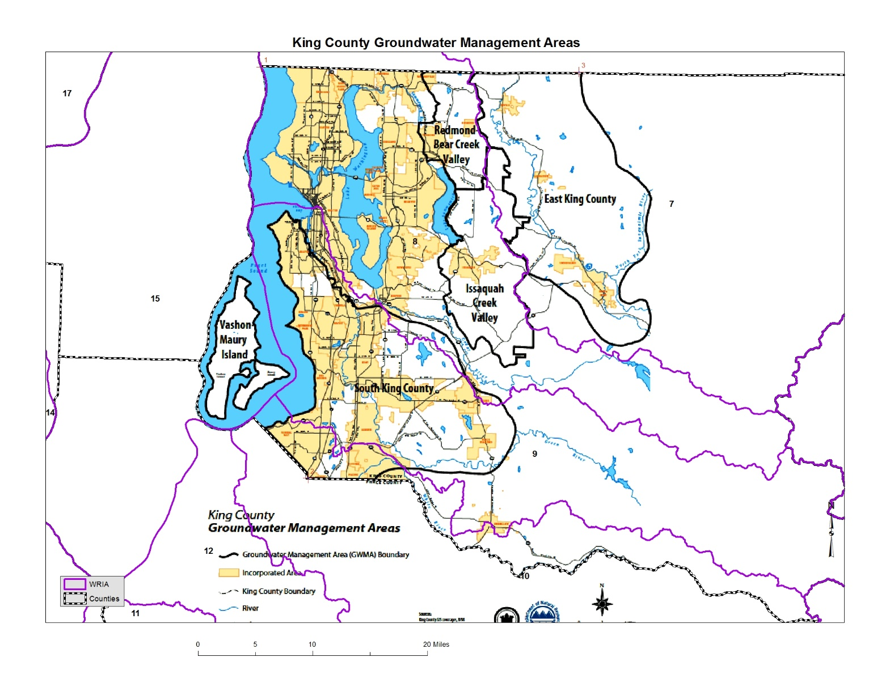
I’m hoping that the Counties have groundwater data that supports their respective GWMAs that overlap WRIA07.

Slide 44
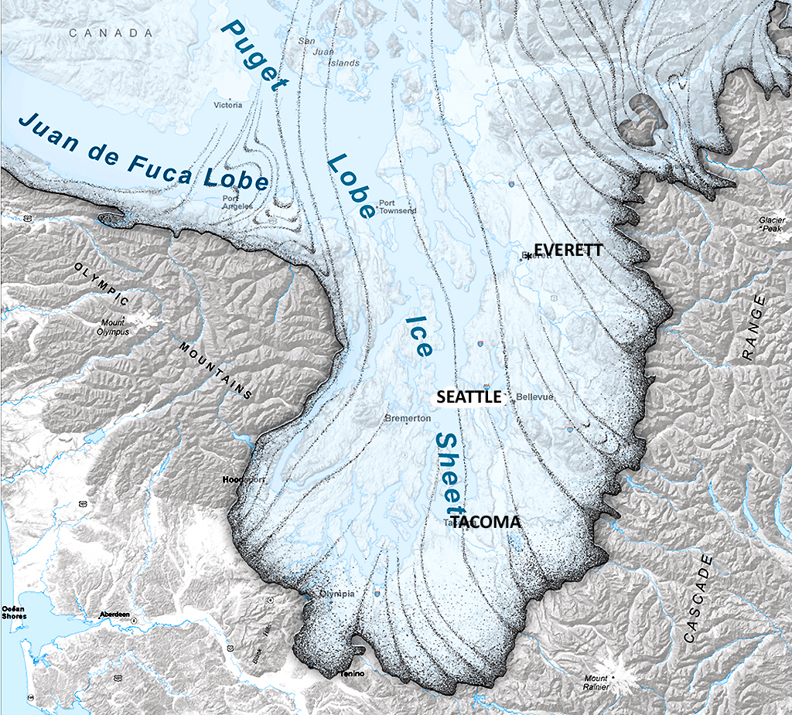
Vashon
Glaciation
lasted
about
19,000 to
16,000 BP
Washington Department of Natural Resources

Slide 46
Evidence for seven episodes of continental glaciation in the Puget Basin over the past 2 million years

Slide 47
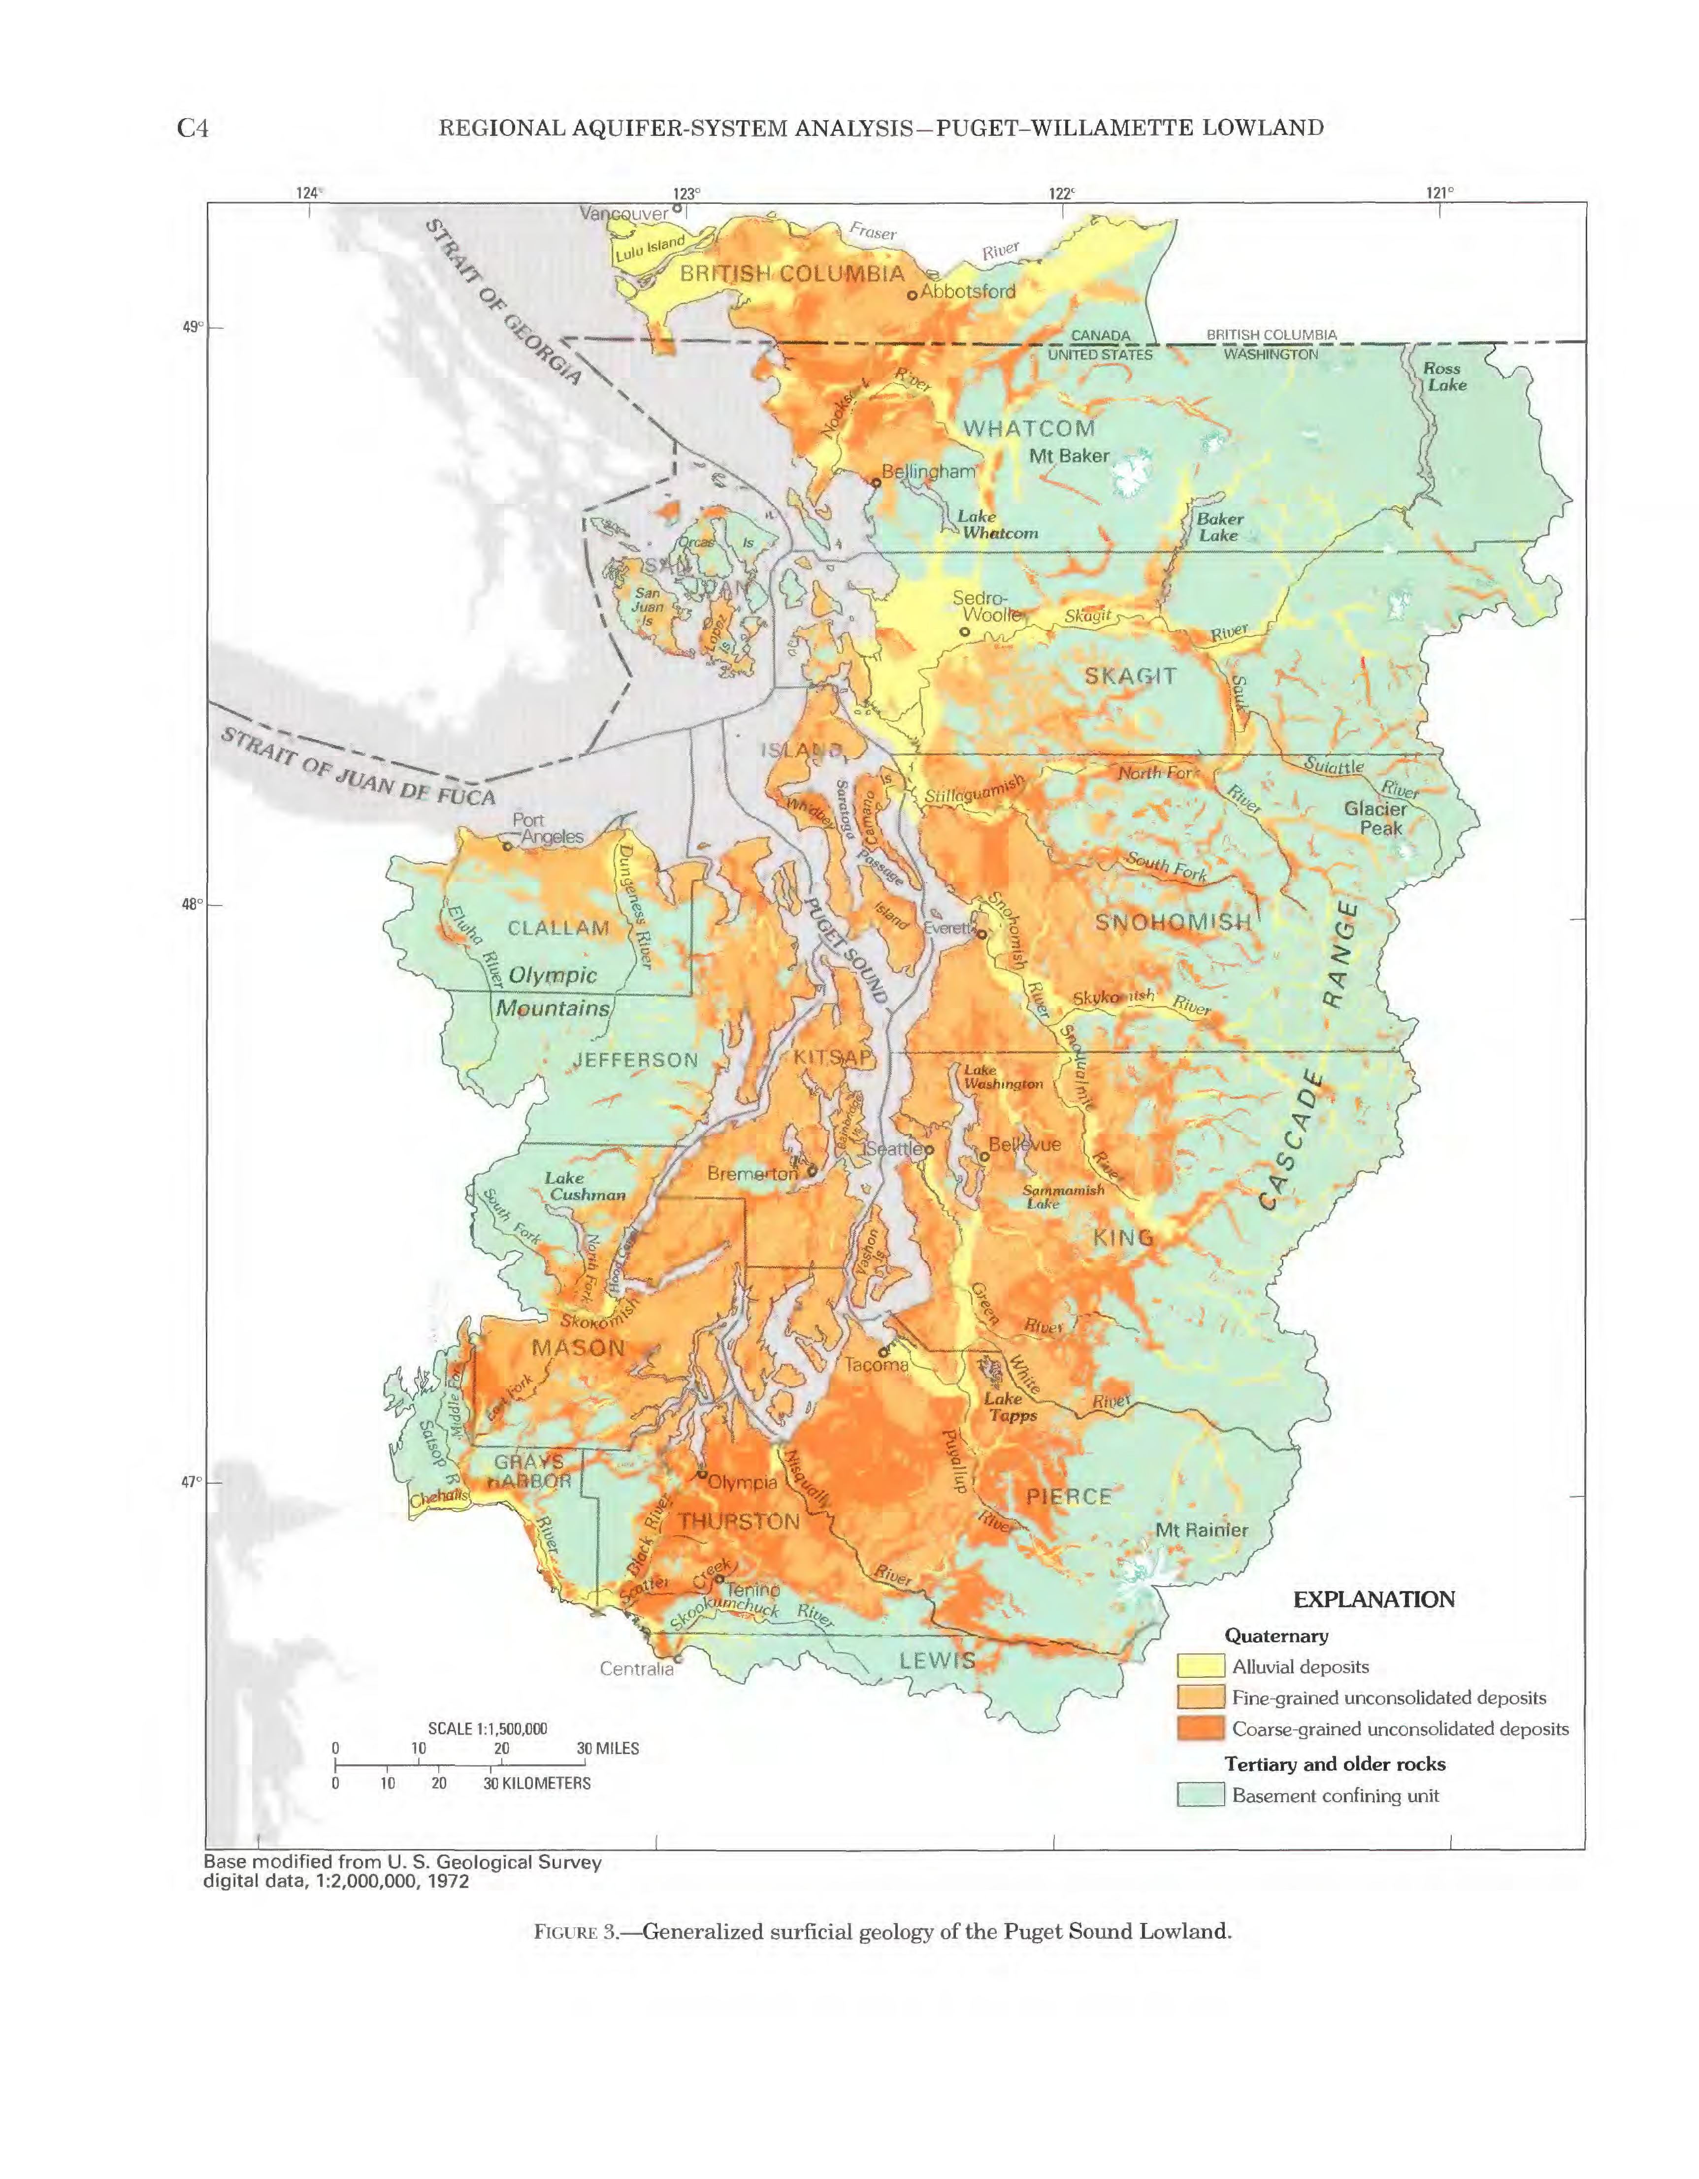
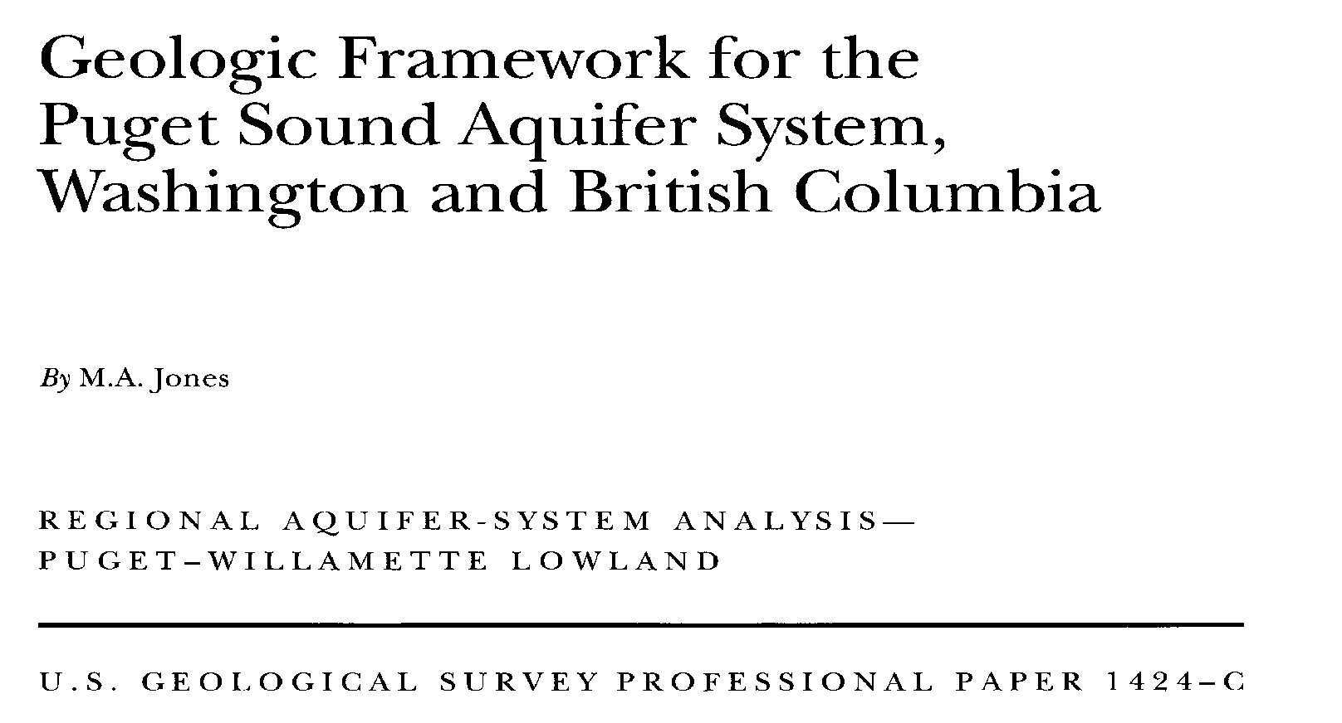

Slide 48
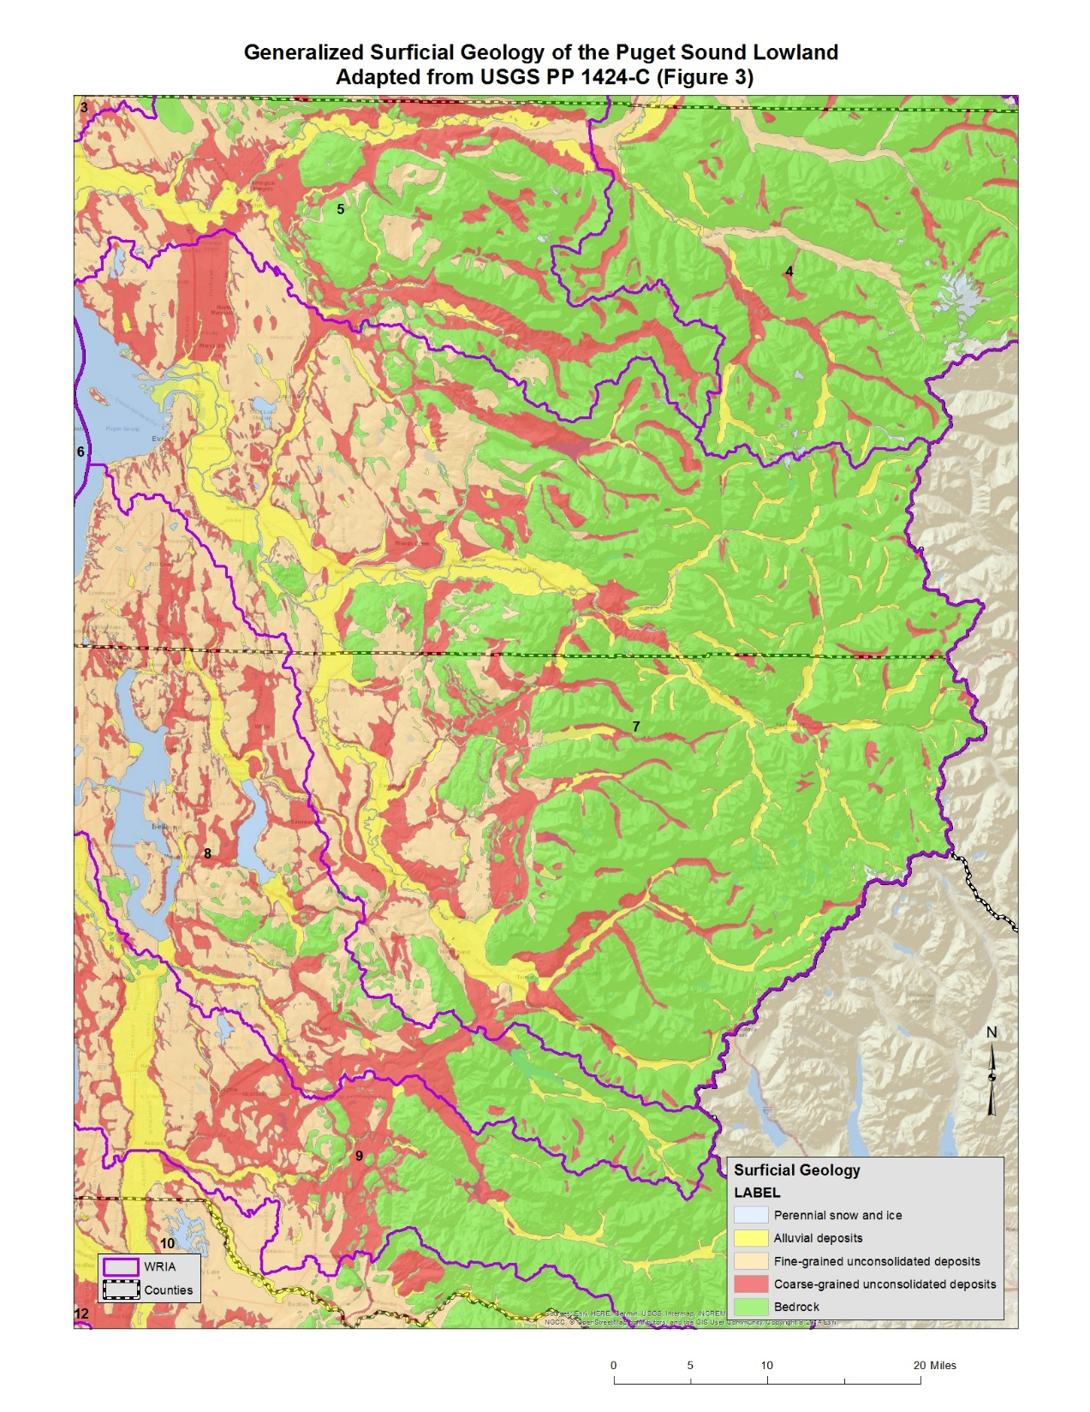

Slide 49
Subsurface detail is, of course, more complex (as seen in this USGS cross section thru western Snohomish County from USGS 96-4312, Plate 3) than just surficial mapping.

Slide 50
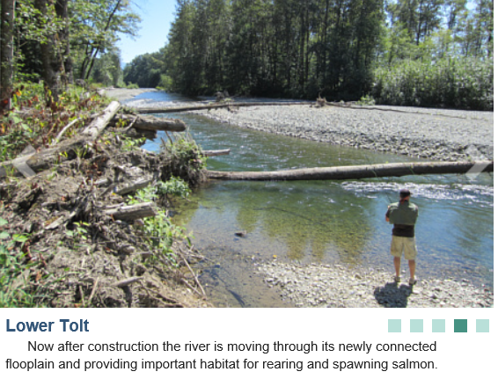
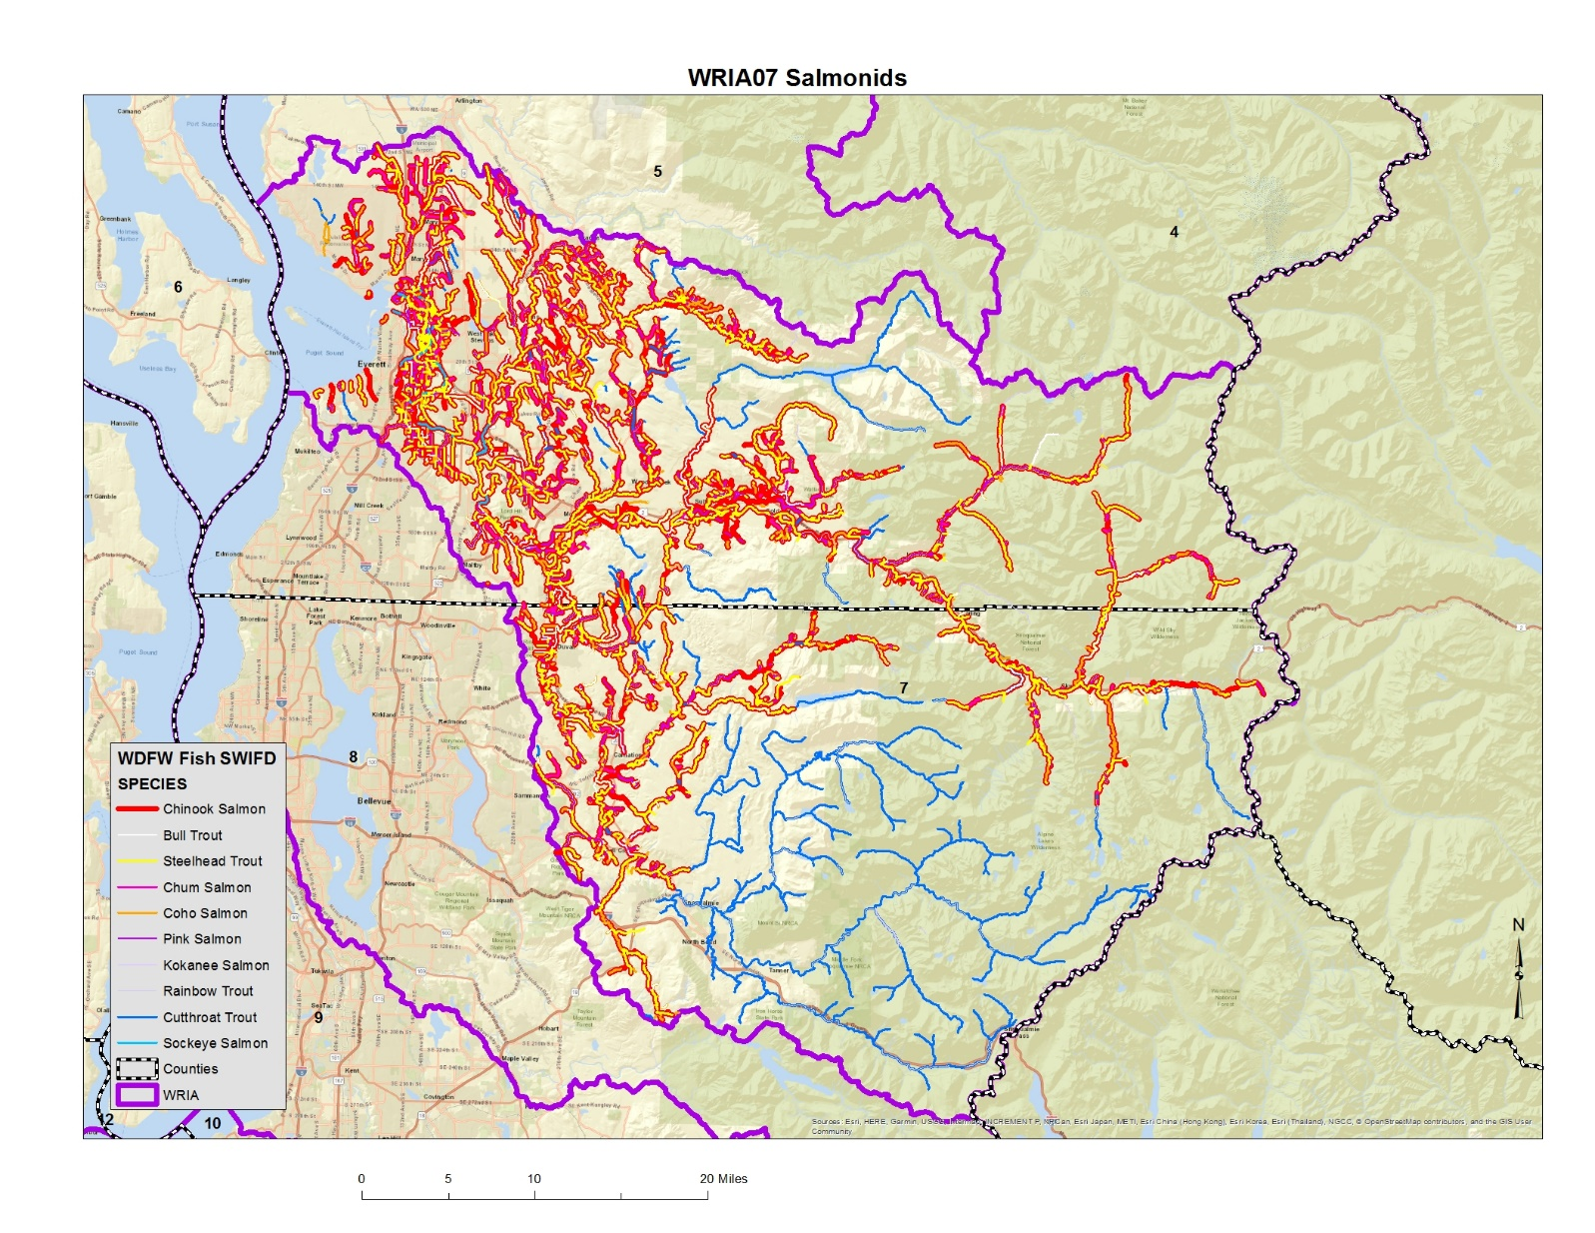
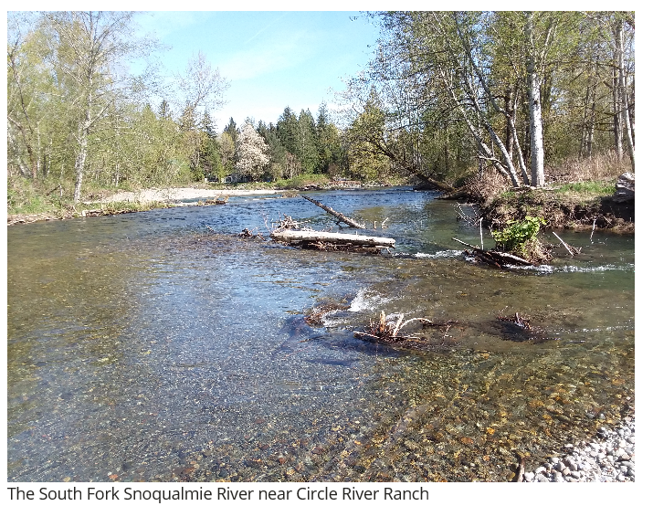


Slide 51
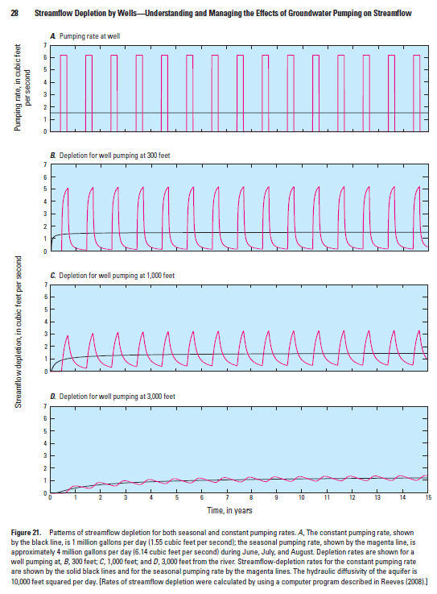
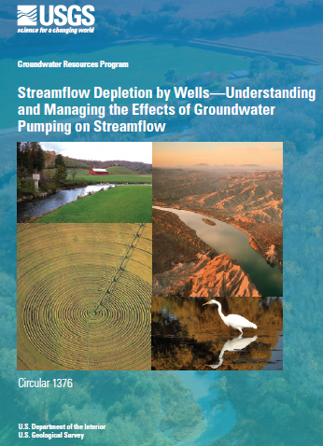
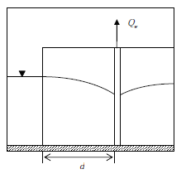
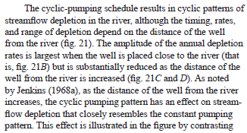
Seasonally Pumping Groundwater can have Year-round impacts on streams.
Seasonally augmenting aquifers can provide Year-round benefits for streams.

Slide 52
Growth is going to occur in your Watershed. People are going to move here and some of them will drill new wells for their new homes. Those new water uses will negatively affect connected surface water bodies.
The agency adopted an Instream Flow Rule for your WRIA back in 1979 and last Updated in1988. Streams in the WRIA have Instream Flows and Closures. Groundwater pumping will impair surface water bodies.
RCW 90.94 allows new domestic exempt wells to be drilled even though we know these new uses will impair instream flows. The statute tells us to offset the new comsumptive uses and make additional improvements to the landscape to achieve a net ecological benefit.
Partition the WRIA into subbasins
Determine how many new wells will be drilled for new rural homes over the next 20 years.
Figure out how much consumptive water use those new wells will need.
Identify a group of projects that can offset the new, consumptive, uses anticipated (retire existing water rights, build storage projects [ponds or aquifer storage projects], move surface water uses to groundwater wells, move shallow wells to deeper aquifers, etc.).
Identify additional, habitat improvement projects to help restore streams.

Slide 53
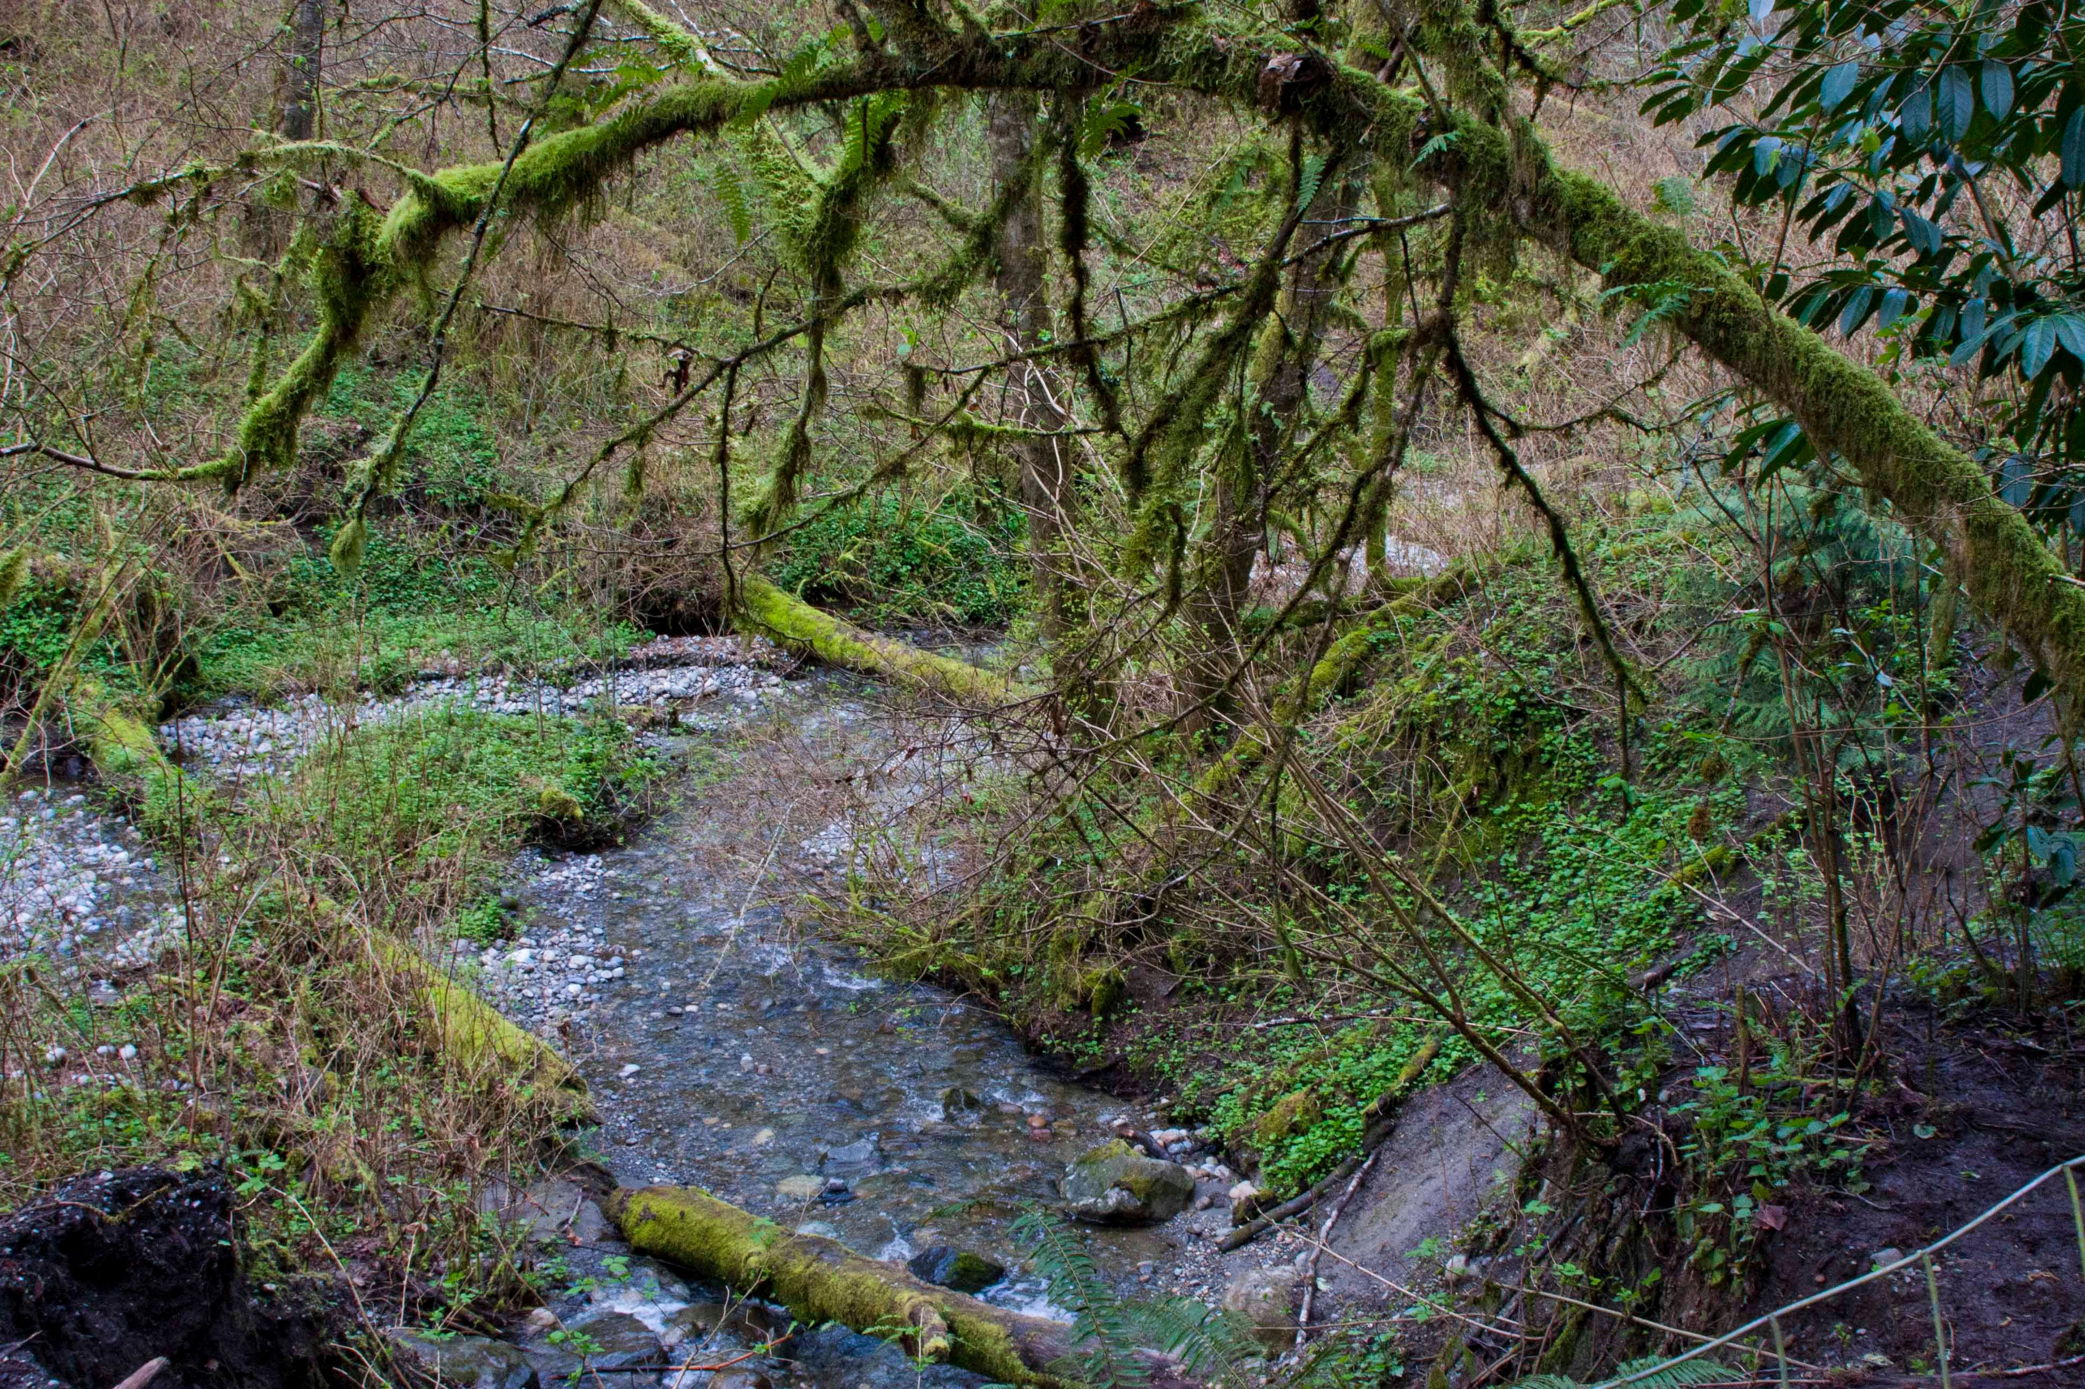
Thank You!
John Covert
Washington Department of Ecology
john.covert@ecy.wa.gov

Slide 58
Total Household Water Use is comprised of both:
a year-round, indoor use and
a seasonal, outdoor use.
While indoor use is fairly consistent on an annual basis, the outdoor lawn and garden watering is not evenly distributed throughout the year.
As most rural domestic users have septic systems, the vast majority of indoor use gets returned to the watershed through the home’s drainfield.
The annual consumptive quantity of a household’s indoor use will likely be on the order of 10,000 gallons per year or less. Whatever the volume is, the impacts to nearby streams will be essentially a stead-state depletion at the annualized pumping rate (as those indoor uses are year-round and less than 0.00005 cfs per household).
The consumptive outdoor use will be largely confined to the irrigation season and will likely be an order in magnitude larger than the indoor use (probably larger than 100,000 gallons per year).
The cyclic nature of pumping for this supply will cause streamflow depletion that is variable over the water year and will impact the watershed’s streams based on distance of the well from impacted streams and aquifer hydraulic properties.
In water short (“closed”) basins, even a single home’s consumptive use can impair an instream flow, and collectively, at the watershed scale, the total, consumptive, domestic use can be sizeable.

Slide 59
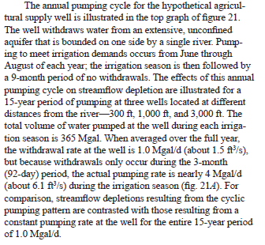

Slide 60
Using an analytical tool from the USGS, once we get a half a mile from the stream, the stream depletion impacts are flattening out and approaching the equivalent steady state pumping rate
(utilizing Reeves 2008)
It can take years for the full effects of groundwater pumping to impact connected streams (see blue curve above).

Slide 61
90.94.020(4)(b) At a minimum, the watershed plan must include those actions that the planning units determine to be necessary to offset potential impacts to instream flows associated with permit-exempt domestic water use. The highest priority recommendations must include replacing the quantity of consumptive water use during the same time as the impact and in the same basin or tributary. Lower priority projects include projects not in the same basin or tributary and projects that replace consumptive water supply impacts only during critical flow periods.
Two of the best ways to offset the potential impacts of new domestic consumptive use is to either provide:
Water for Water Mitigation by building storage in above or below ground reservoirs
or
Acquisition and retiring of beneficially used water rights.
Buying water rights and putting them into a Water Bank is likely the most quickly available
and cost-effective mitigation solution. But buying rights requires a willing seller.
Building storage facilities takes access to real-estate which can be problematic. Small scale managed aquifer recharge
facilities can make a difference.

Slide 62
Example of an aquifer being mined
Springs and seeps within the watershed that used to be fed by this aquifer have slowly dried up as the head in the aquifer declined.

Slide 64


8 acre site
3 acres of spreading basins

Slide 65



IG#2
IG#3
INFILTRATION GALLERIES During Phase II, four different infiltration gallery (IG) designs were installed at the Johnson site to evaluate each design’s performance, longevity, and cost-benefit.
IG #1 was constructed of four corrugated 4-inch perforated pipe,
IG #2 was constructed of twenty 4-inch drain field pipe,
IG #3 was four 4-inch drain field pipe inside Stormtech stormwater chambers, and
IG #4 was a single 4-inch drain field pipe inside Atlantis stormwater devices.
During the first season of testing IG #1 clogged up and has not been utilized since. IG #2, IG #3 and IG #4 have all continued to function and have been operated during each recharge season.
IG#4

Slide 66


Spreading Basins
Infiltration Galleries

Slide 67


Slide 68


2.5 acre pond

Slide 69





Slide 71


Slide 72


Slide 82


Slide 83


Slide 84
Howard Hanson Dam
Completed 12/25/1961

Slide 85
Howard Hanson Dam
Completed 12/25/1961

Slide 89


Slide 90


Slide 98


Slide 99


Slide 100


Slide 101


Slide 102


