Slide 1
Water Right Acquisitions
Kelsey Collins
Water Acquisitions Lead

Slide 2
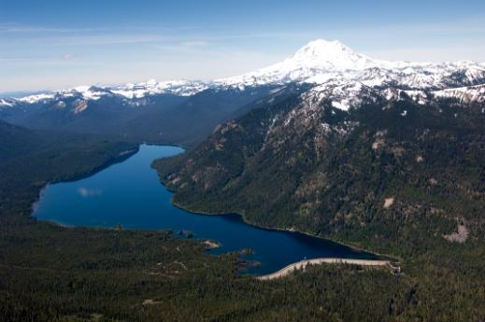
FEARING, J. —
All the water that will ever be is, right now.
(National Geographic, Oct. 1993)

Slide 3
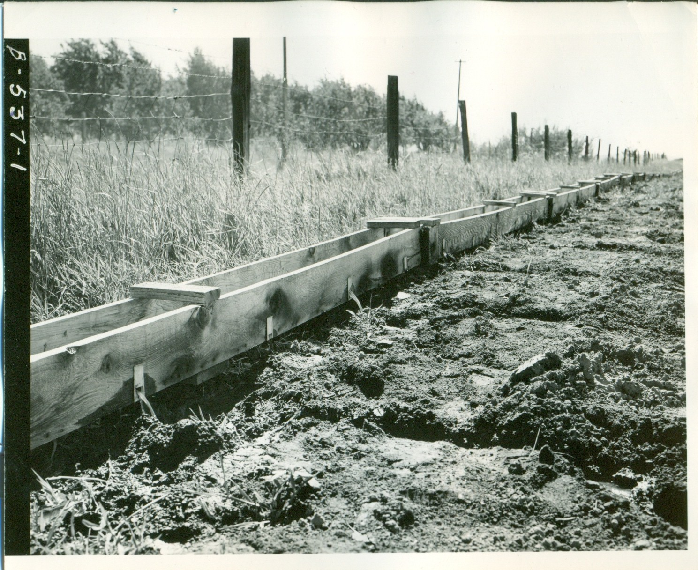
Prior Appropriation: first in time, first in right
Notes:
100 years of Washington water law:
https://ecology.wa.gov/About-us/Get-to-know-us/Our-Programs/Water-Resources/Learn-the-history-of-water-law
Permitting four-part test:
Water must be available (both physically and legally)
Water must be used beneficially
Water use must not be detrimental to the public interest
Water use must not impair existing rights
Senior user gets full right
Relinquishment: use it or lose it
1945 GW code exemption
3

Slide 4
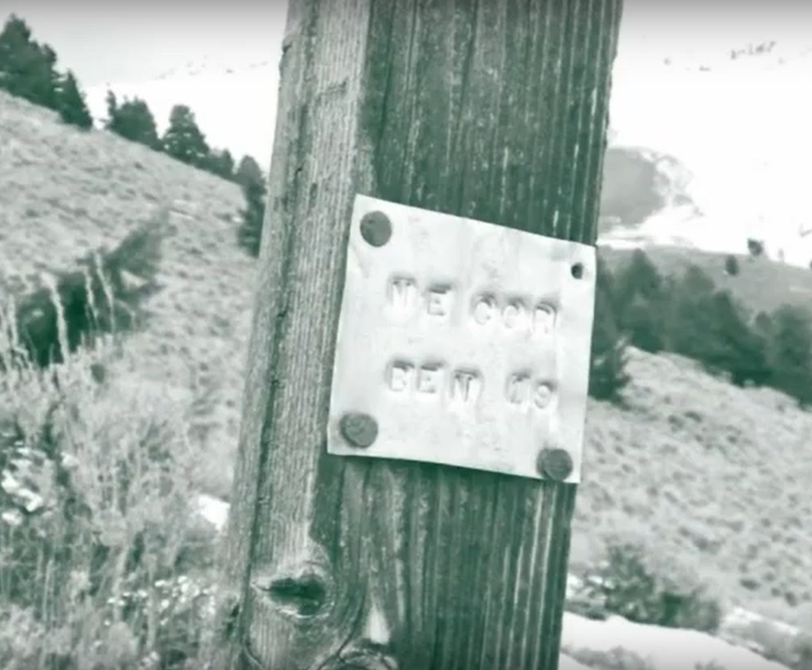
Vested Right
Tribal Right
Adjudicated Certificate
Claim
Permit
Certificate
Notes:
Legal framework established in 1917 with the original surface water code that required documentation and proof of use.
4

Slide 5
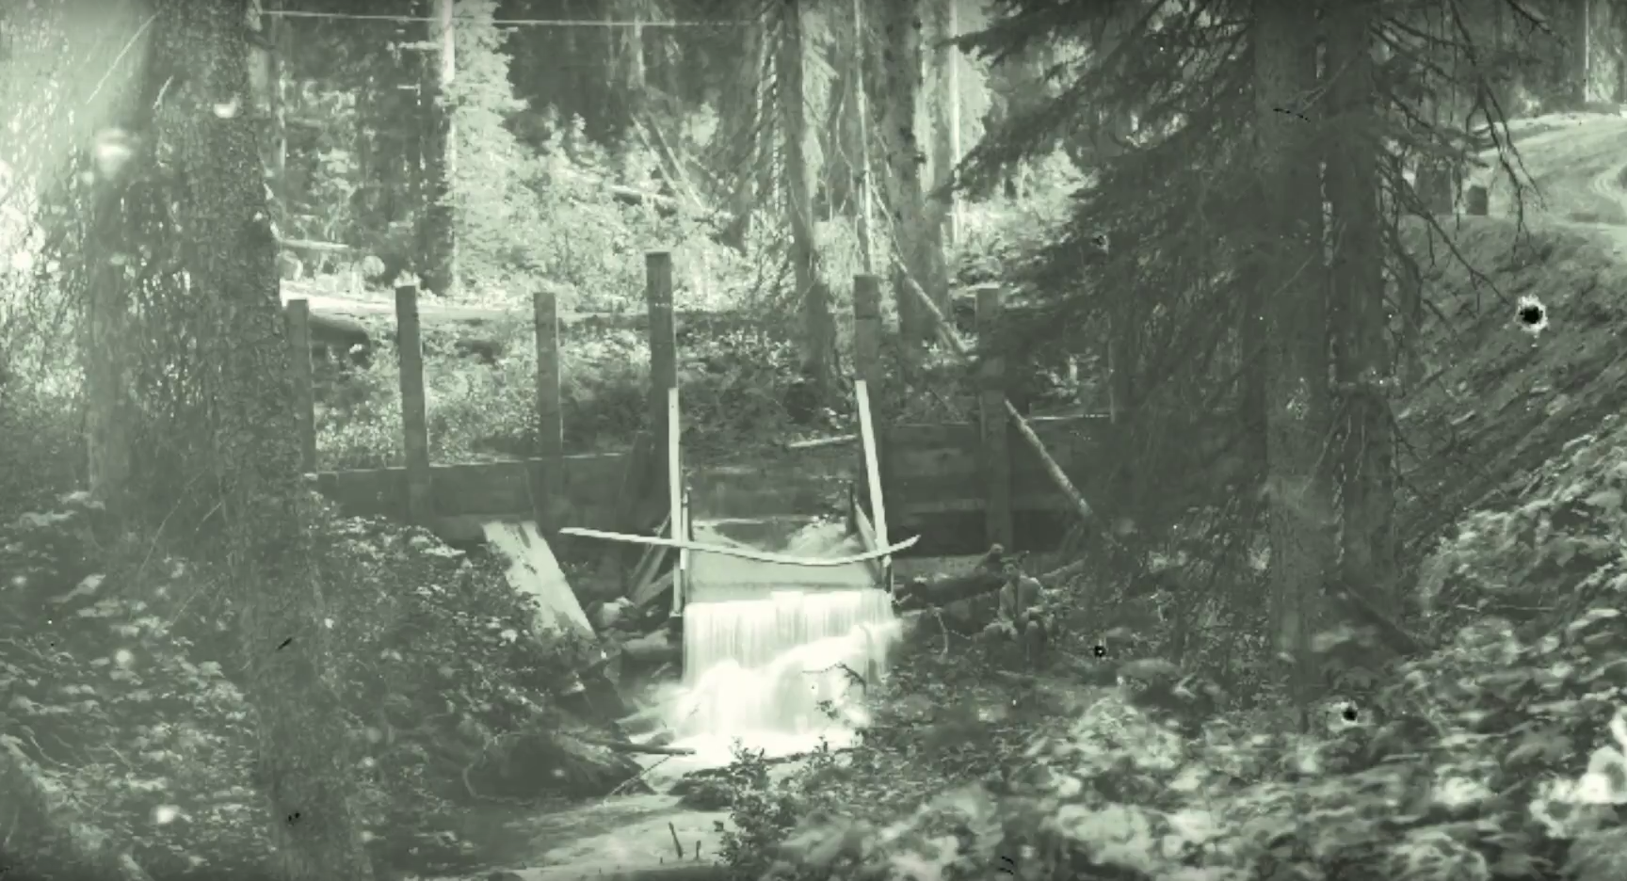
Notes:
Lots of material to cover
Save questions for afterward
5

Slide 6
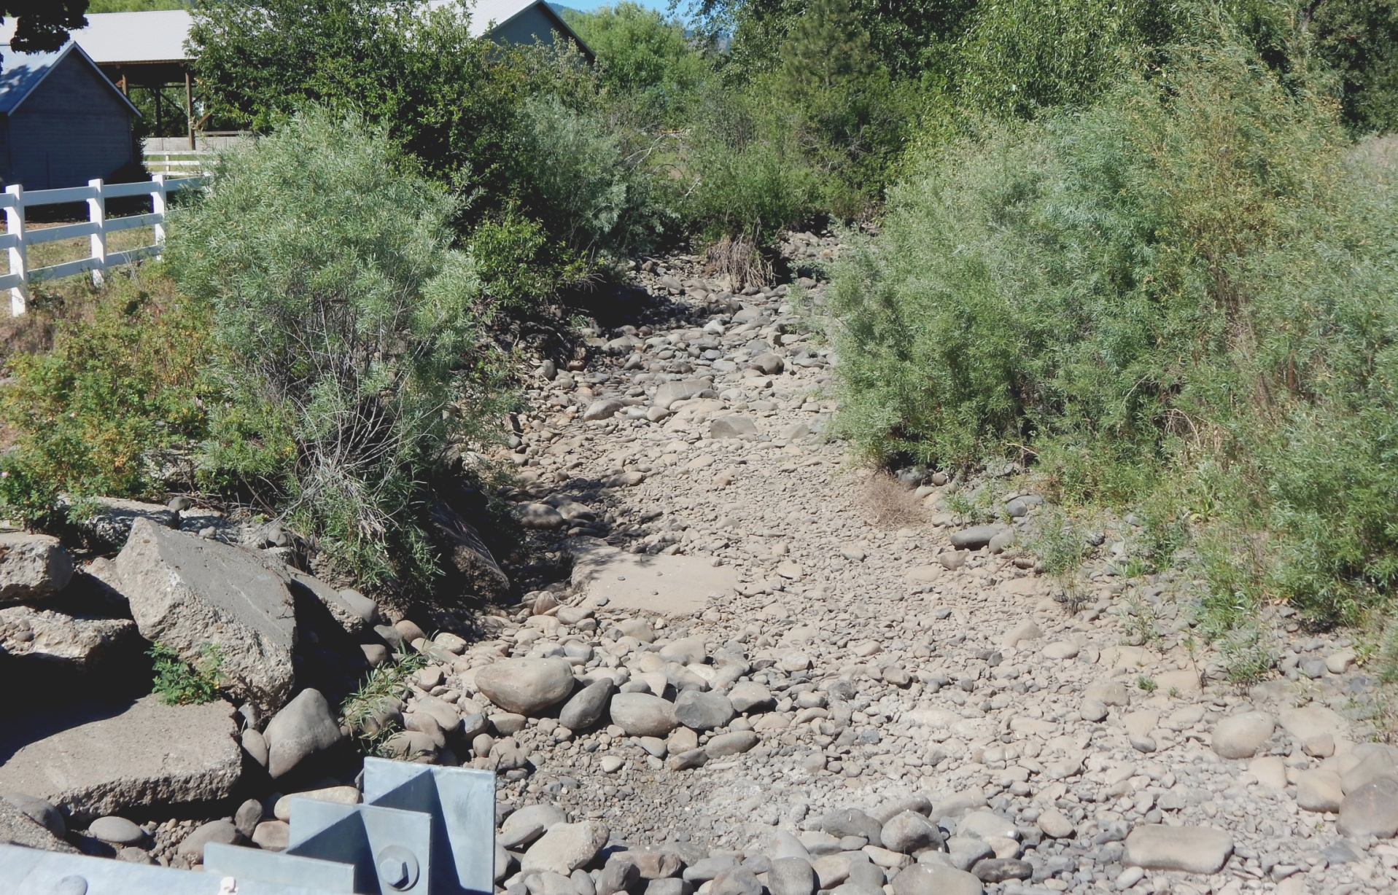
Manastash Creek, Kittitas County

Slide 7
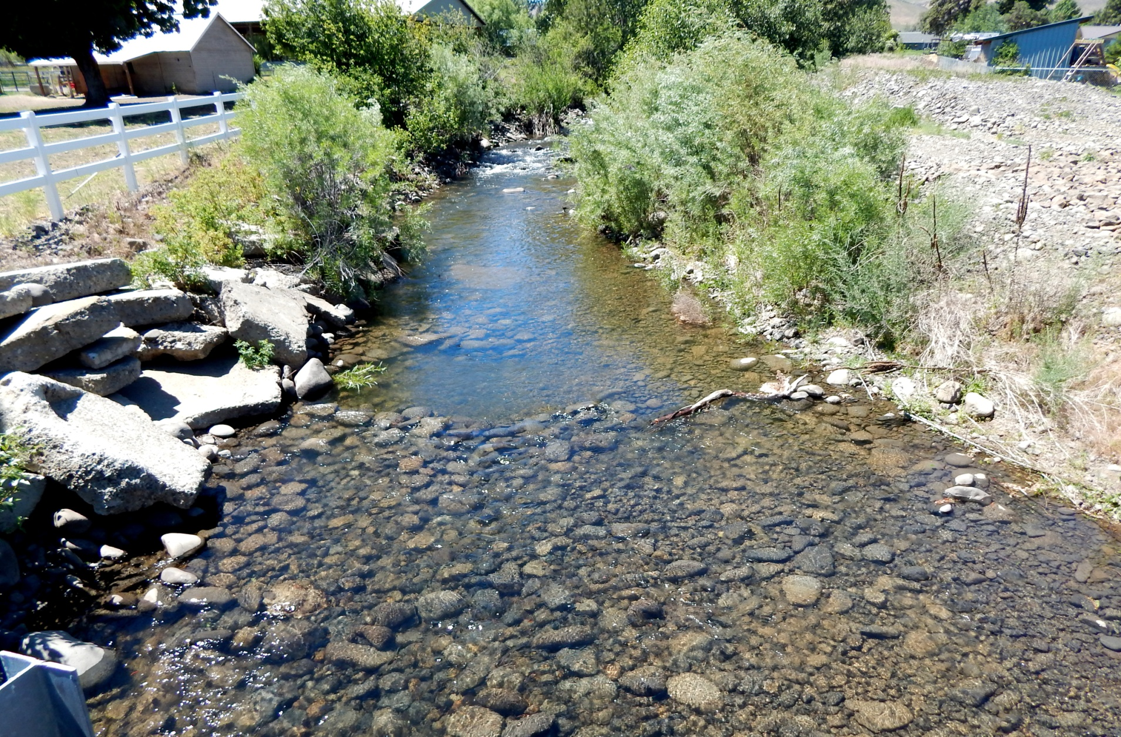
Manastash Creek –Before/After supplementation
Manastash Creek, Kittitas County

Slide 8
Trust Water Rights Program
Notes:
Lots of material to cover
Save questions for afterward
8

Slide 9
Trust Water Rights Program
Ecology’s authority to hold water rights for future uses without the threat of relinquishment.
Notes:
Lots of material to cover
Save questions for afterward
9

Slide 10
Trust Water Rights Program
Ecology’s authority to hold water rights for future uses without the threat of relinquishment.
Only Ecology can hold a water right in trust
Notes:
Lots of material to cover
Save questions for afterward
10

Slide 11
Trust Water Rights Program
Ecology’s authority to hold water rights for future uses without the threat of relinquishment.
Only Ecology can hold a water right in trust
Temporarily or permanently
Notes:
Lots of material to cover
Save questions for afterward
11

Slide 12
Trust Water Rights Program
Ecology’s authority to hold water rights for future uses without the threat of relinquishment.
Only Ecology can hold a water right in trust
Temporarily or permanently
For instream AND out of stream uses
Notes:
Lots of material to cover
Save questions for afterward
12

Slide 13
Conveyed to Ecology
Trust Water Rights Program
Notes:
Lots of material to cover
Save questions for afterward
13

Slide 14
Types of Conveyance
              Ecology holds water rights in the Trust Water Rights Program through…
Notes:
Lots of material to cover
Save questions for afterward
14

Slide 15
Types of Conveyance
              Ecology holds water rights in the Trust Water Rights Program through…
              Temporary Donation
Notes:
Lots of material to cover
Save questions for afterward
15

Slide 16

              Temporary Donation

Slide 17
Types of Conveyance
              Ecology holds water rights in the Trust Water Rights Program through…
              Temporary Donation
              Lease/Purchase
Notes:
Lots of material to cover
Save questions for afterward
17

Slide 18
Types of Conveyance
              Ecology holds water rights in the Trust Water Rights Program through…
              Temporary Donation
              Lease/Purchase
              Other means
Notes:
Lots of material to cover
Save questions for afterward
18

Slide 19

  Lease, purchase, and other means

Slide 20
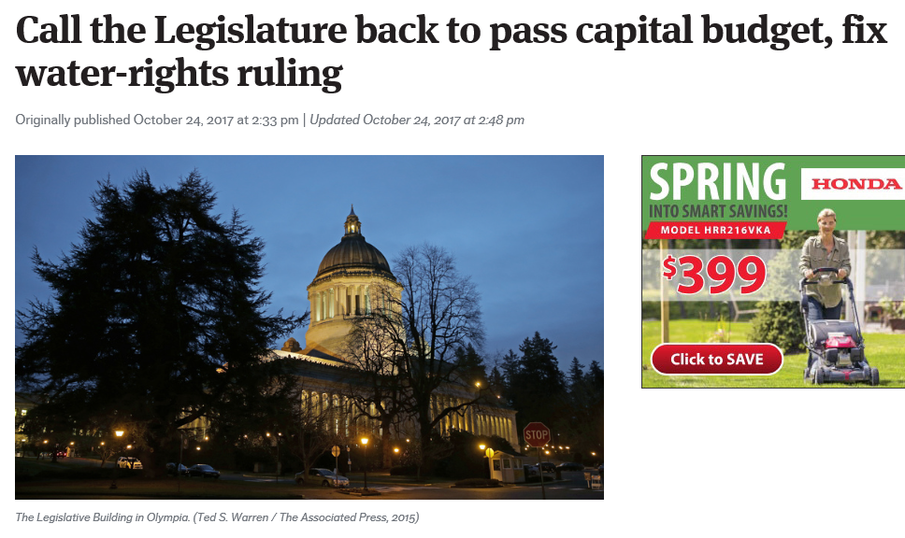

Slide 21
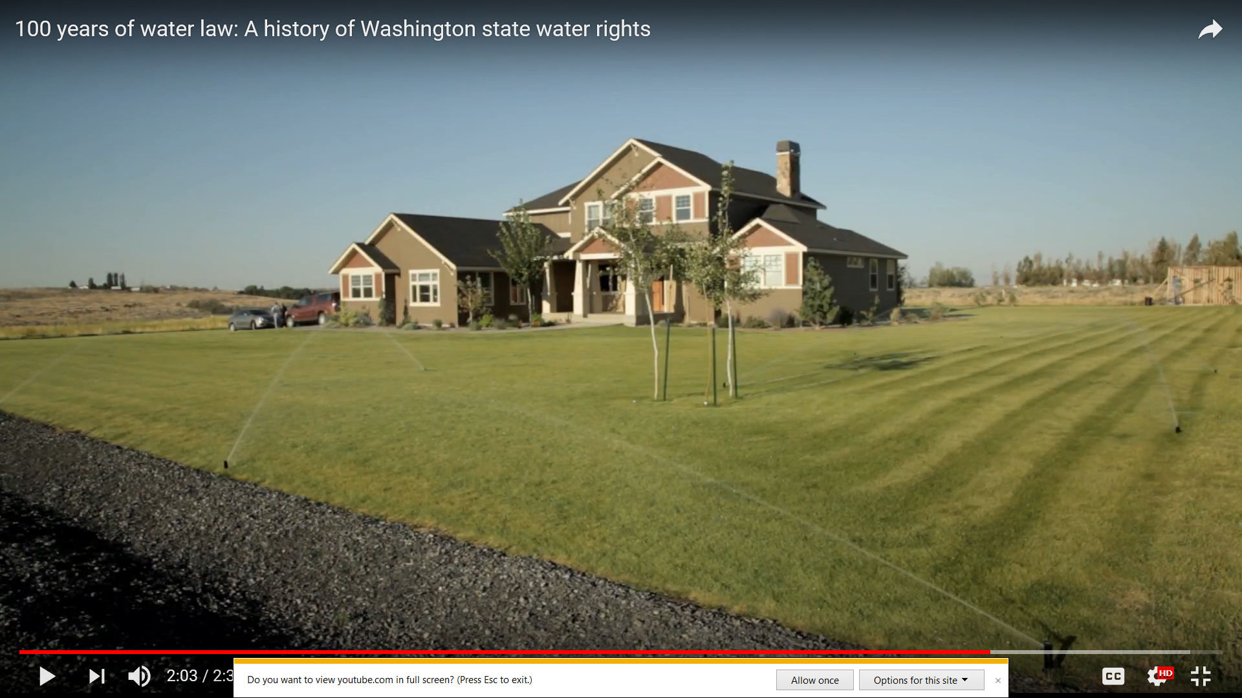
Notes:
Fast forward to the challenge of offsetting the impacts of new domestic well use.
21

Slide 22
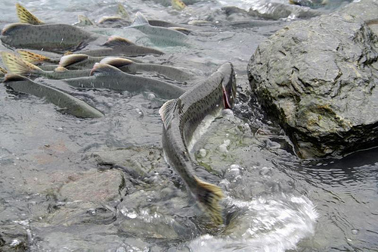
Notes:
Lots of material to cover
Save questions for afterward
22

Slide 23
Acquiring water rights under RCW 90.94:
WHY?
Offset the impacts of new domestic well use
Increase stream flow
Improve water quality
Notes:
Lots of material to cover
Save questions for afterward
23

Slide 24
Acquiring water rights under RCW 90.94:
How?
Notes:
Lots of material to cover
Save questions for afterward
24

Slide 25
Acquiring water rights under RCW 90.94:
How?
          Identify potential projects
Notes:
Lots of material to cover
Save questions for afterward
25

Slide 26
Acquiring water rights under RCW 90.94:
How?
          Identify potential projects
          Negotiate agreements
Notes:
Lots of material to cover
Save questions for afterward
26

Slide 27
Acquiring water rights under RCW 90.94:
How?
          Identify potential projects
          Negotiate agreements
          Change the water right back to the creek or aquifer
Notes:
Lots of material to cover
Save questions for afterward
27

Slide 28
Acquiring water rights under RCW 90.94:
How?
          Identify potential projects
          Negotiate agreements
          Change the water right back to the creek or aquifer
          Pay for the right and convey it to Ecology
Notes:
Lots of material to cover
Save questions for afterward
28

Slide 29
Acquiring water rights under RCW 90.94:
How?
          Identify potential projects
          Negotiate agreements
          Change the water right back to the creek or aquifer
          Pay for the right and convey it to Ecology
          Manage and protect the right instream
Notes:
Lots of material to cover
Save questions for afterward
29

Slide 30

Types of Acquisitions
Notes:
Lots of material to cover
Save questions for afterward
30

Slide 31
Types of Acquisitions
  Water right purchase

Slide 32
Types of Acquisitions
  Water right purchase
  Shortened or shifted season of use

Slide 33
Types of Acquisitions
  Water right purchase
  Shortened or shifted season of use
  Source Switch

Slide 34
Place of Use
Point of Diversion
Return Flows
Notes:
Purchase and transfer of a water right to stream flow or groundwater
Decreased diversion rate
Shortened or shifted season of use
Source Switch
Storage and release
Reclaimed water delivery to replace stream water right
Water right swaps (?)

Slide 35
Types of Acquisitions
  Water right purchase
  Shortened or shifted season of use
  Source Switch
  Reclaimed water delivery to replace stream diversion

Slide 36
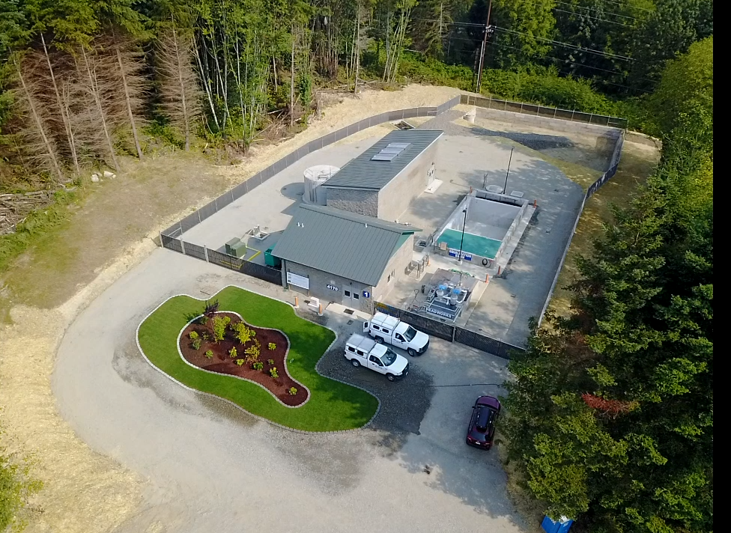
Port Gamble Resource Recovery Facility
Notes:
Lots of material to cover
Save questions for afterward
36

Slide 37
Types of Acquisitions
  Water right purchase
  Shortened or shifted season of use
  Source Switch
  Reclaimed water delivery to replace stream diversion
  Storage and release

Slide 38
Types of Acquisitions
  Water right purchase
  Shortened or shifted season of use
  Source Switch
  Reclaimed water delivery to replace stream diversion
  Storage and release
  Other?

Slide 39
Notes:
Fast forward to the challenge of offsetting the impacts of new domestic well use.
39

Slide 40
Notes:
Lots of material to cover
Save questions for afterward
40

Slide 41
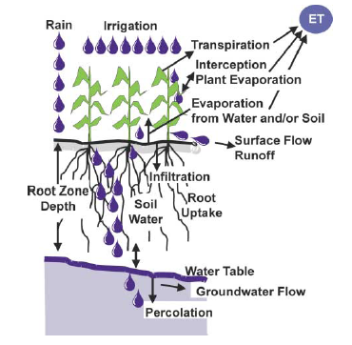
Ecology’s GUID 1210
Calculating Irrigation Efficiencies

Slide 42
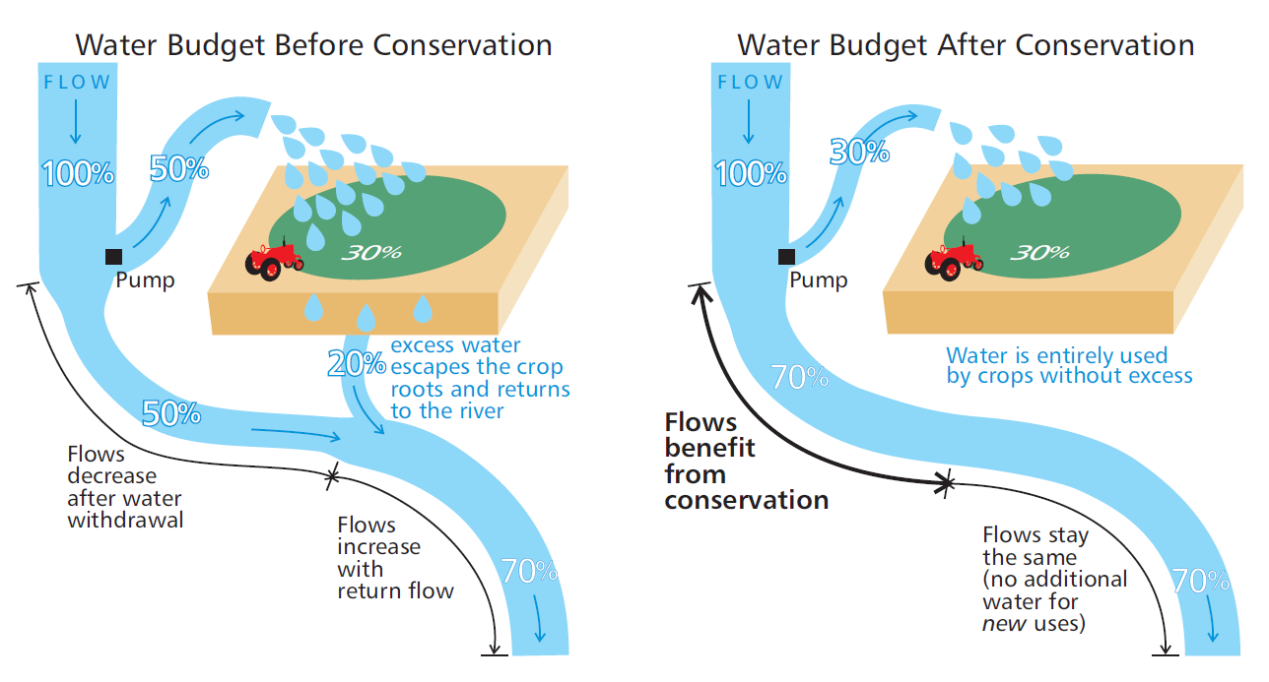
Irrigation Efficiency

Slide 43
Water Acquisitions Program
January 2018, the Legislature passed ESSB 6091 that became RCW 90.94
  Law invests $300 million over 15 years in projects that will help fish and stream flows
    Water right acquisitions are the highest priority

Slide 44
