Slide 1
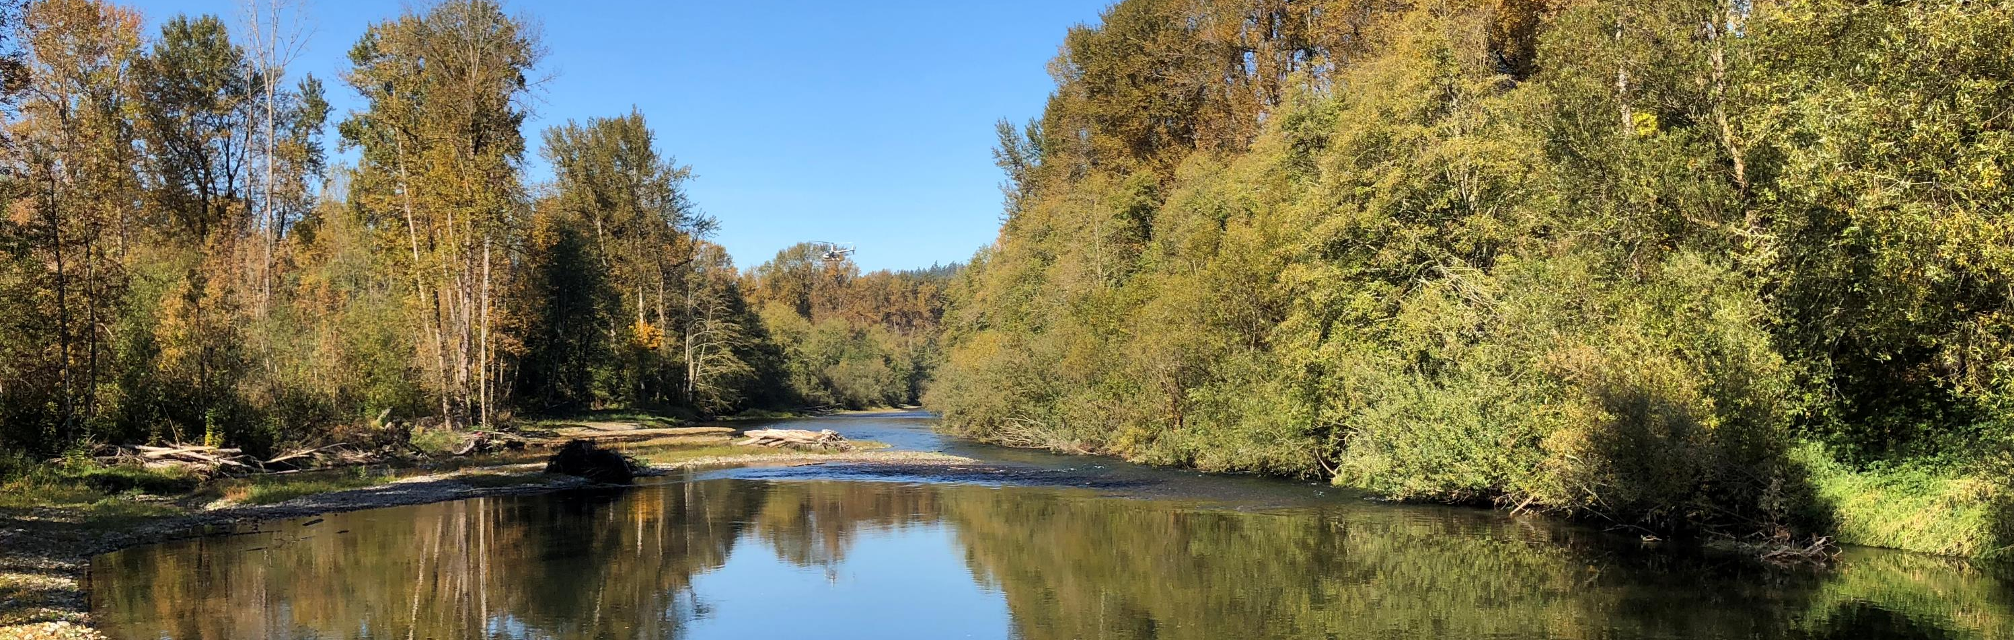
Final Guidance for Determining Net Ecological Benefit
Snohomish (WRIA 7) Watershed Restoration and Enhancement Committee
September 12, 2019
Notes:
This presentation will review the key components of the final NEB guidance, which was released on July 31st. I will also provide a very brief overview of the components we anticipate including in the plan and will bring forward a more detailed plan outline for your input in the next couple of months.
The final policy interpretations document was also released on July 31st – I will not discuss that document in detail but am happy to take questions.
Please ask you questions throughout the presentation. I do want to ensure that we have time at the end to discuss components of the plan.

Slide 2

What is the Net Ecological Benefit guidance and why does it matter?
Ecology’s interpretation of the term “Net Ecological Benefit” used in RCW 90.94.
The standards Ecology will apply when reviewing watershed plans submitted to Ecology under RCW 90.94.020 and RCW 90.94.030.
Notes:
The Streamflow Restoration law, codified as Chapter 90.94 RCW, requires the Department of Ecology to determine whether a Net Ecological Benefit will result from the implementation of watershed restoration and enhancement plans developed under the law before Ecology can adopt them.
The Final NEB guidance describes the standards Ecology will apply when reviewing our WRE Plan to determine whether it meets NEB, and provides transparency for how Ecology interprets NEB. The final guidance replaces the Interim guidance as well as the Recommendations for Water Use Estimates.
Ecology’s interpretation of the term “Net Ecological Benefit” is “The outcome that is anticipated to occur through implementation of projects and actions in a plan to yield offsets that exceed impacts within: a) the planning horizon; and, b) the relevant WRIA boundary.” [definition from final NEB guidance].

Slide 3
How did Ecology develop the NEB guidance?
Workshops
June 2018
Interim Guidance for Determining Net Ecological Benefit
Fall 2018
Public Meetings and comment period
Spring 2018
Public Comment Period
July 2019
Final Guidance for Determining Net Ecological Benefit
Draft Final Guidance
Spring 2018
Notes:
Here’s the timeline and process Ecology used to develop the NEB Guidance. We held workshops in the spring of 2019, issued the interim NEB guidance for WRIA 1 and 11 last June, then went through
In the spring of 2018, we held workshop with key partners to inform the development of interim guidance
We issued Interim Guidance for Determining NEB in June 2018 for the planning groups with deadlines in early 2019 for completing their plans. We wanted to take additional time to consider the subject and solicit public feedback before issuing the Final Guidance.
We asked for feedback on the Interim Guidance in October 2018 and held several workshops around the state to take input
We released the draft final Guidance and held a public comment period in May-June 2019.
There were several opportunities for partners and the public to provide comments on the development of these documents. We appreciate the feedback that we received and have considered all input as we finalized the NEB guidance.

Slide 4
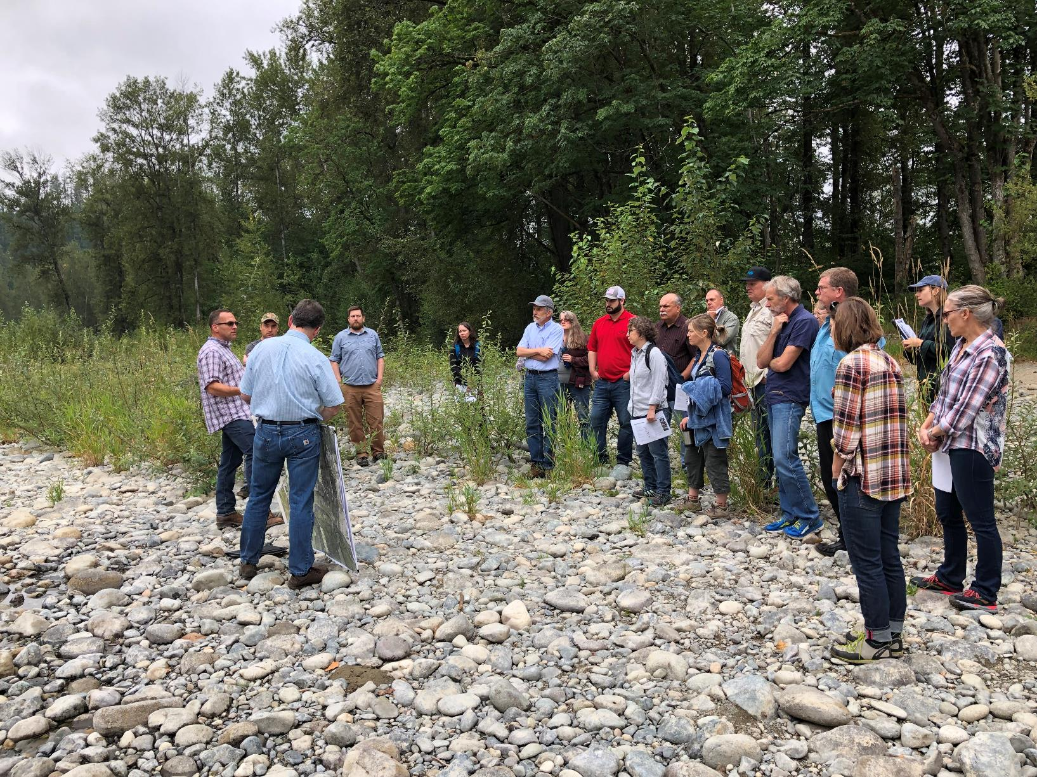
Who should use it?
Notes:
Applies to watershed restoration and enhancement plans (including our plan), the watershed plan updates submitted after December 2019, and the Foster Pilot Projects.
This document does not apply to any of Ecology’s decisions relating to competitive grants applications or any regulatory matter.

Slide 5
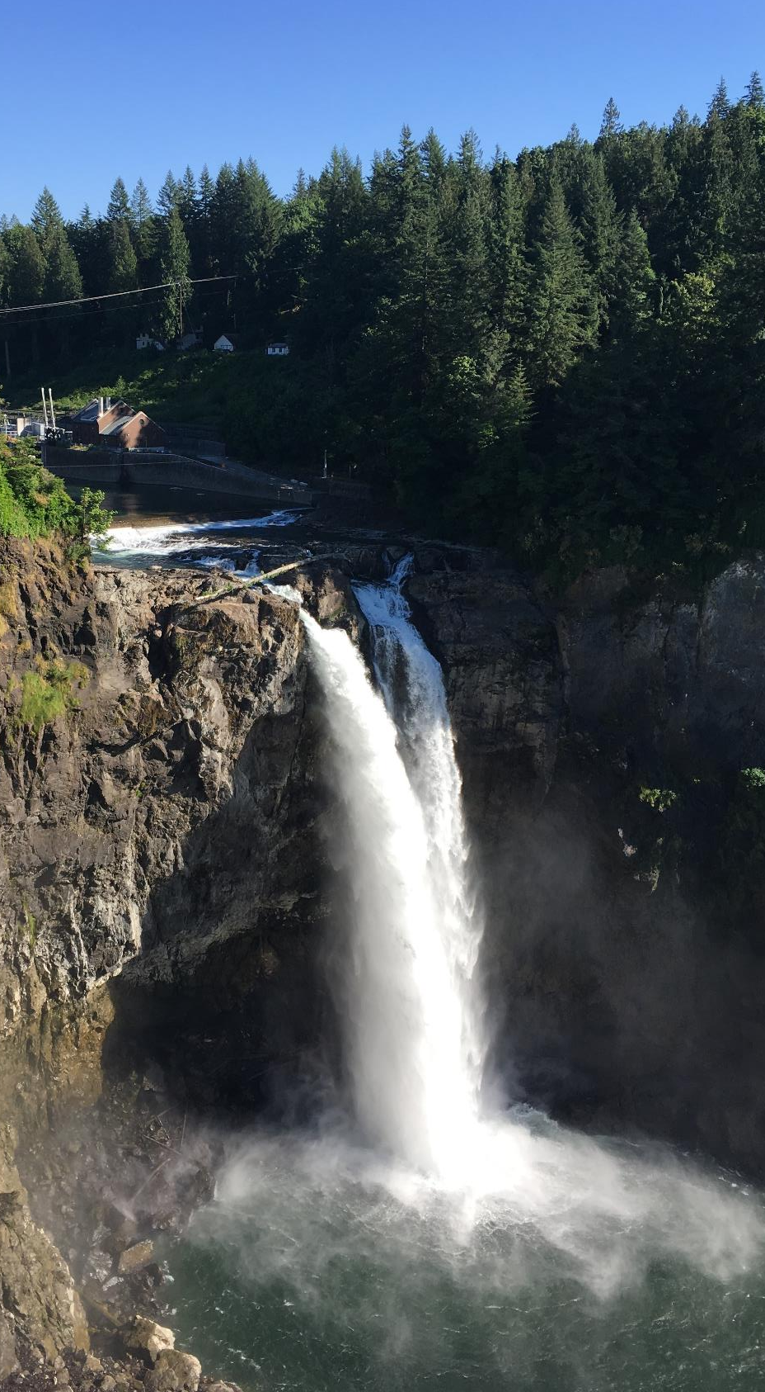
NEB for Watershed Planning
From the final NEB guidance:
“…local planning groups are best situated, and will therefore determine the appropriate amount of benefits beyond the offsetting of projected impacts …”
Notes:
The Final NEB guidance states: “…local planning groups are best situated, and will therefore determine the appropriate amount of benefits beyond the offsetting of projected impacts …”
Ecology gives considerable deference to the planning groups to decide what NEB means for our watershed. This committee knows this watershed best; Ecology is depending on our local expertise to put together a plan that meets the requirements of the law and enhances our watershed.
The guidance sets the minimum threshold: do more than offset the consumptive use from new domestic, permit-exempt groundwater withdrawals over the planning horizon: January 2018-January 2038.
Planning groups can decide to do more; however, we need to balance the desire in doing more with the ability to meet all of the needs and interests around this table and the ability to meet our deadline of having an adopted plan by June 2021.

Slide 6
How do we use the final NEB guidance?
Notes:
The NEB guidance explains the scope of the planning process, information on the minimum requirements of the plan, and helps our committee prepare a NEB evaluation
The Appendices provide recommendations on how to estimate consumptive use and evaluate hydrologic impacts. There is an additional technical supplement prepared by WSU for our consideration.

Slide 7
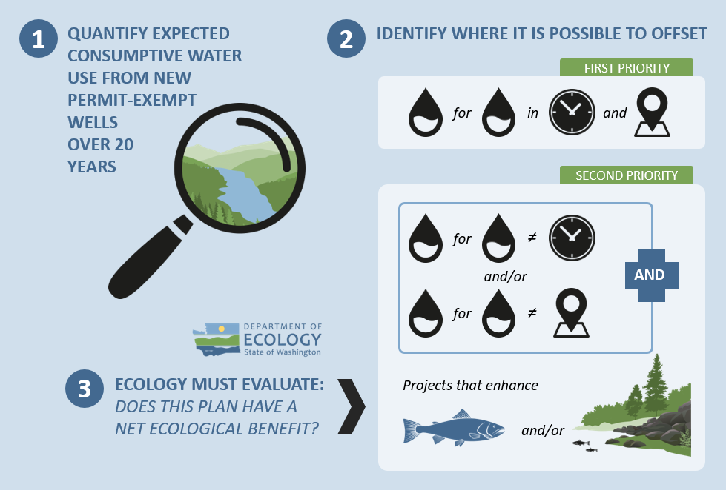
Required Plan Elements –
Legislation
Notes:
The plan must address Indoor and outdoor household water use from new permit-exempt domestic groundwater withdrawals over the 20 year horizon: January 19, 2018 – January 18, 2038
The plan must include projects and actions to offset new consumptive water use and the offsets must continue as long as well pumping continues.
NEB is evaluated at the WRIA scale

Slide 8
Required Plan Elements –
NEB Guidance
Document assumptions and methods
Delineate subbasins
Estimate new consumptive water use
Evaluate impacts from new consumptive water use
Describe and evaluate offsets from projects and actions
Notes:
Planning groups must include the following information in the plans:
­Document assumptions and explain our methods for reaching our conclusions
­Discuss coordination with existing planning efforts like salmon recovery planning and ecosystem recovery planning
­Delineate subbasins to explain the relationship between consumptive use and offset projects, and whether the offsets are “in place”
­Estimate consumptive water use by subbasin. Recommended methods are in Appendix A.
­Evaluate impacts.
The NEB Guidance equates new consumptive use impact with new consumptive water use. We do not have time or resources for the detailed hydrogeologic modeling needed to identify consumptive use impacts to streamflow. Because it will be difficult, as well as unnecessary, to evaluate the impacts of pumping at individual locations, planning groups can assume the impacts from new permit-exempt domestic withdrawals over the planning horizon will be steady-state.
Appendix B provides recommendations on assumptions the planning group can make to evaluate hydrologic impacts from wells and offset projects.
Appendix B concludes that in most instances pumping impacts associated with new domestic wells will be quite small, well dispersed, and nearly steady-state with respect to impact on streams.
Ecology does not expect an in-depth hydrologic impacts analysis and encourages planning groups to focus their efforts on identifying water offset and habitat projects that are most beneficial for fish.

Slide 9
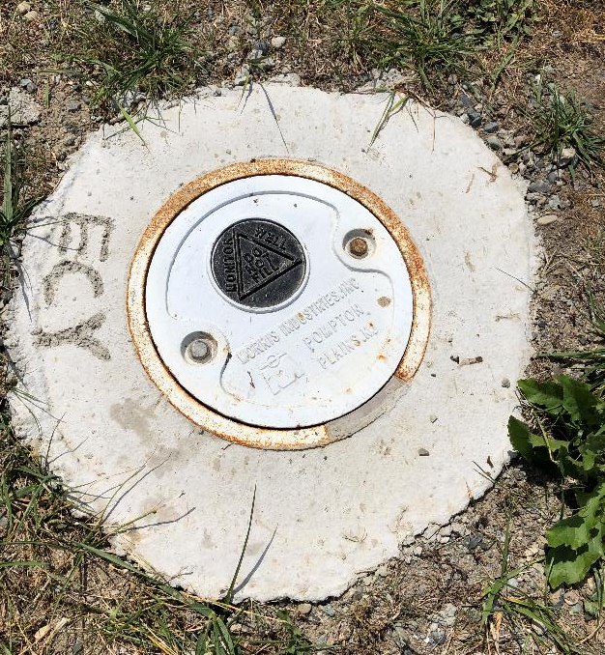
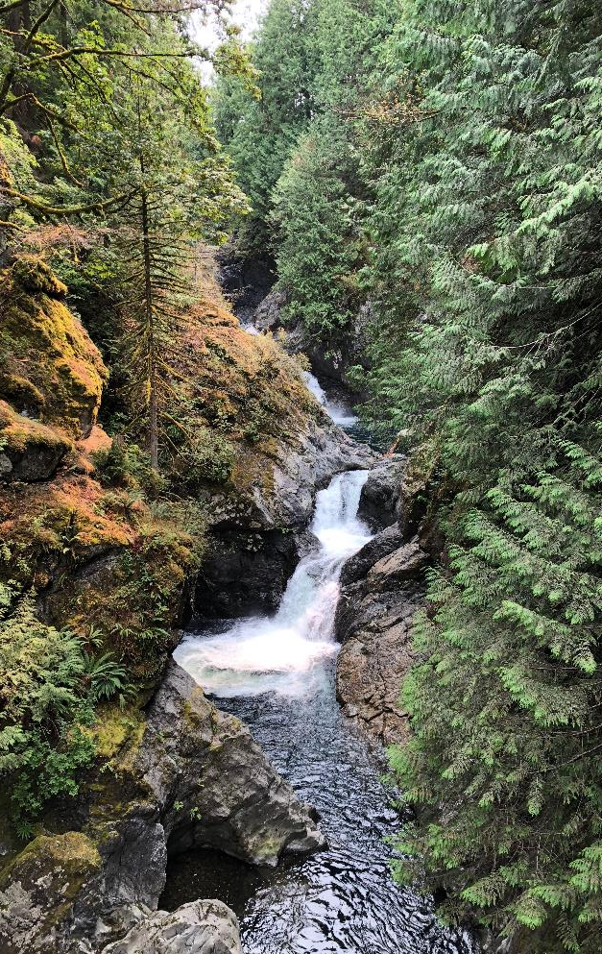
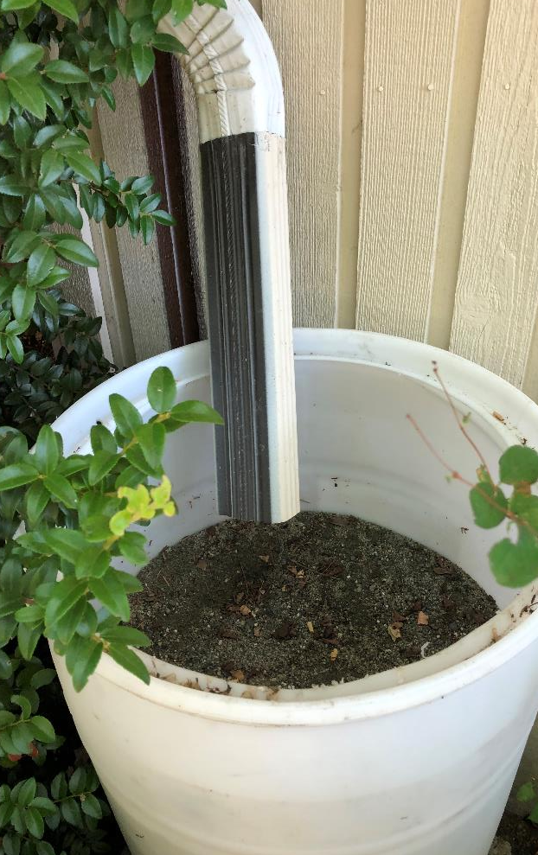
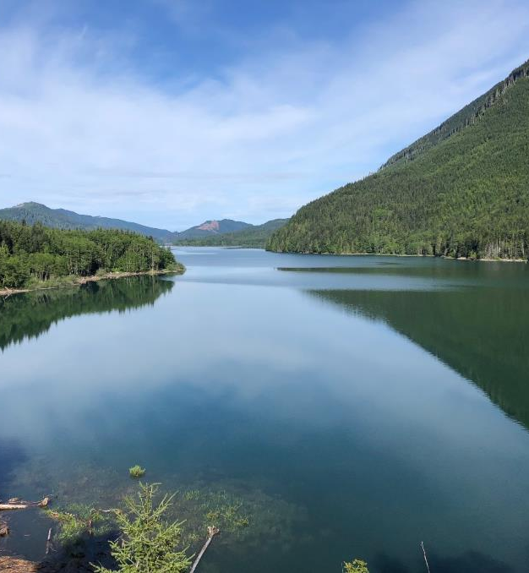
Evaluate Offsets
Project and action description
Offset estimates
Benefit summary
NEB evaluation
Adaptive management
Notes:
­Project and Action description: the NEB guidance describes information on projects and actions the plan should include, such as: a narrative description, quantitative or qualitative assessment of impacts, likely benefits, performance measures, etc.
Plans should describe how the project will offset new consumptive use, if applicable, as well as how it will improve “instream resources” such as fish.
Offset estimates: Projects that contribute toward the offset should quantify the amount of water going back to the stream.
There is no requirement that offsets are in the same time and place as impacts. Plans need to meet NEB at the WRIA scale. Committees can decide where to direct offset projects based on the needs of the watershed.
Plans must offset consumptive water use from new permit-exempt domestic groundwater withdrawals in the planning horizon of 2019-2038
The NEB guidance talks about 3 ways to for committees to consider organizing project lists. None of these are required nor even recommended, but are put forward in case it helps the committee in thinking about how to organize the list.
Benefit summary and NEB evaluation: the plan must include a well-organized and transparent evaluation of the benefits from projects and actions to demonstrate that we’ve met our offset and achieved NEB. Plans must also include an assessment of the likelihood the project and action benefits will occur, including local support and barriers to implementation. The committee can choose to complete their own NEB evaluation (and our consultants have budget to do so) which can help put forward our own justification on why we – the local watershed experts - believe we meet NEB to the Ecology reviewers as they work on the NEB determination. The NEB guidance provide detailed steps on how to complete the NEB evaluation
Adaptive management (not required): an adaptive management component provides greater assurance that the plan will be implemented, however Ecology cannot obligate the planning group to keep meeting. We will discuss this more in the coming months.

Slide 10
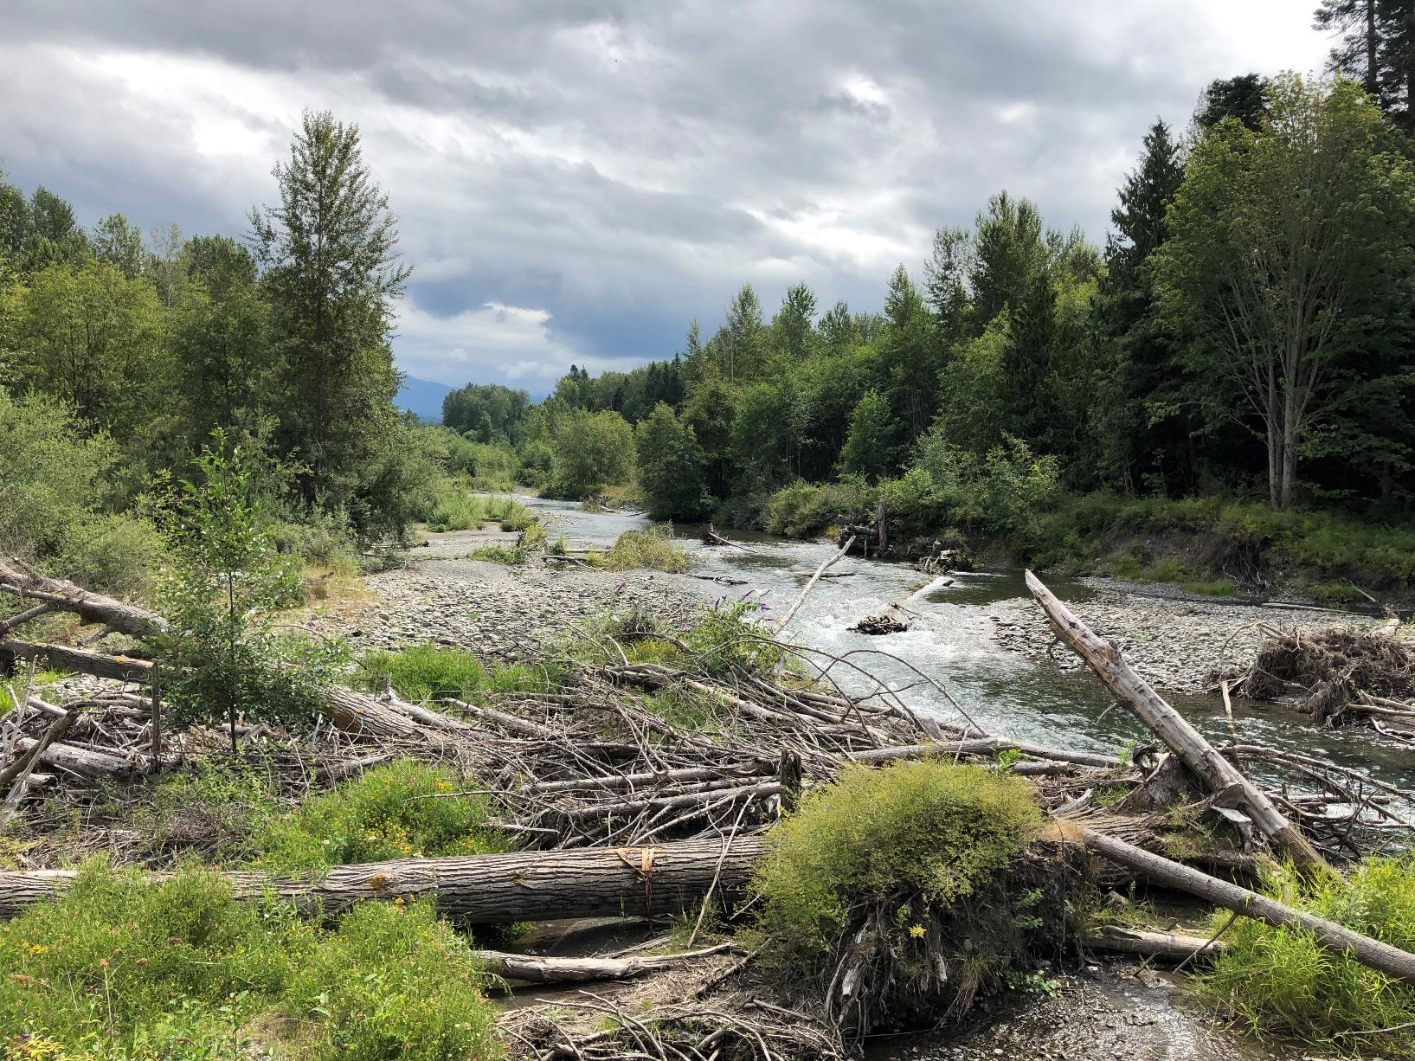
Examples of Projects & Actions
Water rights acquisition offset projects
Non-acquisition water offset projects
Habitat and other related projects
Regulatory actions
Notes:
There are many different types of projects and actions that could address the new consumptive water use and achievement of a net ecological benefit. The examples provided in the NEB guidance are some suggestions. The Committee can come up with new ideas for projects and actions that don’t fit into these categories. Some of the projects in our plan will likely be eligible to apply for streamflow restoration grant funding.
Plans can also include recommended actions, such as change to state regulations or local ordinances
Ecology will consider “actions” that go into effect after the legislation was passed (January 19, 2018) and that were adopted for the purpose of streamflow restoration
The legislation specifically called out changes to the fee and water usage limits for new homes that rely on wells
Ecology and WDFW staff provided an overview of these project types during the May webinar. The WRIA 7 Committee will spend time in the coming months talking in more detail about projects types appropriate for the Snohomish watershed.

Slide 11
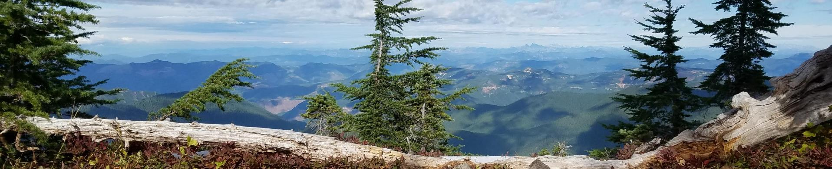
What will the plans look like?
Notes:
For the 203 Committees, Ecology will work with the Committee to write the WRE plan. Ecology will lead the process for writing the plans. We anticipate the plans will be brief (~30 pages) with several detailed technical appendices developed by our technical support consultants that will be summarized to include in the main body of the plan.
Ecology is building from the NEB guidance and the statute to develop a detailed template outline which will be a launching point for committees to provide input on the content, structure and flow of the plan. The following slide provides a high level overview of the required sections (per statute and NEB guidance), recommended sections, and other areas for consideration. We will provide a more detailed template outline for your written feedback in the coming months
We will be talking with the committee over the coming months about the process for reviewing and providing input on the draft sections of the plan.

Slide 12
Plan Outline
Purpose of the plan
Overview of the planning process and committee structure
Overview of the WRIA and Subbasin Delineation
Anticipated Growth in the WRIA
Consumptive Use Estimates for Indoor and Outdoor Use
Projects and Actions, including cost evaluation
Benefit Summary
Detailed Appendices
NEB Evaluation
Adaptive Management/Plan Implementation
Required
Notes:
Reminder: Committee develops plan and approves plan, ECY does NEB review and adopts plan if meets NEB. Ecology will review approved watershed plans submitted by planning groups that provide reasonable time for Ecology review prior to the relevant statutory deadline.15
If a watershed plan has not been adopted by the prescribed deadline, Ecology is required to commence a rulemaking process under 90.94.030.
Ecology will follow the procedures specified in RCW 90.94.030(3)(h). Ecology will submit the final draft plan to the Salmon Recovery Funding Board for a technical review, and provide recommendations to amend the final draft plan, if necessary. Ecology shall consider the recommendations and may amend the final draft plan without committee approval prior to adoption.
Required:
Most of these sections will include a summary of the technical memos that you all will review and provide input on throughout this process, particularly over the next few months. The detailed appendices will include technical memos, various versions of maps that we don’t want to include in the main body of the plan, variations on the project and action list, etc.
Regarding projects and actions, beyond the dirt/water moving projects, we need to talk about policy and regulatory measures that may want to be considered. I hope to open up this conversation in October, but encourage you all to consider ideas you may want to bring forward that could gain traction with the committee. The legislation discusses options around changing the building permit fee (currently at 500) or the gpd allocation (currently at 950) – both of which would trigger rulemaking. However, there may be other considerations, some of which I’ve heard interest in include….[e.g. in WRIA 15, legacy lot LID improvements, expansion of WS areas, considering priority salmon basins as off-limit for future development…]. Reminder that we’ll need to get approval from around the table on all items.

Slide 13
Plan Outline
Purpose of the plan
Overview of the planning process and committee structure
Overview of the WRIA and Subbasin Delineation
Anticipated Growth in the WRIA
Consumptive Use Estimates for Indoor and Outdoor Use
Projects and Actions, including cost evaluation
Benefit Summary
Detailed Appendices
NEB Evaluation
Adaptive Management/ Plan Implementation
Required
Recommended
Notes:
Recommended:
Both of these items are strongly recommended in the NEB guidance and will help increase certainty around our plan meeting NEB and being implemented in the future. We have consultant support for the NEB evaluation. I’ve heard a lot of interest in adaptive management from this group and ensuring the plan is implemented. We’ll talk next month about how our plan and this committee should approach adaptive management – be thinking about if/how you or this committee should engage in monitoring plan implementation and in implementation itself after June 2021.

Slide 14
Plan Outline
Purpose of the plan
Overview of the planning process and committee structure
Overview of the WRIA and Subbasin Delineation
Anticipated Growth in the WRIA
Consumptive Use Estimates for Indoor and Outdoor Use
Projects and Actions, including cost evaluation
Benefit Summary
Detailed Appendices
NEB Evaluation
Adaptive Management/ Plan Implementation
Required
Committee-approved targets beyond 20-year consumptive use
Climate change
History of water use and anticipated future water use, beyond permit-exempt wells
Detailed funding strategy
Others
Recommended
Other Considerations
Notes:
what will make our plan strong, implementable, resilient and resonate with you and your entities? This committee may – time dependent- want to consider other elements to include in the plan. We’ve heard a lot of interest in climate change considerations and will hold an initial discussion next month on how / if our committee wants to approach climate change considerations in our plan.

Slide 15
Inspirational quote
Questions
Ingria Jones
Chair, Snohomish (WRIA 7)
Watershed Restoration and Enhancement Committee

