Slide 1
WRIA 7 Consumptive Use Estimates
Report to WRIA 7 WREC, 12/12/19

Slide 2
Overview
Consumptive use estimate approach and results
Introduction to consumptive use calculator
Notes:
Today I’m going to cover two topics:
Consumptive use estimate results, with minor review of approach and methods
Introduce you to the spreadsheet-based consumptive use calculator

Slide 3
Consumptive Use Estimate Approach
Indoor estimate
  60 gallons per day per person total use
  10% of total use is estimated to be consumptive
Outdoor estimate driving factors
  Irrigation practices
    Size of irrigated yard
    Application season, frequency, volume
  Crop irrigation requirements
    Washington Irrigation Guide (NRCS, 1997)
    Vary significantly across the WRIA
Notes:
Just to review the approach we used to develop the consumptive use estimates:
Indoor estimates are a simple calculation, using the avg people per home from King and Snohomish Counties multiplied by 60 gpd for total indoor use. The consumptive portion is estimated at 10% of the calculated total indoor use.
Outdoor consumptive use is largely driven by irrigation, and you will see in the results that this varies significantly.
Individual irrigation practices include the size of irrigated yard, the length of season over which a person irrigates, how much water they apply at a time, and how frequently. Unless an automated sprinkler system is present, studies have shown that homeowners tend to deficit irrigate.
Crop irrigation requirements also vary across the WRIA, with a CIR range- Upper Skykomish (8.9’) – Patterson (14.0’). This is the amount of water (in inches) NRSC determined was needed to grow turf commercially, so is considered a high estimate for residential lawns. It varies mainly based on amount of rainfall and air temperature. Soil types are also a factor of course.

Slide 4
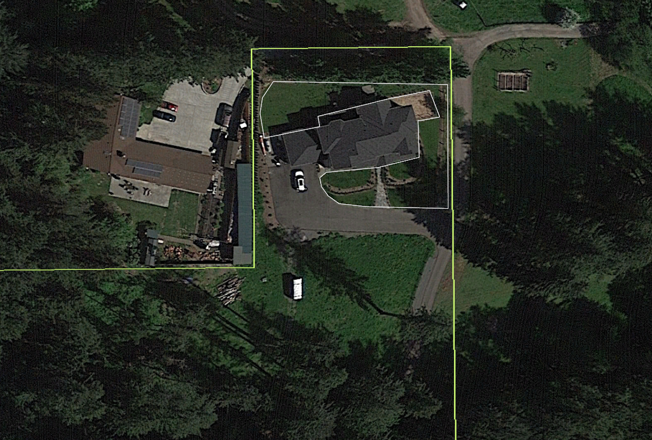
Irrigated Yard Footprint Delineations
Sampled 393 single-family residential building permit sites, 2006-2017
20-30 permit parcels evaluated in each of 16 subbasins with projected permit-exempt well connections
Evaluated irrigation practices at each site using Google Earth imagery
Included sites with zero irrigation and those with >0.5 acres irrigation
Excluded sites still under construction
Yellow line is parcel boundary; white line is irrigated area delineation.
Notes:
To evaluate irrigation practices, we examined 393 SFRs built between 2006 and 2017 in WRIA 7. We evaluated whether yard irrigation is done using Google Earth imagery, which allowed us to scroll through years to see practices over time. Where yard irrigation does occur, we delineated and measured the footprint, including flowerbeds and gardens along with lawns. We included areas over half an acre (legal limit). Sites with no irrigation factored into the calculations as zero acres (so those pull the average down).
Ingria spoke about the comparison Ecology is having done across the 8 Ecology-led WRIAs. Cross-checking these delineation methods is the focus of that comparison, which is why I wanted to share a little more detail about this piece of the consumptive use estimate with you today. Overall, delineation includes judgement and it wasn’t always easy to tell if a parcel was being irrigated or not. If a parcel appeared to be irrigated, even if it wasn’t irrigated to a clear dark green, we counted it. Since we’re assuming water requirements for commercial turf, we believe our estimates are conservative. There’s variability in the results, but we’re very comfortable that our estimate is within the range of variability, and that it’s protective of the resource.

Slide 5
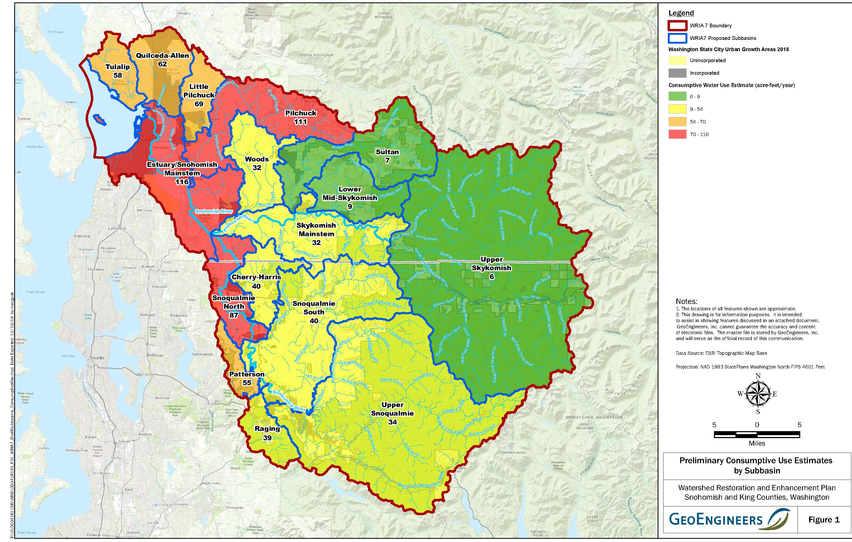
Consumptive Use Estimates by Subbasin
Notes:
This map depicts results of the consumptive use estimate. The labels in each subbasin are the estimated consumptive use in af/yr. The red subbasins have the highest estimated consumptive use from projected PE wells, orange second highest, then yellow, and green is lowest.
I will show you tabulated data next but thought it would be useful context for you to see where in the WRIA the consumptive use estimates are highest and lowest. It does not always correlate directly to the number of projected PE well connections. We will investigate that further in the next few slides.

Slide 6
Preliminary Irrigated Area Analysis
Notes:
We discussed that the size of irrigated yard is a major driver in consumptive use, and this table shows you the results of the irrigated footprint analysis for WRIA 7. Note that some subbasins have very small irrigated yard averages – Tulalip, Quilceda-Allen, Sultan, and all of the Skykomish subbasins. A few subbasins have notable larger irrigated yard averages – Patterson, Raging, and Pilchuck for example. These results were a big driver for the CU estimates shown on the previous map.

Slide 7
Annual Consumptive Use Summary Using Subbasin Average Irrigated Yard
Notes:
This table shows you the CU estimate in tabular form. The total consumptive use estimate for WRIA 7 is 797.4 af/yr.
You can also see in this table how that estimate varies by well connection in the different subbasins. The indoor estimate stays nearly constant, so these differences are largely driven by the outdoor use estimates. At the low end, the Upper Skykomish subbasin estimate is 51.7 gpd per well connection. At the high end are Pilchuck, Patterson, and Raging. These are driven by yard size plus crop irrigation requirements; crop irrigation requirements are highest in the lowland areas, and less in the mountainous eastern part of the WRIA.
You can also see in this table that the projected CU does not always correlate with projected PE well magnitude. For example, Tulalip and Quilceda have PE projections are some of the highest in the WRIA, but the CU estimate is mid-range. I’m sharing this perspective as things to consider as you begin prioritizing your subbasins for offset projects.
*Note for reference only: Total consumptive use equates to 1.1 cfs

Slide 8
Comparison of Consumptive Water Use Scenarios
Scenario (Indoor / Outdoor) | Annual Consumptive Water Use Estimate (acre-feet per year)
60 gpd pp / measured irrigated footprint | 797
60 gpd pp / 0.5-acre irrigated yard | 1,885
950 gpd (legal limit averaged over the year) | 2,448
Notes:
We developed a few CU estimate scenarios for comparison purposes – you’ll see these in the CU memo that Ingria distributed and in the CU calculator.
The first CU estimate shown here is what we’ve been discussing – based on measured avg irrigated footprint.
The second uses the legal limit of half acre irrigated yard – over twice as much as the CU estimate based on measured irrigated footprint. We used ECY assumptions for indoor (60 gpd/person and 10% consumptive), but assumed everyone irrigated ½ acre-the legal limit for lawn size under the permit exemption.
The third line uses 950 gpd as a flat daily withdrawal rate. This estimate is over 3X as much as the estimate from our measured irrigated footprint. For this, we used ECY assumptions for indoor use (60 gpd/person and 10% consumptive) and assumed the rest was used outdoors; results in lawns larger than a half acre.

Slide 9
Metered Water Use Compared to PE Well Estimate
Notes:
One additional comparison we did was against regional water purveyors. Snohomish PUD and Covington Water District (WRIA 9) provided water use data. Note that these comparisons are total water use, not consumptive water use; the water purveyors do not measure consumptive use.
We determined the indoor use fraction of purveyor data based on winter water use. The remainder of purveyor data total use is assumed to be outdoor use.
Results show that the indoor use is very similar to our calculated indoor water use. For outdoor use – our estimates are much higher – 4-5X higher. This comparison reinforces our confidence that the CU estimates are conservative, and actual use is likely to be lower.
*Note for reference only: CWD – 164 gpd indoor; 50 gpd outdoor annual avg / 150-200 gpd summer

Slide 10
Introduction to Consumptive Use Calculator
Notes:
Go to spreadsheet

