Slide 1
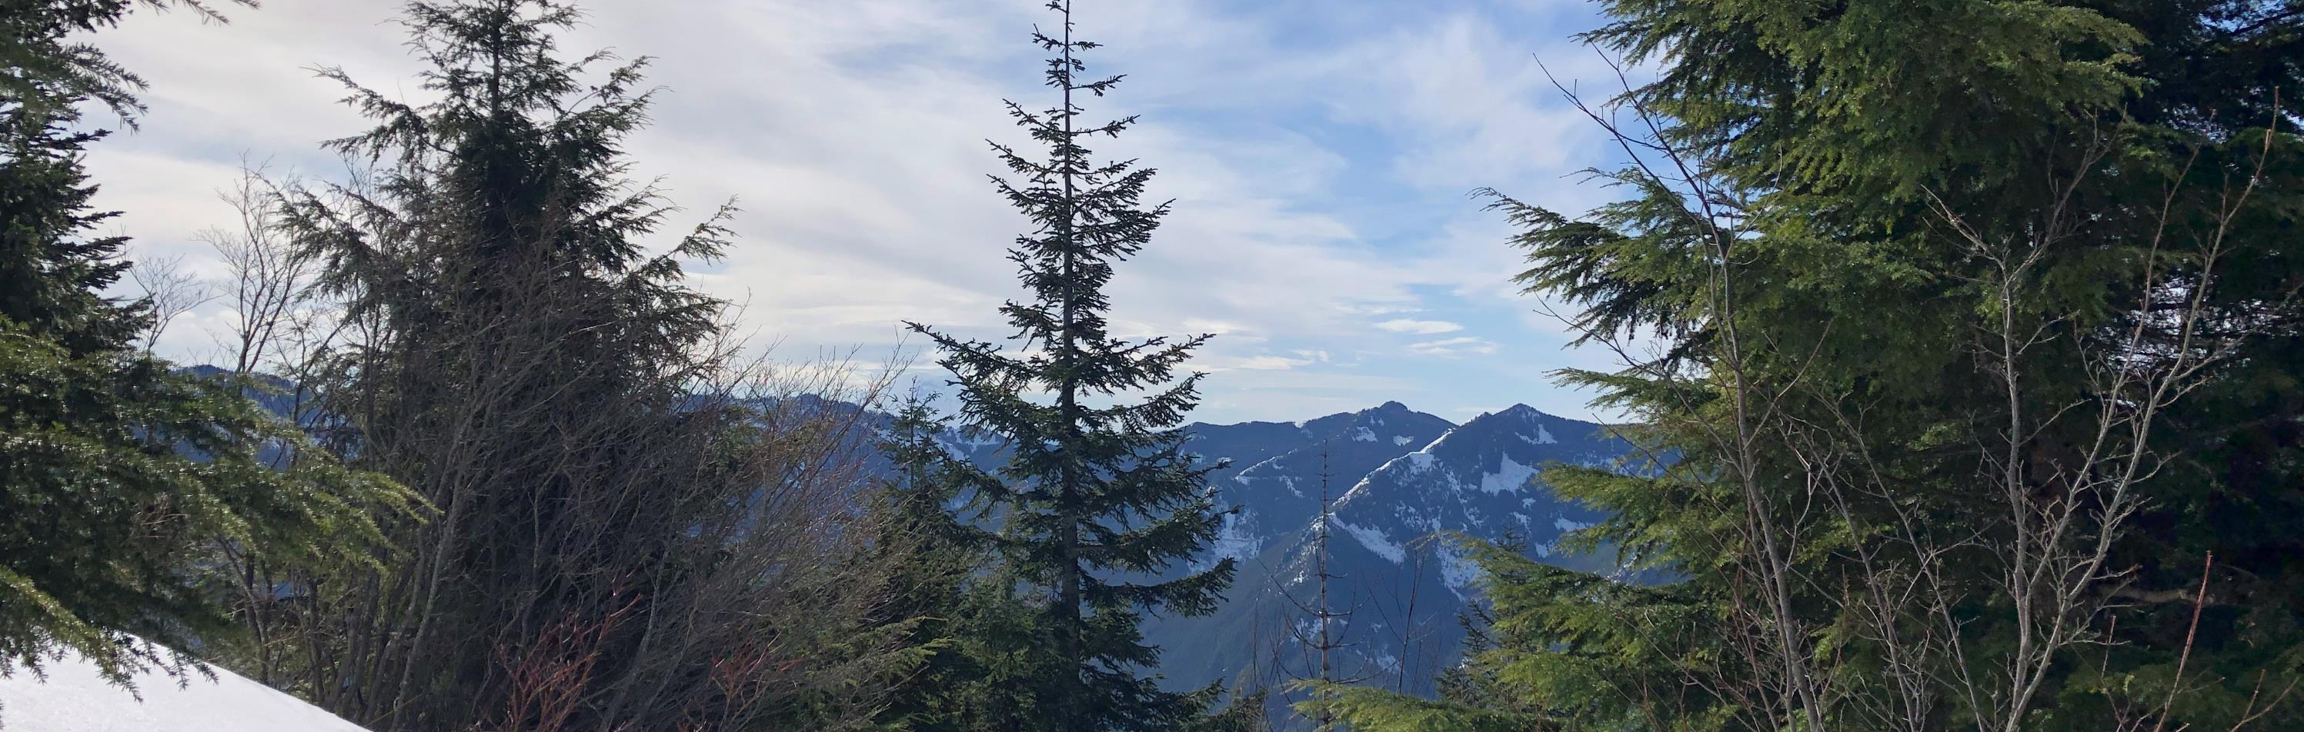
WRIA 7 Watershed Restoration and Enhancement Committee
March 12, 2020

Slide 2
Call-In Information:
WebEX Sign in: https://watech.webex.com/watech/j.php?MTID=m131e1f30ea1daece155cc7dec3f62f80 Please enter your full name Here’s the password (just in case): WRIA7Streamflow
WebEx Audio: +1-415-655-0001 US Toll +1-206-207-1700 United States Toll (Seattle)
Back-Up Conference line – Only If WebEx Fails: (360) 407-3780, PIN Code: 160797#

Slide 3
Agenda
Standing Business
    Introductions
    Review agenda
    Approve February meeting summary
    Updates and Announcements
Consumptive Use Estimate Decision
WRE Plan Approval Process
Policy & Regulatory Actions
Projects Update
Public Comment
Next Steps and Action Items

Slide 4

Pi Day Poll

Slide 5
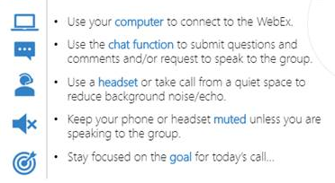
WebEx Meeting Ground Rules
From WRIA 7 Operating Principles:
Be respectful
Be constructive
Be productive
Bring a sense of humor and have fun
Notes:
Be Respectful
Listen when others are speaking. Do not interrupt and do not participate in side
conversations. One person speaks at a time.
Recognize the legitimacy of the concerns and interests of others, whether or not you agree
with them.
Cooperate with the facilitator to ensure that everyone is given equitable time to state their
views. Present your views succinctly and try not to repeat or rephrase what others have
already said.
Silence cell phones and refrain from using laptops during the meeting, except to take notes.
Respect other communication styles and needs.
2. Be Constructive
Participate in the spirit of giving the same priority to solving the problems of others as you do
to solving your own problems.
Share comments that are solution focused. Avoid repeating past discussions.
Do not engage in personal attacks or make slanderous statements. Do not give ultimatums.
Ask for clarification if you are uncertain of what another person is saying. Ask questions
rather than make assumptions.
Work towards consensus. Identify areas of common ground and be willing to compromise.
Minimize the use of jargon and acronyms. Attempt to use language observers and laypersons
will understand.
It is okay to disagree, but strive to reach common ground.
3. Be Productive
Adhere to the agenda. Respect time constraints and focus on the topic being discussed.
4. Bring a Sense of Humor and Have Fun.

Slide 6
WRIA 7 Technical Work - Results
Subbasin Delineation | 16 Subbasins
Growth Projections | 3,389 PE Wells
Consumptive Use Estimate | 797.4 AF

Slide 7
The Committee will strive toward consensus.
The levels of consensus include:
I can say an unqualified "yes"!
I can accept the decision.
I can live with the decision.
I do not fully agree with the decision; however, I will not block it.
Block the decision

Slide 8
Committee decision
The chair proposes a formal decision:
Establish the Committee’s support for the planning horizon consumptive use estimate of 797.4 acre-feet for the WRIA determined using the methodologies and 16 sub-basins recommended by the technical workgroup and described in the decision memo.
This decision is ONLY for the 20-year consumptive use estimate.
Use the WebEx poll to submit your level of support for this decision

Slide 9
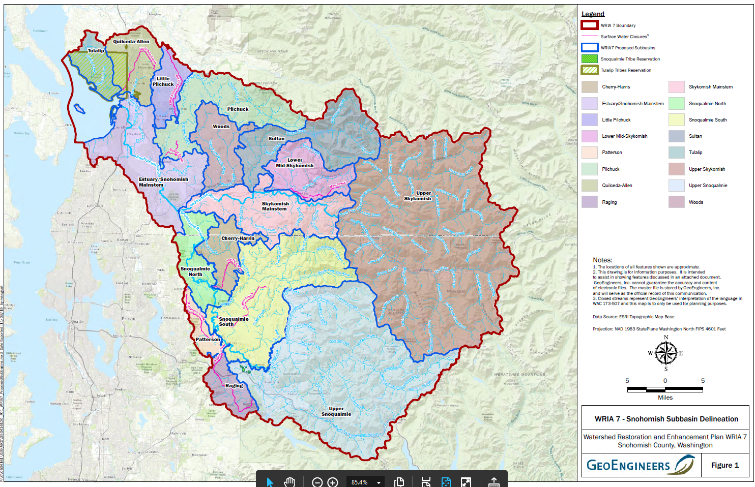
WRIA 7 Subbasin Delineation

Slide 10
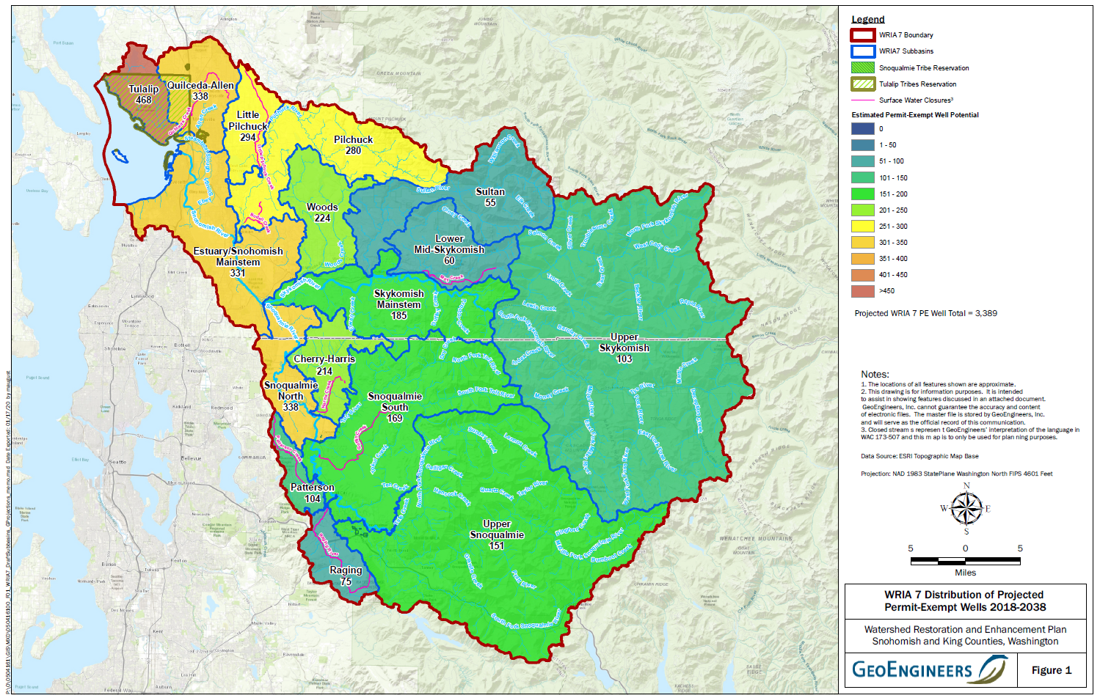
WRIA 7 Growth Projection

Slide 11
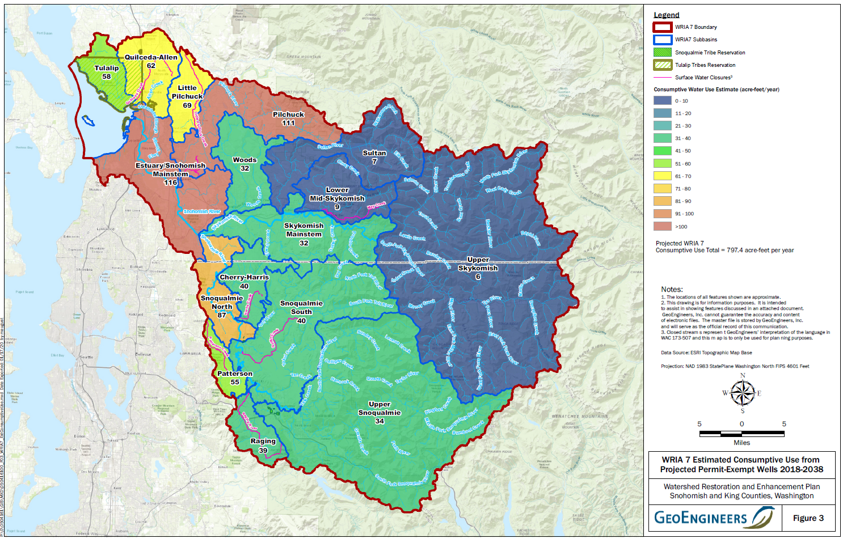
WRIA 7 Consumptive Use Estimate

Slide 12
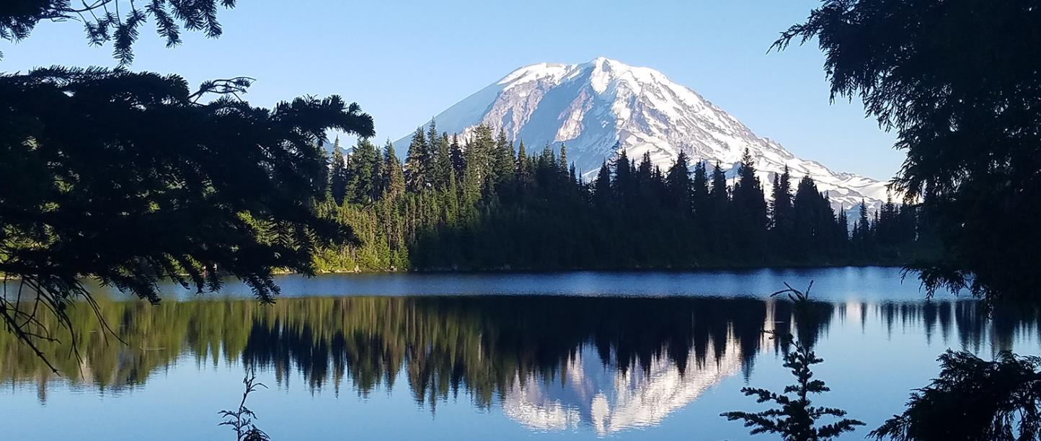
Watershed Restoration and Enhancement Plan Development
Notes:
Provide an overview of the plan development, review and approval process and timeline.
We have a memo that we’ll distribute that outlines the details of what I’ll present.

Slide 13
WRE Plan Outline
- Distributed for comment in November
-Comments received and incorporated
Executive Summary
Section 1. Purpose and Scope (5-6 pages)
  Purpose and scope of plan, brief overview of the process, table of contents, acronyms and glossary, acknowledgements.
Section 2. Watershed Overview and Subbasins (2-4 pages)
  Critical history/overview of the watershed, subbasins, including brief introduction to the WRIA’s geography, hydrology, instream flow rules as relevant for subbasin delineation.
Section 3. Water Use and Impact (3-5 pages)
  Projected population growth, evaluation of impacts from new consumptive water use.
Section 4. Projects and Actions (5-10 pages)
  Description and evaluation of projects and actions.
Section 5. NEB Evaluation (3-5 pages) Recommended
Section 6. Plan Benefit and Summary (2-4 pages)
  Benefit summary of projects and actions, adaptive management process.
Section 7. References
Appendices

Slide 14
WRE Plan Development
Roles and responsibilities
Plan materials distribution and storage
Step-by-step review process
Notes:
The WRIA 7 WREC has made a lot of progress over the last year and a half on some of the key components of the plan:
We divided the WRIA into 16 subbasins
We developed a 20-year projection of new permit-exempt domestic wells
We developed consumptive water use scenarios based on that growth projection
We also have final draft technical memos for each of these key elements of the Plan.
The key remaining tasks are: decide on our consumptive use estimate, develop a list of projects and actions to offset consumptive use and achieve a net ecological benefit, and develop optional components: adaptive management and policy and regulatory recommendations
The technical consultants have completed the technical memos on subbasins, growth projections and consumptive use and Ecology staff are starting to write sections of the plan.
In order to achieve our goal of an approved plan by June 30, 2021, we have identified the following roles and responsibilities
Committee Chair: share technical memos and plan sections for review, compile plan components and share initial draft plan by Aug 14, 2020; distribute final plan for Committee approval; submit final approved plan to Ecology
Committee members: are expected to provide ongoing, thorough review of draft plan components and initial and final drafts of the plan, and vet all draft plan components with appropriate decision makers within your entity; Once we have interim agreement on the final plan, distribute final plan to local decision-makers that require review/approval before we vote.
Ecology staff will develop draft plan sections, provide communications materials, review approved plan and make decision on plan adoption by June 30, 2021
Access to plan materials
Plan materials will be emailed and stored on Box; plan drafts emailed in PDF format; comments submitted through comment tracker
Step-by-step review process
Next slides will cover target deadlines and an overview of the plan development process for the committee

Slide 15

WRE Plan Development
Target date: February 1, 2021
All Committee members must approve the plan
Plans received after target date reviewed in order submitted
2021
FEB
1
Notes:
Ecology has established February 1, 2021 as the target date for submitting an approved plan to Ecology. Target date aligns with previous timelines we’ve shared with the committee.
We feel it is important to provide this target date now, so that we can develop a plan review schedule to accommodate thorough review and vetting based on your internal plan approval process and needs.
Timeframe balances work of committee and Ecology. Ecology will need to review 8 WRE plans simultaneously.
Plans received after target date reviewed on first-come-first-serve basis . It is Ecology’s intent to review all approved plans submitted prior to the statutory deadline (June 30).

Slide 16
Generalized WRE Plan Timeline
Spring
2020
Review and Finalize
Subbasin delineation chapter
Growth projections chapter
We will sequence and package for review based on WRIA 7 needs and as elements are completed
Review and Finalize
Watershed overview chapter
Consumptive use estimates chapter
Project and actions list memo and chapter
Adaptive management (optional)
Policy/Regulatory actions (optional)
NEB evaluation (optional)
Summer 2020
August 14, 2020:
Distribute Draft Plan
Notes:
Committee Chairs will provide plan sections and memos for committee review on an ongoing basis. This timeline highlights actions taken by the committee throughout the plan development process.
Spring 2020:
Reviews and finalize Subbasin Delineation and Growth Projections chapters.
Distribute watershed overview and consumptive use chapters for review.
Summer 2020:
Finalize Watershed Overview chapter and consumptive use chapter.
Review and finalize project list.
Review and finalize Adaptive Management, Policy and Regulatory Actions and NEB evaluation chapters
Goal to distribute a draft plan by August 14.
For project List Development.- develop to the extent possible, recognizing may still be working on details into the fall

Slide 17
Fall
2020
Review and Finalize
Finalize plan components as needed
Review and revise draft plan
Winter 2020/2021
Approve Plan
Send final plan to local decision makers
Vote on approval of plan
Feb 1, 2021:
Submit Final Plan
Notes:
Fall 2020:
Finalize any outstanding plan components.
Review and revise draft plan.
Winter 2020/2021:
Send Final Plan to local decision makers. It is up to you to determine the level of internal review required before you can vote on final plan approval.
We will meets as a Committee to vote on approval of final plan. All Committee members, including cities caucus members, must approve the plan before it’s submitted. Per the operating principles, Committee member are expected to vote in person.
After the Committee votes to approve the plan, I will submit the final approved plan to Ecology by February 1, 2021 (target date).

Slide 18
Post Plan Submission
Ecology will review plan
No changes to plan after submission
Status updates to committee as needed
Director to determine action by June 30, 2021
Notes:
After we submit the final approved plan to Ecology,
Ecology will review plan
No changes to plan after submission
I will provide status updates to committee as needed
Director to determine action by June 30, 2021

Slide 19
Thank you for your time and collaborative work!
Notes:
We developed this timeline to ensure Ecology has enough time to review the plan thoroughly and provide the best possible outcome.
We have a lot to do over the next 6 months. To stay on track with our timeline for plan development, committee members are expected to review materials outside of committee meetings and respond to comments by the requested deadlines.
We appreciate the committee’s hard work and commitment. Thank you.

Slide 20
Local Approval Process – Form
What is your entity’s process and timeline?
Notes:
Chair received forms from most Committee members – thank you for working with your colleagues and supervisors to figure out your local approval process.
Committee member processes range from the committee member providing full review and approval within a week or two, to multiple departmental reviews and a Council approval vote.
Based on the processes that committee members have described to-date, we are looking at a local approval process of up to 16 weeks (4 months).
We’ll be working on incorporating local review into our Committee timeline, working backwards from the target date of February 1st and considering our target date for the draft plan.

Slide 21
Policy and Regulatory Actions – Round Table
Goals of the roundtable:
Advance ideas that have been brainstormed in prior meetings
Identify ideas that won’t get full approval so we don't waste anyone's time
Document positions/champions to further develop ideas into a proposal(s) for the committee to review and discuss

Slide 22
Policy and Regulatory Actions
– Round Table
What are the top policy and regulatory actions that you'd like to see in the plan?
What policies on the list do you know your entity cannot support if in the plan?

Slide 23
Policy and Regulatory Actions
– Round Table
WRIA 7 | Category | Description
X | Enforcement | Make resources available for enforcement.
X | Enforcement | Well pumps that limit usage
X | Financial | Additional funding for tracking plan implementation, projects, & adaptive management
X | Financial | Create a tiered fee structure for permit exempt well construction based on 1) property value, 2) lawn size, 3) reduced irrigation practices, 4) native plantings, 5)LID/BMPs. Note: Ensure that costs associated with new programs do not impede affordable housing and keep the front-end costs of home construction as low as possible
X | Financial | Increase the fee for permit exempt well construction
X | Financial | Perform a financial analysis of the fee rate for permit exempt well construction and consider an annual fee vs. a one-time installation fee.
X | Financial | Establish incentive programs for water conservation: native/drought tolerant plants, water service connection/well decommissioning, rain water storage for irrigation etc.

Slide 24
Policy and Regulatory Actions
– Round Table
WRIA 7 | Category | Description
X | Land use and development | Ban lawns or reduce lot size
X | Land use and development | Change requirements and/or enforcement for tree retention
X | Land use and development | Encourage land acquisitions and create regulations to limit wells and development in key areas with recharge potential.
X | Land use and development | Projects that benefit streamflow and other users (e.g., ag) – not prohibiting multi-purpose
X | Land use and development | PSRC Vision 2050 – cut rural growth target
X | Land use and development | Requirements for maintenance
X | Legislation | Adopt and/or update existing water conservation codes
X | Legislation | Lower the withdrawl limits from wells aka water use limitations
X | Legislation | Restrictions on water use in subbasins with no water offset projects
X | LID/BMP | Develop regulations to promote the use of stormwater and reclaimed water for infiltration and reuse. EG: 1) pervious pavement, 2)industrial users using grey water, 3) sports field irrigation

Slide 25
Policy and Regulatory Actions
– Round Table
WRIA 7 | Category | Description
X | Metering | Meter permit exempt wells for eduction AND/OR compliance.
X | Modeling | Invest in monitoring and research needs (hydrogeological models); 1) Groundwater monitoring, 2) Streamflow, 3) Foreign flow from septic
X | Ordinance | Model ordinances
X | Outreach and education | Establish an outreach and education program.
X | Outreach and education | Technical assistance for native plantings for new homes or new home owners
X | PUD | Stregthen and clarify requirements for individuals to hookup to municipal water. 1) Increase the required distance between a home and a water main and require well decommissioning, 2) Reduce grey area in "timely and reasonable" requirements for connecting to water service
X | Water conservation | Incentivize efficient irrigation systems, reduced irrigation size (through rebate?)
X | Water conservation | Source switching for irrigators
X |  | Allow temporary donations
X |  | Consider strategies in Snohomish Basin Protection Plan
X |  | Flexibility with water right acquisitions regarding inchoate rights and municipal rights
X |  | Reduce burden of beneficial use
X |  | Standard mitigation bank considers stewardship and maintenance cost - Considering phasing in. State cap budget subsidizing this now.

Slide 26
Policy and Regulatory Actions
– Next Steps
Identify champions/volunteers
Build out proposals/ recommendations for committee consideration
Form Disappearing Task Force

Slide 27
Projects Subgroup & Technical Workgroup
Progress
WRIA 7 WRE Committee
March 12, 2020
On track
Work underway
Needs attention

Slide 28
Where are we?
Projects Subgroup Update:
  Meetings have focused on specific project type(s) and project development/narrowing
  Crosswalked habitat project types to subbasins using the Snohomish Basin Salmon Conservation Plan and Snohomish Basin Protection Plan
    Used this to ID priority subbasins for floodplain projects: Snoqualmie S, Snoqualmie N, Upper Snoqualmie, Raging, Skykomish Mainstem, Pilchuck, & Sultan
  Reviewed GeoEngineers’ work plan to estimate water offset for floodplain projects
    Snohomish Forum and Snoqualmie Forum will propose a subset of floodplain restoration projects for further filtering (if needed) and analysis for water offset benefits
  Reviewed guiding principles
  Next meeting will focus on work plan for water offset projects, including MAR and storage projects

Slide 29
Why Guiding Principles?
Articulate and document the subgroup's approach when we are narrowing and finalizing project list for inclusion in plan
Help frame decision points along the way
Use and test considerations discussed in previous meetings now that more is understood about process
Communicate bigger picture approach to committee
  Get buy in
  Get feedback

Slide 30
Draft Guiding Principles so far:
Strive for no “sacrificial sub-basins”
If/where we can’t find offset projects, offset elsewhere (ideally upstream) and justify
Consider projects that are underway and may have more information/design
When there are sufficient projects to choose from, the preference is for those that benefit critical flow period/summer low flow
….

Slide 31
Prioritize habitat projects based on hydrologic benefit
For non-offset habitat projects:
Hydrologic benefit should drive habitat project prioritization:
  Higher priority = projects with hydro benefit (beaver reintroduction, BDA, floodplain*, forest/upland protection)
  Medium priority = Riparian plantings/noxious weed control
  Lower priority = fish passage, projects lower in system
  Not considering nearshore projects

Slide 32
Previous project buckets
Water Rights Acquisitions
Quantifiable? Yes
Projects ID’d? Yes
WWT, King Co and others are seeking projects/ opportunities
Priority subbasins ID’d
Non-acquisition Water Offset Projects
Quantifiable? Yes
Projects ID’d? Some underway
These include:
MAR
Infiltration galleries
Source switch
Off-channel storage
Habitat projects with hydrologic benefit*
Quantifiable? Maybe
Projects ID’d? Yes, priority type and # varies by subbasin
These include:
Floodplain restoration (setbacks, side channel reconnection, large wood)
Beaver introduction
Beaver analogs
Forest protection/mgmt.
(Riparian restoration?)
“Other”

Slide 33
New project buckets
Water Rights Acquisitions
Quantifiable? Yes
Projects ID’d? Yes
WWT, King Co and others are seeking projects/ opportunities
Priority subbasins ID’d
Non-acquisition water offset projects
Quantifiable? Yes
Projects ID’d? Some underway
These include:
Source Switches
Storage and Retiming
Streamflow Augmentation
Conservation and Efficiency
Reclaimed water
Modification to Reservoir Operations
Habitat projects with water offset
Quantifiable? Yes
Projects ID’d? Yes, need to prioritize
These include:
Levee setback
Levee removal
Floodplain/stream restoration
Priority subbasins identified
Other habitat projects
Quantifiable? Maybe, but small water offset
Projects ID’d? Yes, need to prioritize
These include:
Other floodplain projects Beaver introduction
Beaver dam analogs
Forest protection/mgmt.
Etc.
“Other”
??

Slide 34
Updates
Water Rights Acquisitions
Quantifiable? Yes
Projects ID’d? Yes
WWT, King Co and others are seeking projects/ opportunities
Priority subbasins ID’d
Non-acquisition water offset projects
Quantifiable? Yes
Projects ID’d? Some underway
These include:
Source Switches
Storage and Retiming
Streamflow Augmentation
Conservation and Efficiency
Reclaimed water
Modification to Reservoir Operations
Habitat projects with water offset
Quantifiable? Yes
Projects ID’d? Yes, need to prioritize
These include:
Levee setback
Levee removal
Floodplain/stream restoration
Priority subbasins identified
Other habitat projects
Quantifiable? Maybe, but small water offset
Projects ID’d? Yes, need to prioritize
These include:
Other floodplain projects Beaver introduction
Beaver dam analogs
Forest protection/mgmt.
Etc.
“Other”
??
Notes:
What is new?
In addition to WWT, other partners are identifying potential water right acquisitions.
We had previously identified a potential water right acquisition from the City of Snohomish, but the City is not interested in a permanent acquisition, so we’ve removed that from the inventory.
We have identified a King County water right that has potential, but more research is needed to identify whether this can be put into permanent trust. WWT working with King County on this.

Slide 35
Water Right Acquisitions – Status
In Little Pilchuck, Lower/Middle Pilchuck, and Quilceda a total of 1,920 water right documents were found. 167 of these water rights were identified to have 317 potentially irrigated acres.
By Priority Area, # of Water Rights Identified with Irrigation:
  Little Pilchuck: 34
  Lower/Middle Pilchuck: 49
  Quilceda: 84
Analysis for Patterson and Raging is being finalized.
In addition, areas within a half mile of a reclaimed water facility were analyzed.
  Camp Korey at Carnation Farm: 11
  King County Carnation Plant: 0
  Snoqualmie WWTP and Reclaim Facility: 0
  WA State Fire Training Academy: 0

Slide 36
Water Right Acquisitions- Next Steps
WWT recommends to the WREC committee the following prioritization in selecting water rights to further examine in a due diligence review:
Water Right Document Type
  Certificates and claims receive preference.
Irrigated Acreage
  Water rights with more irrigated acreage identified receive preference.
Confidence of Irrigated Acreage
  Water rights with places of use seeing higher and more frequent irrigation confidence receive preference.
Priority Date-
  Water rights with more senior priority dates receive preference.
Distance Upstream
  Water rights higher in the sub-basin receive preference.
Purpose of Use
  Irrigation water rights receive preference due to ability to demonstrate beneficial use.
Qa/Qi Annual and Instantaneous Quantity on Water Right
  Water rights with greater quantities receive preference.

Slide 37
Water Rights Acquisitions
Quantifiable? Yes
Projects ID’d? Yes
WWT, King Co and others are seeking projects/ opportunities
Priority subbasins ID’d
Non-acquisition water offset projects
Quantifiable? Yes
Projects ID’d? Some underway
These include:
Source Switches
Storage and Retiming
Streamflow Augmentation
Conservation and Efficiency
Reclaimed water
Modification to Reservoir Operations
Habitat projects with water offset
Quantifiable? Yes
Projects ID’d? Yes, need to prioritize
These include:
Levee setback
Levee removal
Floodplain/stream restoration
Priority subbasins identified
Other habitat projects
Quantifiable? Maybe, but small water offset
Projects ID’d? Yes, need to prioritize
These include:
Other floodplain projects Beaver introduction
Beaver dam analogs
Forest protection/mgmt.
Etc.
“Other”
??
Notes:
GeoEngineers is developing a work plan for how they will work directly with entities to develop non-acquisition water offset projects. The goal is to further develop concepts that have already arisen, and to identify new opportunities. The Project Subgroup will review the Non-Acquisition Water Offset Project Work Plan at their next meeting.
We have two potential water offset projects related to modification of reservoir releases at Spada Reservoir and Tolt Reservoir. This is a project type where we'd like to discuss with the full committee rather than ask the project subgroup to develop a recommendation.
Some updates to the inventory:
City of Snohomish water right acquisition was removed
Quilceda Stormwater project added –Snohomish Conservation District
Continuing to work on Lake Shoecraft project in Tulalip Subbasin
SVWID Storage project-SVWID developed draft Work Plan for their comprehensive storage study. Anticipate discussion at future Project Subgroup Meeting
Snohmish CD making progress on their Community-Based Water Storage Restoration project. Anticipate discussion at future Project Subgroup meeting.
Removing redundant project listings

Slide 38
Water Rights Acquisitions
Quantifiable? Yes
Projects ID’d? Yes
WWT, King Co and others are seeking projects/ opportunities
Priority subbasins ID’d
Non-acquisition water offset projects
Quantifiable? Yes
Projects ID’d? Some underway
These include:
Source Switches
Storage and Retiming
Streamflow Augmentation
Conservation and Efficiency
Reclaimed water
Modification to Reservoir Operations
Habitat projects with water offset
Quantifiable? Yes
Projects ID’d? Yes, need to prioritize
These include:
Levee setback
Levee removal
Floodplain/stream restoration
Priority subbasins identified
Other habitat projects
Quantifiable? Maybe, but small water offset
Projects ID’d? Yes, need to prioritize
These include:
Other floodplain projects Beaver introduction
Beaver dam analogs
Forest protection/mgmt.
Etc.
“Other”
??
Notes:
Last Committee meeting GeoEngineers presented on their methods to estimate water offset from certain types of habitat projects, including levee setbacks and levee removals.
The Project Subgroup reviewed their Estimating Water Offset from Habitat Projects Work Plan, outlining how they will filter our project inventory for projects that have the most water offset potential, and how they will analyze those.
The priority subbasins identified for floodplain project and analysis include: Snoqualmie S, Snoqualmie N, Upper Snoqualmie, Raging, Skykomish Mainstem, Pilchuck, & Sultan
Snohomish Forum and Snoqualmie Forum reviewed the inventory to identify which projects GeoEngineers should consider for further filtering.
Either next project subgroup meeting or April meeting, we will have a small subset of projects identified that GeoEngineers will analyze.

Slide 39
Water Rights Acquisitions
Quantifiable? Yes
Projects ID’d? Yes
WWT, King Co and others are seeking projects/ opportunities
Priority subbasins ID’d
Non-acquisition water offset projects
Quantifiable? Yes
Projects ID’d? Some underway
These include:
Source Switches
Storage and Retiming
Streamflow Augmentation
Conservation and Efficiency
Reclaimed water
Modification to Reservoir Operations
Habitat projects with water offset
Quantifiable? Yes
Projects ID’d? Yes, need to prioritize
These include:
Levee setback
Levee removal
Floodplain/stream restoration
Priority subbasins identified
Other habitat projects
Quantifiable? Maybe, but small water offset
Projects ID’d? Yes, need to prioritize
These include:
Other floodplain projects Beaver introduction
Beaver dam analogs
Forest protection/mgmt.
Etc.
“Other”
??
Notes:
The Project Subgroup is continuing to develop guiding principles for identifying what other habitat projects we want to include in the Plan.
There was interest in discussing beaver project types at a future meeting.

Slide 40
Water Rights Acquisitions
Quantifiable? Yes
Projects ID’d? Yes
WWT, King Co and others are seeking projects/ opportunities
Priority subbasins ID’d
Non-acquisition water offset projects
Quantifiable? Yes
Projects ID’d? Some underway
These include:
Source Switches
Storage and Retiming
Streamflow Augmentation
Conservation and Efficiency
Reclaimed water
Modification to Reservoir Operations
Habitat projects with water offset
Quantifiable? Yes
Projects ID’d? Yes, need to prioritize
These include:
Levee setback
Levee removal
Floodplain/stream restoration
Priority subbasins identified
Other habitat projects
Quantifiable? Maybe, but small water offset
Projects ID’d? Yes, need to prioritize
These include:
Other floodplain projects Beaver introduction
Beaver dam analogs
Forest protection/mgmt.
Etc.
“Other”
??
Notes:
Other projects may be considered under the non-acquisitions water offset work plan or they may fall under our policy and regulatory actions, to be further developed by a task force.
Keep brainstorming out-of-the-box ideas!

Slide 41
Work ahead – Projects subgroup
ID floodplain projects for GeoEngineers to estimate water offset
Use and further develop guiding principles
Update on water right acquisition progress
Dig into project types and roles of sub-basins
  Grow the list where we need to
  Screen the projects where we need to
  Consider how to bring projects to full committee
Workgroup joins us- less meetings and more integration!
Notes:
The Project Subgroup will continue to dig into project types and the roles of sub-basins. The Subgroup will help to:
Grow the list where we need to – water offset projects (acquisitions, storage, MAR, streamflow augmentation, reservoir releases)
Screen the projects where we need to-lots of habitat projects, some with no hydrological benefit
Consider how to bring projects to full committee – by subbasin in some cases and some by project type

Slide 42
Where are we?
Technical Workgroup:
  Separate CU estimate
  Discussed proposals from entities for safety factor and targets
  Discussed steady-state assumption and timing
  Pausing meetings until more is known about the projects/offsets we have and where they are

Slide 43
Work ahead – Via Disappearing Task Force?
Policy and regulatory actions
Adaptive Management
Other elements of the plan not focused on capital projects?
Notes:
These groups would have a finite number of meetings and clear task then bring recommendations to committee.

Slide 44
Questions/feedback/direction?
Notes:
These groups would have a finite number of meetings and clear task then bring recommendations to committee

Slide 45
2020 Meeting Schedule Q2-Q3
WREC Meetings – 2nd Thursday afternoon, anticipate every month
April 9 (WebEx)
Proposing No May Meeting
June 11
July 9
August 13
September 10

Slide 46
Homework/next steps:
Dig up more projects!!

