Slide 1
WRIA 7 Watershed Restoration and Enhancement Committee
April 9, 2020

Slide 2
Agenda
Standing Business
Introductions
Review agenda
Approve March meeting summary
Updates and Announcements
Non-Acquisition Water Offset Projects Presentation and Work Plan
Reservoir Release Discussion
Water Right Acquisitions: Prioritization Results
Policy & Regulatory Actions
Public Comment
Next Steps and Action Items

Slide 3
Updates & Announcements
Streamflow restoration grant applications period has been extended to 5PM on April 30.
Ecology is launching an Advisory Group on Water Trust, Banking, and Transfers. The first meeting is on April 16.
Project Subgroup met on March 25th to discuss Non-Acquisition Water Offset Projects Work Plan
New* Standing meeting: 4th Wednesday of the month, 2:00-4:00 pm
Next meeting will focus on beaver restoration and other habitat projects

Slide 4
Non-acquisition water offset projects presentation and work plan
Objective: Understand types of non-acquisition water offset project; Provide GeoEngineers with key contacts and project concepts; understand the process to identify new projects

Slide 5
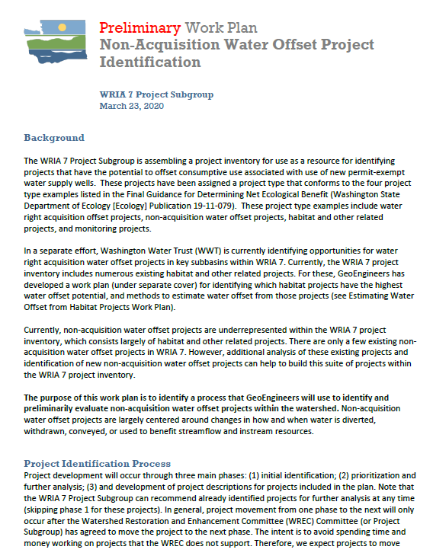
Overview of proposed process to identify new non-acquisition water offset projects

Slide 6
Considerations from Project Subgroup
Streamflow retiming projects: consider potential water quality impacts, especially temperature; prioritize projects that truly benefit low flow period; prioritize projects with no impact to sensitive riparian areas & fish habitat.
Stormwater projects: clearly demonstrate how project goes above existing requirements; prioritize projects higher up in the basin/on a given stream system; consider water quality, especially turbidity.
Modification of existing reservoir operations: interest in opportunities to improve existing facilities; consider water quality.

Slide 7
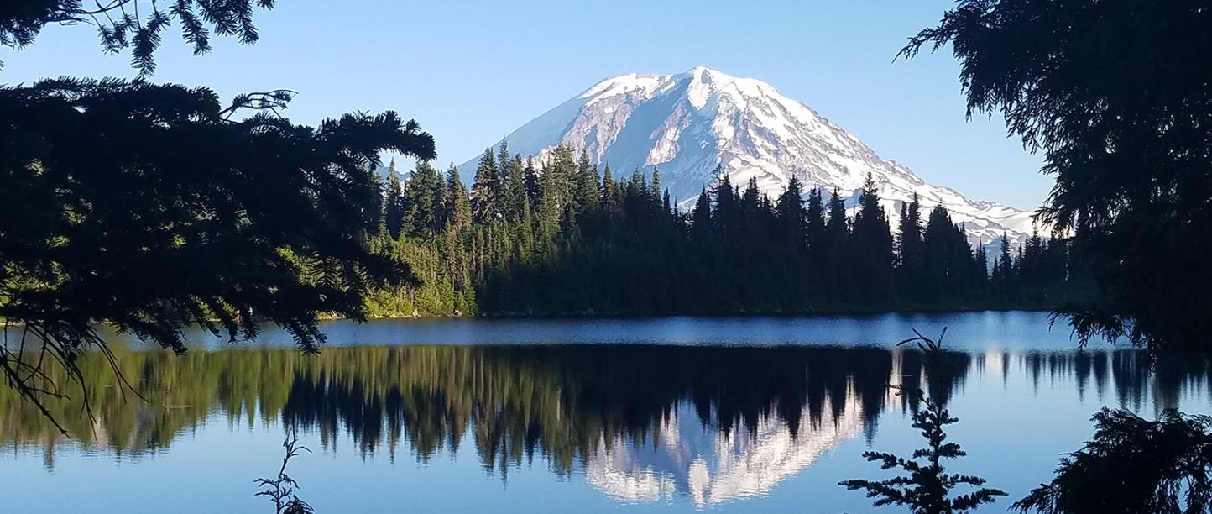
Non-Acquisition Water Offset Project Types and Examples
WRIA 7 Watershed Restoration and Enhancement Committee
April 9, 2020

Slide 8
Disclaimers
Presentation purpose: provide examples of non-acquisition water offset projects to spark new ideas for projects in this WRIA
Project examples are from the WRIA 1 proposed rule and grant applications from the pilot round of streamflow restoration funding
* indicates a project received funding
Water offset estimates are from project descriptions, not determined by Ecology
Photos are for example, not all are from the specific project

Slide 9
Project Types
Ecology’s Final Guidance for Net Ecological Benefit provides examples of non-acquisition water offset projects that the Committee can consider for the WRE Plan.
Examples of these projects include:
Water Storage and Retiming Projects
Stormwater Infrastructure
Modification to Reservoir Operations
Water Right Source Switches
Conservation and Efficiency Projects
Streamflow Augmentation
Notes:
Reclaimed water could be incorporated into some of these project types, but the majority of existing reclaimed water facilities in WRIA 7 are already committed to other uses and/or are operating at capacity.

Slide 10
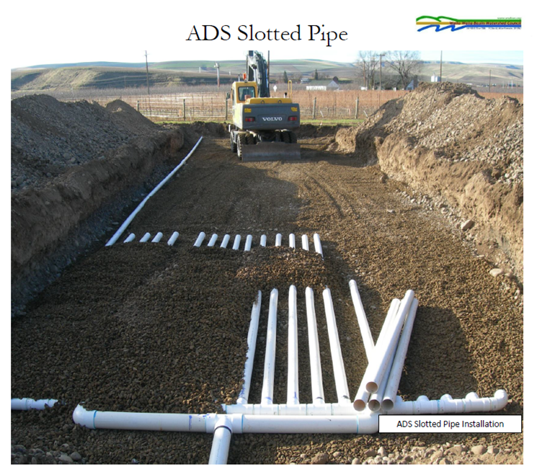
Water Storage and Retiming
Water storage projects, including “retiming” projects, involve the capture of water when it is available (such as during high-flow periods) and the later use or release of that water when needed, thus increasing streamflow.

Slide 11
Water Storage Project Types
Managed Aquifer Recharge
Off-Channel Water Storage Using Existing Features
Surface Water Storage and Release

Slide 12
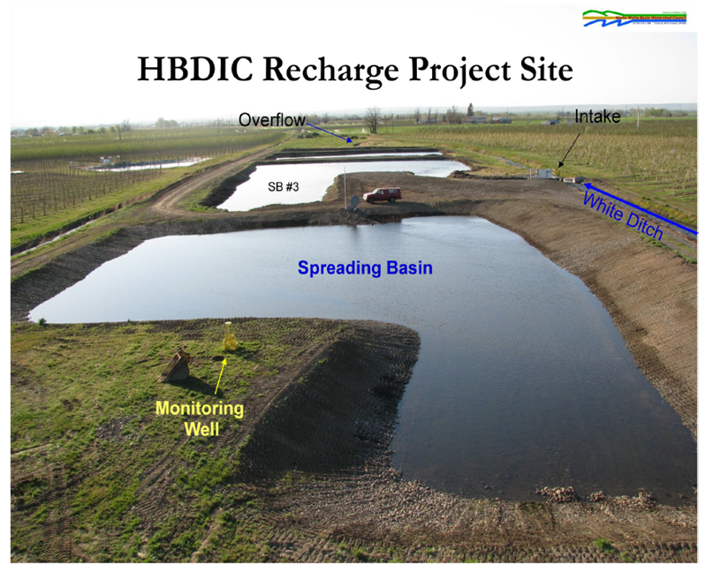
Managed Aquifer Recharge
Managed aquifer recharge projects involving the addition of water to an aquifer through infiltration basins, injection wells, or other methods. The stored water can then be used to benefit stream flows, especially during critical flow periods.

Slide 13
WRIA 1 Plan: MAR North Fork of Nooksack River Site
There is no current project proponent, but Ecology expects to work with the community to identify a proponent.
This project would involve diverting a small fraction of high-flow season streamflow to infiltration facilities in the adjacent floodplain or uplands. This diverted surface water infiltrates into a shallow aquifer, migrates through the aquifer, and ultimately discharges back to surface water as re-timed groundwater baseflow. 200 AFY

Slide 14
WRIA 14: Goldsborough Streamflow Restoration Project*
Squaxin Island Tribe
This MAR project would decrease well pumping and redirect reclaimed water into the ground to benefit groundwater and ultimately surface water of the creek. 560 AFY
*This project was awarded a Streamflow Restoration Grant in 2019.

Slide 15
WRIA 55: MAR Design and Construction Phase I*
Spokane County Utilities - Water Resources Section
identification of locations that are hydrogeologically suitable and available for acquisition or permanent easements,
site specific field work to confirm suitability and support design and permitting,
development of cost estimates and preliminary designs, and
estimation of ongoing O&M costs.
*This project was awarded a Streamflow Restoration Grant in 2019.

Slide 16
Managed Aquifer Recharge What are some ideas for WRIA 7?
Existing ideas/contacts:
Ecology identified potential sites
Look for gravel pits that are retired/will be retired soon
Could be opportunities on King County parks land
WWT has shown interest in investigating
?

Slide 17
Off-Channel Water Storage using Existing Features
Off-channel storage of streamflow within an existing topographic basin.

Slide 18
WRIA 7: Community-based water storage restoration in the Snohomish River watershed*
Snohomish Conservation District
Will implement small farm water storage program in the Pilchuck River, French Creek, Woods Creek, and Lower Skykomish River subbasins. (Project also includes habitat/natural storage projects, incl. wetland restoration and beaver pond expansion.) Sno CD is in the process of identifying potential storage sites. Project size and benefit TBD
*This project was awarded a Streamflow Restoration Grant in 2019.

Slide 19
Existing Storage What are some ideas for WRIA 7?
?

Slide 20
Surface Water Storage and Release
Off-channel storage of streamflow and retimed release and/or substitution.

Slide 21
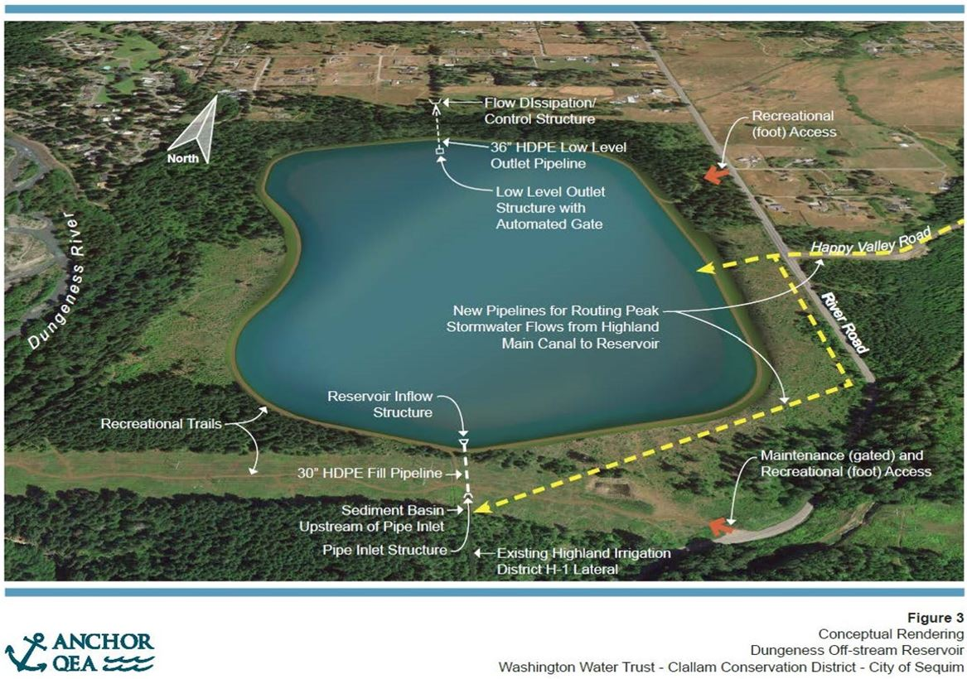
WRIA 18: Dungeness Flow Restoration and Aquifer Recharge Off-Channel Reservoir*
Clallam County - Community Development
The Dungeness Off-Channel Reservoir, would capture high flows in climate-resilient storage for late summer mainstem flow restoration, exempt well mitigation, and small stream restoration via managed aquifer recharge. The project would restore 20-30 cfs of Dungeness River flows by substituting irrigation water supply (typically diverted from the river) with reservoir water. This funded project includes three initial project phases: Land Acquisition (396 acres), Detailed Design, and Permitting. 1,600 AFY
*This project was awarded a Streamflow Restoration Grant in 2019.

Slide 22
WRIA 7: Snoqualmie Comprehensive Storage Study*
Snoqualmie Valley WID
This project involves a watershed-wide study of potential storage sites in the Snoqualmie Watershed to capture high flows for release during critical low-flow periods for the primary benefit of in-stream flows, and advancing one natural storage site to preliminary design. Launching study now. Project size and benefit TBD
*This project was awarded a Streamflow Restoration Grant in 2019.

Slide 23
Surface Storage What are some ideas for WRIA 7?
Tem
Existing Ideas and Notes:
GeoEngineers will look outside of areas where Snohomish CD and SVWID are already looking.
Look for old gravel pits/already impacted areas
?

Slide 24
Stormwater Infrastructure
Off-channel storage of stormwater within an existing stormwater pond or increasing holding capacity for future ponds.

Slide 25
WRIA 23: Albany Street Stormwater Pond*
Thurston County – Resource Stewardship Department
The project will build a new stormwater infiltration pond In Rochester, WA and replace and expand the existing stormwater conveyance system to move stormwater to the new infiltration pond. The project will increase infiltration by about 24 AFY on average and reduce localized flooding. The increased recharge replaces consumptive use re-timed to critical low flow period in the Black River basin.
Image courtesy of Thurston County
*This project was awarded a Streamflow Restoration Grant in 2019.

Slide 26
Stormwater What are considerations for WRIA 7?
Existing Ideas and Notes
Snohomish Conservation District is currently exploring stormwater projects in Quilceda subbasin
GeoEngineers & Snohomish Conservation District plan to discuss opportunities near farmland
?

Slide 27
Modification of Existing Reservoir Operations
Existing reservoir operations could be modified within existing storage capacity to release additional water during periods of low flows, or associated water rights could be purchased for instream flow benefit.

Slide 28
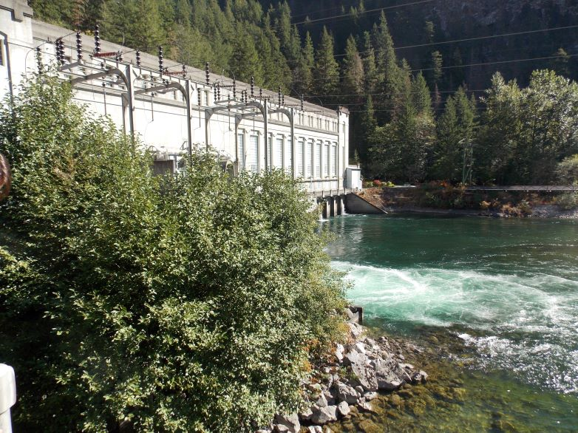
WRIA 5: Big Lake Mitigation Project**
Skagit County – Seattle City Light and Ecology
The project provides a legal water right for a limited number of existing and new domestic uses in Skagit County. An agreement between Ecology and Seattle City Light provides for the continuous release of 0.5 cfs (approx. 362 AF per year) to the Skagit River from the Gorge Reservoir for purposes of instream flow augmentation and mitigating the effects of permit-exempt domestic groundwater withdrawals on the instream flows of the Skagit River. 362 AFY
Image credit: Ecology
**There were no examples of modification of existing reservoir operations from WRIA 1 or the pilot streamflow grant round; this example is from WRIA 5

Slide 29
Modifications of Existing Reservoir Operations What are some ideas for WRIA 7?
Existing Ideas and Notes:
Look for old weirs that need replacement (e.g. Lake Shoecraft in Tulalip subbasin)
Explore Lake Margaret operations
*Will discuss Spada and Tolt opportunities later in the meeting
?

Slide 30
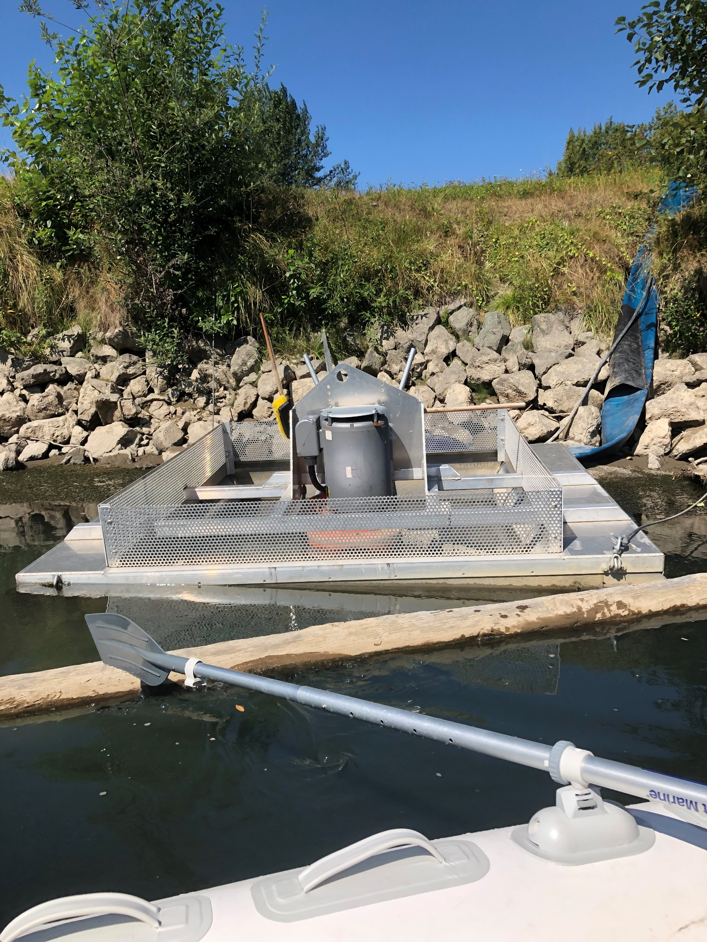
Water Right Source Switches
Water Right Source Switches involve changes in how and when water is diverted, withdrawn, conveyed, or used to benefit streamflows and instream resources. Although a good option in some basins, there are specific challenges to source switches.
Notes:
Foster Supreme Court decision limits ability to permit source switches from surface water to groundwater
Source switches from small surface water body to larger surface water body could benefit habitat

Slide 31
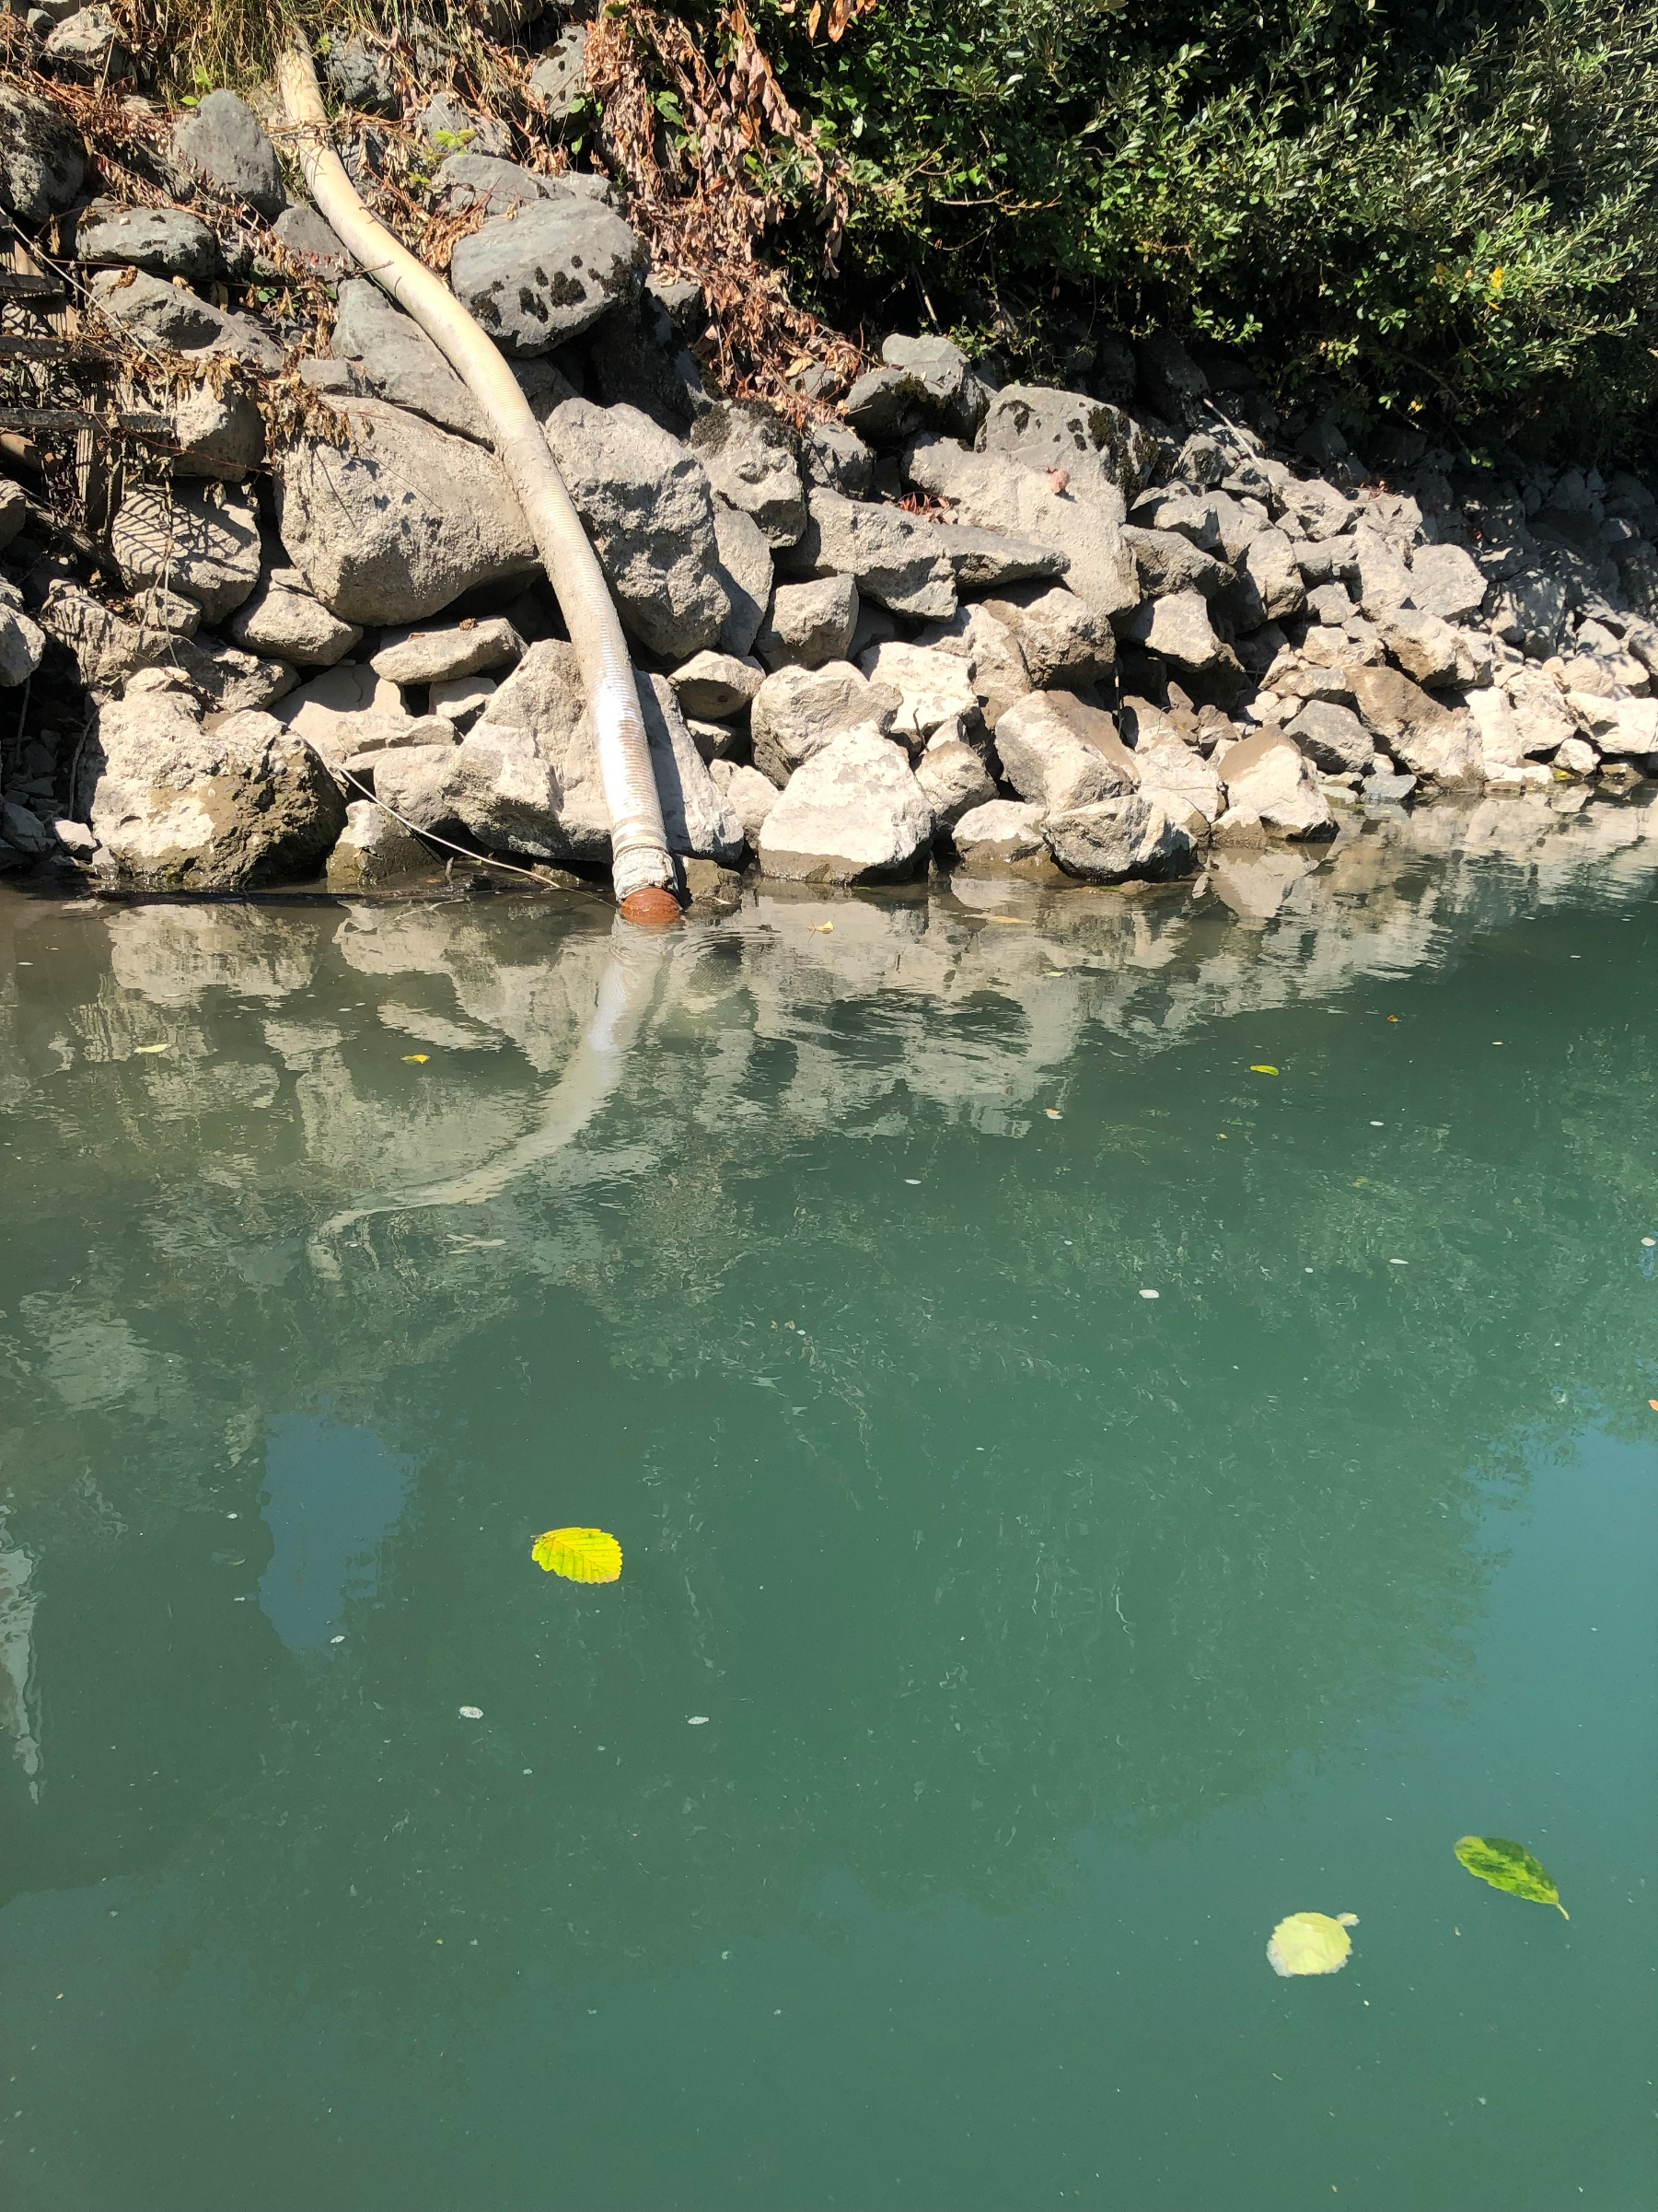
WRIA 1 Plan: Lower Nooksack SW to GW Conversion Projects
Whatcom Watershed Improvement Districts
This project will convert 10 surface water rights to groundwater sources. This project will require water right change applications to be processed through the cost reimbursement program, new wells, and associated equipment. 158 AFY
**Foster Pilot project area, this type of project may not be feasible in other WRIAs

Slide 32
WRIA 27/28: East Fork Lewis River Flow Enhancement Project
Clark Public Utility District
The project improves base flows in the East Fork (EF) Lewis River by substituting upstream groundwater withdrawals with a tidally influenced downstream source near the Columbia River estuary. Discharge of Paradise Point (along with other sources) through associated drainfields are expected to contribute to approximately 3,000 AFY

Slide 33
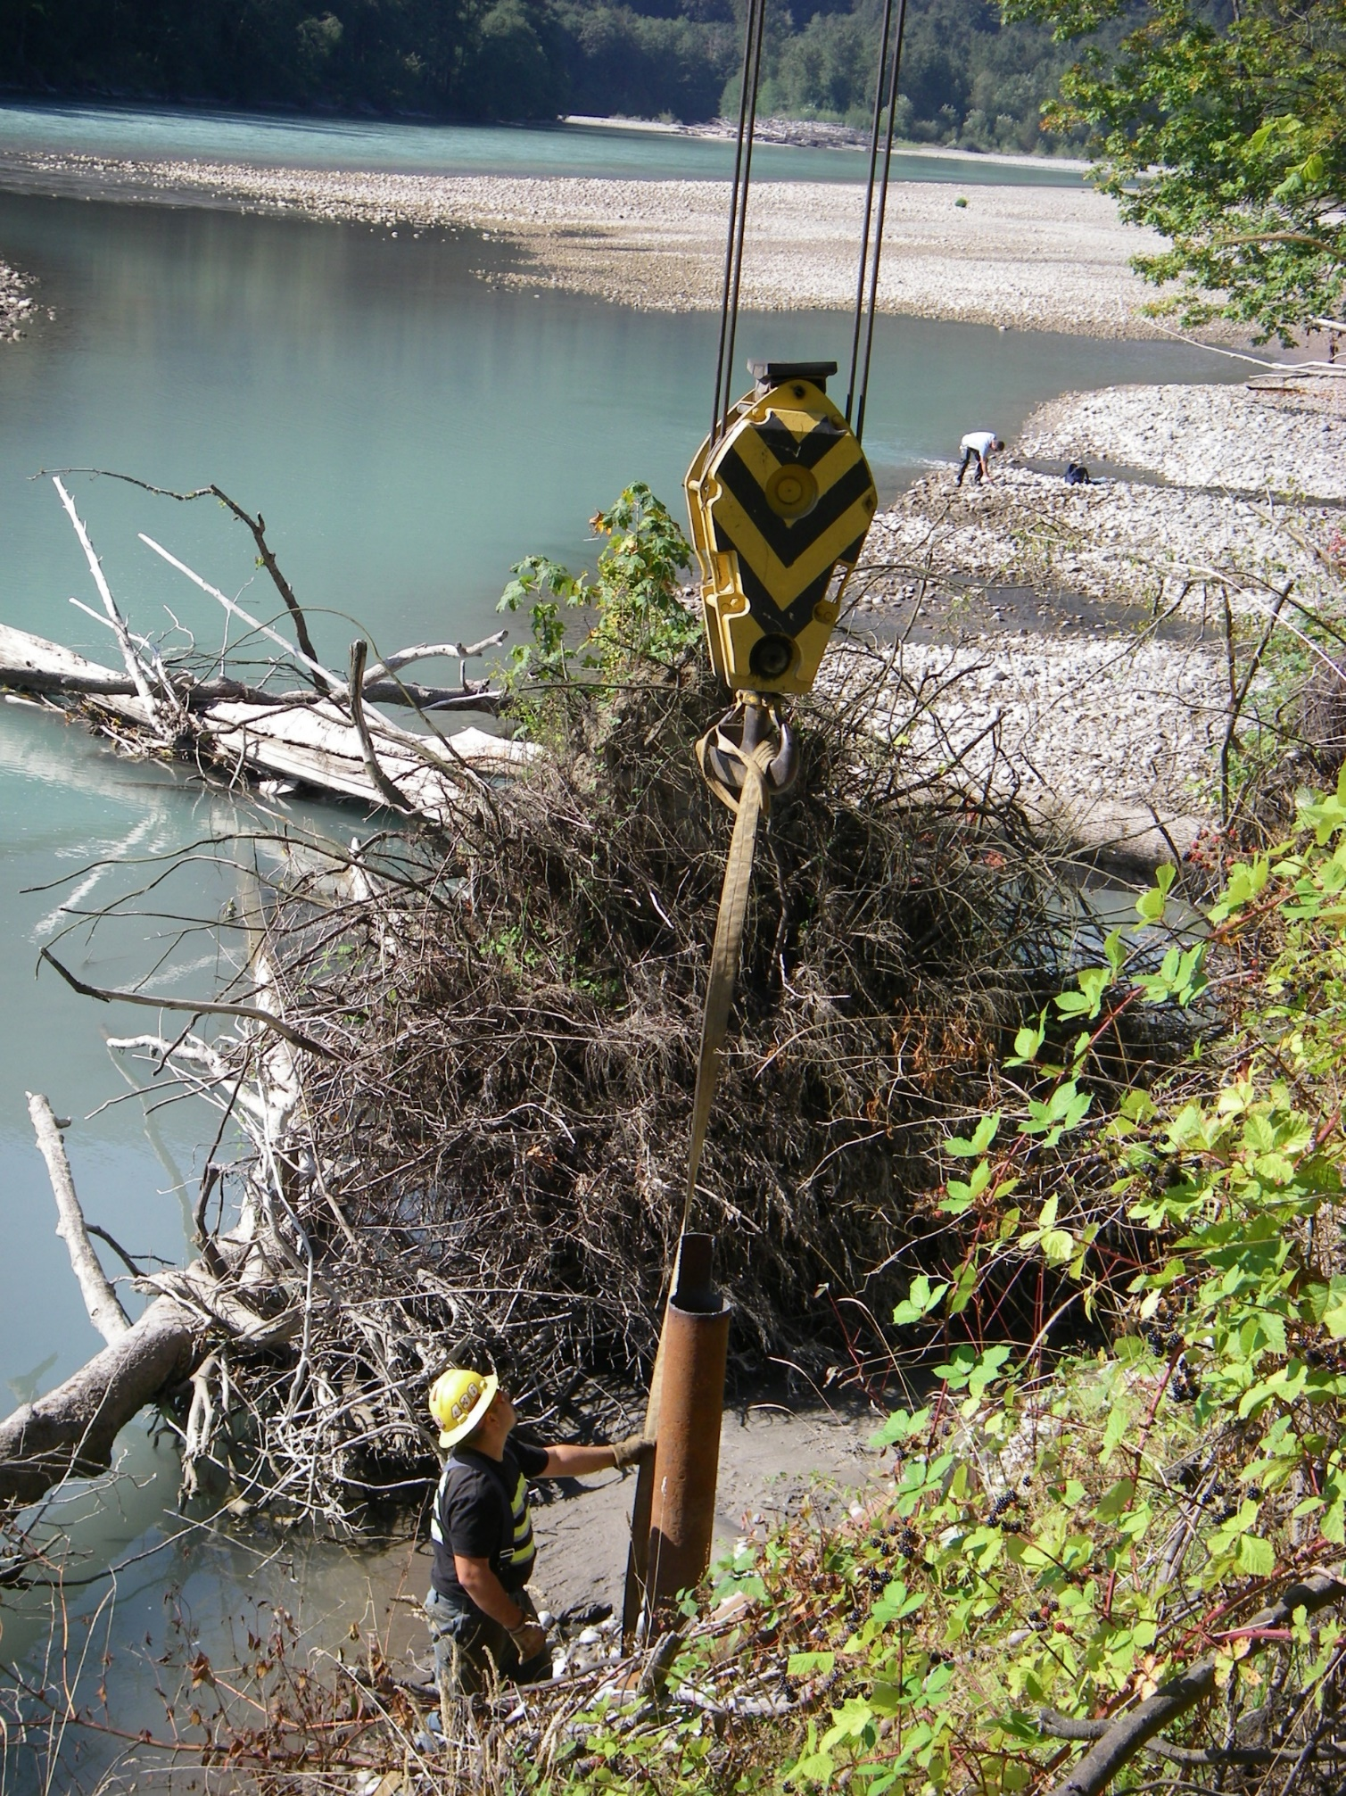
Water Right Source Switches What are some ideas for WRIA 7?
Existing Ideas and Notes:
GeoEngineers identify opportunities with Snohomish CD and SVWID; coordinate with WWT as needed
?

Slide 34
Streamflow Augmentation
Streamflow augmentation projects could involve pumping groundwater from a well and discharging it into a stream, or augmenting streamflow from a pipeline associated with a purveyor’s distribution system (which may be sourced from various sources).
Notes:
For groundwater sources, estimates of benefits may depend on the connection between groundwater and the stream and should take into consideration the possible consequences of unsustainable withdrawals from the affected aquifer.
For surface water or pipeline sources, water compatibility and fish imprinting issues may be important.

Slide 35
WRIA 1 Plan: Bertrand Augmentation
Bertrand Watershed Improvement District
The project would use existing raspberry growers’ irrigation wells after the raspberry crop is harvested and irrigation has ended for the season. Wells are pumped using existing infrastructure and routed via new pipelines on the creek bank, before discharging into Bertrand Creek during late August and September. 170.7 AFY

Slide 36
WRIA 1 Plan: California Creek Domestic Well Use Offset and Streamflow Restoration Project*
Whatcom County Public Utility District 1
The PUD will construct approximately 250 linear feet of pipe and related water quality and conveyance infrastructure to transfer water from their Plant No. 2 intake on the Nooksack River into California Creek. 194 AFY
*This project was awarded a Streamflow Restoration Grant in 2019.

Slide 37
Streamflow Augmentation What are some ideas for WRIA 7?
Existing Ideas and Notes
GeoEngineers discuss opportunities with City of Seattle, SnoPUD and City of Everett
?

Slide 38
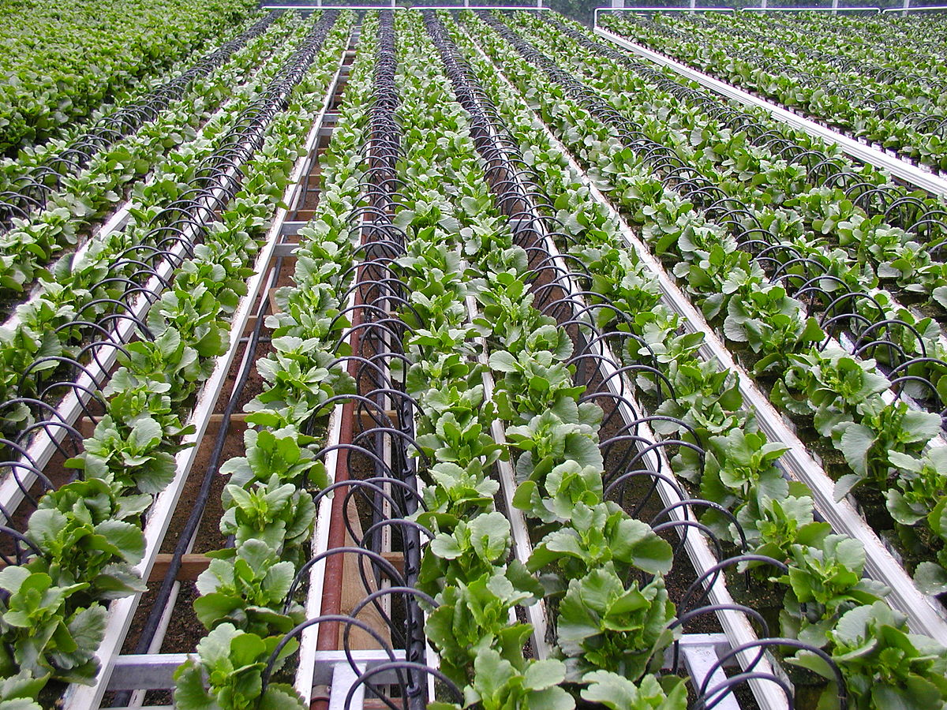
Conservation and Efficiency
From an agricultural perspective, conservation and efficiency projects could be intended to: reduce water loss through canals or ditches (such as lining or piping); increase the efficiency of diversion structures; and increase irrigation efficiency (such as sprinkler conversion).

Slide 39
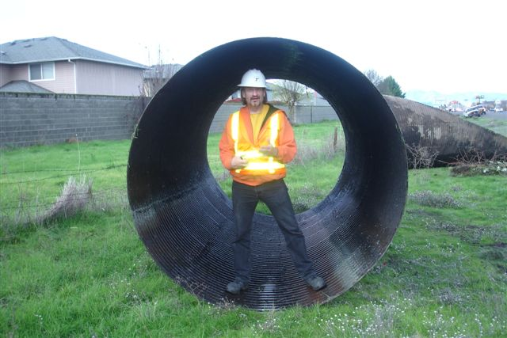
WRIA 32: Gardena Farms Irrigation District #13
Walla Walla County Conservation District
Piping the upper canal of the Gardena Farms Irrigation District (GFID) #13 will result in water that can be saved instream for ESA listed species. Seepage loss can exceed 15 cfs in the upper canal. By eliminating this loss, the GFID could reduce the amount of flow diverted from the Walla Walla River. The project will replace 5 miles of earthen canal with 60-inch diameter PVC pipe and replace the aging Pine Creek siphon. 2,700 AFY

Slide 40
WRIA 39: Tributary Supplementation through Water Conservation*
Kittitas Reclamation District South Branch
This project will finish eliminating water loss in a 4.1 mile section of KRD’s South Branch Canal. Water that was previously lost will be delivered to flow-impaired streams through an allocation, management, and protection agreement, resulting in supplemental flow estimated at 2,476 AFY
*This project was awarded a Streamflow Restoration Grant in 2019.

Slide 41
Conservation and Efficiency What are considerations for WRIA 7?
Existing Ideas and Notes:
GeoEngineers identify opportunities with Snohomish CD and SVWID; coordinate with WWT as needed
Closer review of Snohomish Basin Protection Plan strategies that could provide water offset
?

Slide 42
What are your project ideas in WRIA 7?

Slide 43
Discuss interest in reservoir release project for water offset
Objective: Discuss Committee’s interest in reservoir release projects for water offset

Slide 44
Brief Overview of Reservoir Release Opportunities
Additive (above and beyond minimum flow requirements and normal operations)
Quantifiable and Measurable
Project would identify a method and/or infrastructure to measure offset flows
Could count towards offsetting consumptive use for the WRE Plan
Memorialized
MOA and/or water right change would be developed to guarantee offset in perpetuity
Project is a type of water right acquisition
Certain
Offset water quantity is certain and memorialized through agreement

Slide 45
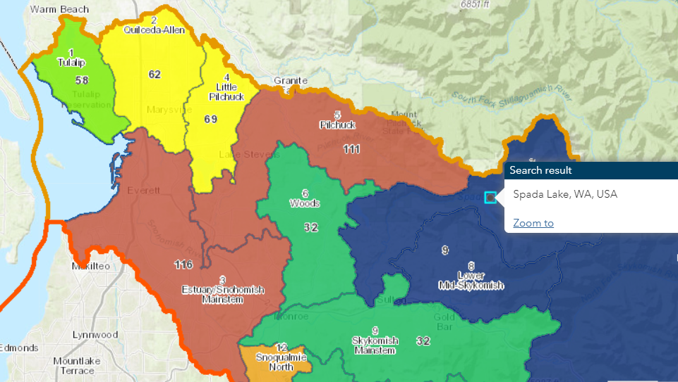
Spada Reservoir
Location: Lower Skykomish subbasin
Water supply, hydropower generation and recreation
Snohomish PUD
Power generation and water supply
City of Everett
Water supply
Notes:
Everett and SnoPUD share a water source; SnoPUD initiated discussion about the project. Additional research is needed to determine if both entities would need to be involved if the project were to move forward.

Slide 46
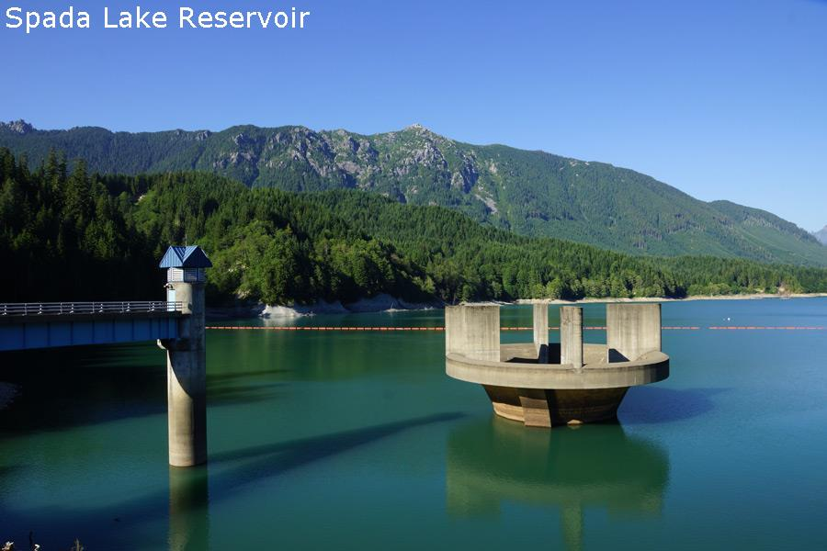
Spada Reservoir
Storage Capacity
Spada: 153,000 acre-feet (ac-ft); 50 billion gallons (BG)
Flow Requirements
Minimum fish flow requirements under FERC license
Source:https://everettwa.gov/DocumentCenter/View/3766/EVERETT-WATER-SITUATION-4-1-20-PDF?bidId= https://everettwa.gov/1287/Water-Supply
Notes:
Spada Reservoir is held back by Culmback Dam on the Sultan River.
The Sultan River supports chum, chinook (summer and fall), cutthroat, steelhead (winter and summer), pink, bull trout, steelhead trout, coho, and rainbow.

Slide 47
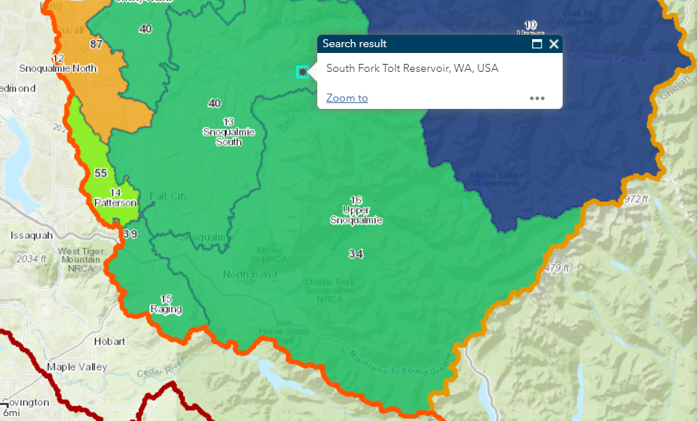
Tolt Reservoir
Location: Snoqualmie South subbasin
Water supply and hydropower generation
City of Seattle
Seattle Public Utilities (water supply)
Seattle City Light (hydropower)
Notes:
Tolt Reservoir is on the South Fork Tolt River. It generates hydropower and water supply for the city of Seattle. Water is released from the dam directly to the South Fork Tolt River. A portion of the water is diverted to a small hydroelectric facility, then continues by gravity to the Tolt water treatment facility.
Source: https://www.seattle.gov/utilities/services/water/water-system-overview

Slide 48
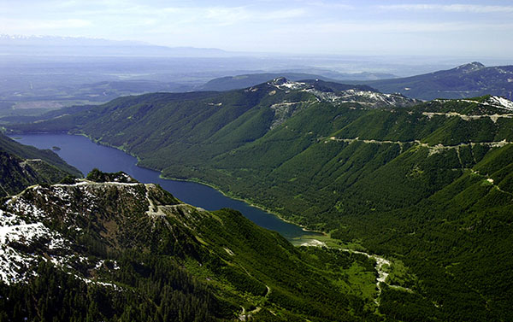
Tolt Reservoir
Storage Capacity
Tolt storage capacity: 57,900 acre-ft
Flow Requirements
Agreement guarantees instream flows
Source:https://www.seattle.gov/utilities/services/water/water-system-overview
Notes:
The South Fork Tolt and Tolt River support coho, pink, fall chum and fall Chinook salmon, summer steelhead, winter steelhead, and cutthroat trout.

Slide 49
Thank you for your time!
Any questions?
ecology.wa.gov

Slide 50
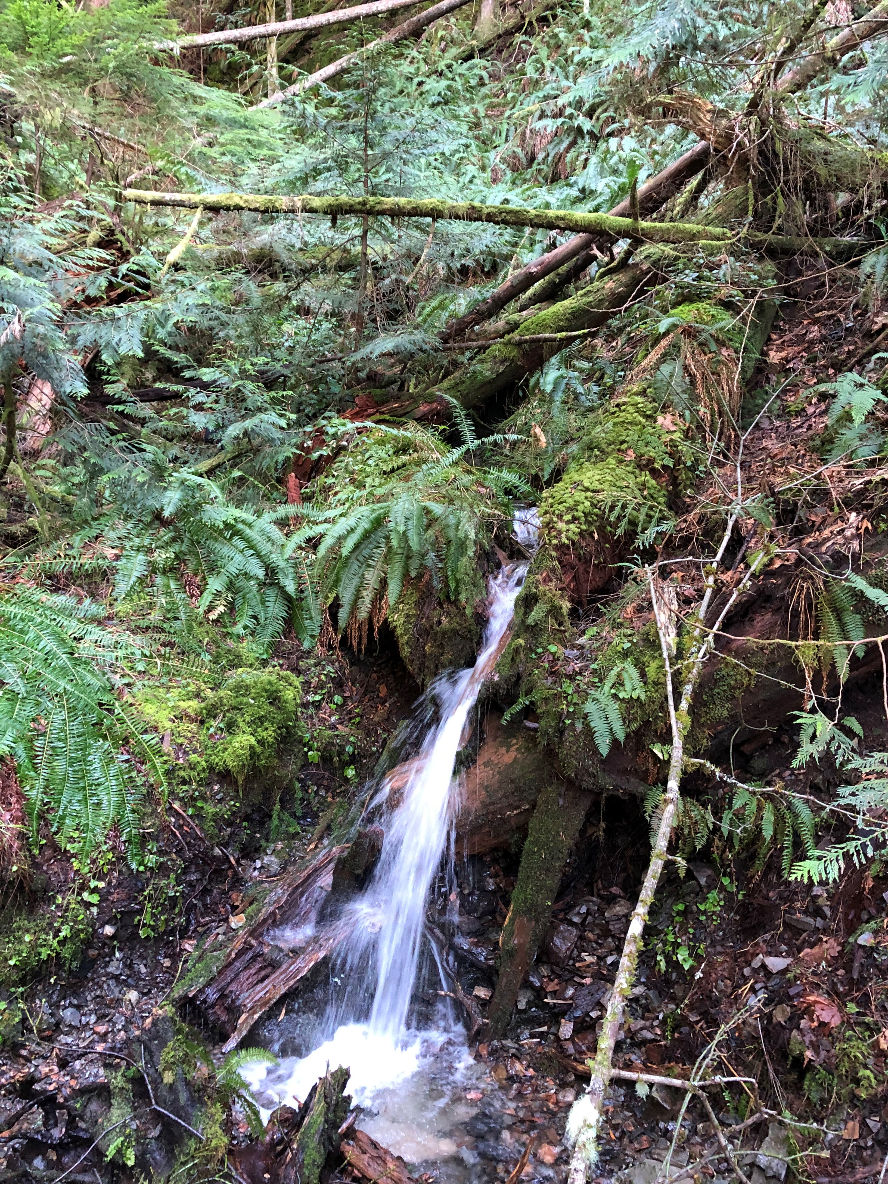
Break

Slide 51
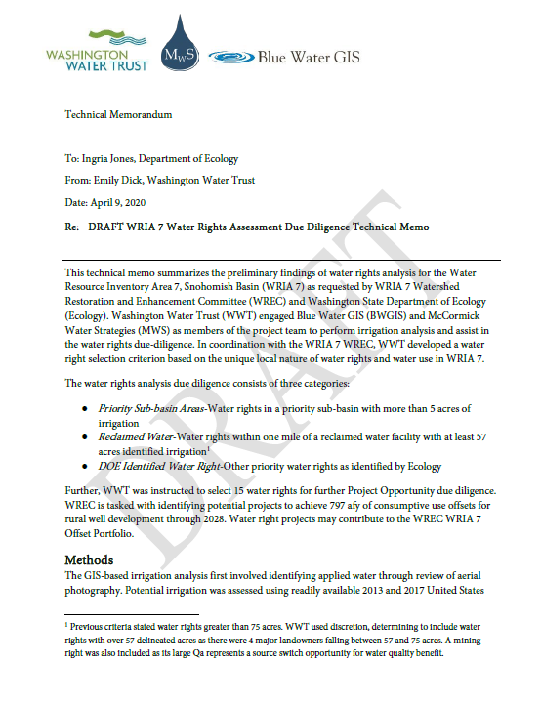
Objective: Presentation on initial water right acquisitions assessment and overview of prioritization
Water Right Acquisitions: Prioritization

Slide 52
Water Rights Analysis Target Areas

Slide 53
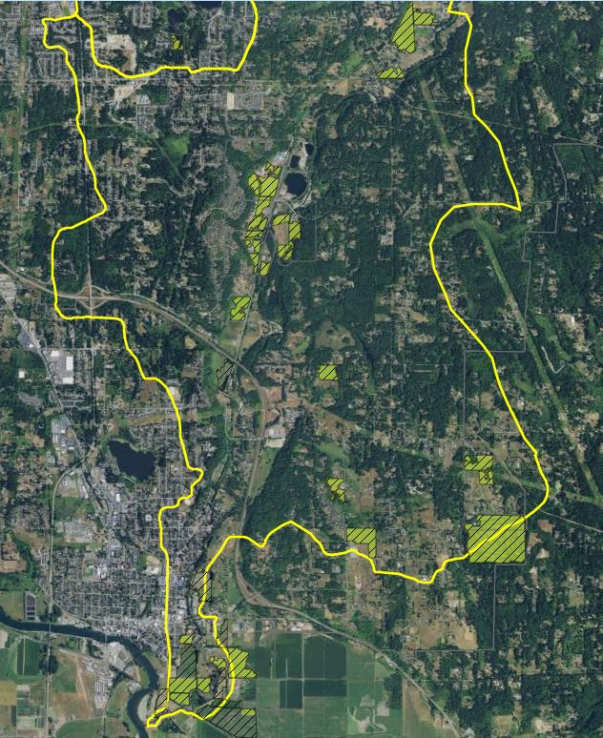
Irrigation Analysis
Found 2,610 water rights within target areas
Only 273 showed active irrigation

Slide 54
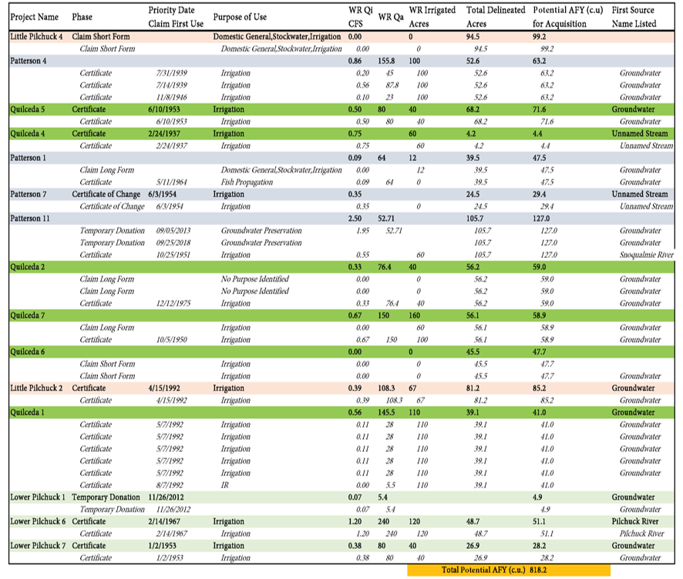

Slide 56
Recommended Water Right Project Maps
Little Pilchuck
Quilceda

Slide 57
Recommended Water Right Project Maps
Lower Pilchuck
Patterson

Slide 58
Potential Project Types
Lease or Forbearance Agreement
Efficiency Upgrade (assuming inefficient irrigation)
Split-Season or Rotational Fallowing Lease
Portion or full Permanent Transaction
Next Steps
Develop 15 project opportunities with further due diligence

Slide 59
Policy and Regulatory Actions Discussion
Objective: Identify task force members to lead development of policy and regulatory recommendations

Slide 60
Policy and Regulatory Actions: Re-cap of discussion at March meeting
Items Discussed last meeting:
Well pumps that limit usage
Model ordinances/outreach to water system providers
Require and/or incentivize well decommissioning
Meter PE wells for education and/or compliance
Increase the fee for PE well construction
Make resources available to strengthen enforcement of existing regulations
Water rights acquisitions
Establish specialized water courts for water-based claims
Adjudication in WRIA 7
Change instream flow rule to allow for retiming projects
Notes:
Little interest in well pumps that limit usage
Good discussion on model ordinances, well decommissioning, and metering.
Concerns about increasing the fee; questions about rulemaking.

Slide 61
Updates
Foster Pilot projects update – in development
PE well metering overview – in development
Rulemaking (if time allows)

Slide 62
Overview of Committee member top recommendations
Existing leads and significant interest
No leads but significant interest
Leads but no significant interest
No lead and no significant interest

Slide 63
Overview of Committee member top recommendations
Policy/Regulatory Action Recommendation | Willing to Take the Lead | Anticipate being able to support | Anticipate not being able to support
Model ordinances/outreach to Water Service Providers (WSPs) to increase connections to water service | 1 | 7 | 1
Require and/or incentivize well decommissioining | 2 | 7 | 1
Meter permit-exempt wells for education AND/OR compliance | 1 | 6 | 2
Change the fee for permit exempt well construction | 1 | 6 | 1
Increased funding for water right acquisitions | 1 | 7
Incentivize rain catchment and storage for outdoor irrigation | 1 | 10
Education and outreach. | 2 | 9
Develop mitigation bank. | 1 | 5
Change instream flow rule to allow for retiming projects in closed subbasins | 1 | 5 | 1
Improve Ecology well tracking. | 1 | 8
Additional funding for tracking plan implementation, projects, & adaptive management | 1 | 7

Slide 64
Overview of Committee member top recommendations
Policy/Regulatory Action Recommendation | Willing to Take the Lead | Anticipate being able to support | Anticipate not being able to support
Building permit enforcement. |  | 9 | 1
Adopt and/or update existing water conservation codes |  | 8
Make resources available to strengthen enforcement of existing water codes |  | 6 | 3
Source switching for irrigators. |  | 6 | 2
Flexibility with water right acquisitions regarding inchoate water rights and municipal water rights. |  | 6
Requirements for builders. |  | 7 | 2

Slide 65
Overview of Committee member top recommendations
Policy/Regulatory Action Recommendation | Willing to Take the Lead | Anticipate being able to support | Anticipate not being able to support
Credit septic return from return flows. | 3 | 3 | 2
*Added 4/8/20: Recognize One-Water principle. | 1 | 1 | 1
Well pumps that limit usage |  | 3 | 3
Establish specialized water courts for water-based claims. |  | 3 | 3
Adjudication in WRIA 7 |  | 2 | 4
Water use limitations. |  | 3 | 2
PSRC Vision 2050. Cut rural growth target. |  | 3 | 5

Slide 66
Policy and Regulatory Actions: Discuss and assign task force members to lead development of policy and regulatory recommendations
Identify champions/volunteers
Build out proposals/ recommendations for committee consideration
Form Disappearing Task Force

Slide 67
Public Comment

Slide 68
Next Steps and Action Items
Next WRIA 7 Committee meeting: Thursday, June 11, TBD; no Committee meeting in May
Next Project Subgroup meeting: April 22, 2:00-4:00 pm
Next Technical Workgroup meeting: TBD

