Slide 1
Streamflow Restoration Planning
Speaker’s name
WRIA 7 Watershed Restoration and Enhancement Plan
Date of presentation

Slide 2
Streamflow Restoration law RCW 90.94
Clarifies how local governments can issue building permits for homes intending to use a permit-exempt well for their domestic water supply and offsets those impacts through a local watershed planning effort.
Ecology chairs the WRIA 7 Committee, composed of tribes, counties, cities, WDFW, municipal water purveyor, largest irrigation district, and interest groups. The committee has met over the last two years to develop the Watershed Restoration and Enhancement Plan.
Notes:
This is Summary Slide 1. It can be used, along with the next slide, as very high level overviews of the law and plan components.
WRIA – Watershed Resources Inventory Area

Slide 3
Presentation Outline
Background
Streamflow Restoration law
Role of the Committee
Elements of the Watershed Plan
Steps to complete plan
3

Slide 4
What is a permit-exempt domestic well?
Serve single homes, small developments, irrigation of small lawns and gardens
Chapter 90.94 RCW establishes withdrawal limits for permit-exempt domestic well connections in this watershed
Notes:
Certain "small withdrawals" of groundwater are exempt from the permitting process. These uses are commonly referred to as "permit exempt."
Permit-exempt groundwater wells often provide water where a community supply is not available, serving single homes, small developments, irrigation of small lawns and gardens. PE wells are typically located outside of UGAs.
90.94 RCW applies to domestic and non-commercial lawn or garden irrigation uses.
The law establishes new water use limits for permit exempt wells in certain watersheds in the state, including WRIA 7.
90.94 RCW restricts new permit-exempt domestic withdrawals in this WRIA to a maximum annual average of 950 gallons per days per connection, subject to the 5000 gallons per day and ½-acre outdoor irrigation of non-commercial lawn/garden limits established in RCW 90.44.050.
[add any additional talking points relevant to your work in the watershed, such is how your entity works with PE wells, where they are located historically, etc.]

Slide 5
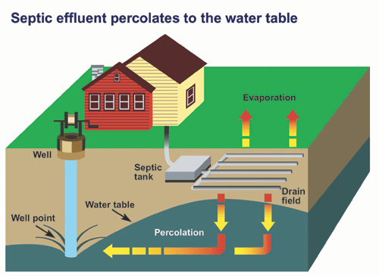
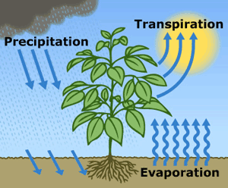
What is consumptive water use?
Water that is evaporated, transpired, consumed by humans, or otherwise removed from an immediate water environment due to the use of new permit-exempt domestic wells.
Indoor Consumptive Use
Outdoor Consumptive Use
10%
80%
90%
20%
Notes:
Source: NEB Guidance Page 5
For indoor water use most houses with domestic wells are connected to septic systems, so it is reasonable to assume that only about 10% is lost from groundwater system.
For outdoor water use a good assumption is that about 80% is lost, mainly due to evapotranspiration.

Slide 6
How are groundwater and streamflows connected?
Notes:
Most groundwater in Washington is hydraulically connected to nearby lakes and streams. In fact, during much of the year, groundwater discharge may make up most of the water in a stream.
Source: https://ecology.wa.gov/Water-Shorelines/Water-supply/Protecting-stream-flows

Slide 7
How do wells affect streamflows?
Notes:
When groundwater is pumped and water is put to use, this often leads to a decrease in streamflow.
Many factors influence where and how much a groundwater use may affect a stream, such as the nature of the aquifer, the distance between the well and the stream, the well depth, and the type of water use (for example, lawn watering consumes much more water than in-house use that discharges to a septic system).
However, at least some portion of the well water used in a home typically has a negative impact on nearby streams. https://ecology.wa.gov/Water-Shorelines/Water-supply/Protecting-stream-flows

Slide 8
Streamflow Restoration law RCW 90.94
Clarifies how local governments can issue building permits for homes intending to use a permit-exempt well for their domestic water supply and offsets those impacts through a local watershed planning effort.
Notes:
The law, and consequently this watershed plan, is concerned with the identification of projects and actions intended to offset the anticipated impacts from new permit-exempt domestic groundwater withdrawals over the next 20 years and provide a net ecological benefit.
In order to aid in project implementation, the law also authorized $300 million in capital funds over the next 15 years.
The local watershed planning effort began with the committee’s formation in each watershed called out in the law. There are 15 watersheds across the state undergoing planning efforts under this law; there are 7 other watersheds that are developing watershed restoration and enhancement plans like ours.

Slide 9
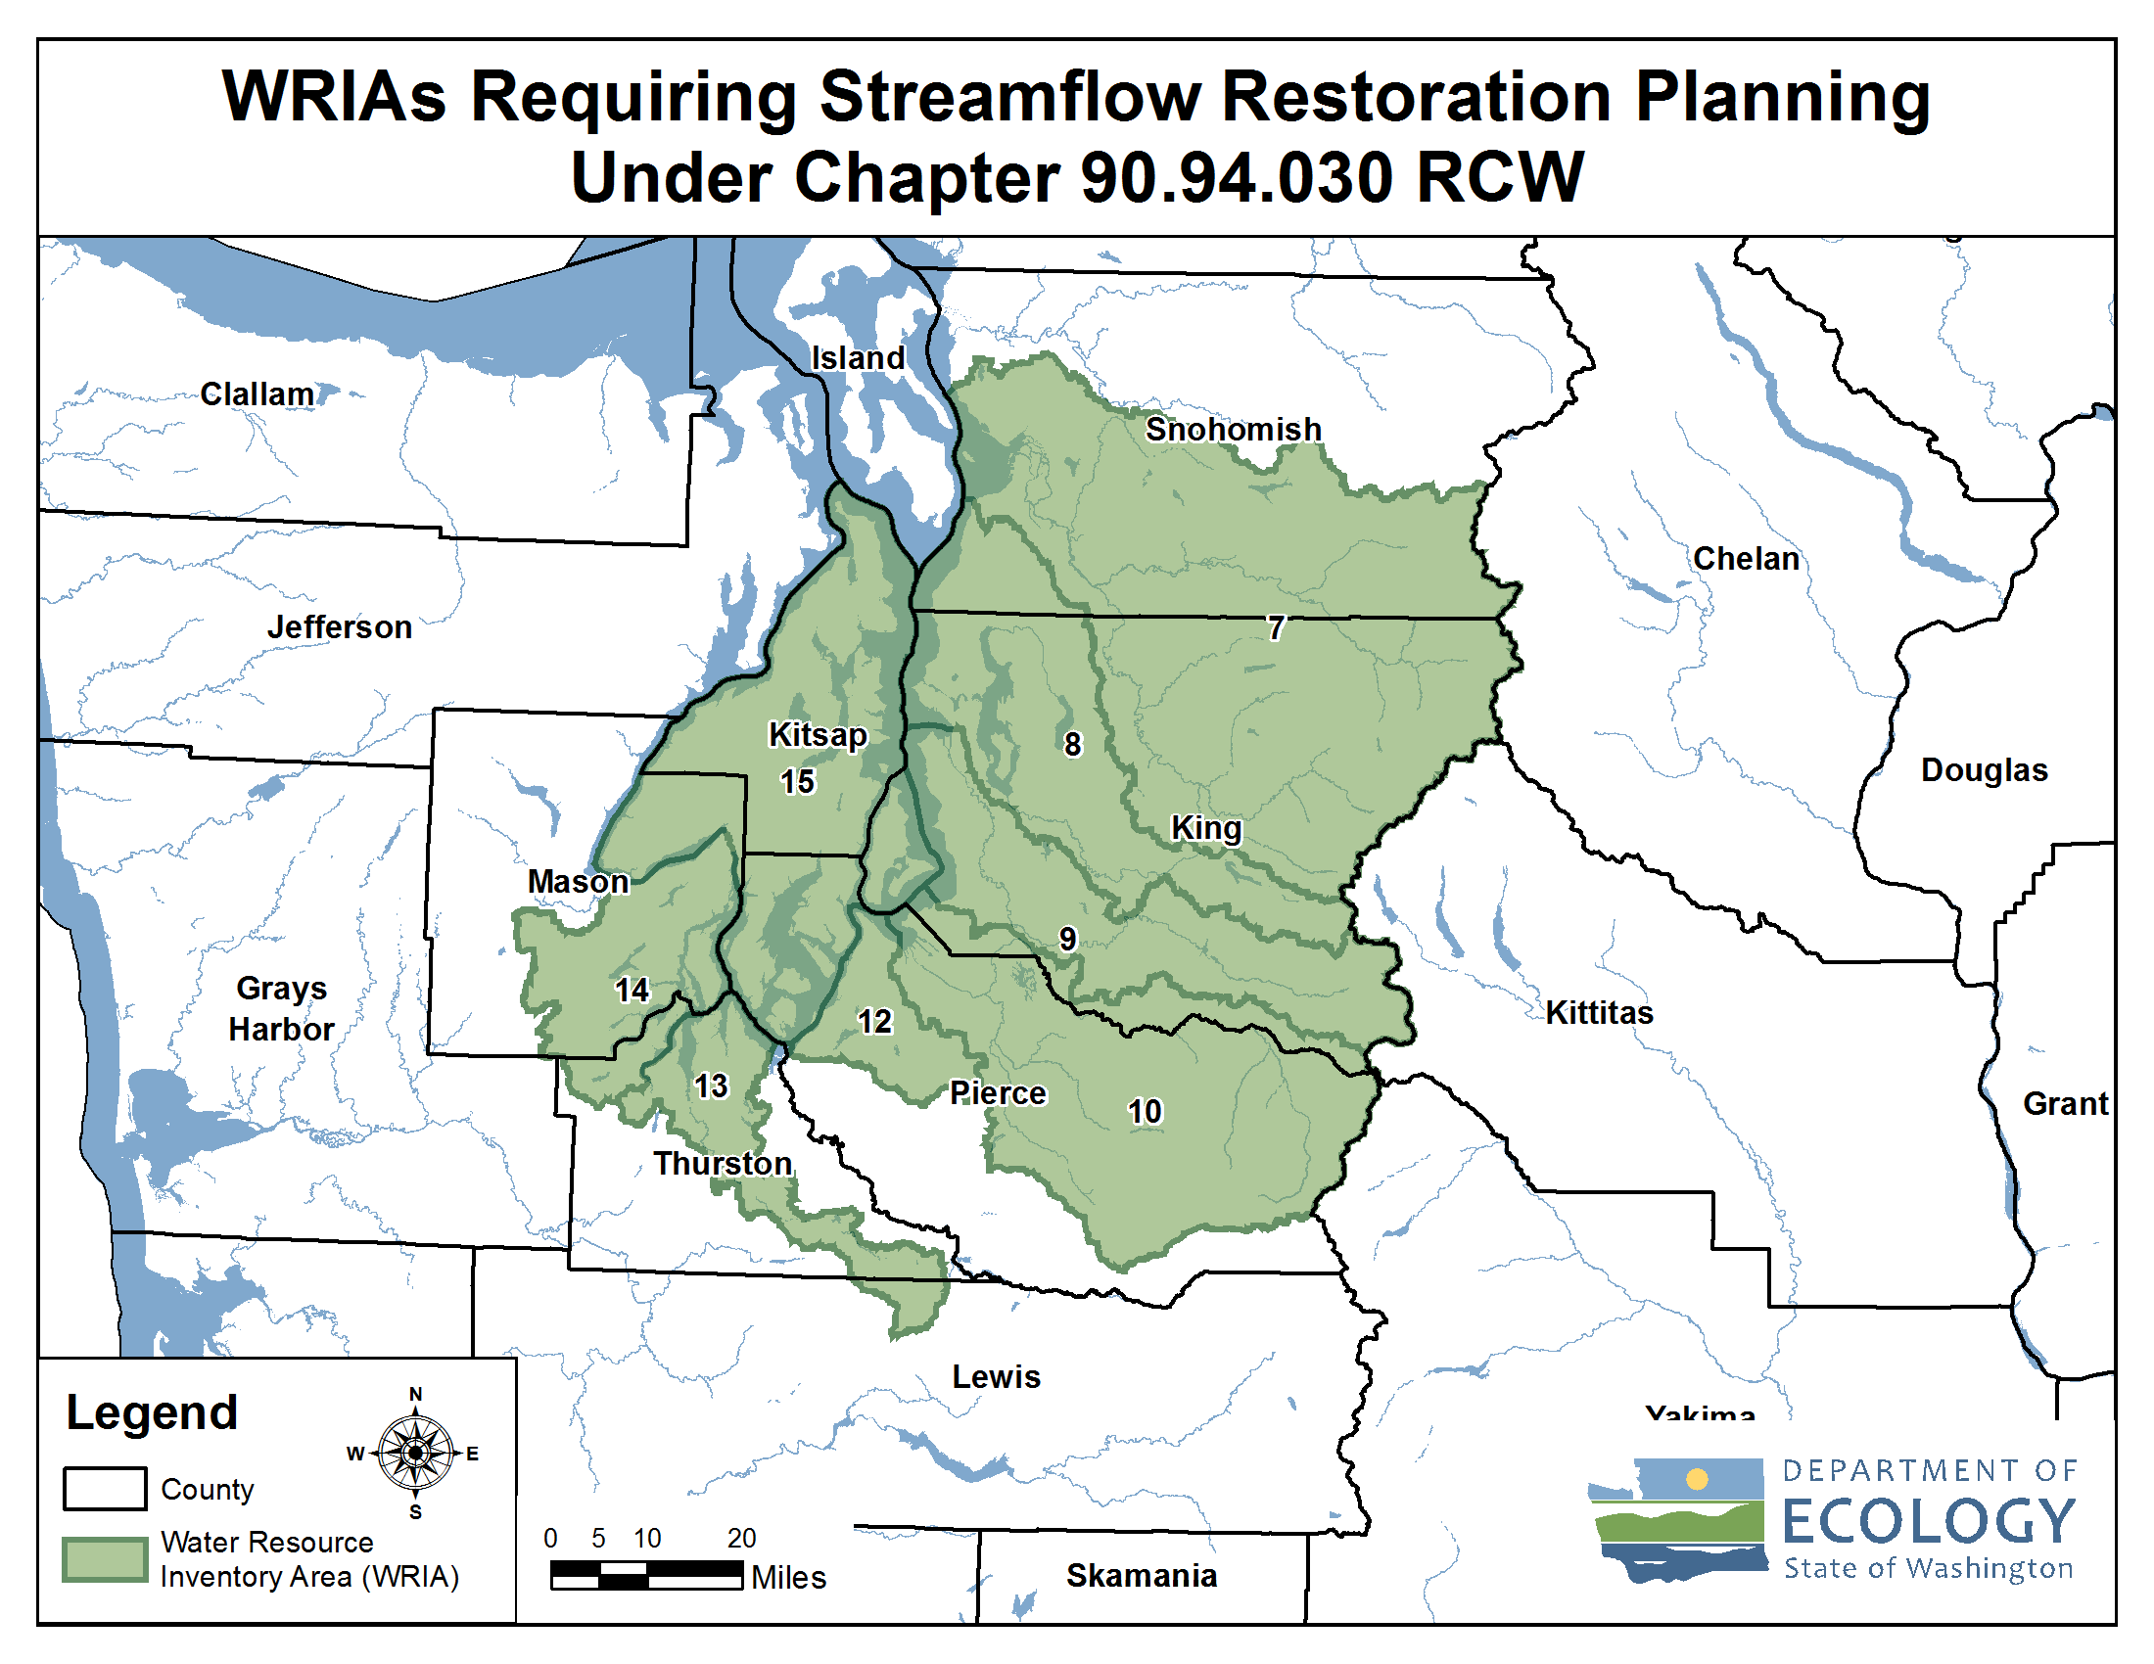
Streamflow Restoration Planning
Notes:
These are the watersheds that are developing Watershed Restoration and Enhancement Plans chaired by Ecology.
[Direct to “brochures” if questions about how these WRIAs were selected. Relates to whether instream flow rules addressed PE wells.]
WRIA 7 Committee brochure
https://fortress.wa.gov/ecy/publications/documents/2011071.pdf

Slide 10
Streamflow Restoration Funding Program Overview
15 Year Competitive Grant Program - $300 million
Pilot Round (2018/2019)
Current Round (2020)
Statewide
Funding Rule
Chapter 173-566 WAC
Funding Guidance
Publication 19-11-089
Notes:
How is Ecology supporting implementation of the watershed plans?
The legislature has given Ecology $300 over the course of 15 years to restore and enhance streamflows, and meet the requirements of the Chapter 90.94 RCW. Grant funding will help incentivize state and local agencies, tribal governments, and non-profit organizations to implement local watershed plans and projects.
It is important to note that local project needs developed through the watershed planning process are greater than available statewide funds. The grant process is competitive and other sources of funding beyond these grants is needed to implement all projects within the watershed restoration and enhancement plan.

Slide 11
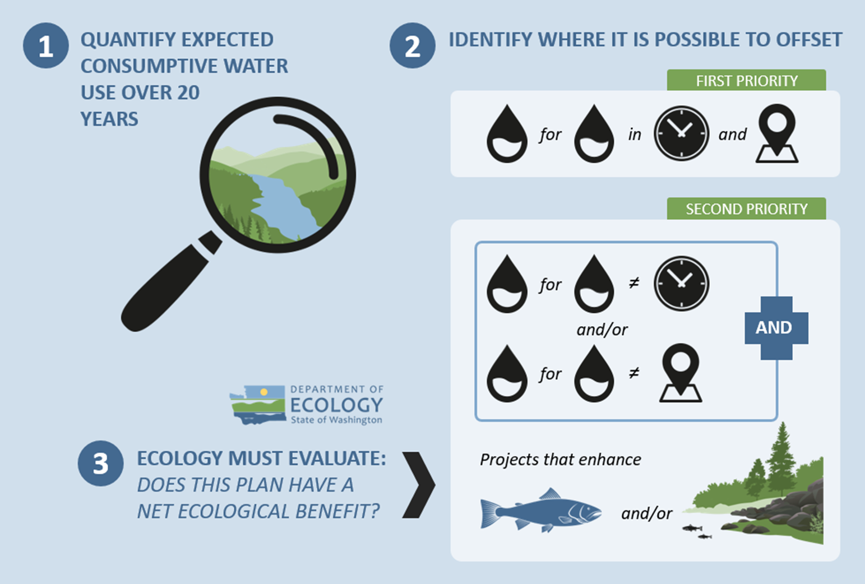
Overview of the Watershed Plan
Notes:
The major steps to complete the plan include:
1. Estimate the consumptive water use of new domestic permit-exempt wells through 2038;
2. Identify projects to offset consumptive use – we must identify projects that provide “water for water” offsets within the WRIA. Projects are not required to provide water offset in the same place or at the same time as well impacts. However, projects that offset water during the same time and in the same areas where wells are expected are a higher priority. The plan also includes projects that enhance habitat for fish.
3. Ecology is then required to evaluate the plan to make a determination of whether it achieves a net ecological benefit.

Slide 12
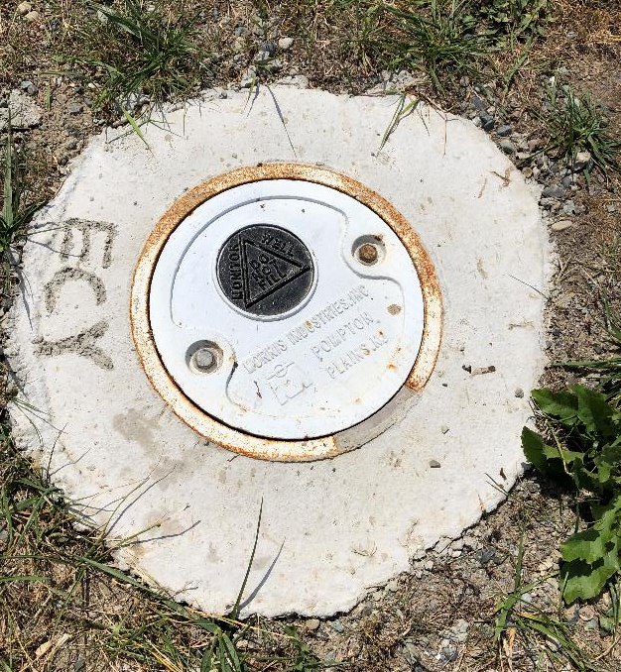
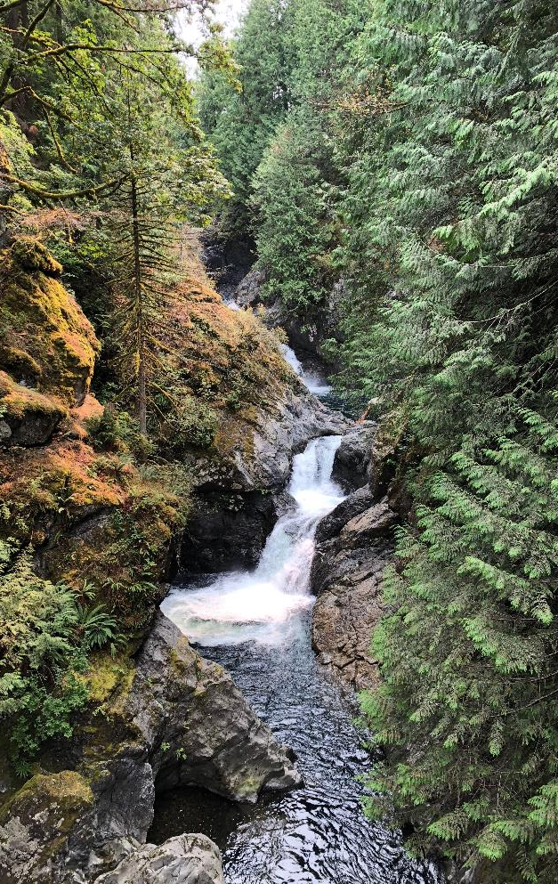
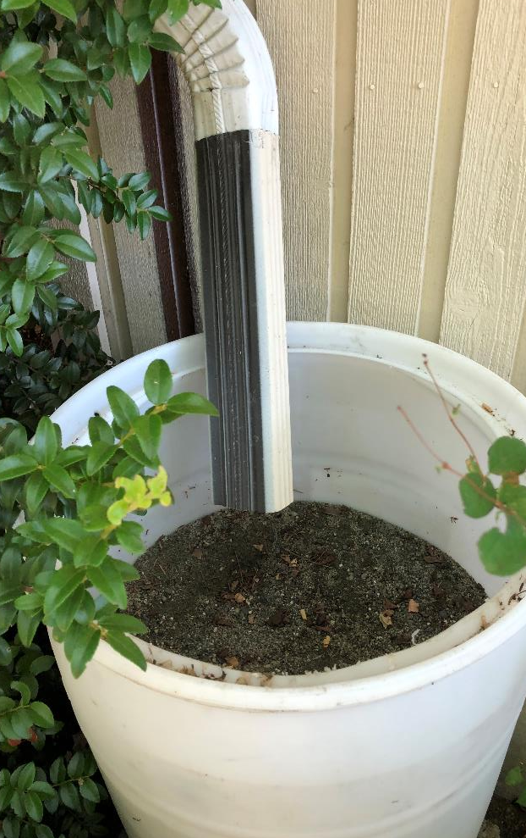
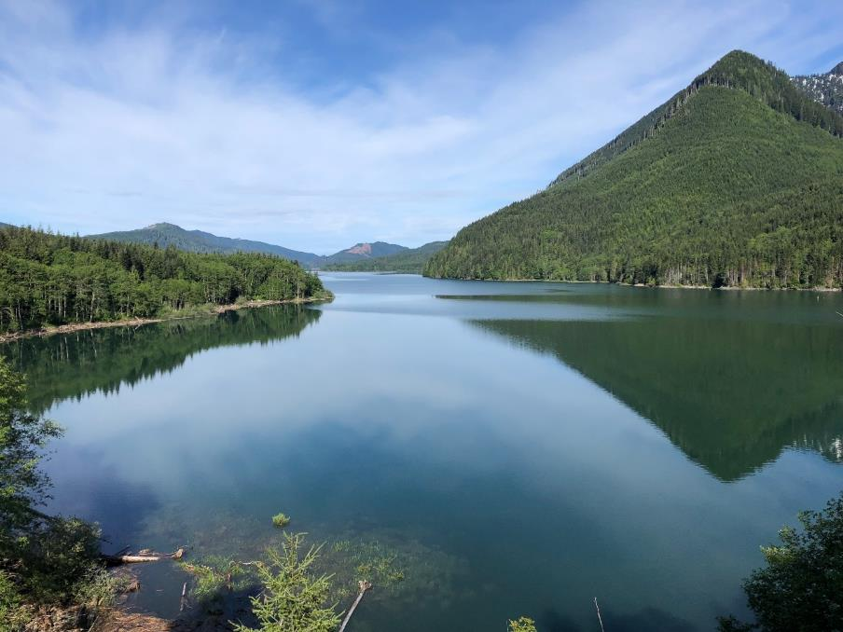
What is offset?
The anticipated ability of a project or action to counterbalance some amount of the new consumptive water use over the next 20 years (2018-2038).

Slide 13
Net Ecological Benefit (NEB)
The outcome that is anticipated to occur through implementation of projects in a plan to yield offsets that exceed impacts within the planning horizon and WRIA boundary.
Notes:
Ecology released Final NEB Guidance in July 2019 to support committees in their planning process.
NEB is the outcome that is anticipated to occur through implementation of projects in a plan to yield offsets that exceed impacts within the planning horizon and WRIA boundary.
[Prompt for speaker to make comments: Please reflect on the committee’s work regarding NEB (based on your view)
For example:
Through the committee discussions, meetings, and plan writing, it is our opinion that this plan meets NEB. The committee estimated a consumptive use of 797.4 acre-feet per year, and identified projects that provide a potential offset of 1,373.4 acre-feet. The plan includes additional projects that that provide habitat benefits to the WRIA. Through the plan’s portfolio of water offset and habitat projects, we anticipate that the plan achieves a net ecological benefit. ]

Slide 14
Watershed Restoration and Enhancement Committee
Washington State Department of Ecology
Tulalip Tribes
Snoqualmie Indian Tribe
King County
Snohomish County
Snoqualmie Valley WID
Snohomish PUD
Washington Department of Fish and Wildlife
Washington Water Trust
Snohomish Conservation District
Master Builders Association of King and Snohomish Counties
City of Arlington
City of Carnation
City of Duvall
City of Everett
City of Gold Bar
Town of Index
City of Lake Stevens
City of Marysville
City of Monroe
City of North Bend
City of Snohomish
City of Snoqualmie
Snoqualmie Watershed Forum, ex officio
City of Seattle, ex officio
Snohomish Basin Salmon Recovery Forum, ex officio

Slide 15
What is the Committee’s role?
Committee
Develops Watershed Plan
Approves Plan
Ecology
Determines NEB
Adopts Plan

Slide 16
Required Watershed Restoration and Enhancement Plan Components
Planning Horizon
2018 - 2038
WRIA Subbasin Delineation
16 Subbasins
Projected New Permit-Exempt Wells
3,389 projected new PE Well Connections (2018-2038)
Estimated Consumptive Use
797.4 acre-feet per year projected consumptive
Projects and Actions
to offset estimated consumptive use and meet Net Ecological Benefit (NEB)
Notes:
Net Ecological Benefit (NEB): The outcome that is anticipated to occur through implementation of projects and actions in a plan to yield offsets that exceed impacts within: a) the planning horizon; and, b) the relevant WRIA boundary.

Slide 17
Delineate Subbasins
The WRIA 7 Committee divided WRIA 7 into 16 suitably sized subbasins for the purposes of assessing consumptive use and project offsets.
Notes:
The subbasin delineation was helpful in describing the location and timing of projected new consumptive water use, the location and timing of impacts to instream resources, and the necessary scope, scale, and anticipated benefits of projects. In some instances, subbasins may not correspond with hydrologic or geologic basin delineations (e.g. watershed divides)

Slide 18
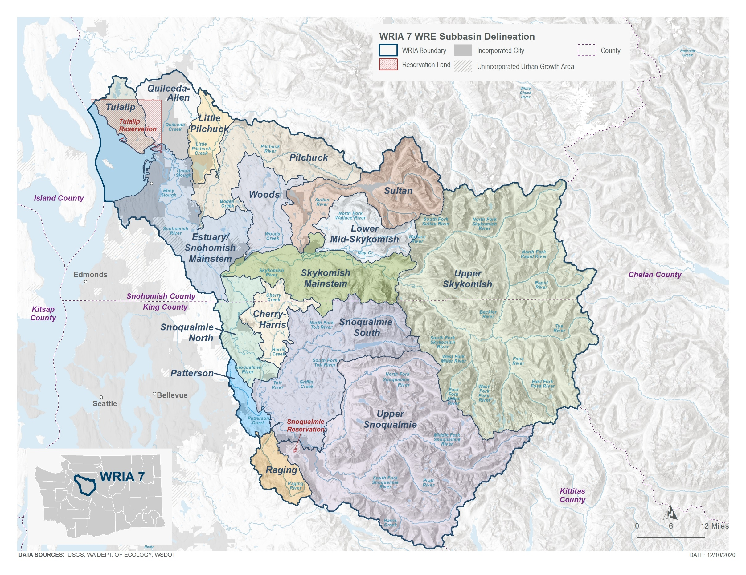
Subbasin Delineation

Slide 19
Project New Permit-Exempt Wells
The WRIA 7 Committee projects 3,389 PE wells over the planning horizon. Most of these wells are likely to be installed in Tulalip, Quilceda-Allen, Estuary/Snohomish Mainstem, and Snoqualmie North Subbasins.
Notes:
The Committee developed a method that they agreed was appropriate to project the number of new PE wells over the planning horizon in the WRIA, in order to estimate new consumptive water use. They used methods based on recommendations from Appendix A of Ecology’s Final NEB Guidance (Ecology 2019) and, with help of the Counties and technical consultants, estimated 3,389 new PE wells over the next 20 years.
[add any specific talking points relevant to the method to project wells that is relevant to the audience, along with other important details]
Additional Notes:
The WRIA 7 Committee gave deference to each County for identifying the most appropriate method of projecting PE wells within their jurisdiction. The WRIA 7 PE well projection method included using King and Snohomish Counties historical building data to predict potential PE well growth assuming the rate and general location of past growth will continue over the 20‑year planning horizon.
King County projects approximately 980 new PE wells over the planning horizon within WRIA 7 portions of unincorporated King County. Snohomish County projects approximately 2,369 new PE wells over the planning horizon within WRIA 7 portions of unincorporated Snohomish County (including a projection of 35 PE wells on tribal owned lands provided by Tulalip Tribes). The King and Snohomish County methods do not account for potential PE wells in cities or Urban Growth Areas (UGAs) so the WRIA 7 Committee completed an analysis of potential new PE wells within the UGAs and projected 40 new PE wells (UGA Well Log Spot Check).

Slide 20
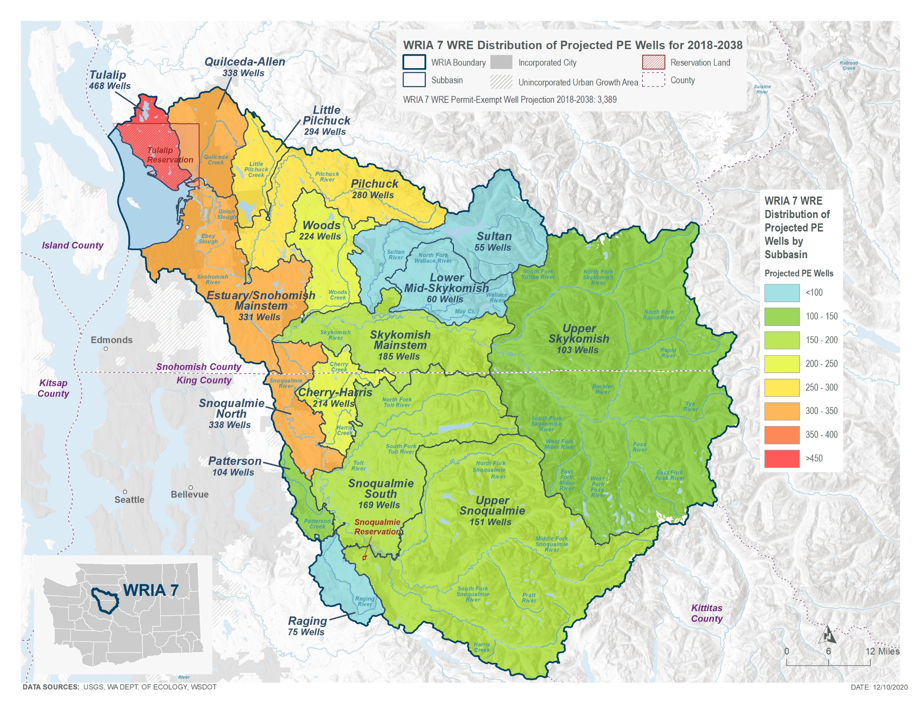
Projected New Permit-Exempt Wells

Slide 21
Number of PE Wells Projected between 2018 and 2038 for the WRIA 7 Subbasins
Subbasins | King County | Snohomish County | UGAs | Total PE Wells per Subbasin
Tulalip | -- | 468 | 0 | 468
Quilceda-Allen | -- | 330 | 8 | 338
Estuary/Snohomish Mainstem | -- | 322 | 9 | 331
Little Pilchuck | -- | 289 | 5 | 294
Pilchuck | -- | 278 | 2 | 280
Woods | -- | 224 | 0 | 224
Sultan | -- | 53 | 2 | 55
Lower Mid-Skykomish | -- | 60 | 0 | 60
Skykomish Mainstem | 0 | 183 | 2 | 185
Upper Skykomish | 48 | 53 | 2 | 103
Cherry-Harris | 200 | 11 | 3 | 214
Snoqualmie North | 240 | 98 | 0 | 338
Snoqualmie South | 169 | 0 | 0 | 169
Patterson | 104 | -- | 0 | 104
Raging | 73 | -- | 2 | 75
Upper Snoqualmie | 146 | -- | 5 | 151
Totals | 980 | 2,369 | 40 | 3,389

Slide 22
Estimate New Consumptive Water Use
The WRIA 7 Committee used the 20-year projection of new PE wells for WRIA 7 (3,389) to estimate the consumptive water use that this watershed plan must address and offset.
The WRIA 7 Committee estimates 797.4 acre-feet per year (1.10 cfs) of new consumptive water use in WRIA 7.
Notes:
The WRIA 7 Committee used methods recommended in Ecology’s Final NEB Guidance to estimate consumptive use. Indoor water use patterns differ from outdoor water use, so the Committee took this into consideration. The Committee estimates 797.4 acre-feet per year (1.10 cfs) of new consumptive water use in WRIA 7.
The Consumptive Use Estimates Technical Memorandum provides a more detailed description of the analysis and alternative scenarios considered (Appendix)
Additional Notes
Indoor use is generally constant throughout the year, while outdoor use occurs primarily in the summer months. Also, the portion of water that is consumptive varies for indoor and outdoor water use. To develop the consumptive use estimate, the WRIA 7 Committee relied on assumptions for indoor use and outdoor use from Appendix A of the Final NEB Guidance (Ecology 2019).
1.1 cfs = 710,810 gpd.

Slide 23
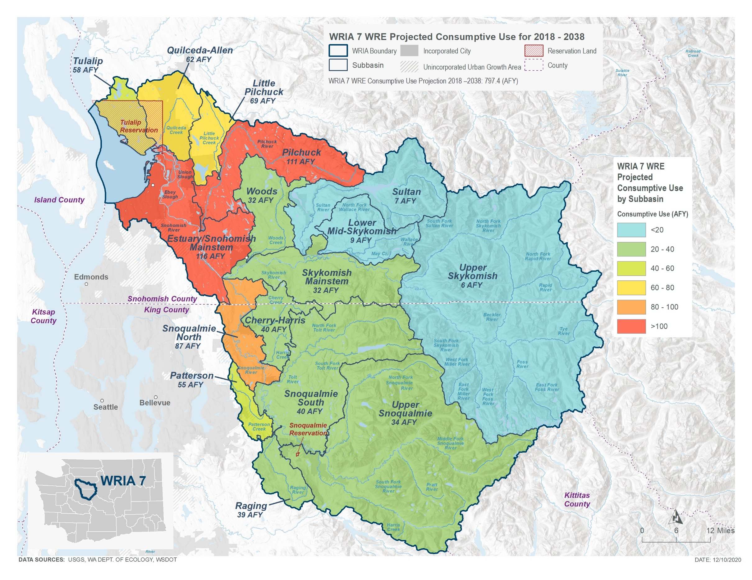
Estimate New Consumptive Water Use

Slide 24
Consumptive Use Estimate
Subbasin | Projected PE wells | Average lawn size (acres) | Indoor CU per well (AF/year) | Outdoor CU per well (AF/year) | Total CU/year per well (AF/year) | Total CU 2018-2038 (AF/year)
Tulalip | 468 | 0.09 | 0.0185 | 0.11 | 0.12 | 58.1
Quilceda-Allen | 338 | 0.15 | 0.0185 | 0.17 | 0.18 | 62.1
Estuary/Snohomish Mainstem | 331 | 0.29 | 0.0185 | 0.33 | 0.35 | 115.8
Little Pilchuck | 294 | 0.2 | 0.0185 | 0.22 | 0.24 | 69.5
Pilchuck | 280 | 0.37 | 0.0185 | 0.38 | 0.40 | 111.0
Woods | 224 | 0.12 | 0.0185 | 0.12 | 0.14 | 31.5
Sultan | 55 | 0.11 | 0.0185 | 0.10 | 0.12 | 6.5
Lower Mid-Skykomish | 60 | 0.14 | 0.0185 | 0.13 | 0.15 | 8.8
Skykomish Mainstem | 185 | 0.16 | 0.0185 | 0.16 | 0.17 | 32.1
Upper Skykomish | 103 | 0.05 | 0.0184 | 0.04 | 0.06 | 6.0
Cherry-Harris | 214 | 0.16 | 0.0184 | 0.17 | 0.19 | 40.4
Snoqualmie North | 338 | 0.21 | 0.0184 | 0.24 | 0.26 | 87.4
Snoqualmie South | 169 | 0.21 | 0.0183 | 0.22 | 0.24 | 40.3
Patterson | 104 | 0.41 | 0.0183 | 0.51 | 0.53 | 55.0
Raging | 75 | 0.43 | 0.0183 | 0.50 | 0.52 | 38.8
Upper Snoqualmie | 151 | 0.23 | 0.0183 | 0.21 | 0.23 | 34.2
WRIA 7 Aggregated | 3,389 | 0.20 | 0.00184 | 0.22 | 0.24 | 797.4
Notes:
The outdoor consumptive use varies by subbasin due to different irrigation requirements across the watershed.

Slide 25
Types of Projects & Actions
Reservoir Outlet Modification
Streamflow Augmentation
Water Right Acquisition
Managed Aquifer Recharge
Stormwater Infiltration
Floodplain Reconnection
Beaver Restoration
Land Acquisition
Riparian Restoration
Notes:
The plan includes 11 water offset projects and 27 habitat projects to meet net ecological benefit.

Slide 26
WRIA 7 Water Offset Projects
Subbasin | Water Offset Project Name | Project Type | Water Offset Estimate (acre-feet per year)
Tulalip | Lake Shoecraft Outlet Modification | Modification of Reservoir Operations | 62.5
Quilceda-Allen | Coho Creek Relocation and Streamflow Enhancement | Streamflow Augmentation | 362
Little Pilchuck | Lake Stevens Outlet Structure & Lake Level Management | Modification of reservoir operations | 500
Pilchuck | Lochaven Source Switch | Water Right Acquisition | 12.7
Pilchuck | Lower Pilchuck 1 | Water Right Acquisition | 2.8
Pilchuck | Lower Pilchuck 11 | Water Right Acquisition | 2.1
Snoqualmie South | Raging River 1 | Water Right Acquisition | 126
Patterson | Patterson 1 | Water Right Acquisition | 29.7
Patterson | Patterson 4 | Water Right Acquisition | 71.6
Upper Snoqualmie, Snoqualmie South, Snoqualmie North | MAR in Snoqualmie Watershed | Managed Aquifer Recharge | 100
Upper Snoqualmie, Snoqualmie North, Snoqualmie South, Cherry/Harris | Snoqualmie River Watershed Surface Water Storage | Water Storage and Retiming | 104 – 3,311
Total Water Offset Potential |  |  | 1,373.4
Notes:
The WRIA 7 Committee identified 11 projects that provide water offset to WRIA 7. The WRIA 7 Committee estimates a total of 1,373.4 acre-feet per year (1.9 cfs) of water offset from these projects.

Slide 27
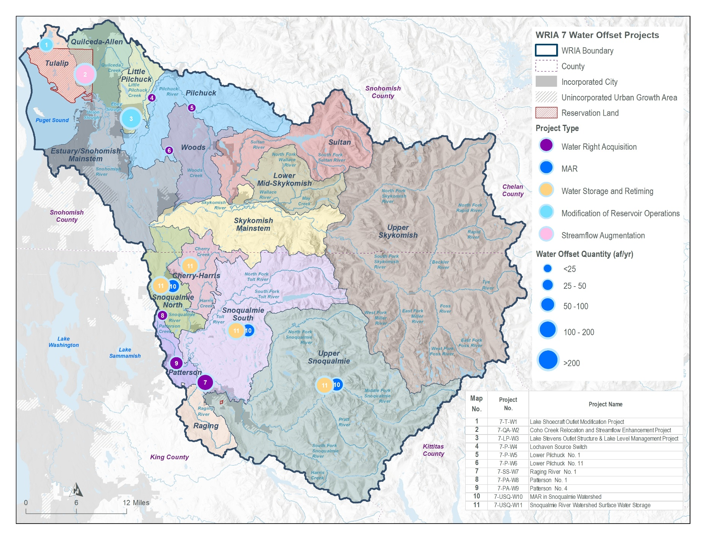
WRIA 7 Water Offset Projects

Slide 28
WRIA 7 Habitat Projects
Subbasin | Habitat Project Name | Project Type
Quilceda-Allen | Jones Creek Relocation and Wetland Enhancement | Floodplain Restoration and/or Reconnection
Quilceda-Allen | Marysville Stormwater Retrofits (Quilceda stormwater project) | Stormwater Retrofit
Quilceda-Allen | Quilceda 8 Restoration & Potential Water Right Acquisition | Riparian Restoration and Other
Estuary/Snohomish Mainstem | Silver Firs Stormwater Pond Retrofits (Little Bear Stormwater) | Stormwater Retrofit
Estuary/Snohomish Mainstem | Thomas' Eddy Hydrualic Reconnection | Floodplain Restoration and/or Reconnection
Estuary/Snohomish Mainstem | Snohomish Floodplain Acquisitions Phase 1 (Lund Acquisition) | Land Acquisition
Pilchuck | Pilchuck River Armoring Removal | Riparian Restoration and Other
Pilchuck, Woods, Estuary/Snohomish Mainstem, Little Pilchuck | Living with Beavers Program | Beaver Restoration
Pilchuck, Woods, Estuary/Snohomish Mainstem, Little Pilchuck | Small Farm Storage Initiative | Small Scale Storage
Pilchuck, Woods, Estuary/Snohomish Mainstem, Little Pilchuck | District Wetland Restoration | Riparian Restoration and Other
Woods | Woods Creek Riparian Restoration Partnership | Riparian Restoration and Other
Sultan | Expansion of Sultan River Side Channel Network (Sultan River Floodplain Activation) | Floodplain Restoration and/or Reconnection
Skykomish Mainstem | Haskel Slough Connectivity | Floodplain Restoration and/or Reconnection

Slide 29
WRIA 7 Habitat Projects Continued
Subbasin | Habitat Project Name | Project Type
Skykomish Mainstem | East Monroe Heritage Site Acquisition | Land Acquisition
Skykomish Mainstem | Shinglebolt Slough | Floodplain Restoration and/or Reconnection
Skykomish Mainstem | Snohomish Confluence Project + Left Bank Floodplain reconnection at RM 1.5 | Floodplain Restoration and/or Reconnection
Upper Skykomish | Miller River Alluvial Fan Restoration | Floodplain Restoration and/or Reconnection
Lower Mid-Skykomish, Upper Skykomish, Ragin, Upper Snoqualmie | Tulalip Tribes Beaver Reintroduction Program | Beaver Restoration
Cherry-Harris | Cherry Creek Climate Resilient Watershed | Floodplain Restoration and/or Reconnection
Snoqualmie North | Camp Gilead Levee Removal Phase 2 | Floodplain Restoration and/or Reconnection
Snoqualmie North | McElhoe-Pearson Restoration Project | Floodplain Restoration and/or Reconnection
Snoqualmie North | Lower Tolt LB Floodplain Reconnection (SR 203 to Confluence) | Floodplain Restoration and/or Reconnection
Snoqualmie North | Fall City Floodplain Reconnection Design and Construction – Left Bank and Right Bank | Floodplain Restoration and/or Reconnection
Patterson | Patterson Creek Floodplain Restoration (Sub-Watershed 2C) + Patterson Creek Floodplain Acquisitions | Floodplain Restoration and/or Reconnection
Raging | Raging River Left Bank Mouth Levee Removal (Bernard Memorial Park) | Floodplain Restoration and/or Reconnection
Raging | Raging River Bridge to Bridge Acquisitions + Raging River Bridge to Bridge Floodplain Restoration | Floodplain Restoration and/or Reconnection
Upper Snoqualmie | South Fork Snoqualmie River Levee Setback Project (Nintendo Project) | Floodplain Restoration and/or Reconnection

Slide 30
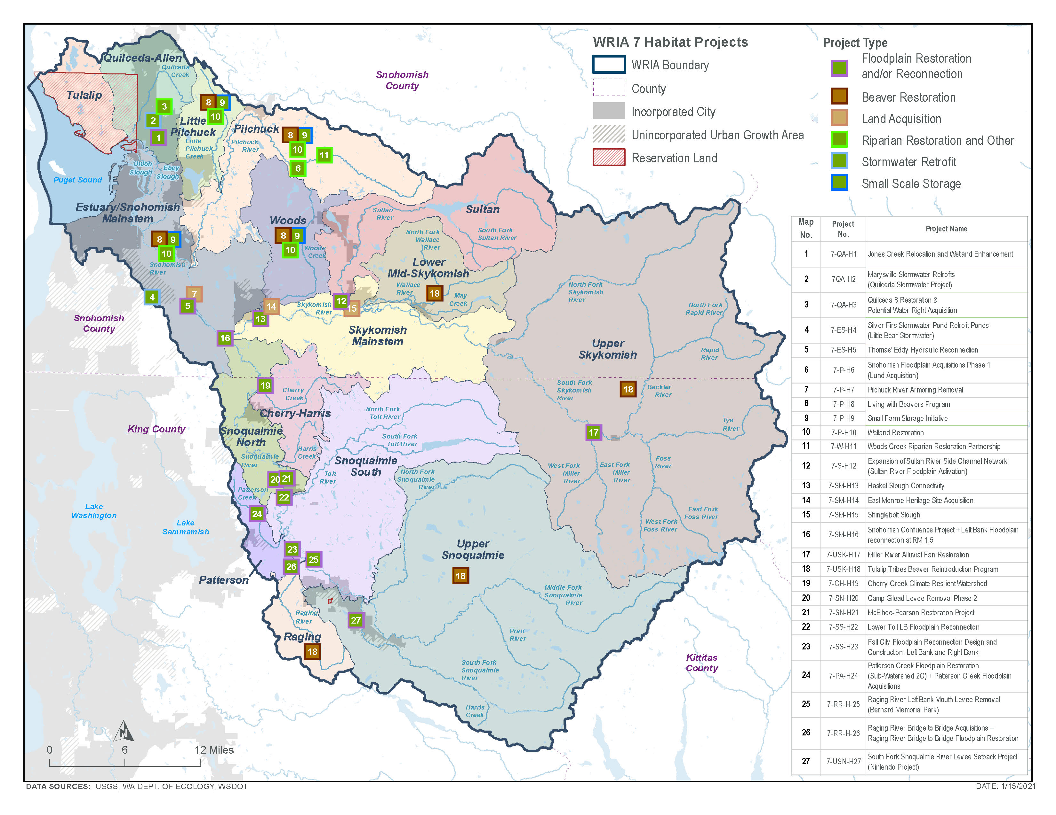
WRIA 7 Habitat Projects

Slide 31
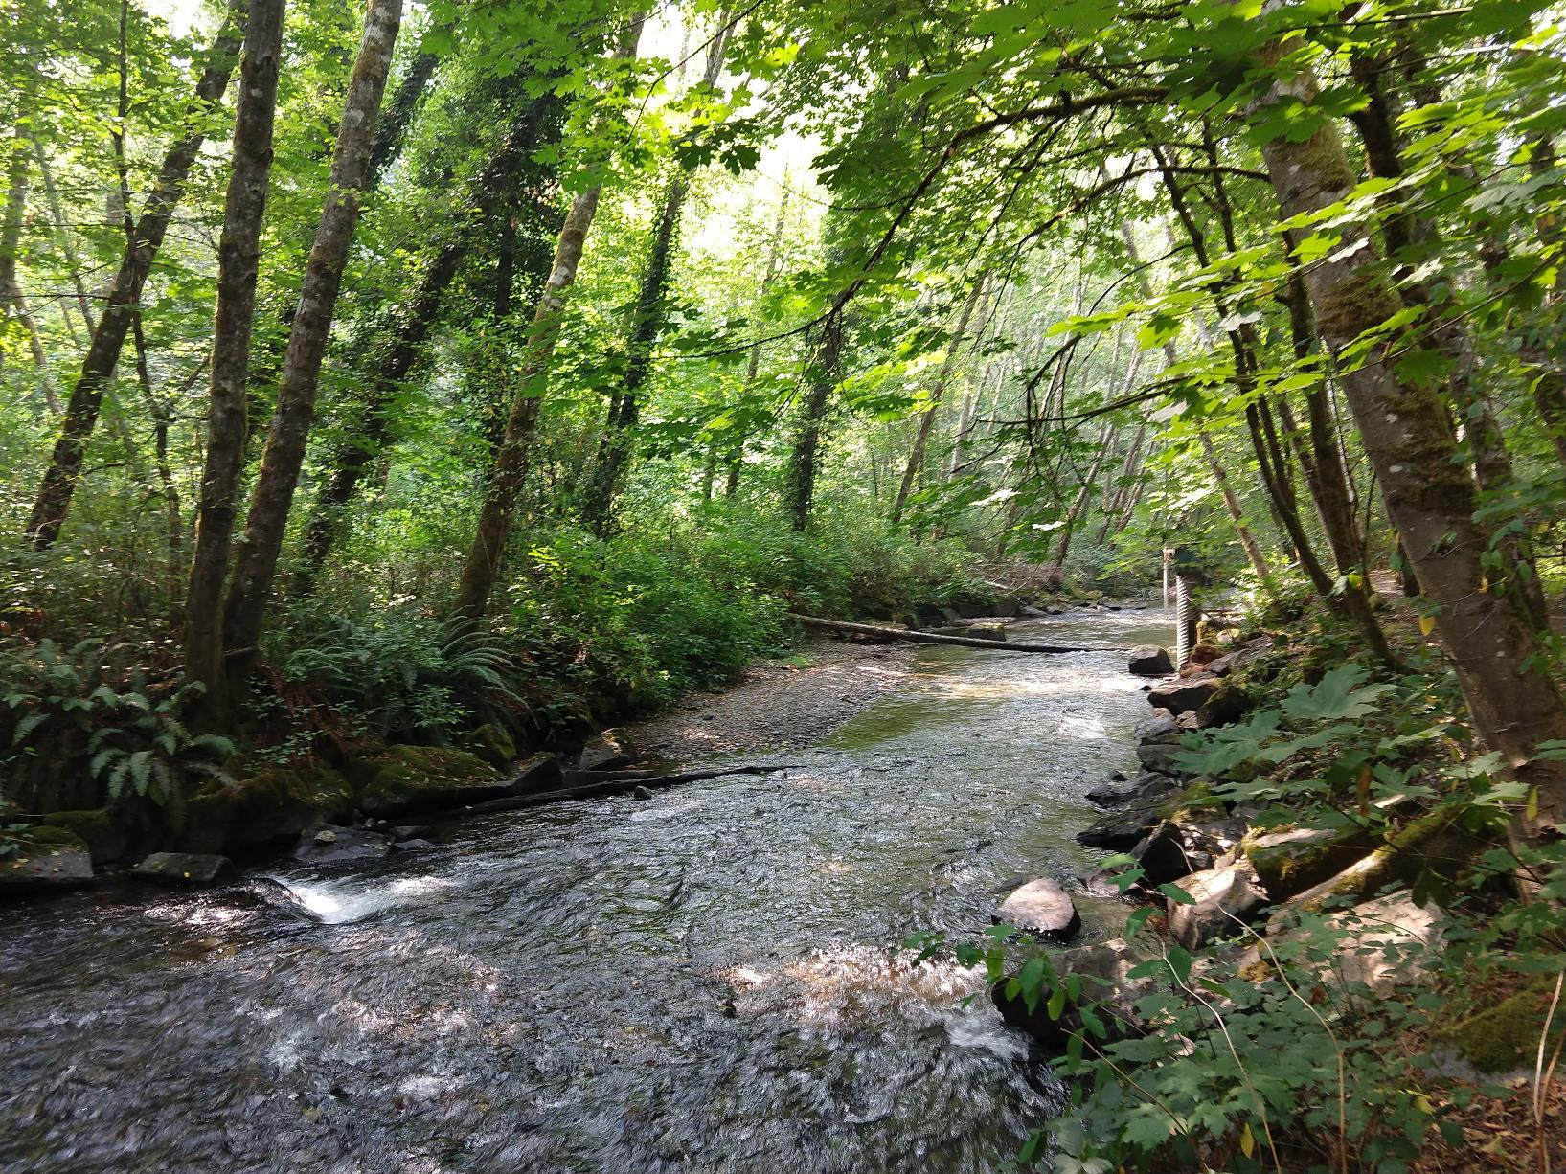
Potential Future Projects
Water right acquisitions
Improved lake level management
Projects to improve stormwater infiltration
Managed aquifer recharge
Increase connections to public water systems
Outreach and incentives for water conservation
Long-term forest management
Beneficial water source switches
Habitat restoration
Notes:
Instream flows are an element of water and river management — finding ways to maintain healthy and diverse ecosystems that are part of Washington’s high quality of life, while sustaining basic life functions and economies.
Not every watershed has instream flow levels established. Instream flow rules vary by watershed. In WRIA 7, instream flow levels are established on certain streams, and several streams are closed to further appropriations.

Slide 32
Policy and Regulatory Recommendations
Well reporting upgrades
Encourage conservation through connections to public water
Development and use of reclaimed water
Voluntary permit exempt well metering pilot program
Water conservation education & incentives program
Statewide mandatory water conservation measures in unincorporated areas of the state during drought

Slide 33
Adaptive Management Recommendations
Funding for adaptive management
Additional funding for project implementation
Ability to add projects to the plan
Track PE wells and project implementation
Monitoring of streamflow and groundwater
Studies to improve understanding of hydrology
Monitor projects for effectiveness
Watershed plan implementation reports
Ecology can adjust the plan, if needed
Committee can reconvene, if needed
Reporting on streamflow restoration grant program

Slide 34
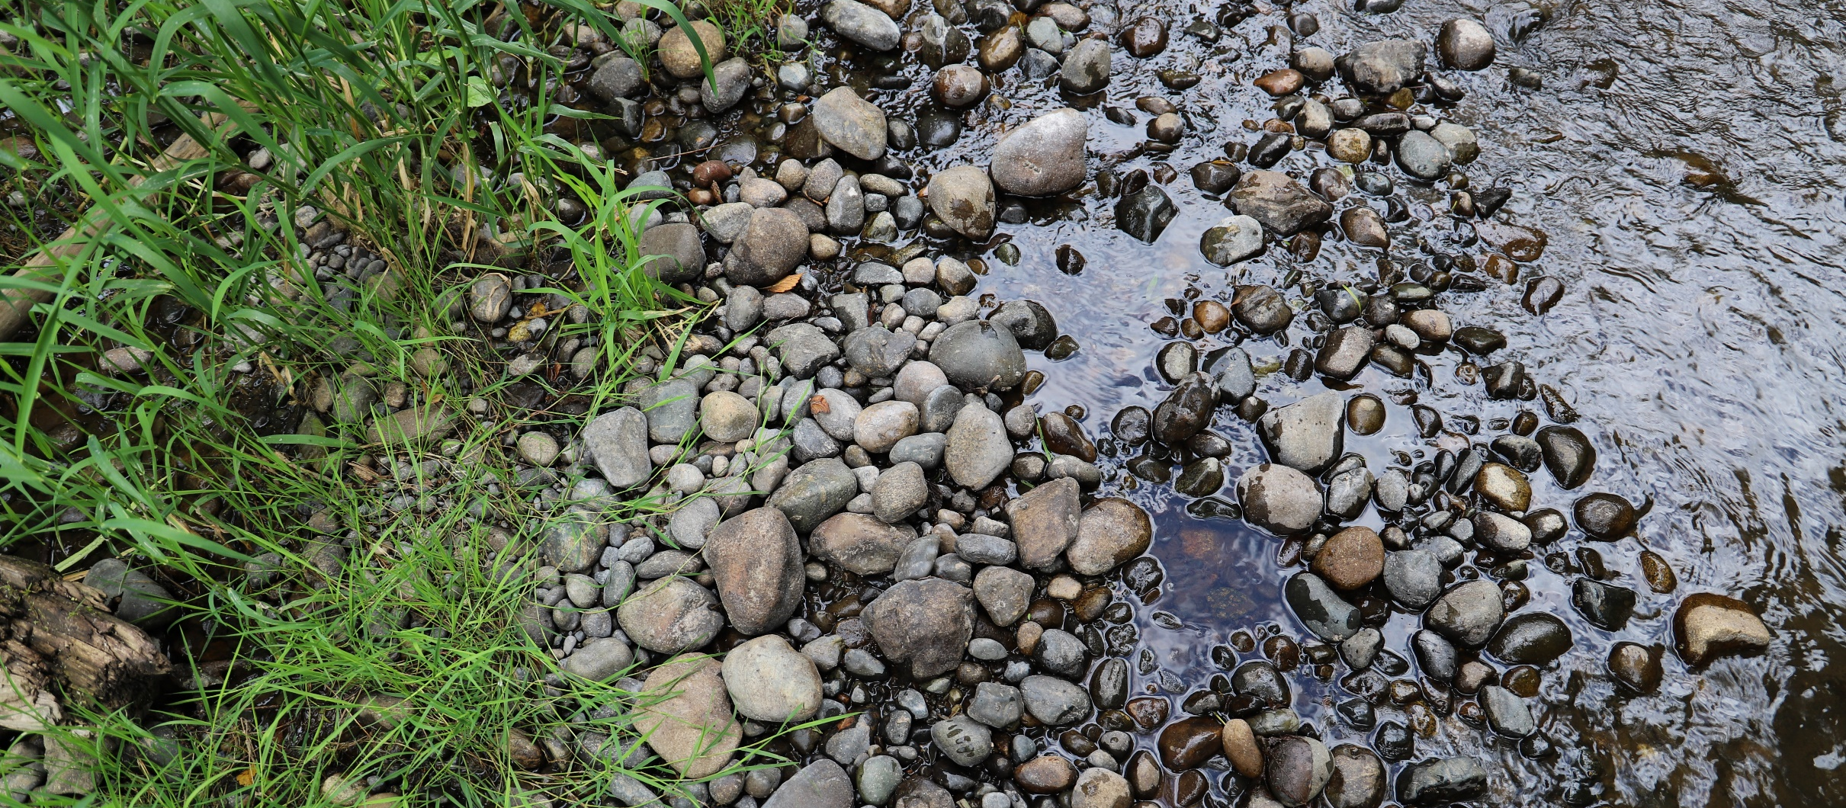
Plan Implementation
As required by the NEB Guidance, the Committee prepared the watershed plan with implementation in mind. However, as articulated in the Streamflow Restoration Policy and Interpretive Statement (POL-2094), “RCW 90.94.020 and 90.94.030 do not create an obligation on any party to ensure that plans, or projects and actions in those plans or associated with rulemaking, are implemented."
Notes:
Presenter should use this slide and speak to it as appropriate for the audience. This slide can also be moved before the recommendations slide.

Slide 35
Steps to complete plan
Committee members reviewed and provided comments on draft plan.
Committee members share final draft plan with local decision makers for review.
Committee members meet (virtually) to vote on plan.
If all members of the Committee approve the plan, the Committee chair will submit the plan to Ecology for review and NEB determination.
If the Committee does not approve the plan, Ecology will prepare the plan. Ecology will send the plan to the Salmon Recovery Funding Board for technical Review. Ecology will then finalize the plan and the Director shall initiate rulemaking.

Slide 36
Post Plan Submission
SEPA public comment period
No changes to plan after submission
Ecology will review plan
Ecology will determine action by June 30, 2021
If achieves NEB, adopt plan

Slide 37
Thank you for your time!
Any questions?

Slide 38
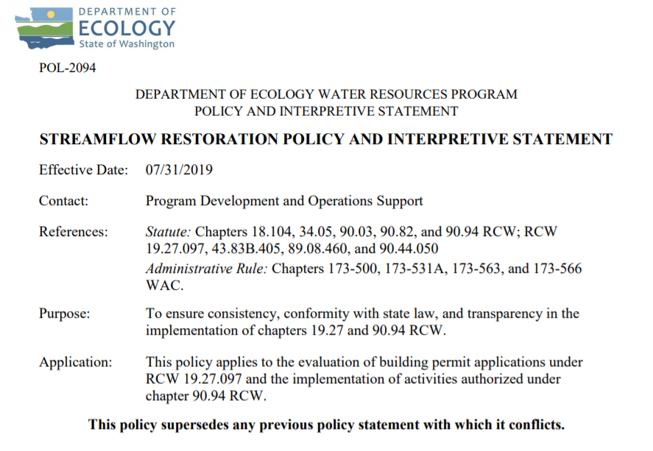
Ecology’s Policy Interpretation
More information on the Streamflow Restoration law can be found online
Notes:
RCW 90.94.030 adds to the management regime for new homes using domestic permit-exempt well withdrawals in this WRIA and elsewhere. For example, local governments must, among other responsibilities relating to new permit-exempt domestic wells, collect a $500 fee for each building permit and record withdrawal restrictions on the title of the affected properties. Additionally, this law restricts new permit-exempt domestic withdrawals in this WRIA to a maximum annual average of up to 950 gallons per days per connection, subject to the five thousand gallons per day and ½-acre outdoor irrigation of non-commercial lawn/garden limits established in RCW 90.44.050. Ecology has published its interpretation and implementation of RCW 19.27.097 and RCW 90.94 in Water Resources POL 2094.

Slide 39
Ecology’s NEB Guidance
More information on the Final Guidance for Determining Net Ecological Benefit can be found online
Notes:
After conducting a thorough scientific literature review, Ecology has determined that NEB is not a technical term that has been defined in the natural sciences. Instead, it is a creation of the Washington State Legislature. Therefore, Ecology has prepared this guidance for interpretation and application of this term. This guidance provides supplemental information, beyond that provided expressly in the law, for those groups engaged in the watershed planning work required by RCW 90.94.020 and RCW 90.94.030.

Slide 40
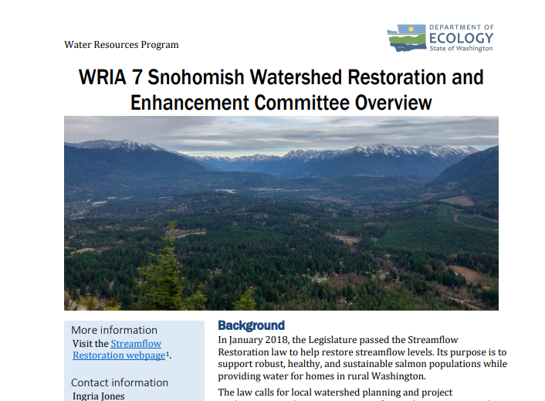
WRIA 7 Committee Brochure
More information on WRIA 7 Committee can be found
online

Slide 41
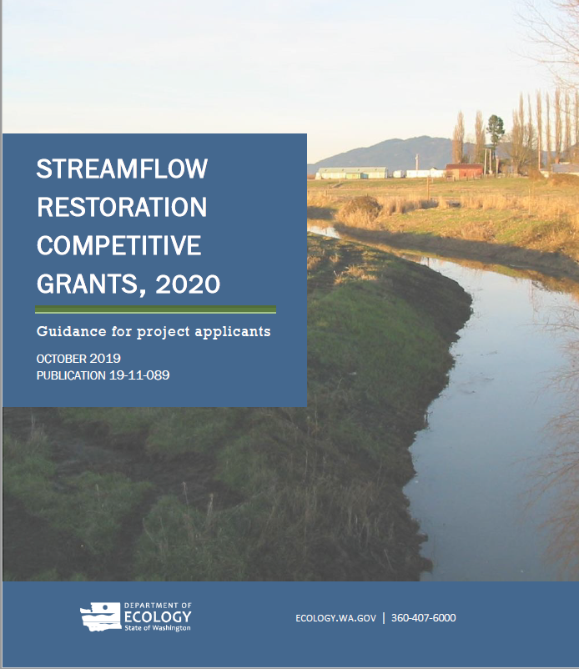
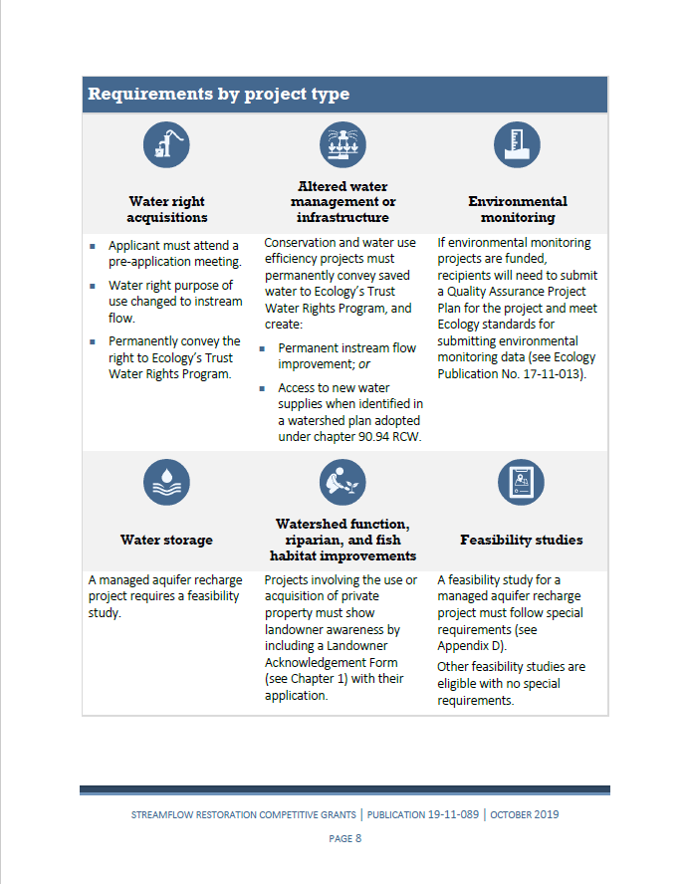
Grants Guidance Overview
Notes:
More information online: https://ecology.wa.gov/About-us/How-we-operate/Grants-loans/Find-a-grant-or-loan/Streamflow-restoration-implementation-grants

