Slide 1
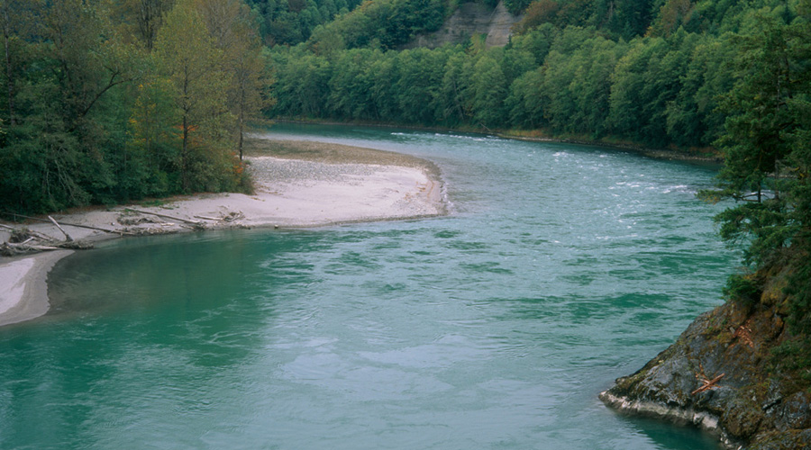

Consumptive Water Use Estimates
& Related Considerations for
RCW 90.94
May 2019
John Covert
Washington State Department of Ecology
john.covert@ecy.wa.gov

Slide 2
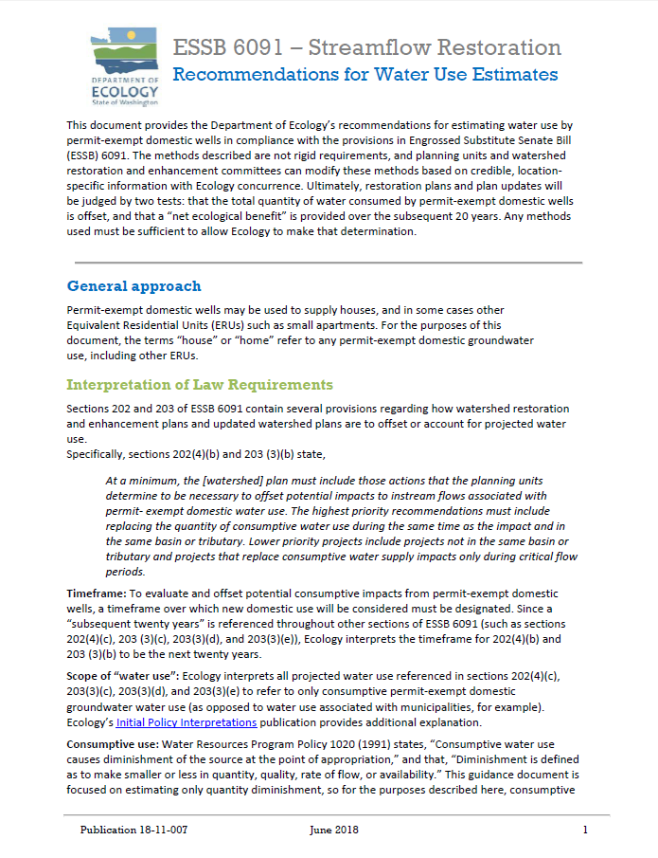
Ecology published recommendations for estimating water use by permit-exempt domestic wells in compliance with RCW 90.94.
This presentation was developed mainly from that document.

Slide 3

Basic RCW 90.94 Requirements
Permit-exempt domestic well water use must be estimated to establish amount of water use that watershed restoration plans and plan updates must address.
Plans must estimate cumulative consumptive water use over 20 years subsequent to signing of bill (effective 1/19/18).
Ultimately, watershed plans will be judged by two tests:
  total potential impacts of new permit-exempt domestic wells are offset
  “net ecological benefit” (NEB) is provided by plan.

Slide 4
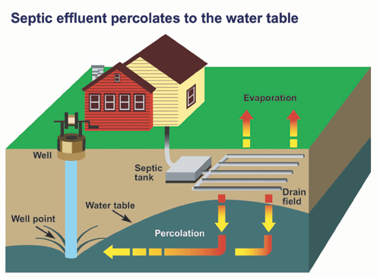
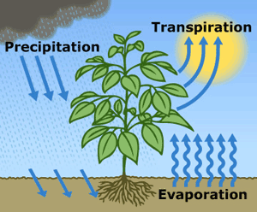
Consumptive Use:
- water that is evaporated, transpired, consumed by humans, or otherwise removed from an immediate water environment due to use of permit-exempt domestic wells.

Slide 5
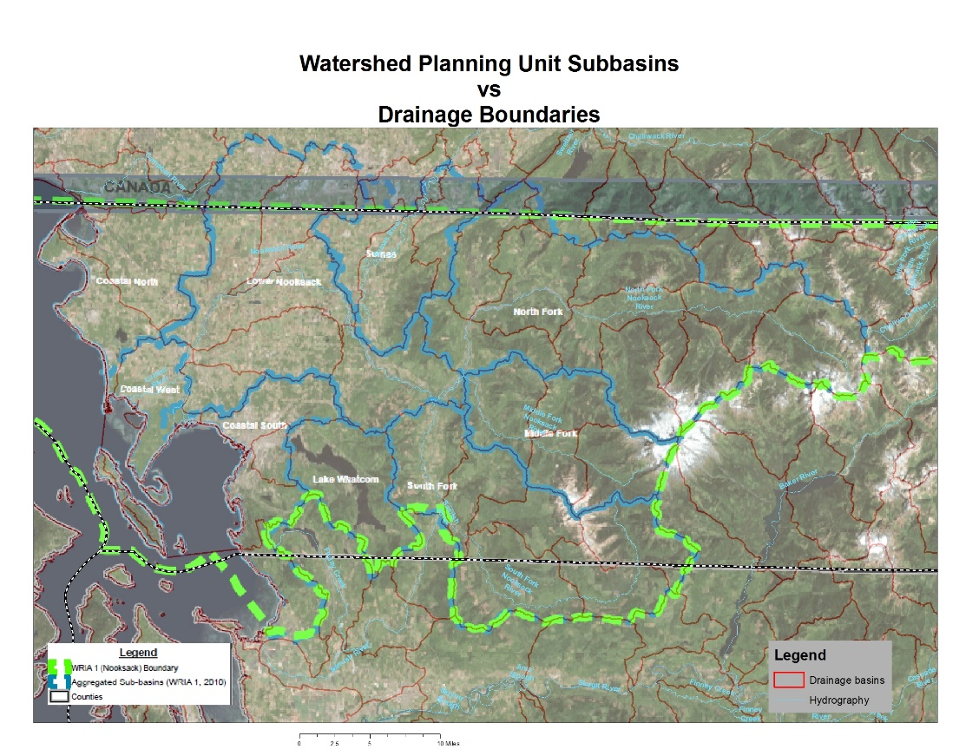
Subbasins
Planning groups must delineate subbasins within WRIAs, and these must be suitably sized to allow meaningful determinations of whether mitigation is in-time and in same subbasin in the context of RCW 90.94 high priority and low priority projects, without being so small that they are unwieldly.
In some instances, subbasins may not correspond with hydrologic basin delineations (i.e. watershed divides).
WRIA 01 has 49 USGS HUC12 subwatersheds and
9 Planning Unit subbasins

Slide 6
RCW 90.94 High and Low Priority Projects
Highest priority projects must replace consumptive water use during same time as impact and in same basin or tributary.
Lower priority projects include those 1) not in same basin or tributary or 2) projects that replace consumptive impacts only during critical flow periods.
In reality, there probably won’t be a strict dichotomy between lower and higher priority projects and many projects will fall in between.

Slide 7
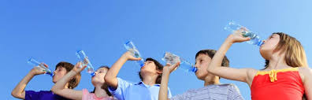
Total Water Use vs. Consumptive Water Use
Estimates of water use by future permit-exempt domestic wells must account for portion of water consumptively used.
  For indoor water use most houses on permit-exempt domestic wells are connected to septic systems, so a reasonable assumption is that only about 10% is lost from the groundwater system.
  For outdoor water use a good assumption is that about 80% is lost, mainly due to evapotranspiration.
Planning groups can use assumptions other than 10% and 80% if justification is provided.

Slide 8
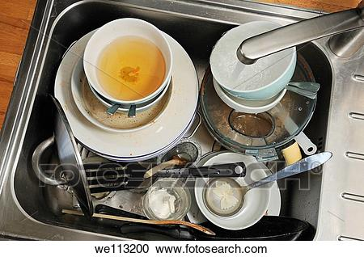
Indoor Water Use
The Water Research Foundation (DeOreo, et al., 2016) evaluated water use in homes provided by municipal water in 23 areas across U.S. and Canada (ave = 59 gpd per capita). A sampling of homes supplied by Tacoma Water averaged 51 gpd per capita indoor water use (in this study).
Since homes supplied municipal water are more likely to be fitted with water saving appliances, an assumption of 60 gpd per capita is reasonable for indoor water use.

Slide 9
Household Consumptive Indoor Water Use
Average household size estimates are available from OFM.
Assuming 2.5 people per household, 60 gpd per capita water use, and 10% of indoor water use consumption, household consumptive indoor water use (HCIWU) equals :
60 gpd X 2.5 people/house X 365 days X 3.07 (10⁻⁶)AF/gal. X 10%
= 0.017 AF/YR

Slide 10
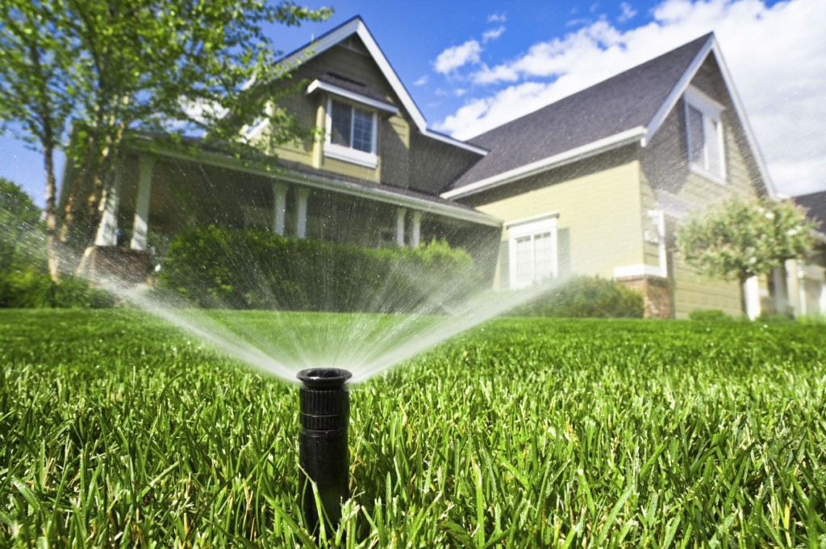
Outdoor Water Use
Irrigation requirements are available in Appendix A of the Washington Irrigation Guide (WAIG) (USDA, 1997).

Slide 11

Household Consumptive Outdoor Water Use
For example, if there is a 0.4 acre outdoor watering area and you’re near Sedro Woolley and the
net irrigation requirement for pasture/turf is 11.11 inches (page 254 of 323 Appendix A):
Irrig. Req. (in.) = 11.11 in./12 in./ft. X 0.4 acres = 0.37 AF/YR
Assuming 75% efficiency for residential pop-up sprinkler system (to account for water lost during water application process):
0.37 acre-feet ÷ 75% application efficiency = 0.49 acre-feet per year
Assuming 80% outdoor water use consumptive loss, total Household Consumptive Outdoor Water Use (HCOWU) per house would be:
0.49 acre-feet x 80% consumed (i.e. 20% return flow) = 0.39 acre-feet per year
indoor use + outside use
For our example, total consumptive household use = 0.017 + 0.39 = 0.407 AF/yr (96% outside use!)

Slide 12


When & Where Consumptive Use
Impacts Will Occur
ESSB 6091 requires high priority offset projects to replace 20-year water use in-time and in same subbasin.
Estimating timing of groundwater impacts on streams is complicated due to lags between when a well is pumped and when those impacts propagate to a stream.
If shallow well pumps an unconfined aquifer adjacent to a stream, pumping effects can be almost instantaneous. However, if well pumps aquifer farther from stream, smaller effects can occur over longer periods.

Slide 13
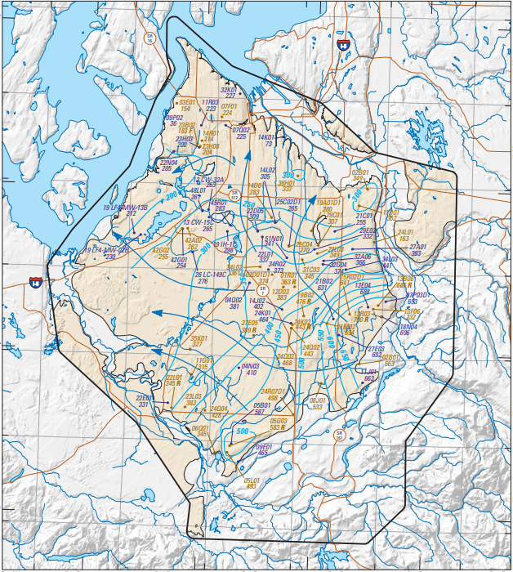
Water-level altitudes and direction of groundwater flow in A3 aquifer, Chambers-Clover Creek Watershed and vicinity, Washington, September 2006–September 2008.
In the real world, groundwater and surface water interconnections are complicated by precipitation patterns, topography, geology, aquifer parameters, impervious surfaces, water use, and a host of other considerations.
USGS SIR 2010-5055

Slide 14
Need to Simplify
Due to hydrogeologic variability, uncertainty regarding new well locations, limited money, and limited time, planning groups will not be able to model pumping effects in detail.

Slide 15
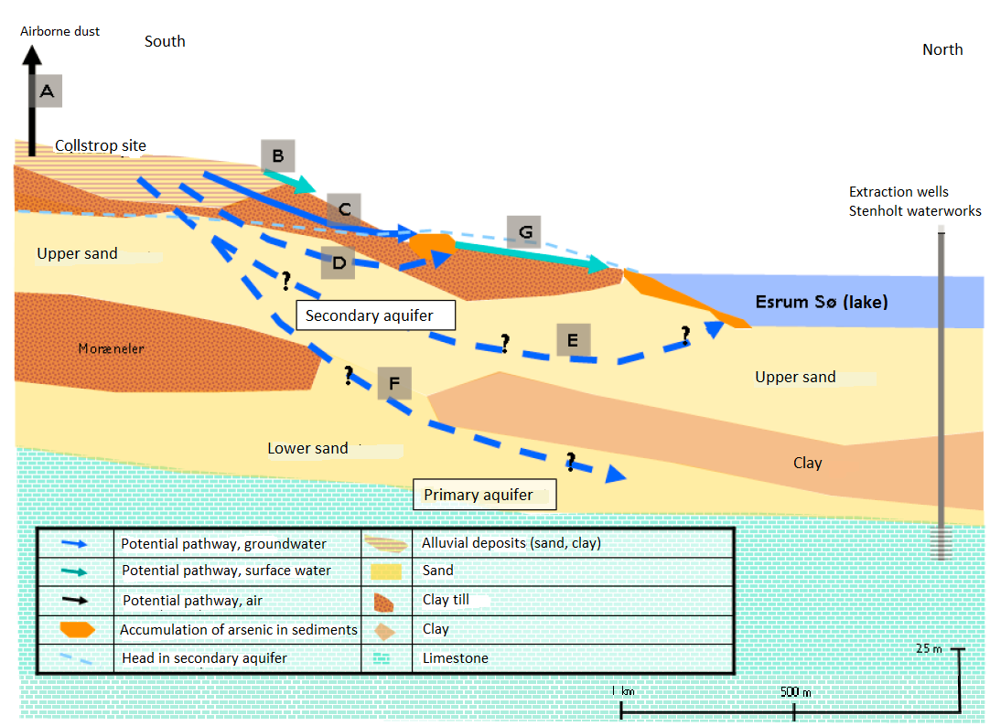
Conceptual Groundwater Models
Conceptual Groundwater models provide overall hydrogeologic understanding.
In water resources terms, conceptual groundwater models generally include:
spatial delineations of recharge and discharge areas
identification of pathways from unsaturated zones through saturated zones to groundwater receptors
analyses and estimates of time scales of flow and effects of groundwater pumping

Slide 16
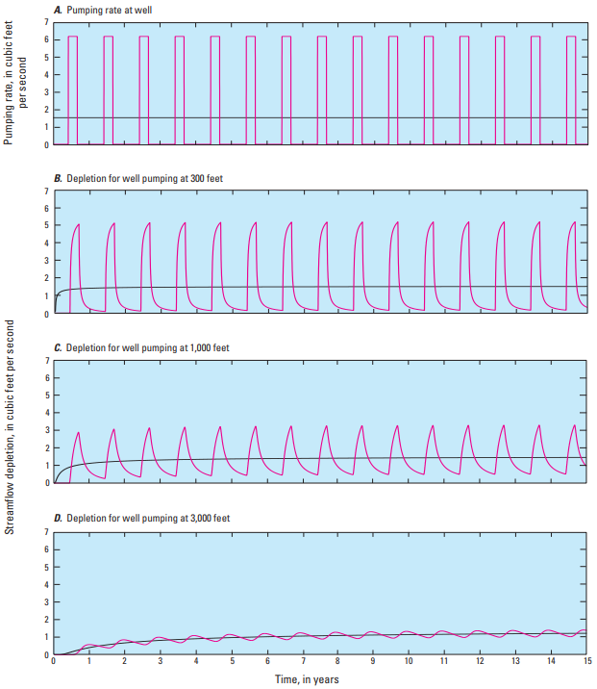
Seasonal vs. Steady State
Magnitudes of aquifer pumping pulses decay over distance and time as effects spread out.
In this example water-level changes range from a distinct pump-on – pump-off pattern, to a relatively constant impact.
In most instances it is reasonable to assume streamflow depletion will essentially be steady state - especially beyond distance of few thousand feet.
USGS Circular 1376

Slide 17
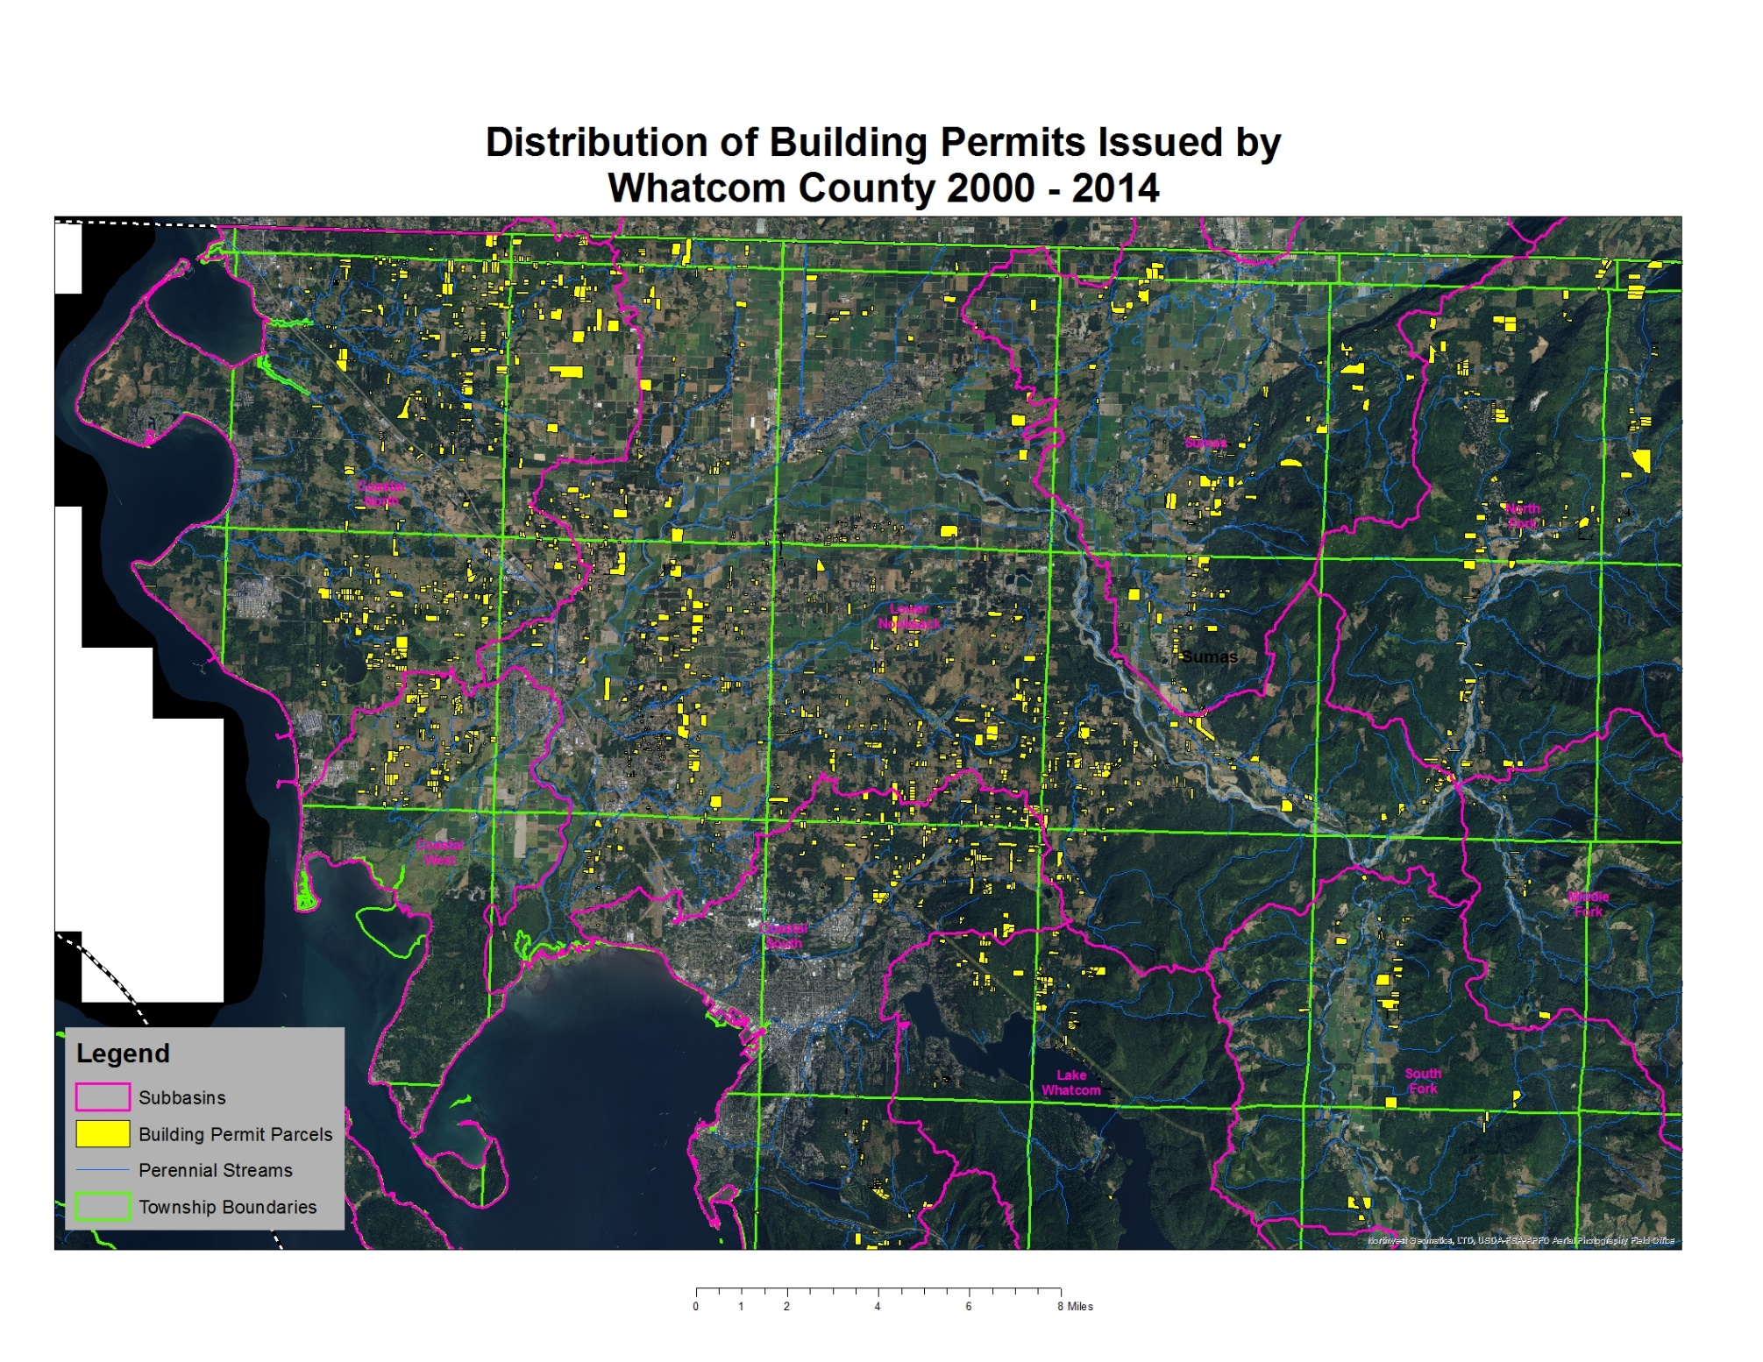
Most of the permit exempt wells drilled in WRIA 01 between 2000 and 2014 were not located adjacent to perennial streams.
Steady-state depletion impacts are reasonable.

Slide 18
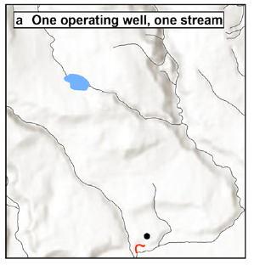
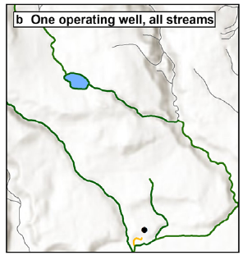
Spatial Considerations
Even when planning groups assume steady state conditions, they will need to consider how steady state pumping effects are distributed spatially.
Conceptually, the pumping impacts may be focused on only the closest stream (a).
Alternatively, the pumping effects will remain within a subbasin and will be distributed evenly to all surface water bodies (b).
Deeper Aquifers likely affect a larger area than the immediate subbasin
Streamflow depletion model results presented with incremental complexity.
(a) Where a single operating well is depleting the most proximal stream with unapportioned impacts.
(b) Where a single operating well is depleting the adjacent stream network with apportioned impacts. All results are presented for August 2050, utilizing the Glover method.

Slide 19

Significance of Scale
When evaluating the hydrologic impacts of new permit-exempt domestic wells or water offset projects on surface water another significant consideration is what the magnitude of impacts or benefits will be relative to the size of the water bodies.
If domestic consumptive uses change the flow in a 1000 cfs stream by 1 cfs, the impacts are different than if a 10 cfs stream is impacted by the same 1 cfs.

Slide 20
Major Conclusions
In most cases wide distribution of future well locations and well depths, and hydrogeological conditions will make it reasonable to assume steady state pumping effects on streamflow depletion.
Magnitude of pumping effects on streamflow depletion will generally be small relative to size of any one particular surface water body.
In most cases placement of water offsets projects at locations most beneficial to fish will be more effective at achieving a NEB than trying to scatter many offset projects throughout an entire WRIA.

Slide 21
Basinwide Consumptive Use Estimates from watershed planning groups that have already tackled the question

Slide 22
WRIA 01 Nooksack Basin
They broke their WRIA into nine aggregated subbasins.

Slide 23
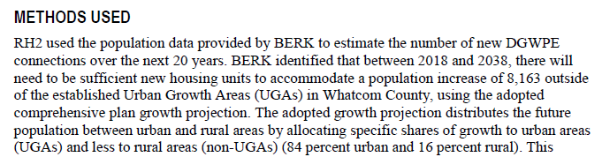
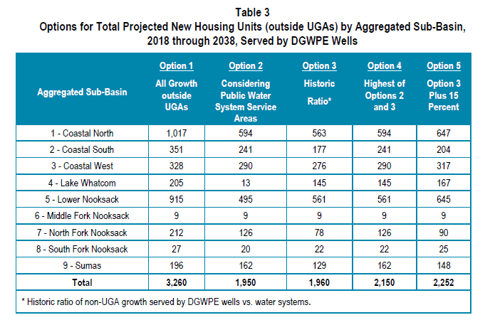
They used their adopted comprehensive plan growth projections for rural growth outside of UGA’s.
They made adjustments because of public water system capacity in areas outside the UGAs.

Slide 24
They calculated the irrigated footprint of a representative sample of domestic lots developed between 2000 and 2014 to estimate average outside lawn and garden irrigation requirements by subbasin to carry forward for the anticipated new uses coming in the 20 year timeframe.

Slide 25
They calculated a suite of potential outcomes based on a matrix of possible scenarios. Their most likely outcome is in the red box.

Slide 26
They believe the consumptive use impacts from new domestic uses will most likely be 647 AF/year by the end of the 20 year horizon. They apportioned those impacts out by subbasin based on expected new well locations.

Slide 27
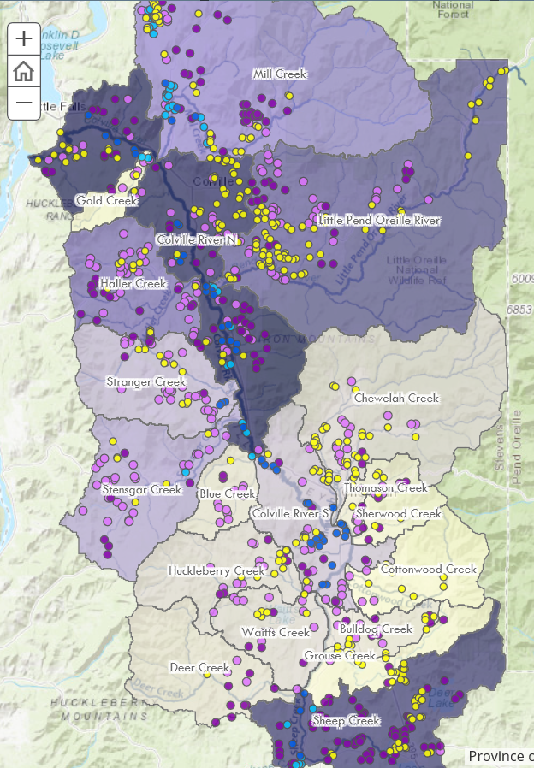
WRIA 59
Colville Basin
They broke their WRIA
into 19 subbasins.

Slide 28
They calculated the number of domestic exempt building permits issued by subbasin over the period of 2001 thru 2017.
They used this ratio to estimate the number of new anticipated domestic wells for the coming 20 years by subbasin.

Slide 29
They also estimated the aquifer type for each of the 950 wells.
They also evaluated parcels that are unlikely to be developed.

Slide 30
They calculated the irrigated footprint of a representative sample of domestic lots developed between 2001 and 2017 to estimate average outside lawn and garden irrigation requirements by subbasin and aquifer type to carry forward for the anticipated new uses coming in the 20 year timeframe.
Bedrock aquifer wells are typically poor producers and homes with bedrock wells typically have much smaller irrigated areas.

Slide 31
They combine in-house consumptive use with 2.64 people per house density plus the appropriate irrigated lot size per subbasin with pertinent irrigation requirements to get a total forecasted new consumptive use estimate.

Slide 32
They believe the consumptive use impacts from new domestic uses will most likely be 426 AF/year by the end of the 20 year horizon. They apportioned those impacts out by subbasin and aquifer type based on expected new well locations.

Slide 33
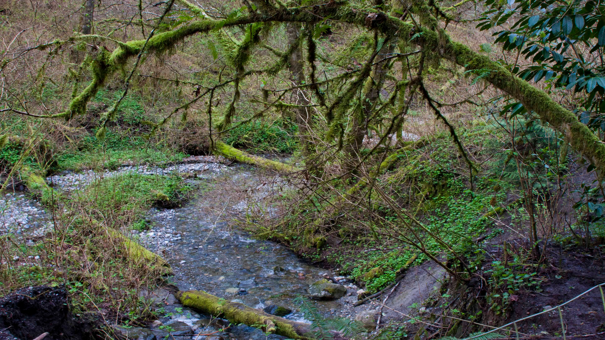
Questions?
John Covert
Washington Department of Ecology
john.covert@ecy.wa.gov

