Slide 1
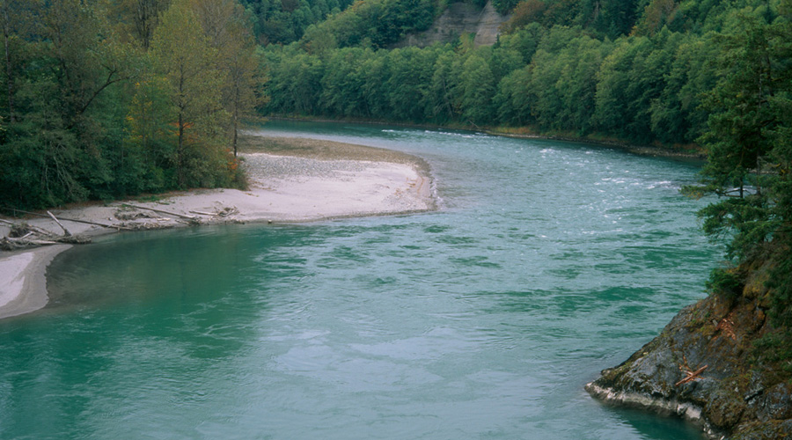

Hydrogeology for Streamflow Restoration,
RCW 90.94
John Covert
WDOE Bellingham
john.covert@ecy.wa.gov
February 28, 2019

Slide 2
3 Messages from Today:
Hydrogeologic Principles that demonstrate that groundwater and surface water are connected.
  (pumping domestic exempt wells does have an impact on streamflows)
Talk about the hydrology and geology of the Cedar-Sammamish River Basin.
Talk about Our Planning Group’s To Do List

Slide 3
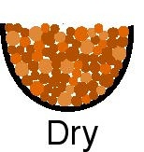
Place aquifer material (sand or gravel) in a bowl
Is the bowl full?
It appears to be full up to the brim.

Slide 4
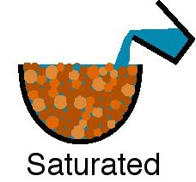
There are holes (pore spaces) between the grains that can be filled with water

Slide 5
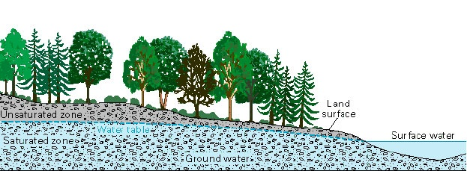
All pore spaces (openings) below the water table are full of groundwater

Slide 6
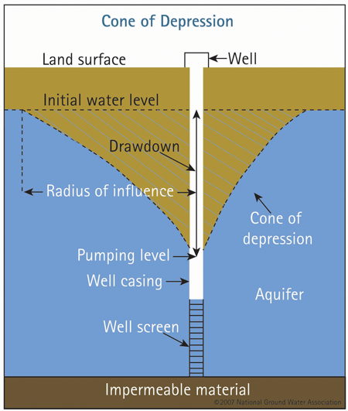
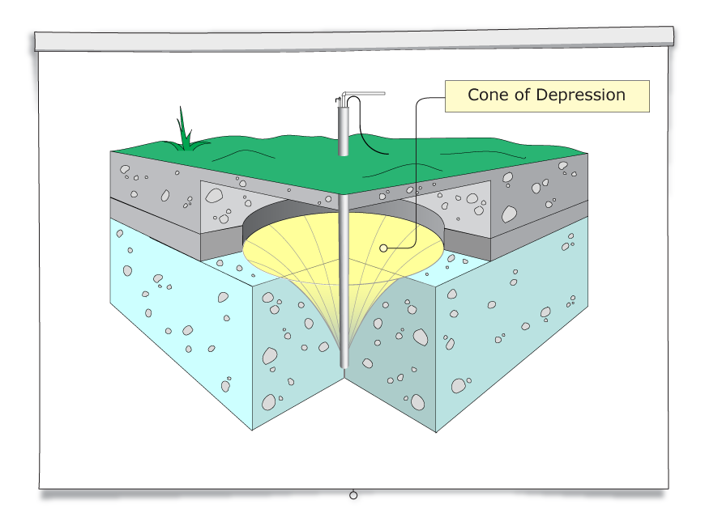
Notes:
These images show that when water is pumped from a well, it creates a cone of depression.

Slide 7
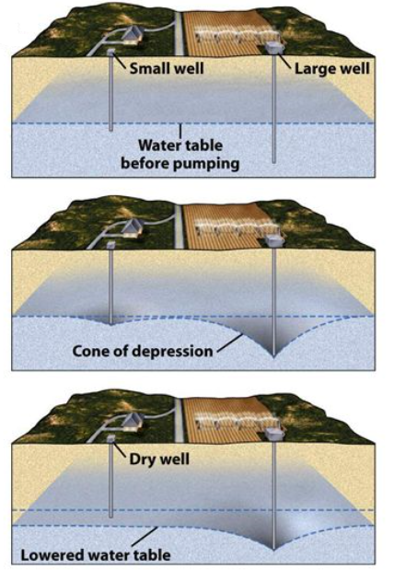
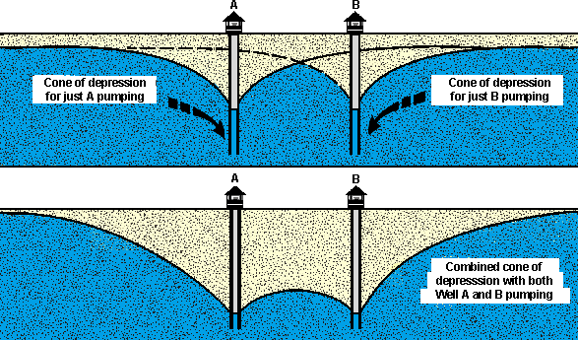
Well interference can lower the water table to the point where it leads to a dry well.
Notes:
Multiple wells pumping at the same time are additive, and create a larger combined cone of depression which can lower the water table.

Slide 8
Aquifers
Aquifer -- saturated earth material permeable enough to transmit useful quantities of water to a well
Aquitard -- saturated geologic material with low permeability; well yields low; also called “confining layer”
Confined Aquifer -- saturated geologic material below an aquitard
The water in the well rises above the bottom of the confining layer.

Slide 9
Notes:
Statewide population trends have increased from under 2 million people in the 1940s to over 7 million today.

Slide 10
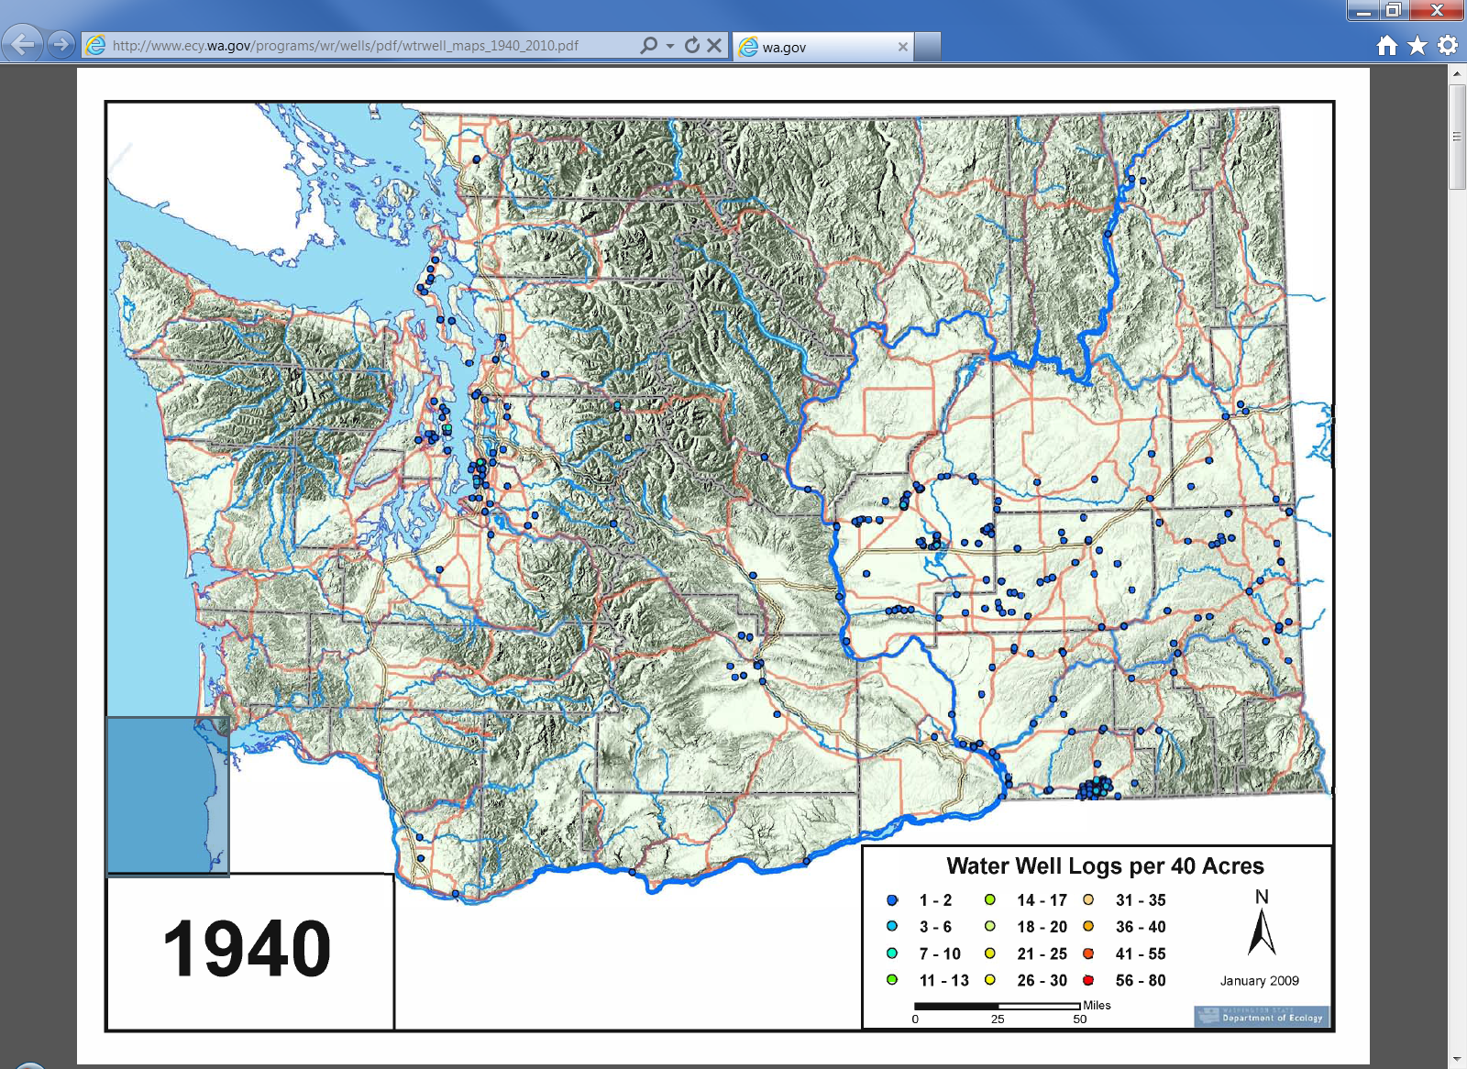
These are the pre-1940 wells that are listed in our well log database. There were more wells than this in the state (just not in our database).
Notes:
The next series of map shows the active water well logs per 40 acres and the increase over the next several decades. Decommissioned wells and Resource Protection wells are not included on the maps.

Slide 11
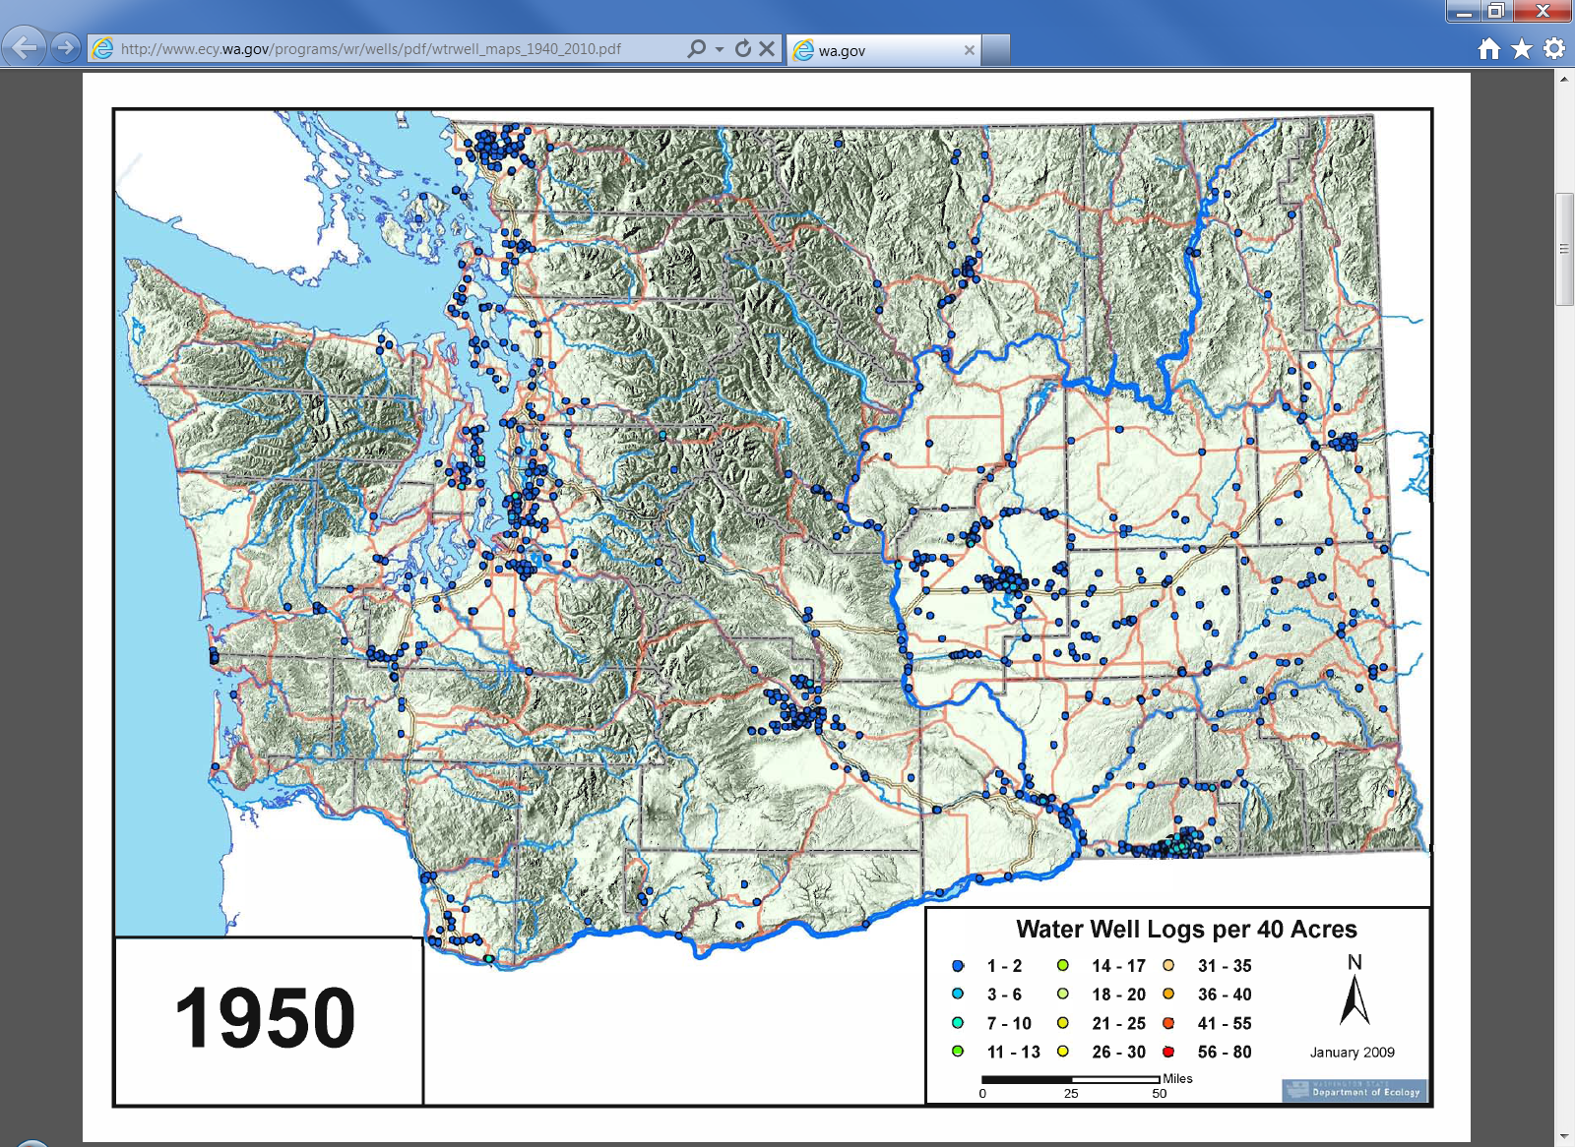
Notes:
Wells increased by the 1950s.

Slide 12
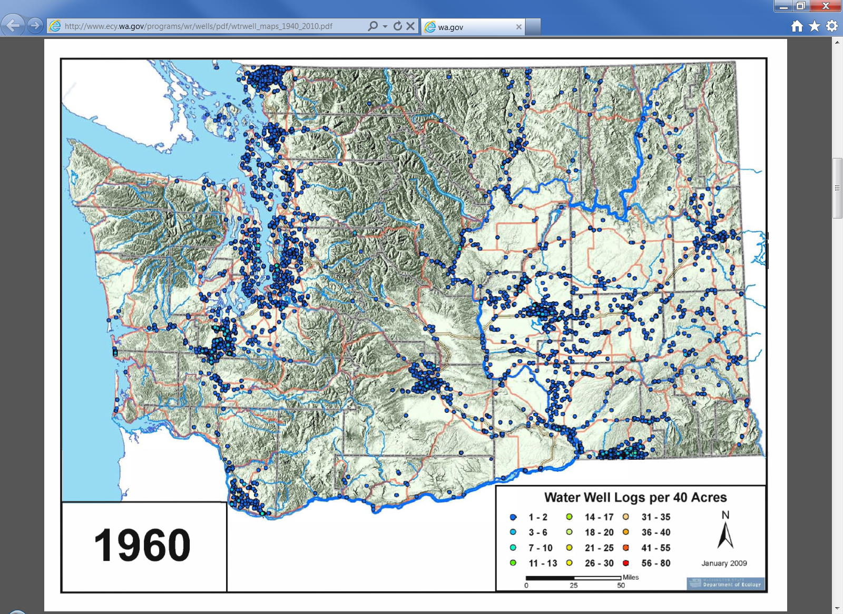
Notes:
Wells continue to increase into the 60s.

Slide 13
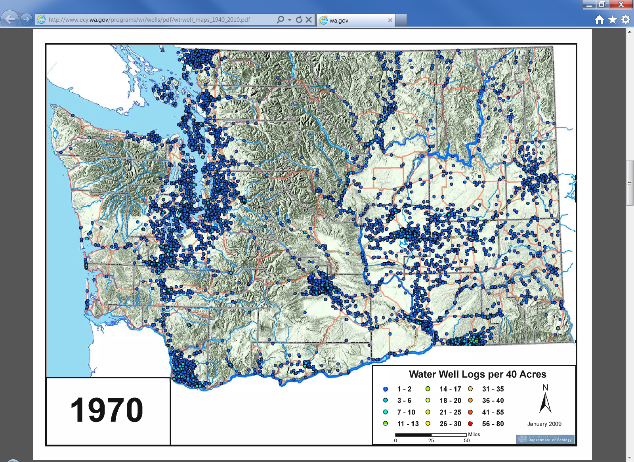
Notes:
And increase into the 70s.

Slide 14
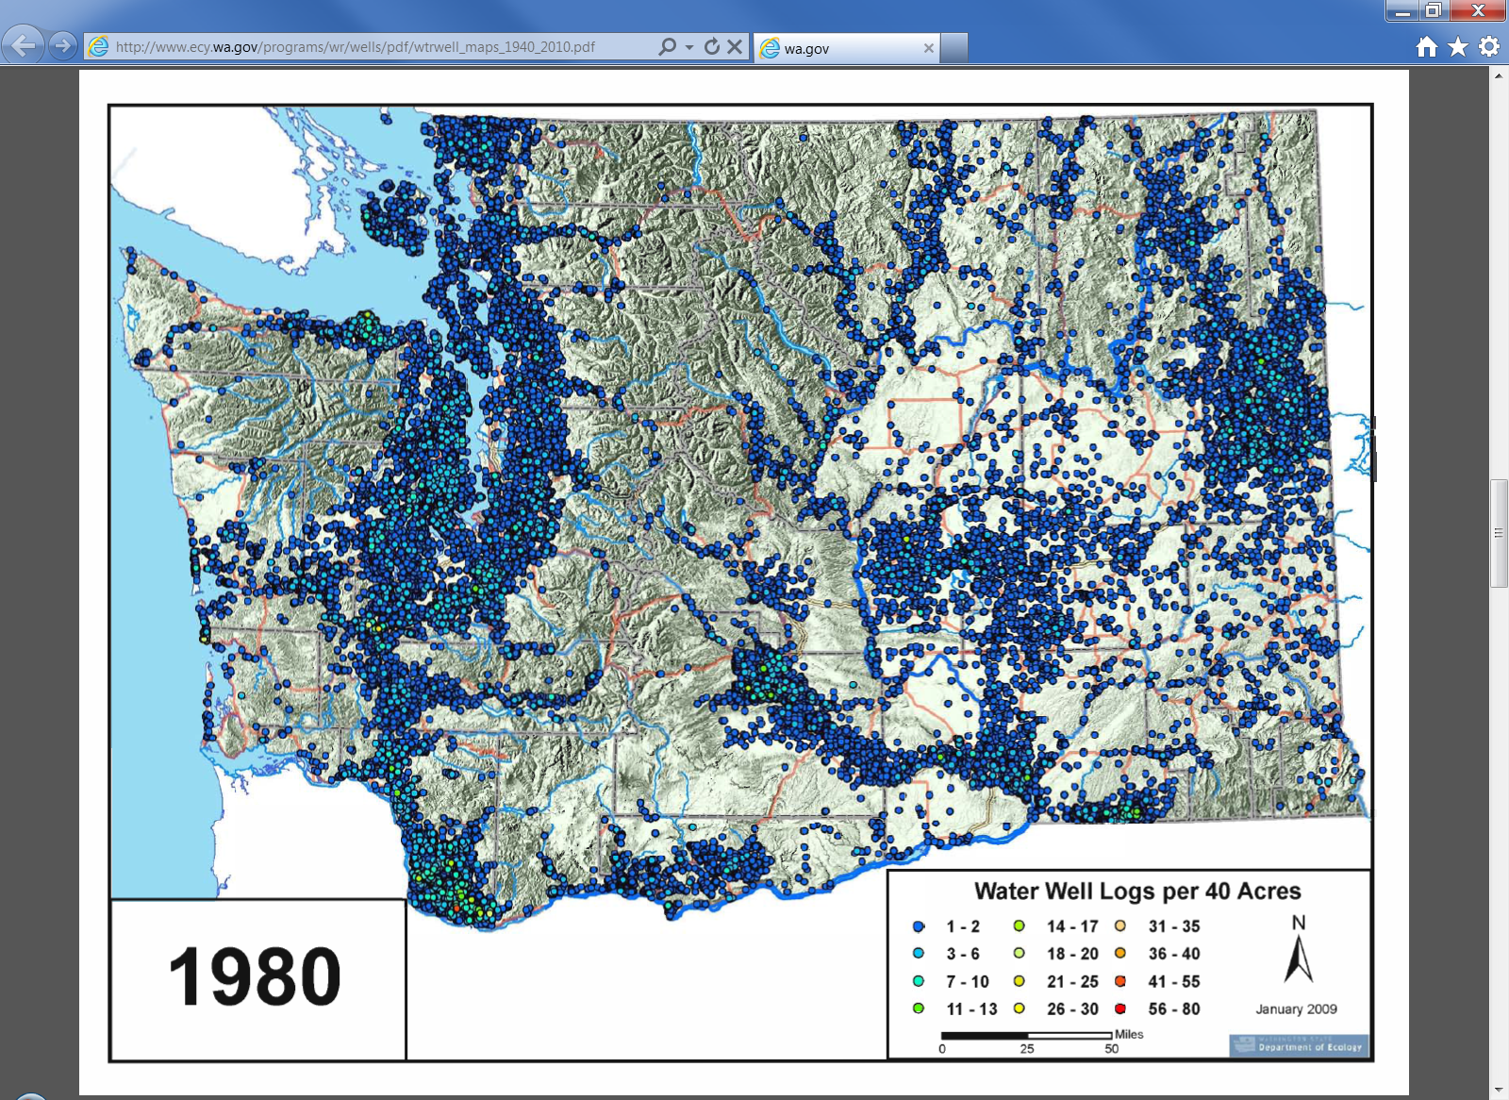
Notes:
And continue to increase significantly into the 80s.

Slide 15
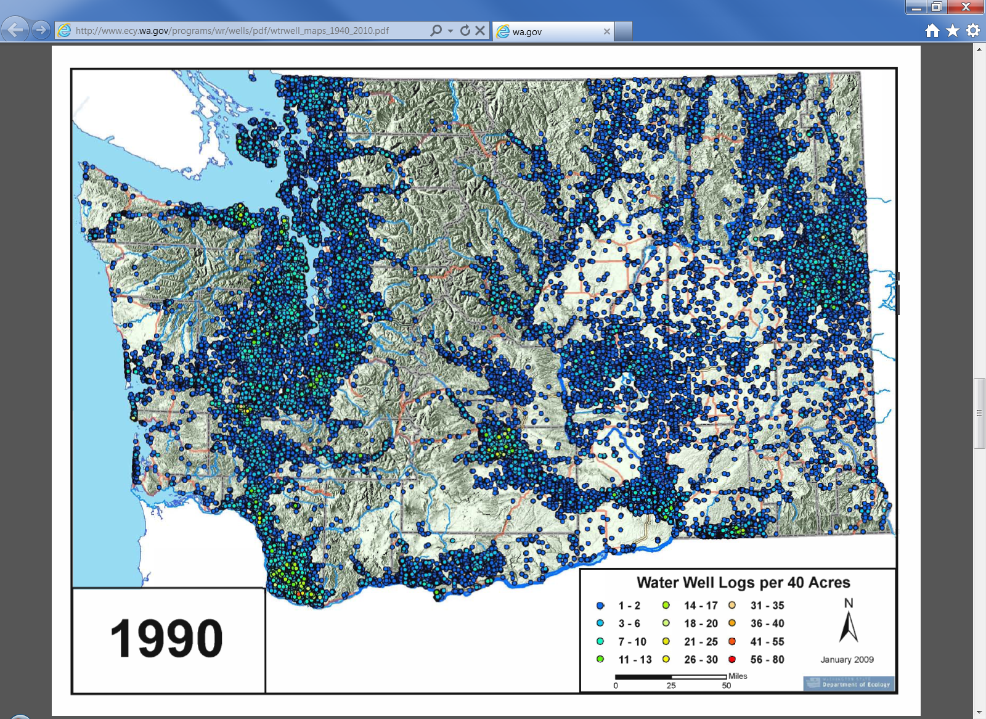
Notes:
And further increase in the 1990s.

Slide 16
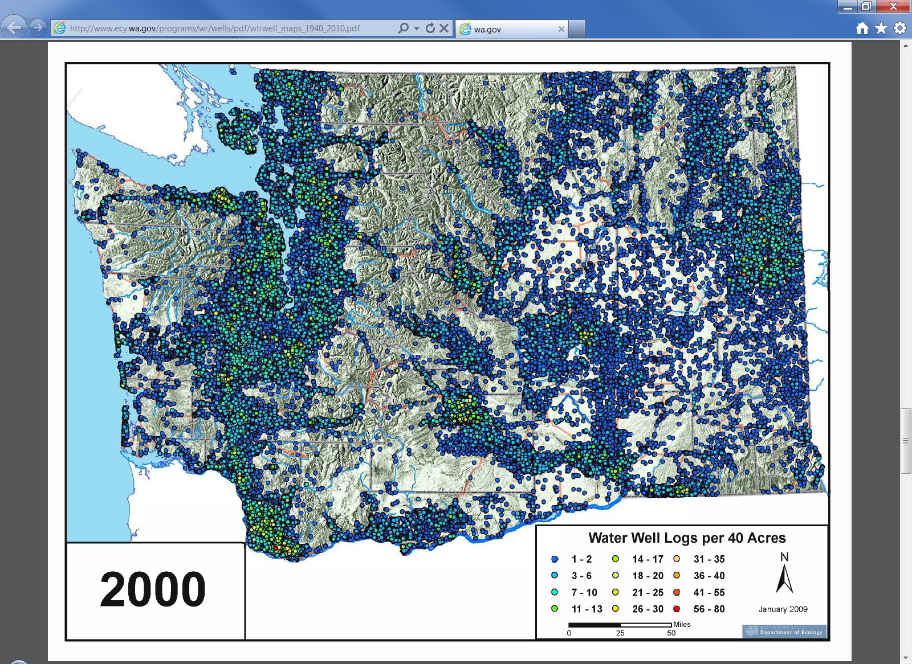
Notes:
And into the 2000s.

Slide 17
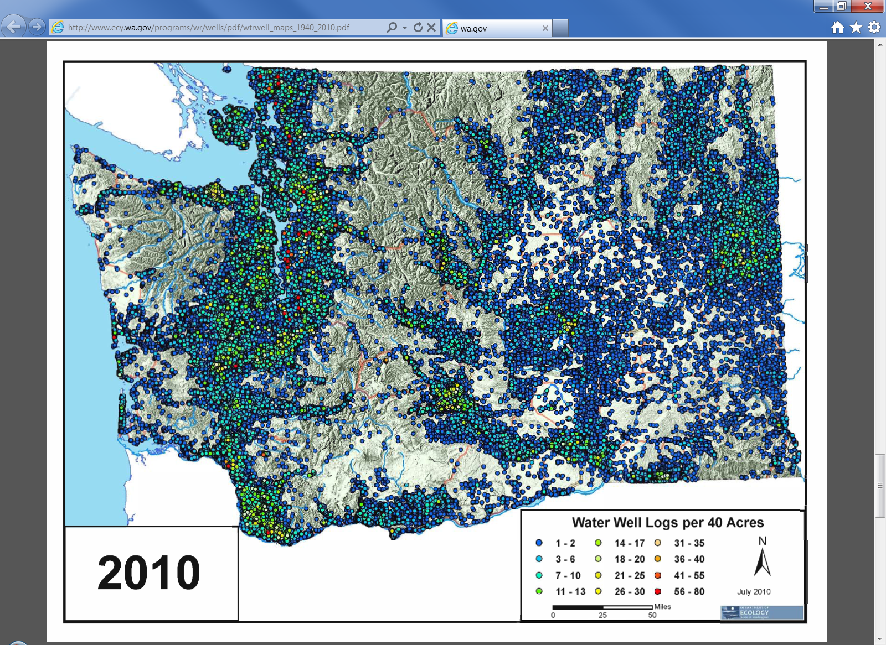
Notes:
This map shows the active water well logs per 40 acres in 2010.

Slide 18
Example of an aquifer being mined by over pumping
Groundwater pumping for irrigation uses exceeds annual recharge in the basin and has resulted in declining groundwater levels for more than 70 years.
Numerous, shallow, hand dug wells in the Walla Walla Gravel aquifer have gone dry over the decades.

Slide 19
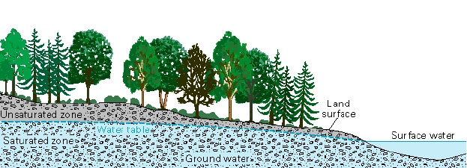
In addition to well interference issues, groundwater use can change the dynamics between an aquifer and its connected surface water body.
Groundwater flows from areas of recharge to it’s natural discharge area in a connected stream.

Slide 20
“Streams interact with ground water in three basic ways:
streams gain water from inflow of ground water through the streambed (gaining stream),
they lose water to ground water by outflow through the streambed (losing stream),
or they do both,
gaining in some reaches and losing in other reaches”
USGS Circular 1139, Winter et. al. 1998

Slide 21
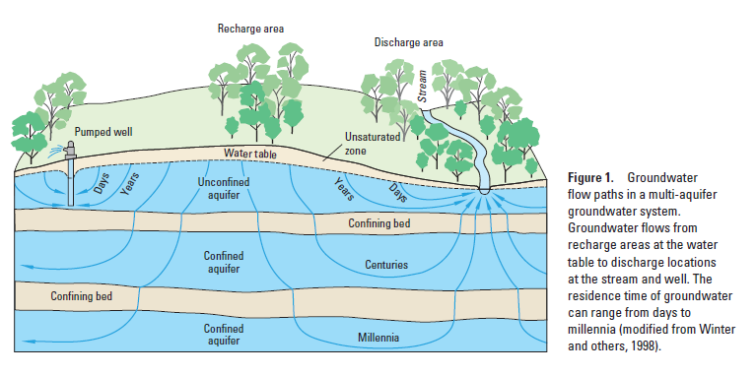

Slide 22
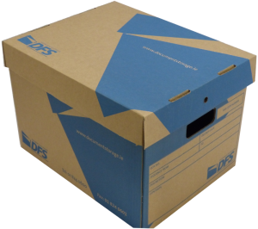

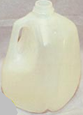
We measure streamflow in cubic feet per second (cfs). One cubic foot is the size of a standard archive box. It takes 7.5 gallons of water to fill one cubic foot.

Slide 23
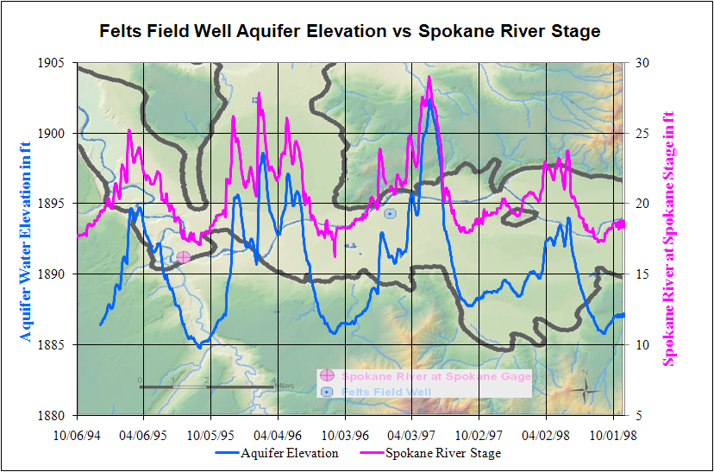
Notes:
This graph shows the relationship between the Walla Walla aquifer level and the Walla Walla river flow. There is a pretty clear relationship.

Slide 24
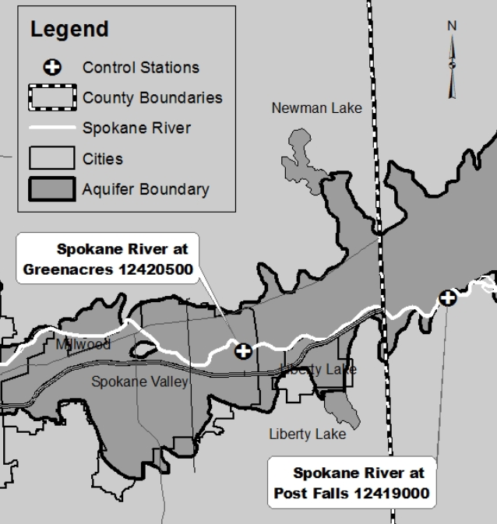
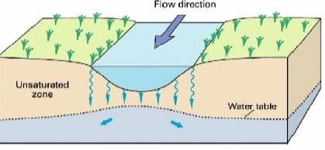
This portion of the Spokane River is an example of a losing river

Slide 25
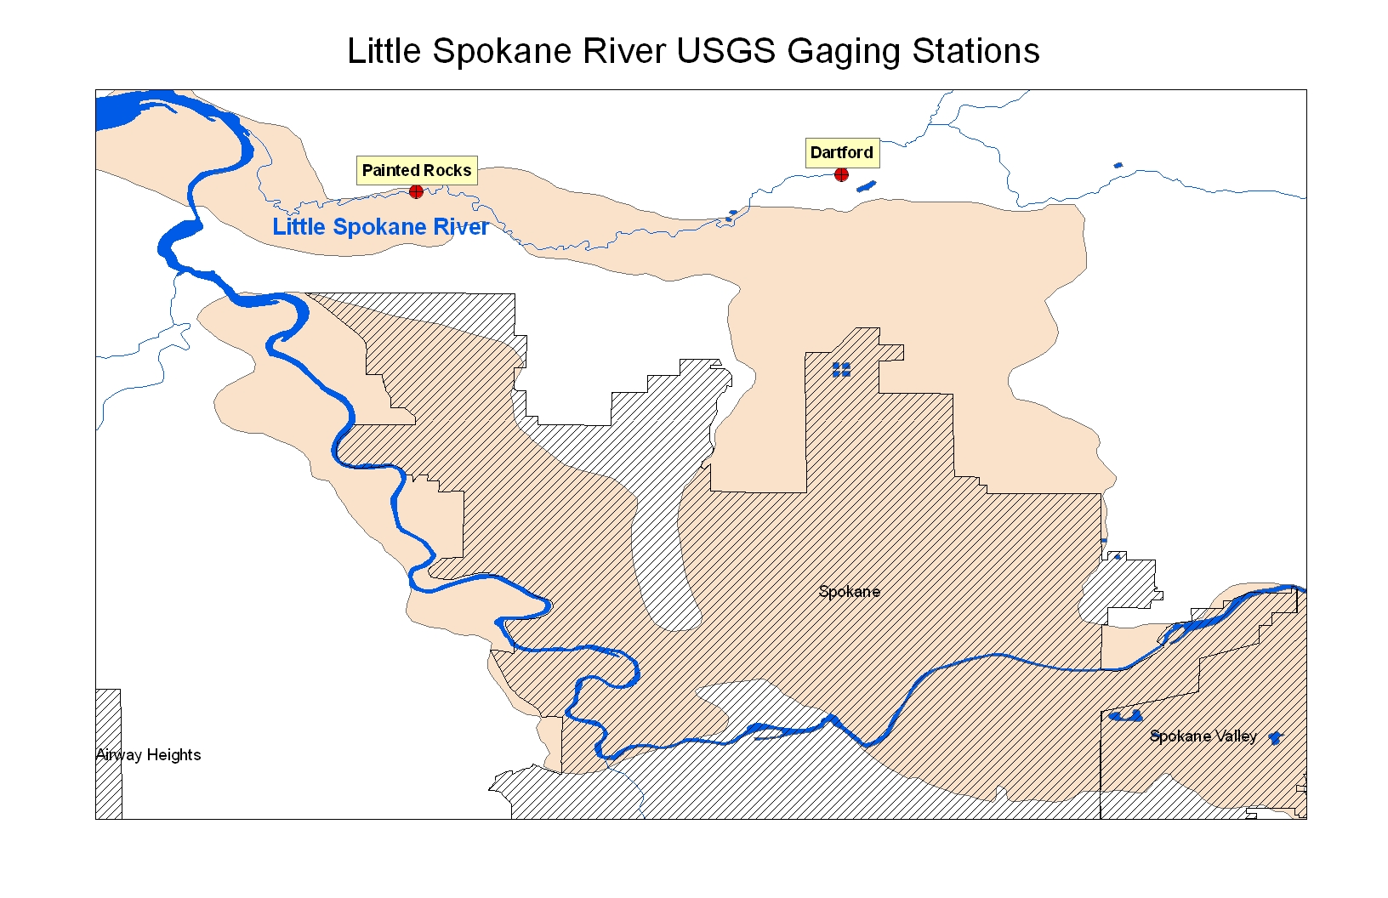
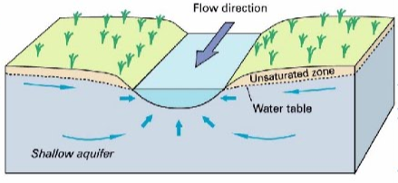
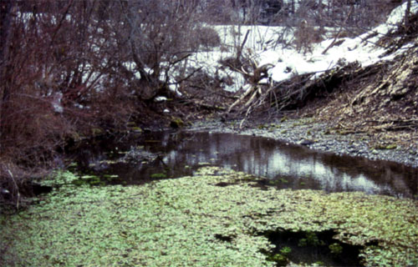
The Little Spokane River is an example of a gaining river
Griffith Spring

Slide 26
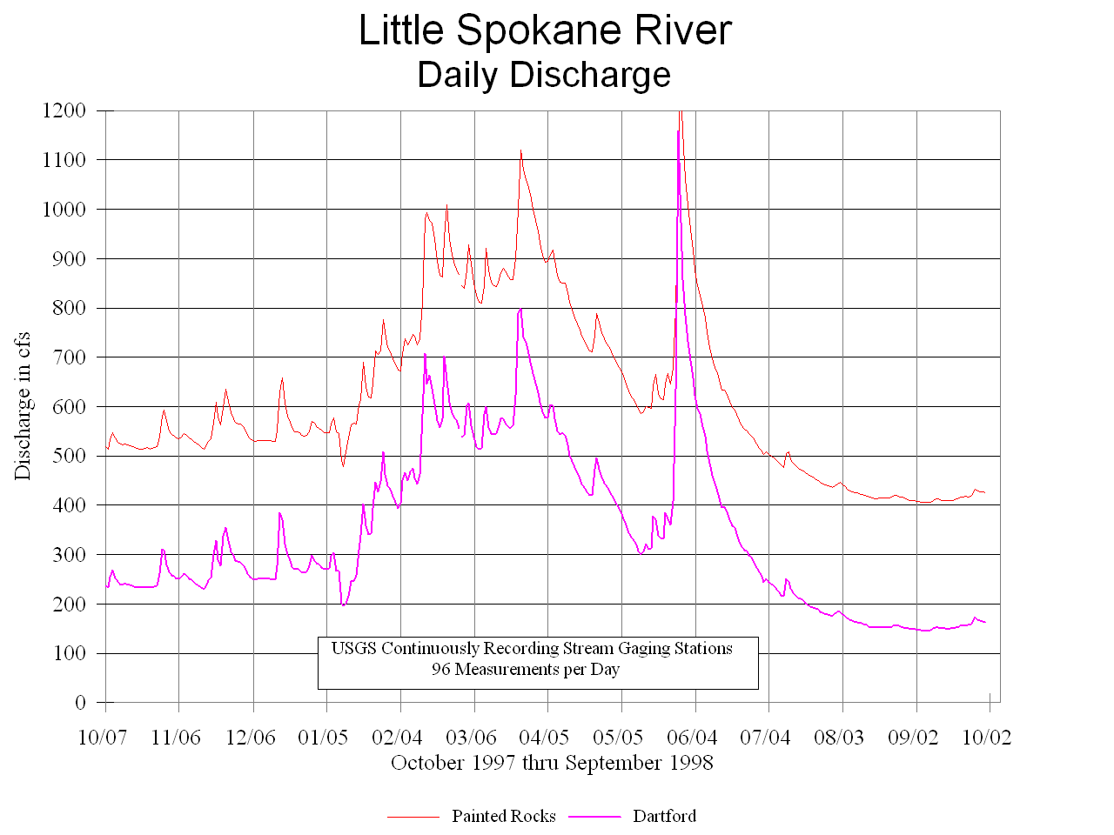
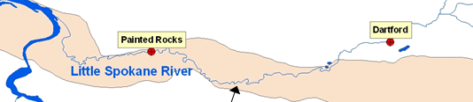
Spokane Aquifer discharges ~ 250 cfs to the Little Spokane River between Dartford and Painted Rocks

Slide 27
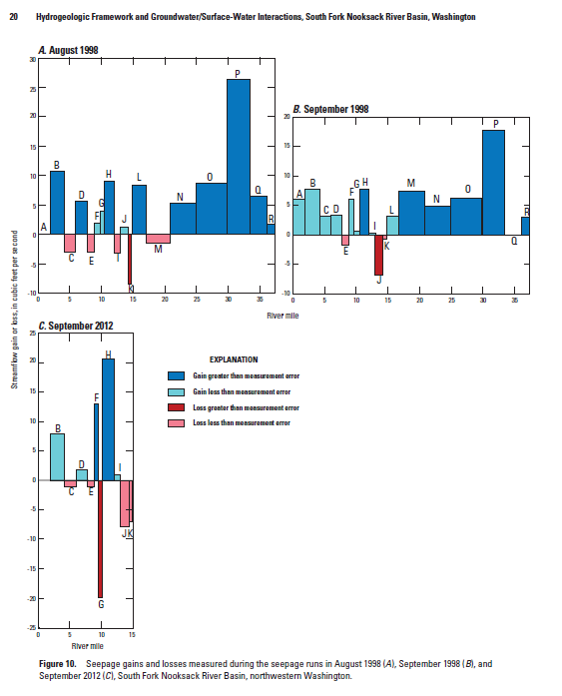
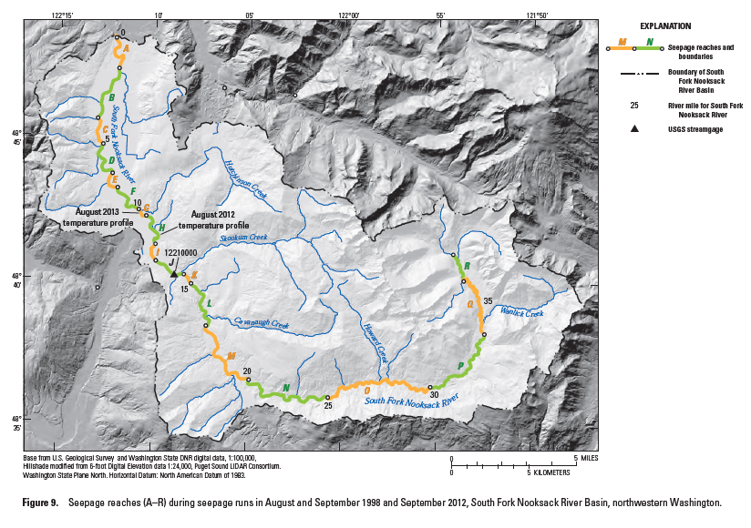

Gains and losses in flow can be within the measurement error of individual flow measurements making it harder to interpret.

Slide 28
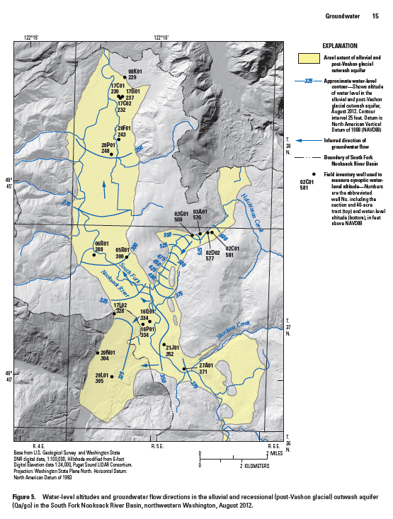
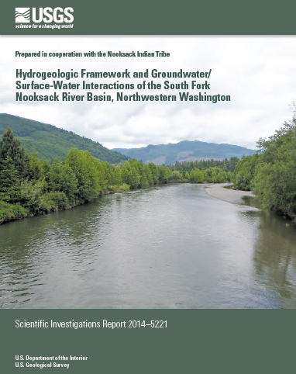
In valley aquifers, the groundwater flows parallel to streamflow for both the tributary and main stem valleys.

Slide 29
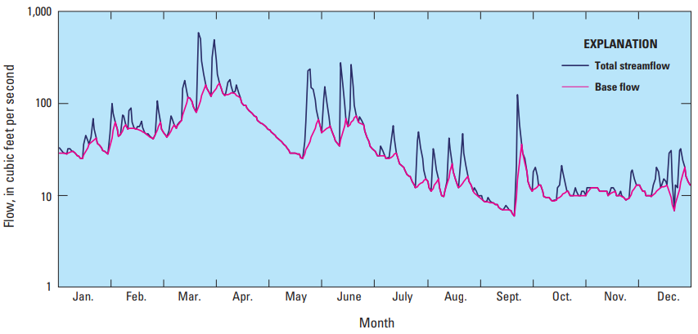
Given the interconnectedness of groundwater and surface water, it’s not surprising that a stream’s total flow is often comprised mostly of groundwater baseflow.
In WA state, groundwater baseflow contributes 68% of the total annual flow for 594 studied gages (WSB 60)
USGS’s 2012 Circular 1376

Slide 30
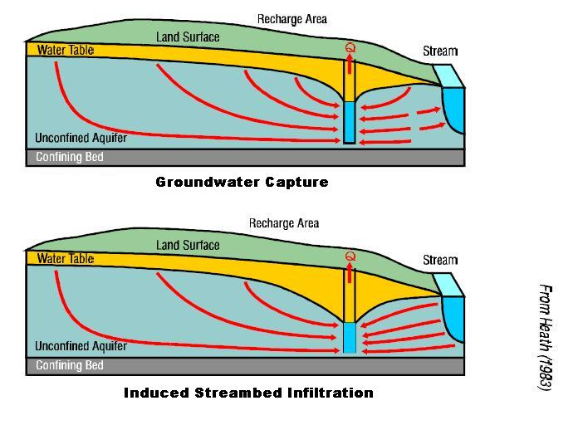
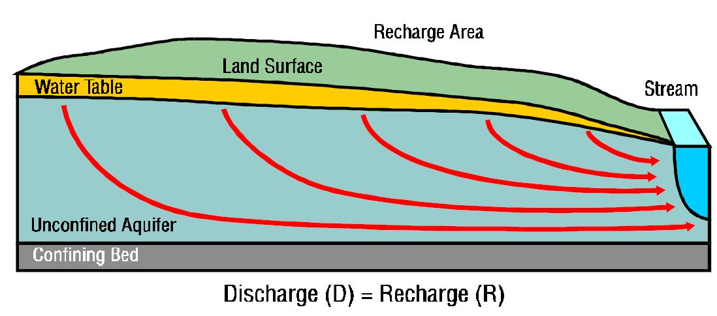
Groundwater pumping produces two separate components that contribute to total streamflow depletion:
The first component, groundwater capture, is the interception of groundwater flow tributary to the stream. This ultimately reduces the hydraulic gradient near the stream and baseflow to the stream. Streamflow depletion from groundwater capture usually continues after pumping ends and may require long periods of time to recover.
The second component, induced streambed infiltration, occurs when the pumping causes surface water to be pulled from the stream toward the well.

Slide 31
Groundwater declines have led to diminished discharge
Springs and seeps within the watershed that used to be fed by this aquifer have slowly dried up as the head in the aquifer declined.

Slide 32
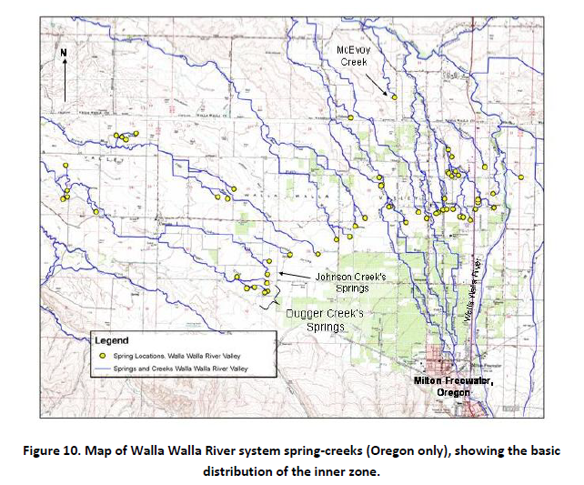
Notes:
These images show a system with many springs that have been significantly impacted by the increase in wells.

Slide 33
Groundwater and Surface Water are interconnected. Pumping aquifers affects streamflow (or Puget Sound).
As more wells get drilled in your watershed, they will have an impact on streamflow.
Let’s look at the Cedar-Sammamish River Basin Hydrology and Geology.

Slide 34
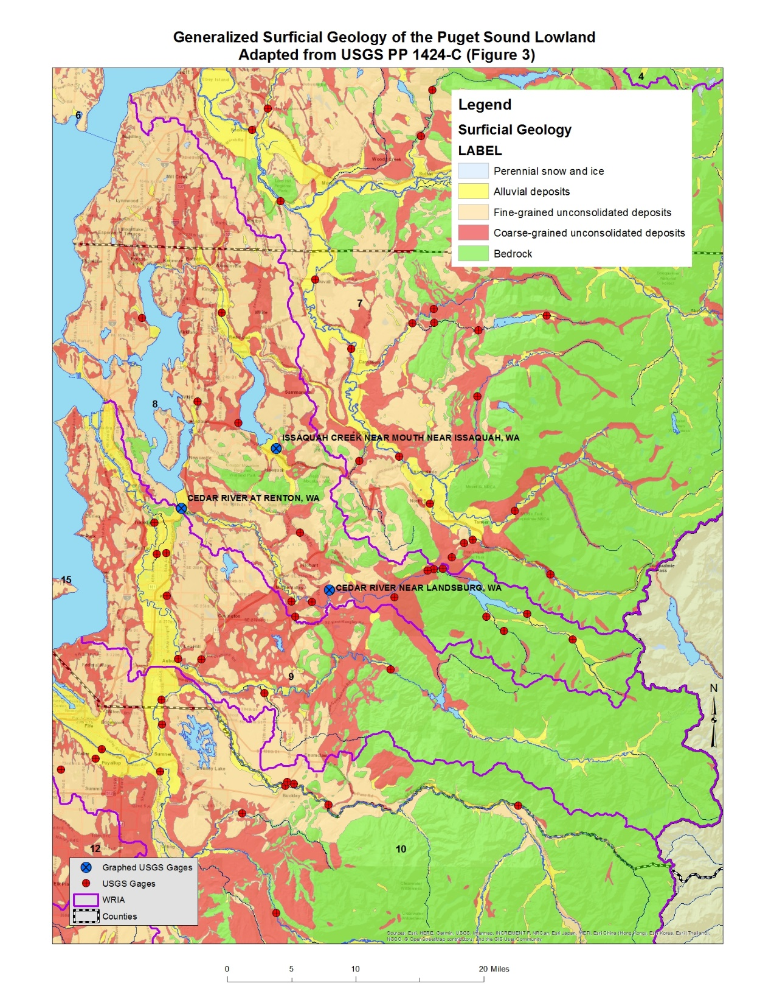
In WRIA 8, the USGS has measured streamflow at numerous sites over the years. We’re going to look at streamflow data from three of the gaging stations to get a sense of flow conditions within the WRIA over time:
  Cedar River at Renton;
  Issaquah Creek near Issaquah
  Cedar River near Landsburg;

Slide 37
Notes:
This graph shows the percent exceedance for the Cedar River at Renton, WA.

Slide 40
Notes:
This graph shows the percent exceedance for Issaquah Creek.

Slide 42
Notes:
This graph shows the percent exceedance for the Cedar River near Landsburg, WA.

Slide 43
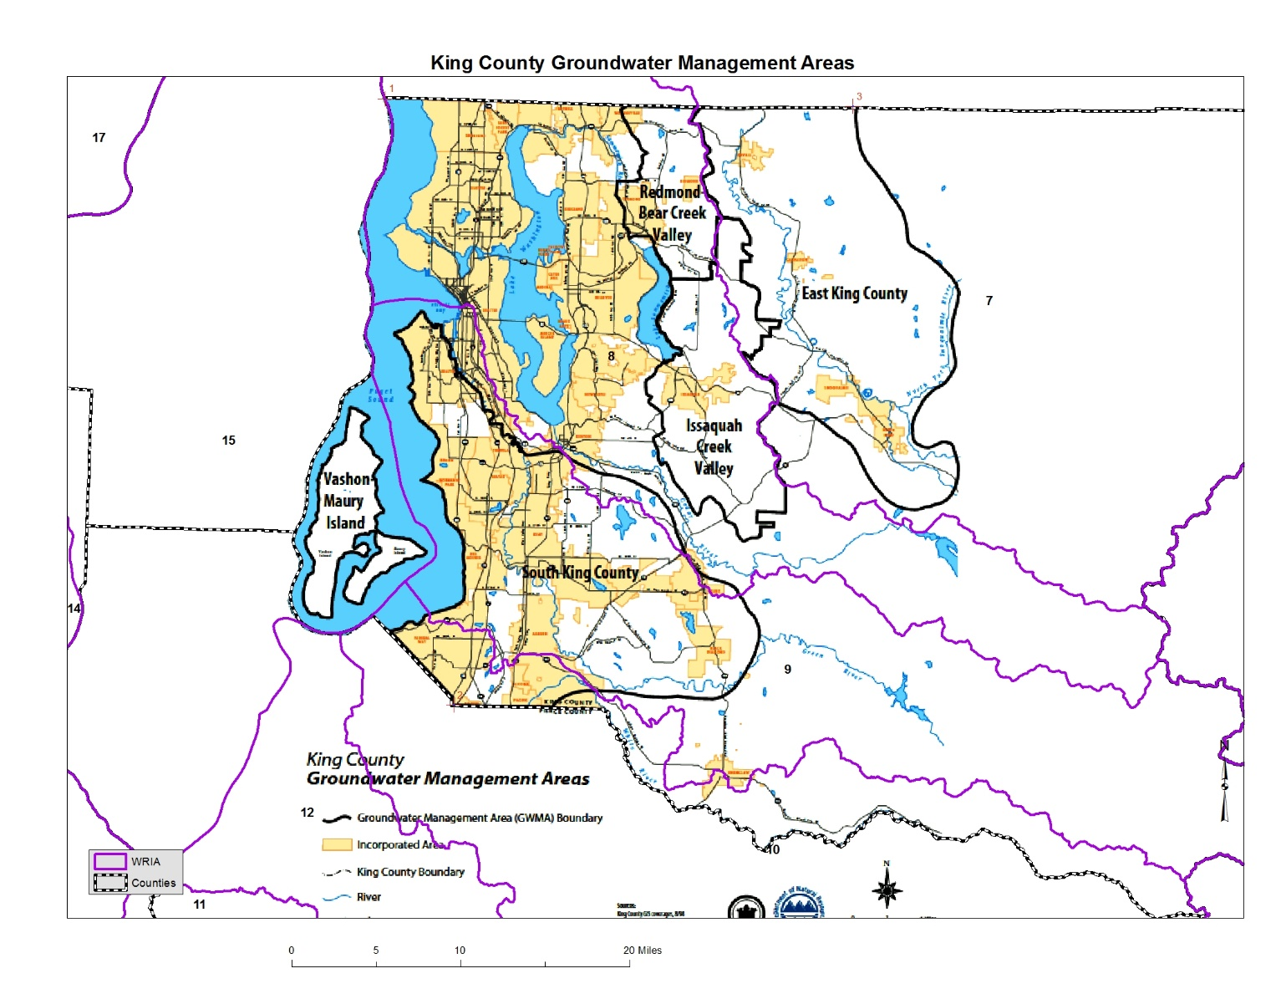
I’m hoping the County has long-term groundwater data from their Issaquah Creek Valley and Redmond Bear Creek Valley GWMAs that overlaps WRIA08.

Slide 44
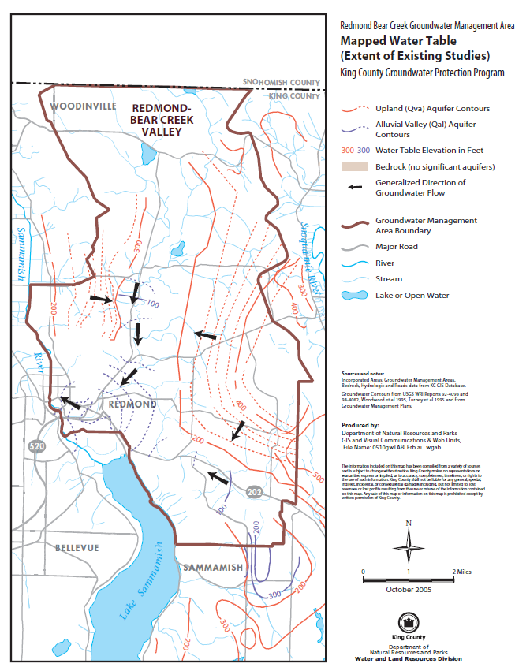
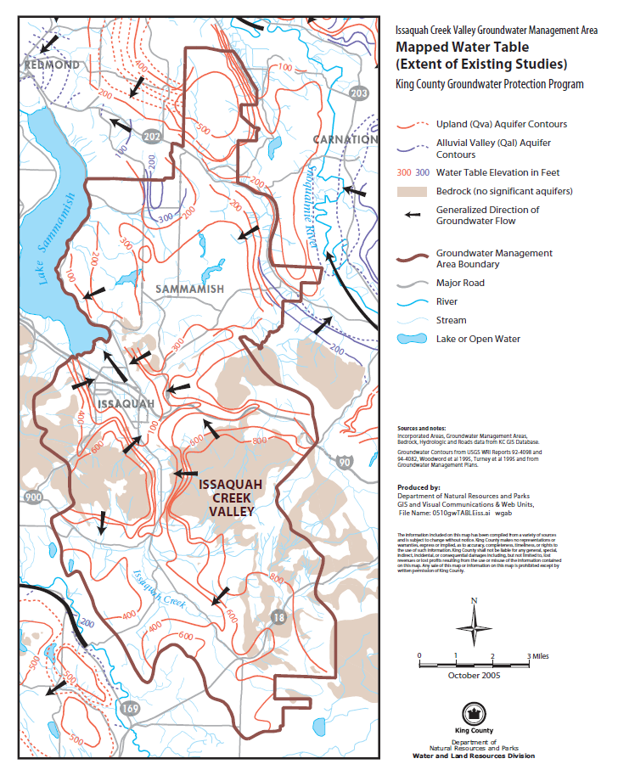
Notes:
These maps show the mapped water table for the Qva aquifer and Qal aquifer for the Redmond-Bear Creek Valley and Issaquah Creek Valley.

Slide 45
Notes:
This image shows the shaping of the Puget Sound basin as surrounded by the Olympic and Cascade Mountains.

Slide 46
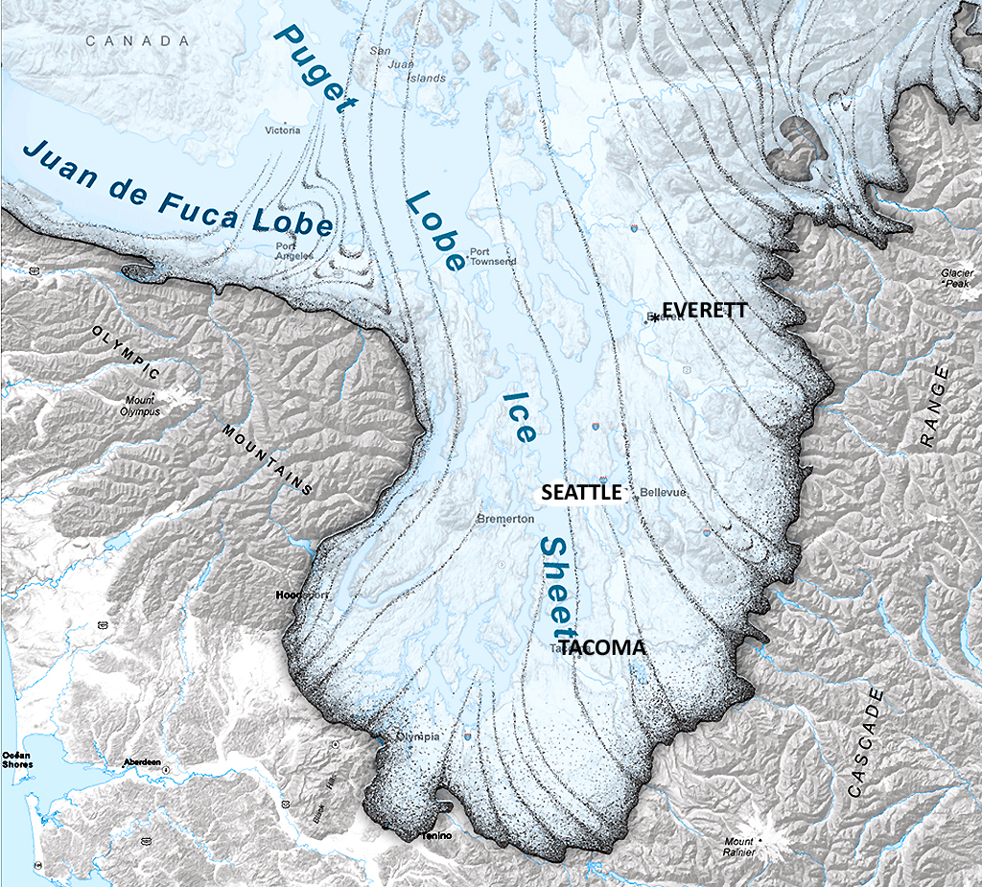
Vashon
Glaciation
lasted
about
19,000 to
16,000 BP
Washington Department of Natural Resources
Notes:
This image shows the extent of the Puget Lobe ice sheet extension into South Puget Sound.

Slide 47
Notes:
The thickness of the ice around the Puget Sound was the equivalent of 5 space needles tall.

Slide 48
Evidence for seven episodes of continental glaciation in the Puget Basin over the past 2 million years

Slide 49
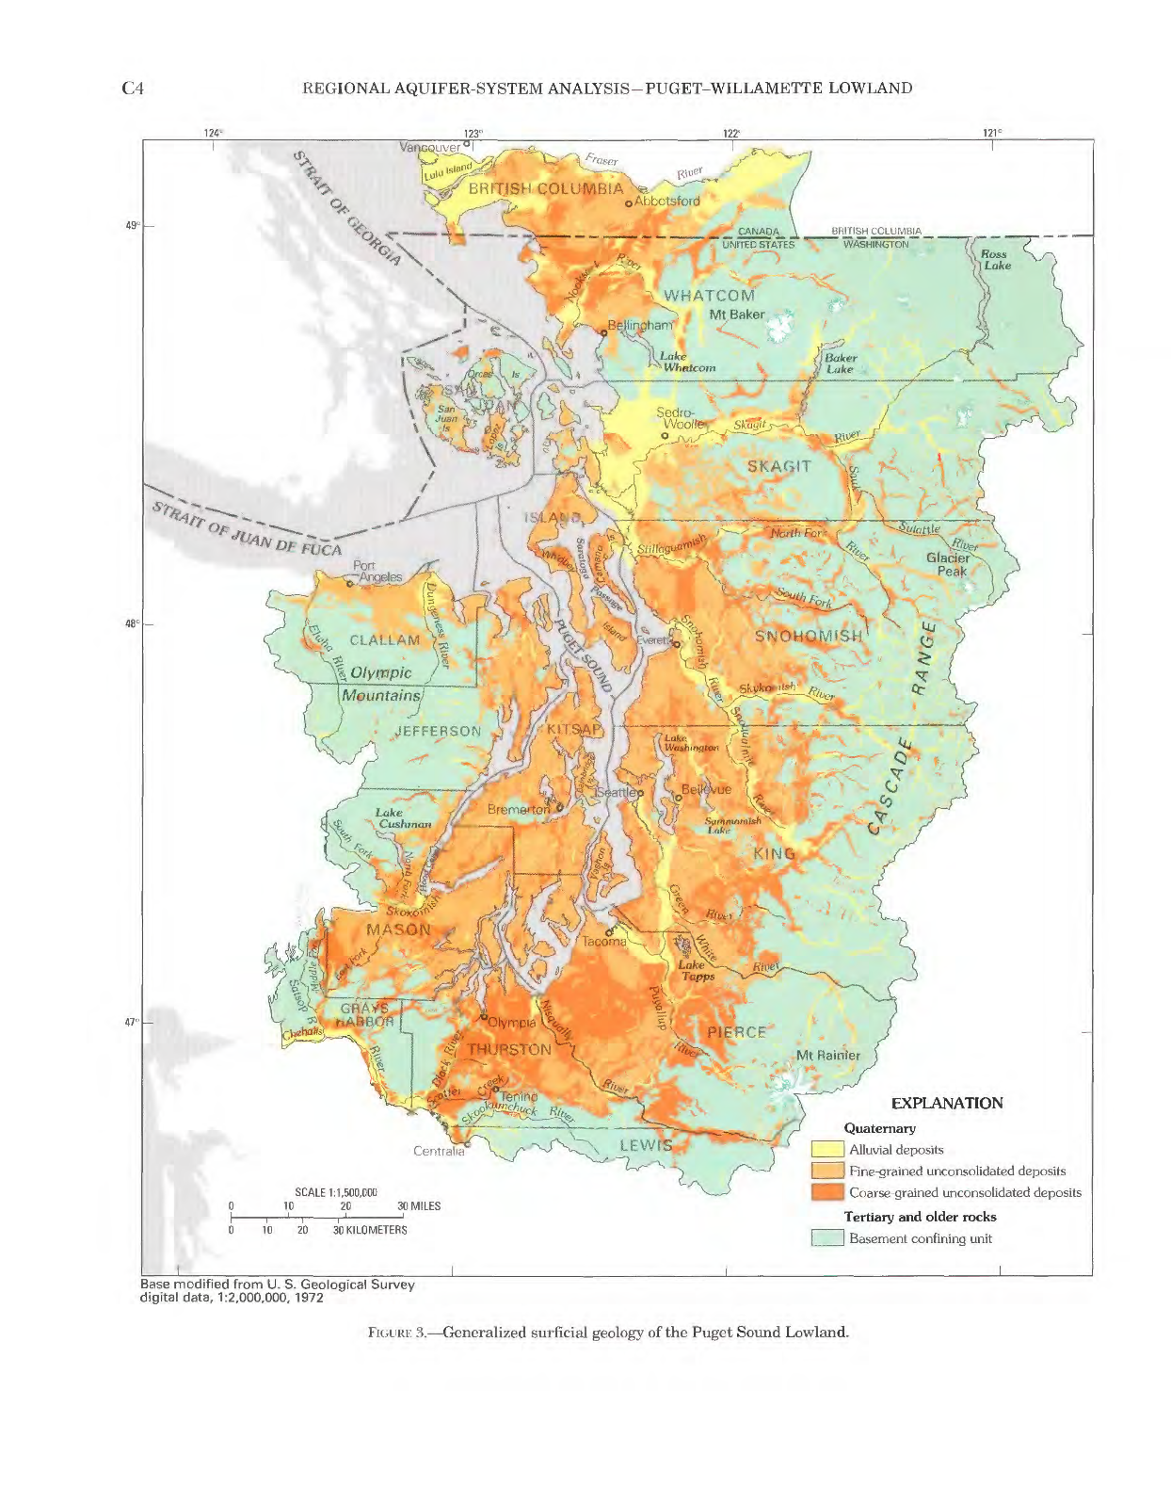
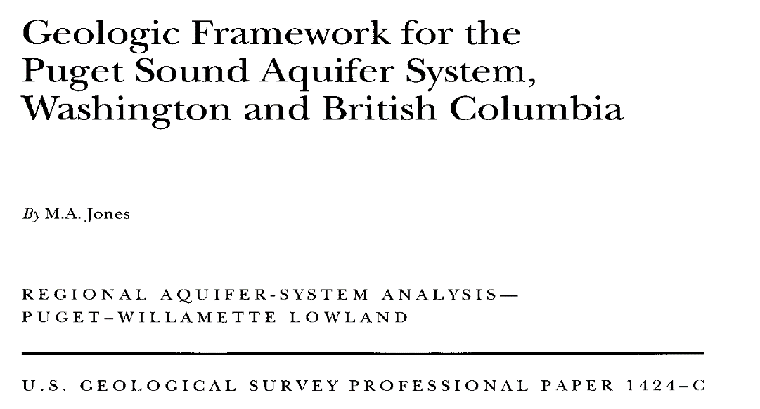
Notes:
The aquifers are complex with many layers.

Slide 50
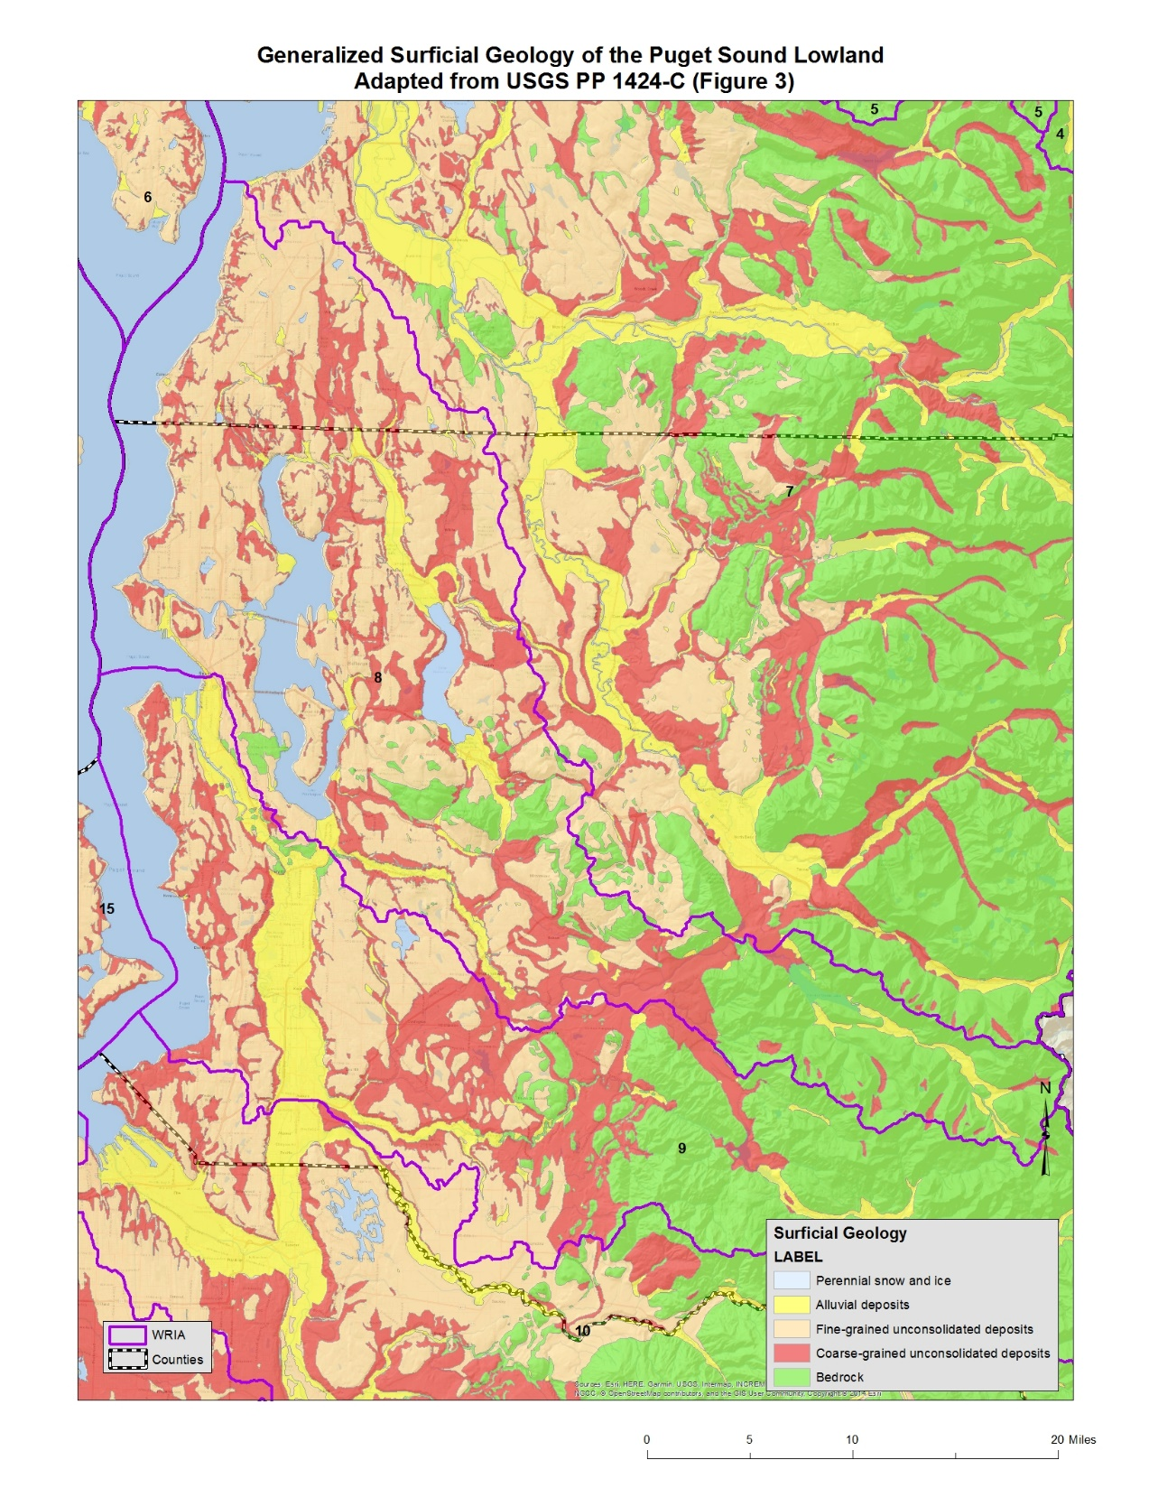
Notes:
For WRIA 8, we have mostly fine grained unconsolidated deposits with some alluvial deposits and coarse grained unconsolidated deposits in the eastern part of the watershed and bedrock in the upper watershed.

Slide 51
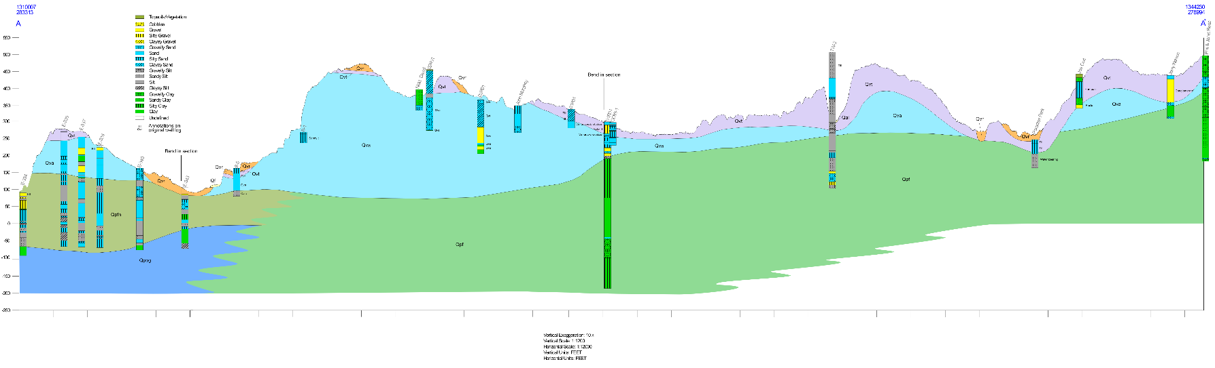
Subsurface detail is, of course, more complex (as seen in this King County cross section thru Redmond Bear Creek than just surficial mapping.

Slide 52

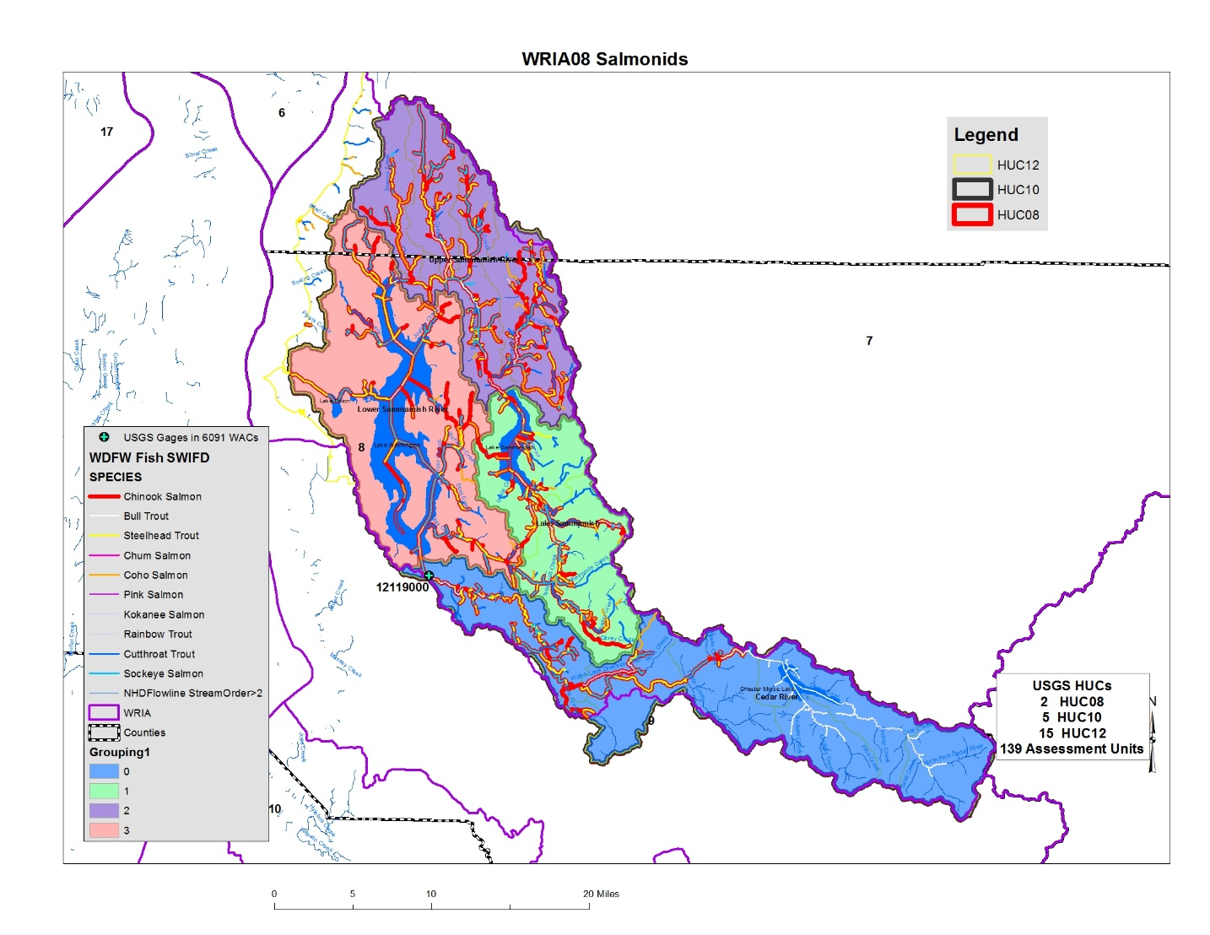

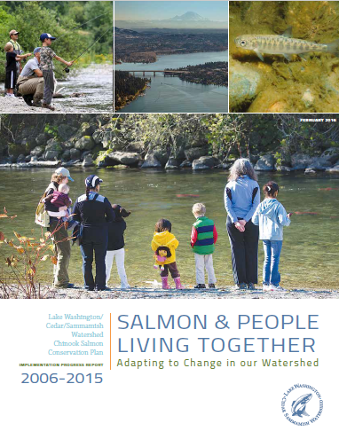
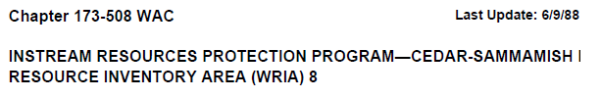


Notes:
Fish are an important resource in the Cedar-Sammamish basin and we have instream flows to protect fish and other aquatic resources.

Slide 53
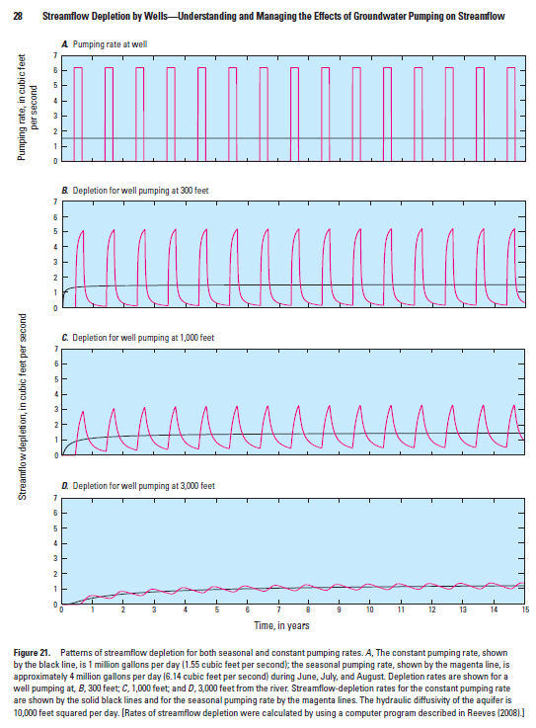
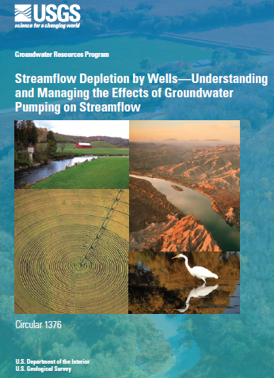


Seasonally Pumping Groundwater can have Year-round impacts on streams.
Seasonally augmenting aquifers can provide Year-round benefits for streams.

Slide 54
Growth is going to occur in your Watershed. People are going to move here and some of them will drill new wells for their new homes. Those new water uses will negatively affect connected surface water bodies.
The agency adopted an Instream Flow Rule for your WRIA back in 1979 and last Updated in 1988. Streams in the WRIA have Instream Flows and Closures. Groundwater pumping will impair surface water bodies.
RCW 90.94 allows new domestic exempt wells to be drilled even though we know these new uses will impair instream flows. The statute tells us to offset the new consumptive uses and make additional improvements to the landscape to achieve a net ecological benefit.
Partition the WRIA into subbasins
Determine how many new wells will be drilled for new rural homes over the next 20 years.
Figure out how much consumptive water use those new wells will need.
Identify a group of projects that can offset the new, consumptive, uses anticipated (retire existing water rights, build storage projects [ponds or aquifer storage projects], move surface water uses to groundwater wells, move shallow wells to deeper aquifers, etc.).
Identify additional, habitat improvement projects to help restore streams.

Slide 55

Thank You!
John Covert
Washington Department of Ecology
john.covert@ecy.wa.gov

