Slide 1

An Introduction to
Instream Flows
Science, Policy, and Perspective
Jim Pacheco
Washington State Department of Ecology
(360) 407-7458
James.Pacheco@ecy.wa.gov
WRIA 8 Watershed Restoration and Enhancement Committee
January 24 2019
Videos by Manu Esteve 2000
Notes:
I’ve been working on ISF science and policy since I started with Ecology in 2002.
Through the years I’ve conducted numerous ISF studies, have helped many watershed groups develop the instream flow component of their watershed and detailed implementation plans, and developed the scientific rationale for instream flow rules.
Currently I am the senior ISF biologist for Water Resources and the lead ISF modeler for the State.
Because much of my work involves technical discussions and negotiations with a lay audience,
I’ve found trust to be critically important.
To develop and maintain this trust,

Slide 2
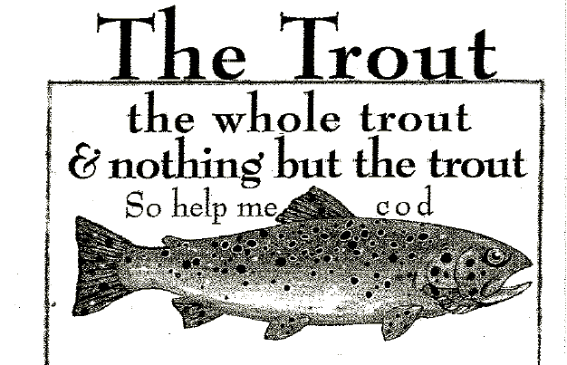
Notes:
I rely on the simple principal of speaking the trout,
the whole trout, and nothing but the trout.

Slide 3
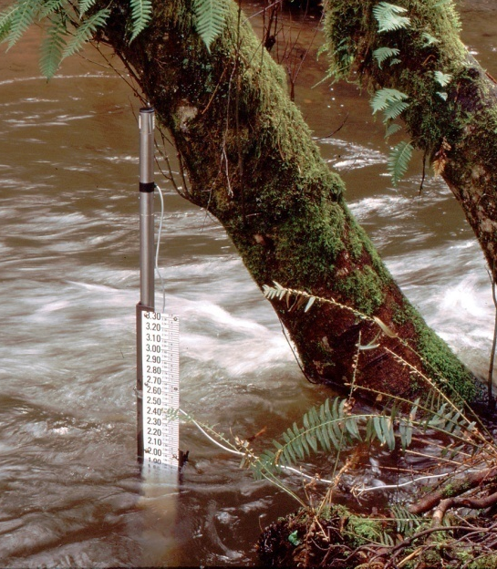
What is an Instream Flow?
An instream flow (ISF) is a water right for the stream.
It has a priority date
  Water rights senior to the instream flow are unaffected but junior water rights can be regulated
It is not required to be met.
  Water rights e a right to use when available, not a guarantee that water will be available.
ISFs do not and cannot add more water to a stream
Notes:
One of the tools used to manage the water is an instream flow.
Which is a very confusing term and is often misused, even by WR. For example, there is a huge difference between stream flow and ISF.
Stream flow is the volume of water in the stream at any moment
An instream flow is a water right for the stream
Like other water rights, it has a priority date, is based on beneficial use, and follows the seniority system set up in water law
This means that water rights senior to the instream flow are not affected, but water rights junior to the ISF can be regulated
Like other water rights, an ISF is not required to be met.
Water rights are a right to use when its available, not a guarantee that water will be available.
ISFs do not and cannot add more water to a stream.

Slide 4
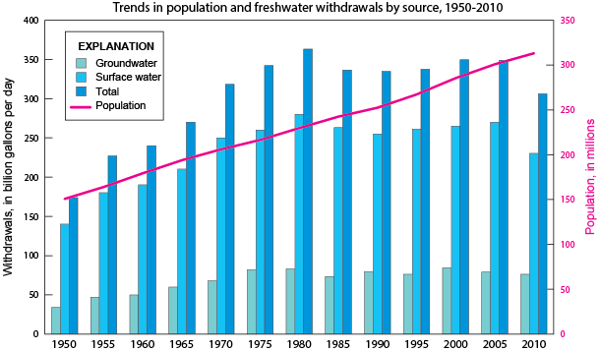

Why we need Instream Flows
Our thirst for water is often greater than nature’s ability to provide it, especially in the summer.
Lower stream flows contribute to a number of environmental concerns
Source USGS: Trends, 1950-2010
Notes:
Washington’s ISF laws originated in 1969 and 1971, but concept of Instream Flows dates back at least 1949 where the Fisheries Code stated: (Chapter III, sec 46)
That a flow of water sufficient to support game fish and food fish populations be maintained at all times in the streams of this state.
But it took decades of increasing water withdrawals and lower stream flows for us to recognize and take action on one simple truth:
That our thirst for water is often greater than nature’s ability to provide it, especially in the summer.
For example, if that if we irrigated all the available acreage in central and eastern Washington, Idaho, and Montana, we could dry up the Columbia.
These lower stream flows contributed to a number of environmental concerns, including reduced fish populations.

Slide 5
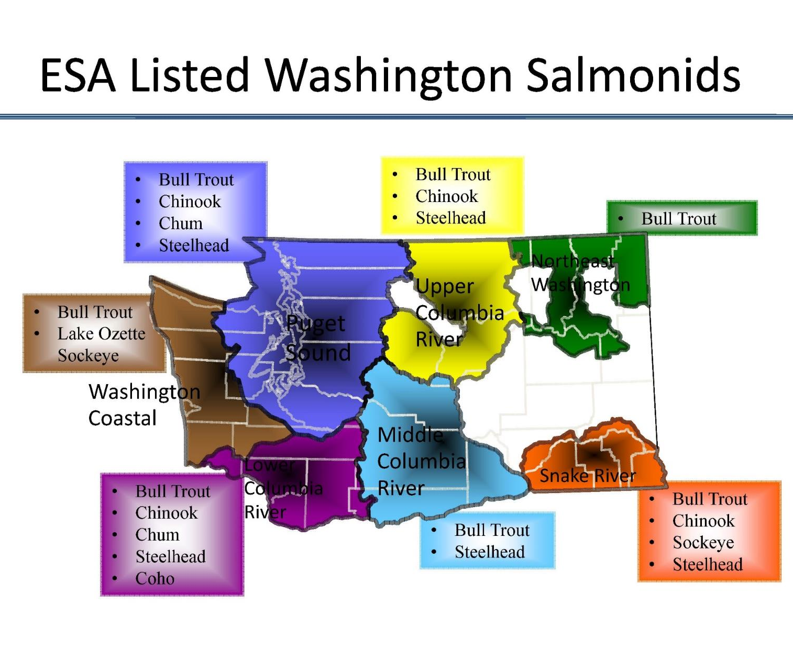
Why we need Instream Flows
About 75% of the state has at least one endangered or threatened salmon or trout species.
Low streamflows are just one of the reasons for this decline.
In the early 1970’s, Ecology started developing Instream Flow rules.
Notes:
It’s a sad fact, but around 75% of the state has at least one endangered or threatened salmonid.
There are many factors contributing to this decline, commonly grouped into the four H’s; Habitat, Hatcheries, Harvest, and Hydro.
Low streamflows are just one of the habitat factors.
Because of these many factors, It’s taking a comprehensive approach to address this decline.
In the early 70’s Ecology began developing ISF rules to address the low flow factor and to protect and preserve instream resources.
What are Instream Resources? These are the are the animals, activities and social values that benefit from having enough water in the stream.
These include:

Slide 6
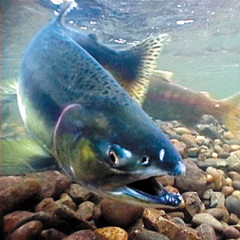
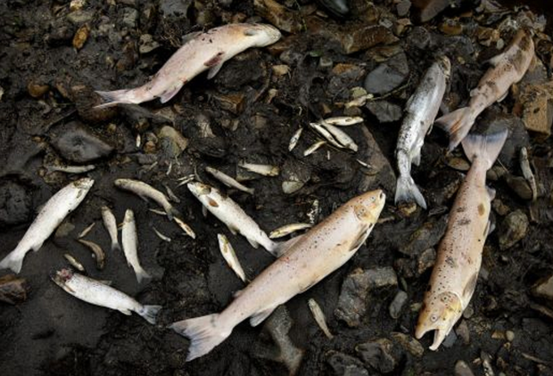
Instream Resources:
Fish & Wildlife
Notes:
Fish and wildlife: It’s sad to say, but we have had to point out that fish do indeed need water and that dry streams or increasing the dry period in intermittent streams does not protect the resource. <CR>
Boating, Fishing, and other recreational activities : I don’t think dragging a kayak through the shallows is the experience most boaters are looking for <CR>.
Scenic or Aesthetic values, These are pictures of Shoshone Falls in Idaho and for many years, it was dry during the summer as all the water was diverted for power generation.
Now it has a 300 cfs instream flow;
During daylight hours;
Between April 1 and Labor Day.
I know it sounds funny, but it protects and preserves aesthetic qualities when people are most likely to see it.
Other instream resources include Water Quality and Navigation. <CR>

Slide 7
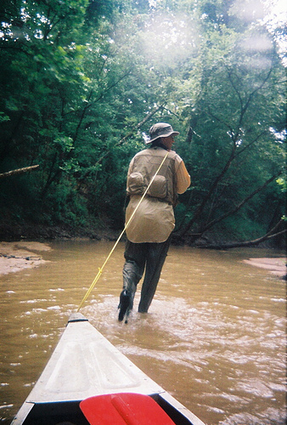
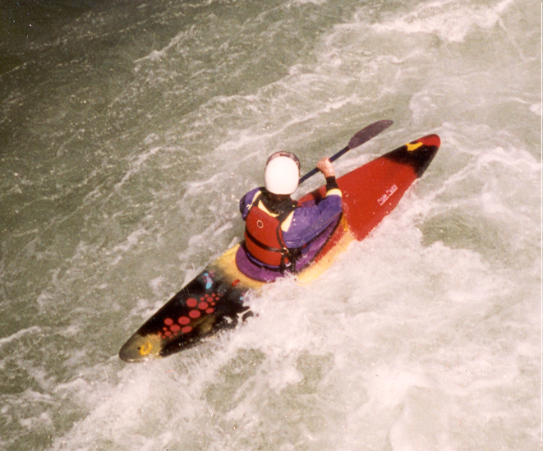
Instream Resources: Recreation such as Boating and Fishing
Notes:
Recreation: Boating and Fishing

Slide 8
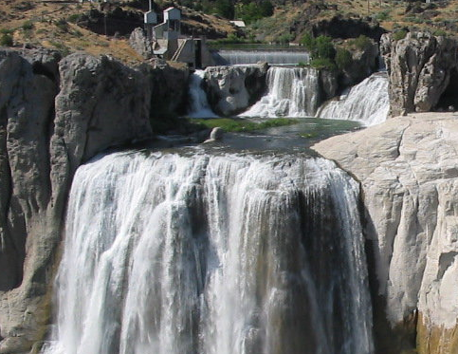
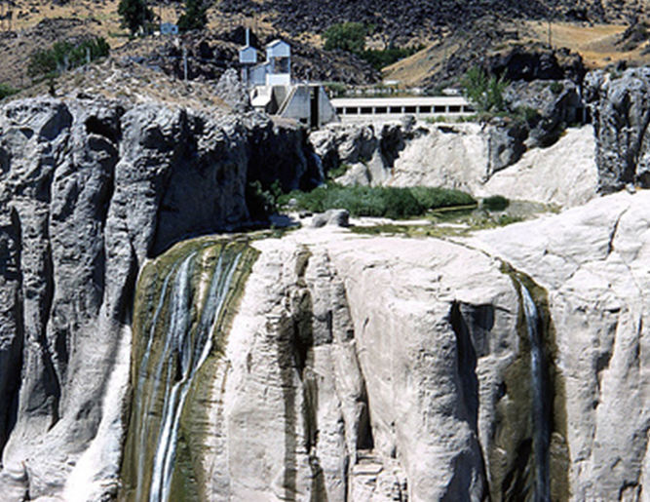
Instream Resources: Scenic or Aesthetic Values
Notes:
Scenic or Aesthetic Values

Slide 9
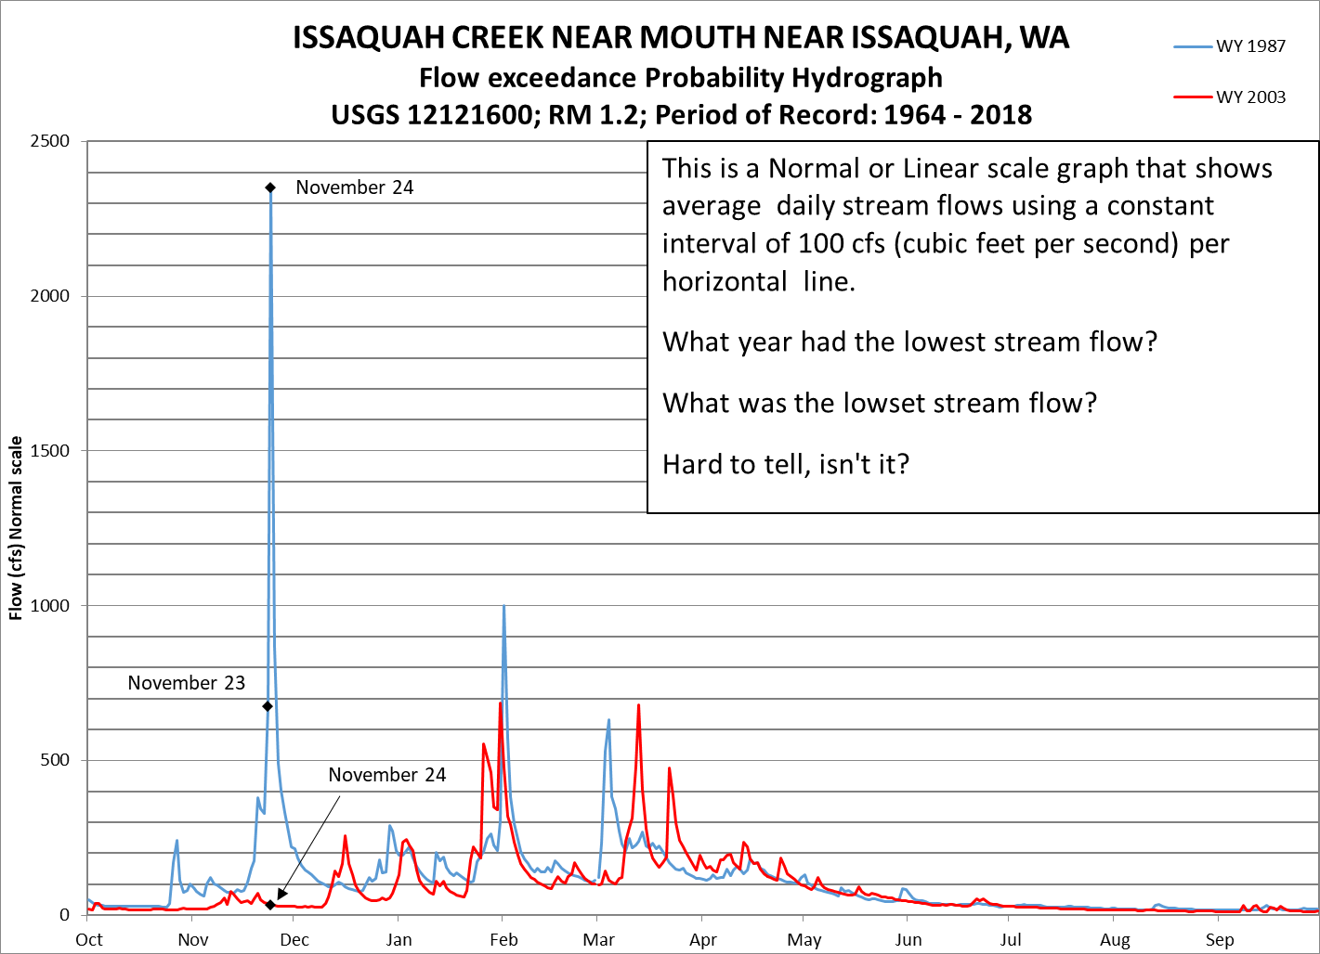
Hydrology 101
Streamflows Vary
Daily
Yearly
Seasonally
Notes:
To help understand instream flows, we should have an understanding of stream hydrology and streamflow statistics.
Here is a hydrograph showing two different years of daily stream flow data on Issaquah Creek.
This graph uses a normal or linear scale graph where each gridline represents the same interval, in this case the vertical interval is 100 cfs or cubic feet per second, a measurement of volume/time
As you can see, streamflows vary…a lot.
They vary daily: In 1987, the November 23 streamflow was 672 cfs. On November 24 the streamflow was 2375 cfs, that’s a 1600 cfs increase in one day.
They vary yearly: In 1987, the November 24 the streamflow was 2375 cfs. In 2003 on the same day, flows were only 32 cfs.
And they vary seasonally: This system has wet winters and dry summers
With linear graphs it’s easy to see the large difference between stream flows, but what about low flows. Can anyone tell me the lowest flow year and volume?
Hard to tell isn’t it?

Slide 10
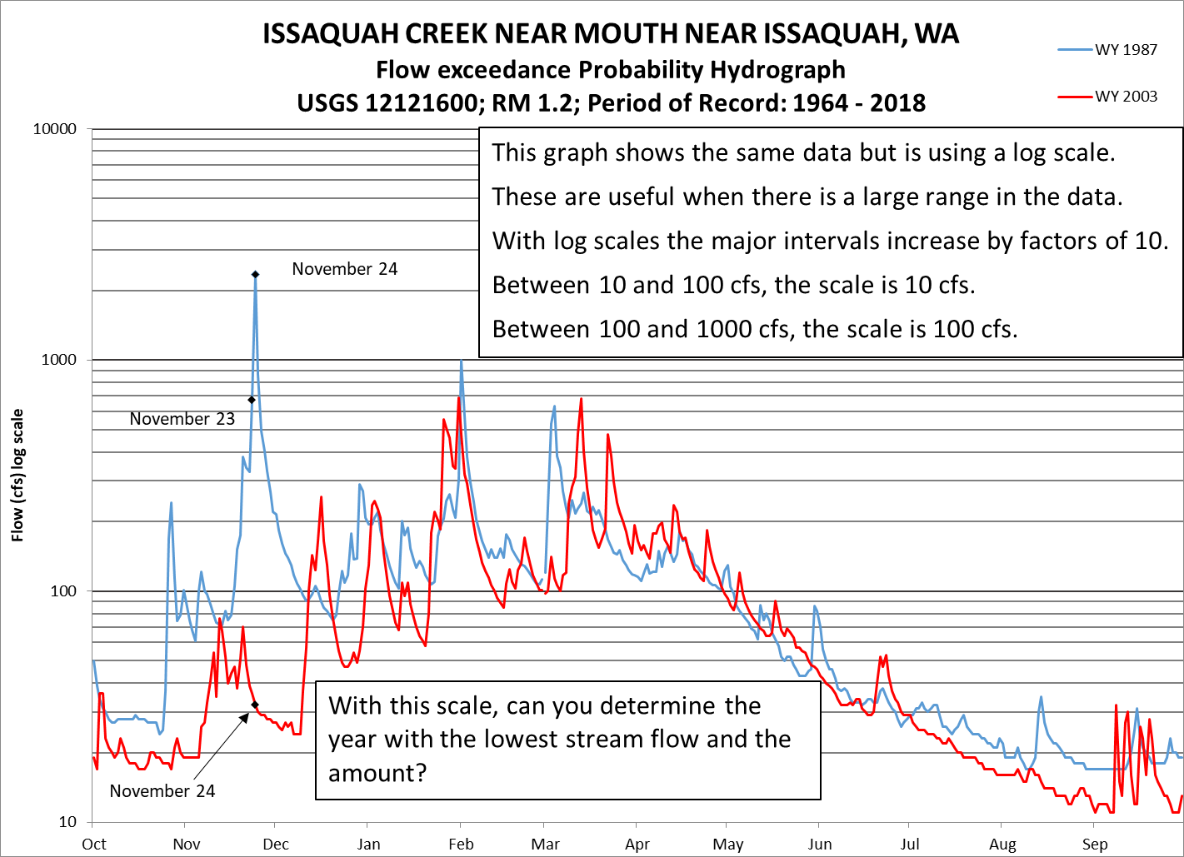
Hydrology 101
Logarithmic Scale
This is the same data shown in a different way
Log scales are used to show data with widely ranging values
Notes:
This hydrograph shows the same two years of data, but it uses a logarithmic or Log scale where the major vertical intervals represents increasing orders of magnitude or factors of 10.
With this scale we can see that the lowest flow was in 2003 flow was around 11 cfs.
Log scales are useful for showing data with widely ranging data, so I commonly use a log scale to show streamflows

Slide 11
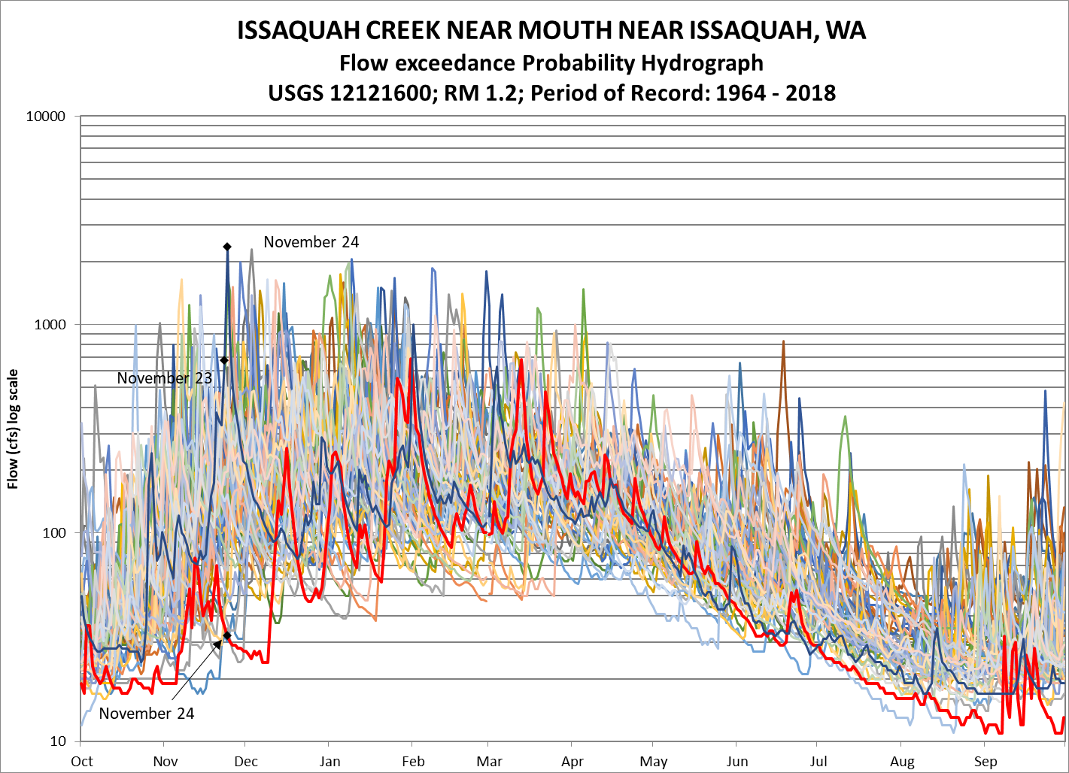
Hydrology 101
Logarithmic Scale
55 years of data
Daily flows can vary by 2 orders of magnitude
Seasonal flows can vary by 3
Notes:
This graph shows the same stream with all the daily stream flow data for last 55 years
It is quite messy, but it shows us that with any given day, streamflow commonly varies by 2 orders of magnitude.
Seasonally they can vary by up to 3 orders of magnitude,

Slide 12
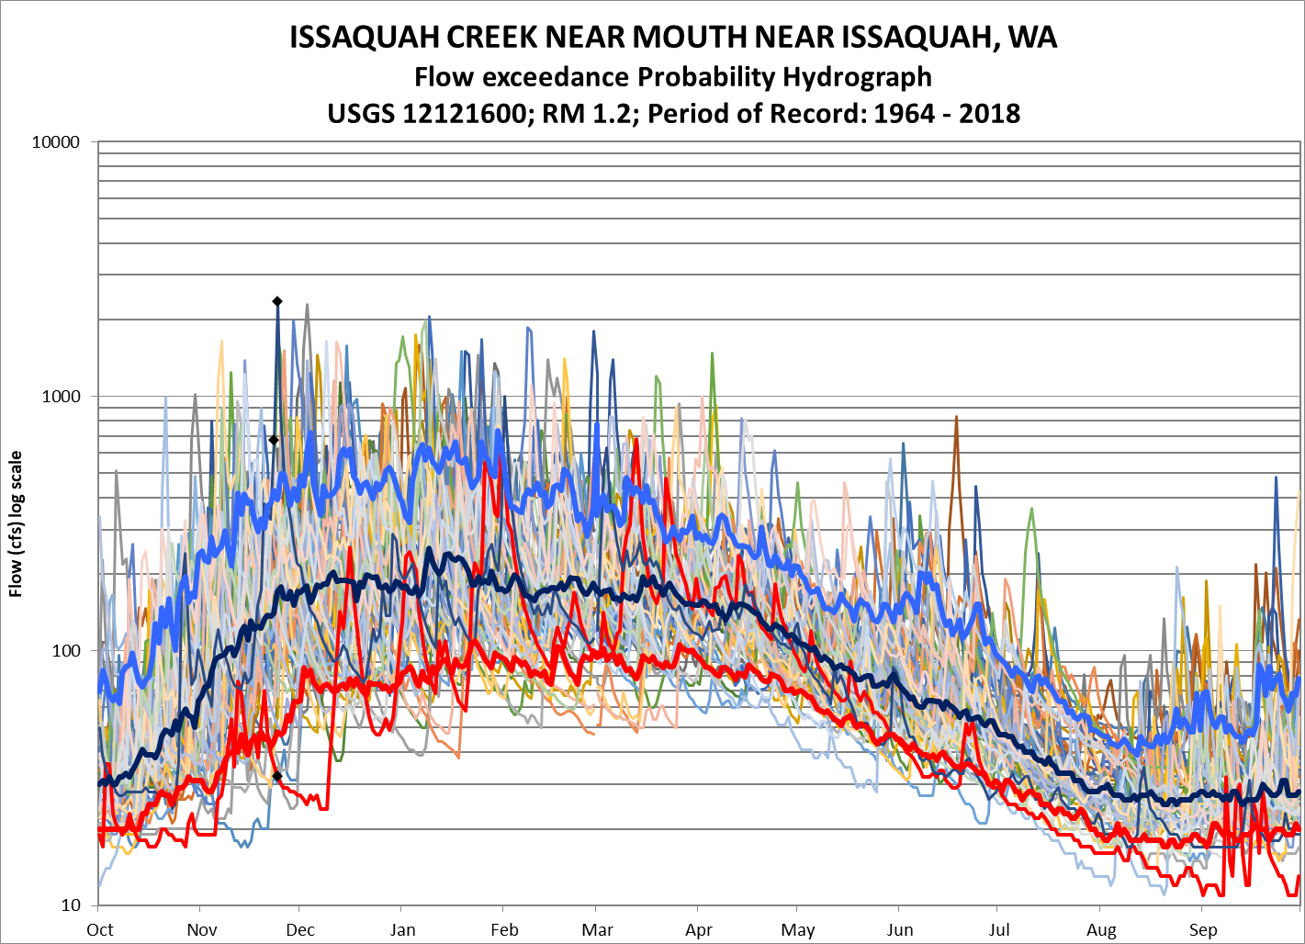
Hydrology 101
Exceedance Curves
Show the yearly and seasonal variability without the mess
Notes:
Here is the same graph overlaid with a streamflow statistic called exceedance curves
The upper blue line represents the 10% exceedance flow.
Streamflows at this level are only exceeded 10% of the time.
Think of it as a rare wet day where it has been raining for a while, or when its raining really hard.
The bottom red line is the 90% exceedance flow.
Streamflows at this level are exceeded 90% of the time.
When streamflows reach this level, it has been dry for a while.
In the summer, these would be drought conditions.
The dark blue line in the middle is the 50% exceedance flow. This is the same as the median.
By using 10-50-and 90% exceedance curves we can see most of the variability in a stream along with its seasonal pattern.

Slide 13
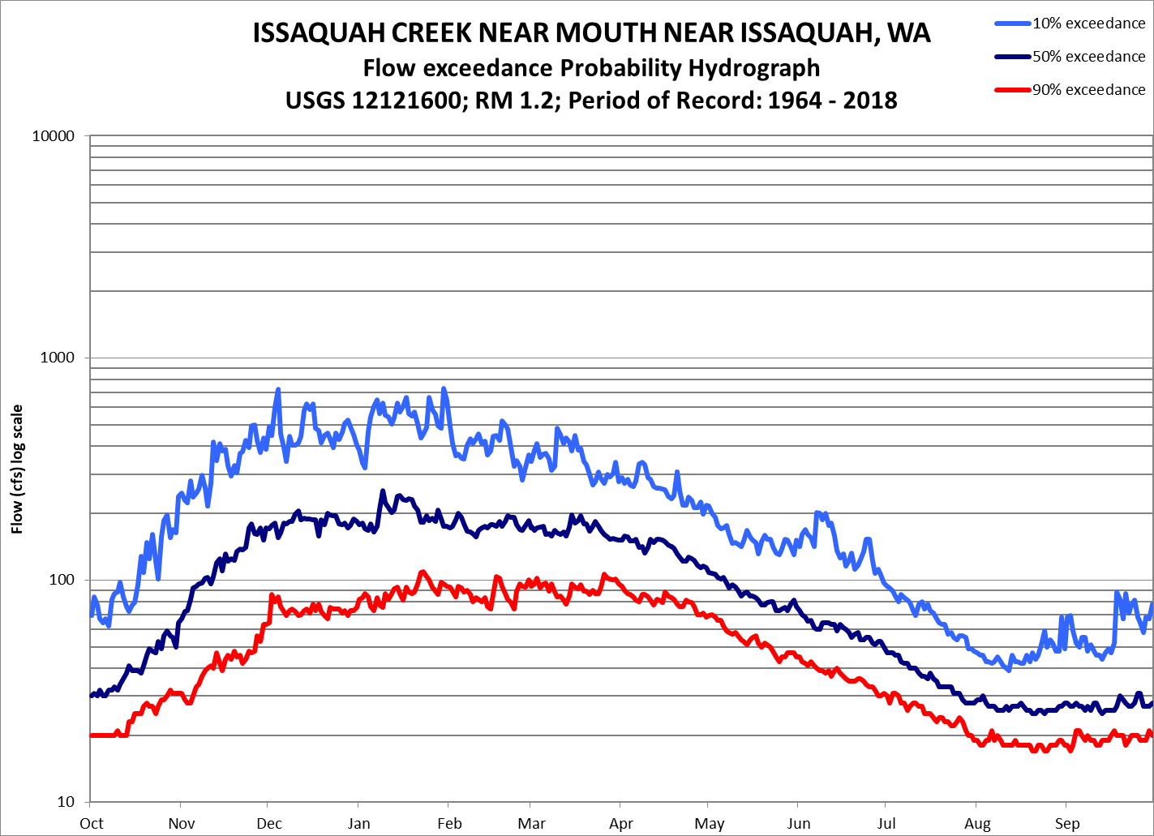
Hydrology 101
Streamflow
Patterns
A Mixed (Rain with Snow or Glacial melt) streamflow pattern have two bumps
Notes:
Which is why I usually display stream flows using these exceedance curves.
In Washington, streams tend to follow one of three flow patterns
Issaquah Creek shows a mild mixed pattern with high streamflows in the winter from rain in the low lands and another in the spring and summer from melting snow and ice in the mountains.

Slide 14
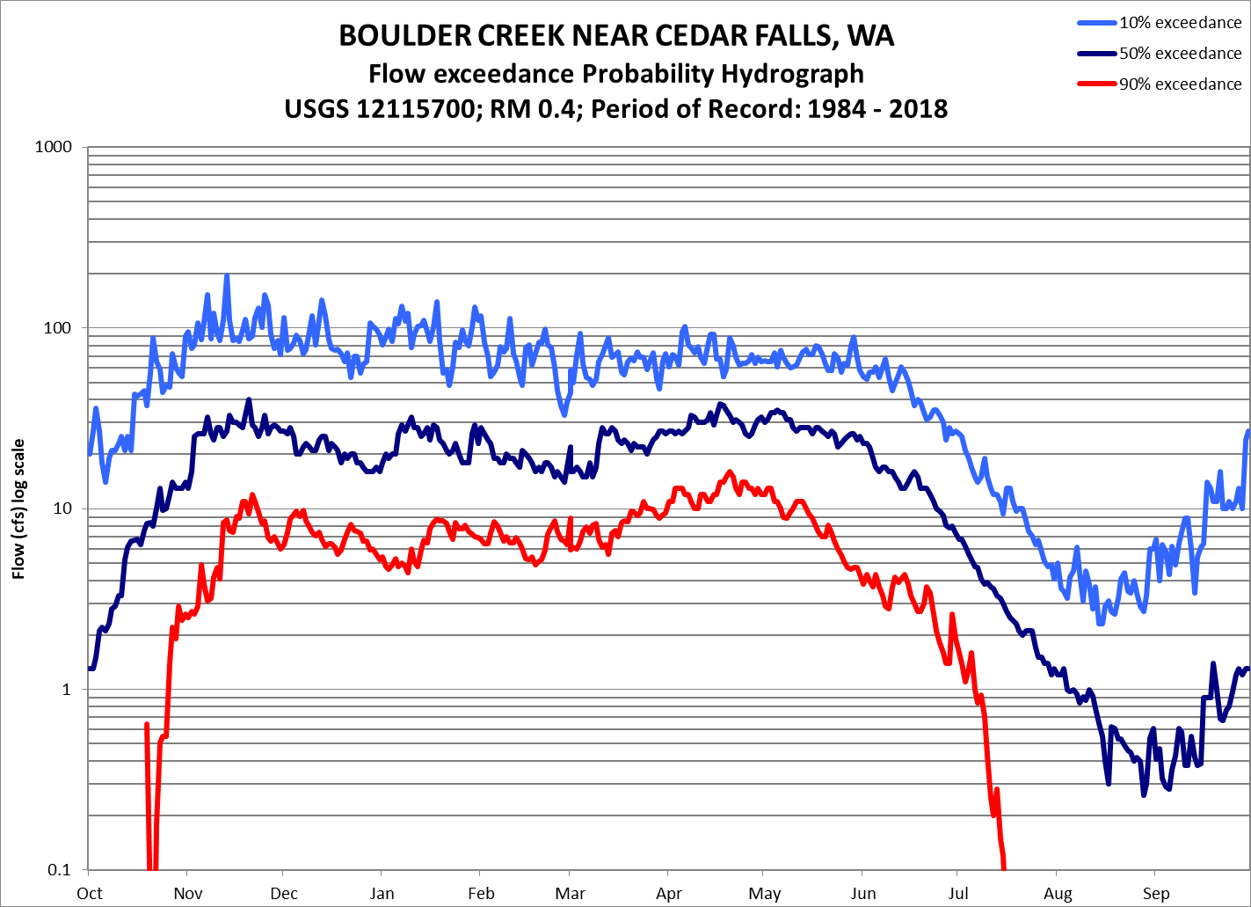
Hydrology 101
Streamflow
Patterns
A Mixed (Rain with Snow or Glacial melt) streamflow pattern have two bumps
Notes:
Boulder Creek is a better example of a mixed system showing winter and spring peaks

Slide 15
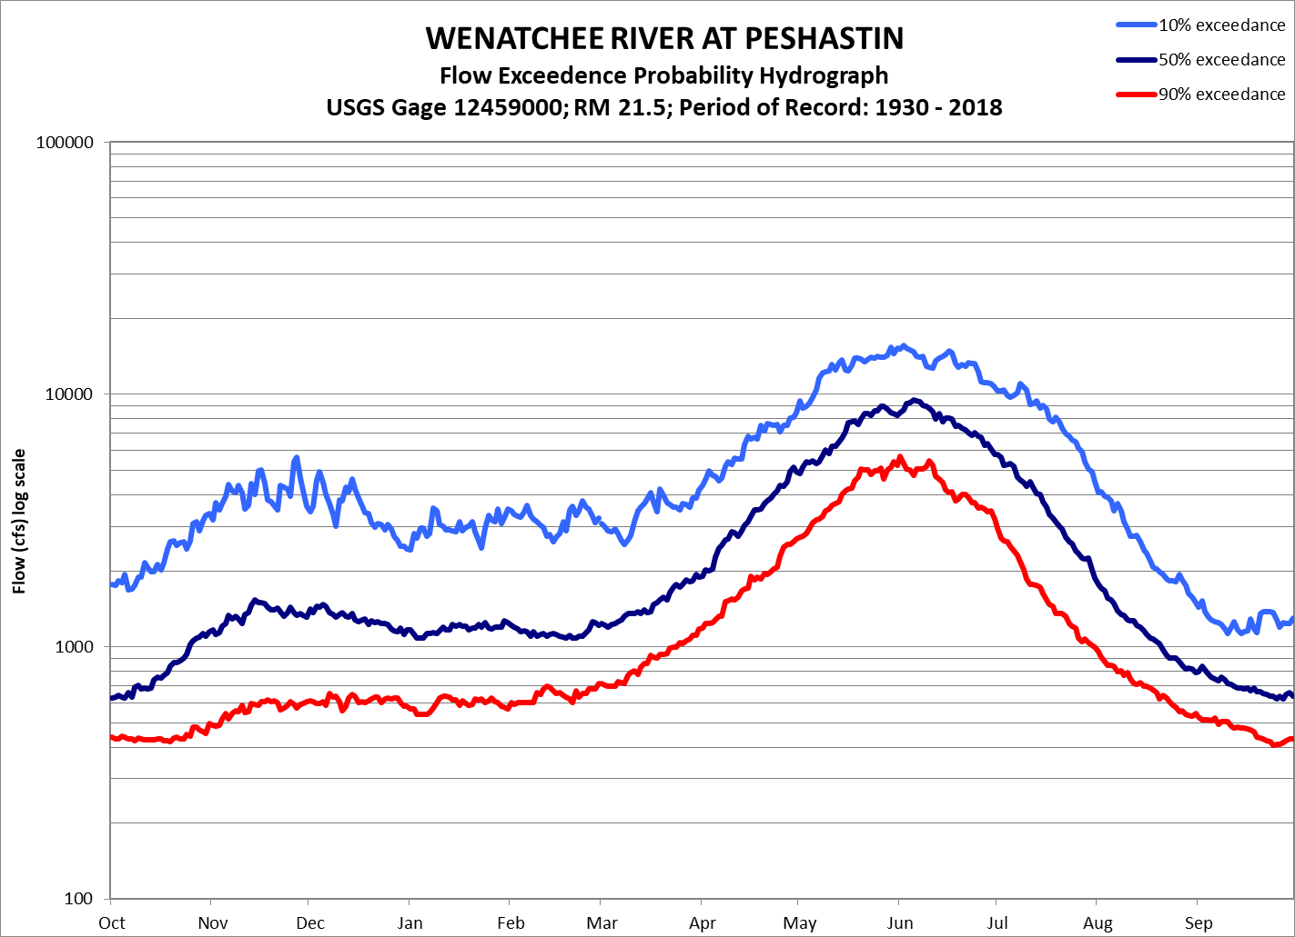
Hydrology 101
Streamflow
Patterns
A Snow dominated streamflow pattern
Note the lack of large November and December rain events
Notes:
This is a Snow dominated streamflow pattern
With a Snow dominated streamflow pattern there can be some rain in the winter, but most of the precipitation is stored as snow.
Note the lack of large November and December rain events. The February bump is from the rare early runoff events.
Streamflows get a large bump with the summer melt.

Slide 16
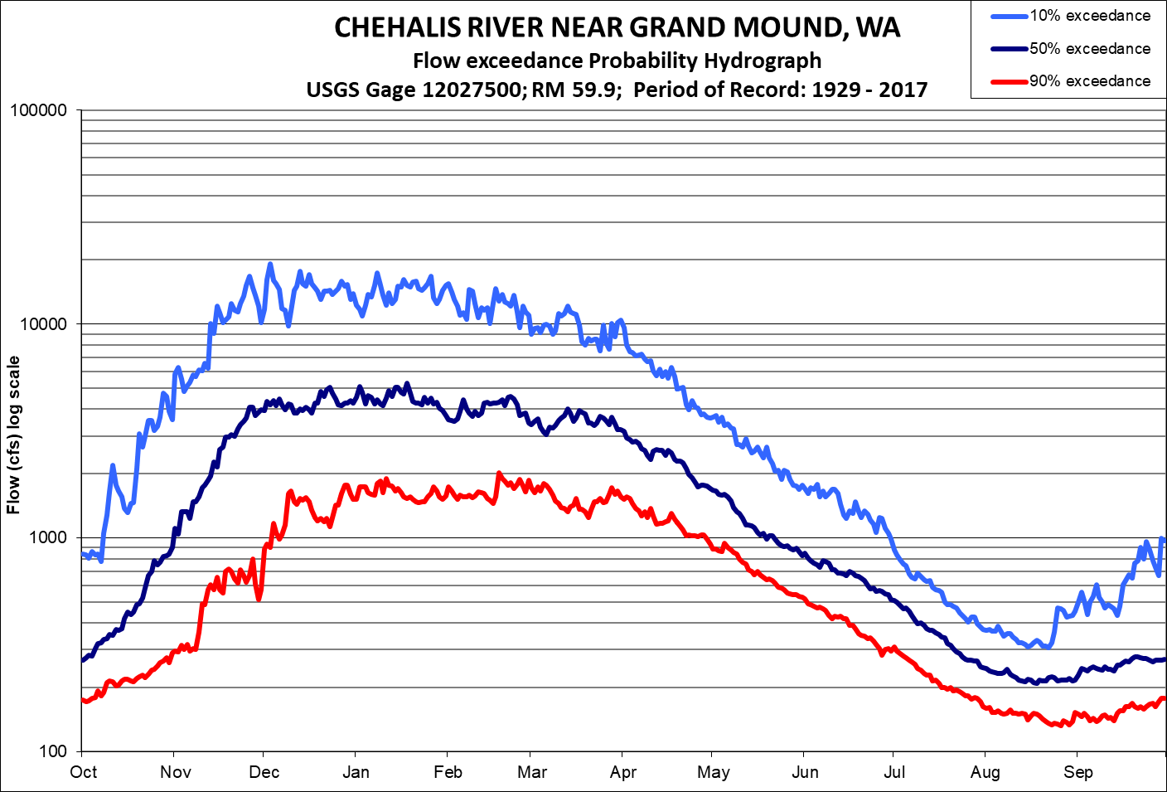
Hydrology 101
Streamflow
Patterns
A Rain dominated streamflow pattern
Notes:
In a Rain dominated system, streamflows are highest in the winter and rapidly decline as the rains stops.
Rain dominated systems tend to have the longest period of low flows and the highest seasonal flow differences.
Stream hydrographs will be an important tool for you to determine critical flow periods and the months where water could be available for storage or recharge projects.
Now back to instream flows.

Slide 17
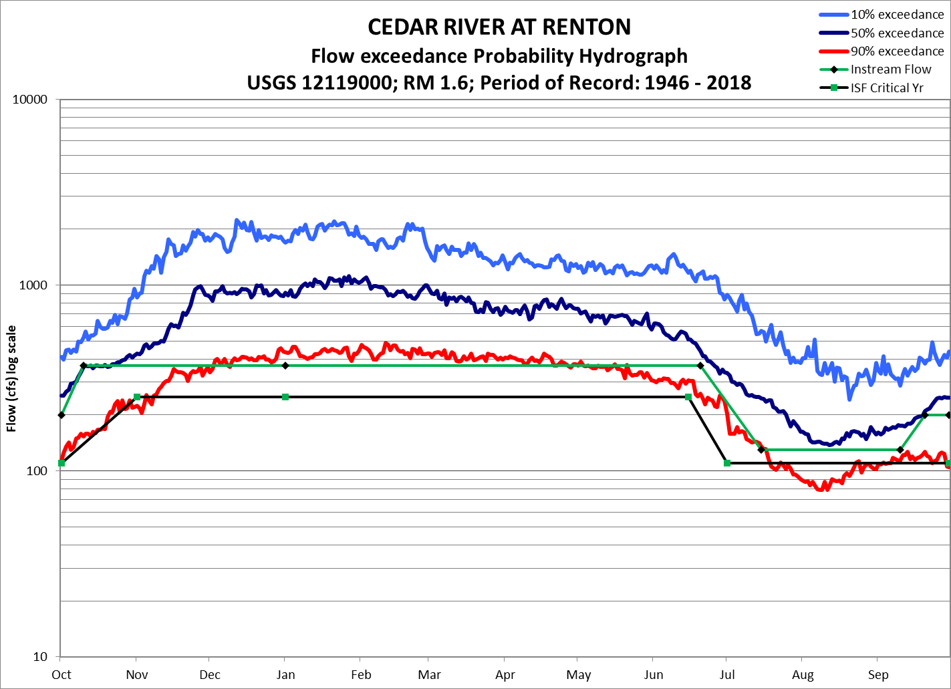
Instream Flow Rules
1971-1979
Oct 10-June 20: 95% Exceedance
July 15-Sept 10: 70% Exceedance
Notes:
There have been roughly three phases of ISF development.
From 1971-1979, ISFs were determined by what was loosely called the hydrologic method.
With this method, a stream was split into a high and a low flow period
The high flow period had the ISFs set at the 95% exceedance
For example, the Cedar River had a high flow period from November 1 to July 1, and the ISF, shown by the green line, was set at 300 cfs.
The low flow period had an ISF that varied between the 95 and 60% exceedance depending the ranking from several agencies. For the Cedar River the low flow period was July 15 to September 15 and
the ISF set at about the 70% exceedance or 130 cfs
A straight line was used to connect the two periods.
It was that simple
There was also lower ISFs when critical conditions are declared, lowering the high flow period to 250 cfs and 110 cfs for the low flow period.
This was our least protective standard

Slide 18
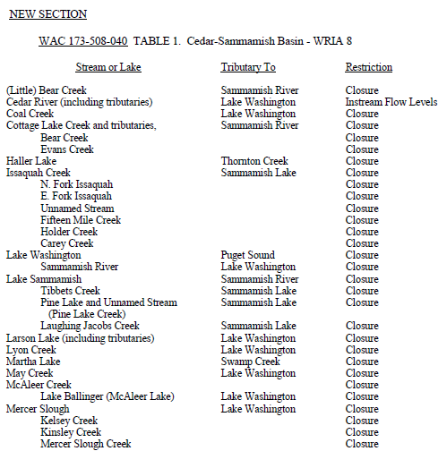
WRIA 8 Instream Flow Rule
Partial table of year-round closures set in rule.
Notes:
In addition to ISFs, the WRIA 8 rule included a number of smaller streams and lakes with closures recommended by WDFW.
These are know as Surface Water Source Limitations or SWSLs.
By themselves, these recommendations that may be used to condition or deny new water rights.
Most of your streams have year-round closures.

Slide 19
“Base Flow”, “Minimum Flow”
What does it mean?
Definitions and consequences
Hydrology: streamflow from groundwater discharge This hydrologic minimum is similar to drought conditions and does not provide much protection for the instream resource
Resource-Focused: streamflow needed to protect or preserve the resource
This usually leads to flows higher than the hydrologic minimum, but it provided a better level of protection
Notes:
The legislature directed Ecology to develop instream flows in 1971, but did not define several key terms such as
Base flow and minimum flow
The definition you use is important because it could lead to very different ways of determining an instream flow.
For example, a base flow defined by hydrology would use the level of streamflow coming solely from groundwater.
This is relatively easy to measure, but since this hydrologic minimum can be similar to drought conditions, it does not provide much protection
On the other hand, A Resource-Focused definition would look at a streamflow that protects and preserves the instream resource.
This is harder to measure and it usually leads to ISFs higher than the hydrologic base, but it provided a better level of protection.

Slide 20
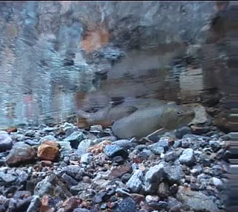
Instream Flow Rules 1980-1985
Several models/methods were developed in the 1970s, but were not factors until this second phase.
The most common for ISF rules were the Toe-Width Method and IFIM/PHABSIM (Instream Flow Incremental Methodology/Physical HABitat SIMulation model)
Notes:
In the second phase of ISF development, biologists from WDFW and Ecology pushed for a more resource focused definition for ISFs.
There were several habitat based instream flow models/methods developed in the 1970s and used in Washington, but they were not used for ISFs until this second phase.
These include the Toe-Width which was the most commonly used method, and
IFIM which stands for Instream Flow Incremental Methodology which is a five-part process.
One of those parts calls for a habitat model such as PHABSIM which stands for Physical HABitat SIMulation.
This was commonly used on the larger streams.

Slide 21
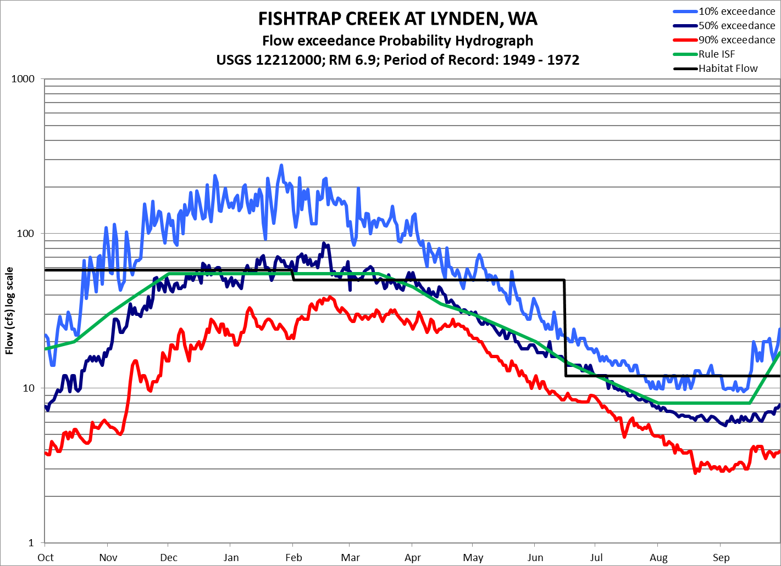
Instream Flow Rules 1980-1985
A hybrid between habitat based ISFs and the hydrologic method
Notes:
Fishtrap Creek in WRIA 1 is an example of ISFs from this second phase.
Here the black line shows the recommend flows based on a Toe-Width study and the green line shows the negotiated instream flow.
They didn’t published rationale for this difference, but, ISFs in this phase were commonly limited to the 50% exceedance flow during the wet season and up to the 40% exceedance during the dry season suggesting an unwritten hydrologic limit.
ISFs set during this period were usually higher and more protective than those set in the first phase

Slide 22
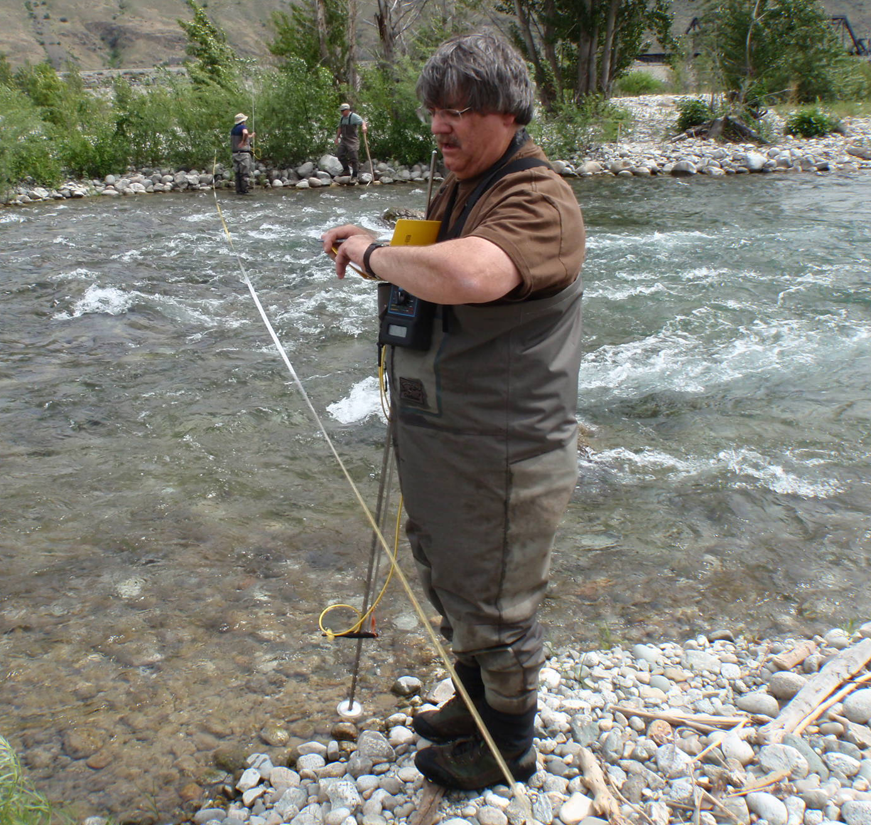
Instream Flows
1986-2000:
The Dark Ages
Instream flow rule making motatorium for 15 years
Instream flow studies and fish habitat research continued
Notes:
Then the dark ages fell and we has an ISF moratorium for 15 years
During this time, WDFW and Ecology continued to conducted Phabsim and toe-width studies all over the state.
They also continued their fish habitat research to improve the accuracy of the models

Slide 23
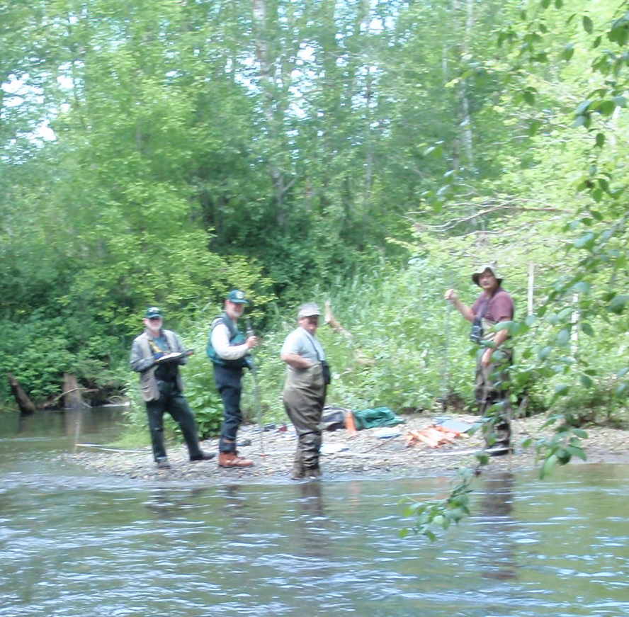
Instream Flow Rules 2000-2015
Ecology hired a second biologist and increased the size of WDFWs water team to implement RCW 90.82
Watershed plans were adopted resulting in 10 new instream flow rules
Entered another dark age
Notes:
During the third phase of ISF protection hired a second biologist, increased the size of WDFWs water team, and started implementing RCW 90.82
During this time, we used the adopted watershed plans to develop or update 10 ISF rules
We continued our fish habitat preference studies and analysis and published updates to our state-wide fish preference curves leading to more accurate modeling
We are currently not setting any new ISF rules, but the option is now available and our process has not changed
So let’s look at how we develop a modern ISFs

Slide 24
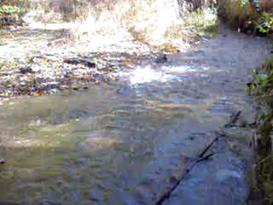

Key Instream Resources
Fish habitat is a key instream resource. The goal is to protect flows needed for:
Migration
Spawning
Rearing
Notes:
ISFs are designed to protect instream resources which are defined as fish, wildlife, recreation Scenic or aesthetic values, water quality, navigation and livestock watering
All these resources need to be considered when developing an ISF, but we have the best quantitative tools for measuring fish habitat so we generally use fish as the key instream resource.
We have also found that if we protect fish habitat, the other instream resources are protected as well.
All Fish lifestages need adequate depth and velocity. But Spawning adults also need suitable gravel for building their redds (or nests),
And Rearing juveniles also need cover or places to hide from high velocities and/or predators.

Slide 25
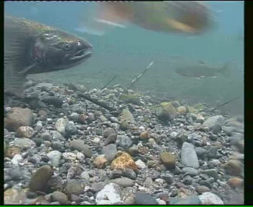
How Do We Develop Instream Flows?
1) Habitat Study
2) Fish Periodicity
3) Stream Hydrology
Notes:
To develop an ISF, we first need a study that relates fish habitat to stream flow.
Second, we need a Periodicity Chart. This comes from local biologists and tells us what fish species and lifestage are in the stream month by month, and
Third, we would like to have a long-term hydrograph of the stream.
For the Habitat Study, we continue to prefer either the Toe-Width method or a PHABSIM study.

Slide 26
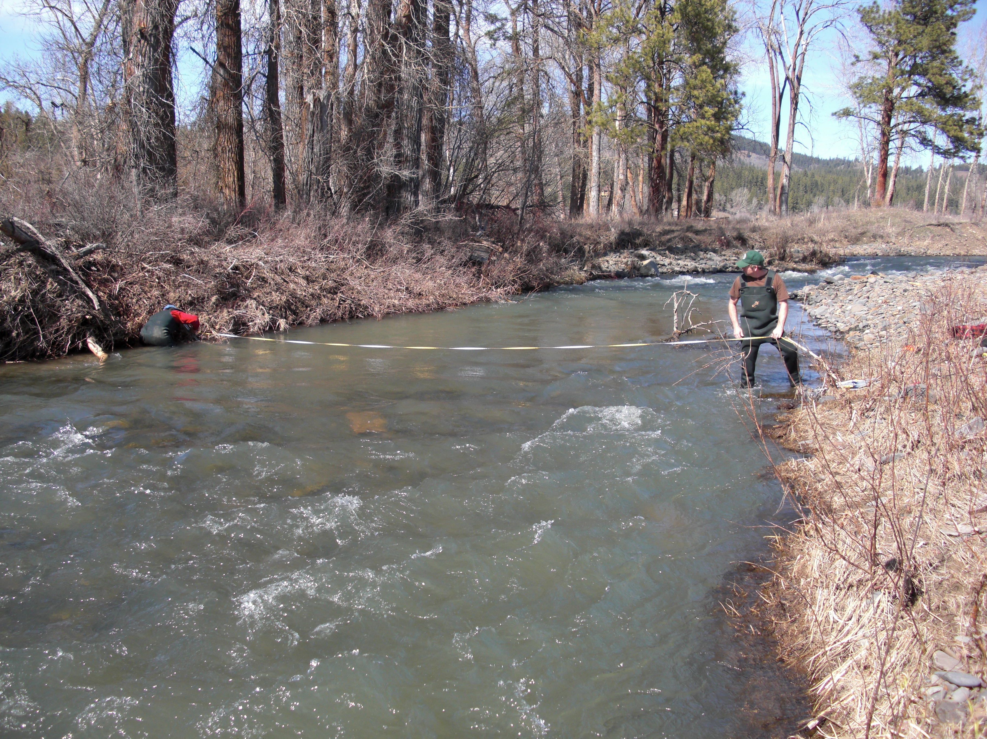
The Toe-Width Method
Measuring stream width at the toe of the bank - the point where the stream bed meets the stream bank.
Notes:
The toe-width method uses the width of the river measured at the toe of the bank, which is the point where the stream bed meets the stream bank.
When measured at pool tail-outs and riffles, and using the new protocols we published, the widths are quite consistent and give more accurate estimate the ISF recommended by a PHABSIM study, but with much less effort.
This type of study is easy enough that all the key streams in an entire watershed can be measured in 1 to 3 days.
In fact, most of Washington’s ISF rules were developed using the Toe-Width method.

Slide 27
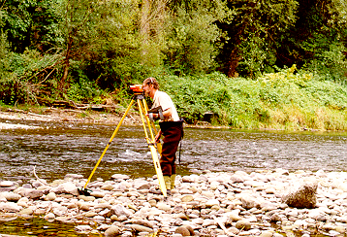
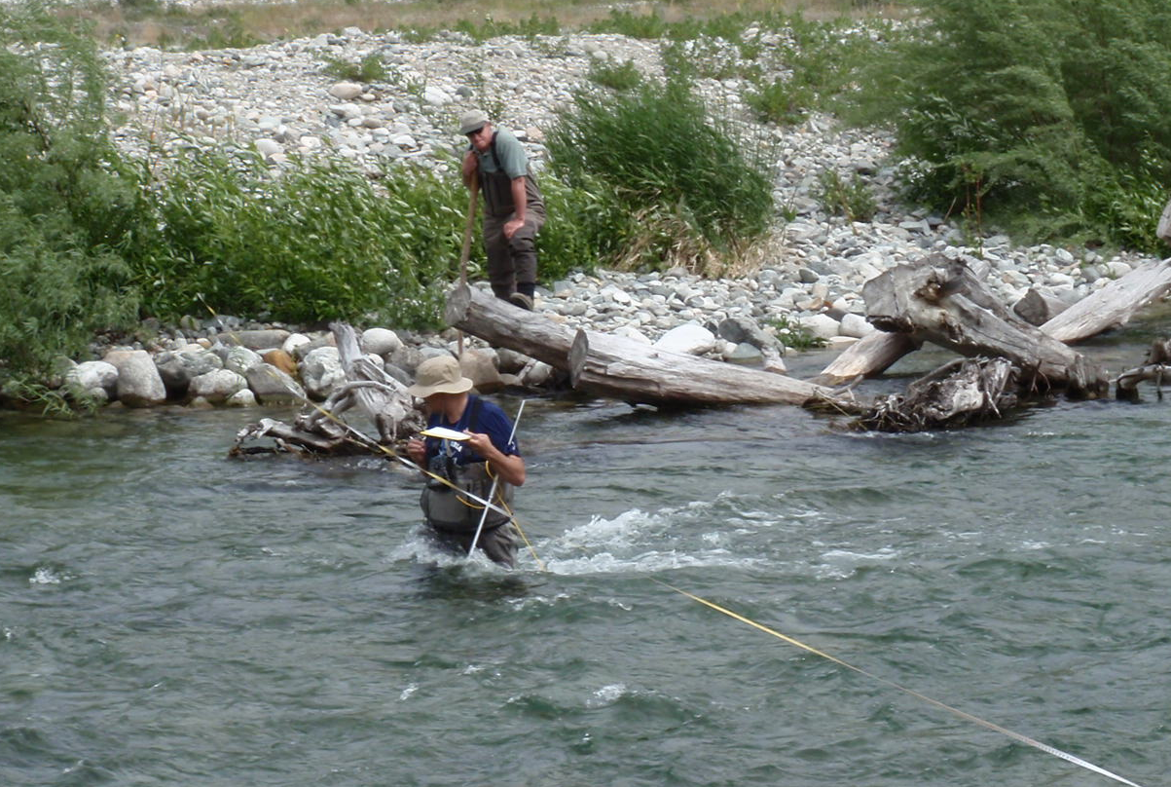
IFIM / PHABSIM
Measure around a thousand points for depth velocity and substrate at low, medium, and high stream flows
The hydraulic model predicts how depth and velocity changes with different stream flows
The habitat model compares the predicted depth and velocity at different stream flows with the depth and velocity preferred by different fish species.
Notes:
PHABSIM is currently our gold standard for setting ISFs.
To conduct a Phabsim study, we first take hundreds of depth and velocity measurements at several different stream flows. Data collection for this type of study is much more time intensive.
The hydraulic component of the model takes these measurements and predicts depth and velocity conditions at a wider range of stream flows.
Then the habitat model takes the predicted depth and velocity at different stream flows and compares it to the depth and velocity preferred by different fish species.
In general, low flows are too shallow and slow and fish don’t like it.
High flows are too deep and fast and fish don’t like it.
At some varied stream flow, the stream produces the most fish habitat for each of the modeled species and life histories.
This type of model is considered reliable and defensible because it is quantitative and based on biological principals.
It is also quite popular.
PHABSIM is used in 13 of the 17 western states and is the preferred method in 11 of them.

Slide 28
Instream Flow Rules
2002-2017
Periodicity tells us when different species and lifestages are in the stream.
The habitat study tells us how high the ISF should be
Hydrology lets us truth check the results.
Notes:
Woods Creek has an old PHABSIM study from 1986 and will serve as an example of how we develop a modern resource-focused ISF.
Periodicity comes from local biologists and tells us when different species and lifestages are in the stream and The habitat study gives us the recommended ISF
In this case Chinook Salmon are spawning and incubation from November through February and 180 cfs provides the preferred streamflow.
Steelhead spawn from March 1 to May 15 and 140 cfs provides a spawning flow.
Steelhead juveniles real year-round so all the other months get a rearing flow of 110 cfs.
Modern rules also use a hydrologic limit because the ISF should be achievable. However, rare flow events can still provide benefits to rearing fish populations, we use the 10% exceedance as our hydrologic limit to habitat flows.
So if the habitat study recommends a flow that is above the 10% exceedance, we would lower the recommendations to the 10% exceedance. This has been our most protective ISF standard.
Under this ISF regime, new water users would have a reasonable chance of obtaining water from November through April.
But how do ISFs affect uninterruptable water needed for new homes?

Slide 29
WRIA 27/28 Availability-2009 rule
Stream No. of years the Avg. days per year
name ISF was not met ISF was not met
Kalama River 20/20 183
E Fork Lewis River 8/8 169
Washougal River 11/11 177
Burnt Bridge Creek 4/4 251
Notes:
To answer this question, I looked at how often the ISF was not met on streams from a recent ISF rule using up to 20 years of daily streamflow data and a continuous 7-day not met threshold.
This means that the streamflow had to be below the ISF for at least 7 continuous days before the ISF was considered “not met” for that year.
With today’s high standard, all the gaged streams in the WRIA had at least one 7 day event in every year and the ISF was “not met” an average 195 days per year
Because of recent Washington Supreme Court rulings such Hirst, any impairment of the ISF is not allowed meaning that new uninterruptable water would not be available.

Slide 30
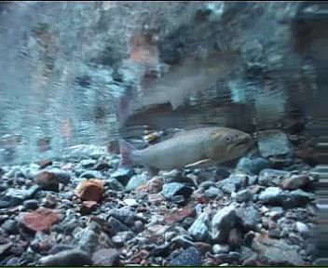
SEE!!!
I told you the Instream Flow is Too High!!!
Fish don’t need that much water!
Notes:
Mark Twain’s old adage that “whiskey's for drinking and water’s for fighting over”, is alive and well with instream flow negotiations.
We are frequently challenged with the claim that the ISF is too high,
And, that fish don’t really need that much water!
HOWEVER, since 1935 research studies have consistently found a strong relationship between salmon abundance and streamflow.

Slide 31
Fish vs Flow Research
Dave Seiler’s studies on Bingham Creek for 1980-1997 found more summer flow equals more coho smolts outmigrating the following spring.
Notes:
The strongest relationship I’ve seen comes from Dave Seiler’s studies on Bingham Creek. He found that a higher summer flow resulted in more coho smolts out-migrating the following spring
The R^2 was 0.96. How often have you see a 0.96 as a biological response?
One of the reasons for this is that it is for a single stream. He also corrected for outliers, but interestingly, the outliers had their own fish to flow relationship.
In 1995, 96 and 98, smolt numbers were positively correlated to the prior November and December’s spawning flow suggesting that at a certain level, the spawning flow is a dominant factor.
Regardless, more flow in the summer resulted in more outmigrating fish.
However, if our critics are correct, simply using a lower ISF standard would solve the rural water problem, right?

Slide 32
WRIA 1 Availability-1985 rule
Stream No. of years the Avg. days per year
name ISF was not met ISF was not met
Fishtrap Creek 20/20 209
Nooksack (RM 36.6) 19/20 154
Nooksack (RM 5.8) 20/20 142
MF Nooksack (RM5.0) 20/20 144
SF Nooksack (RM 14.8) 20/20 204
Skookum Creek 20/20 181
Notes:
Here I used the same 7-day threshold analysis looking at availability under ISFs set during our 2nd phase of rule development .
Under this standard, we started using a resource focus for ISFs, but had hydrologic limits of 50% during the winter and about 40% during the summer.
Using this lower protective standard, ISFs were not met in almost every year, and for an average of 172 days.
So even with a lower standard, new rural water would not be available.

Slide 33
WRIA 8 Availability-1971 rule
Stream No. of years the Avg. days per year
name ISF was not met ISF was not met
Cedar River (normal) 14/20 38
Cedar River (Critical) 1 of 2 years 10
Notes:
Finally, let look at availability with an ISF rule from the first phase.
WRIA 8 had our least protective standard that based ISFs on the 95% exceedance during high flow periods and between the 95 and 60% exceedance during the low flow period.
The results were quite stunning.
Even using this low standard, WRIA 9 ISFs were not met in most years and for an average of 49 days.
2003, 2015
Lower standards may make water available more often, but even they will not allow for new uninterruptable use needed for new homes.

Slide 34
Instream Flow Rules
1971-1979
Oct 10-June 20: 95% Exceedance
July 15-Sept 10: 70% Exceedance
Notes:
Here again is what the ISFs look like for the Cedar River with 300 or 250 cfs during the high flow period and a 130 or 110 cfs ISF during the low.
A Low standard may make water available more often, but even they will not allow for new uninterruptable use needed for new homes.

Slide 35
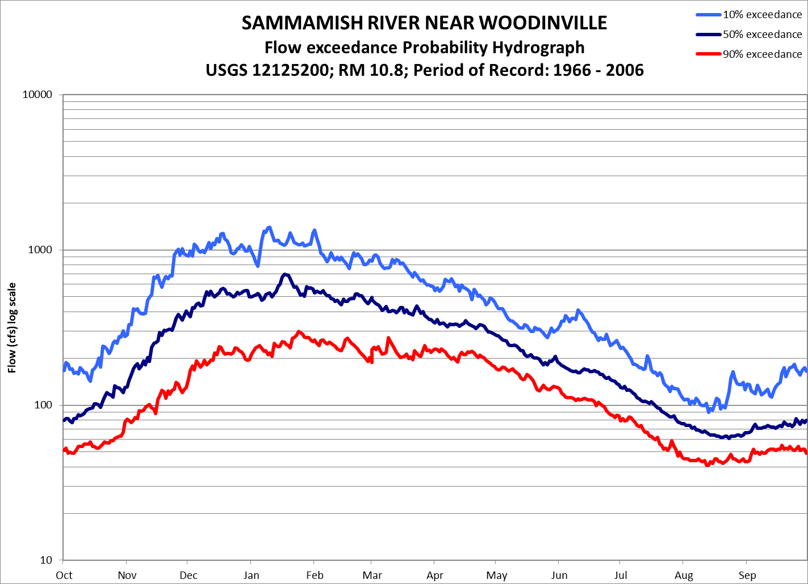
All Year Stream Closures in the WRIA 8 Rule
Are they justified, or can they be seasonal?
Sammamish River
Issaquah Creek
May Creek
And many others
Notes:
These streams all have year around closures which means that water is not available, even for beneficial projects.
Are all the closures justifies?
We would need to conduct a habitat study, like a toe-width to check, but if winter and spring water is regularly available, you could recommend changing the year-round closure to seasonal.
<CR>
<CR>

Slide 36
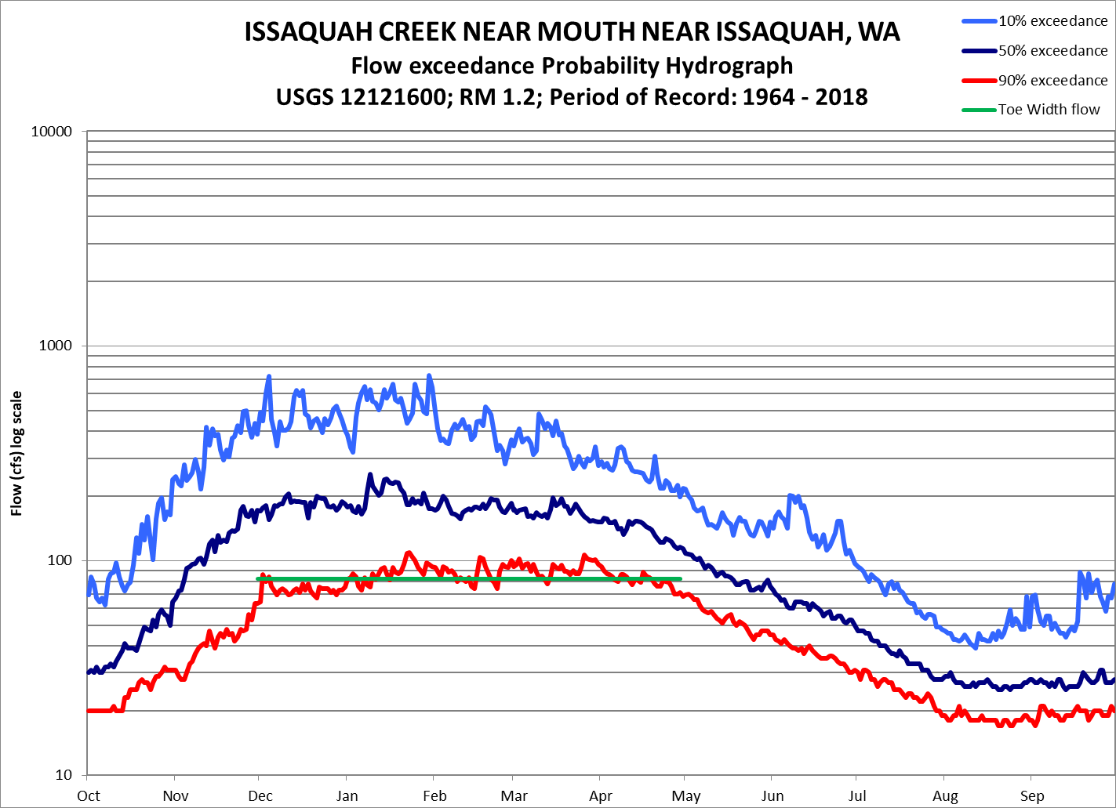
All Year Stream Closures in the WRIA 8 Rule
Are they justified, or can they be seasonal?
Sammamish River
Issaquah Creek
May Creek
And many others
Notes:
These streams all have year around closures which means that water is not available, even for beneficial projects.
Are all the closures justifies? TW Flow 82 cfs
We would need to conduct a habitat study, like a toe-width to check, but if winter and spring water is regularly available, you could recommend changing the year-round closure to seasonal.

Slide 37
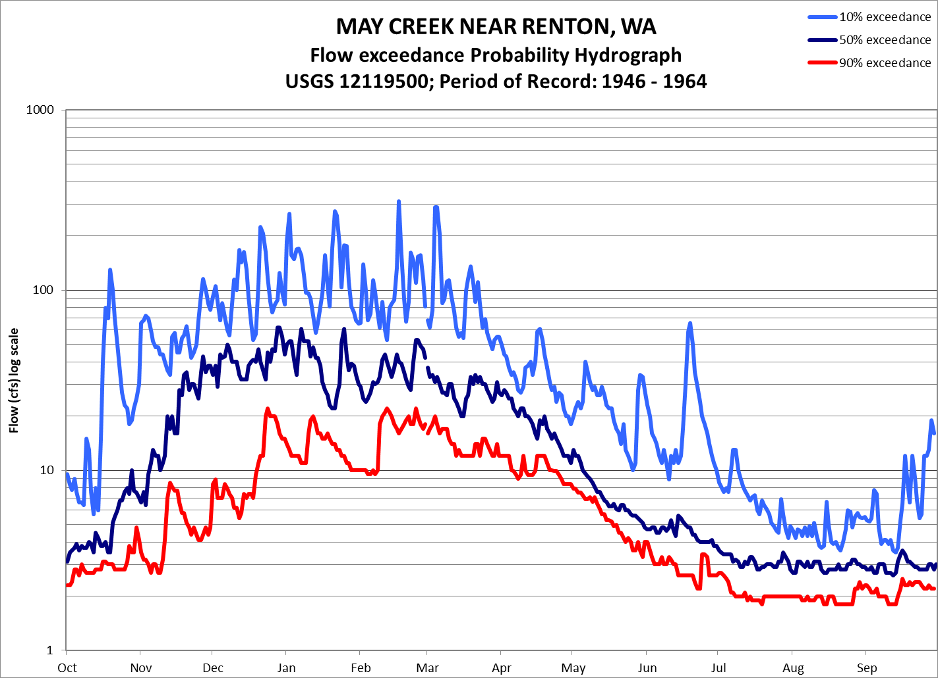
All Year Stream Closures in the WRIA 8 Rule
Are they justified, or can they be seasonal?
Sammamish River
Issaquah Creek
May Creek
And many others
Notes:
These streams all have year around closures which means that water is not available, even for beneficial projects.
Are all the closures justifies?
We would need to conduct a habitat study, like a toe-width to check, but if winter and spring water is regularly available, you could recommend changing the year-round closure to seasonal.

Slide 38
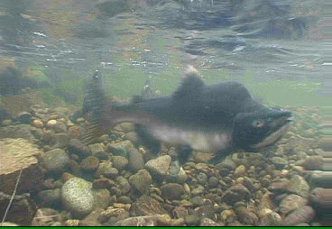
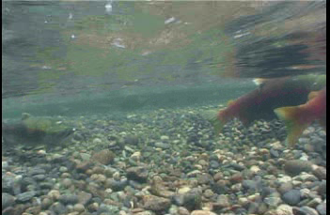
In a Nutshell
Stream Flows vary; daily, yearly and seasonally, by 2-3 orders of magnitude
If we want to protect rare but productive stream flows, higher ISFs are needed, but even low standards would limit new homes
A 100 cfs withdrawal affect streams differently than a 0.00004 cfs in-house use, but water law treats them the same
Flexibility is needed
Notes:
Stream Flows vary – on a given day, average streamflow can vary by two orders of magnitude but the instream flow is a single number.
If we want to protect the rare, but productive high flow years, a high level of protection is needed,
But uninterruptable water unavailable even with low levels of protection.
Large water uses such as municipal, industrial, and agriculture can have a measureable impact on streams, but in-house domestic use only has about a 25 gpd consumptive impact or .00004 cfs
With rare exceptions, this use would not would not affect the stream, but water law treats them the same.
Flexibility within water law is needed,

Slide 39
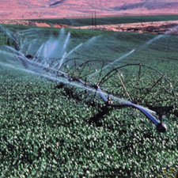

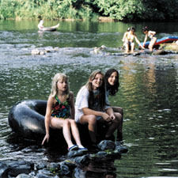
There are many competing uses for water. RCW 9094 is the new tool we have been given to have strong ISF protection and provide water for new homes. My role is to give you the technical assistance needed to successfully implement it.
Jim Pacheco
Instream Flow Biologist
360-407-7458
Notes:
There are many competing uses for water.
Ecology has tried to find ways to allow small uses within an ISF rule, but these have invalidated, or declared are too risky.
RCW 9094 is the new tool we have been given to have strong ISF protection and provide water for new homes.
My role is to provide the technical assistance needed to help you successfully implement it.

