Slide 1
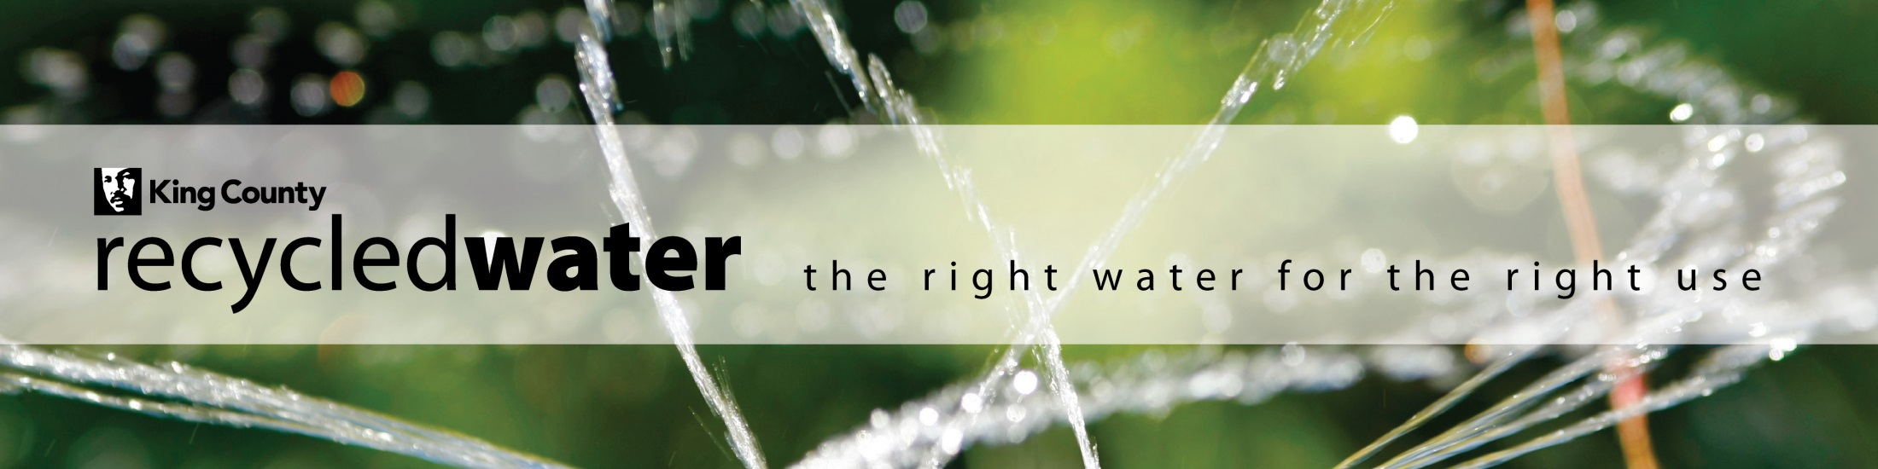
Brightwater Recycled Water:
New Water, New Solutions
Jacque Klug
Recycled Water Project Manager
King County Department of Natural Resources & Parks
Wastewater Treatment Division

Slide 2
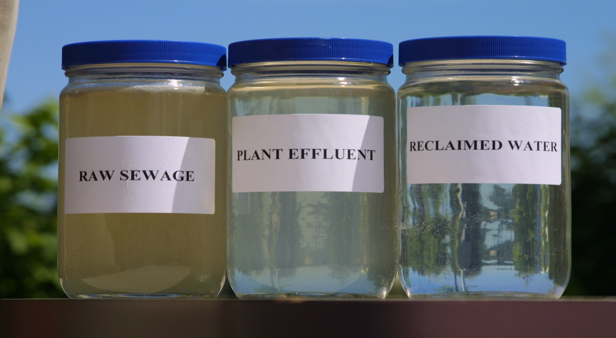
Recycled Water is:
Also known as “Reclaimed Water” or “Reuse Water”
Notes:
Picture tells the story. Recycled water is the clean water produced from wastewater treatment process that can be used for a variety of water needs. Water is “right-sized” for uses.
-Reclaimed water is treated water with a domestic wastewater component, per WA state law
-Variety of “reuse” of waters – stormwater, rainwater, industrial water

Slide 3
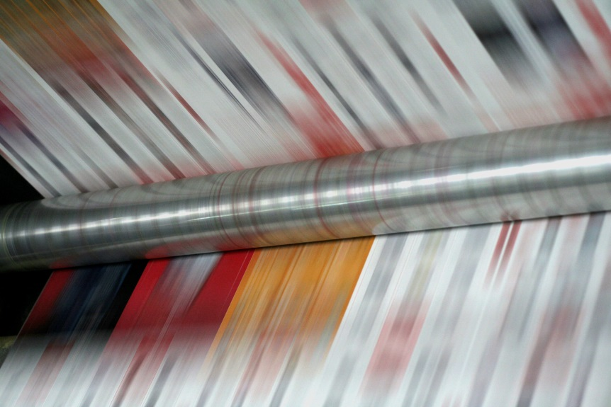
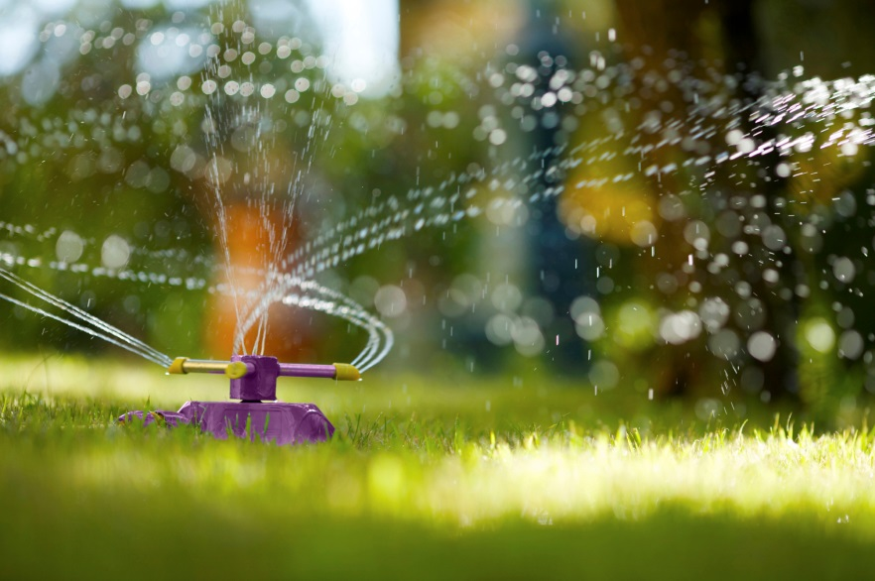
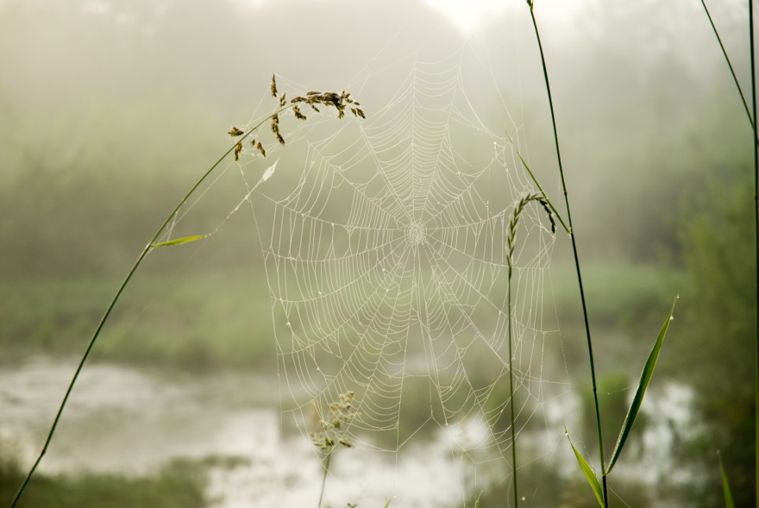
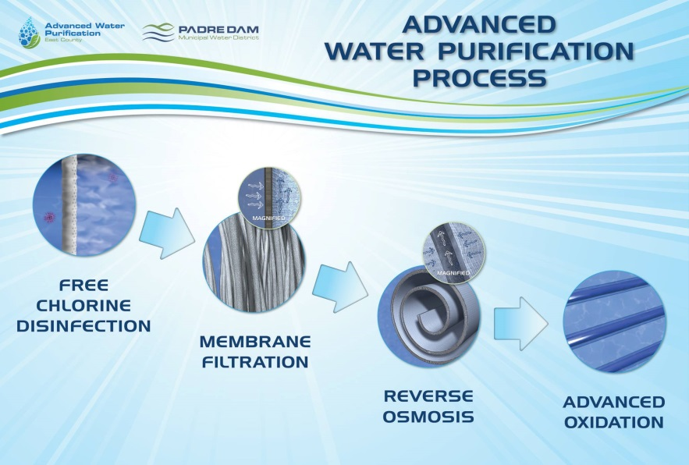
The many uses of recycled water…
Industrial process water
Irrigation
Environmental Enhancement
Even for potable water
Notes:
What is recycled water used for?
Cooling and equipment and pipe flushing
Irrigation
Recharge aquifers, augment surface water and wetlands
More recently, for augmentation of raw water supplies for drinking water systems

Slide 4
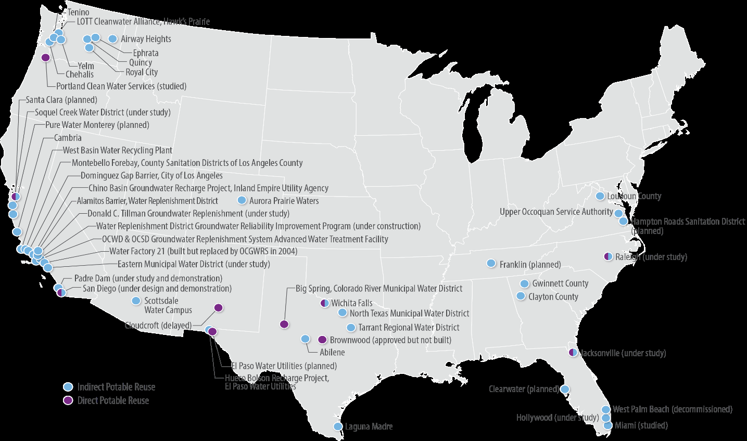
Direct and Indirect potable reuse projects
(as of April 2017)
From 2017 Potable Reuse Compendium, EPA
Notes:
Water reuse is used extensively for groundwater and surface water augmentation around the United States
San Diego’s Pure Water project can produce one-third of their drinking water supply by 2035.
El Paso Water’s Advanced Water Purification Facility scheduled to be online in 2024 to produce 8 MGD of purified water
TX, CA, NV, CO, AZ, OK, and FL have or are exploring adoption of DPR regulations
Growing use in the SE and Mid-Atlantic States– not arid West but areas experiencing increasing water shortages

Slide 5
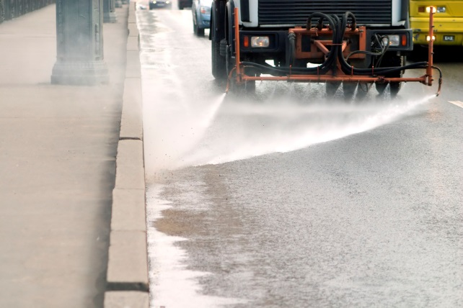
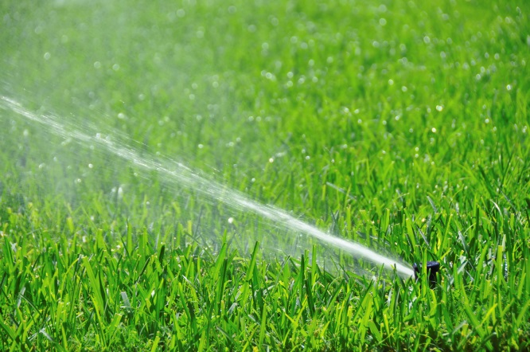

Reclaimed Water in Washington
Authorized in 1992 in Washington, codified in RCW 90.46.
Regulated jointly by Department of Ecology and Department of Health.
Notes:
More locally here in Washington, reclaimed water has been authorized since 1992
Regulated by DOH and Ecology
State reclaimed water rule recently adopted, February 2018

Slide 6

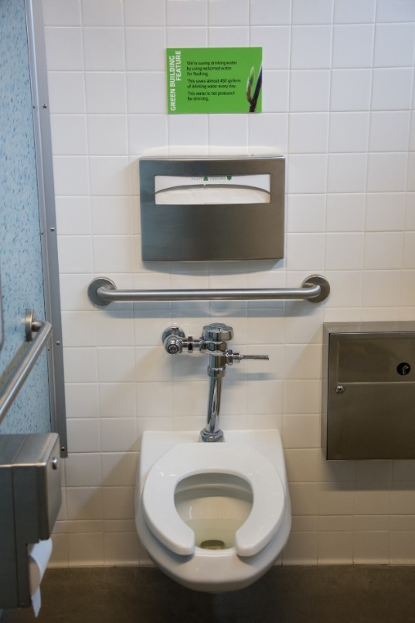

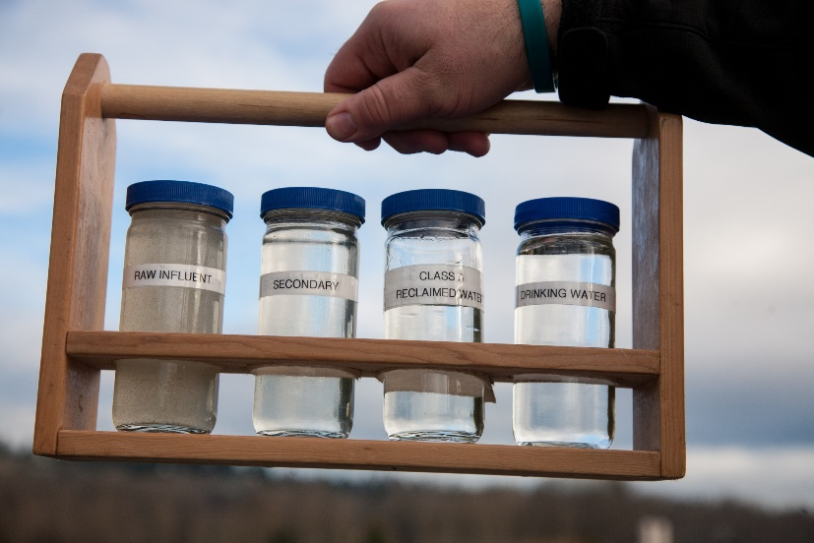
Water quality requirements align with end use
Environmental uses requires additional treatment.
Water where public can contact requires Class A water.
Reclaimed water rule creates approval pathway for direct reuse.

Slide 7
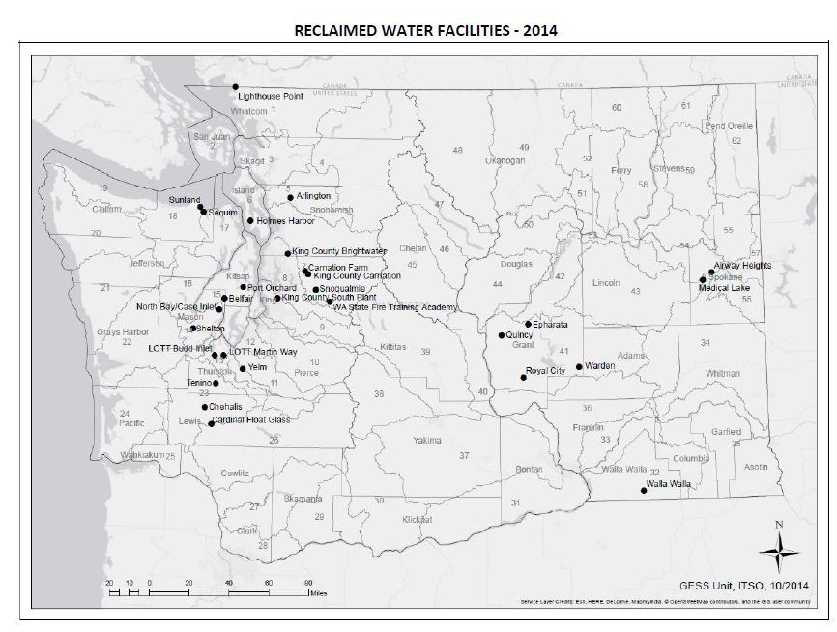
There are 29 permitted recycled water facilities in Washington.
Map from Department of Ecology
Notes:
Locally, there are 29 permitted facilities in Washington State that produce recycled water for a variety of uses.

Slide 8
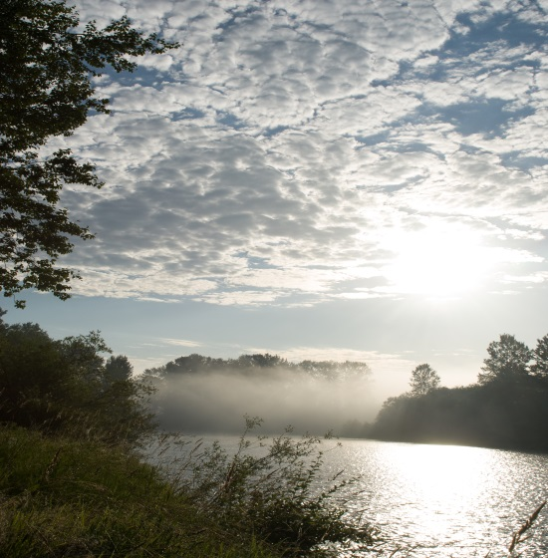
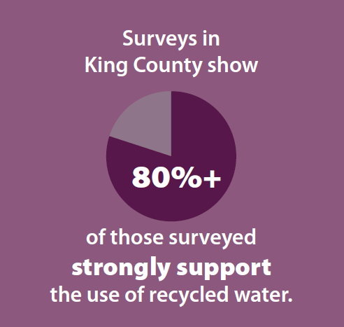
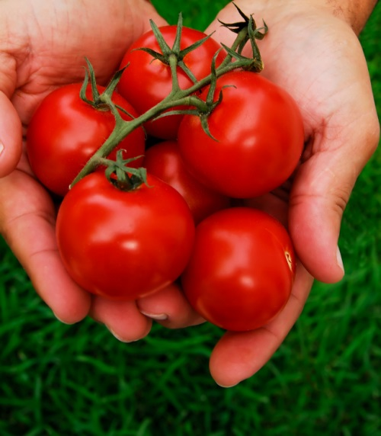
Why does King County make recycled water?
Reduce reliance on Puget Sound for discharge
Keeps more water in streams and aquifers
Recycle nutrients and reduce fertilizer use
Supports conservation and recycling values of our community
Notes:
King County uses recycled water to address all three of these issues
-reduce discharge to Puget Sound
-Supply water to farms and businesses
-Recycle nutrients and reduce fertilizer use
-Most importantly, reflects the conservation values of community and ratepayers

Slide 9
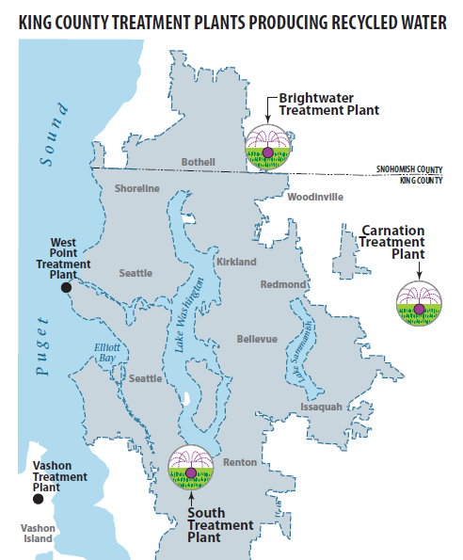
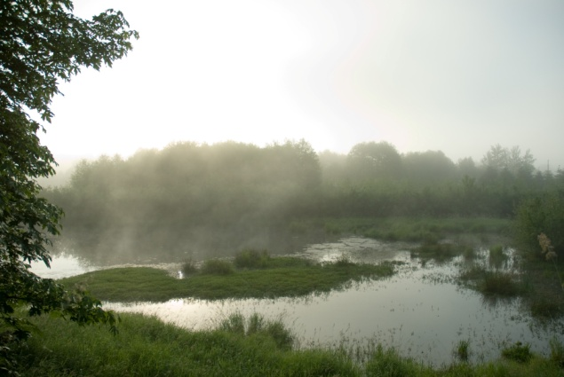



King County
Recycled Water Facilities
Notes:
Produce recycled water at 3 of 5 treatment plants. Wetland Enhancement at Carnation, we keep the Sounders practice field green and lush at Starfire Sports in Tukwila, and as well soccer fields and golf courses in the Sammamish Valley.

Slide 10
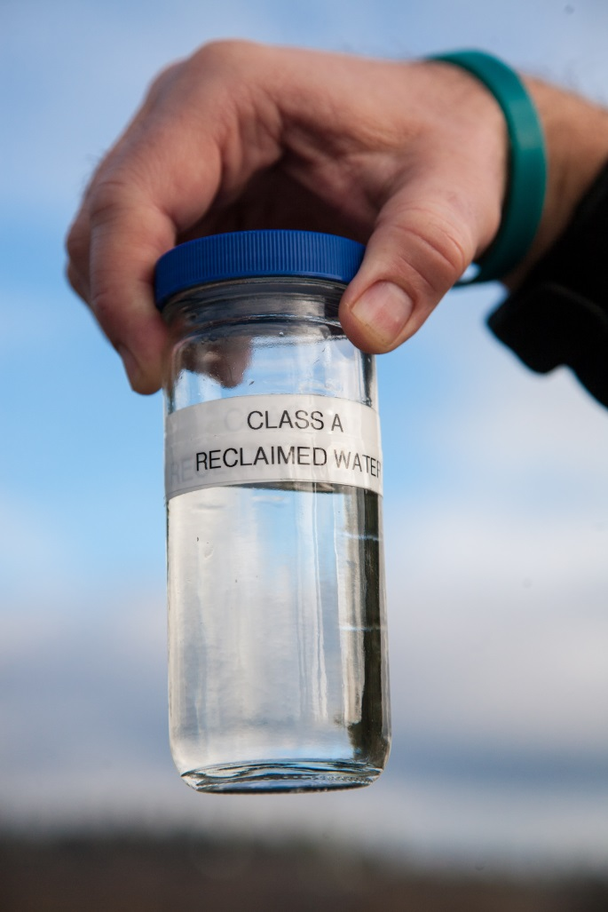
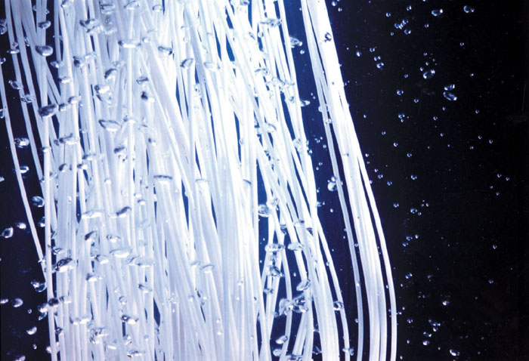
King County recycled water is safe!
  Recycled water treatment produces water with zero bacteria but keeps valuable nutrients plants need to thrive!
  King County has been safely recycling water for nearly 20 years.
Notes:
Really? Ag irrigation, groundwater recharge, a swimming pool? Is it safe?
YES! Here in King County we’ve been using recycled water for two decades with a perfect track record of safety.
Our recycled water keeps the good stuff, like nutrients, but removes the bad stuff, like bacteria and viruses in wastewater through the advanced treatment process
We use same the processes mother nature does, microorganisms, filters, to clean water, but engineered and sped up

Slide 11
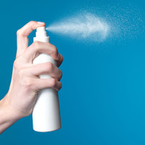
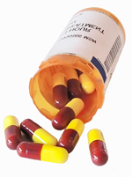
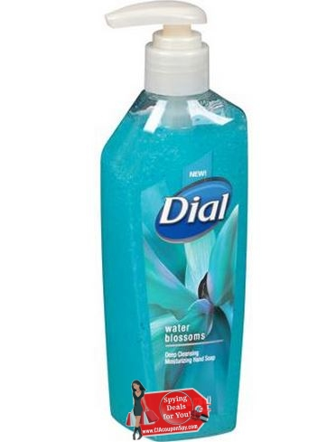
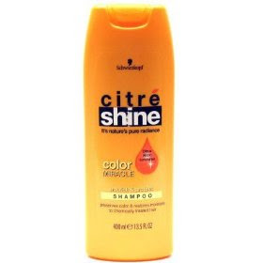
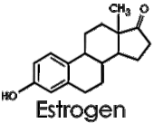
What about pharmaceuticals and personal care products?
Notes:
So, the treatment process treats bacteria and viruses but what about all the other stuff that makes it way in the sewer system? There has been a lot of research done on these issues nationally, internationally and locally. The take away message from the research is that yes, many of these compounds can be measured in recycled water but at very small concentrations. And when we look at the variety of ways humans are exposed in our daily lives, recycled water represents a small risk.

Slide 12
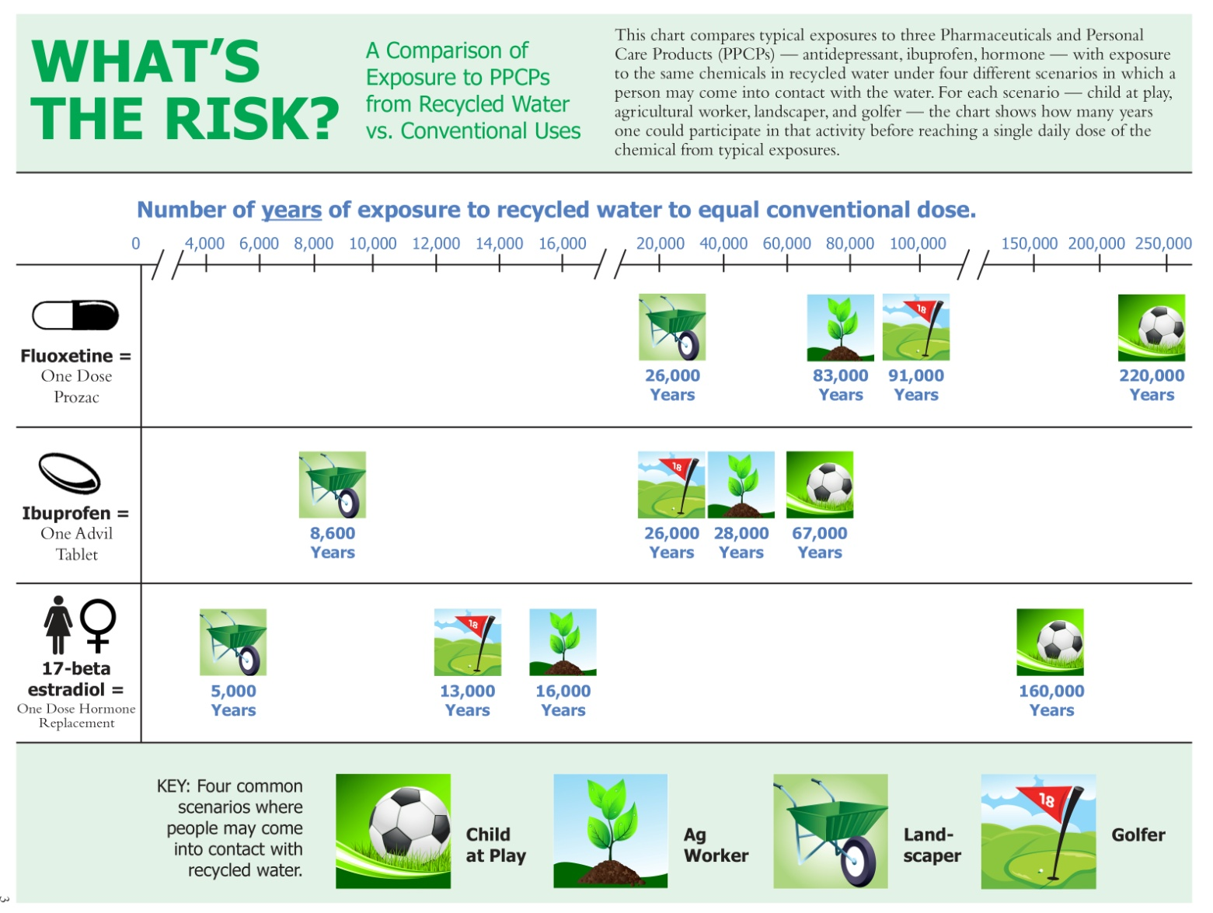
Putting Risk Into Perspective
Example:
A child could play on a lawn irrigated with recycled water for 67,000 years before being exposed to the equivalent of one dosage of Ibuprofen.
Source: WateReuse Research Foundation
Notes:
Pharmaceuticals, personal care products, bactericides, etc. are not new, they have been in our waters for as long as we have used these chemicals in our civilized societies. Only recently have we had the analytical power to be able to tested them at parts-per-billion and even lower levels. Research has shown that these chemicals are not relevant in irrigation and not relevant at low exposure levels compared to other ways we interact with these products.
For example: According to this study from the WateReuse Research Foundation, it would take 67,000 years of playing soccer daily for a child to receive the equivalent of one dose of Ibuprophen from the recycled water used for irrigation of the soccer field.
This is an emerging field and we try to keep pace with current research and work to understand CECs and the environment

Slide 13
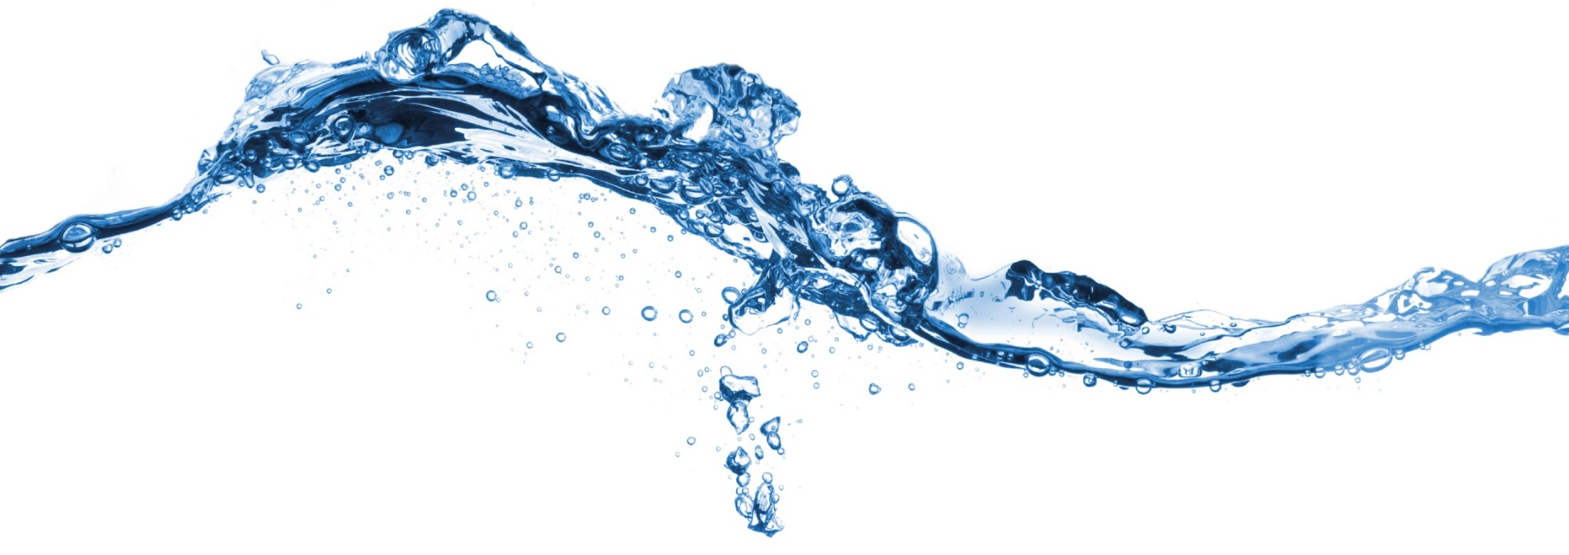
Brightwater recycled water

Slide 14
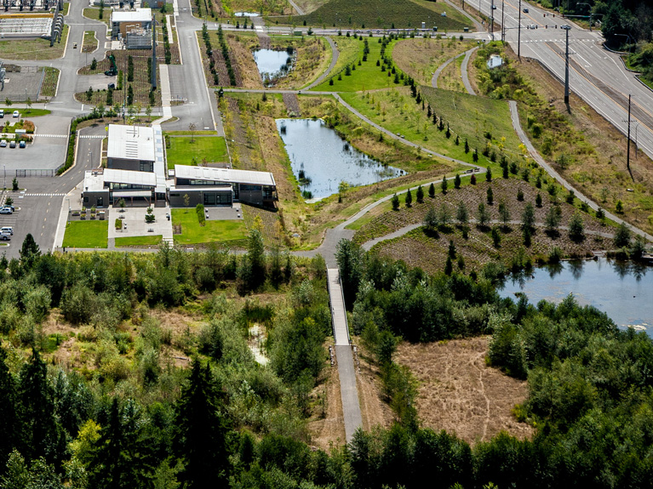
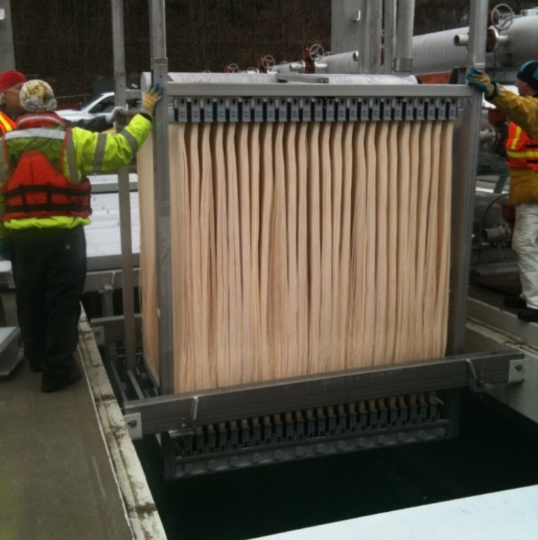
Produces Class A reclaimed water distributed to the Sammamish Valley
Capacity of 11 MGD (7,639 gallons per minute)
Used for irrigation of landscape crops, turf, food and commercial/industrial uses
King County Brightwater Treatment Plant
Woodinville, WA
Notes:
Brightwater is our newest and largest reclaimed water facility. We produce high quality recycled water from the Brightwater treatment process that is distributed to the Sammamish Valley.

Slide 15
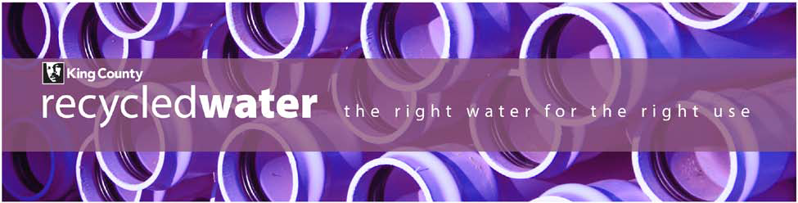
Why recycled water at Brightwater?
Requirement of outfall lease
Cost-effective infrastructure
Large irrigation demand in the Sammamish Valley for farms, parks and golf courses.
Opportunity to get water back in stream to improve habitat.
Notes:
Why
Most importantly we were told we had to through our outfall lease agreement with DNR
Re-purposing wastewater pipelines allowed us to build the system in a cost-effective manner
The farms, parks and golf course in the Sammamish Valley provides a concentration of irrigators
Sammamish Valley RW System provides multiple benefits-source substiution from river water to RW keeps more water back in the Sammamish River

Slide 16
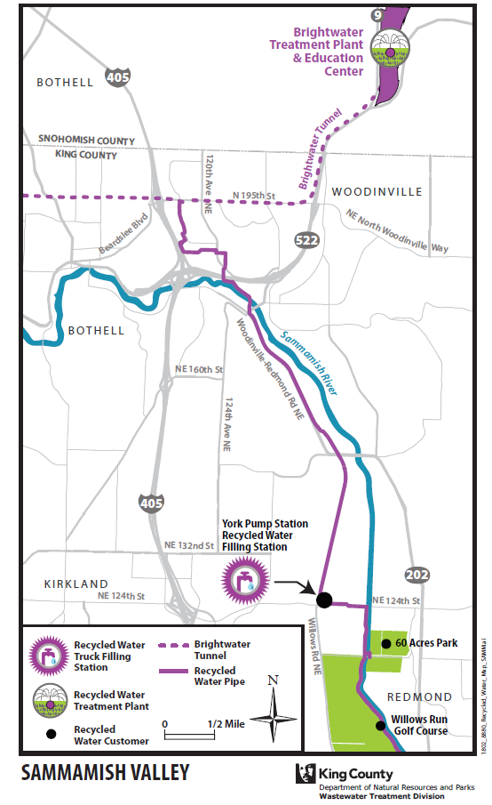
Brightwater Recycled Water Distribution System

Slide 17
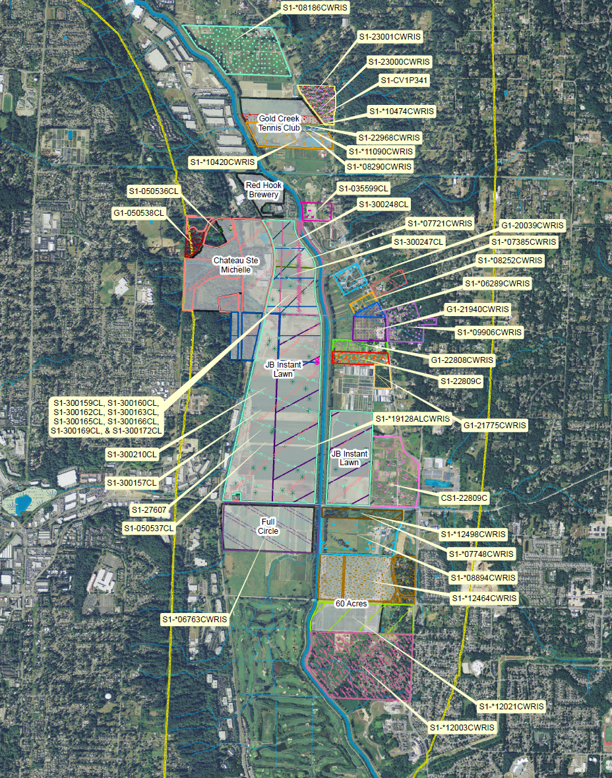
Sammamish Valley
Irrigators &
Water Rights
Source:
Department of Ecology
Notes:
Contains a 1000 + acre agricultural production district. Permanently protected as ag land.
And there are a lot of ground and surface water withdrawals in the Sammamish Valley.
Our distribution system serves the heart of the valley and is replacing former water withdrawals of river and hydraulically connected groundwater with recycled water

Slide 18
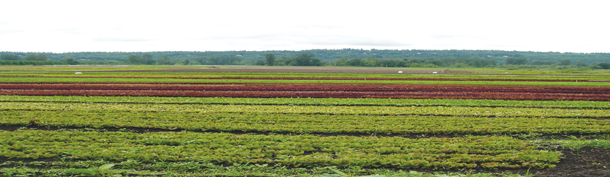
Sammamish Valley Recycled Water Project
Keep water in the Sammamish River
Enhances parks, golf courses and local agriculture
Creates opportunities for water markets/trading water rights
Drought-resistant water supply
Notes:
Small watershed but embodies a lot of resources of Puget Sound river basins – supports people (recreational facilities valued), farms and salmon
Recycled water keeps about 50-60 million gallons of water per year in the Sammamish River basin during critical summer months (while seems small, it is about equivalent to bringing back a small tributary in the river)
Connecting all irrigators along pipeline could leave 7 cfs of water in the stream (10-15% increase in summer streamflow)
Many farmers do not have water rights or adequate water rights and RW creates opportunity to increase yield or farm higher value crops
Creating opportunities to move water rights around the basin more easily through water rights trading
Resilient water supply- available in times of low flow and water supply restrictions

Slide 19
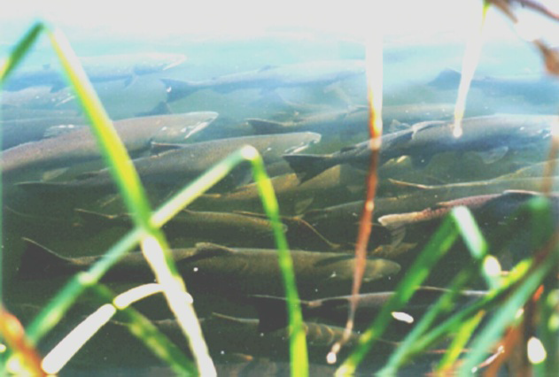
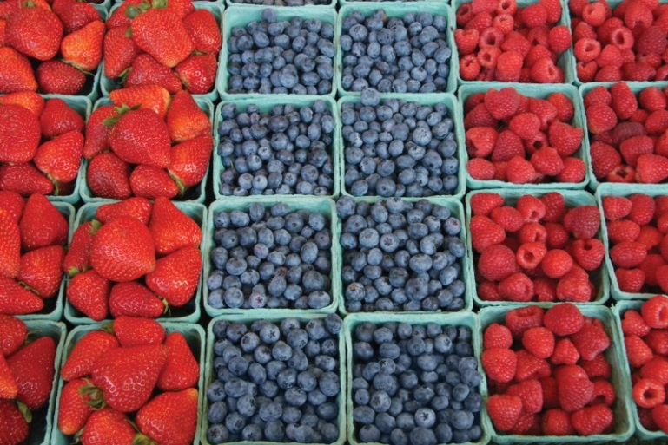

Brightwater Recycled Water:
Future Benefits
Keep water in the Sammamish River: by switching irrigators to recycled water, we could keep about 7 cfs in the river.
Expand Local Agriculture: recycled water can provide water for farms with no or limited access to water.
Supplement regional water supplies: recycled water can stretch municipal water supplies and support regional water resiliency efforts to drought and climate change.
Notes:
What’s next?
Expand use in the Sammamish Valley along our existing distribution network. Actively working with new irrigation customers. If we could switch all the irrigators that we can serve just with our existing distribution system, we could keep about 7 cubic feet per second. That’s a 15-20% increase in streamflow during the low-flow periods.
Expand Local Agriculture. The Sammamish has been closed to new water rights since 1979. Lot of ag land that has no water or limited water and water is limiting agriculture production. By expanding recycled water use, we can serve agriculture either directly through our pipes or by transferring water rights for users that can connect to the pipeline. We’re going to studying different options and possibilities in 2016 as part of the Local Agriculture Initiative.
Finally, we can help supplement regional water supplies. Thanks to efforts you, the cities and water districts, we have a robust water supply system. Recycled water is a drought-proof water supply that’s always available and adds to our region’s water supply portfolio and our regional efforts to build resilient communities.

Slide 20
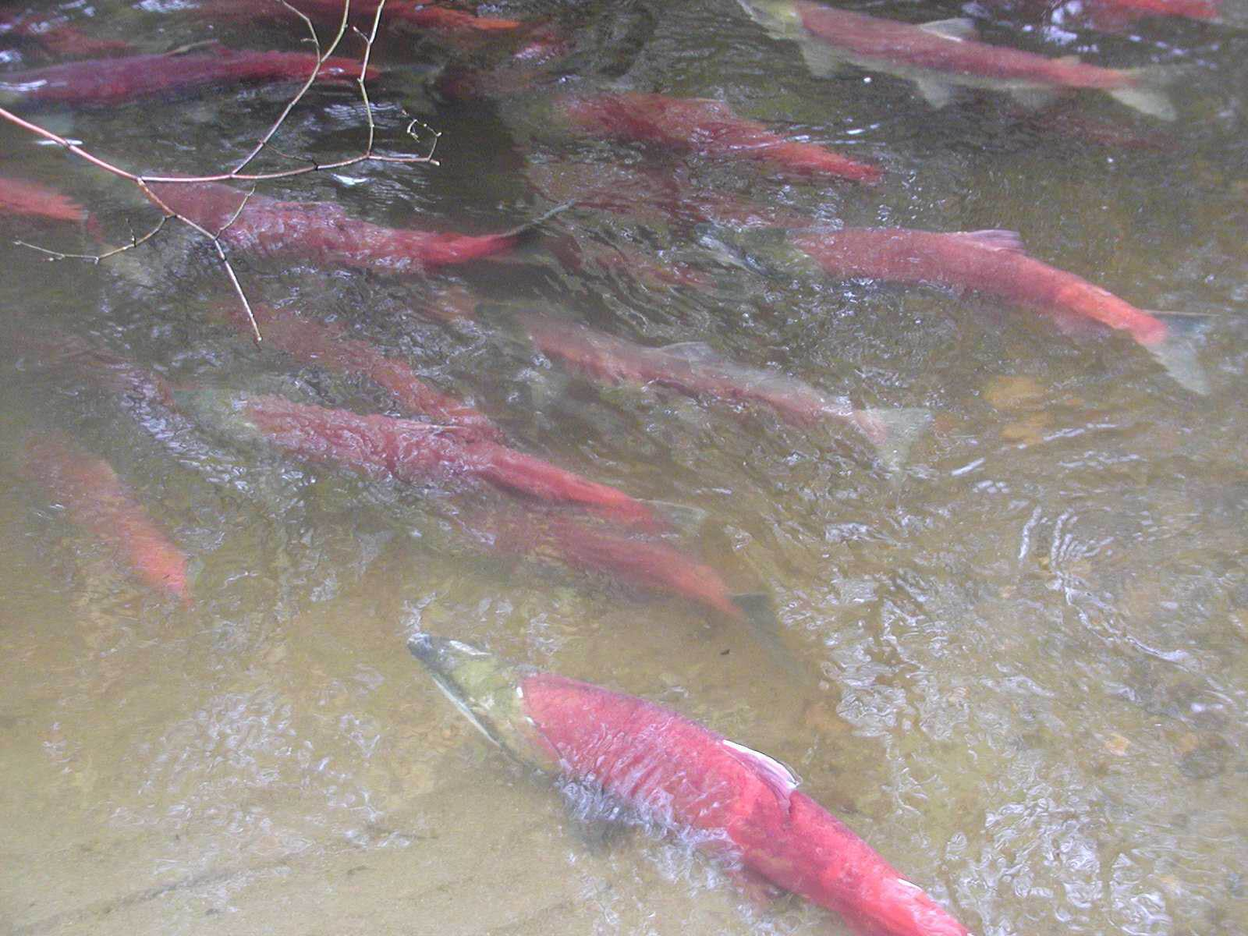
Sammamish River Restoration and Recycled Water
Switching Sammamish basin ground and surface water uses with recycled water is recommended in these plans:
Lake Washington/Cedar/Sammamish Chinook Salmon Conservation Plan (2005)
    Sammamish River Corridor Action Plan (2002)
Bear-Evans Temperature, Dissolved Oxygen and Fecal Coliform Bacteria Water Quality Implementation Plan (2011)
Notes:
Switching Sammamish basin water users to recycled water helps address the impacts of low stream flows and the related water quality impairments of high water temperatures and low dissolved oxygen. You know that water quality and stream flow are core components of healthy aquatic habitat.
It’s one of the recommended actions in the Chinook Conservation Plan you developed and are implementing, the Sammamish River Corridor Action Plan and the Bear-Evans Temperature-DO-Bacteria TMDL Plan.

Slide 21
Innovative recycled water projects

Slide 22
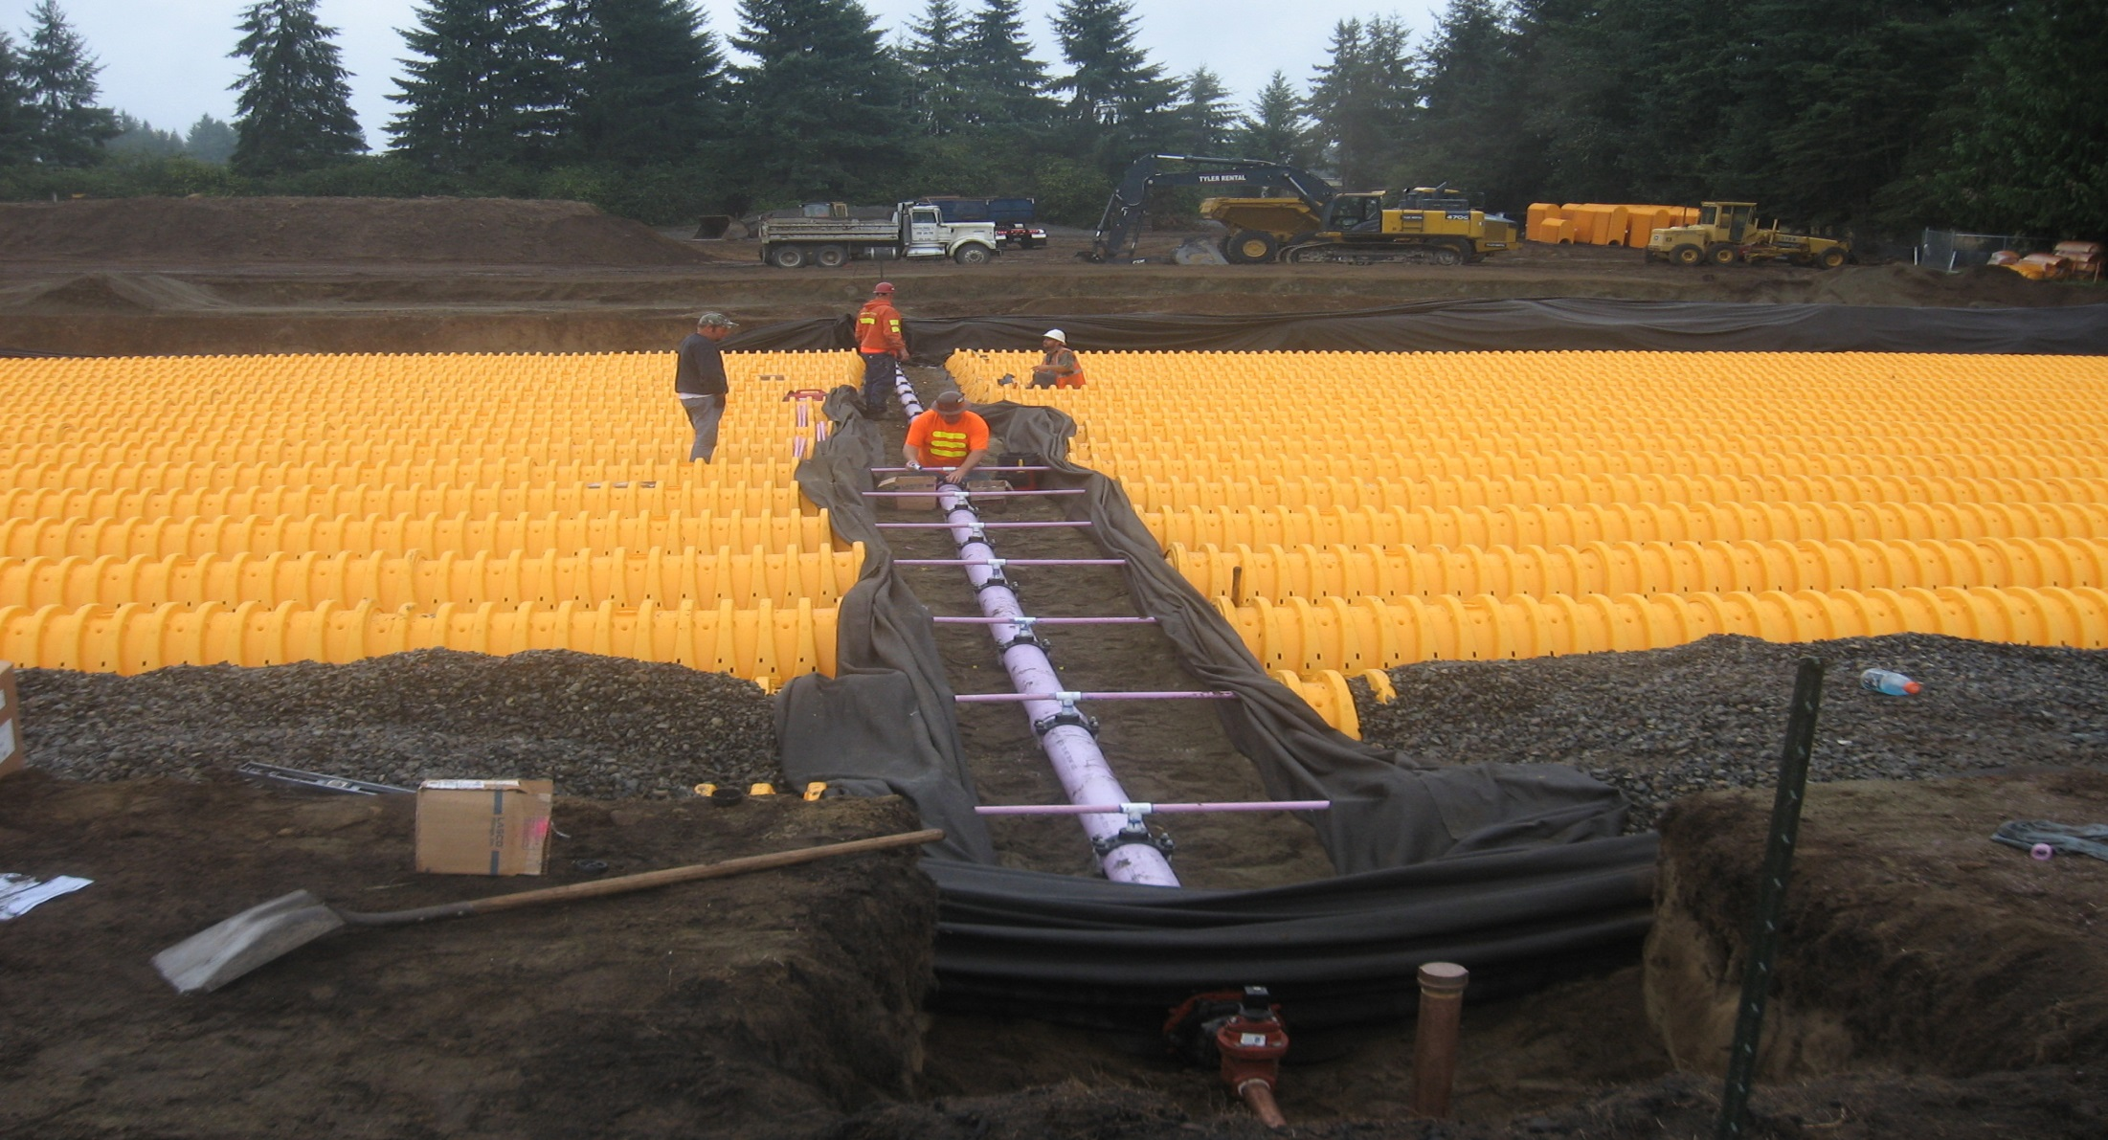
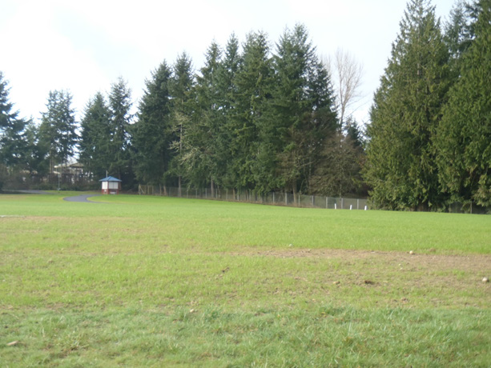
Woodland Creek Groundwater Recharge Facility, Lacey, WA
Subsurface infiltration beds
Mitigation for municipal water rights
Recharge basins is public park
Notes:
Construction of a subsurface infiltration facility at an existing park site that will recharge area groundwater with Class A reclaimed water (produced by the LOTT Clean Water Alliance) to provide in-kind mitigation of impacts associated with exercise of future water rights, while offering a secondary benefit of public education in a multi-use urban setting.
Started operating in July of 2015.
This is not an ASR project or indirect potable reuse project. There are some exempt wells nearby but no public water wells.
It is operated and maintained by the City of Lacey and the RW comes from LOTT Clean Water Alliance
On city park land purchased years ago with a grant from the recreation commission office requiring it to remain parkland. A major criteria in the project. Best geological characteristics.
Olympia
Transitioning from spring source to well field
Wellfield is immediately adjacent to and up-gradient from the Nisqually Indian Reservation
Impacts upon local area streams and lakes due to switch
Lacey
Water Rights Limited and Significant growth projected
2007 Use = 8,727 afy
2007 Water Rights = 8,638 afy + Olympia Intertie
2029 demand = 13,000 afy
Source - LOTT Satellite Class A RW Plant
Transmission – 8,300 LF 12” Main
Site - Woodland Creek Community Park
4.6 acres

Slide 23

King County Chinook Bend
Reclaimed water enhances wetland
Habitat and ecological restoration
Notes:
Recycled water can be used to create different water-dependent habitats. This photo shows the Chinook Bend wetland near the City of Carnation. Recycled water is supplied to the wetland year-round creating flow of water to the wetland, creating habitat used by a variety of wildlife (birds, mammals, fish). Also serves as recreation for humans.

Slide 24
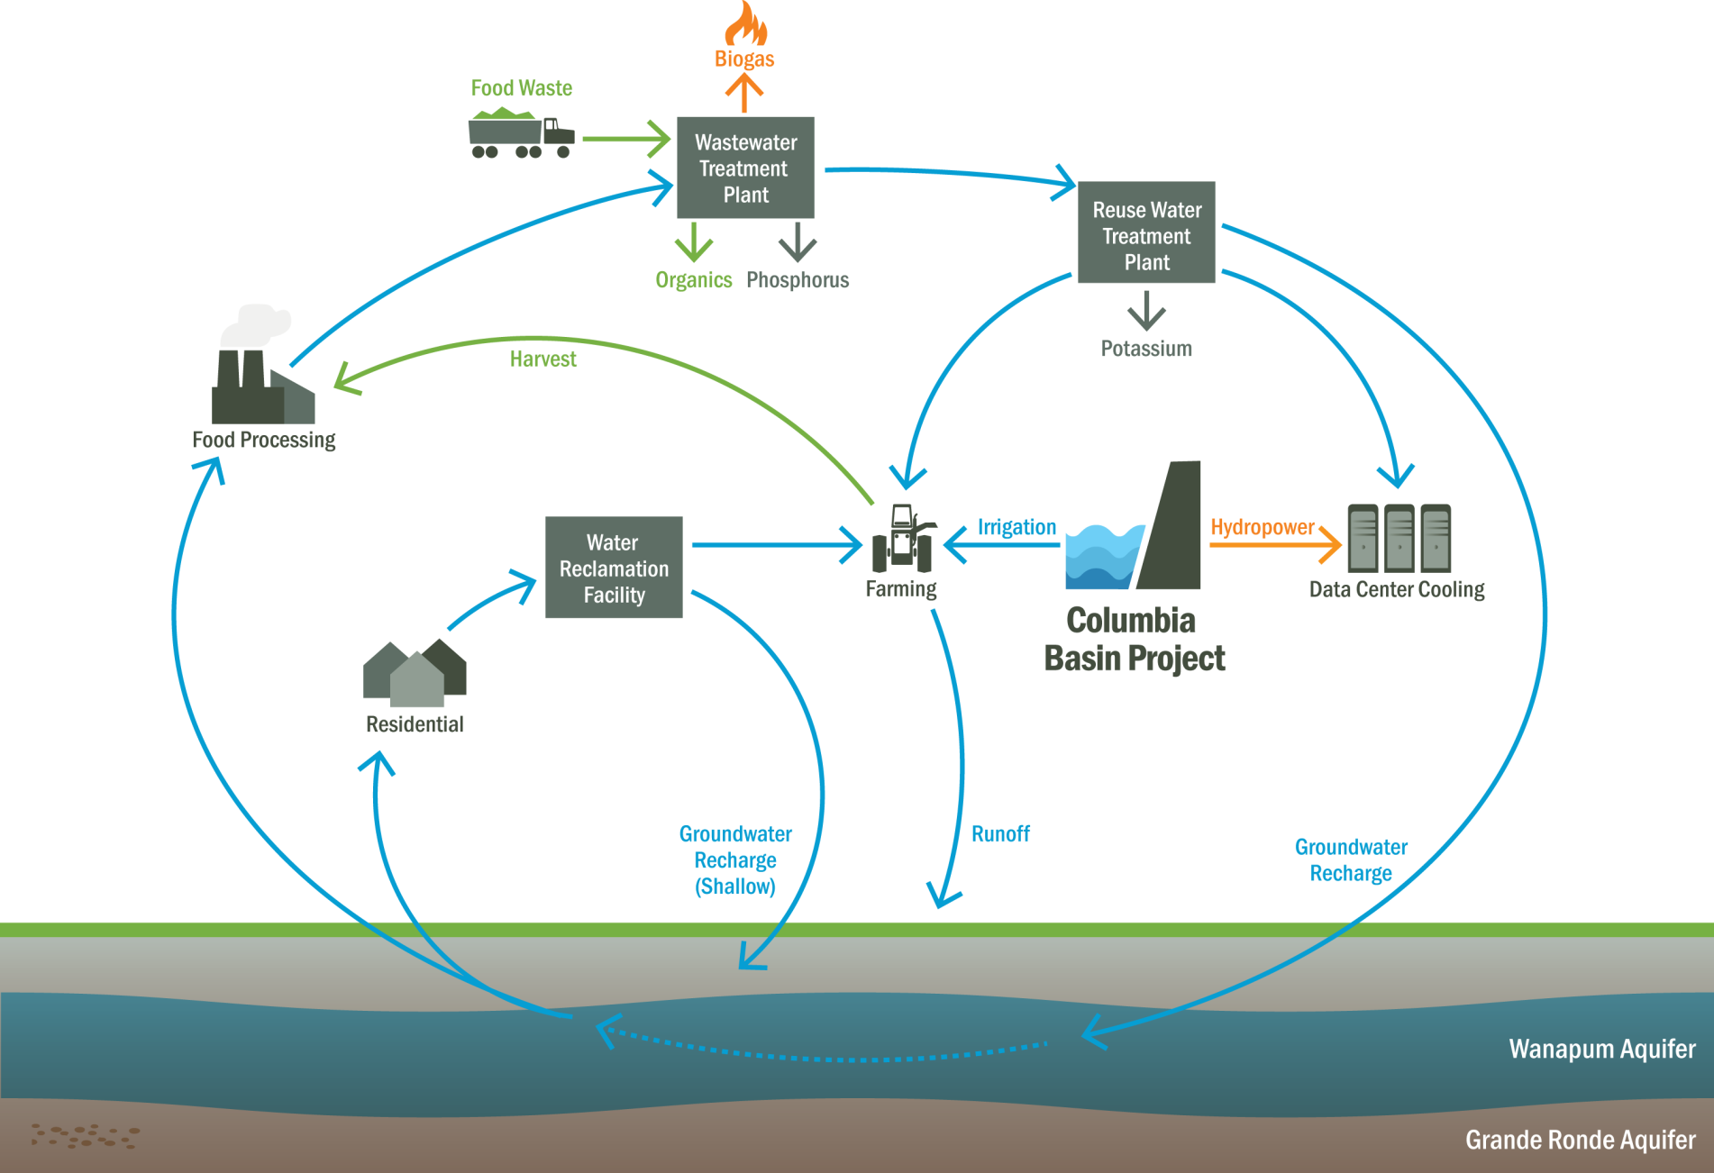
City of
Quincy, WA
Economic development -water supply for data centers, food processors
Pursuing Aquifer Storage and Recovery
Notes:
Quincy, WA is pursuing recycled water in many innovative ways.
An agricultural community, it is now growing a new kind of farms : Server Farms
Creating new integrated wastewater and water supply management for industries and community. Integrates water treatment and supply creating secure water supply for food processors, Quincy, WA is pursuing recycled water in many innovative ways.
An agricultural community, it is now growing a new kind of farms : Server Farms
Creating new integrated wastewater and water supply management for industries and community. Integrates water treatment and supply for irrigators, food processors and data centers.

Slide 25
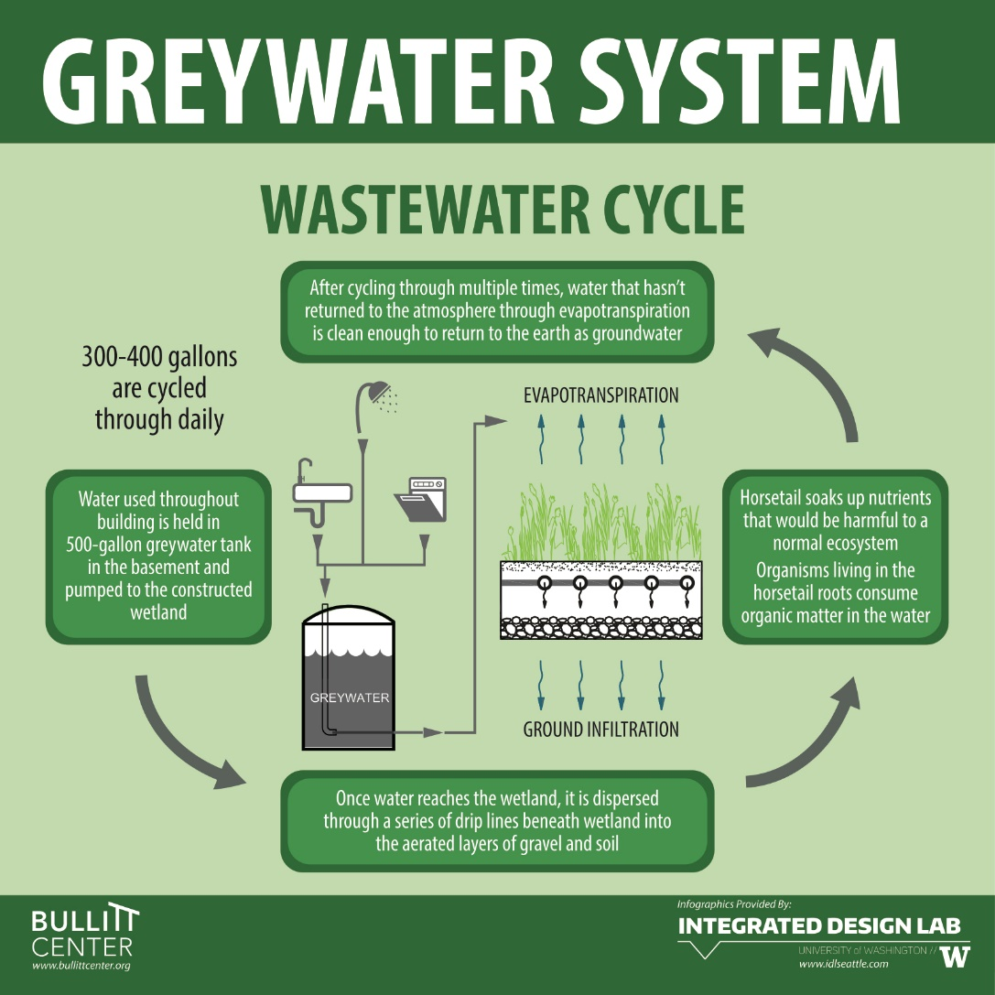
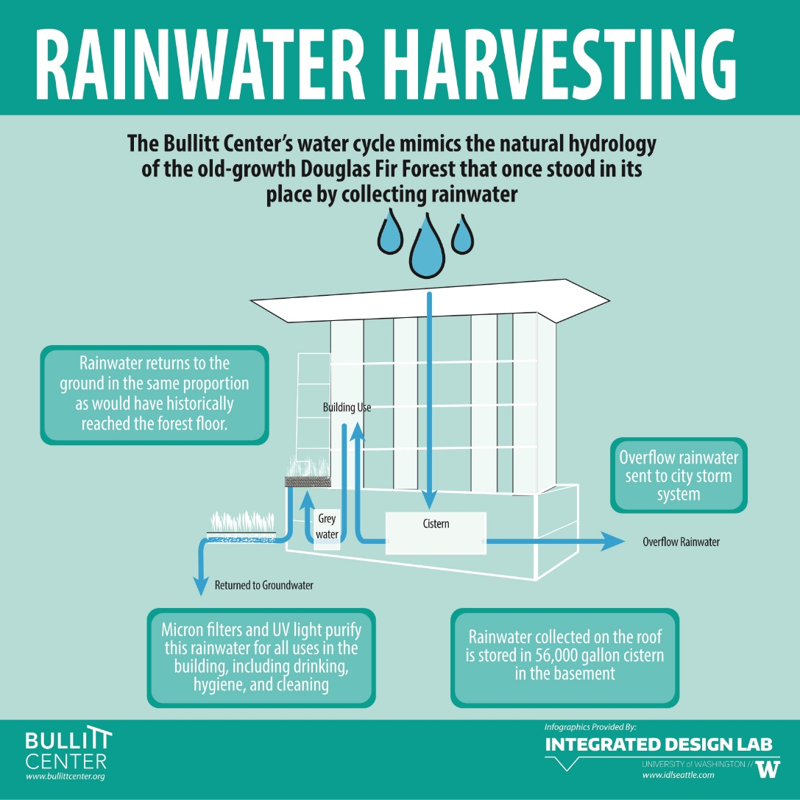
Decentralized non-potable reuse
Greywater and rainwater captured and reused onsite for non-potable uses
Composting toilets treat and reuse human waste
Bullitt Center
Notes:
Growing interest in decentralized non-potable reuse capturing and using a variety of alternative waters (e.g., rainwater, foundation water, greywater, even blackwater)
Great session later on in this conference on Hasslo and 8th district scale decentralized wastewater treatment system using MBR and wetland onsite to treat stormwater and wastewater
Legislation in WA and OR considered this session that would required state rules to establish treatment, use and permitting standards based on expert panel’s risk-based water quality standards for non-potable reuse
Interest in “deep green” development driven by developers and their clients (businesses and residents)

Slide 26
Future Drivers for water reuse in the pacific northwest

Slide 27
Puget Sound Nutrient Source Reduction Project
Department of Ecology is investigating nitrogen limits for wastewater plants to improve water quality in Puget Sound.
Notes:
-Ecology launched in 2017 a process to investigate nutrients and contribution to dissolved oxygen in Puget Sound
-Nitrogen is believed to be contributing to DO impairments
-Using Salish Sea model to model different scenarios including lowering WWTP nutrient loading and non-point loading
-If this proceeds towards more nutrient removal requirements, reclaimed water use may expand either as a compliance strategy to reduce nutrient loading or to maximize the ancillary benefit of using highly clean water for supply purposes (e.g., mitigate water rights, shave peaking)

Slide 28
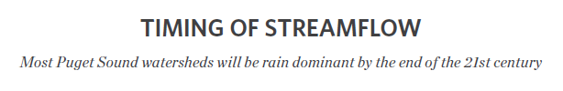
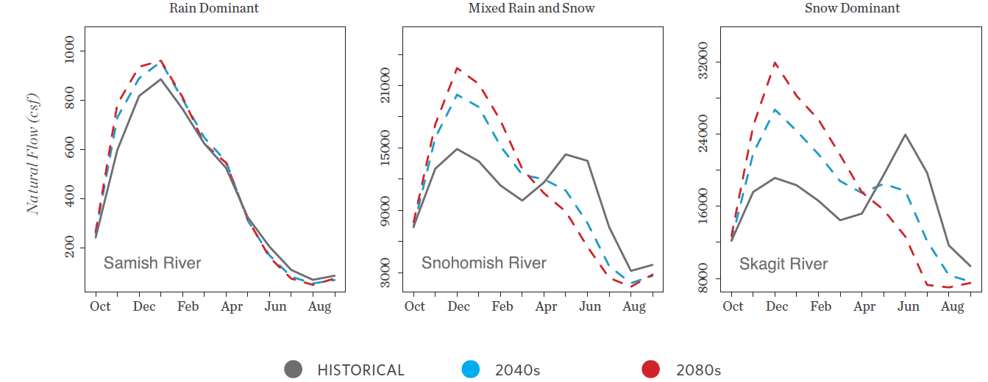
2015 State of Knowledge: Climate Change in Puget Sound. Climate Impacts Group
Recycled water may help respond to changing watershed hydrology due to climate change.
Notes:
Respond to changing hydrology caused by climate change.
- Reclaimed water can help reduce summer demand for irrigation water
Reclaimed water offer secure water supply for watershed enhancement through stream flow augmentation or ASR

Slide 29
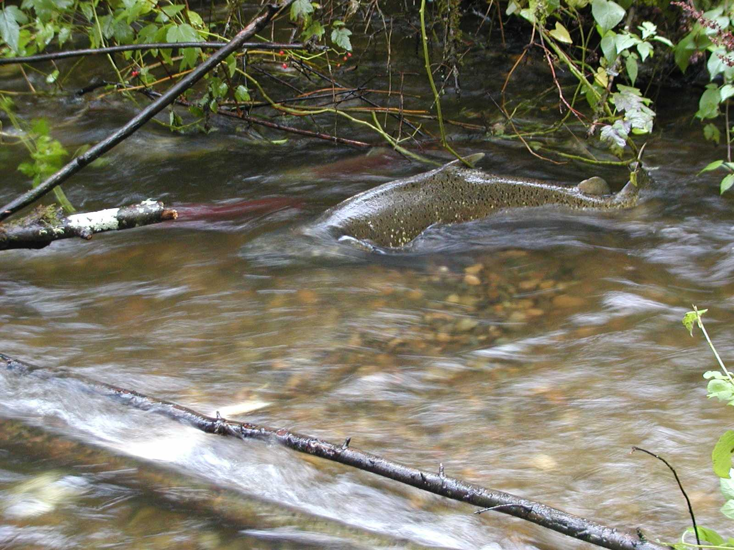
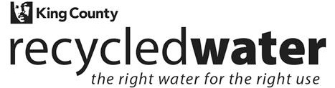
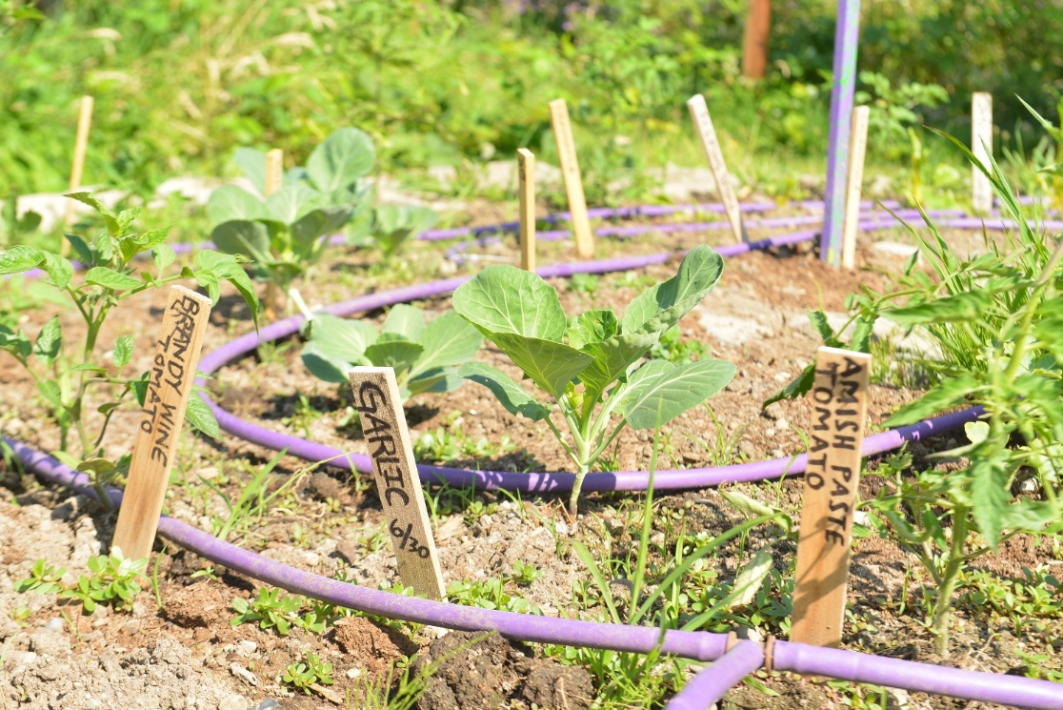
Find out more:
Jacque.Klug@kingcounty.gov
Tel: 206-477-4474
www.kingcounty.gov/recycledwater
Notes:
Around the state, watershed restoration and enhancement committees will be developing projects to mitigate flow reductions from use of new domestic wells
-Growing interest to look at projects that can accomplish the higher value “water for water” mitigation
-Hard to find water rights to retire – reclaimed water may be a viable source of water to recharge aquifers and restore streamflows

