Slide 1



Foundations of Growth Management Act Planning in King County
WRIA 8 - March 28, 2019
Karen Wolf, FAICP

Slide 2
Overview
The challenge faced by the region to accommodate projected growth
How the state Growth Management Act is implemented in King County
How VISION 2040 influences planning in King County through the Multi-County Planning Policies and the Regional Growth Strategy and the VISION 2050 update
How growth targets are set in King County
Coordinated planning in King County
WRIA 9 specific conditions

Slide 3
GMA Framework: Goals
Local jurisdictions balance and prioritize goals, tailored to their local visions
Encourage compact urban growth
Reduce sprawl
Encourage coordinated, multimodal transportation
Encourage affordable housing
Encourage economic development
Protect property rights
Predictable permitting
Maintain natural resource industries
Retain open space, enhance recreation
Protect the environment
Encourage citizen participation
Ensure availability of public facilities and services
Encourage historic preservation
Manage shoreline development

Slide 4
GMA Framework
Local jurisdictions balance and prioritize the 14 goals, tailored to their local visions
New growth must be concentrated in urban growth areas
State agencies including commerce do not certify plans but do review and comment on plans to make sure required elements are included
Only the Regional Transportation Planning Organizations (PSRC) have certification authority for plan elements

Slide 5
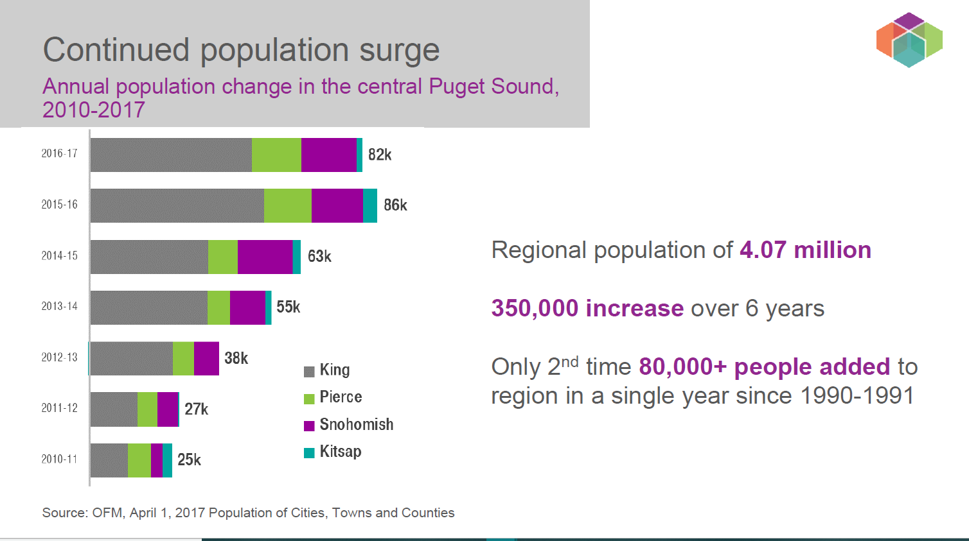
Rapid Growth in the 4-County Region

Slide 6
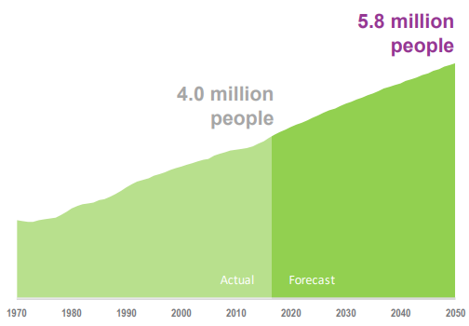
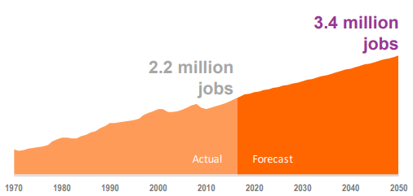
Looking Forward to 2050 in the 4-County Region
5.8 million people – an increase of 1.8 million
3.4 million jobs – an increase of 1.2 million
2.4 million households – an increase of 830,000

Slide 7
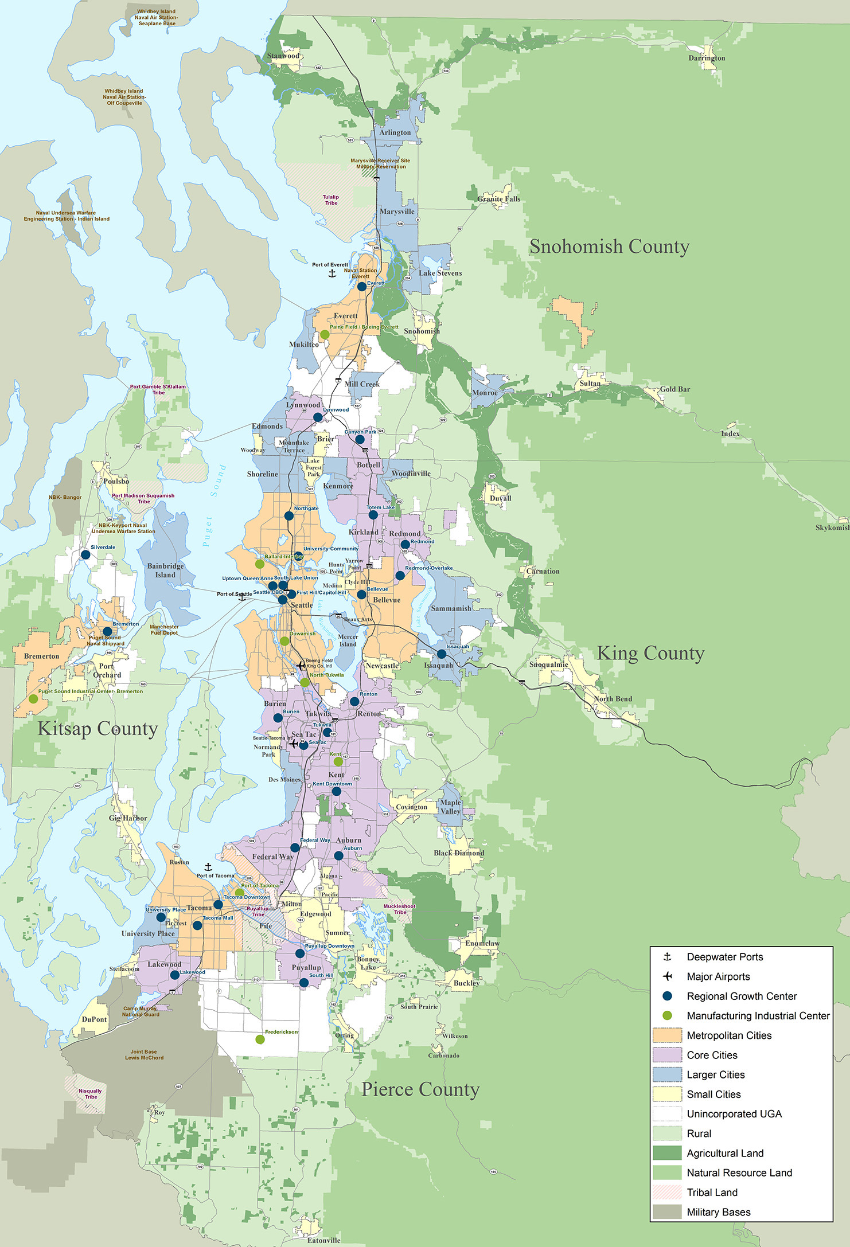
Multicounty Planning Policies
Regional policy direction
  Development patterns
  Environment
  Housing
  Economy
  Transportation
  Public Services
Establish a common region-wide framework to ensure consistency among comprehensive plan and countywide planning policies

Slide 8
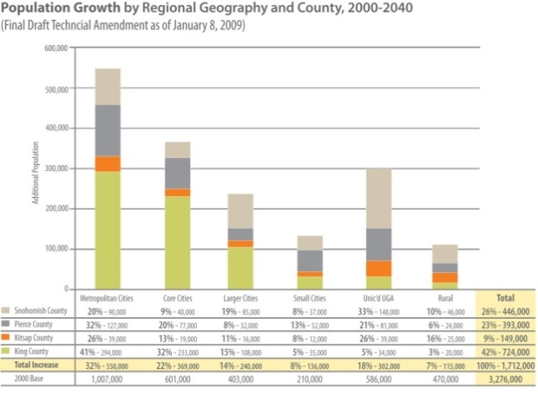
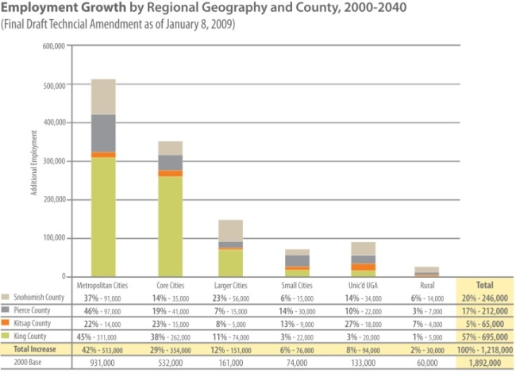
Regional Growth Strategy
Provides numerical guidance for countywide targets
MPPs require consistency between Growth Targets and the Regional Growth Strategy, and consistency between Growth Targets and Land Use Assumptions in Plan
Acknowledgement that targets and local plans may not precisely align with RGS in every geography
  “consistent with” is the term in VISION 2040 and Countywide Planning Policies
  Where land use assumptions vary from targets, jurisdictions to show actions and measures to bend the trend

Slide 9
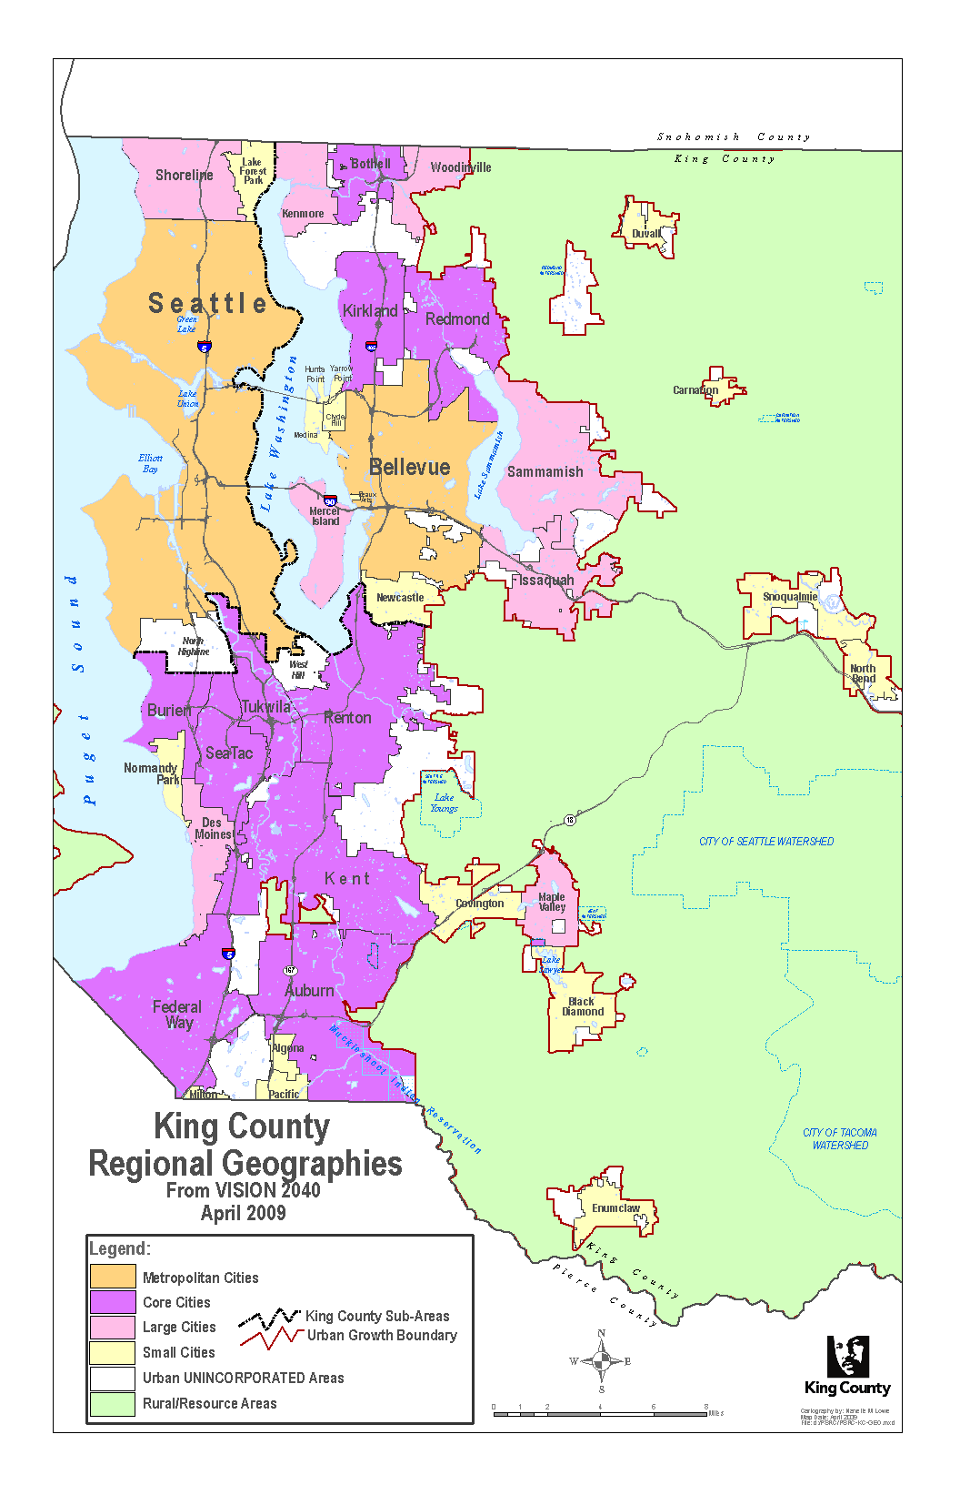
Target Setting: Regional Growth Strategy
Regional Growth Strategy calls for:
Increased growth in mid- to large-size cities, especially cities with designated Centers
Decreased growth in Rural areas
Decreased growth in Urban unincorporated areas and smaller cities, especially at the urban edge
Increased jobs-housing balance in the region

Slide 10
VISION 2050 Growth Alternatives
Stay the Course | Transit Focused Growth | Reset Urban Growth
Growth focused in Metropolitan and Core cities | More compact growth focused in high capacity areas | Growth more distributed throughout the urban growth area

Slide 11
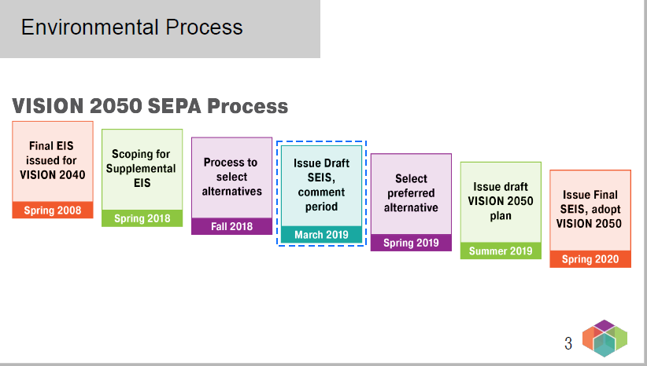
Environmental Process

Slide 12
GMA in King County
King County chose to work closely and collaboratively with cities to set the UGA and establish the Countywide Planning Policies
Interlocal Agreement (1992)
  Growth Management Planning Council (GMPC)
  Interjurisdictional Staff Team
  Rules for adoption and ratification of Countywide Planning Policies

Slide 13
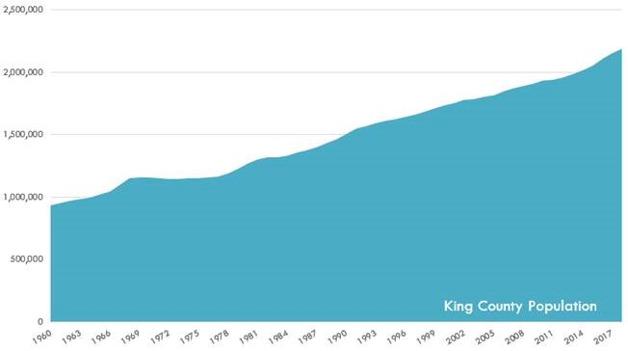
King County Population Growth

Slide 14
GMA in King County
Countywide Planning Policies (last updated 2012) establish:
  Urban Growth Area (UGA)
  Criteria for revising the UGA
  Growth targets for each jurisdiction
  Criteria for defining urban centers and manufacturing/industrial centers

Slide 15
GMA in King County
Countywide Planning Policies provide guidance for local comprehensive plans on:
  Development pattern
  Transportation
  Affordable housing
  Public capital facilities
  Annexation and joint planning
  Economic development
  Environment

Slide 16
Target Setting: CPPs establish guiding principles
Accommodate most recent 20-year population forecast from OFM, and 20-year jobs forecast from PSRC.
Plan for growth consistent with Regional Growth Strategy
  Focus growth in cities with major centers, & in other large cities
  Limit development in Rural Areas, protect Resource Lands
Efficiently use existing development capacity
Promote a land use pattern served effectively with infrastructure and transit
Improve jobs/housing balance within the county
  Source: Policy DP-11 in Countywide Planning Policies, 2012
Notes:
16

Slide 17
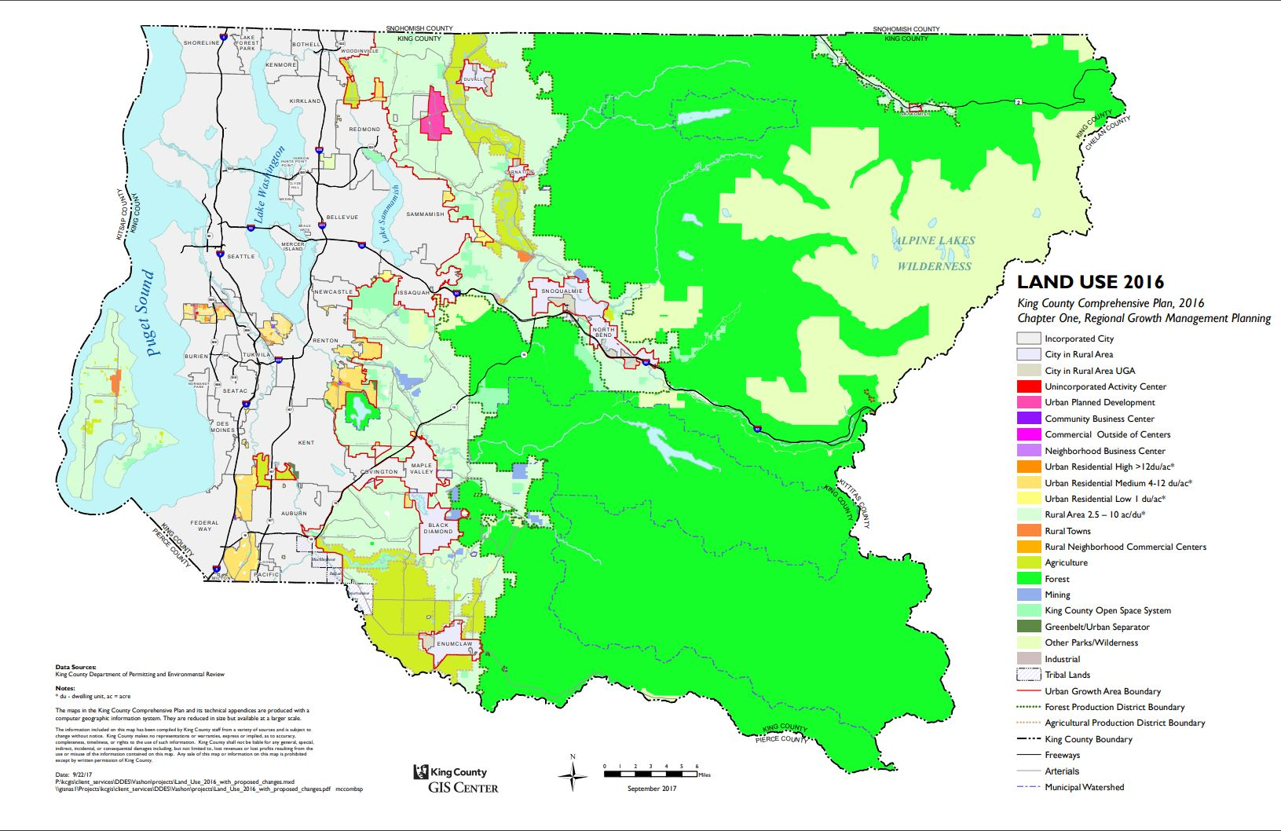
King County Land Use Map

Slide 18
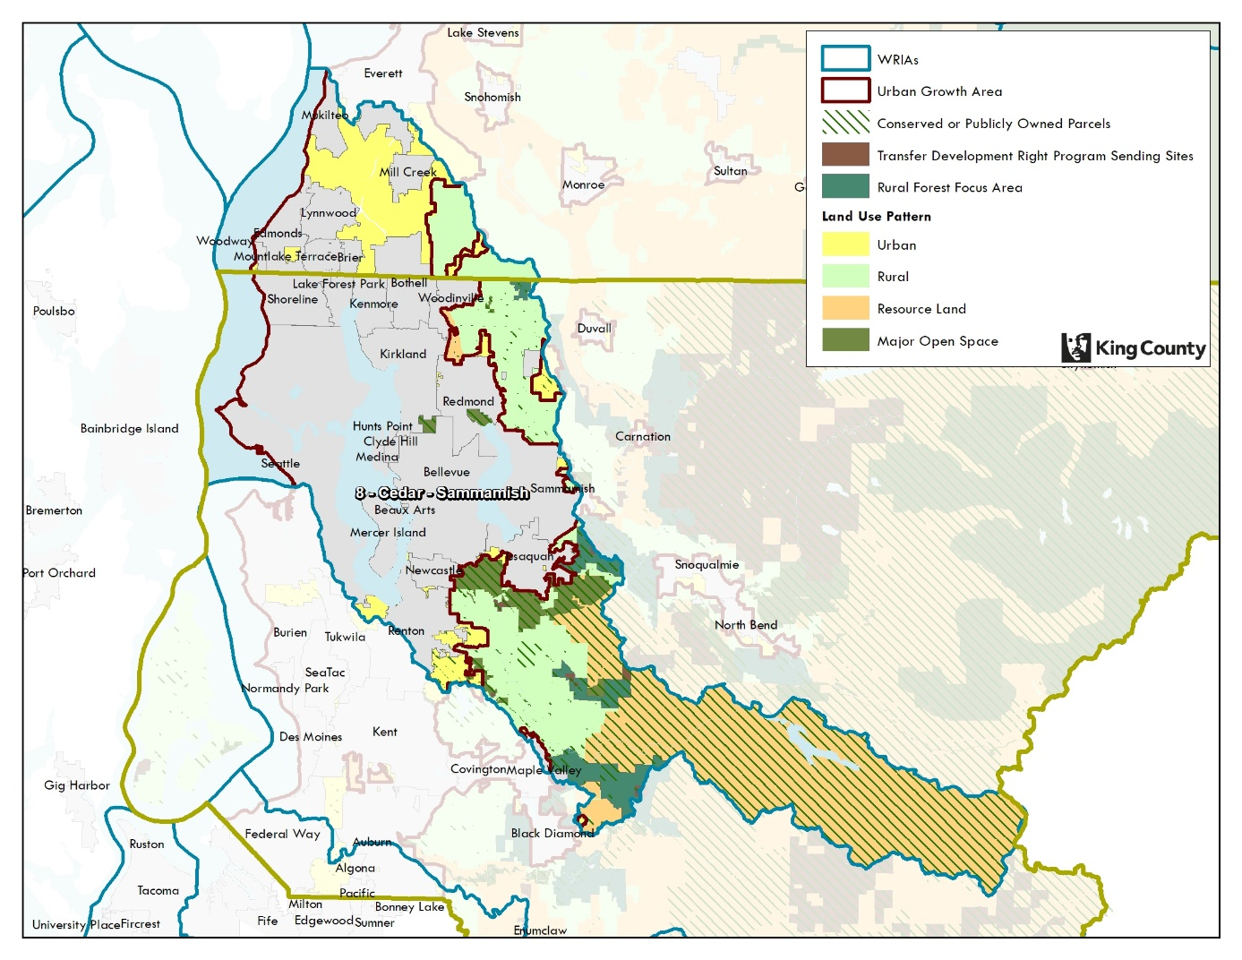
WRIA 8 Land Use

Slide 19
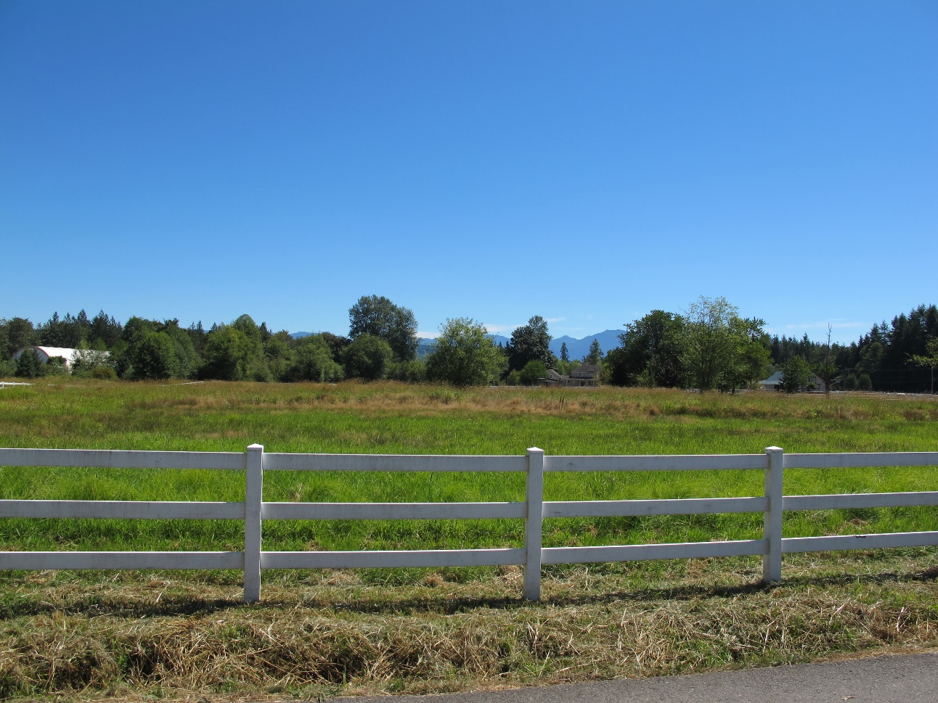
WRIA 8 Land Use
The unincorporated portions of WRIA are primarily resource lands and rural
Includes ½ of the Redmond Ridge UPD, which is built-out
There is no growth target for these lands
Includes the Sammamish Valley Agricultural Production District
The cities have limited expansion areas

Slide 20
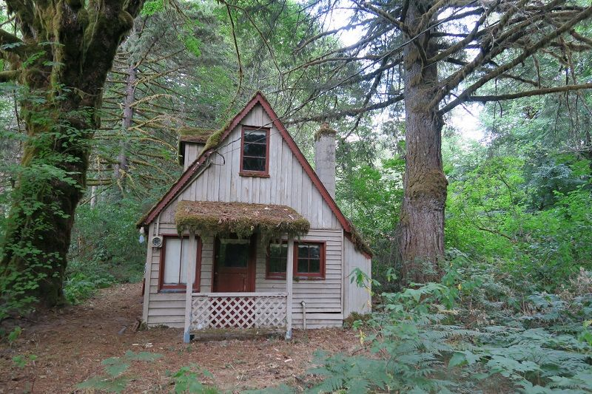
WRIA 8 Zoning
Majority of the land area is in protected status either as public land or with easements such as a TDR sending site or PDR site
The Cedar River Watershed is completely protected
Rural zoning is either RA-5 or RA-10
Agriculture zoning is either A-10 or A-35
Forest zoning is F-80

Slide 21
King County Comprehensive Plan Domestic Water Supply
Existing Group A for new construction and subdivisions
Satellite management by a Group A
Satellite management by an agency or existing Group B
New system, private well, rain catchment
Individual private wells not allowed on urban lots unless would deny reasonable use of the property and then only interim

Slide 22
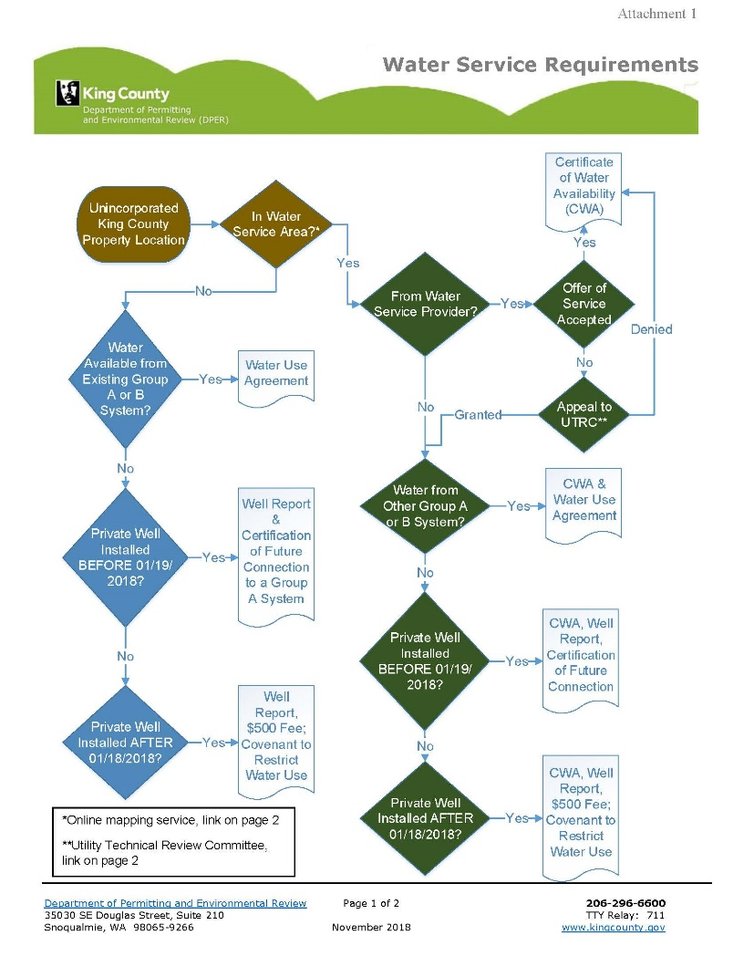
Water Service Requirements

Slide 23
KC Comprehensive Plan 2020 Schedule
July 1, 2019 – Executive releases a Public Review Draft with a 30-day public comment period and public meetings (dates and location TBD)
September 30, 2019 – Executive transmits the Executive Recommended Plan to the County Council
June 30, 2020 – Deadline for Council adoption of 2020 Comprehensive Plan

Slide 24
Major Update Schedule Overview
Local Comp Plans
2004 GMA updates
2015 updates
2023 updates
Buildable Lands, Countywide Planning Policies, Growth Targets
VISION 2050
VISION 2040

Slide 25
  King County
  Office Performance, Strategy, & Budget
  Karen Wolf, FAICP
  206-263-9649 karen.wolf@kingcounty.gov

