Slide 1
Land Use Planning and Population Projections
Watershed Restoration and Enhancement Committee WRIA 8
March 2019
SNOHOMISH COUNTY
WRIA 8

Slide 2
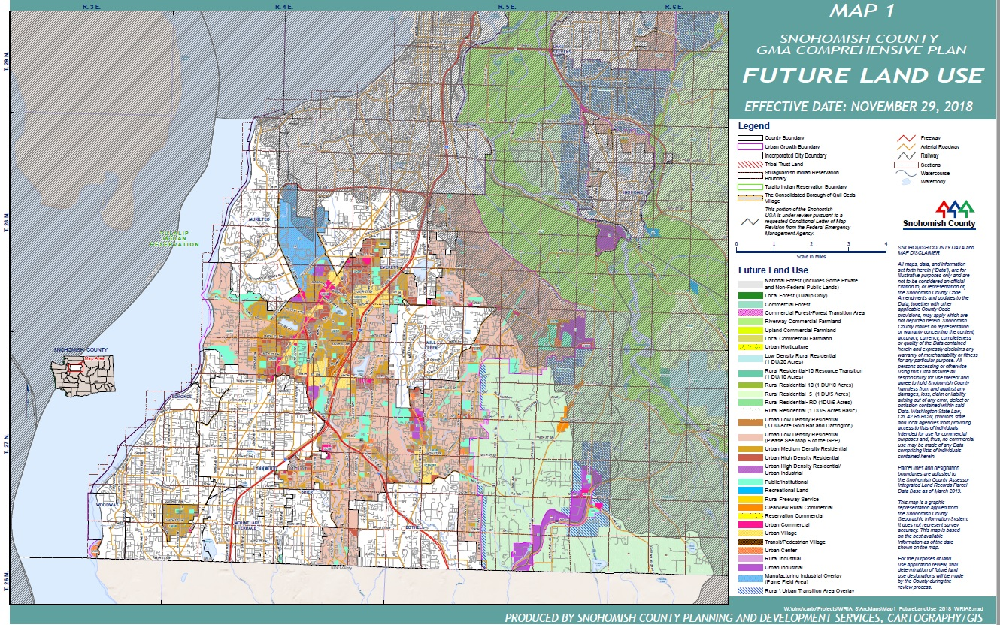
Snohomish County future land use map

Slide 3
Policy and Regulation that will affect future growth in WRIA 8
Vision 2050 and Regional Growth Strategy
Local Policies:
91.5% of growth allocated to UGAs
8.5% of growth allocated to Rural/Resource areas
Prohibition on sewer extension outside of UGAs
County and city development regulations:
Zoning code
Rural cluster subdivisions
Critical area protection
Tree canopy requirements
NEW county water code (2019)
Non-Regulatory Programs affecting development density:
Current Use tax program
Transfer of Development Rights

Slide 4
Growth Forecasts: Rural Housing Units
OFM
Total Pop
2038
OFM
Total Pop
2018
Total Pop
Growth 2018-2038
1,039,163
807,659
231,504
Total Pop
Growth 2018-2038
8.5%
Rural Pop
Growth 2018-2038
231,504
19,678
Rural Pop
Growth 2018-2038
Rural Avg. HU Size
Rural HU
Growth 2018-2038
19,678
2.51048
7,866 *
* Countywide rural and resource area HU growth 2018 -2038: WRIA 3, 4, 5, 7 and 8

Slide 5
Growth Forecasts: Urban Housing Units
OFM
Total Pop
2038
OFM
Total Pop
2018
Total Pop
Growth 2018-2038
1,039,163
807,659
231,504
Total Pop
Growth 2018-2038
91.5%
Urban Pop
Growth 2018-2038
231,504
211,827
Urban Pop
Growth 2018-2038
Urban Avg. HU Size
Urban HU
Growth 2018-2038
211,827
2.466
85,899*
* Countywide UGA HU growth 2018 -2038: WRIA 3, 4, 5, 7 and 8

Slide 6
Countywide HU Growth Estimate 2018-2038
Total Countywide
HU Growth
2018-2038
Rural HU
Growth 2018-2038
Urban HU
Growth 2018-2038
7,866
85,899
93,765
How much of the 2018-2038 HU growth will be in WRIA 8 ?
How much HU growth will be in each subbasin within WRIA 8? Timing?
How many new HU will connect to public water systems?
How many new HU will rely on new permit-exempt wells?

Slide 7
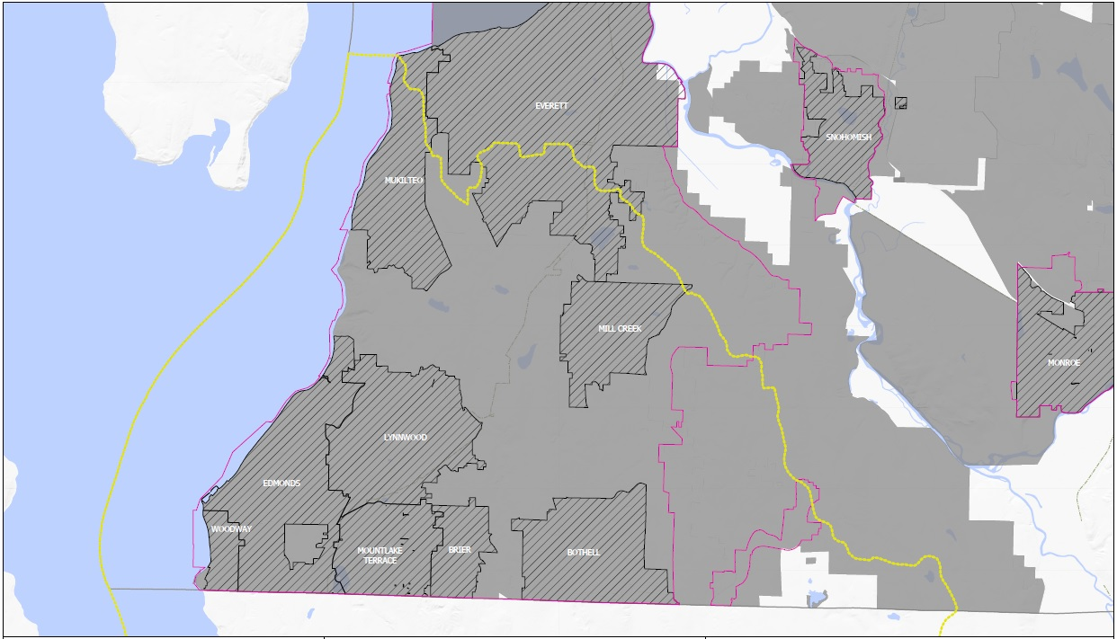
WRIA 8 city and unincorporated UGA water supply map

Slide 8
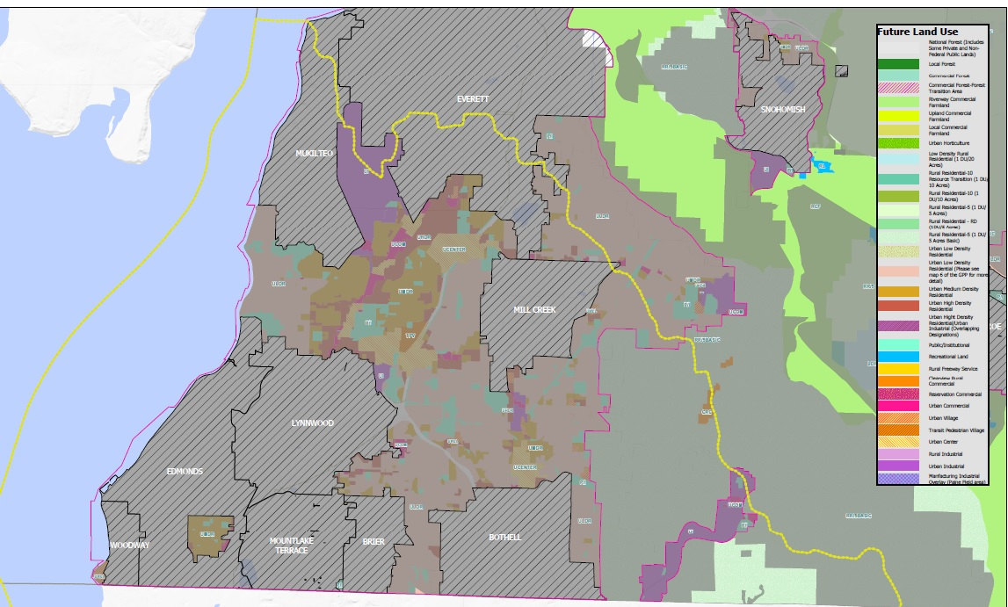
WRIA 8 City and Unincorporated UGA water supply map

Slide 9
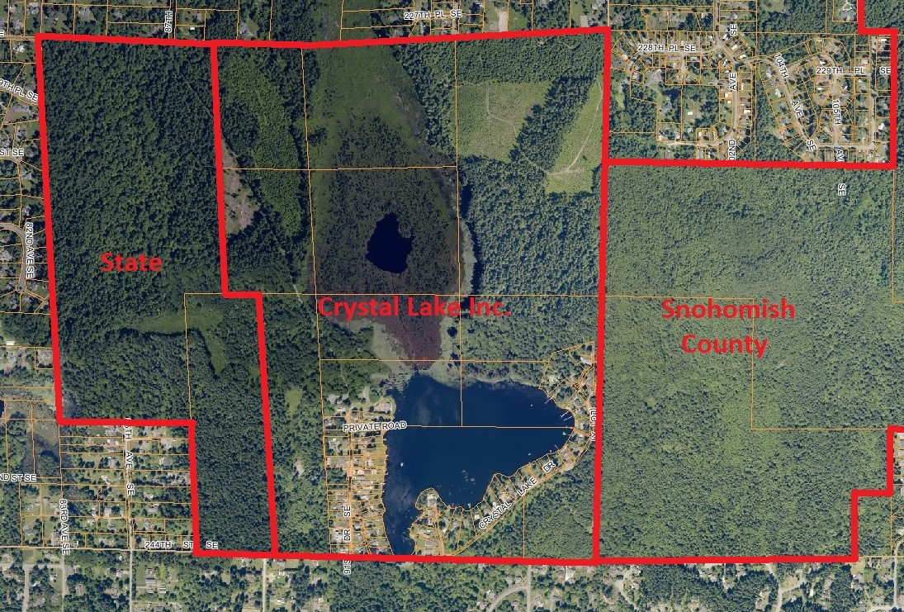
Crystal Lake

Slide 10
How much HU growth will be in WRIA 8?
Assumption:
Past trends are good predictors of future growth distribution by WRIA; provided …
Adjustments needed for vacant land availability

Slide 11
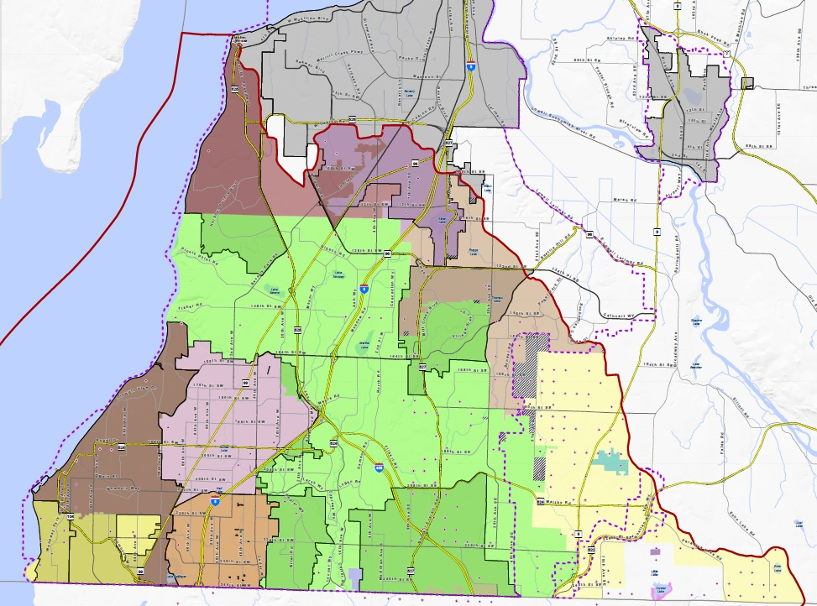
WRIA 8 well logs 1998-2018 map

Slide 12
Water Well Data in WRIA 8 (1998-2018)
1,684 wells added between 1999-2018 in WRIA 8
Average of 84 new wells each year over twenty years
New wells added over 5-year increments:
Years | New Wells inside Water District | New Wells outside Water District | Total
1999 - 2003 | 92 | 6 | 98
2004 - 2008 | 302 | 8 | 310
2009 - 2013 | 355 | 6 | 361
2014- 2018 | 909 | 6 | 915
Total | 1658 | 26 | 1684

Slide 13
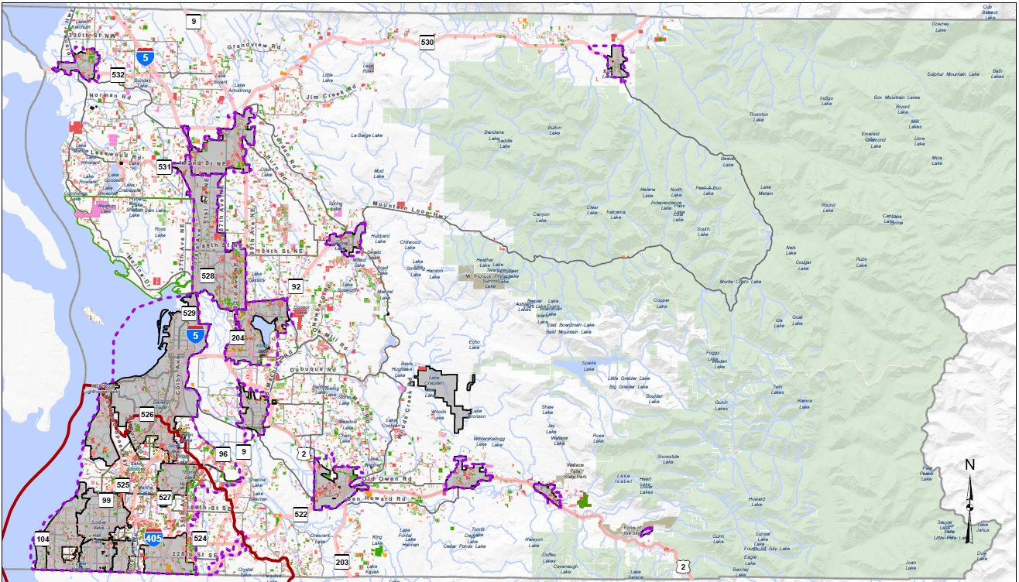
Snohomish County Growth map

Slide 14
Year Built HU Data for WRIA 8 (1998-2018)
Snohomish County Location | SFR Year-Built 1998-2018 *
WRIA 8 | 46.55%
WRIA 8 Cities | 14.7%
WRIA 8 Uninc. UGA | 30.9%
WRIA 8 Rural / Resource | 0.9%
Non-WRIA 8 | 53.45%
* “Year Built” data shows that a new house was constructed, however, there is no indication if the new house is replacing an old one, and therefore not precisely reflecting HU growth and a corresponding increase in demand for potable water.

Slide 15
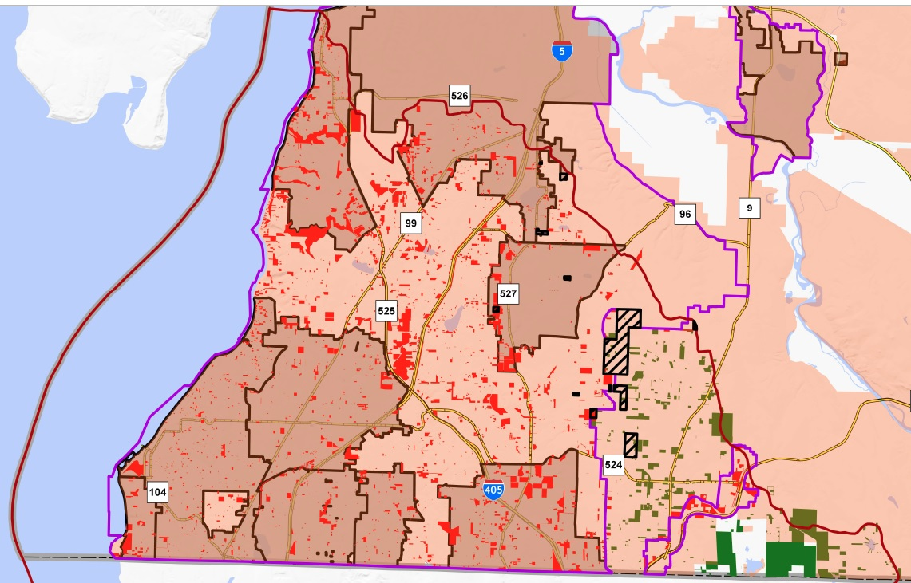
Snohomish County WRIA 8 growth projections
“Vacant” records
in WRIA 8:
4,510 inside UGAs
360 outside UGAs
4,870 total

Slide 16
Vacant Land in WRIA 8
A caution about “Vacant” land data
– Snohomish County Assessor
Does not guarantee that the parcel is actually vacant:
Many parcels have multiple records in the database
Example: Leased land will have a land record and a separate record for the improvements – the land will appear as if it is vacant so the land owner is not taxed on the improvements; the improvements will be in a separate record for the owner of the buildings.
Timberlands, agricultural lands, mineral resource operations, parks, estuaries, conservation areas, submerged lands, critical areas, NGPAs & CAPAs, etc. are included as “vacant”.
“Vacant” will include small slivers of land along right-of-way that do not have “lot status” and are too small to develop.

Slide 17
Snohomish County Comprehensive Plan Update - 2023
# | Project/Task | 2019 | 2020 | 2021 | 2022 | 2023
1 | Vision 2050
2 | CPP Update
3 | Buildable Lands Report
4 | 2043 Initial Growth Targets
5 | 2020 Census/OFM Forecasts
6 | Major Docket Applications
7 | GMA Compliance Review
8 | Comprehensive Plan Update
9 | SEPA
10 | Legislative Adoption Process
WREC WRIA 8 deadline

Slide 18
Conclusion
Data availability and WREC timelines are not coincident
Growth forecasting requires reliance on numerous assumptions
The subbasin strategy should not imply a level of detail that cannot be supported by the data and assumptions.
There are many factors that will influence the timing of growth
Mitigation in kind, in time and in place – acceptable level of accuracy?

