Slide 1
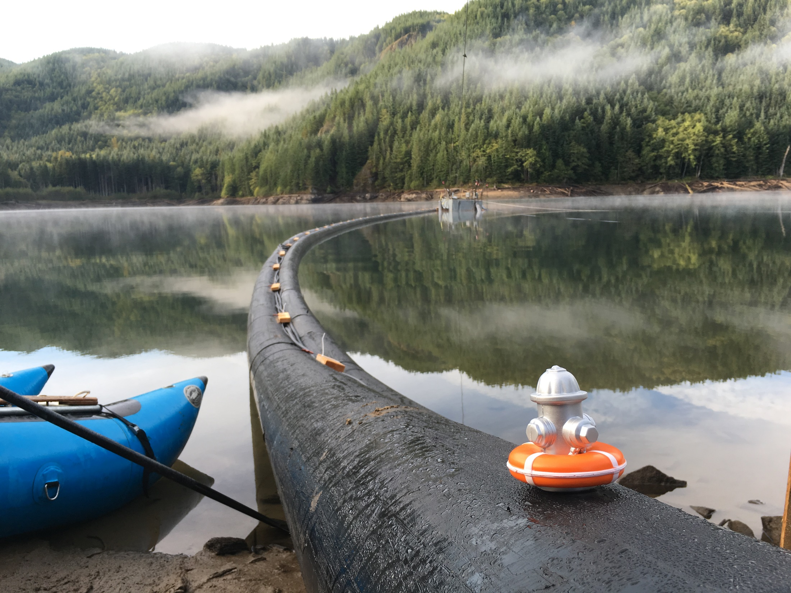
Eagle Lake Siphon Project
WRIA 9 Streamflow restoration Committee Meeting
July 23, 2019

Slide 2
Upper Green River Watershed

Slide 3
Per Additional Water Storage Project (AWSP)
Municipal Water Used from storage
1167
Municipal 20000AF*/10000AF = 40%/20%
1147
Howard
Hanson
Dam
Conservation and
Resource storage
plus donated
29200AF/39200AF
= 60%/80%
Amount of Water used in a Normal Year (average of
last 5 years)
Municipal used 4000AF = 8%
Municipal donated 16000AF = 12%
Howard
Hanson
Dam
Conservation and
Resource storage
plus donated
80% + 8% = 88%
*Will become 20000AF when Fish Passage Facility is complete
Notes:
This picture is how the storage volumes are allocated (top graphic), how the breakdown usually goes (middle), and then how 2015 is predicted to go due to low river flows.
As part of the project which allows the RWSS to store water at Hanson Dam (Additional Water Storage Project), a number of environmental improvements were planned and most have been completed,
with the exception of construction of a downstream fish passage facility (for Juveniles and adults).
In recognition that this work has not yet been completed, the RWSS has annually donated half of the our storage allotment for instream flow support purposes. Under this informal agreement, the resource agencies receive ½ of the water stored for municipal purposes,
and TW and the other RWSS partners have the use of the other ½.
This usually amounts to 10k AF as a donation to the resource agencies and 10k AF for the RWSS.
So that is a major source of water for TW in the summer. Another is our In-Town Wells:

Slide 4
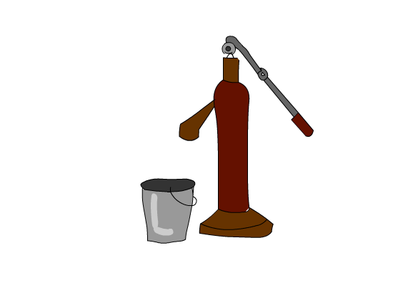
Summer Augmentation and Use Period
Period 1: June 1 to July 14 and September 16 to October 31
Period 2: July 15 to September 15
To Duwamish River
A
FDWR: Tacoma is responsible to maintain Auburn gage >250 cfs
SDWR Period 1: The Auburn gage must maintain flows >250 cfs
SDWR Period 2: The Auburn gage must maintain flows >400 cfs
These river
flow rates are
generally NOT
achievable without
augmentation, so the
stored water is released to:
be taken into the pipelines,
increase river flow so that FDWR may be used,
and for use by fish.
Corps Requirement:
The Palmer gage must maintain flows >110 cfs
SDWR Period 1:
The Palmer gage must maintain flows >300 cfs
SDWR Period 2:
The Palmer gage must maintain flows >200 cfs
P
North
Fork
Wells
Eagle Gorge Reservoir is emptying
HHD
GRFF
Municipal water to
Tacoma and RWSS
FDWR = First Diversion Water Right; SDWR = Second Diversion Water Right; cfs = cubic feet per second
Notes:
Note the period and dates.
Explain.

Slide 5
Upper Green River Watershed
Eagle Lake

Slide 6
Who will forget 2015

Slide 7
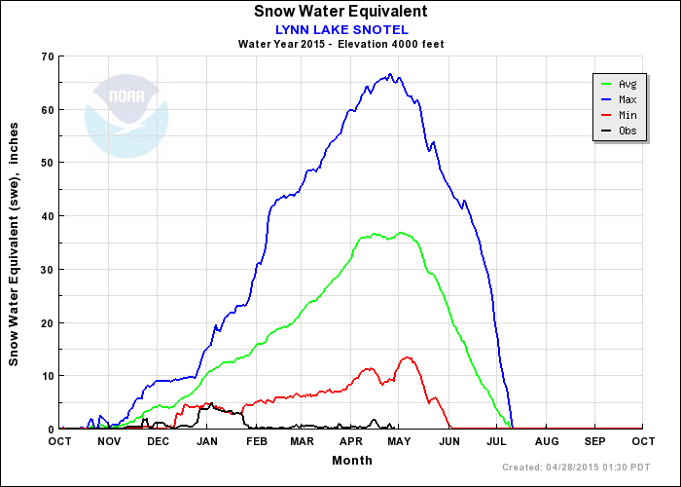
2015 Snowpack in Green River Watershed
Notes:
Much, much less than normal, or even the previous minimum.

Slide 8
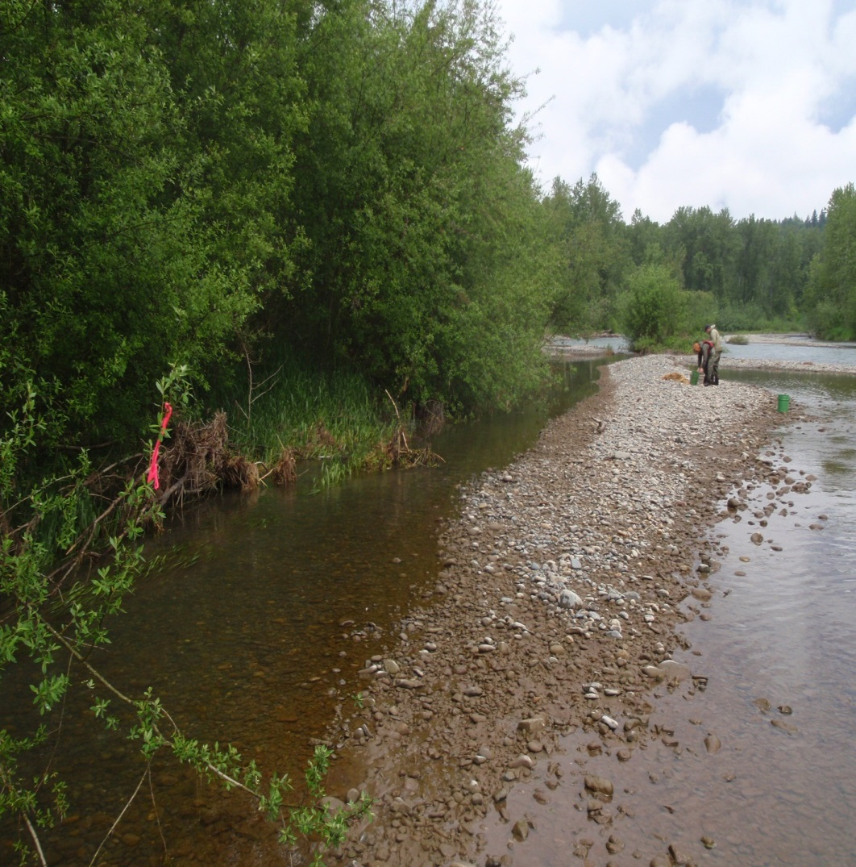
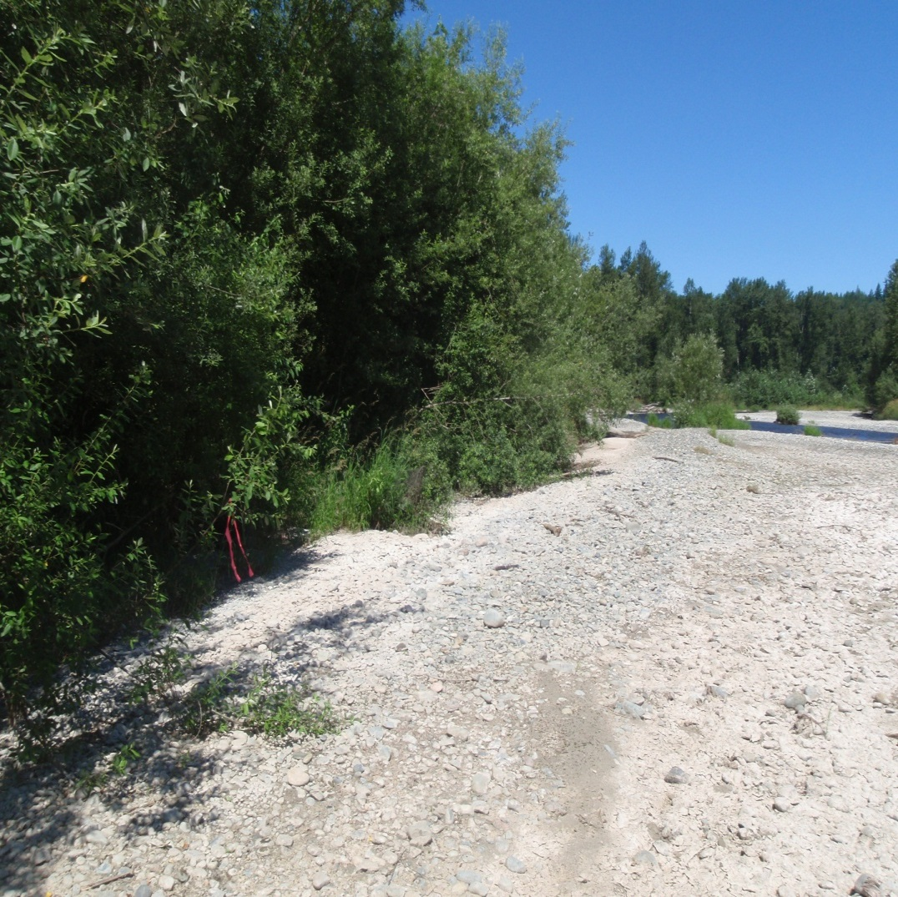
June green river instream flow
2011
2015
Juvenile chinook salmon

Slide 9
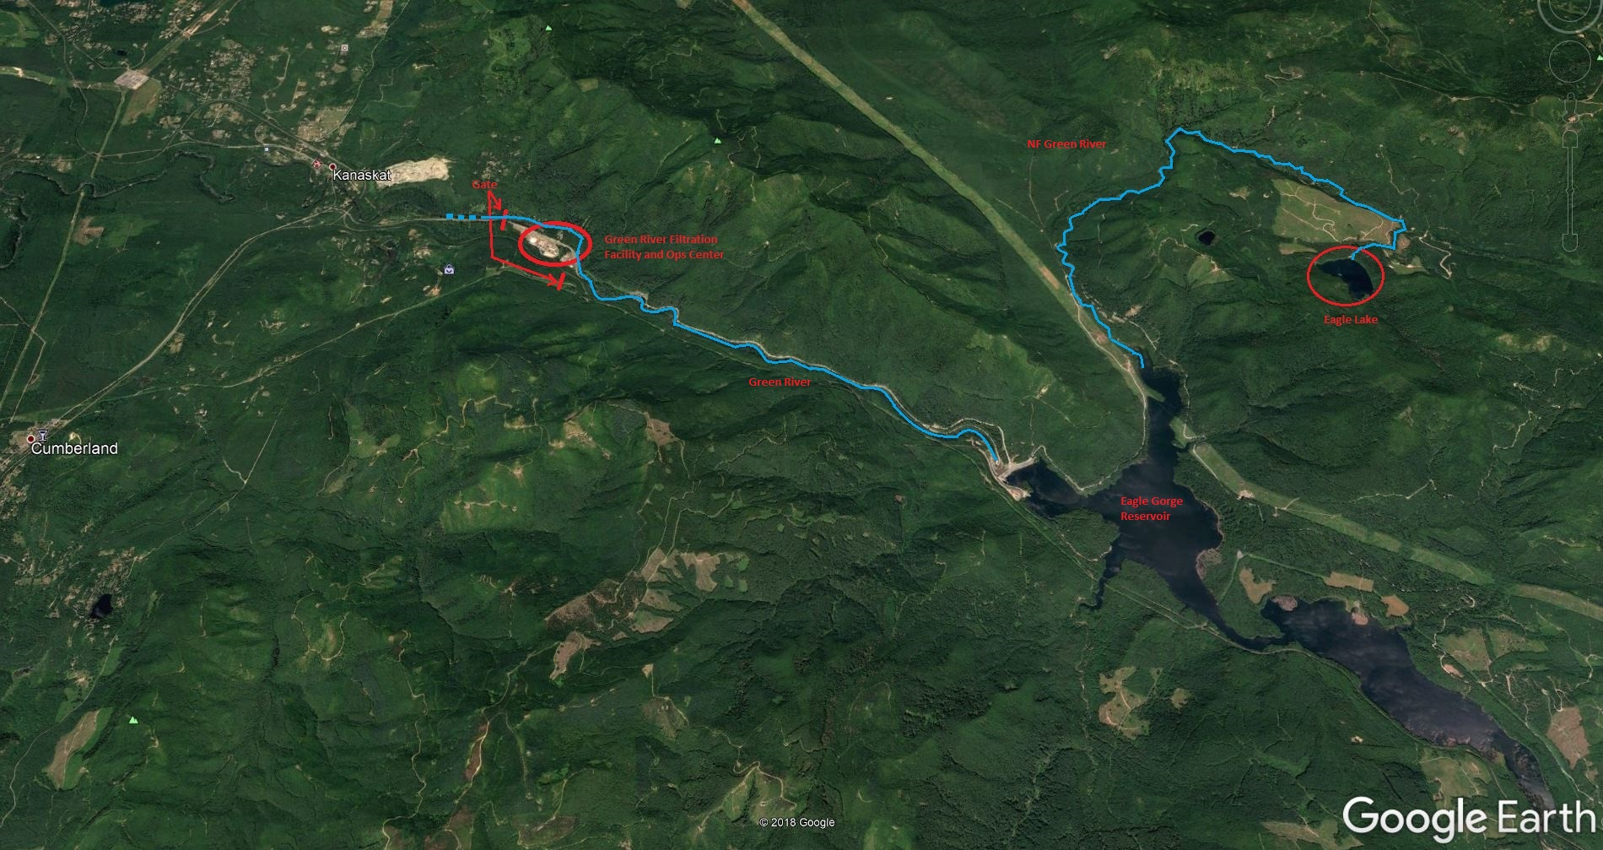
Eagle Lake Vicinity Map

Slide 10
2015 Eagle Lake Pumping Project

Slide 11
Eagle Lake Pumping Project
Pump barge with 3-10cfs pumps
HDPE Pipe
Pumping Operations
September 26 – October 9
30 cfs continuous discharge
~1,000 AF removed
Lake restored: December 8
Generator

Slide 12
NF Green River 4pm, September 25, 2015

Slide 13
NF Green River 12 pm, September 27, 2015

Slide 14
Last Day

Slide 15
Project Concept

Slide 16
Elevation Schematic: Siphon Concept

Slide 17
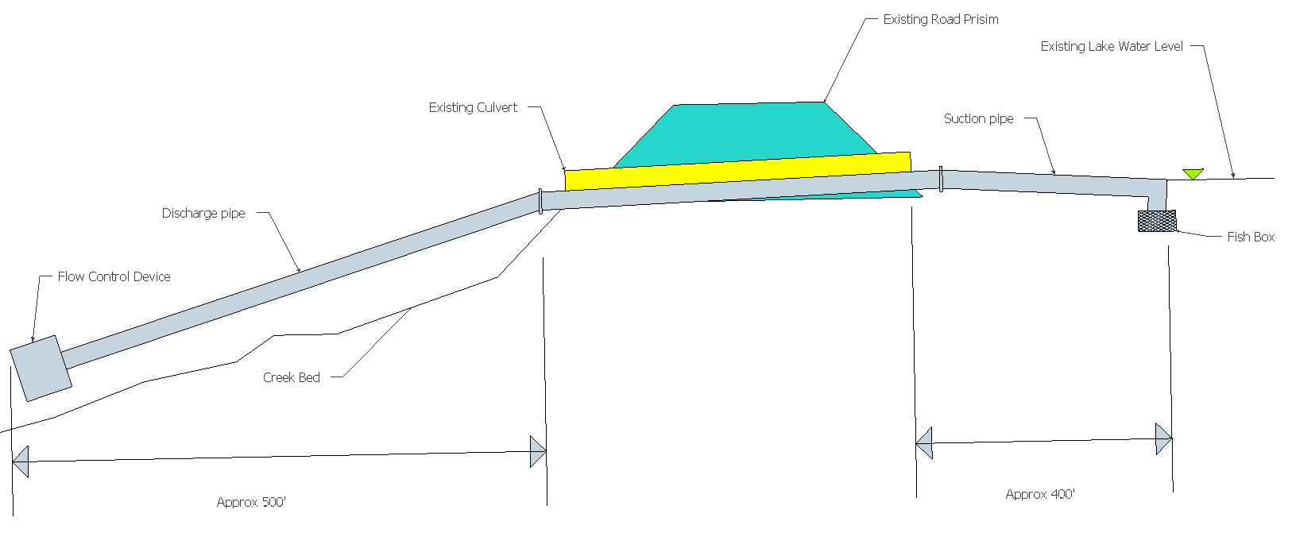
Elevation Schematic: Siphon Concept
Operations
July 15 – September 30
1,000 AF
6.55 cfs

Slide 18
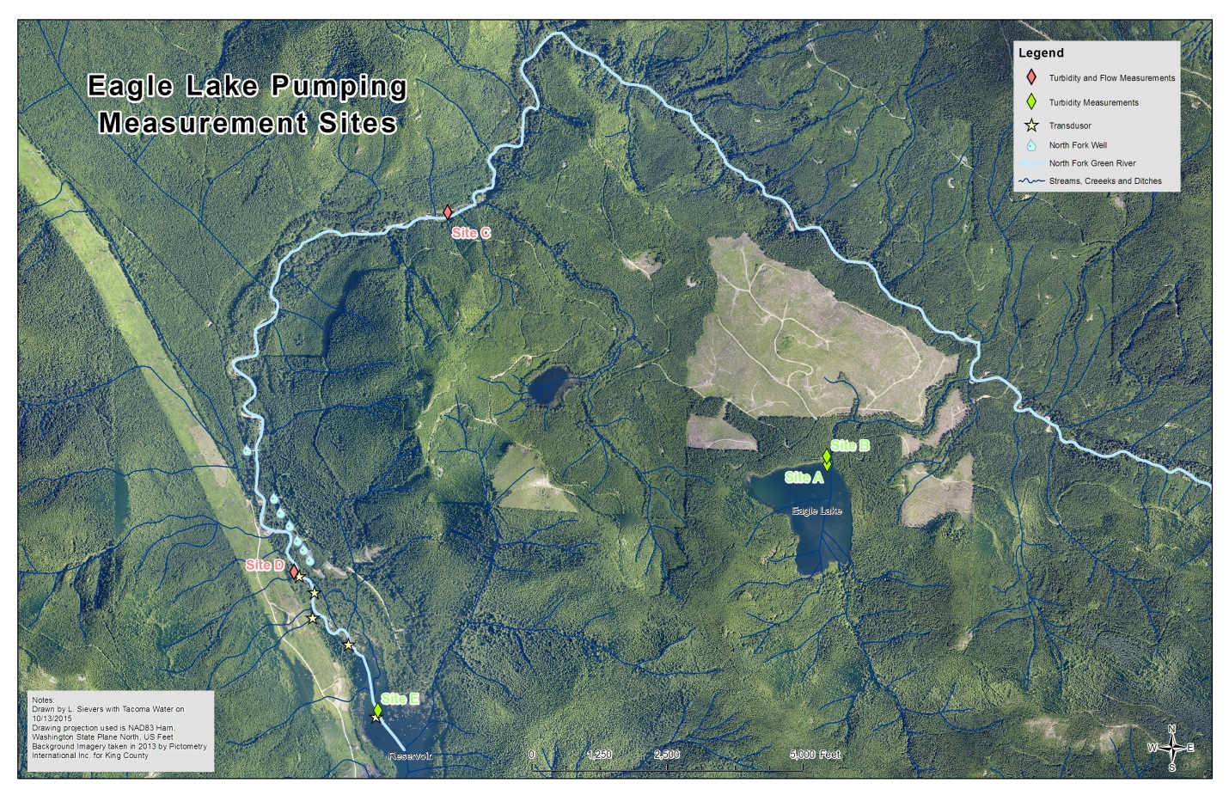
Uncertainties Losing/Gaining Reach Impacts

Slide 19
Stage Discharge Date
Date | Station Discharge (cfs)
 | Lake Discharge | NF Green - Middle | NF Green - Losing
9/24 | 0
9/25 | 28.4
9/28 | 28.4 |  | 17.4
9/29 | 28.4 | 27.8
9/30 | 29.4
10/1 | 29.2
10/2 | 28.1
10/5 | 29.8
10/6 | 28.2
10/7 | 28.5
10/8 | 29.3 | 34.1 | 24.0
10/9 | 28 | 10.6 | 9.7
10/16 | 0 | 9.0 | 13.0

Slide 20
Elevation Schematic: Siphon Concept
Project Element | Estimated Cost
Excavation | $25,000
Materials | $15,000
Design/Labor | $35,000
Permitting | $30,000
Contingency | $20,000
Totals | $125,000
Operations & Maintenance | Estimated Cost
O&M | $2,500

Slide 21
Summary
1,000-AF is annually sustainable
6.55 cfs could be produced over a 77 day period, or otherwise adjusted
Likely offsets exempt well impacts
Construction cost: $125,000
Operating cost: $2,500 per year
Some uncertainties related to realized yield

