Slide 1

Introduction to Subbasins
Duwamish-Green WRIA 9
Streamflow Restoration
Water Resources Program
Washington State Department of Ecology

Slide 2
Why do we need subbasins for this process?
In RCW 90.94.030: The highest priority recommendations must include replacing the quantity of consumptive water use during the same time as the impact and in the same basin or tributary.
Project identification and development
Population projection scenarios
Notes:
RCW 90.94.030(3)(b) says plans must include actions to offset new consumptive use impacts in either 1) the same subbasin (higher priority projects) or 2) not in the same subbasin or only during critical flow periods (lower priority projects).
The fewer the number of subbasins, the more likely you’ll have more higher priority projects.
Too many subbasins will make project identification difficult
Key for NEB evaluation- highest priority given to water for water projects in the same place as the projected water use. We can include other projects, but will need to justify why a project in one part of the watershed should be counted towards offsetting water use on a stream in a different part of the watershed.
Will support organization of population projections and scenarios and project identification

Slide 3
Timeline for Decision
February-April 2019: Discussion with Committee to identify options and seek input
March-May 2019: Workgroup discusses subbasins and proposes options and recommendations
May 2019: Committee decision on initial subbasins
Fall 2019-Spring 2020: Revisit initial subbasin delineation to revise as necessary to align with project proposals
Notes:
Form technical workgroup and have this be the first task
Technical workgroup to take some of the ideas and information we’ll discuss today and create a proposal for the Committee
Committee to make decision on initial subbasins in May

Slide 4
Options and Recommendations
Develop initial subbasin delineation now (as begin growth projections)
Identify a manageable number of subbasins
Support from technical consultant, ECY technical staff, workgroup
Revisit as develop projects to refine as necessary
No right answer

Slide 5
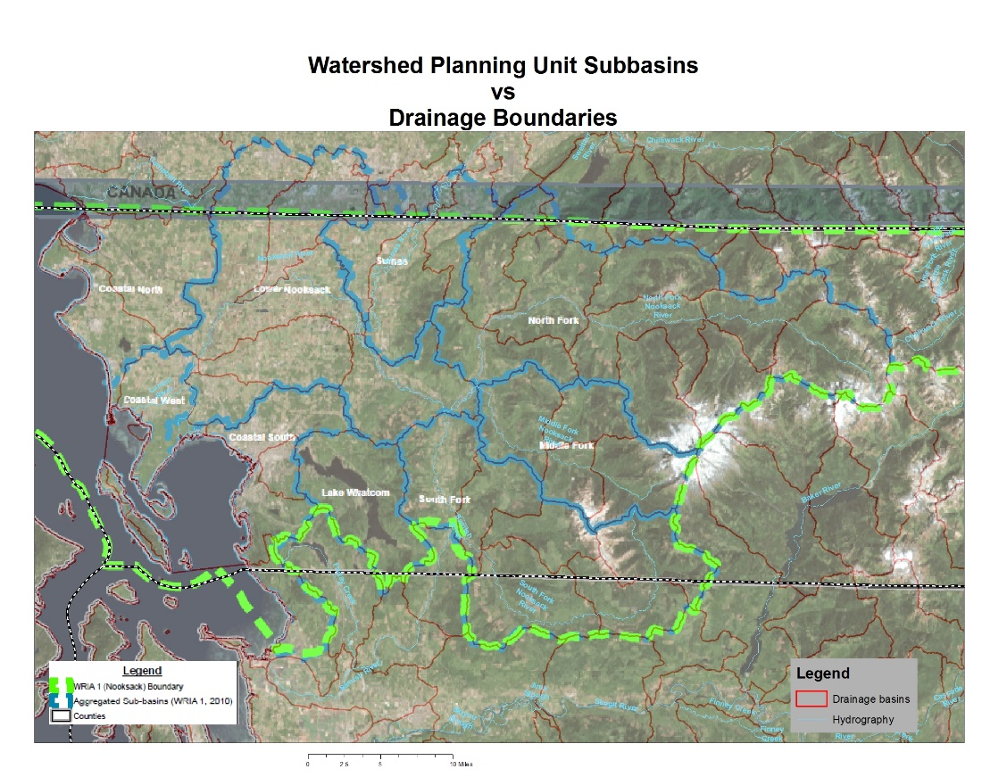
Introduction to Subbasin Delineation for Watershed Restoration and Enhancement Plans
Planning groups must delineate subbasins within WRIAs, and these must be suitably sized to allow meaningful determinations of whether offset projects are in-time and in same subbasin, without being so small that they are unwieldly.
In some instances, subbasins may not correspond with hydrologic basin delineations (i.e. watershed divides).
WRIA 01 has 49 USGS HUC12 subwatersheds and
9 Planning Unit subbasins
Notes:
Map shows example from WRIA 1, which had 49 HUC 12 subbasins and created 9 planning unit subbasins.

Slide 6
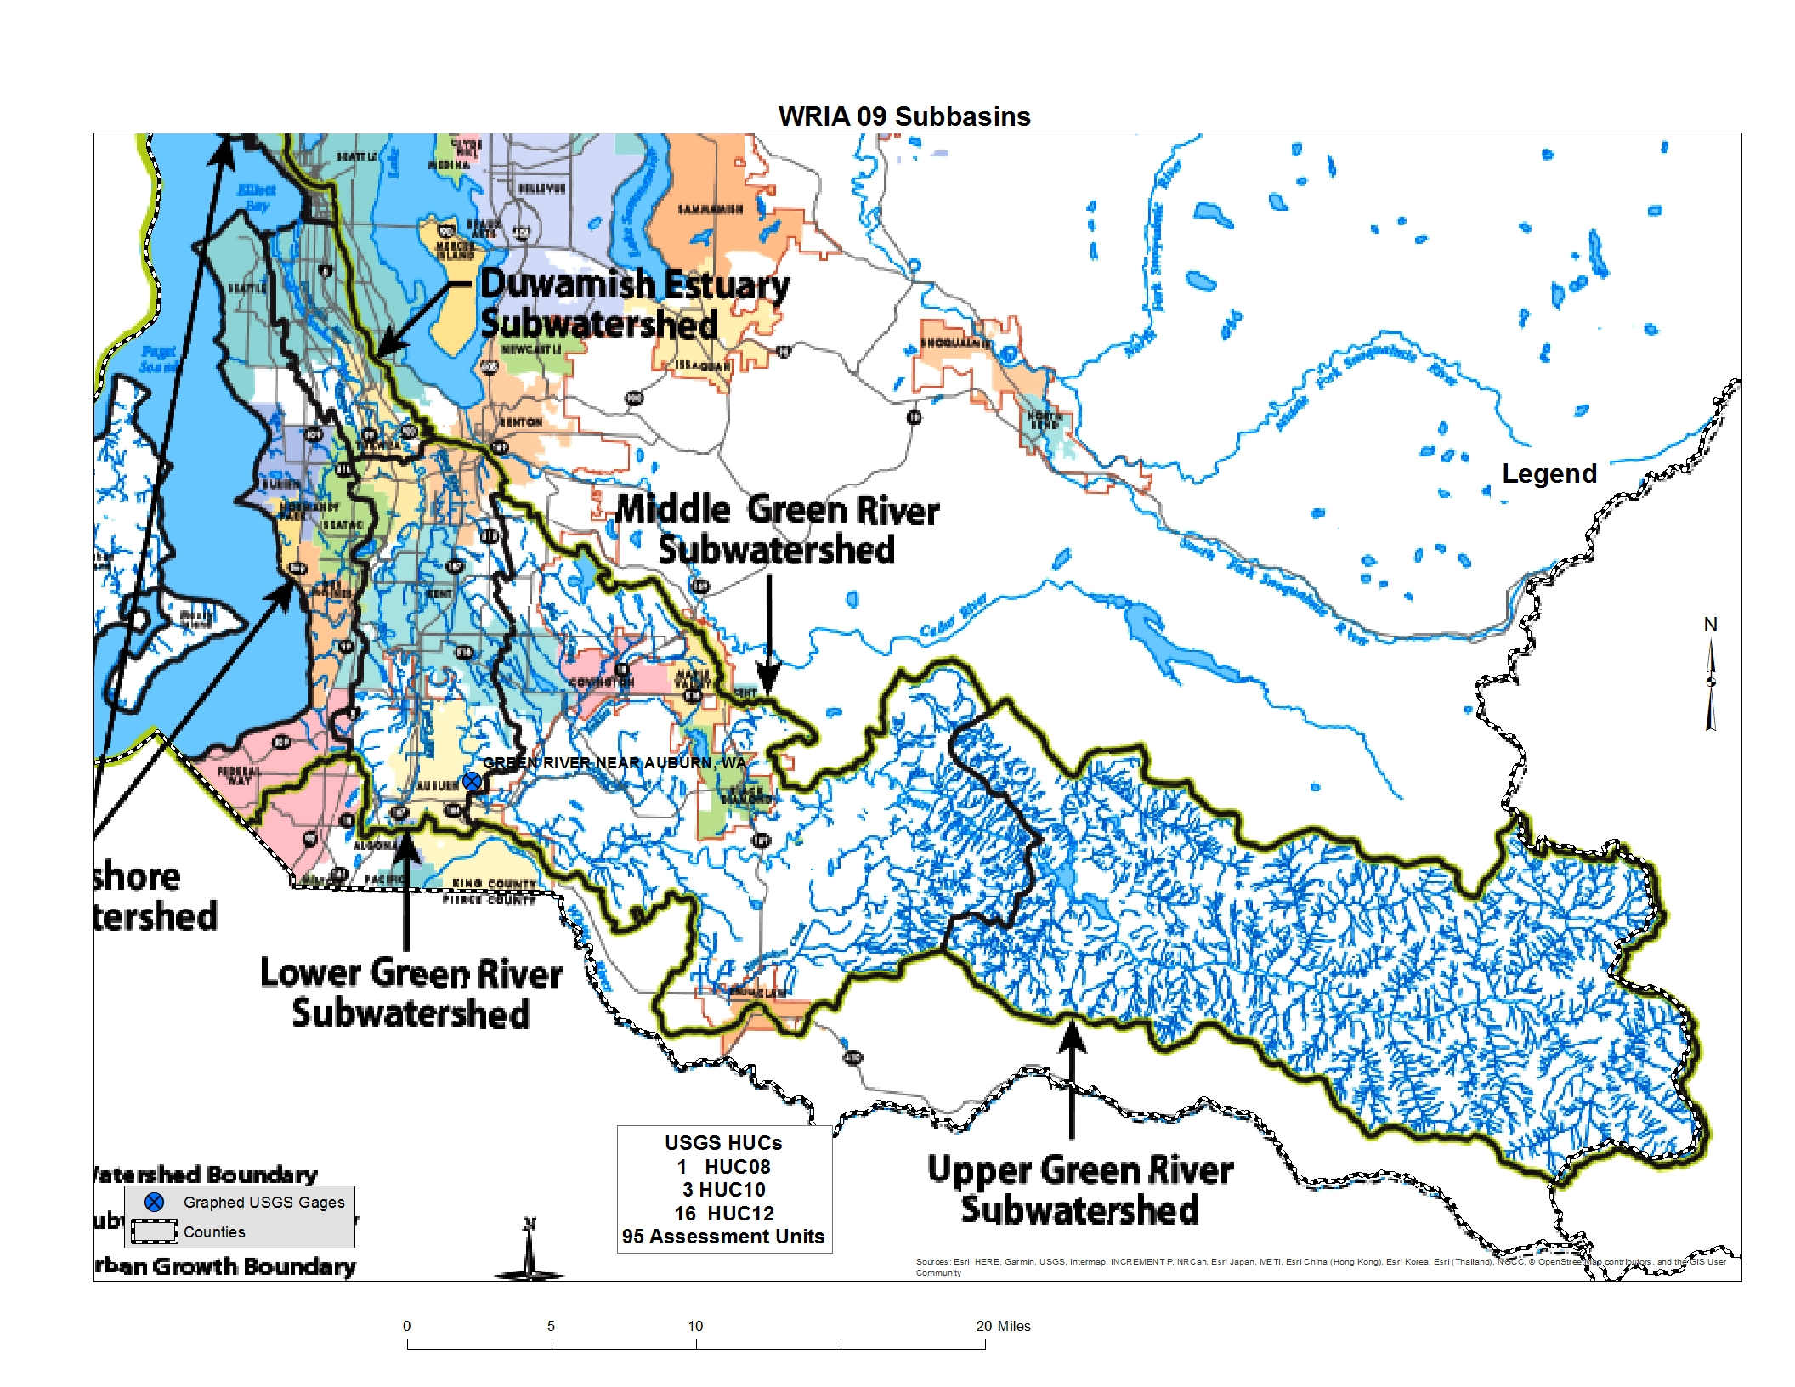
Salmon Recovery Lead Entity Map
December, 2004
5 Sub-watersheds
Notes:
This map shows subbasin delineations created by the Salmon Recovery Lead Entity. They came up with 5 sub-watersheds.

Slide 7
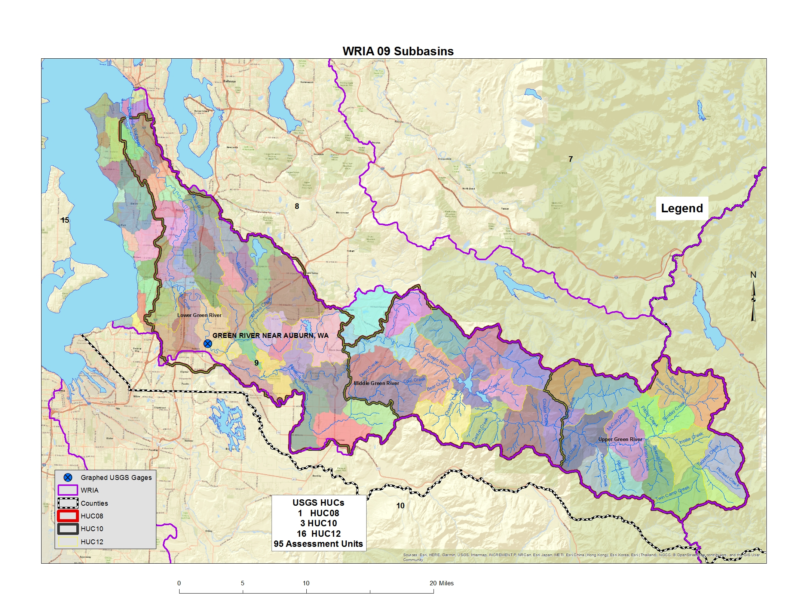

Subbasin Delineations by Hydrologic Unit Code (HUC) and Assessment Units
Too few of subbasins reduces our understanding of the relationships between where pumping effects will be and where benefits of offset projects will occur.
Too many subbasins can make it unwieldly to evaluate all of the offset projects needed to achieve a net ecological benefit for the WRIA.
Notes:
John developed an example map for using the USGS HUC (Hydrologic Unit Codes) at various scales: HUC08-subbasin; HUC10-watershed; HUC12-subwatersheds and overlaid them for WRIA 9. This map also shows even smaller Assessment Units (AU) that Ecology developed several years ago.
There is one HUC08 in WRIA 9; there are three HUC10s; and sixteen HUC12s. There are 95 AUs as well.
While at some level all 95 drainages deserve some attention, it is important to keep in mind the purpose of this delineation process, which is to support estimating the consumptive impacts of new domestic exempt well uses in the WRIA. If no new wells are going to be constructed in a specific drainage, then there won’t be new impacts caused by new domestic wells in that area.
The fewer the number of subbasins, the more likely you’ll have more higher priority projects. Too many sub-basins may be unwieldy

Slide 8
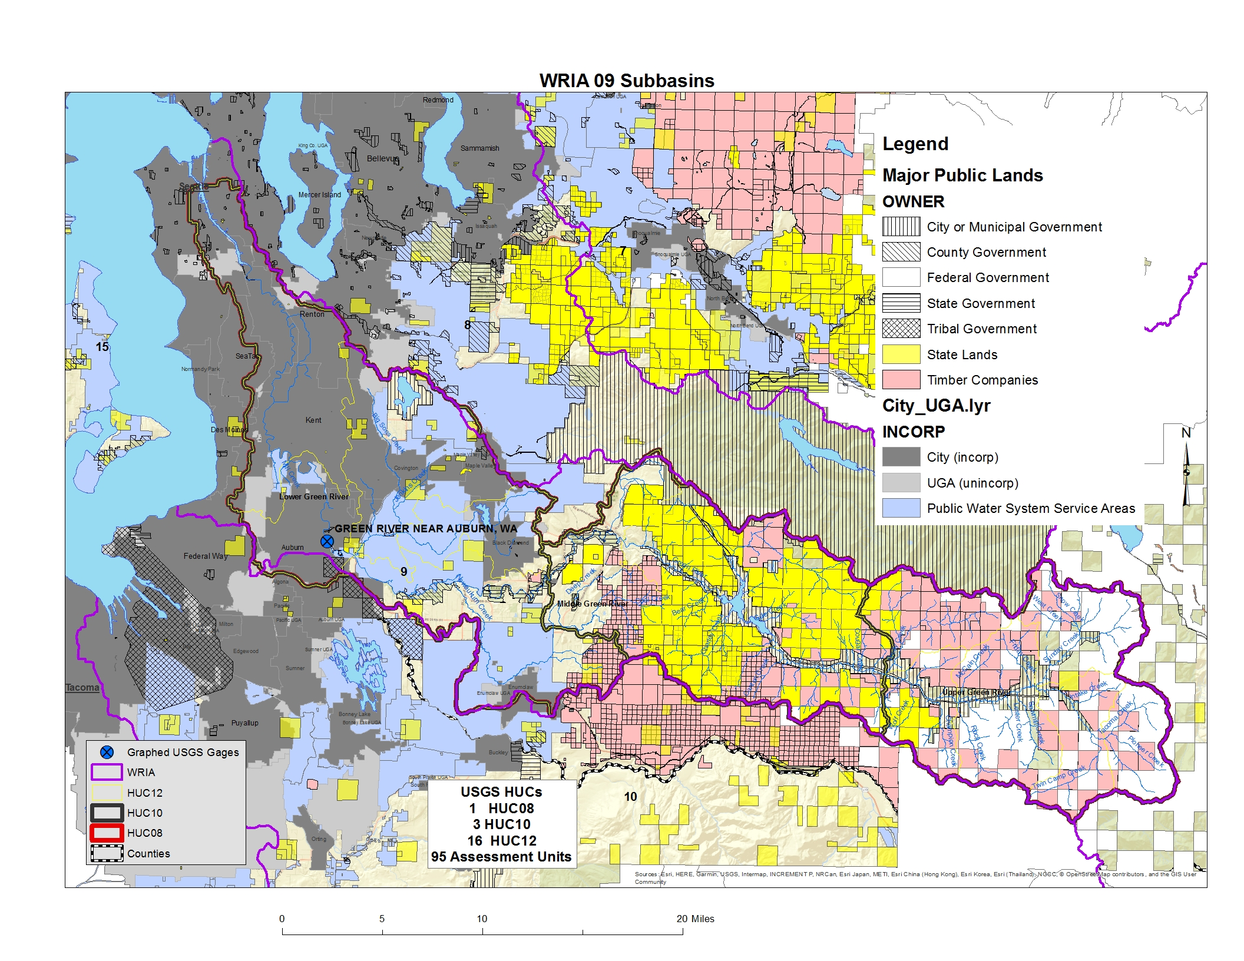
Location of New Domestic Exempt Wells Considerations
Where can new domestic exempt wells be drilled in the WRIA?
Notes:
The Committee will want to consider where growth is most likely to occur as it delineates sub-basins. In areas where very little growth is expected, the Committee may want to make sub-basins larger.
To make this map, John overlaid major public lands, parcels obviously owned by major timber companies (missing all the smaller ones), water system service area maps and the incorporated/UGA boundaries. Most of the polygons he added preclude domestic well new uses because the land is publicly owned or in commercial timber.
This shows that virtually the entire upper watershed isn’t likely to experience much new domestic exempt use in the coming decades. Much of the watershed seems to be unlikely to experience a lot of new, rural, domestic exempt well use. There isn’t that much real estate that isn’t either inside a water service area, or public land, or timber property.
Other considerations include hookup policies within UGAs and water service areas and whether water service areas have the capacity to serve new users (‘blue’ areas on this map.)
The Committee’s technical team and technical support will dive into the consumptive use estimates further.

Slide 9
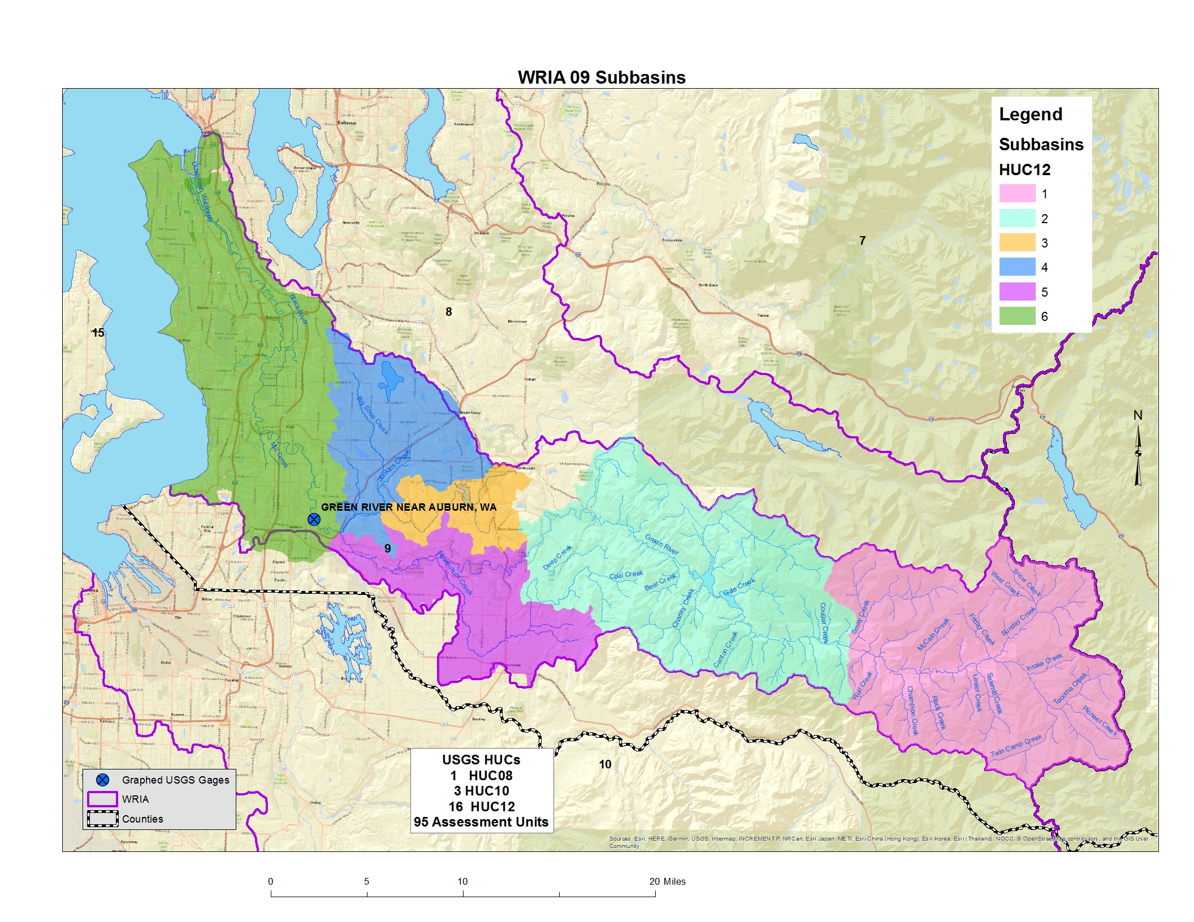
Example Subbasin Delineations by HUC Groupings
I ended up with 6 subbasins
Notes:
John created an example subbasin delineation for the Committee by using the HUC10 and HUC12s to arrive at 6 subbasins.
Since much of the upper watershed is publically owned, he combined these drainages. “I’m quite certain that I have oversimplified the process and ignored very important information that I’m not aware of given my inexperience in the watershed.”
This is a as a strawman to start the conversation about how to do it correctly. “Ecology” is not proposing this as ‘the’ way to partition out the WRIA, it’s just someplace to start the conversation.

Slide 10
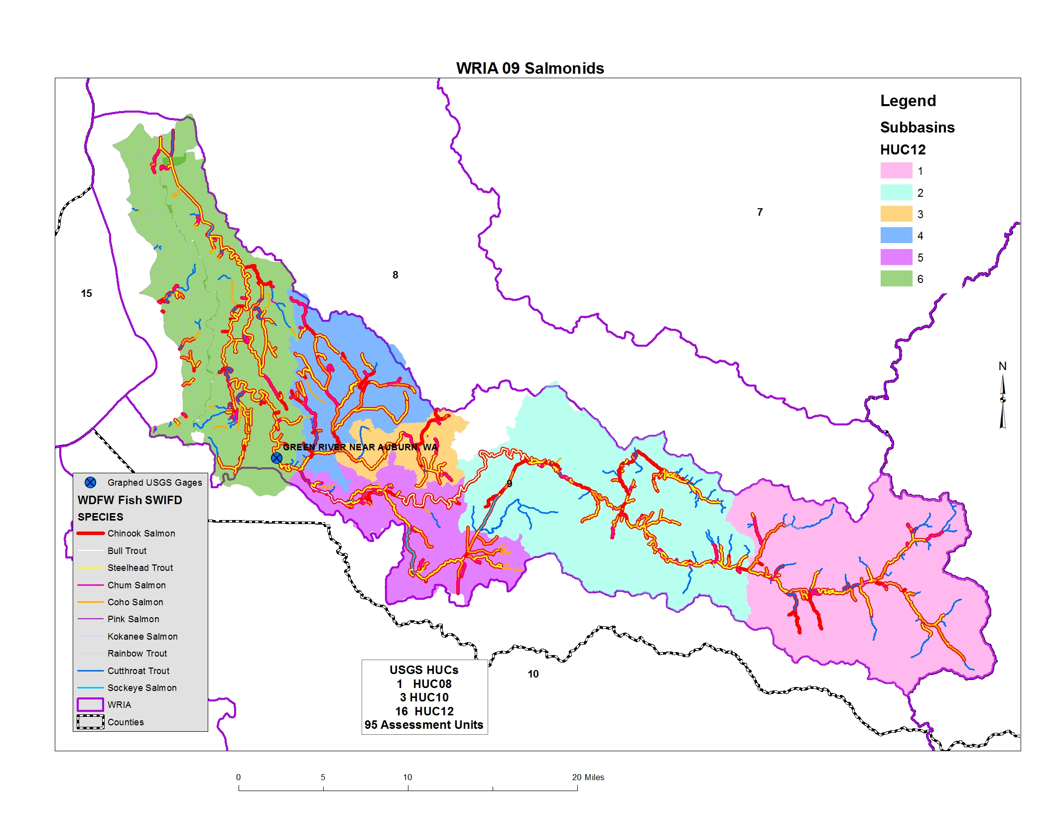
Salmon Distribution Considerations
Source: https://gispublic.dfw.wa.gov/arcgis/rest/services/MapServices/SWIFD/MapServer
Notes:
Committee may want to consider unique salmon habitat and species distribution

Slide 11
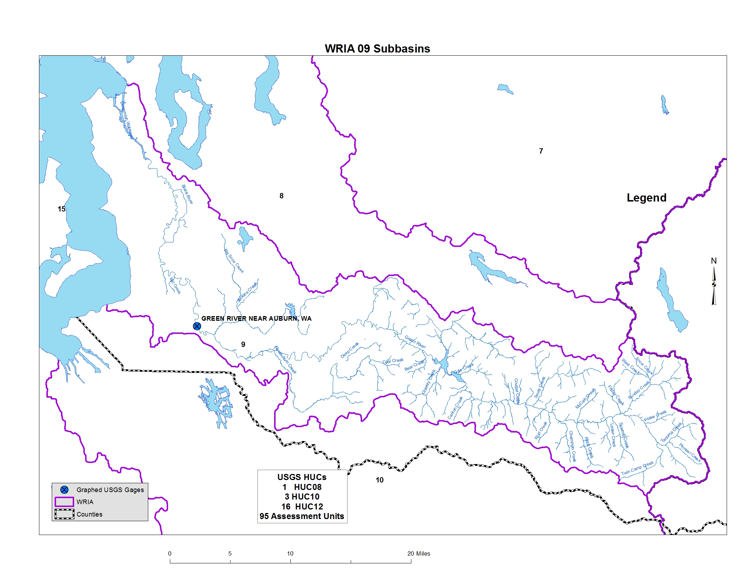

Notes:
The WRIA 9 Committee can choose how it will delineate sub-basins, taking into consideration the need to meet net ecological benefit.
Ecology is here to help. John will try to make a few of our Committee meetings each year and assist where he can.

