Slide 1
Streamflow Restoration Planning
Speakers name
WRIA 9 Watershed Restoration and Enhancement Plan
date

Slide 2
Streamflow Restoration law RCW 90.94
Clarifies how local governments can issue building permits for homes intending to use a permit-exempt well for their domestic water supply and offsets those impacts through a local watershed planning effort.
Ecology chaired the WRIA 9 Committee, composed of tribes, counties, cities, WDFW, municipal water purveyor, and interest groups. The committee met over the last two years to develop the Watershed Restoration and Enhancement Plan.
Notes:
This is Summary Slide 1. It can be used, along with the next slide, as very high level overview of the law and plan components.

Slide 3
Watershed Restoration and Enhancement Plan Components
Planning Horizon
2018 - 2038
WRIA Subbasin Delineation
12 subbasins
Projected New Permit-Exempt Wells
632 new permit-exempt wells
Estimated Consumptive Water Use
247.7 acre-feet per year (0.34 cfs)
Projects and Actions
16 projects to offset estimated consumptive use and meet Net Ecological Benefit (NEB)
Notes:
Summary Slide 2. This slide provides an overview of the planning requirements per the law (RCW 90.94). Ecology provided additional guidance and a policy interpretive statement to provide more direction to the committees.
WRIA – Watershed Resources Inventory Area
New permit-exempt wells focus on new wells for domestic use
Consumptive use: For the purposes described here, consumptive water use is considered water that is evaporated, transpired, consumed by humans, or otherwise removed from an immediate water environment due to the use of new permit-exempt domestic wells.
Net Ecological Benefit (NEB): The outcome that is anticipated to occur through implementation of projects and actions in a plan to yield offsets that exceed impacts within: a) the planning horizon; and, b) the relevant WRIA boundary.

Slide 4
Presentation Outline
Background
Streamflow Restoration law
Role of the Committee
Elements of the Watershed Plan
Steps to complete plan
4
Notes:
Long Presentation Outline

Slide 5
What is a permit-exempt domestic well?
Serve single homes, small developments, irrigation of small lawns and gardens
Chapter 90.94 RCW establishes withdrawal limits for permit-exempt domestic well connections in this watershed
Notes:
Permit-exempt groundwater wells often provide water where a community supply is not available, serving single homes, small developments, irrigation of small lawns and gardens.
90.94 RCW applies to domestic and non-commercial lawn or garden irrigation uses.
90.94 RCW restricts new permit-exempt domestic withdrawals in this WRIA to a maximum annual average of 950 gallons per days per connection, subject to the 5000 gallons per day and ½-acre outdoor irrigation of non-commercial lawn/garden limits established in RCW 90.44.050.
[add any additional talking points relevant to your work in the watershed, such is how your entity works with PE wells, where they are located historically, etc.]

Slide 6
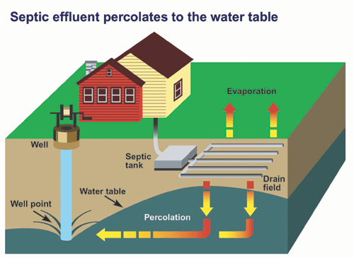
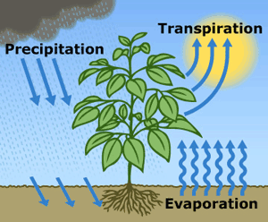
What is consumptive water use?
Water that is evaporated, transpired, consumed by humans, or otherwise removed from an immediate water environment due to the use of new permit-exempt domestic wells.
Indoor Consumptive Use
Outdoor Consumptive Use
10%
80%
90%
20%
Notes:
Source: NEB Guidance Page 5
For indoor water use most houses with domestic wells are connected to septic systems, so it is reasonable to assume that only about 10% is lost from groundwater system.
For outdoor water use a good assumption is that about 80% is lost, mainly due to evapotranspiration.

Slide 7
How are groundwater and streamflows connected?
Notes:
Most groundwater in Washington is hydraulically connected to nearby lakes and streams. In fact, during much of the year, groundwater discharge may make up most of the water in a stream. https://ecology.wa.gov/Water-Shorelines/Water-supply/Protecting-stream-flows

Slide 8
How do wells affect streamflows?
Notes:
When groundwater is pumped and water is put to use, this often leads to a decrease in streamflow. Many factors influence where and how much a groundwater use may affect a stream, such as the nature of the aquifer, the distance between the well and the stream, the well depth, and the type of water use (for example, lawn watering consumes much more water than in-house use that discharges to a septic system). However, at least some portion of the well water used in a home typically has a negative impact on nearby streams. https://ecology.wa.gov/Water-Shorelines/Water-supply/Protecting-stream-flows

Slide 9
Streamflow Restoration law RCW 90.94
Clarifies how local governments can issue building permits for homes intending to use a permit-exempt well for their domestic water supply and offsets those impacts through a local watershed planning effort.
Notes:
The law, and consequently this watershed plan, is concerned with the identification of projects and actions intended to offset the anticipated impacts from new permit-exempt domestic groundwater withdrawals over the next 20 years and provide a net ecological benefit. In order to aid in project implementation, the law also authorized $300 million in capital funds over the next 15 years.
The local watershed planning effort began with the committee’s formation in each watershed called out in the law. There are 15 watersheds across the state undergoing planning efforts under this law; there are 7 other watersheds that are developing watershed restoration and enhancement plans like ours.

Slide 10
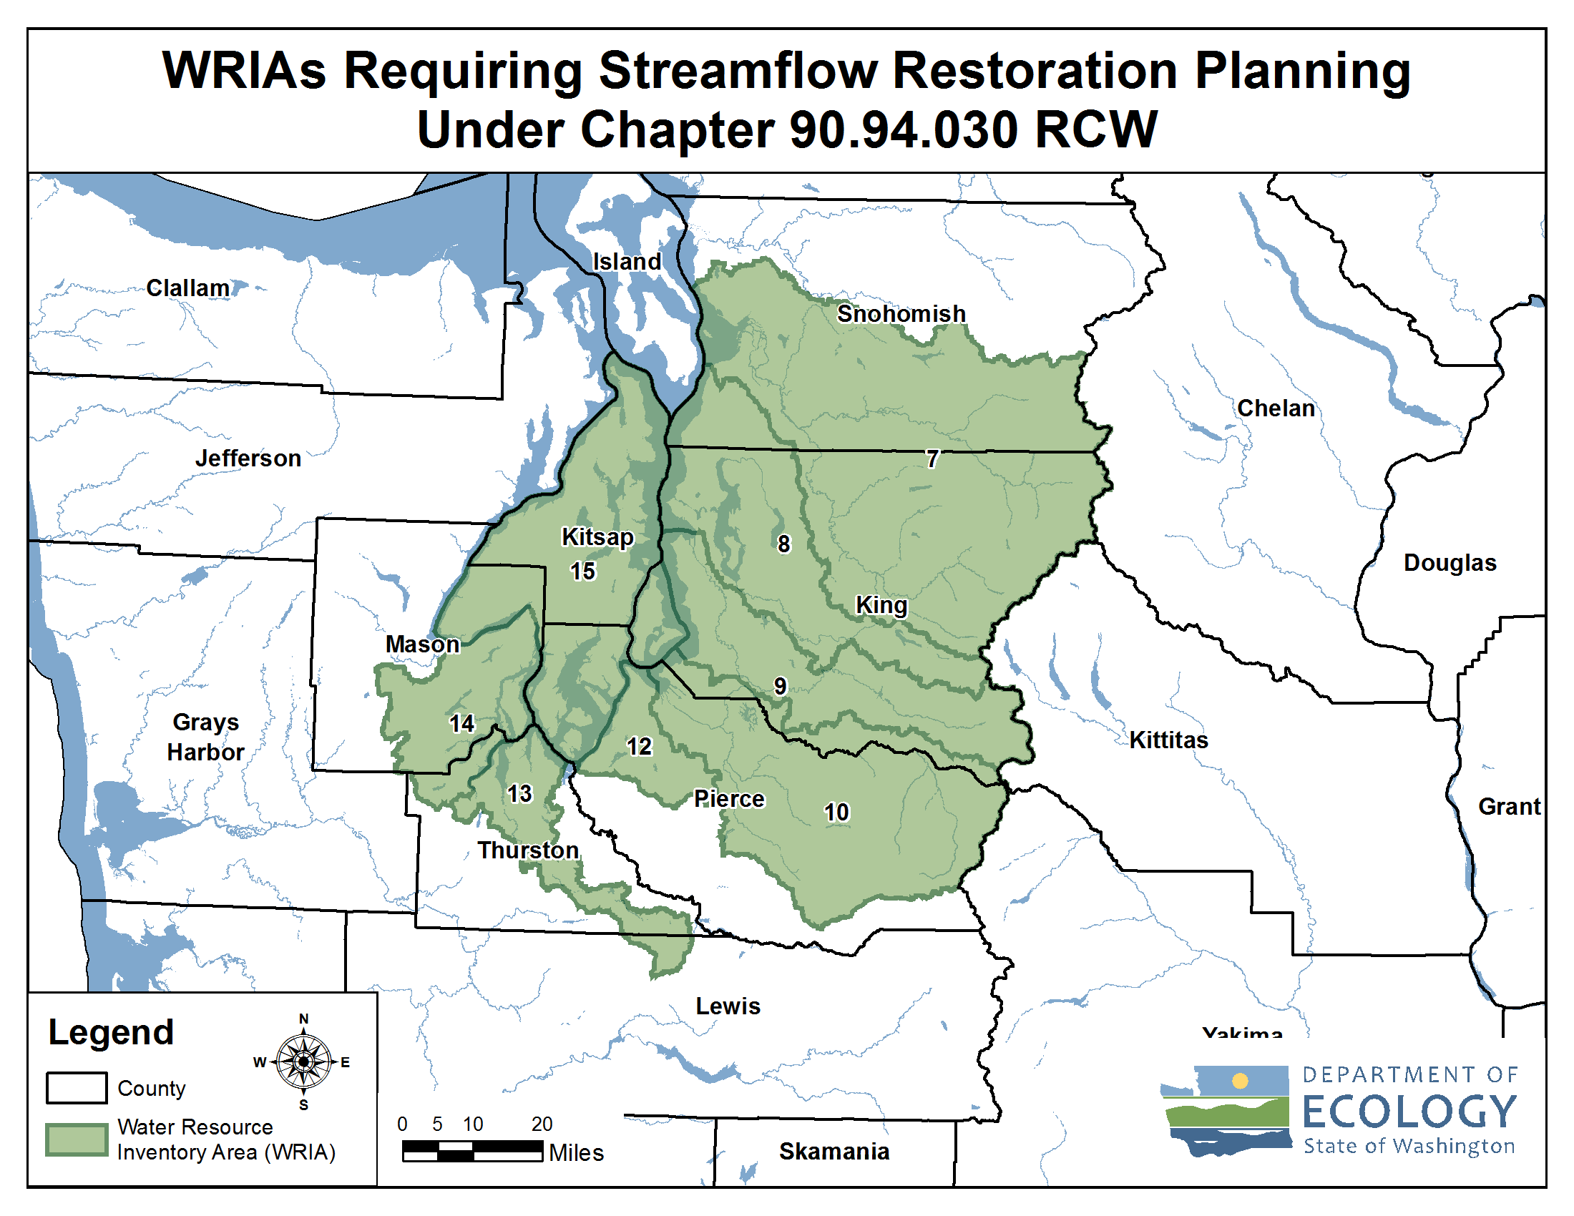
Streamflow Restoration Planning
Notes:
These are the watersheds that are developing Watershed Restoration and Enhancement Plans chaired by Ecology.
[Direct to “brochures” if questions about how these WRIAs were selected. Relates to whether instream flow rules addressed PE wells.]
WRIA 9 Committee brochure
https://fortress.wa.gov/ecy/publications/documents/2011069.pdf

Slide 11
Streamflow Restoration Funding Program Overview
15 Year Competitive Grant Program - $300 million
Pilot Round (2018/2019)
Current Round (2020)
Statewide
Funding Rule
Chapter 173-566 WAC
Funding Guidance
Publication 19-11-089
Notes:
How is Ecology supporting implementation of the watershed plans?
The legislature has given Ecology $300 over the course of 15 years to restore and enhance streamflows, and meet the requirements of the Chapter 90.94 RCW. Grant funding will help incentivize state and local agencies, tribal governments, and non-profit organizations to implement local watershed plans and projects.
It is important to note that local project needs developed through the watershed planning process are greater than available statewide funds. The grant process is competitive and other sources of funding beyond these grants is needed to implement all projects within the watershed restoration and enhancement plan.

Slide 12
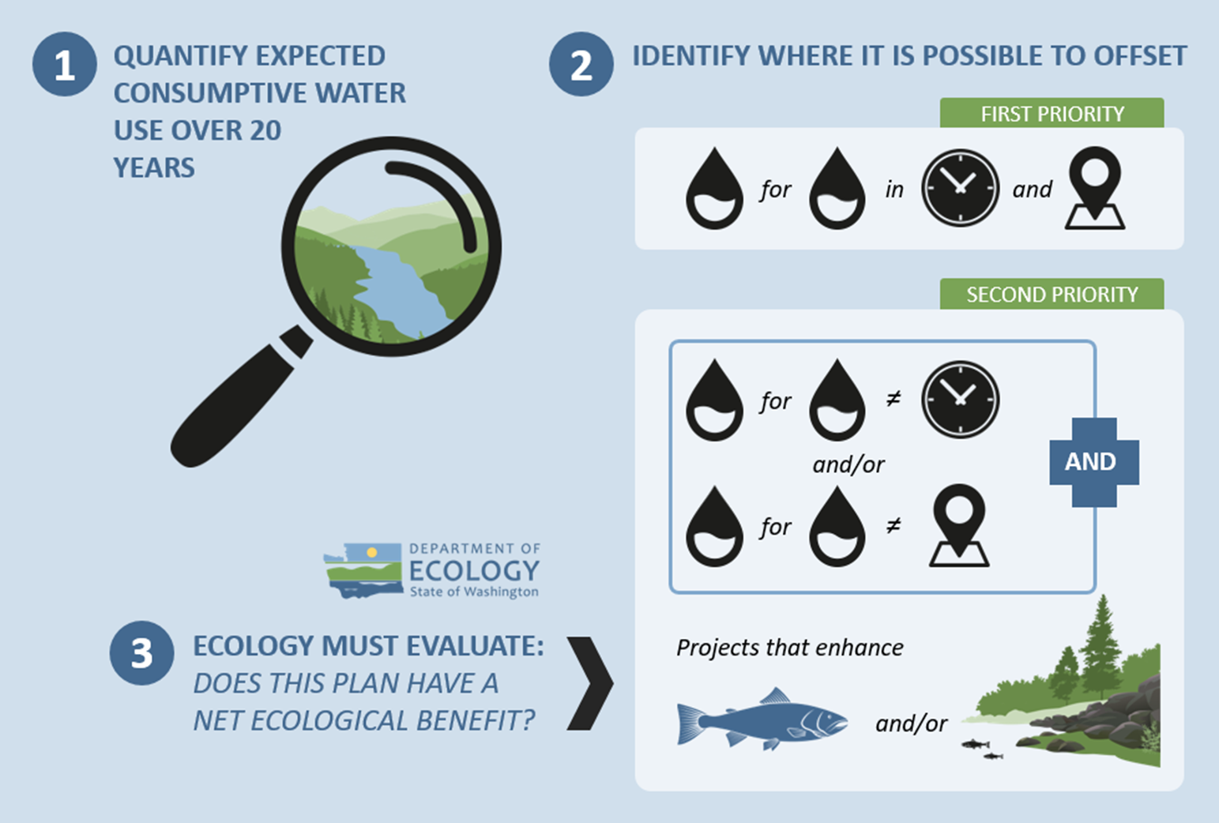
Overview of the Watershed Plan
Notes:
The major steps to complete the plan include:
1. Estimate the consumptive water use of new domestic permit-exempt wells through 2038;
2. Identify projects to offset consumptive use – we must identify projects that provide “water for water” offsets within the WRIA. Projects are not required to provide water offset in the same place or at the same time as well impacts. However, projects that offset water during the same time and in the same areas where wells are expected are a higher priority. The plan also includes projects that enhance habitat for fish.
3. Ecology is then required to evaluate the plan to make a determination of whether it achieves a net ecological benefit.

Slide 13
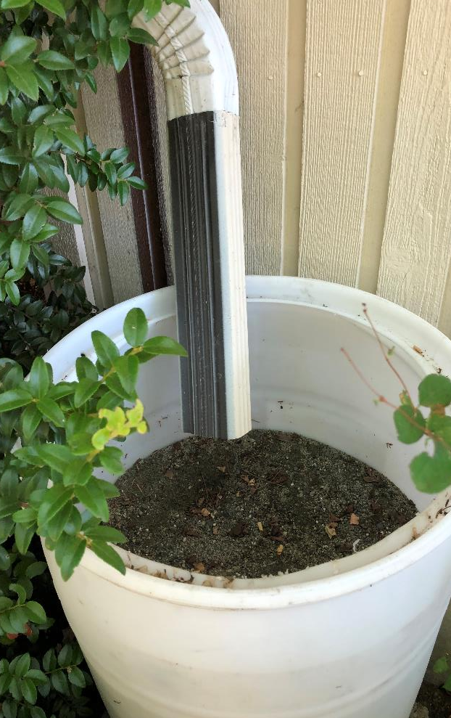
What is offset?
The anticipated ability of a project or action to counterbalance some amount of
the new consumptive water use over the next 20 years (2018-2038).

Slide 14
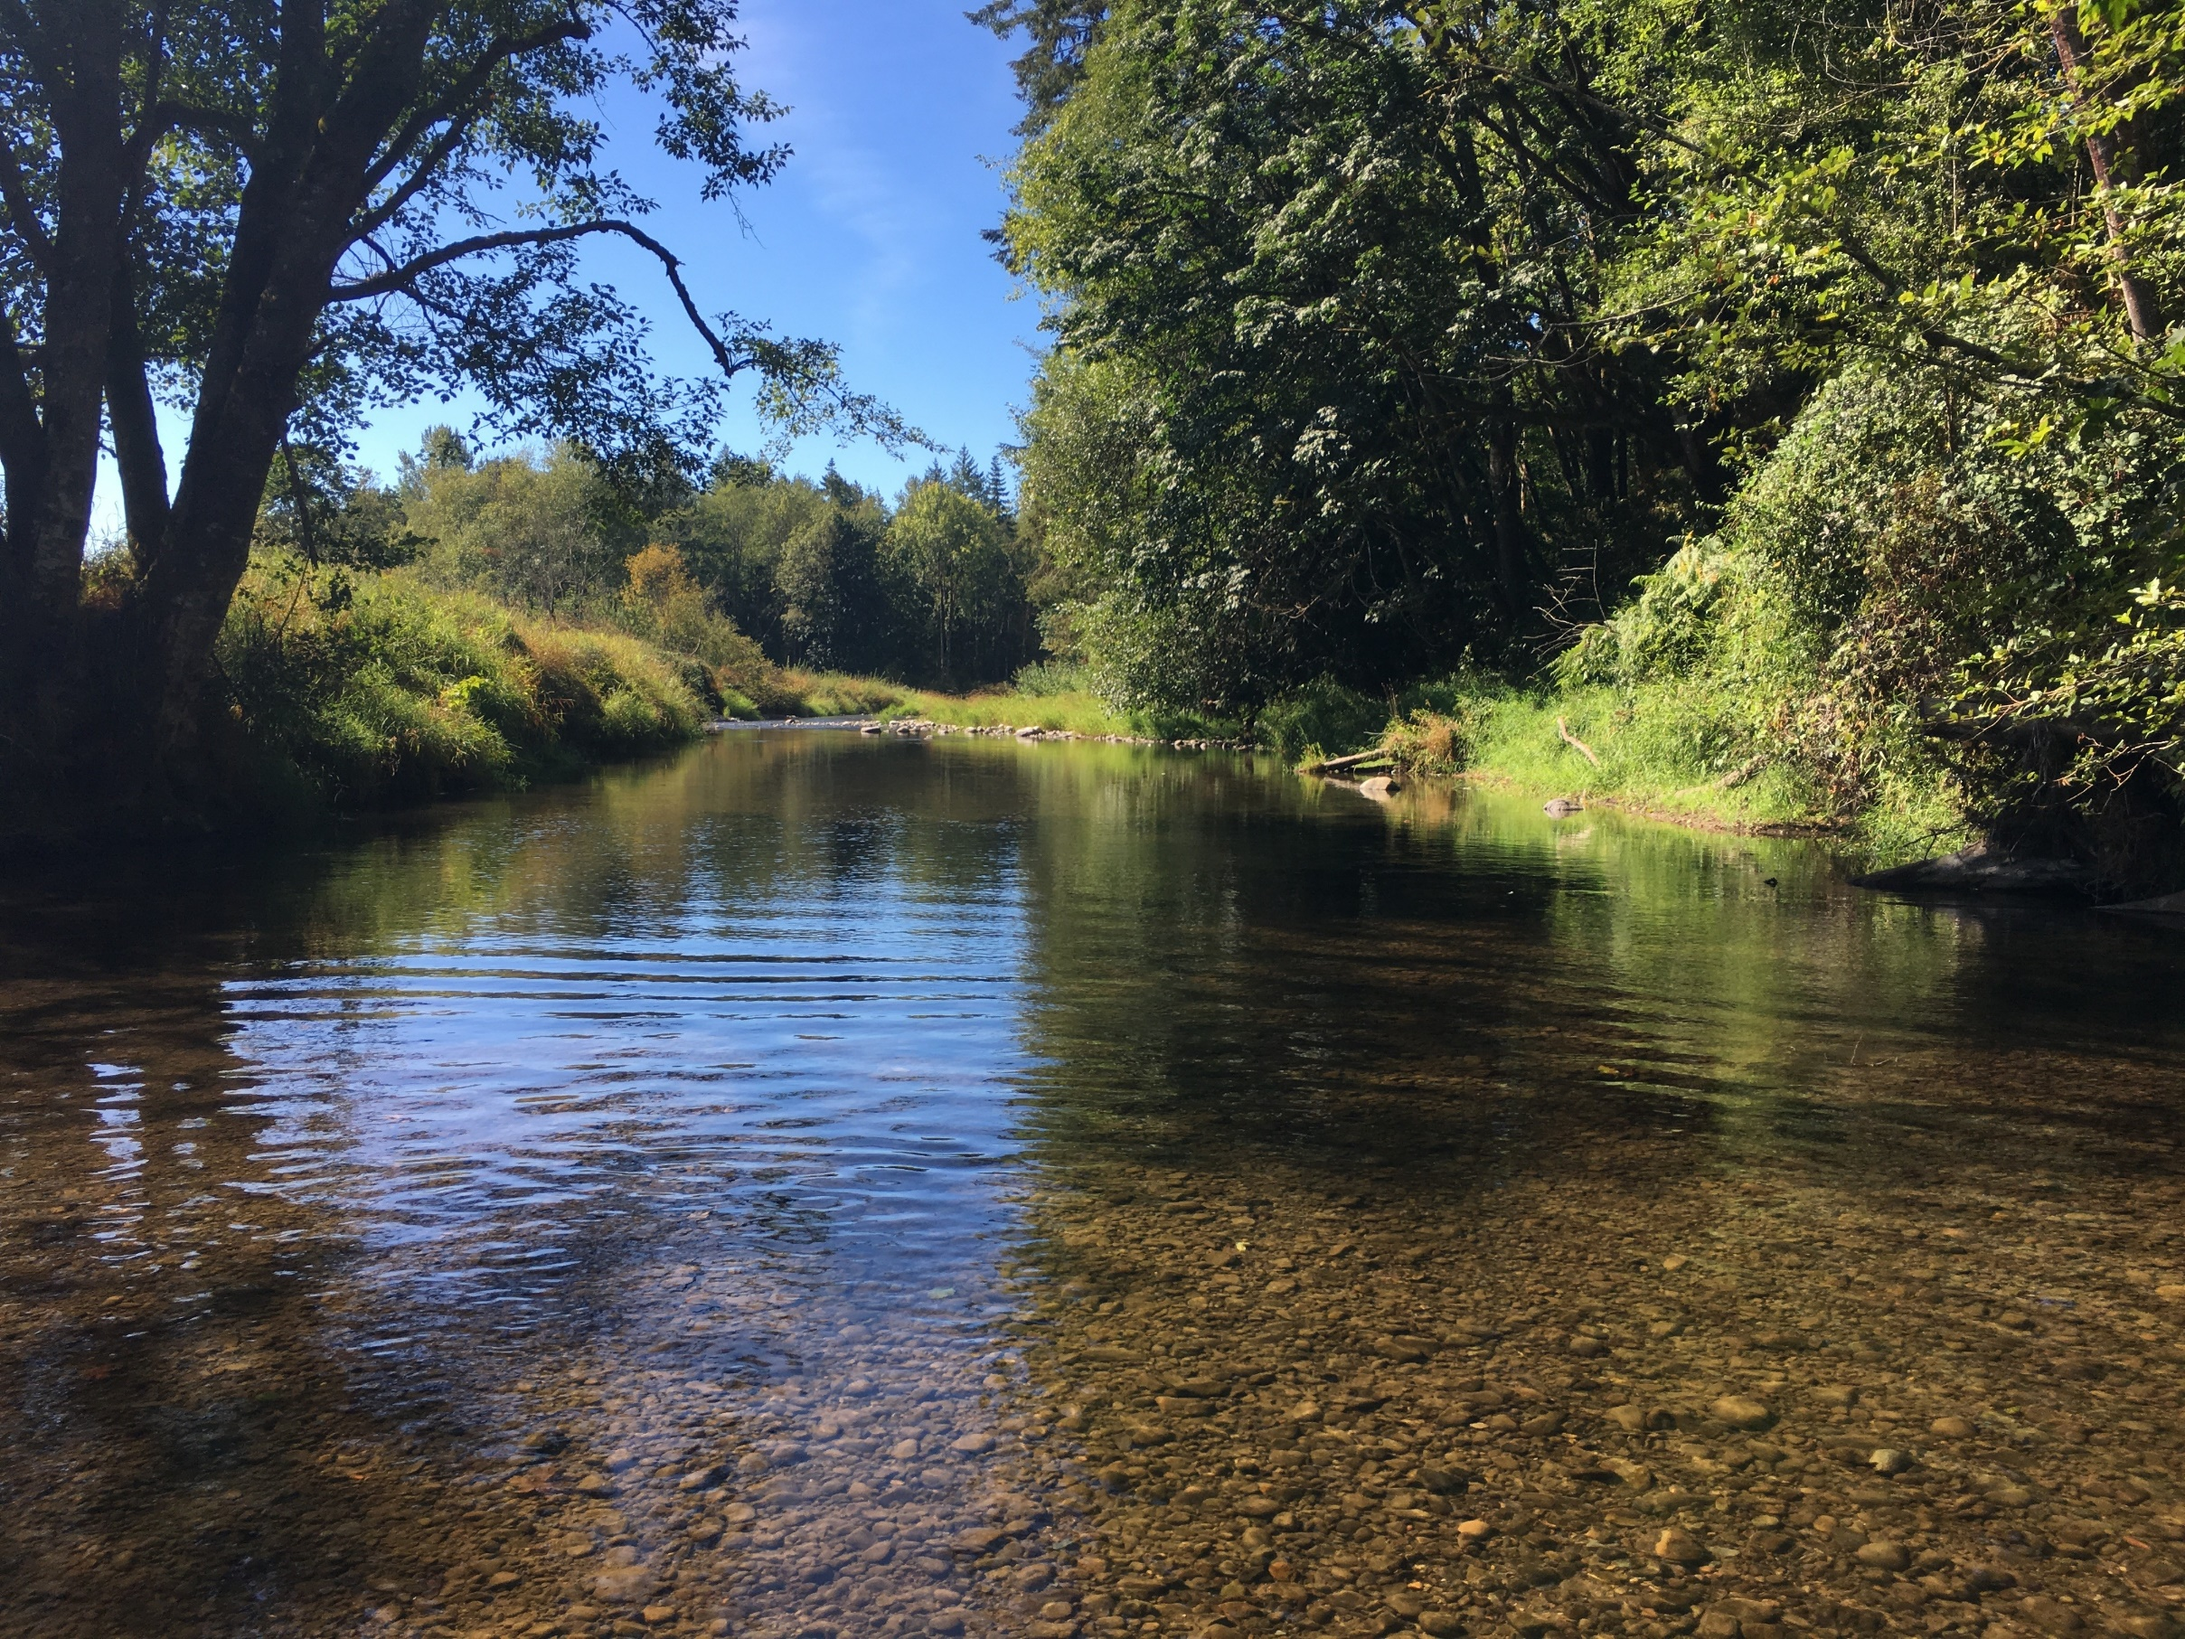
What is Net Ecological Benefit (NEB)?
From Ecology’s Final NEB Guidance
“…local planning groups are best situated, and will therefore determine the appropriate amount of benefits beyond the offsetting of projected impacts …”
Notes:
Ecology released Final NEB Guidance in July 2019 to support committees in their planning process.
NEB is the outcome that is anticipated to occur through implementation of projects in a plan to yield offsets that exceed impacts within the planning horizon and WRIA boundary.
[Prompt for speaker to make comments: Please reflect on the committee’s work regarding NEB (based on your view)
For example:
Through the committee discussions, meetings, and plan writing, it is our opinion that this plan meets NEB. The committee estimated a consumptive use of 247.7 acre-feet per year, and identified projects that provide a potential offset of 1075 acre-feet. The plan includes additional projects that provide habitat benefits to the WRIA. Through the combination of water offset and habitat projects, we anticipate that the plan achieves a net ecological benefit.

Slide 15
Watershed Restoration and Enhancement Committee
City of Auburn
City of Black Diamond (cities caucus)
City of Enumclaw
City of Kent
City of Normandy Park (cities caucus)
City of Seattle
City of Tukwila (cities caucus)
King County
Muckleshoot Indian Tribe
Covington Water District
Washington Department of Fish and Wildlife
Master Builders Association of King and Snohomish Counties
King County Agriculture Program
Center for Environmental Law and Policy
Washington State Department of Ecology
WRIA 9 Watershed Ecosystem Forum, ex officio
Tacoma Water, ex officio

Slide 16
What is the Committee’s role?
Committee
Develops Watershed Plan
Approves Plan
Ecology
Determines NEB
Adopts Plan

Slide 17
Watershed Restoration and Enhancement Plan Components
Planning Horizon
2018 - 2038
WRIA Subbasin Delineation
12 subbasins
Projected New Permit-Exempt Wells
632 new permit-exempt wells
Estimated Consumptive Water Use
247.7 acre-feet per year (0.34 cfs)
Projects and Actions
16 projects to offset estimated consumptive use and meet Net Ecological Benefit (NEB)

Slide 18
Delineate Subbasins
The WRIA 9 Committee divided WRIA 9 into 12 suitably sized subbasins for the purposes of assessing consumptive use and project offsets.
Notes:
Subbasin delineation was helpful in describing the location and timing of projected new consumptive water use, the location and timing of impacts to instream resources, and the necessary scope, scale, and anticipated benefits of projects. In some instances, subbasins may not correspond with hydrologic or geologic basin delineations (e.g. watershed divides)

Slide 19
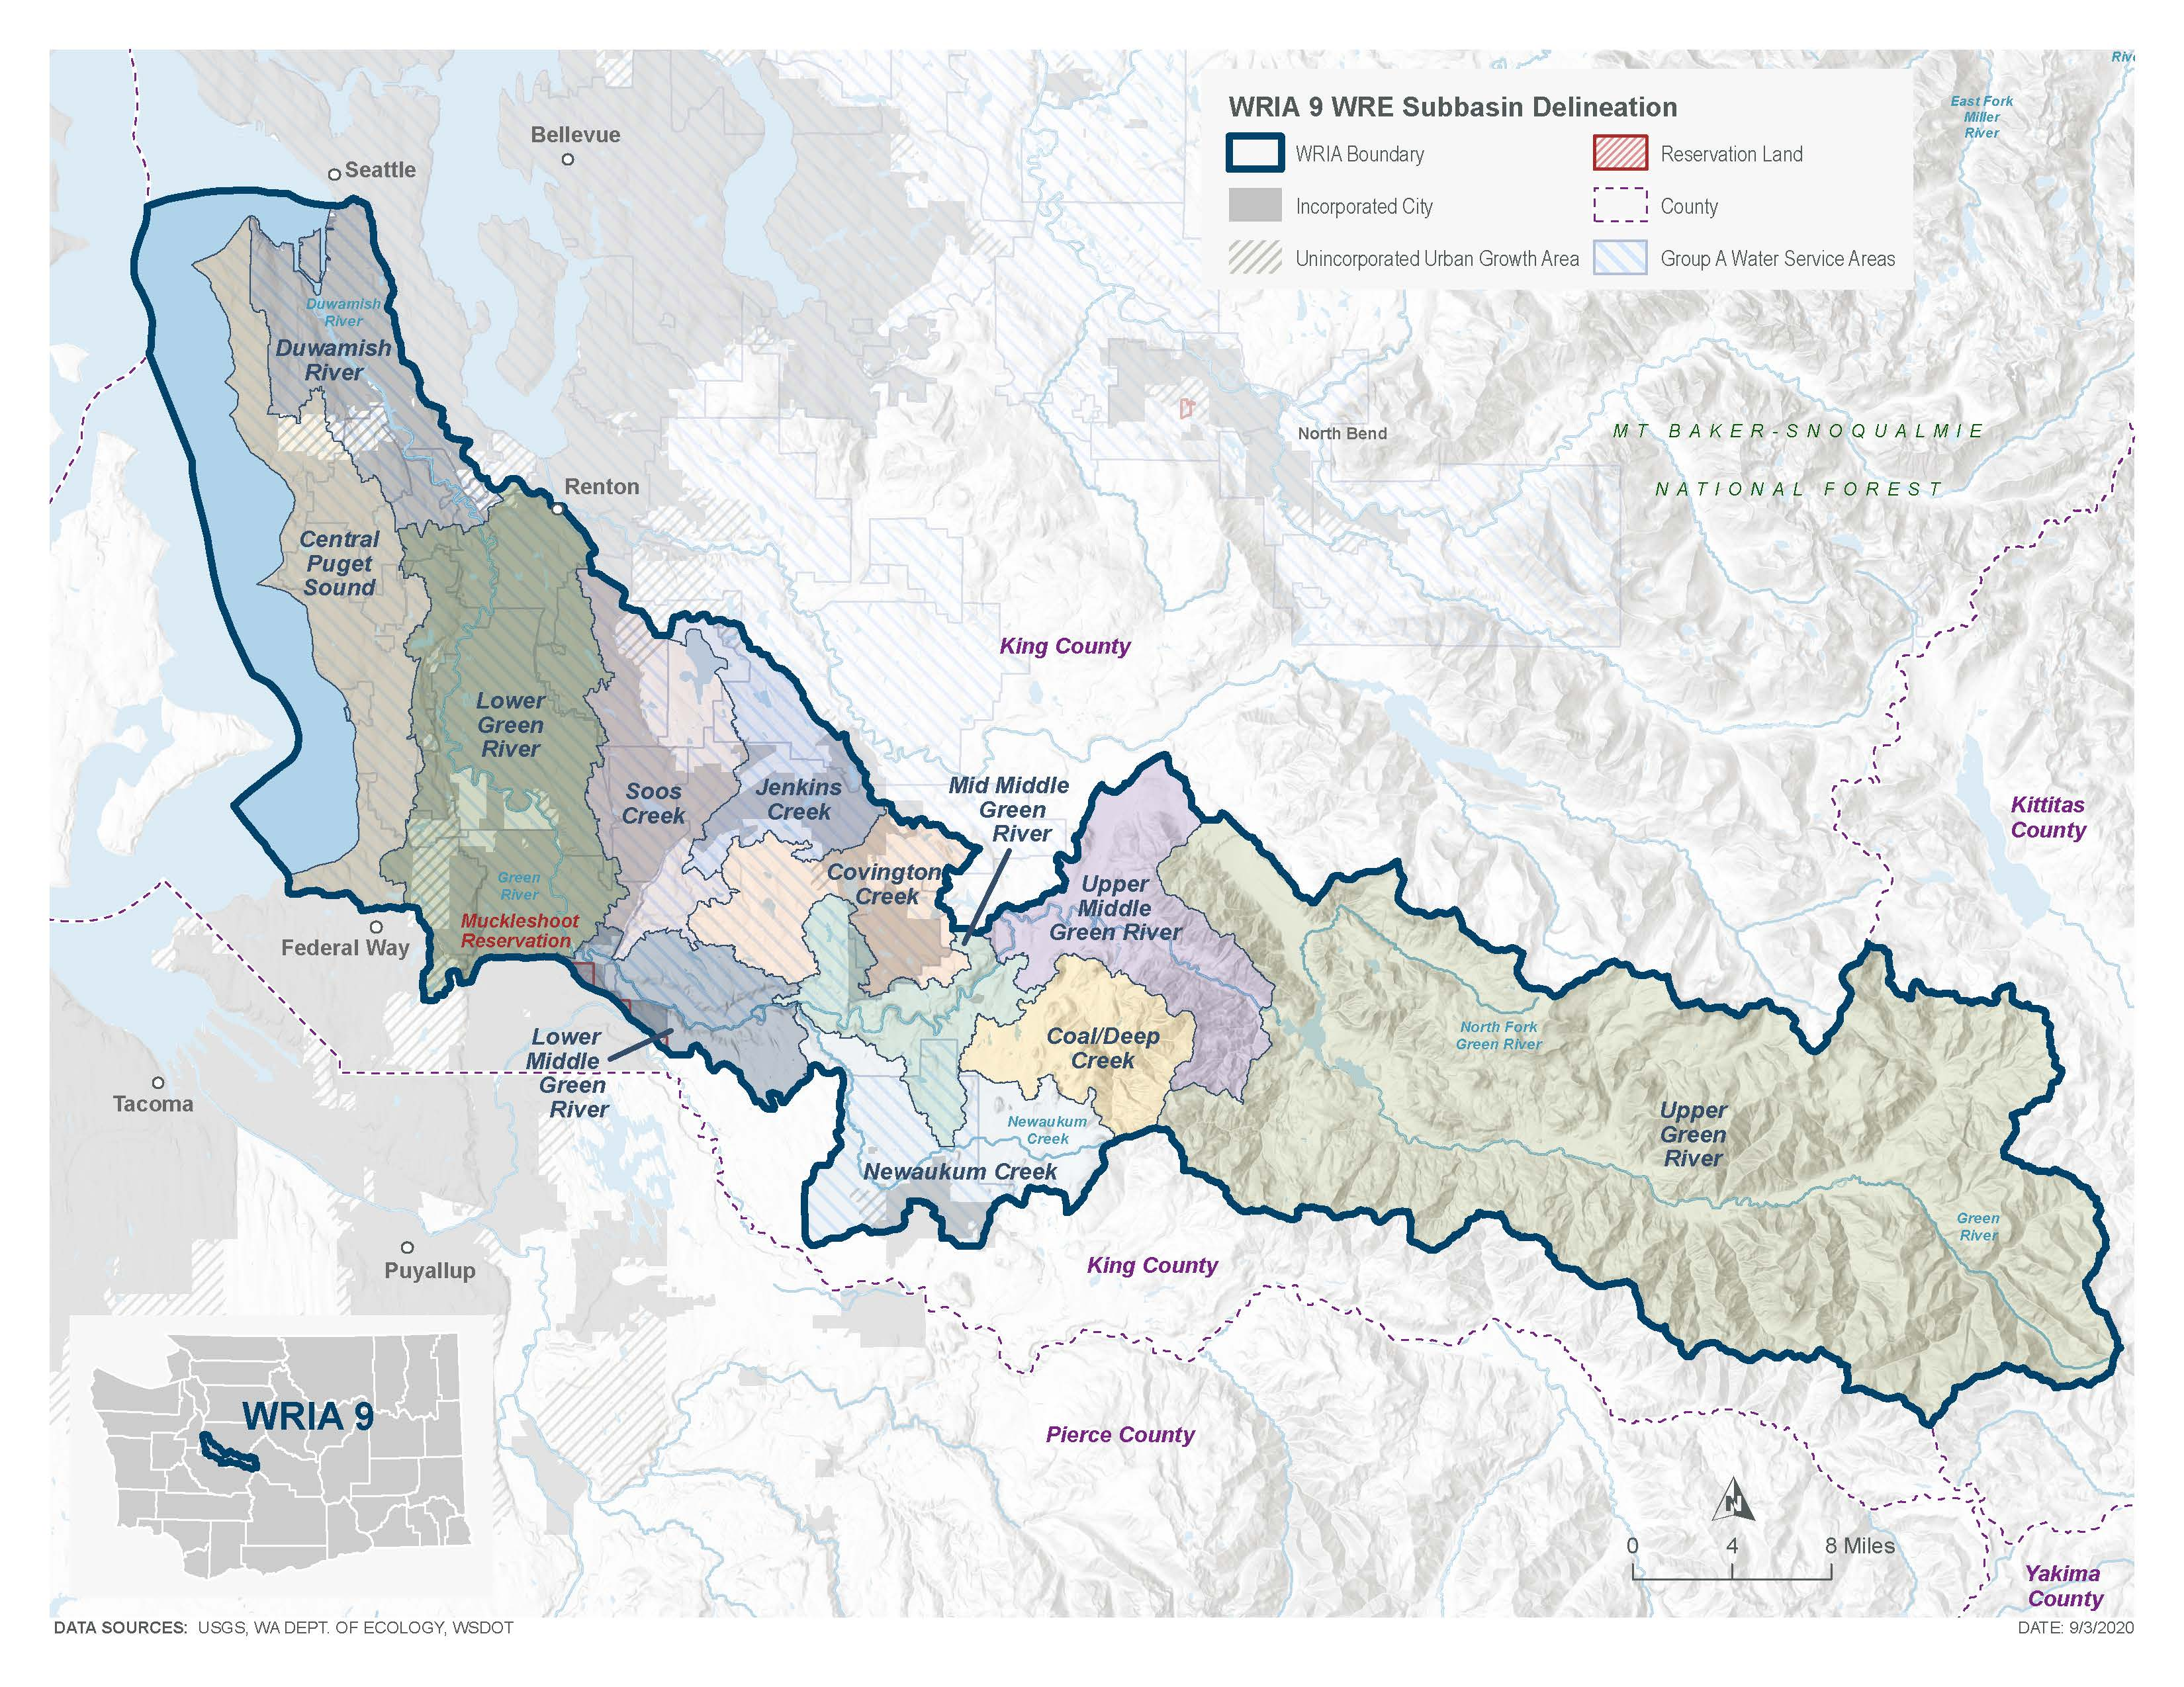
Subbasin Delineation Map

Slide 20
Project New Permit-Exempt Wells
The WRIA 9 Committee projects 632 PE wells over the planning horizon. Most of these wells are likely to be installed outside of the Urban Growth Area in the following subbasins: Soos Creek, Lower Middle Green River, Mid Middle Green River, Upper Middle Green River, and Newaukum Creek.
Notes:
This Committee developed a method that they agreed was appropriate to project the number of new PE wells over the planning horizon in the WRIA, in order to estimate new consumptive water use. This method, referred to as the PE well projection method, is based on recommendations from Appendix A of Ecology’s Final NEB Guidance (Ecology 2019).
[add any specific talking points relevant to the method to project wells that is relevant to the audience, along with other important details]

Slide 21
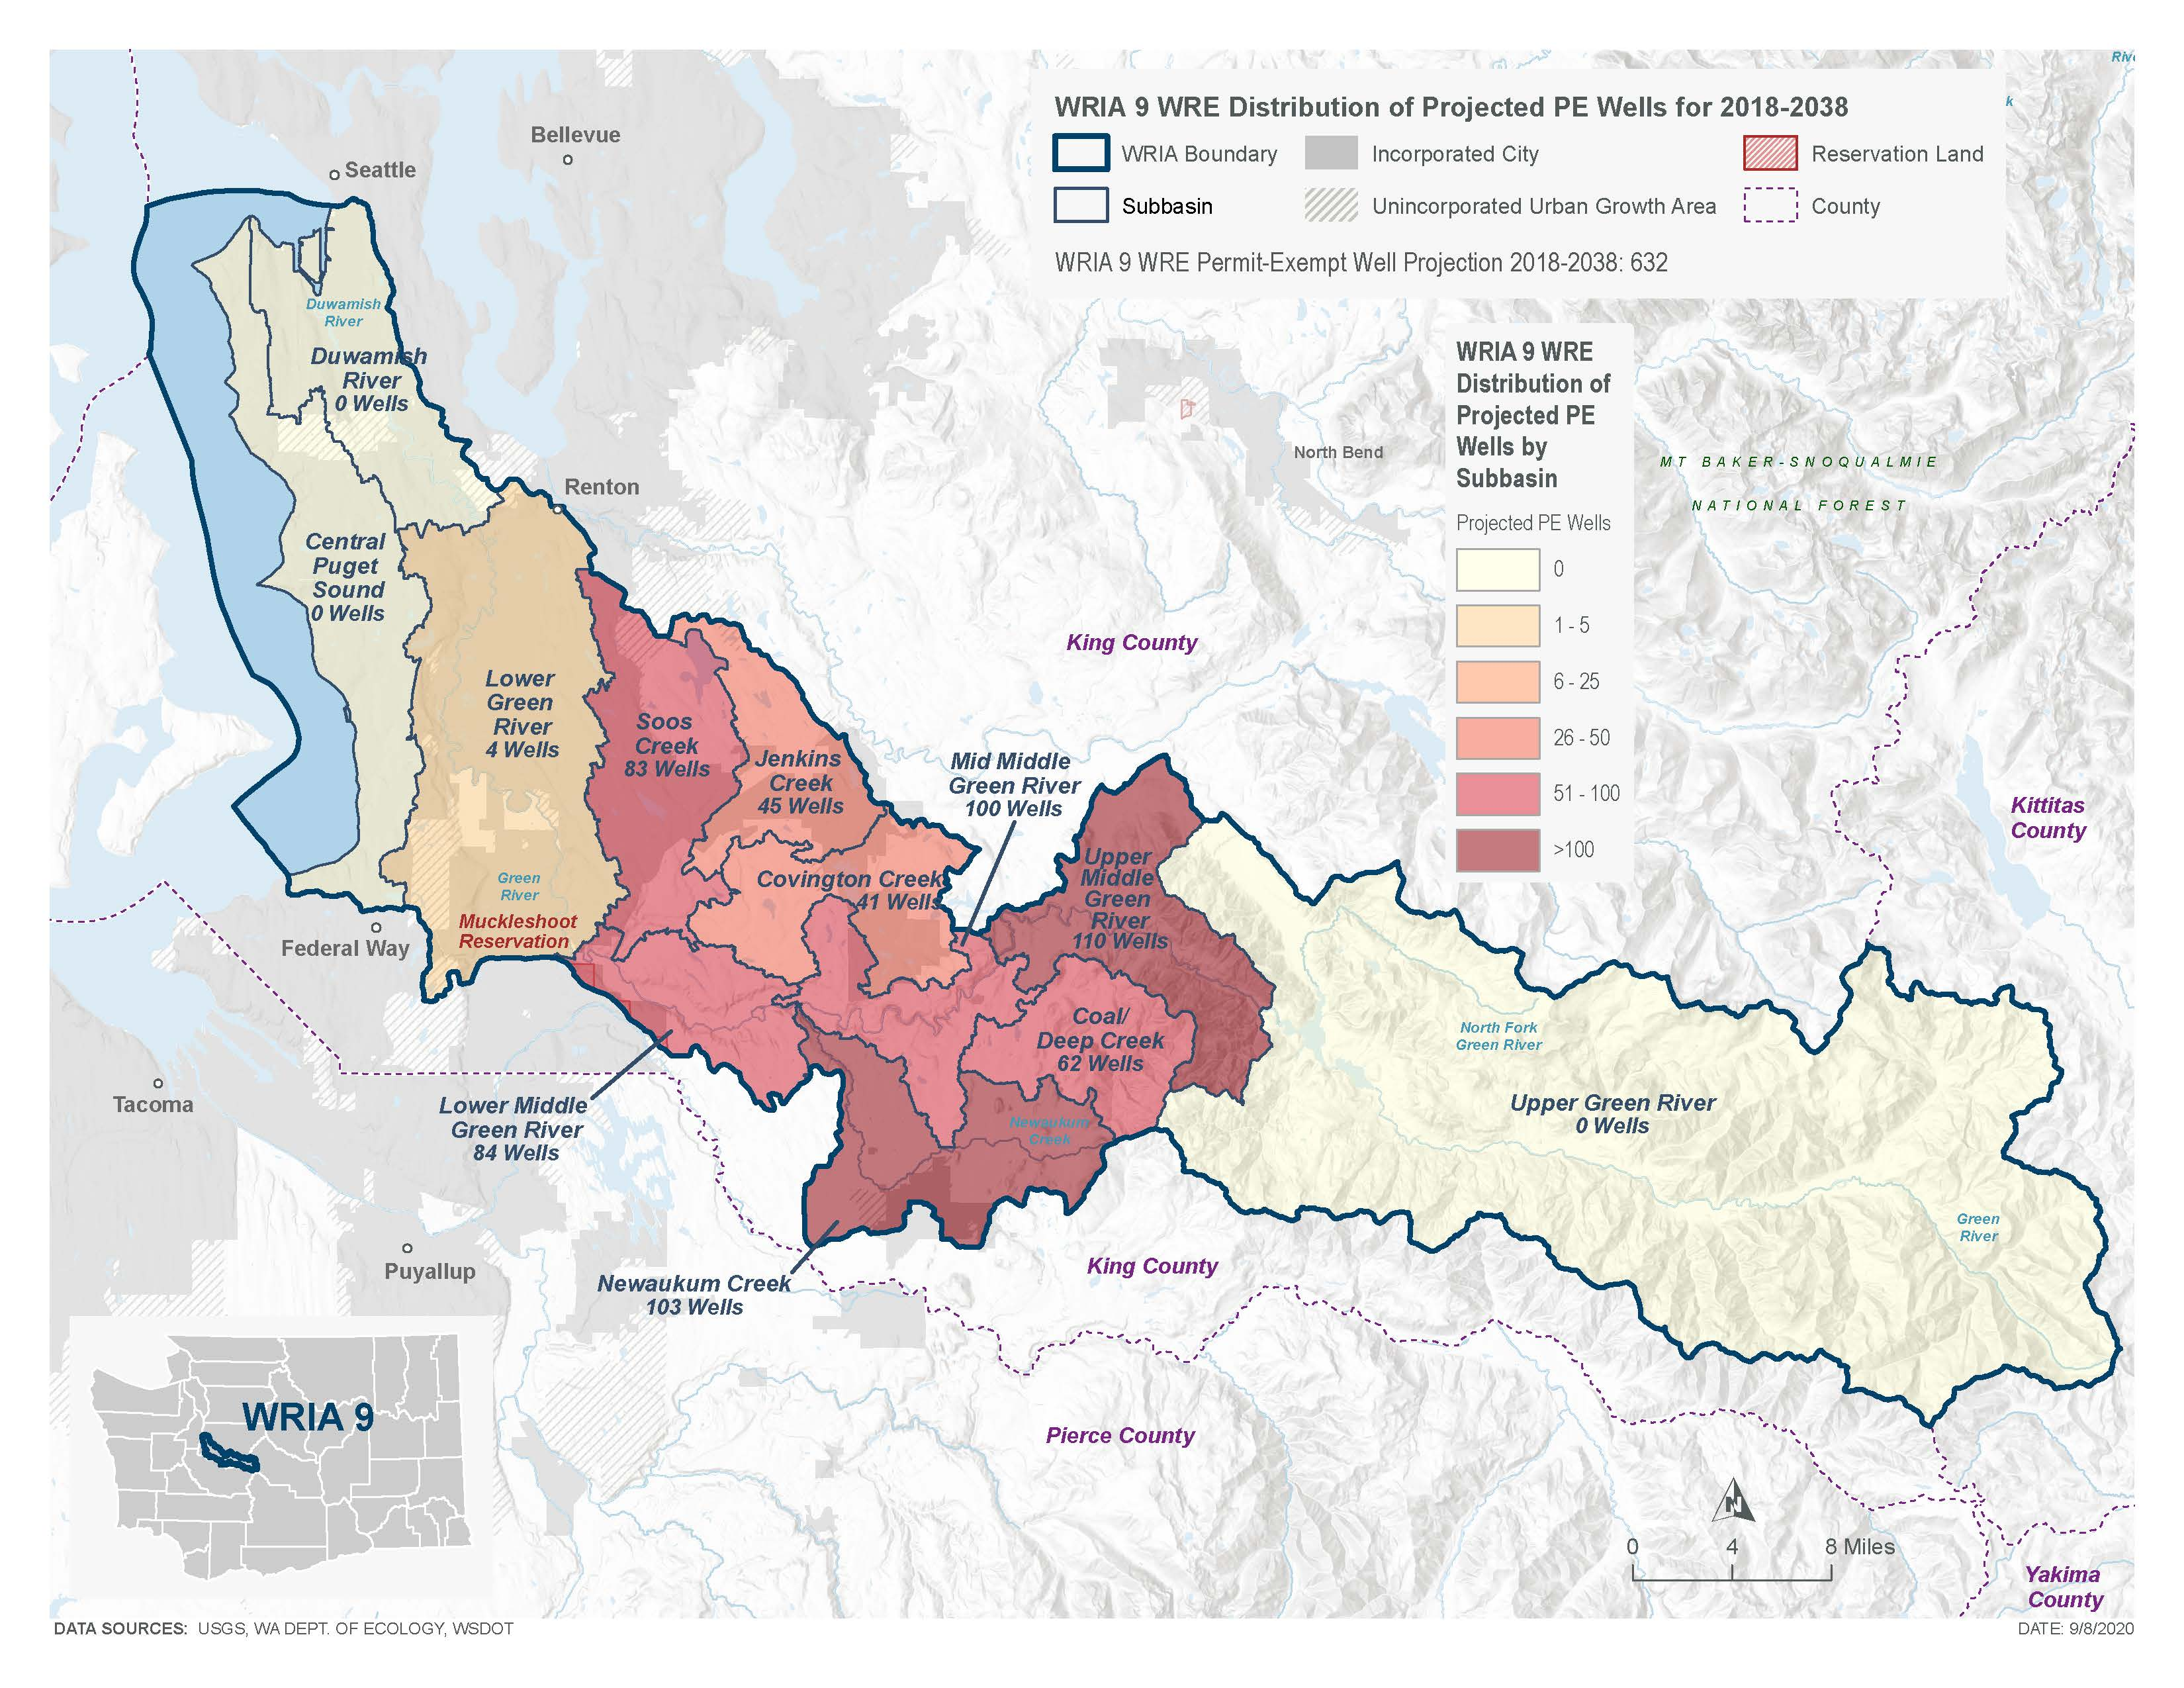
Projected New Permit-Exempt Wells Map

Slide 22
Number of PE Wells Projected between 2018 and 2038 for the WRIA 9 Subbasins
Subbasins | King County | Urban Growth Areas | Total PE Wells per Subbasin
Central Puget Sound | 0 | 0 | 0
Duwamish River | 0 | 0 | 0
Lower Green River | 0 | 4 | 4
Soos Creek | 72 | 11 | 83
Jenkins Creek | 44 | 1 | 45
Covington Creek | 41 | 0 | 41
Lower Middle Green River | 81 | 3 | 84
Mid Middle Green River | 100 | 0 | 100
Newaukum Creek | 102 | 1 | 103
Upper Middle Green River | 110 | 0 | 110
Coal Deep Creek | 62 | 0 | 62
Upper Green River | 0 | 0 | 0
Totals | 612 | 20 | 632

Slide 23
Estimate New Consumptive Water Use
The WRIA 9 Committee used the 20-year projection of new PE wells for WRIA 9 (632) to estimate the consumptive water use that this watershed plan must address and offset.
The WRIA 9 Committee estimated 247.7 acre-feet per year (0.34 cfs) of new consumptive water use in WRIA 9.
The WRIA 9 Committee sought projects to offset at least 495.4 acre-feet of water per year (double the consumptive use estimate) to account for uncertainties in the planning process.
Notes:
The Consumptive Use Estimates Technical Memorandum provides a more detailed description of the analysis and alternative scenarios considered (Appendix)
[add any specific talking points relevant to the method to estimate CU that is relevant to the audience, along with other important details]

Slide 24
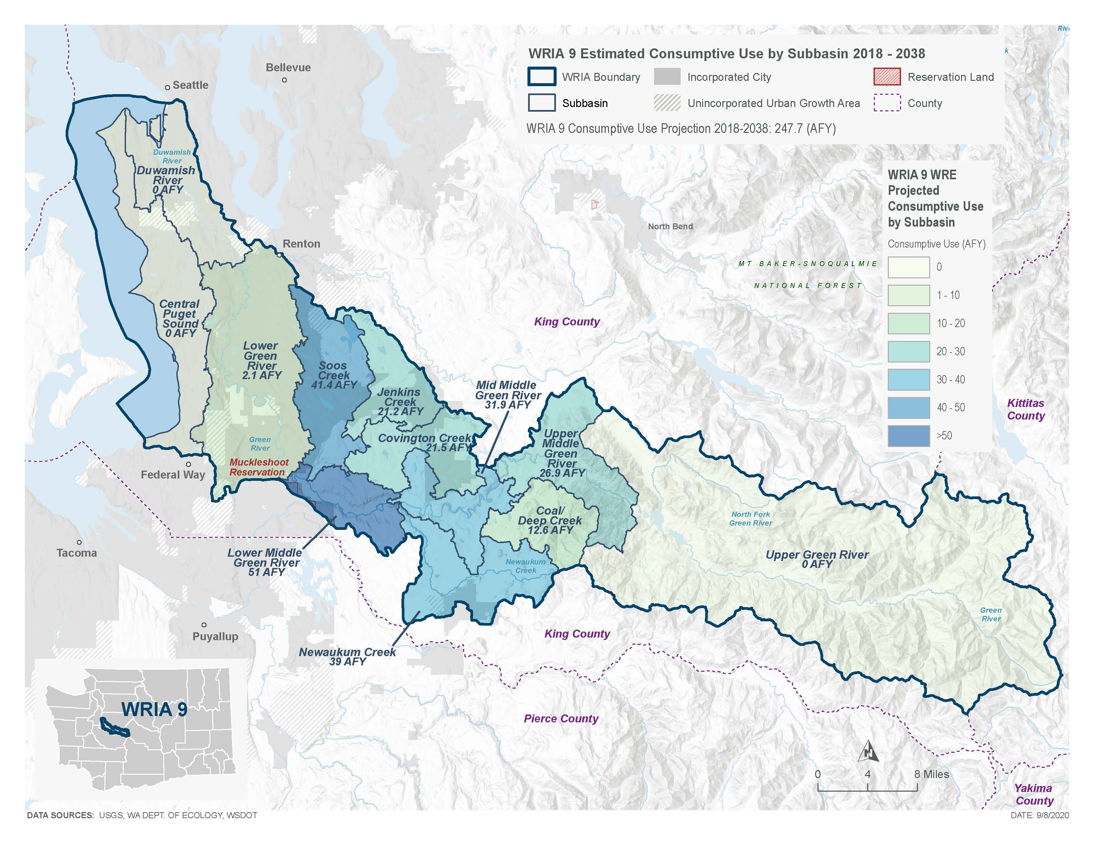
Estimated New Consumptive Water Use Map

Slide 25
Consumptive Use Estimate
Subbasin | Projected PE wells | Average lawn size (acres) | Indoor CU per well (AF/yr) | Outdoor CU per well (AF/yr) | Total CU/year per well (AF/year) | Total CU 2018-2038 (AF/year)
Central Puget Sound | 0 | - | - | - | - | 0
Duwamish River | 0 | - | - | - | - | 0
Lower Green | 4 | 0.3 | 0.0183 | 0.51 | 0.53 | 2.1
Soos Creek | 83 | 0.3 | 0.0183 | 0.48 | 0.50 | 41.4
Jenkins Creek | 45 | 0.3 | 0.0183 | 0.45 | 0.47 | 21.2
Covington Creek | 41 | 0.4 | 0.0183 | 0.51 | 0.52 | 21.5
Lower Middle Green River | 84 | 0.4 | 0.0183 | 0.59 | 0.61 | 51.0
Mid Middle Green River | 100 | 0.3 | 0.0183 | 0.30 | 0.32 | 31.9
Newaukum Creek | 103 | 0.3 | 0.0183 | 0.36 | 0.38 | 39.0
Upper Middle Green River | 110 | 0.2 | 0.0183 | 0.23 | 0.24 | 26.9
Coal/Deep Creek | 62 | 0.2 | 0.0183 | 0.19 | 0.20 | 12.6
Upper Green River | 0 | - | - | - | - | 0
WRIA 9 | 632 | 0.3 | 0.0183 | 0.42 | 0.43 | 247.7

Slide 26
Types of Projects & Actions
Water Right Acquisition
Managed Aquifer Recharge
Habitat Projects
Streamflow Augmentation
Notes:
The plan includes 6 water offset projects and 11 habitat projects to meet net ecological benefit.

Slide 27
Water Offset Projects
Subbasin | Project Name | Project Type | Offset Estimate (acre-feet/year)
Soos | Soos Creek Park water right acquisition (pre-identified water right No. 5) | Water Right Acquisition | 11
Soos | Pre-identified No. 6 water right acquisition | Water Right Acquisition | 182
Covington | Pre-identified No. 2 water right acquisition | Water Right Acquisition | 54
Covington | Covington Water District Managed Aquifer Recharge | Water storage and retiming - MAR | 357
Upper Mid Green | Green River Managed Aquifer Recharge (2 sites) | Water storage and retiming - MAR | 114
Upper Green River | Tacoma Water Streamflow Augmentation and Eagle Lake Siphon | Streamflow augmentation | 357
Total Offset Potential |  |  | 1075

Slide 28
Habitat Projects
Subbasin | Habitat Project Name
Lower Green | Mill Creek Stormwater Retrofit
Soos | Lower Soos Creek Restoration
Lower Middle Green | Turley Levee Setback
Lower Middle Green | Hamakami Levee Setback
Lower Middle Green | Burns Creek Restoration
Mid Middle Green | Crisp Creek Watershed Protection Project
Mid Middle Green | Flaming Geyer Revegetation
Newaukum | Newaukum Creek Riparian Revegetation and Beaver Colonization
Newaukum | Newaukum Creek Tributary Restoration (Gwerder, et al)
Soos, Jenkins, Covington, Lower Middle Green, Mid Middle Green, Upper Middle Green, Newaukum | Middle Green Open Space Acquisition

Slide 29
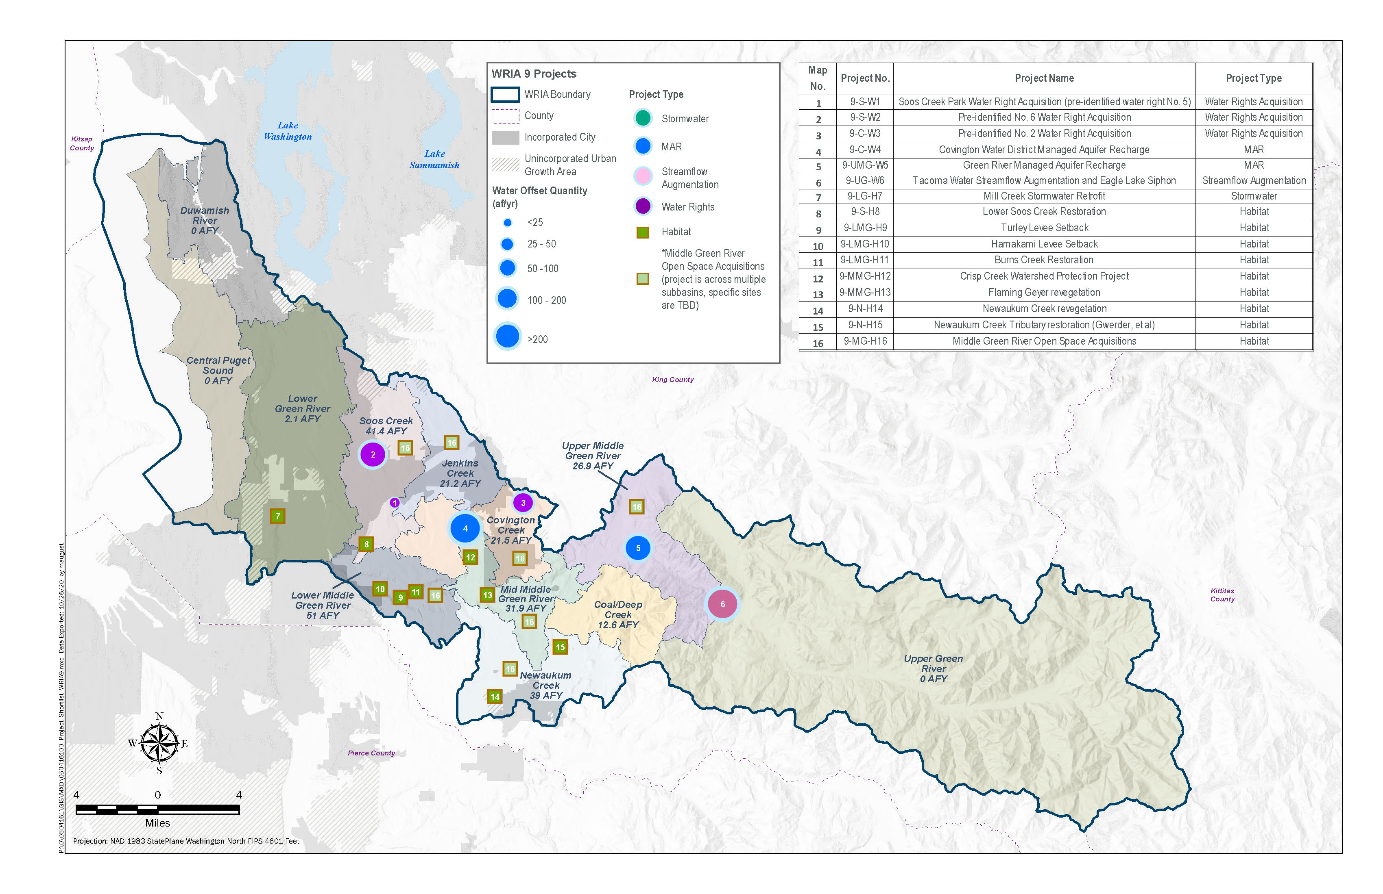
WRIA 9 Projects

Slide 30
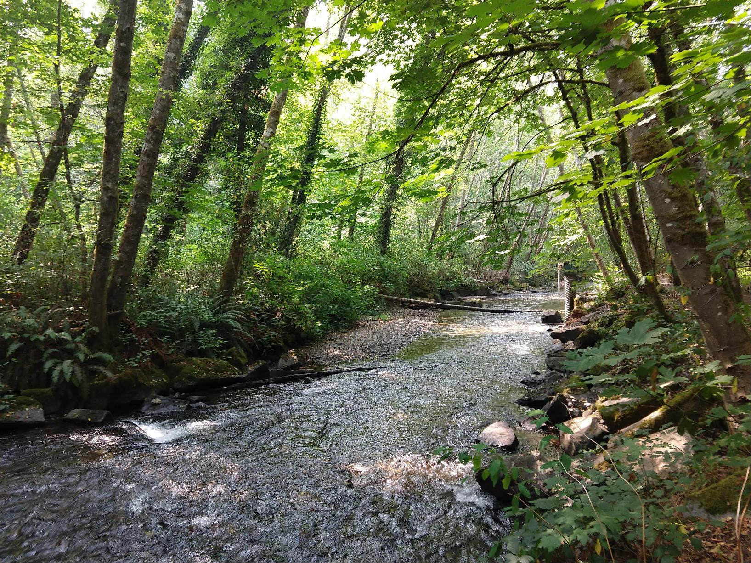
Potential Future Projects
Water right acquisitions
Increase connections to public water systems
Outreach and incentives for water conservation
Beneficial water source switches
Habitat restoration
Reclaimed water use
Future projects in subbasins with higher projected PE wells
Monitoring and studies
Notes:
[provide examples of other plan recommendations that may be of interest to the audience]

Slide 31
Adaptive Management Recommendations
Track number and location of new PE wells
Monitor project implementation and water offset achieved
Regular reporting from Ecology on plan implementation (every 5 years)
Ecology can adjust the plan, if needed
Notes:
[provide examples of other plan recommendations that may be of interest to the audience]

Slide 32
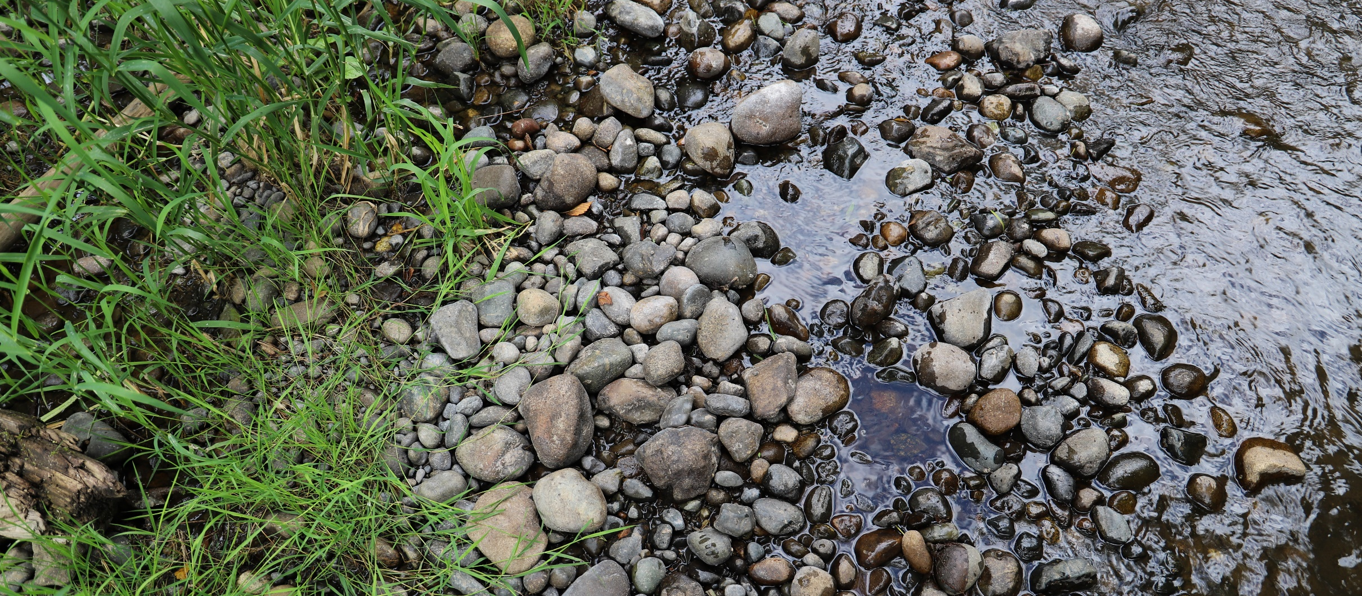
Plan Implementation
As required by the NEB Guidance, the Committee prepared the watershed plan with implementation in mind. However, as articulated in the Streamflow Restoration Policy and Interpretive Statement (POL-2094), “RCW 90.94.020 and 90.94.030 do not create an obligation on any party to ensure that plans, or projects and actions in those plans or associated with rulemaking, are implemented."
Notes:
Presenter should use this slide and speak to it as appropriate for the audience. This slide can also be moved before the recommendations slide.

Slide 33
Steps to complete plan
Committee members reviewed and provided comments on draft plan.
Committee members shared final draft plan with local decision makers for review.
Committee members meet (virtually) to vote on the plan.
If all members of the Committee approve the plan, the Committee chair will finalize the plan and submit the plan to Ecology for review and NEB determination.
If the Committee does not approve the plan, Ecology will prepare the plan. Ecology will send the plan to the Salmon Recovery Funding Board for technical Review. Ecology will then finalize the plan and the Director shall initiate rulemaking.

Slide 34
Post Plan Submission
SEPA public comment period
No changes to plan after submission
Ecology will review plan
Ecology will determine action by June 30, 2021
If achieves NEB, adopt plan

Slide 35
Thank you for your time!
Any questions?

Slide 36
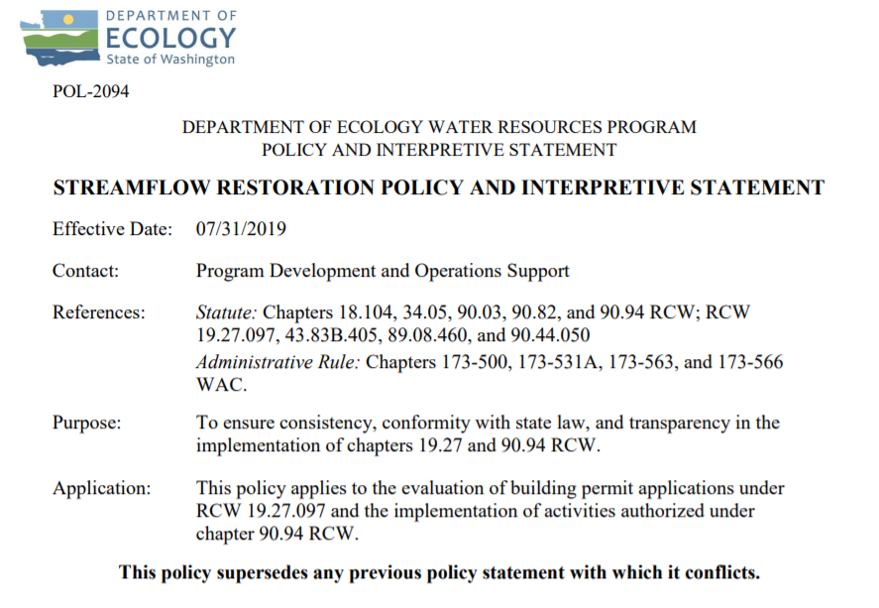
Ecology’s Policy Interpretation
More information on the Streamflow Restoration law can be found online
Notes:
RCW 90.94.030 adds to the management regime for new homes using domestic permit-exempt well withdrawals in this WRIA and elsewhere. For example, local governments must, among other responsibilities relating to new permit-exempt domestic wells, collect a $500 fee for each building permit and record withdrawal restrictions on the title of the affected properties. Additionally, this law restricts new permit-exempt domestic withdrawals in this WRIA to a maximum annual average of up to 950 gallons per days per connection, subject to the five thousand gallons per day and ½-acre outdoor irrigation of non-commercial lawn/garden limits established in RCW 90.44.050. Ecology has published its interpretation and implementation of RCW 19.27.097 and RCW 90.94 in Water Resources POL 2094.

Slide 37
Ecology’s NEB Guidance
More information on the Final Guidance for Determining Net Ecological Benefit can be found online
Notes:
After conducting a thorough scientific literature review, Ecology has determined that NEB is not a technical term that has been defined in the natural sciences. Instead, it is a creation of the Washington State Legislature. Therefore, Ecology has prepared this guidance for interpretation and application of this term. This guidance provides supplemental information, beyond that provided expressly in the law, for those groups engaged in the watershed planning work required by RCW 90.94.020 and RCW 90.94.030.

Slide 38
WRIA 9 Committee Brochure
More information on WRIA 9 Committee can be found online

Slide 39
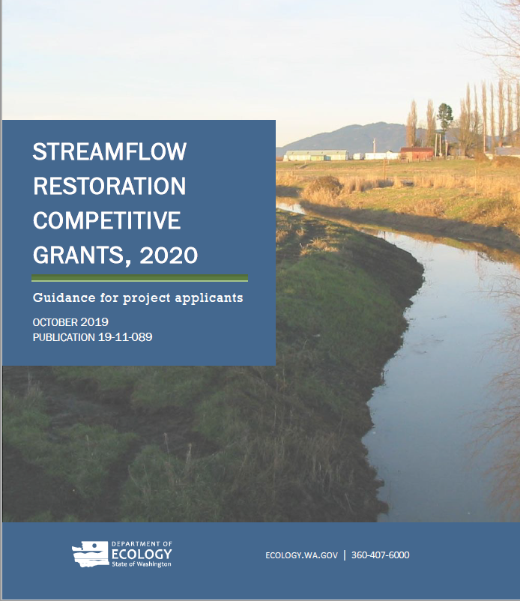
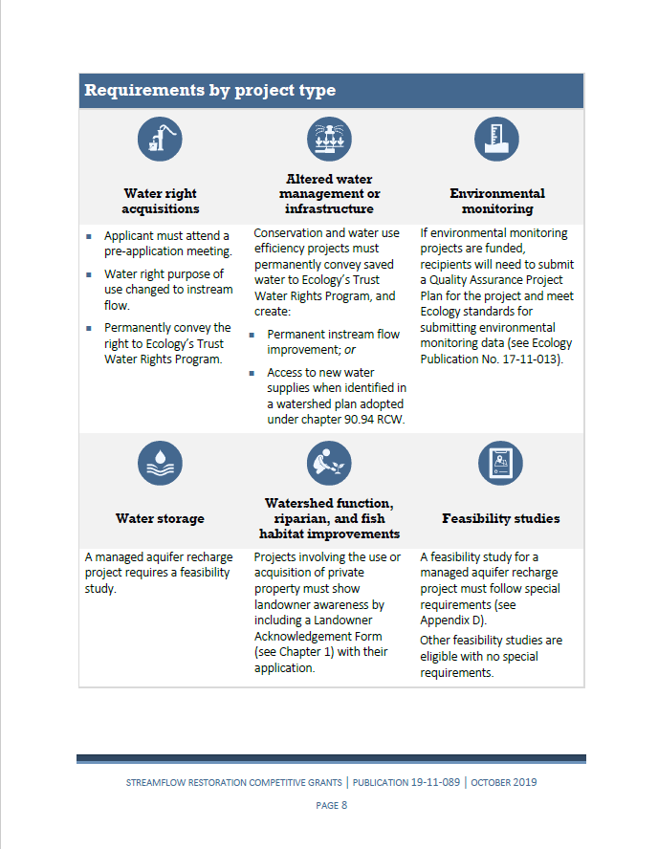
Grants Guidance Overview

