Slide 1


Growth Projections for RCW 90.94
May 2019
Rebecca Brown
Washington State Department of Ecology
Rebecca.brown@ecy.wa.gov

Slide 2
1. Building Permits
GIS analysis of building permits, zoning, and parcel information.
Segregate data by WRIA and/or subbasins
Estimate number of single-family building permits issued over some previous time period (e.g. past 10 years)
Use results to predict permit-exempt domestic wells over subsequent 20- year period
Assumptions: rate of increase for new building permits, number/percent of permits that rely on wells, zoning restrictions, undeveloped parcels, etc.

Slide 3
2. Population Forecasts: Option 1
Look at populations for 2 different years (e.g. 2008 and 2018), then use rates of increase to predict future populations.
Upon request, OFM can prepare 2000-2017 small area estimates for a basin or subbasins.
Assumptions: rate of increase, % of population using municipal/ community water system, average number of people per household, etc.

Slide 4
2. Population Forecasts: Option 2
Rely on current county or OFM population estimates for a given basin or subbasin, then increase that number based on available population projections.
Assumptions: rate of increase, population per basin/subbasins that span municipal boundaries, population using municipal/community water system, average number of people per household, etc.

Slide 5
2. Population Forecasts: Option 3
Use growth projections from County Comprehensive Plans.
Assumptions: rate of increase, population per basin/subbasins that span municipal boundaries, population using municipal/community water system, average number of people per household, etc.

Slide 6
3. Well logs
Segregate data into sub-basins.
Evaluate data to estimate number of permit-exempt wells drilled over some previous time period (e.g. past 10 years).
Use results to predict permit-exempt domestic wells over subsequent 20-year period.
Assumptions: wells in Ecology database are permit-exempt, wells in water service areas, rate of increase, well locations, etc.
It is unlikely that we would use the Ecology well log database for Pierce County, but we can consider the data for King County.

Slide 7
Well Logs, Cont.
Pierce County has accurate well data from the Tacoma Pierce County Health Department.
More details on the Pierce County method on the “Projecting Future Exempt Wells” Presentation on the WRIA 10 Webpage.

Slide 8
Example: Well Logs
Cannot filter to show only permit-exempt wells
Information in the database is provided by the driller
Location of wells is on the quarter-quarter section
Notes:
cannot filter ecology database to show only permit-exempt wells
Information in the database is provided by the driller and is not always correct, sometimes fields are missing
Location of wells is on the quarter quarter section
The map shows water wells and excludes dewatering wells
We filtered for wells 6-8 inches in diameter, and deeper than 30 feet, as a proxy for domestic wells

Slide 9


Projecting Future Exempt Wells using Historical Permit Data
Tacoma-Pierce County Health Dept
Review 20 year Trend Data
Moderate Approach
Eliminates Assumptions
  Subarea (WRIA) Population/Housing Projections
  Person Per Household (pphh)
  Exempt Wells within Group A water systems
  Notes:
  No Sub-area projections for 2040
  Vision 2050 Growth Allocation
  Rural = 22,000 = 242 HUs per year
  Unrealistically Low
  Full Build-out
  Beyond 20 years
  Won’t be realized

Slide 10
4. Developable Lands (King County study)
Use GIS data to identify buildable/developable land.
Overlay zoning information to capture residential density potential.
Remove areas with municipal/community water systems.
Determine likelihood of development in the next 20 years based on growth rates.
Assumptions: 20 year rate of development, parcels to exclude, connections in water service areas, need to rely on a method to determine growth rates, etc.

Slide 11
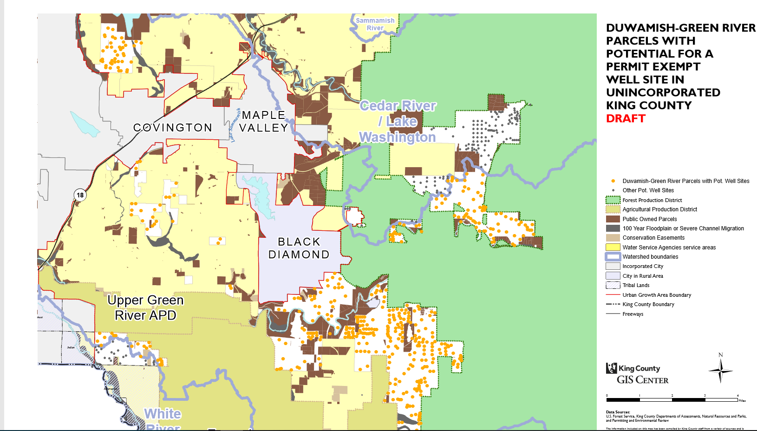
Example: Developable Lands

