Slide 1
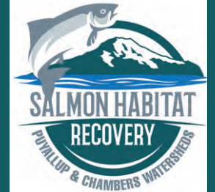
Salmon Habitat Protection and Restoration Strategy WRIA 10
Liz Bockstiegel & Lisa Spurrier
June 5, 2019

Slide 2
Puyallup and Chambers Watersheds Salmon Recovery Lead Entity Established by RCW Chapter 77.85.050 –Salmon Recovery- Effective date—1999 RCW Chapter 77.85.050-sp.s. c 13: "This act is necessary for the immediate preservation of the public peace, health, or safety, or support of the state government and its existing public institutions, and takes effect July 1, 1999."
(1)(a) Counties, cities, and tribal governments must jointly designate, by resolution or by letters of support, the area for which a habitat project list is to be developed and the lead entity that is to be responsible for submitting the habitat project list. No project included on a habitat project list shall be considered mandatory in nature and no private landowner may be forced or coerced into participation in any respect. The lead entity may be a county, city, conservation district, special district, tribal government, regional recovery organization, or other entity.
WRIA 10 & 12 Lead Entity = Pierce County
WRIA 11 Lead Entity = Nisqually Tribe
WRIA 15 Lead Entity = Kitsap County
Notes:
Lead entities were established by the Revised code of Washington Chapter 77.85 –which states ) Counties, cities, and tribal governments must jointly designate, by resolution or by letters of support, the area for which a habitat project list is to be developed and the lead entity that is to be responsible for submitting the habitat project list. habitat project list means the ranked list of projects that we present to the SRFB at the completion of our grant round. Pierce County is the Lead Entity – the fiscal agent for WRIA’s 10 and 12.

Slide 3
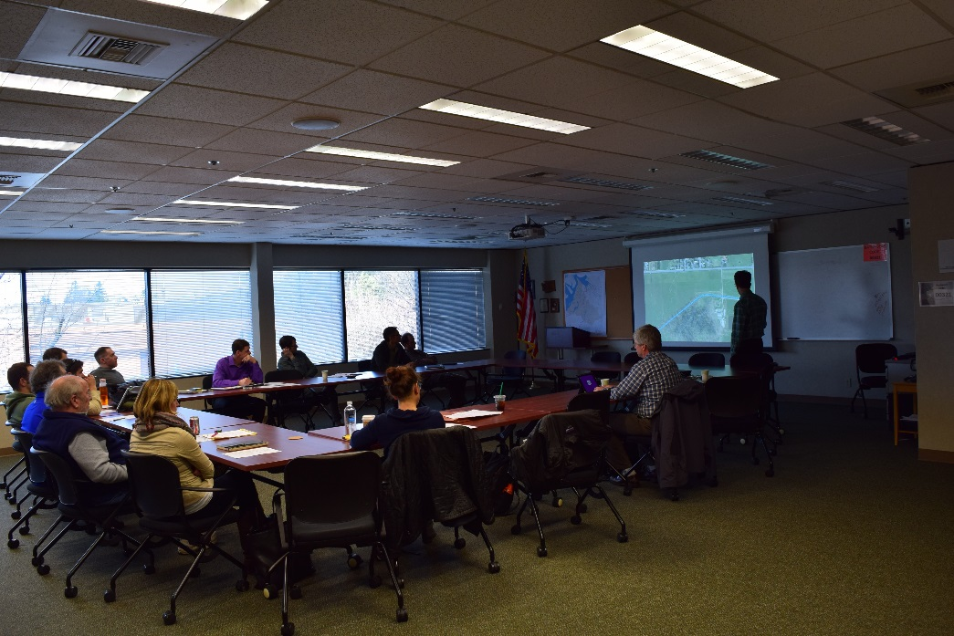
RCW Chapter 77.85.050 77.85.050 b) The lead entity shall establish a committee (Citizens Advisory Committee – CAC) that consists of representative interests of counties, cities, conservation districts, tribes, environmental groups, business interests, landowners, citizens, volunteer groups, regional fish enhancement groups, and other habitat interests.
Puyallup and Chambers Watersheds Salmon Recovery Lead Entity
Notes:
The legislation also says that ….

Slide 4
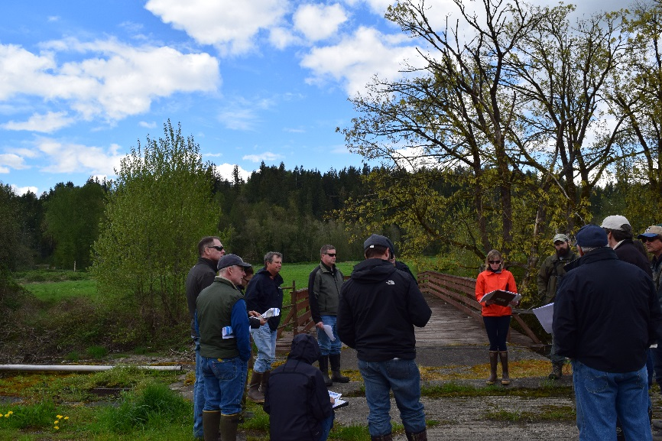
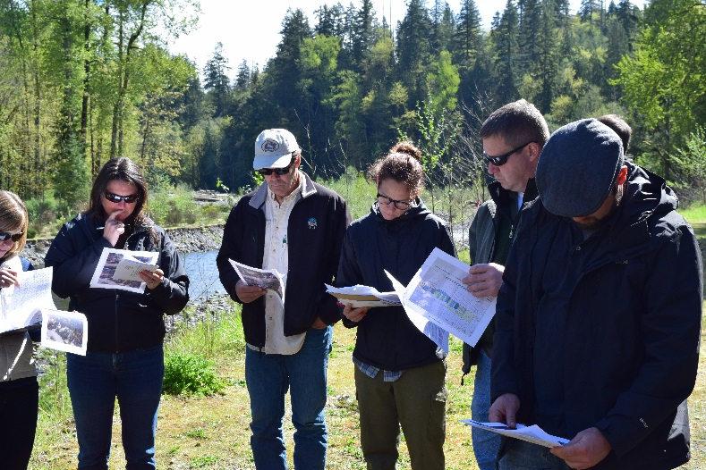
Lead Entity Core Functions
Administer Grant Rounds for:
Salmon Recovery Funding Board (RCO)
State and Federal (PCSRF) funds;
Puget Sound Acquisition and Restoration (RCO and PSP) State funding ;
King County Cooperative Watershed Management (King County Flood Control Zone District);
PSAR Capacity Funds -Small grants –future project development.
Salmon Habitat Protection & Restoration Strategy
Monitoring and Adaptive Management of PS Chinook Recovery Plan Chapters(Next Steps are EDT Update and Monitoring Plan)
Four Year Work Plans - to implement the Strategy
Technical Support
Habitat Work Schedule

Slide 5
Recovery Plan Legislation
ESHB 2496 – 1998 established GSRO; State of the Salmon reporting; Regional Councils; HWS; science panel.
1999 –Puget Sound Chinook salmon listed as threatened
2005, Shared Strategy for Puget Sound presented the Puget Sound Chinook Recovery Plan to NMFS.
collaborative initiative that began in 1999- included reps from Federal, state, Tribal, and local governments, business, the agriculture and forestry industries, conservation and environmental groups, and local watershed planning groups.
“(B)uild a scientifically robust, practical, cost-effective recovery plan by June 2005 that defines the strategies and actions necessary to recover naturally spawning Chinook salmon, bull trout and Hood Canal summer chum to self-sustaining and harvestable levels within the context of a prosperous economy and sustainable growth (Volume I, Chapter 1).”
Puget Sound Chinook Recovery Plan also has Watershed Chapters – Tom Kantz was originally hired by PC to do the EDT modeling that provides the basis for ours in WRIA’s 10/12. Model update underway now.
Notes:
Engrossed substitute House Bill
(after listing of some WA state salmon species) Background: The listing of threatened or endangered salmon under the Endangered Species Act will require the development of a recovery plan for each listing. Recovery plans frequently consist of measures that prevent the take of a species, and improve or protect the habitat necessary for the well being of a species. Washington State currently has four listings of threatened or endangered salmon species and more are expected in the near future. A coordinated framework is needed to direct the state’s response to threatened or endangered salmon listings. Senate Bill Report -1- ESHB 2496 Summary of Amended Bill: The state retains primary responsibility for salmon recovery planning and implementation. A Salmon Recovery Office is created within the Office of the Governor. The Governor must prepare a summary of salmon recovery recommendations to the Legislature and a biennial state of the salmon report. The Department of Fish and Wildlife is authorized to create three new regional fishery enhancement groups in eastern Washington and one new group in western Washington. The Department of Fish and Wildlife is authorized to establish regional councils for the purpose of developing regional salmon habitat restoration plans. Habitat projects include both fish habitat and water quality related efforts. A wide variety of public and private entities may conduct habitat projects under the approval of regional councils. A critical pathways methodology is specified for development of habitat work plans and habitat work schedules. A technical assistance group and an independent science panel are established to assist regional councils. The Puget Sound Action Team is empowered to extend its authority to aquatic and upland habitats to assist salmon recovery. New members are added to the Puget Sound Action Team to represent Indian tribes and federal agencies. The Puget Sound Council is enlarged by two members that represent commercial fishers and recreational fishers. A work group is established to evaluate mitigation proposals for wetlands and aquatic habitat.

Slide 6
What is the Strategy?
The Salmon Habitat Protection and Restoration Strategy helps guide the ranking of projects for the SRFB/PSAR grant rounds. These projects must benefit ESA-listed species or result in a benefit to tribally important species and have a high cost-benefit.
Our work covers just one of the 4 “H” ’s of salmon recovery, Habitat. Two other “H”’s , harvest and hatchery are managed by the tribes and Washington State Department of Fish and Wildlife, the third “H” being hydropower.

Slide 7
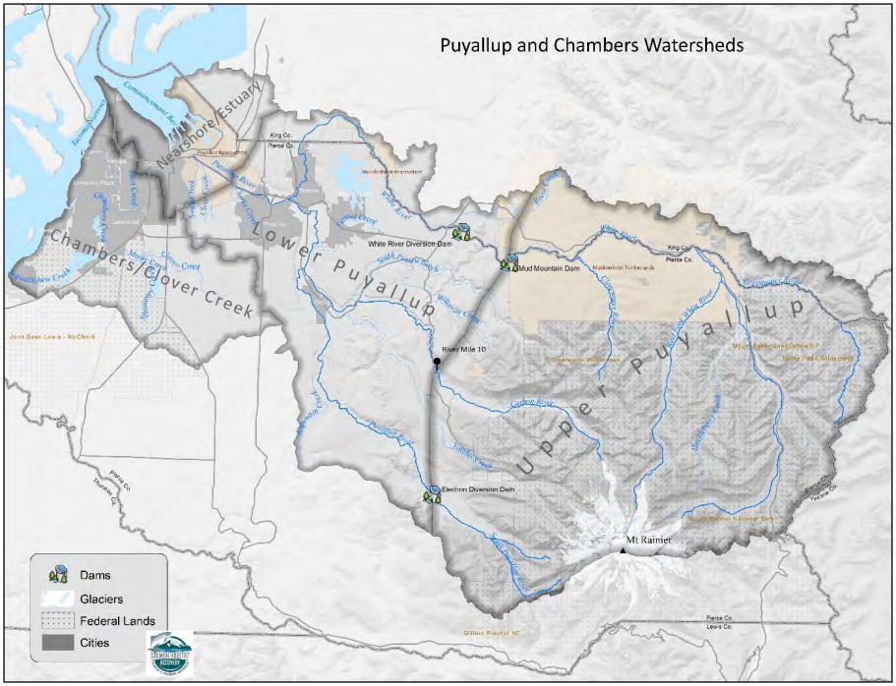
What is the Strategy?
Identify priorities and strategies for protection & restoration of salmon habitat in the watershed.
Developed by the Puyallup and Chambers Watersheds Salmon Recovery Lead Entity
Citizens Advisory Committee
Technical Advisory Group
Information Sources included the following:
Limiting Factors Analysis for WRIAs 10 & 12
Puyallup Tribe Habitat Surveys
Ecosystem Diagnosis and Treatment (EDT) Modeling
PCD/WDFW Barrier Inventories
Commencement Bay habitat studies
WRIA 12 Nearshore Habitat Assessment
All “H” Analyzer (AHA) Modeling
Puget Sound Chinook Monitoring and Adaptive Management Phase I

Slide 8
Salmonid Species in WRIA 10
The White River Spring Chinook is the only remaining spring Chinook salmon stock found in South Puget Sound
Chinook Salmon are a staple food source for the endangered resident orca.
*Includes Puyallup River Fall Chinook and White River Spring Chinook

Slide 9
Habitat Goals – Puyallup Watershed
Established as part of our adaptive management in 2017
50-Year habitat goals – implemented by 2067
32,000 acres of floodplain habitat is protected from development
3,300 acres of functioning riparian buffer will define a protected Riparian Buffer Zone
62 stream miles open to fish movement and passage
10-Year Implementation Goals – implemented by 2027
203,000 linear feet of levees removed and 2,300 acres of floodplain reconnected
Ten percent increase in functioning riparian buffer habitat
Three major physical barriers to fish migration removed or modified
153 acres of nearshore habitat restored
Notes:
I intend to focus on the floodplain habitat, riparian buffer parts of the Habitat Goals

Slide 10
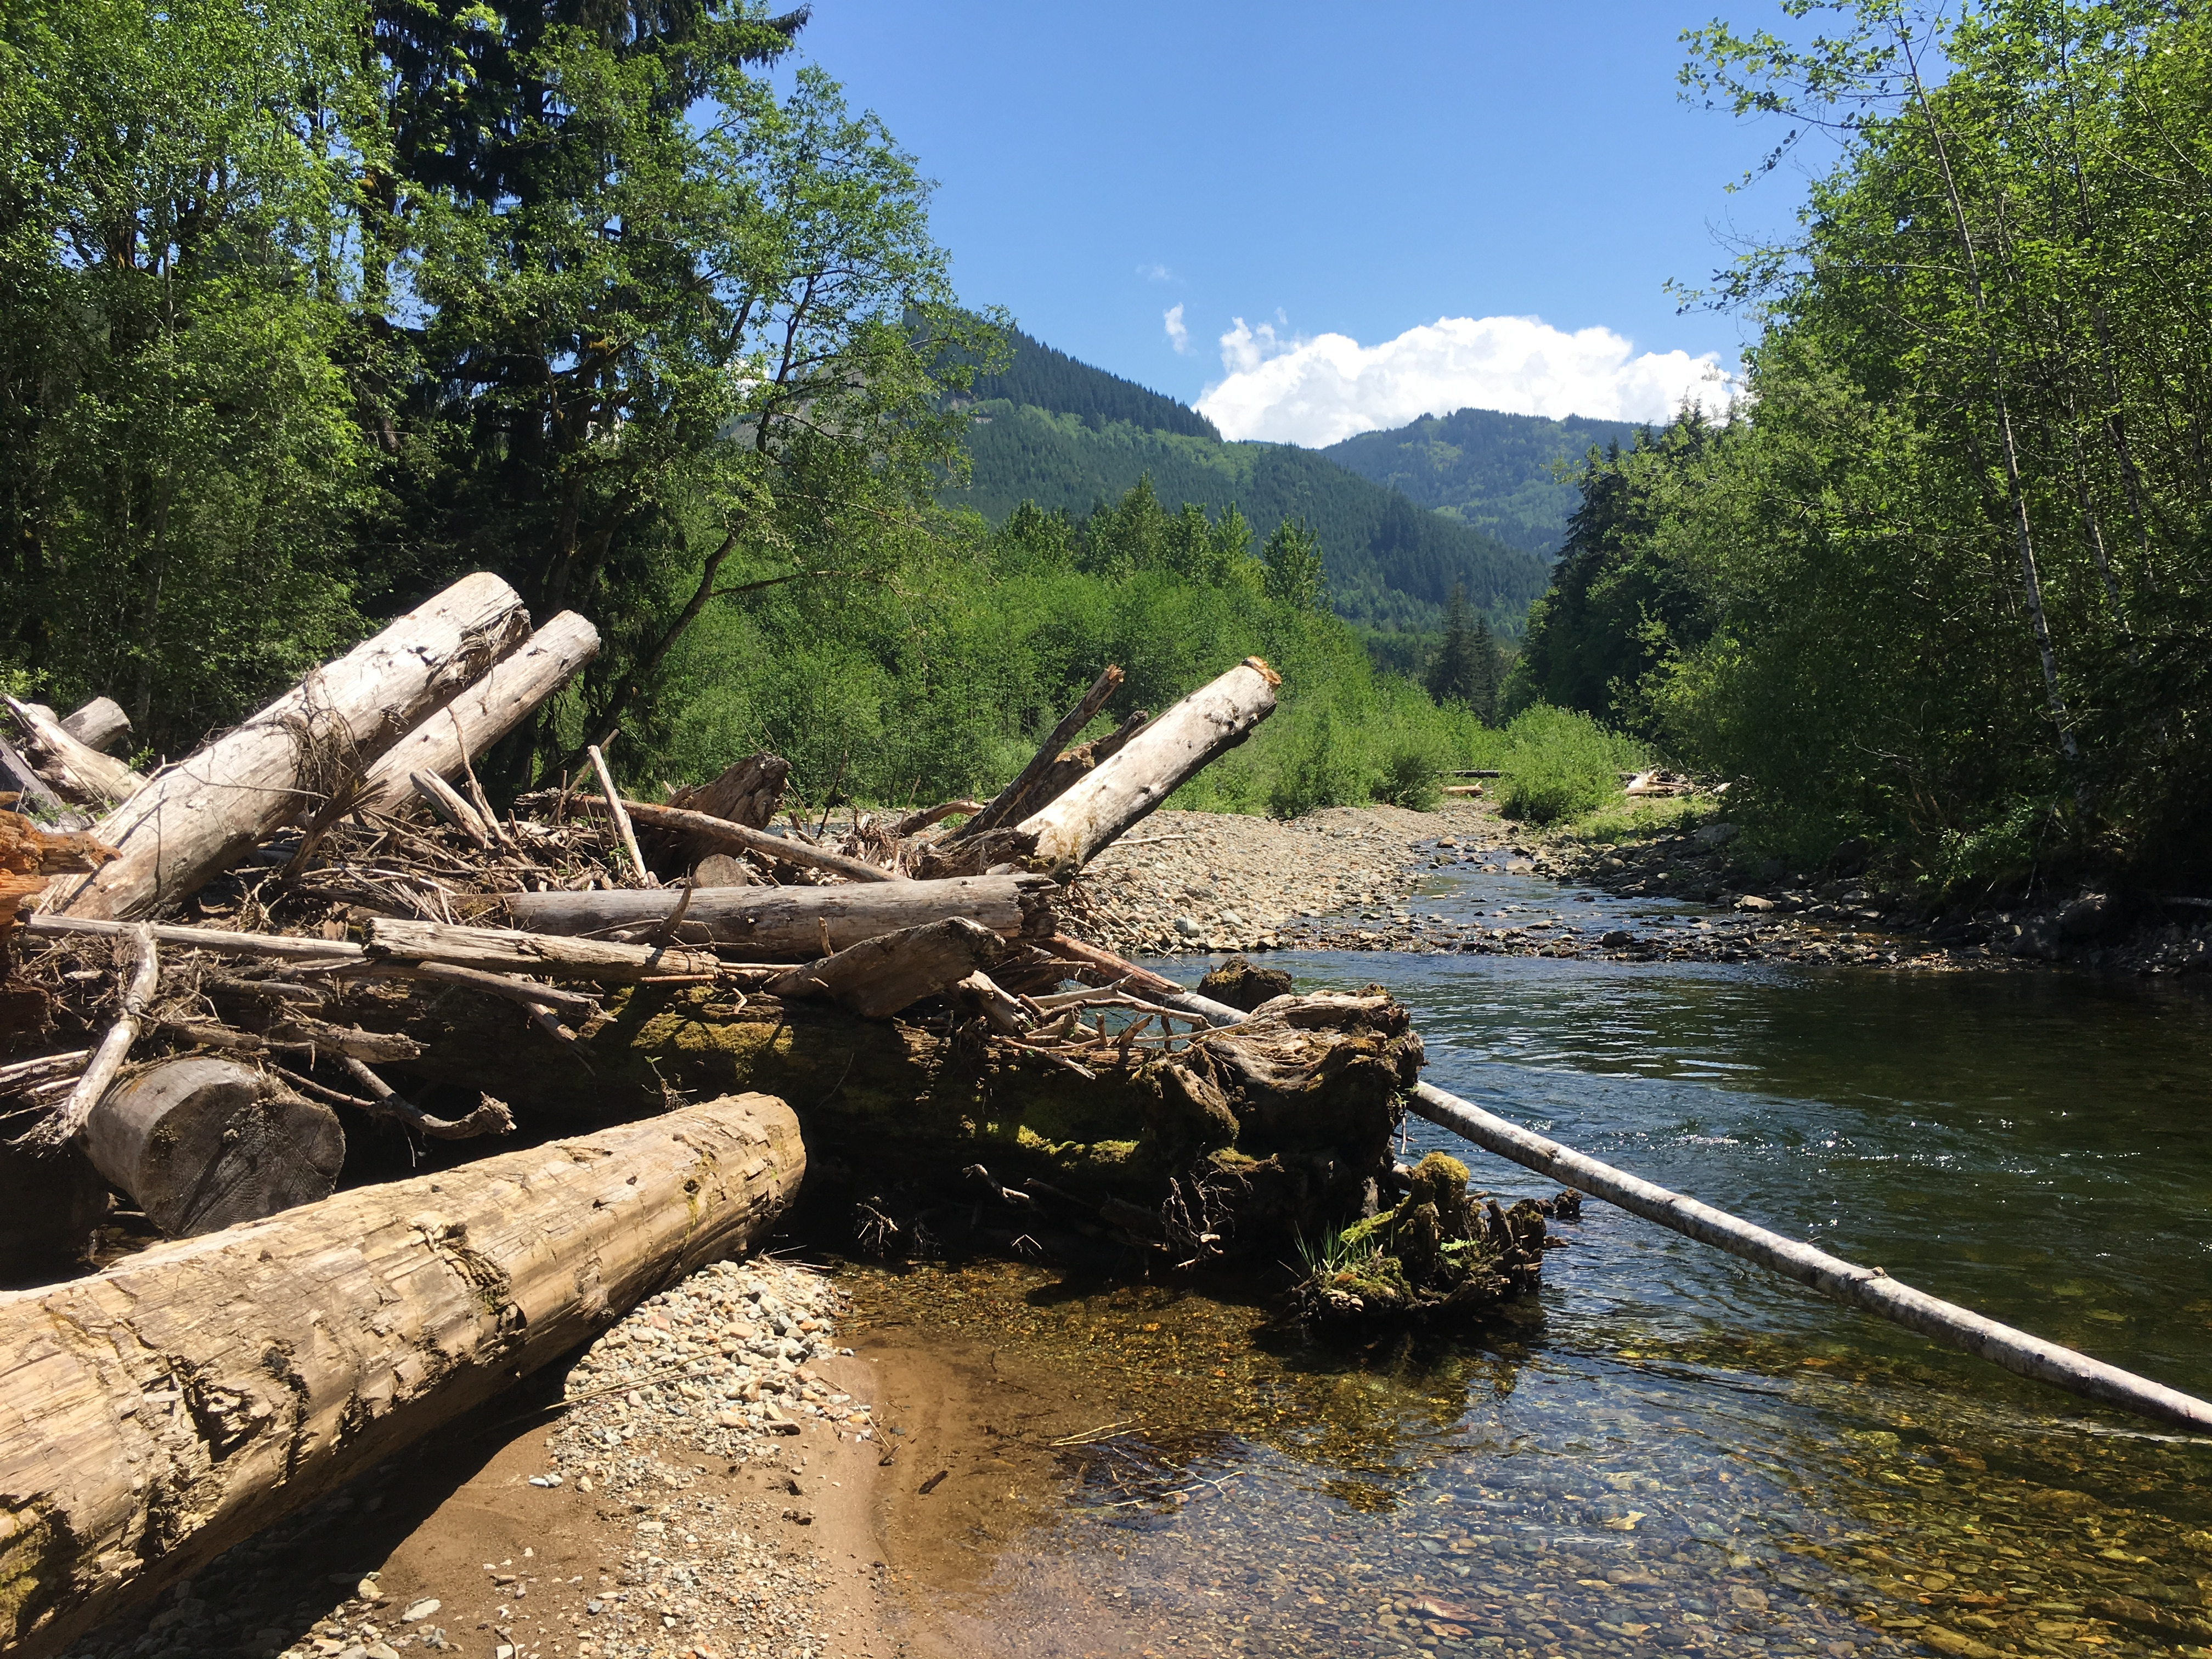
How will we achieve our goals?
Through implementing the following strategies:
Reconnect mainstem river channels to their floodplains
Restore habitat in highly productive tributaries and mainstem areas
Restore and maintain hydrologic regime
Focus for Streamflow
Protect Highly Productive Tributary and Mainstem Areas
Remove Physical Barriers to Fish Movement and Migration
Restore Estuarine Habitats
Restore Nearshore Areas
Improve Water Quality
Coordinate Regulatory and Incentive Programs
Develop and Implement Salmon-Safe Farming Practices
Conduct Outreach and Education
Photo: Liz Bockstiegel
Notes:
Point out that the first three will be the focus of the rest of this presentation – and that Liz will talk about them in more detail….

Slide 11
Reconnect Mainstem Rivers to their Floodplains
48 river miles contained in revetments and levees on the Puyallup, Carbon, and White Rivers
Levee setback or removal projects
Restore habitat forming processes & increase habitat diversity
Reconnected floodplain
Side channels
Off-channel habitat
Floodplain Wetlands
Water/Flood Storage
Restore natural habitat forming processes
Sportsman Levee Maintenance
Countyline Levee Setback
Photos: Liz Bockstiegel

Slide 12
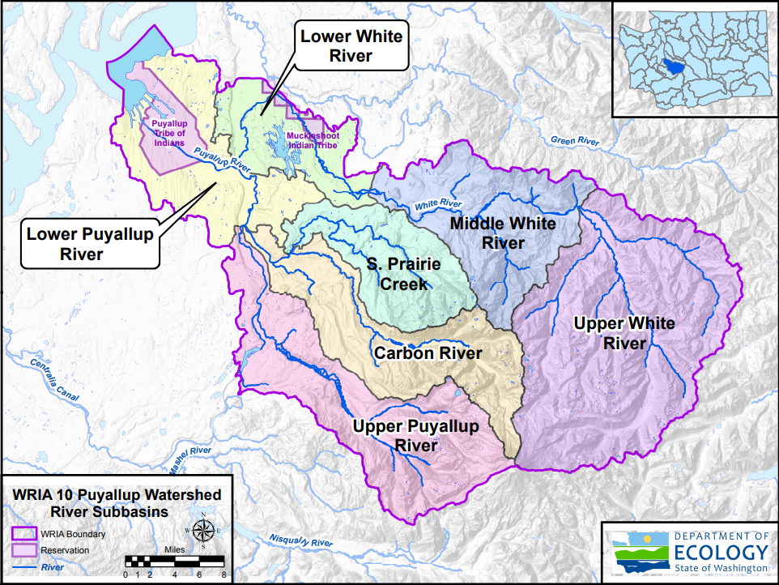
High Priority Tributaries in WRIA 10
Lower Puyallup River
Fennel Creek
Clear Creek
Clarks Creek
Lower White River
Boise Creek
Middle White River
Clearwater River
Upper White River
Greenwater River
Huckleberry Creek
West Fork White River
Upper Puyallup River
Kapowsin Creek
Carbon River
Voights Creek
South Prairie Creek
Wilkeson Creek

Slide 13
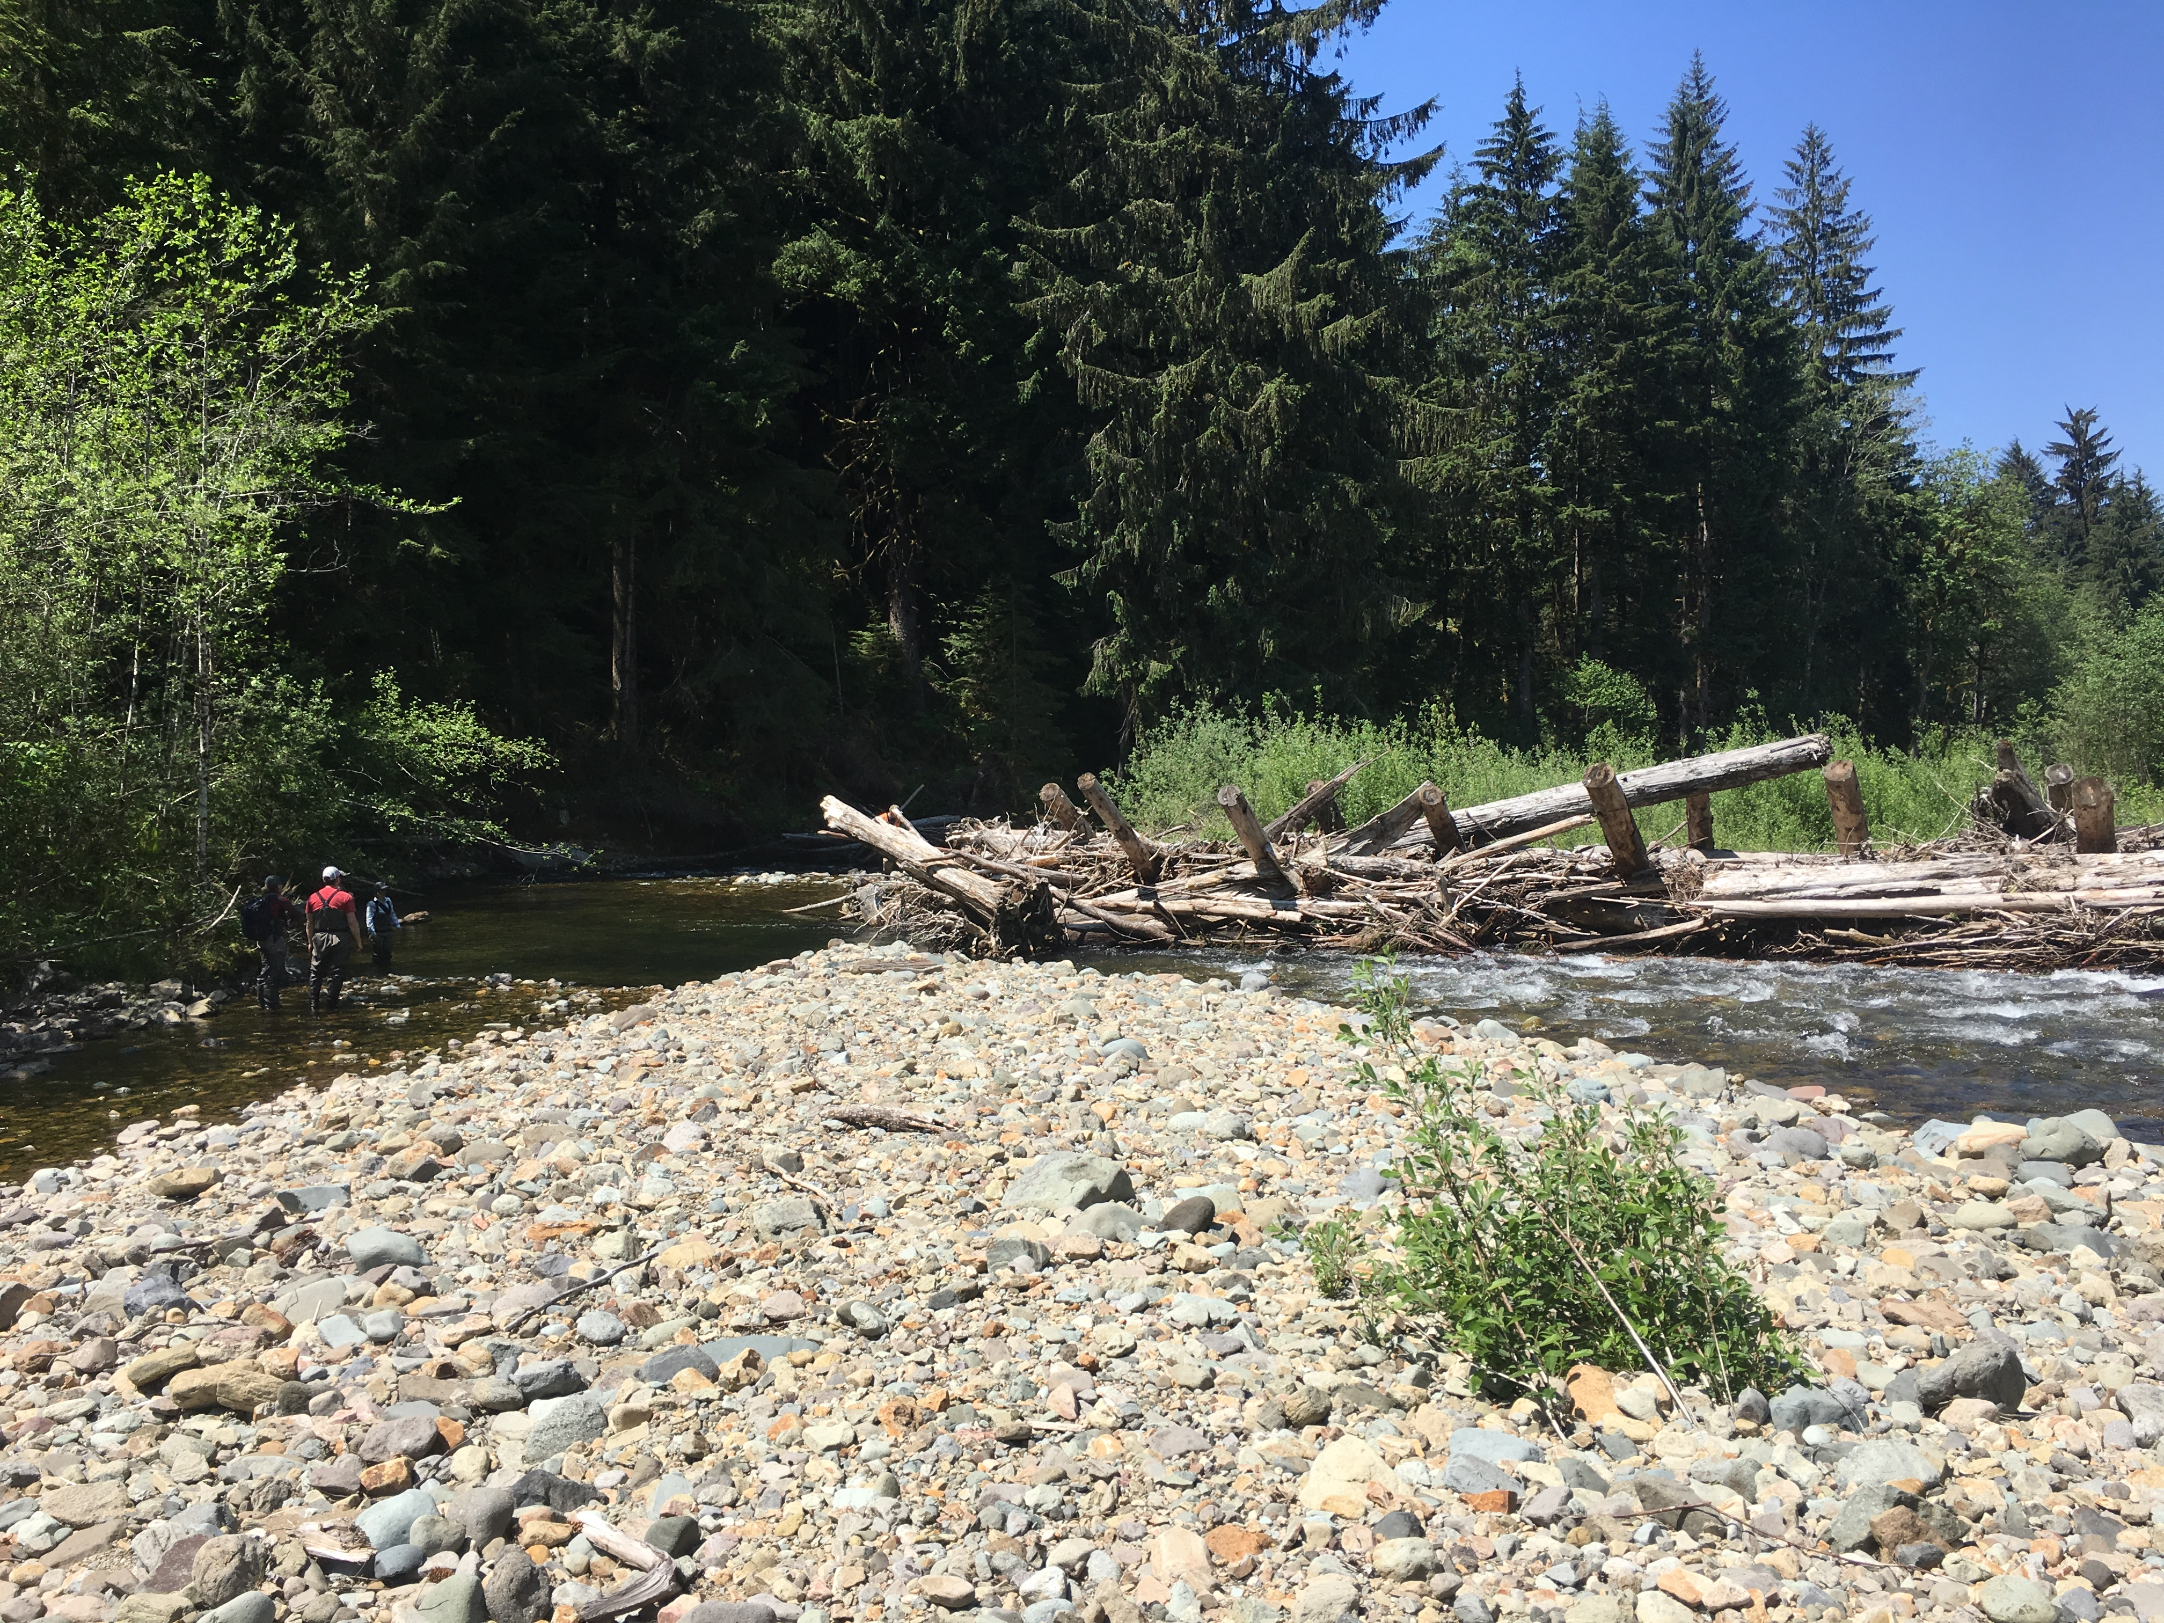
Restore habitat in highly productive tributaries and mainstem areas
Potentially Compatible Project Types:
Riparian Buffer Restoration/Enhancement
Large Woody Material Installation
Create/Enhance/Re-engage side channel and off-channel habitat
Beaver Dams and Analogues
Effective habitat projects usually have a combination of these types
Photo Liz Bockstiegel

Slide 14
Riparian Buffer Enhancement or Restoration
Shade for moderated water temperatures and microclimate
Recruitment of wood for instream habitat
Contribute organic material
Filtering of sediment and nutrient inputs
Retain water during storm events and release it slowly over time
Increase floodplain roughness

Slide 15
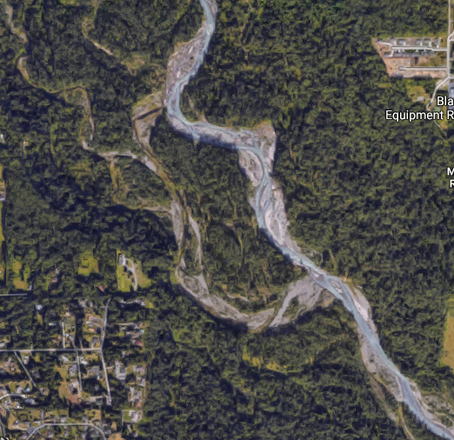
Riparian Restoration Projects
Photos: Pierce Conservation District, Aerial Images from Google Maps
Notes:
First aerial image is south prairie creek preserve showing limited riparian buffer. Note the south side has been planted by Pierce Conservation District to start the process. Second image is the lower/middle White River. Note complex forested floodplain and many side channels and off-channel habitat.

Slide 16
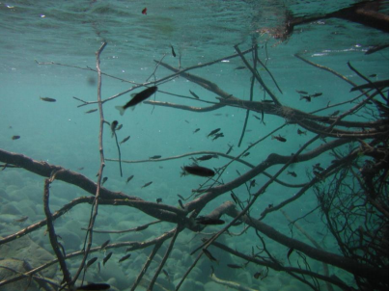
Large Wood Installation
Provides fish habitat complexity and cover from predators
Creates pools and habitat diversity within a stream
Provides refuge from water velocities during high flows or floods
Traps and sorts spawning gravels
Provides substrate and food source for macroinvertebrates
Influences riparian successional processes
Photo: Roger Peters USFWS
Photo: Liz Bockstiegel

Slide 17
Create/enhance/re-engage side channel and off-channel habitat
Increase diversity of aquatic habitat available to salmonids
Provide valuable rearing habitat for juveniles
Refuge from flood flows
Create spawning habitat
Re-engage hyporheic flow and groundwater sources

Slide 18
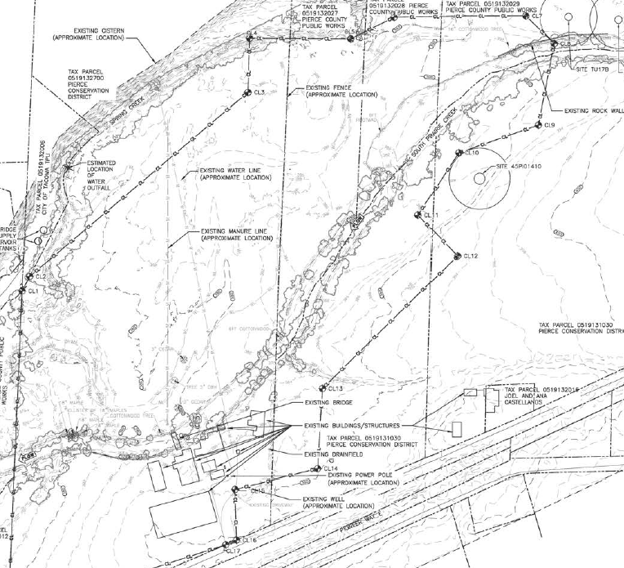
South Prairie Creek

Slide 19
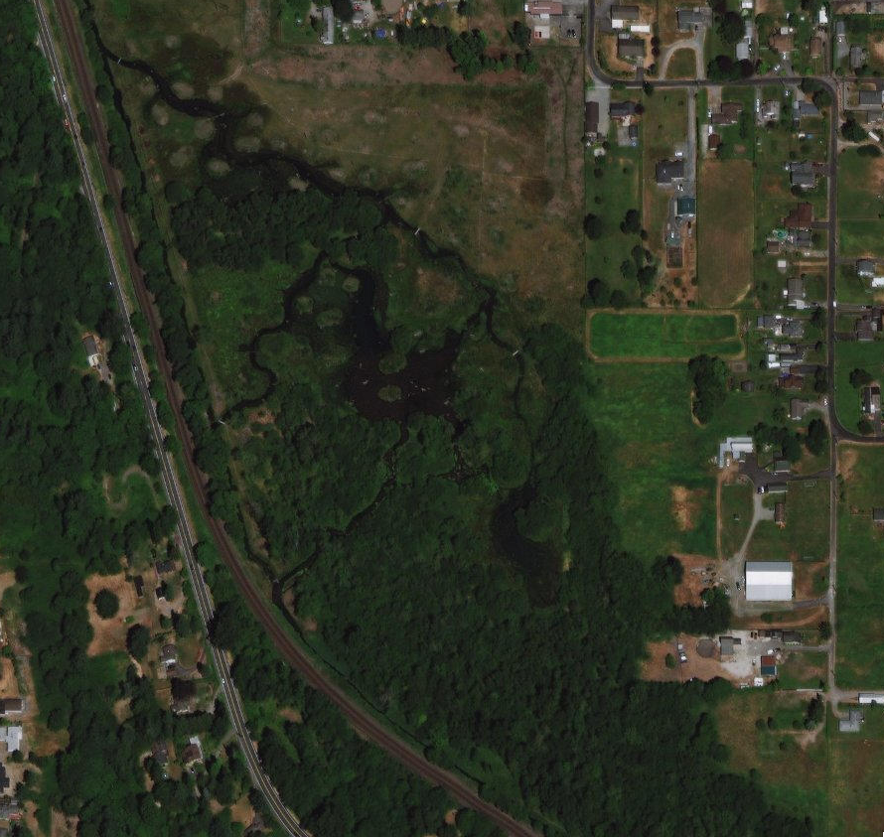
Clear Creek Mitigation Project
Side Channels
Wetlands
Forested Floodplain
Revegetation
Rearing Habitat
Aerial Image Google Maps

Slide 20
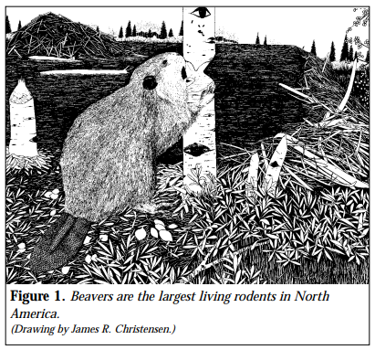
Beaver Dams & Analogues
Habitat Engineers
Elevate water table upstream of a dam
Increase water storage, surface and subsurface
Improve water quality
Increase habitat, create habitat diversity
Look for areas that are flood compatible or high water compatible

Slide 21
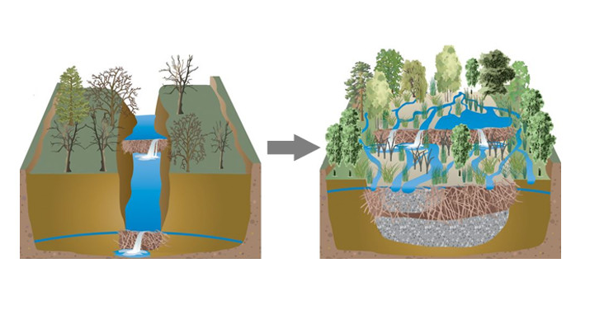
Beaver Dams & Analogues
Photo & Illustration from South Fork Research

Slide 22
Restore and maintain hydrologic regime
Land management
Impervious surfaces
Stormwater management
Dam regulation
Preventing conversion and protecting forest lands

Slide 23
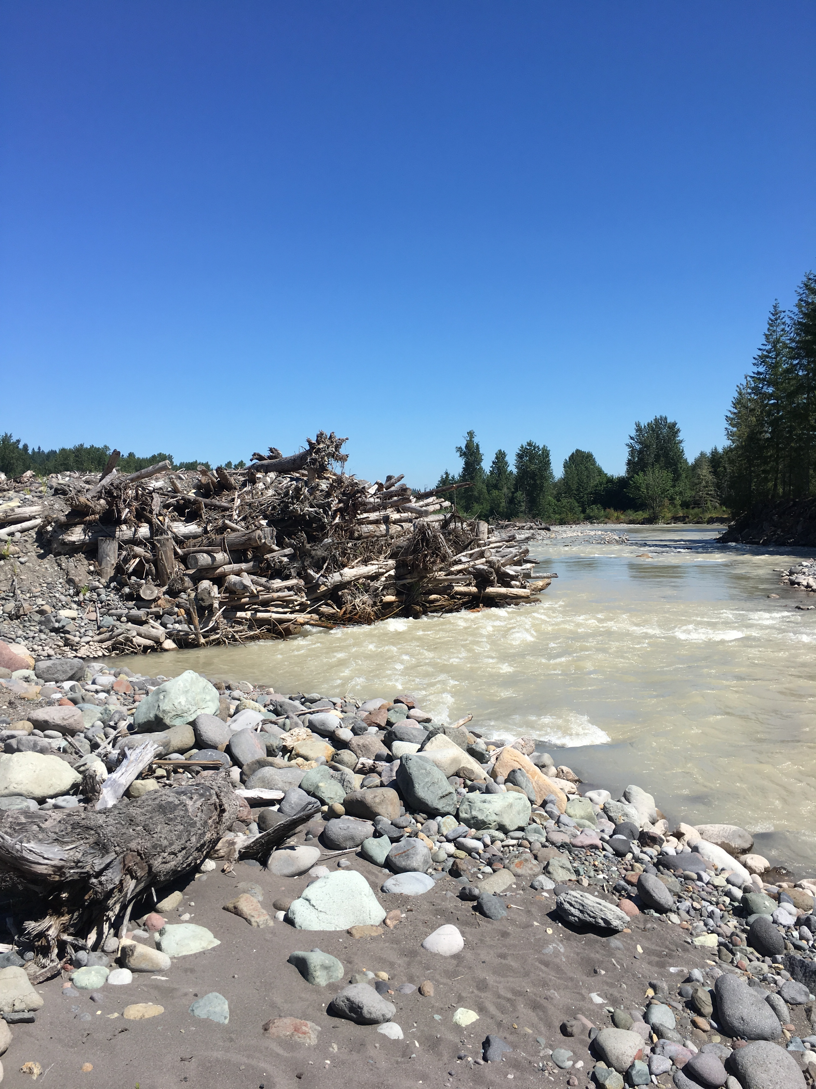
Questions?

