Slide 1
Channel Stabilization Upper Clarks Creek Project
November 27, 2018

Slide 2
Channel Stabilization - Upper Clarks Creek Project Manager – Paul Marrinan Construction Inspector – Ron Johnson Contractor – Active Construction Inc. (ACI) Contract Amount - $2,760,693 Funded from City Stormwater Fund PIERCE Conservation district – planting

Slide 3
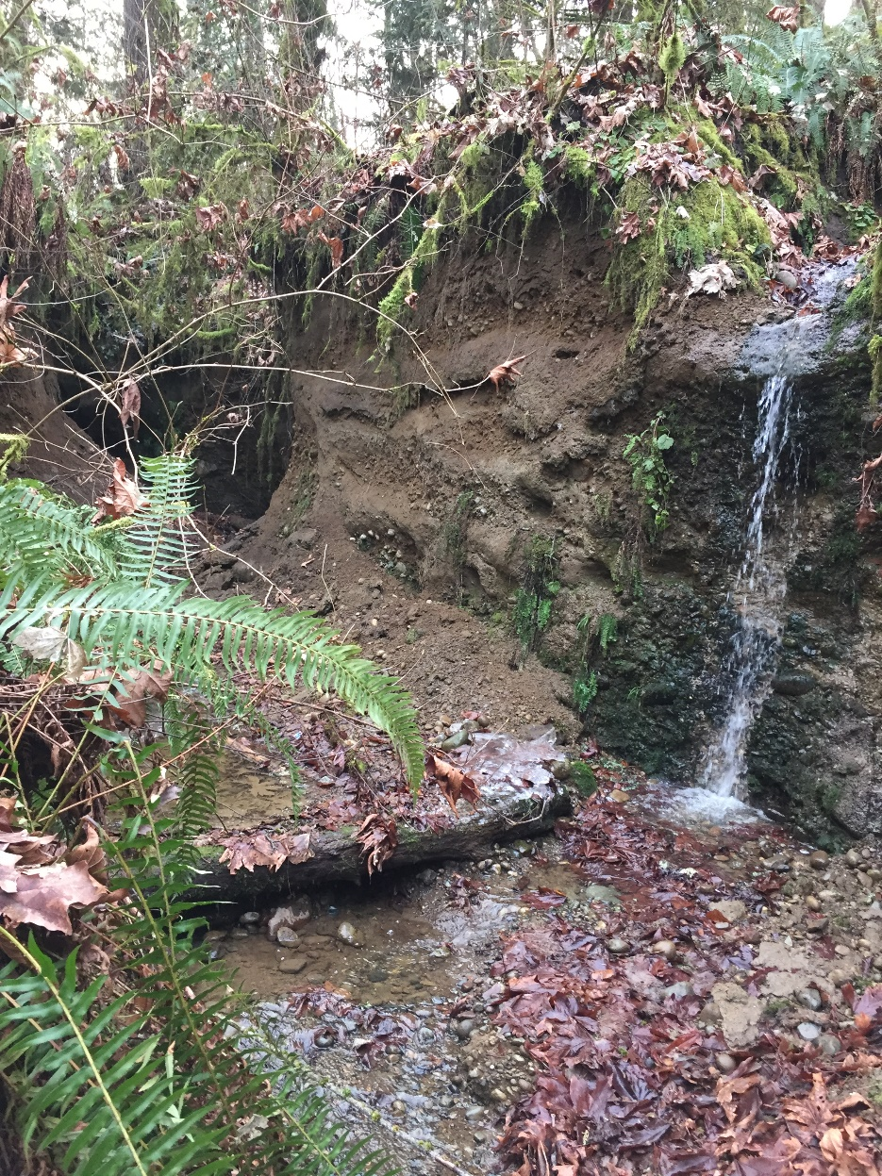
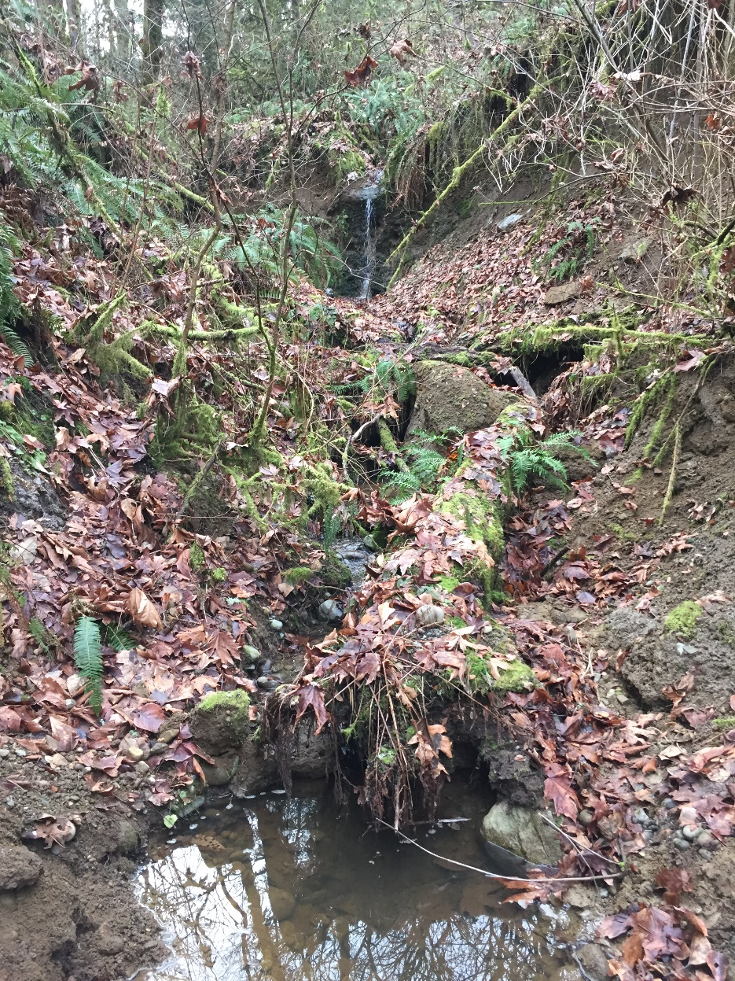
Before Project

Slide 4
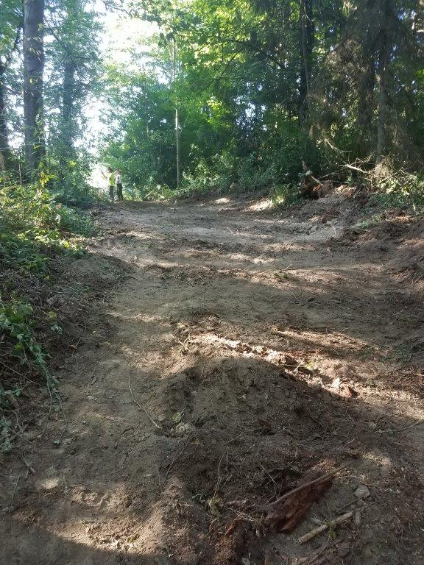
Access Road

Slide 5
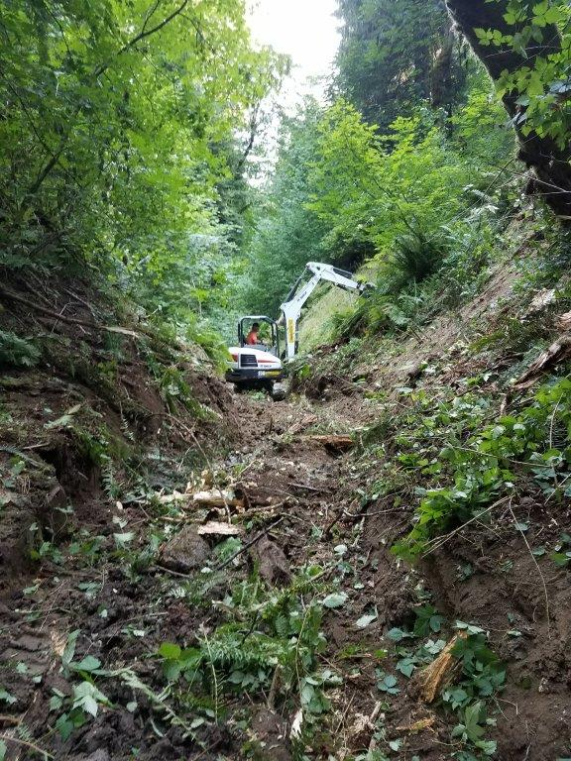
Tributary Preparation

Slide 6
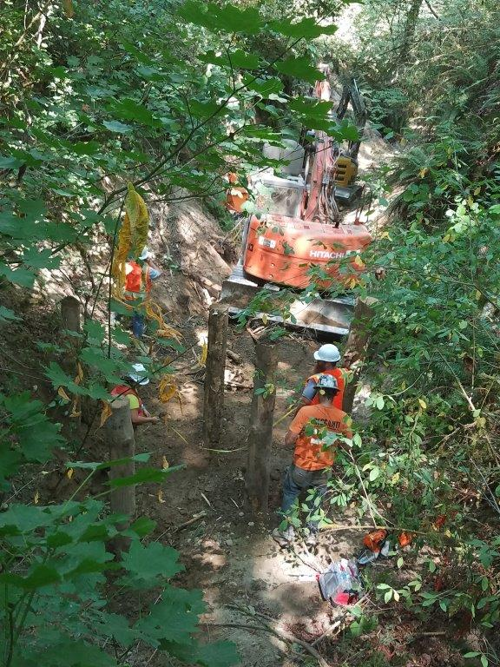
Vertical LOGS FOR sUPPORT

Slide 7
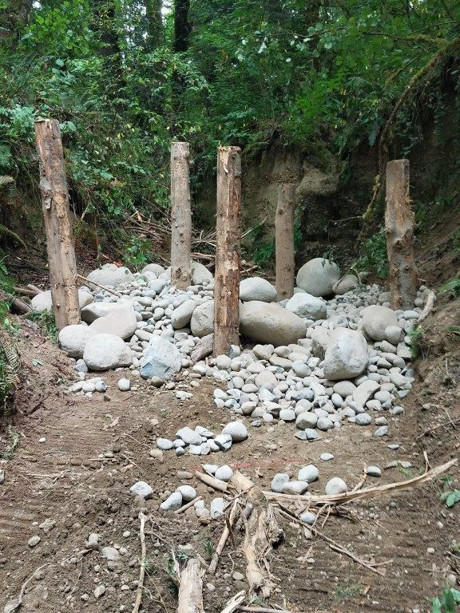
MORE STRUCTURE

Slide 8
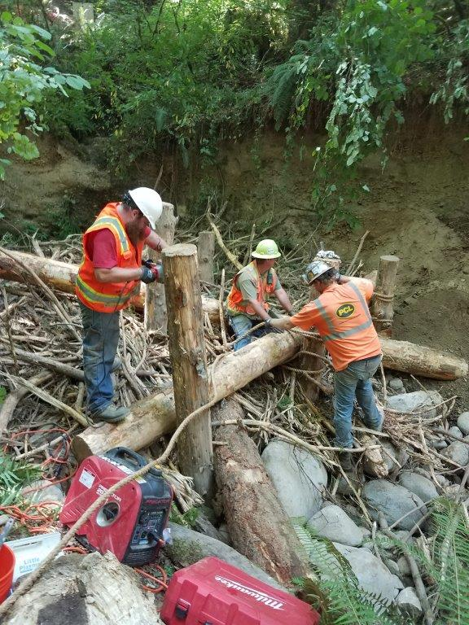
MORE STRUCTURE

Slide 9
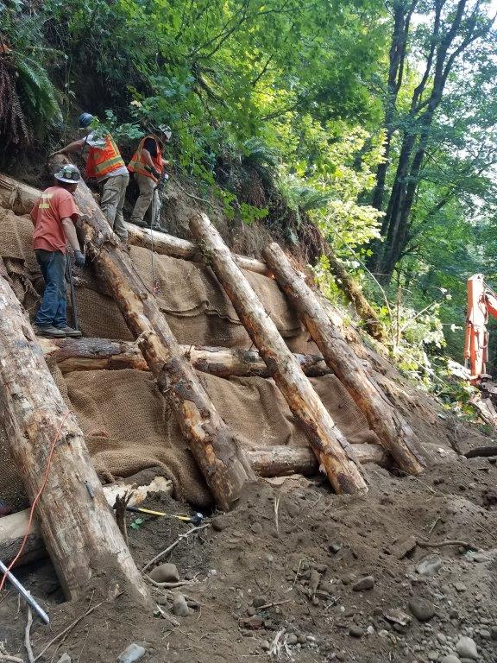
Stabilize existing slide areas

Slide 10
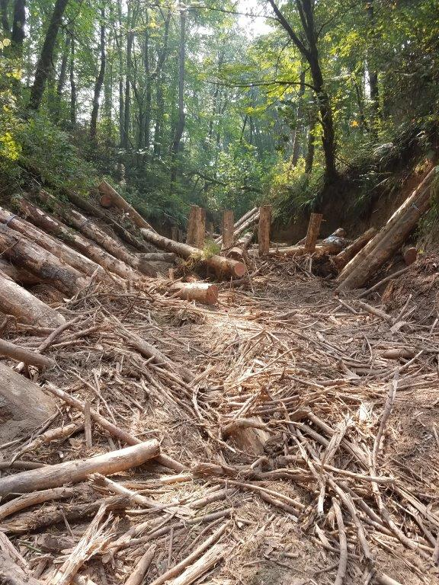
Slash logging debris

Slide 11
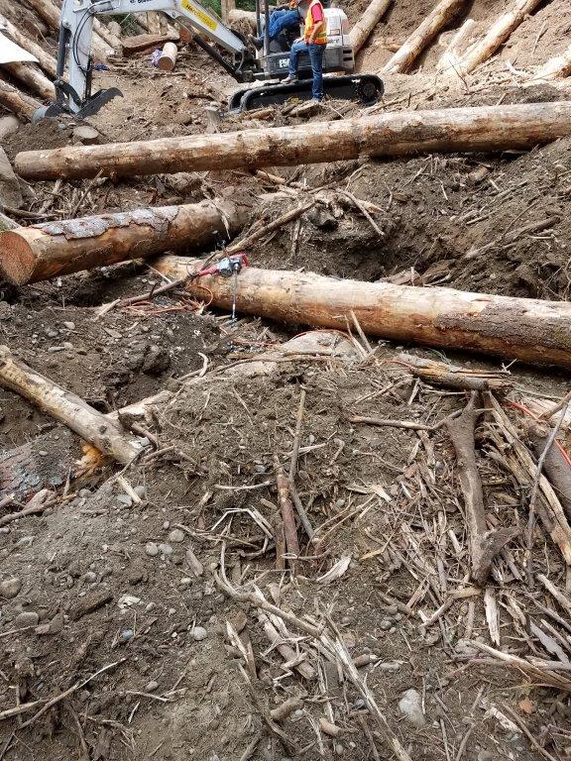
Mimicking Nature’s organized chaos

Slide 12
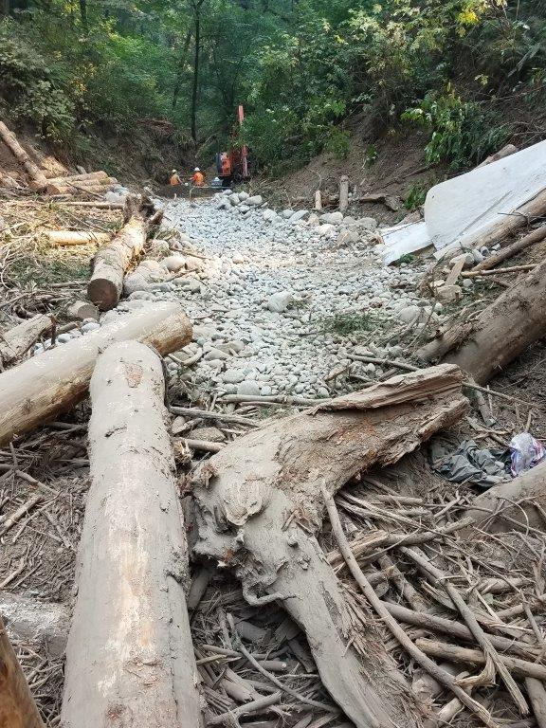
Delivery chute off to the right

Slide 13
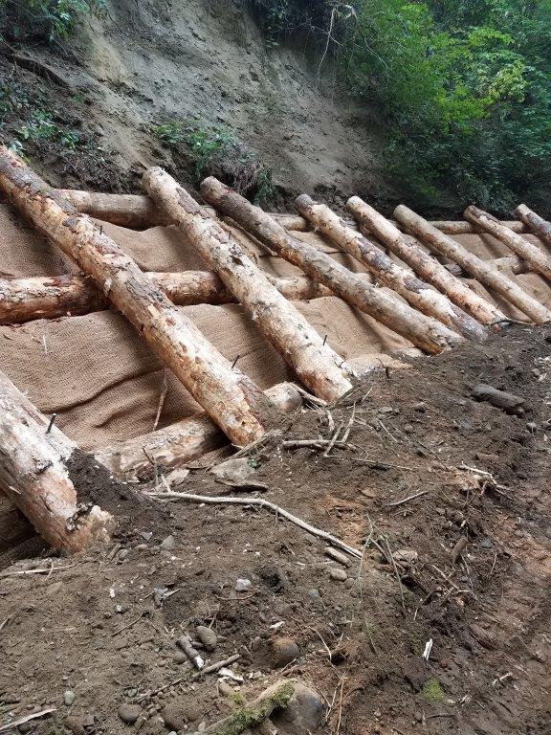
the system works with Nature

Slide 14
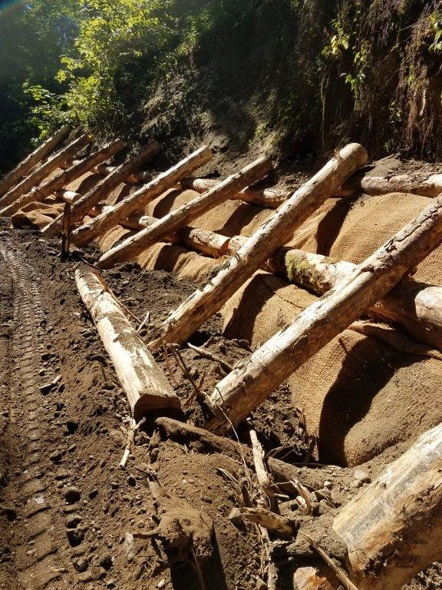
Some erosion will still occur

Slide 15
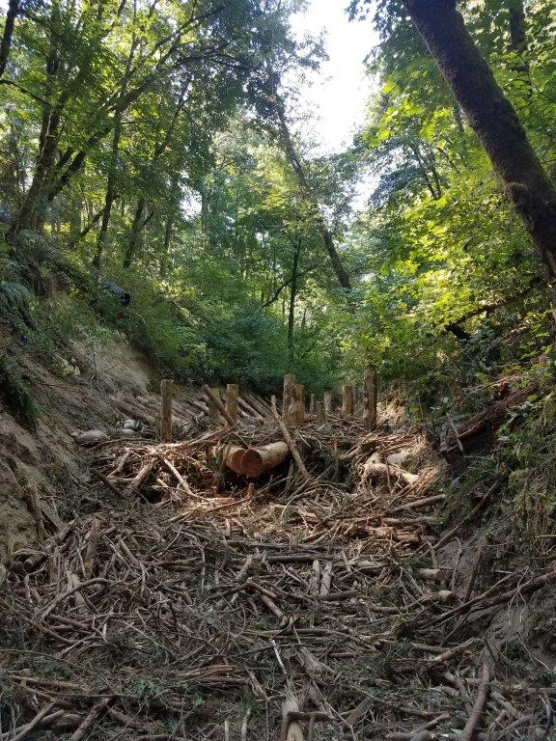
Finished log jam

