Slide 1
HDR Scope for Project Development
Identify suitable projects in existing plans, and brainstorm for new project opportunities.
Propose project screening and evaluation criteria.
Screen a long list of water offset projects (5-20).
Evaluate a short list of water offset projects (2-10) in more detail.
  Includes categorizing projects into approximate cost bins.
  Describe and evaluate projects as part of the NEB development.
Evaluate habitat restoration or enhancement projects.

Slide 2
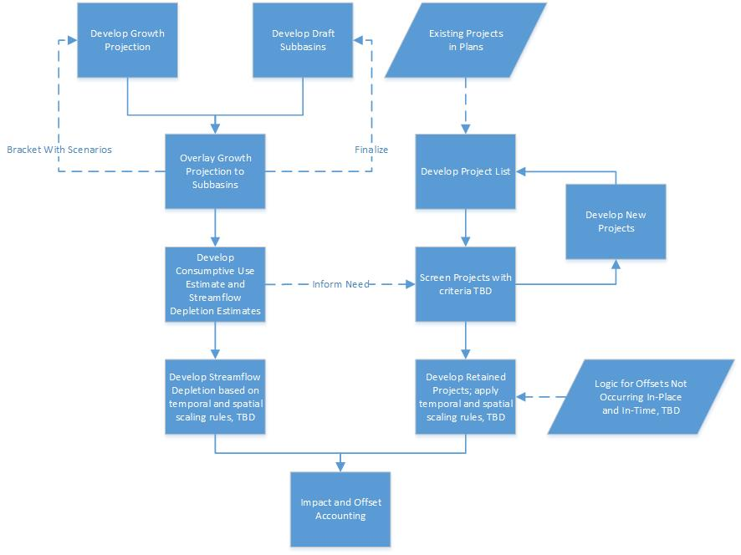
Context in Overall Workflow

Slide 3
Sources to Develop Project List
Ecology’s Trust Water Rights Program
  Water Acquisitions Program
  Water Banking Program
Stormwater, Flood Hazard Management or Watershed Plans
Water System Plans (municipal and group A/B)
Wastewater Utility Capital Investment Plans
  Reclaimed water conveyance and infiltration
TMDL Implementation Plans
Puget Sound Salmon Recovery Four Year Work Plan and NTAs
Historic grant applications to Ecology, Health, or others that had flow benefits but weren’t funded

Slide 4
Next Steps
Compile existing projects: August 31
Define project screening criteria: In process
Evaluate existing projects
Develop new projects based on screening criteria
Develop top projects at a more detailed level to accommodate NEB evaluation

Slide 5
Projects- Screening Criteria
Status
Draft Methods being reviewed by WRIA 7-9 technical support team.
Draft review by Ecology and then subsequent submittal to WRE committees for review.
Screening attributes will drive collection of project information.
Draft Methods
Attributes are categorized (NEB, Feasibility, Implementation, Habitat)
Scored 0 (fatal flaw), 1, 3, or 5. Fatal flaws cause the overall score to be zero
Scores in each category are expressed as percent of perfect score
Categories can be weighted
Weighted category scores are summed; Summed scores range from 20 - 100

