Slide 1
WRIA #10 – Puyallup-White and
WRIA #12 – Chambers-Clover
Dan Cardwell
Pierce County Planning & Public Works
March 6, 2019 Watershed Restoration and Enhancement Committee

Slide 2
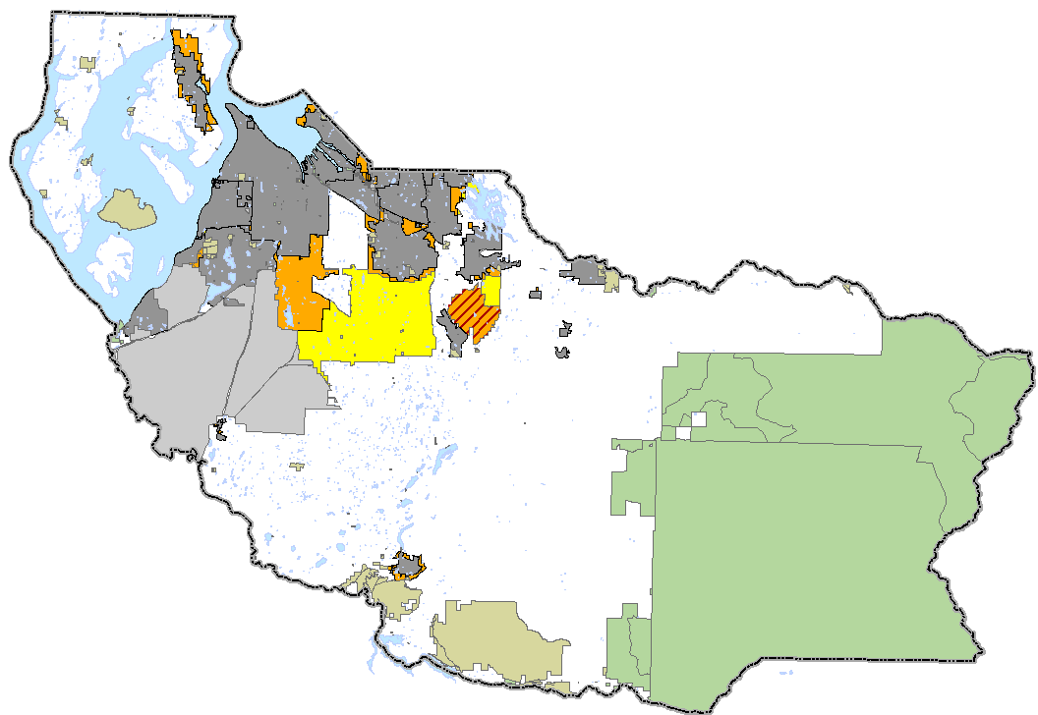
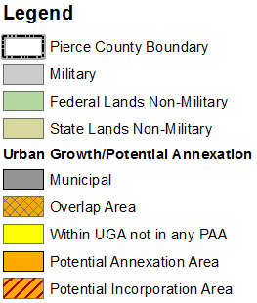
Growth Management Planning
Notes:
U/R map – countywide level
Table of growth patterns
Comment on how GMA has shifted growth toward urban

Slide 3
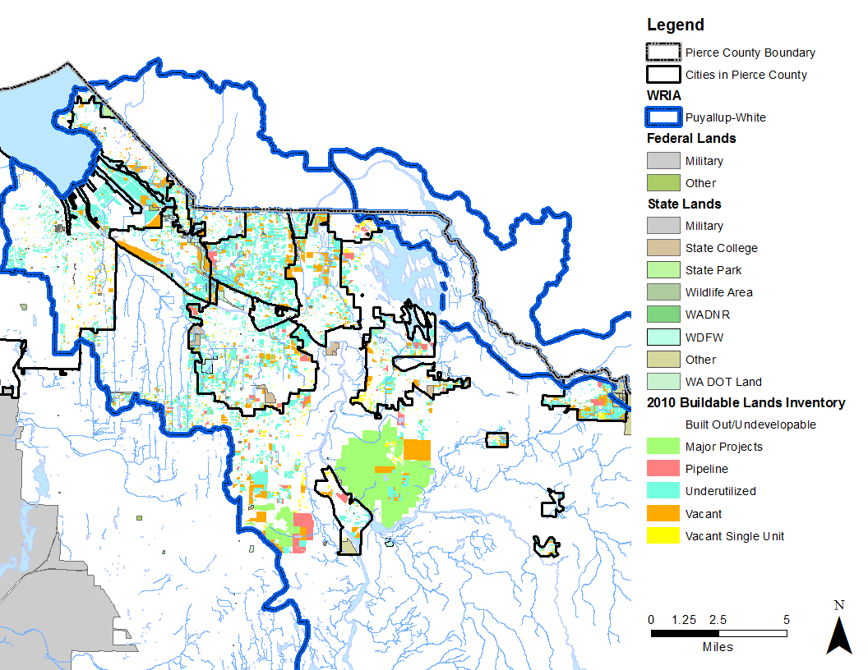
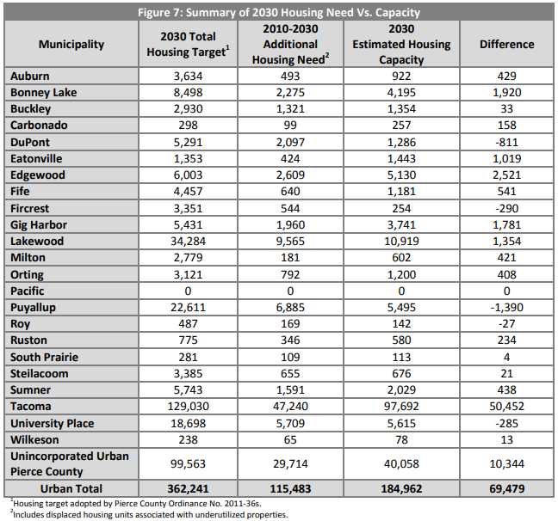
WRIA #10: Buildable Lands
Whole jurisdiction within WRIA
Part of jurisdiction within WRIA

Slide 4
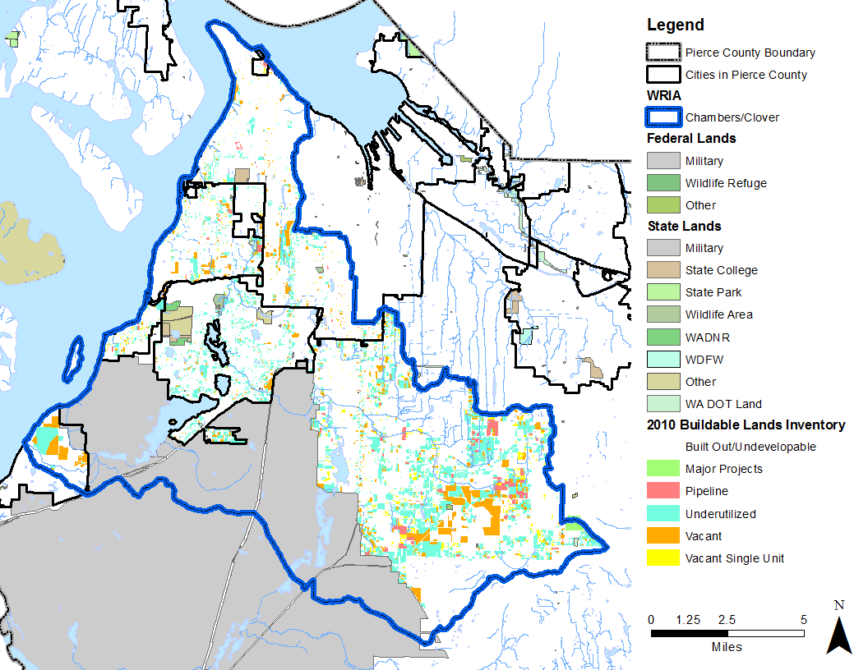
WRIA #12: Buildable Lands
Whole jurisdiction within WRIA
Part of jurisdiction within WRIA

Slide 5
Unincorporated Pierce County GMA Trends

Slide 6
Unincorporated Pierce County GMA Trends
39%
31%
60%
30%
28%
40%
69%
61%
72%
70%

Slide 7
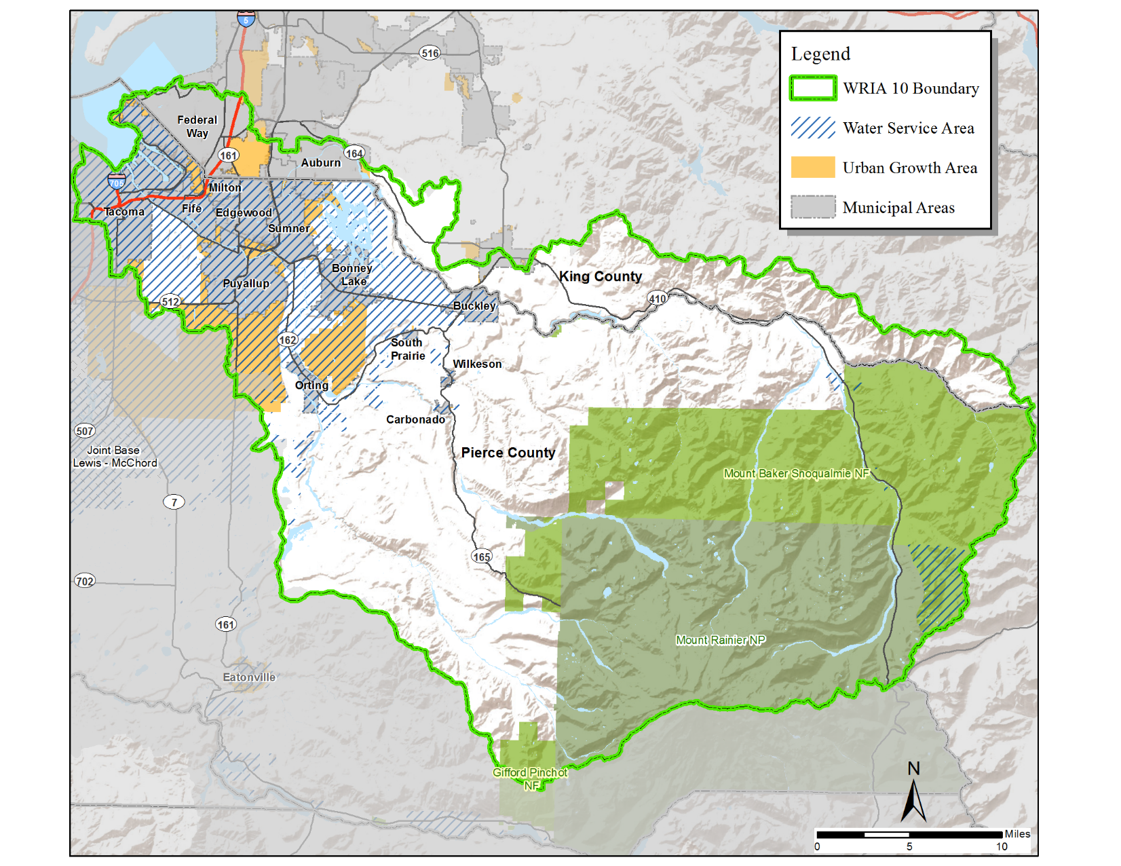
WRIA #10 Puyallup-White
Total Population | 2010 Census | 2018 (ESRI Est.)
Total: | 440,944 | 492,076
Pierce County: | 331,405 | 369,415
Unincorporated: | 120,303 | 133,649
Land Base | Acres
Total: | 669,934
Pierce County: | 581,390
Urban: | 78,637
Rural: | 502,753
Federal or Designated Forest Land: | 427,110
Not within Group A Water Service Area*: | 36,008 (6% of PC)
* Does not include permits within Federal Lands and/or permits with areas zoned Forest Land

Slide 8
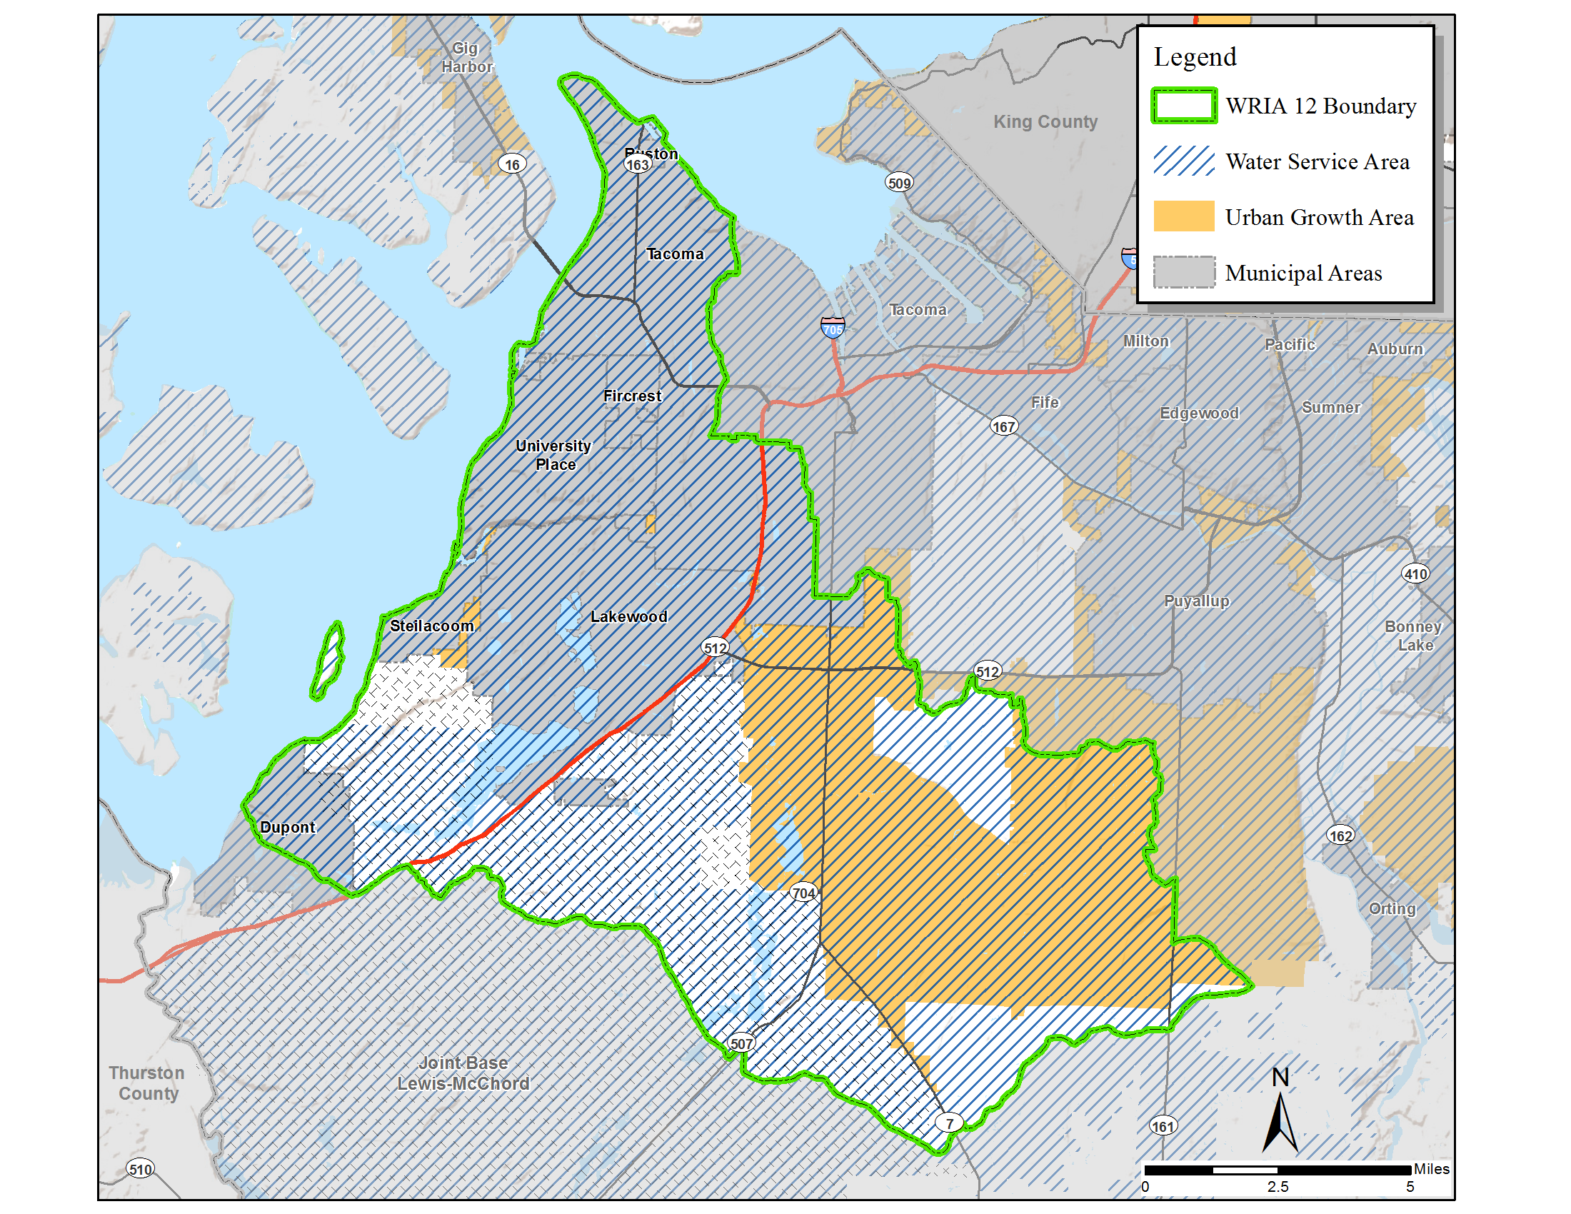
WRIA #12 Chambers-Clover
Total Population | 2010 Census | 2018 (ESRI Est.)
Total: | 344,942 | 381,640
Pierce County: | 333,836 | 367,771
Unincorporated: | 133,545 | 152,049
Land Base | Acres
Total: | 95,941
Joint-Base Lewis-McChord (JBLM): | 24,969
Urban (Non-JBLM): | 63,859
Rural (Non-JBLM): | 7,113
Not within Group A Water Service Area (Non-JBLM): | 107
* Does not include permits within Federal Lands and/or permits with areas zoned Forest Land

Slide 9
Unincorporated Development Regulations
Zoning Type |  | Minimum Density | Maximum Density
URBAN | Multifamily/ Mixed Use | 6 units per acre | 25 units per acre*
 | Single Family | 4 units per acre | 6 units per acre (sewer)
RURAL | Single Family | 1 unit per 10 acres | 1 unit per 2.5 acres
 | Forest Land/ Large Lot | 1 unit per 80 acres | 1 unit per 10 acres
Highest Density
Lowest Density
*Current proposal may increase maximum urban density

Slide 10
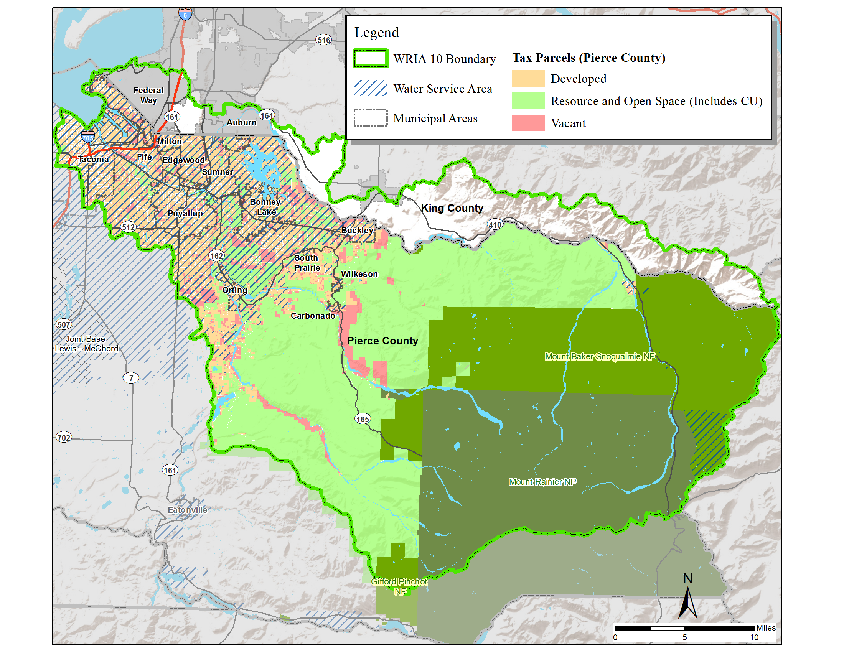
WRIA #10: Land Characteristics
 | Parcels | Avg. Parcel Size | Vacant Parcels
Total: | 172,955 | 2.6
Pierce County (PC): | 140,428 81% of total | 2.5 | 9,310 7% of PC
Unincorporated: | 53,505 31% of total 38% of PC | 5.7 | 4,758 9% of PC unincorporated
Not within Group A Water Service Area*: | 4,452 3% of total 3% of PC | 8.8 | 798 18% of those not within Group A
* Does not include permits within Federal Lands and/or permits with areas zoned Forest Land (FL)

Slide 11
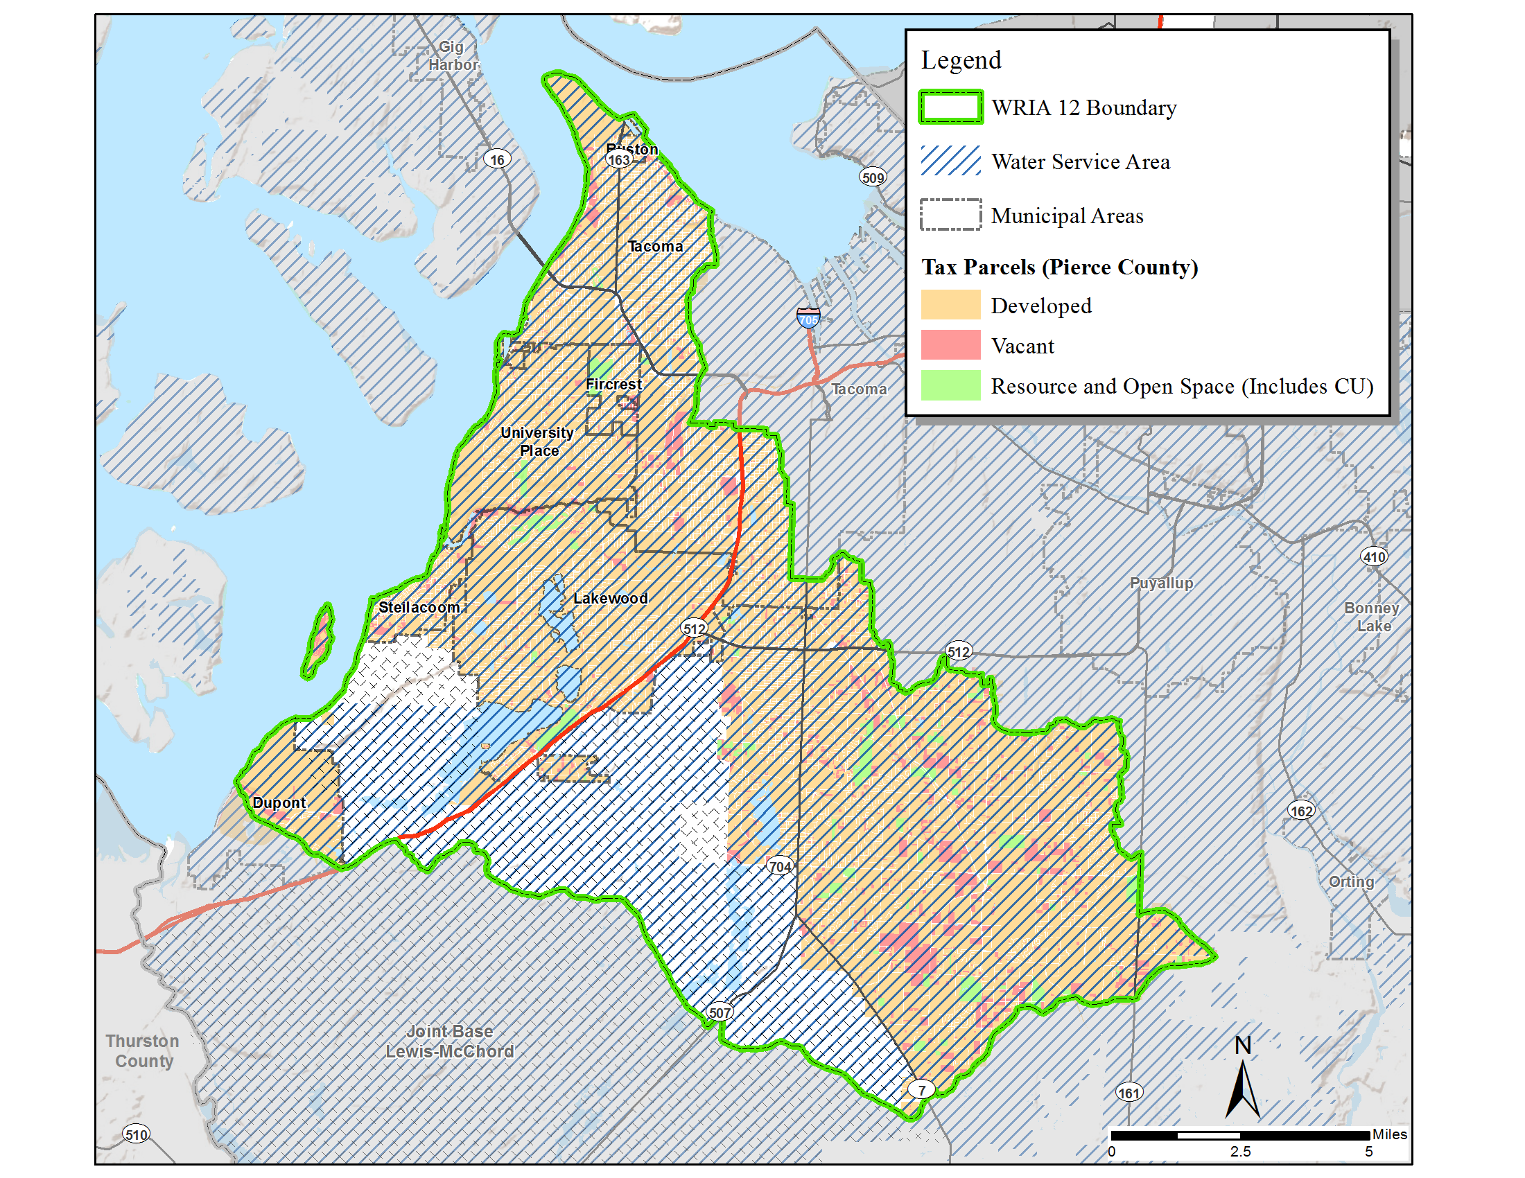
WRIA #12: Land Characteristics
 | Parcels | Avg. Parcel Size | Vacant Parcels
Total: | 122,343 | 0.5 | 4,971 4% of total
Unincorporated: | 51,451 42% of total | 0.6 | 2,489 5% of unincorporated
Not within Group A Water Service Area: | 82 0.07% of total 0.2% of unincorporated | 1.7 | 18 22% of those not within Group A
Note: There are no parcels within Joint-Base Lewis-McChord

Slide 12
WRIA #10 (Pierce): Housing Development Trends
* Does not include permits within Federal Lands and/or permits with areas zoned FL

Slide 13
WRIA #12 (Pierce): Housing Development Trends
* Does not include permits within Federal Lands and/or permits with areas zoned FL

Slide 14
Pierce County Policy
Pierce County policy: no new individual wells in Group A Water Systems
Building permits or subdivisions proposing permit-exempt wells in the #10 Puyallup-White, #12 Chambers-Clover, and #15 Kitsap WRIAs:
  Limited to 950 gallons per day
  Fee of $500 ($350 to Ecology, $150 to County for reporting requirements)
  Record restrictions on title (additional recording fee)
Tacoma Pierce County Health Department reviews well applications.

Slide 15
Tacoma-Pierce County Health Dept. Requirements
Tacoma-Pierce County Health Department (TPCHD) regulates the drilling of new individual wells
TPCHD policy: individual wells prohibited in the Urban Growth Area or Group A Water Service Area
  Except when related to timely and reasonable service
Restrictions/well siting and setbacks
  Saltwater intrusion areas
  Landfill setbacks
  Impact to nearby wells or the source

Slide 16
Water Purveyor Coordination
Water availability letters
  Water purveyors grant approval for proposed permit-exempt wells within their service areas
    Only occurs when they are unable to provide timely and reasonable service
    Permit-exempt well could be temporary until system expands and can take over
  Other option may be for a neighbor system to adjust boundaries and provide service
Updating Coordinated Water System Plan
  Required by State law to coordinate process
  Review plans for consistency with local government growth plans

Slide 17
Questions?
Dan Cardwell
(253)798-7039 or dan.cardwell@piercecountywa.gov

