Slide 1
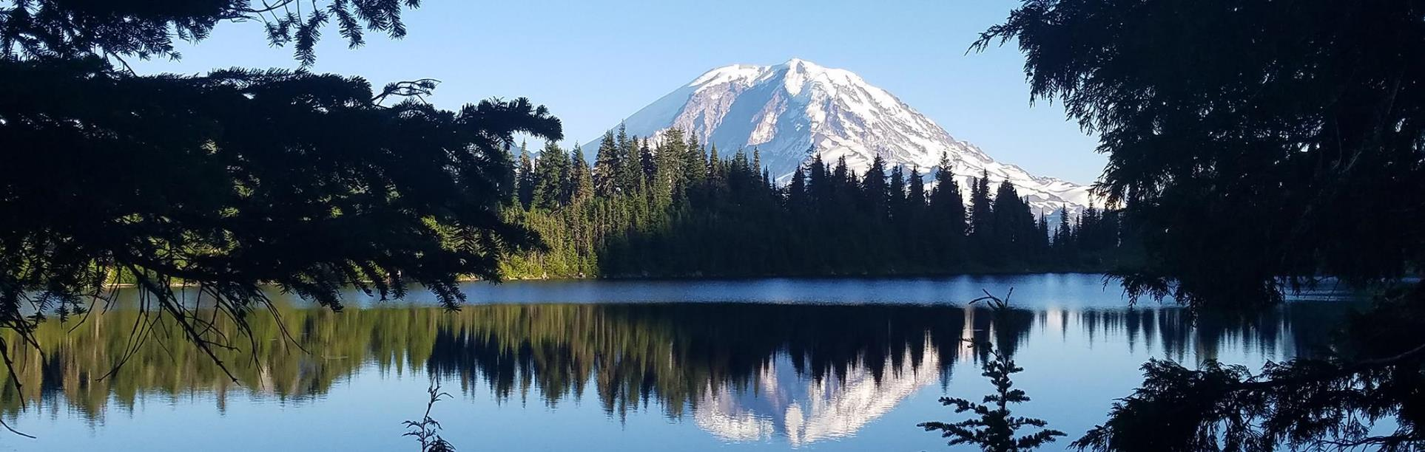
An Introduction to Instream Flows
Science, Policy, and Impacts to Availability
Jim Pacheco
Instream Flow Biologist
April 10 2019
WRIA 12 Restoration and Enhancement Committee
Notes:
Because of our research and support, Washington State has been a national leader in the development of instream flows.
And I’ve been working on ISF science and policy since I started with Ecology in 2002.
Today I hope to give you an understanding of the what's, why’s, and how's of ISFs and their recent impact on water availability
Over the years, I’ve conducted numerous ISF studies,
helped many watershed groups develop the instream flow component of their watershed plans,
and worked to improved the science behind our instream flow recommendations
Because much of my work involves technical discussions and negotiations with a lay audience,
I’ve found trust to be critically important.
To develop and maintain this trust,

Slide 2
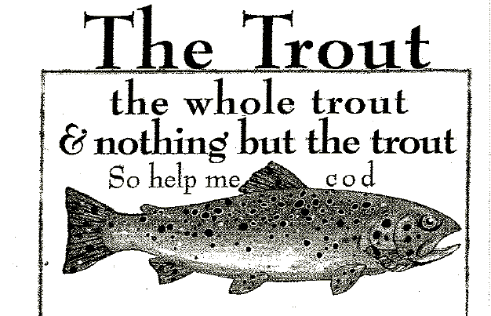
Simple principle
Notes:
I rely on the simple principal of speaking the trout,
the whole trout, and nothing but the trout.

Slide 3

The Water Resources Program
The state’s water managers
Notes:
The Water Resources Program is tasked with water management for the state
Our job is to manage water to meet the needs of People Farms and Fish.

Slide 4
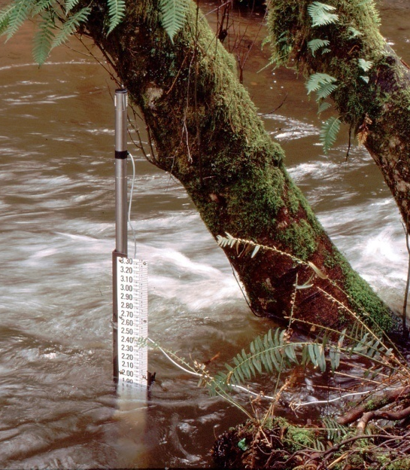
What is an Instream Flow?
An instream flow is a water right for the stream.
It has a priority date
  Water rights senior to the instream flow are unaffected but junior water rights can be regulated
It is not required to be met.
  Water rights e a right to use when available, not a guarantee that water will be available.
ISFs do not and cannot add more water to a stream
Notes:
One of the tools used to manage the water is an instream flow.
This is a very confusing term and is often misused, even by WR. For example, people often use the term ISF when they mean stream flow.
Stream flow is the volume of water in the stream at any moment
An instream flow is a water right for the stream
Like all other water rights, it is based on beneficial use, has a priority date, and follows the seniority system set up in water law
This means that water rights senior to the instream flow are not affected, but water rights junior to the ISF can be regulated
Like all other water rights, an ISF is not required to be met.
Water rights are a right to use when its available, not a guarantee that water will be available.
ISFs do not and cannot add more water to a stream.

Slide 5
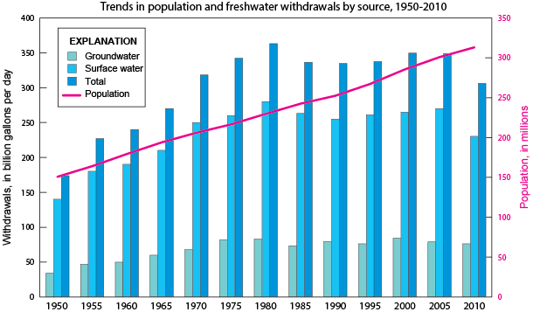

Why we need Instream Flows
Our thirst for water is often greater than nature’s ability to provide it, especially in the summer.
Lower stream flows contribute to a number of environmental concerns
Source USGS: Trends, 1950-2010
Notes:
Washington’s ISF laws originated in 1969 and 1971, but concept of Instream Flows dates back at least 1949 where the Fisheries Code requires: (Chapter III, sec 46)
That a flow of water sufficient to support game fish and food fish populations be maintained at all times in the streams of this state.
But it took decades of increasing water withdrawals and lower stream flows for us to recognize and take action on one simple truth:
That our thirst for water is often greater than nature’s ability to provide it, especially in the summer.
For example, if that if we irrigated all the available acreage in central and eastern Washington, Idaho, and Montana, we could dry up the Columbia.
Lower stream flows contributed to a number of environmental concerns, including reduced fish populations.

Slide 6
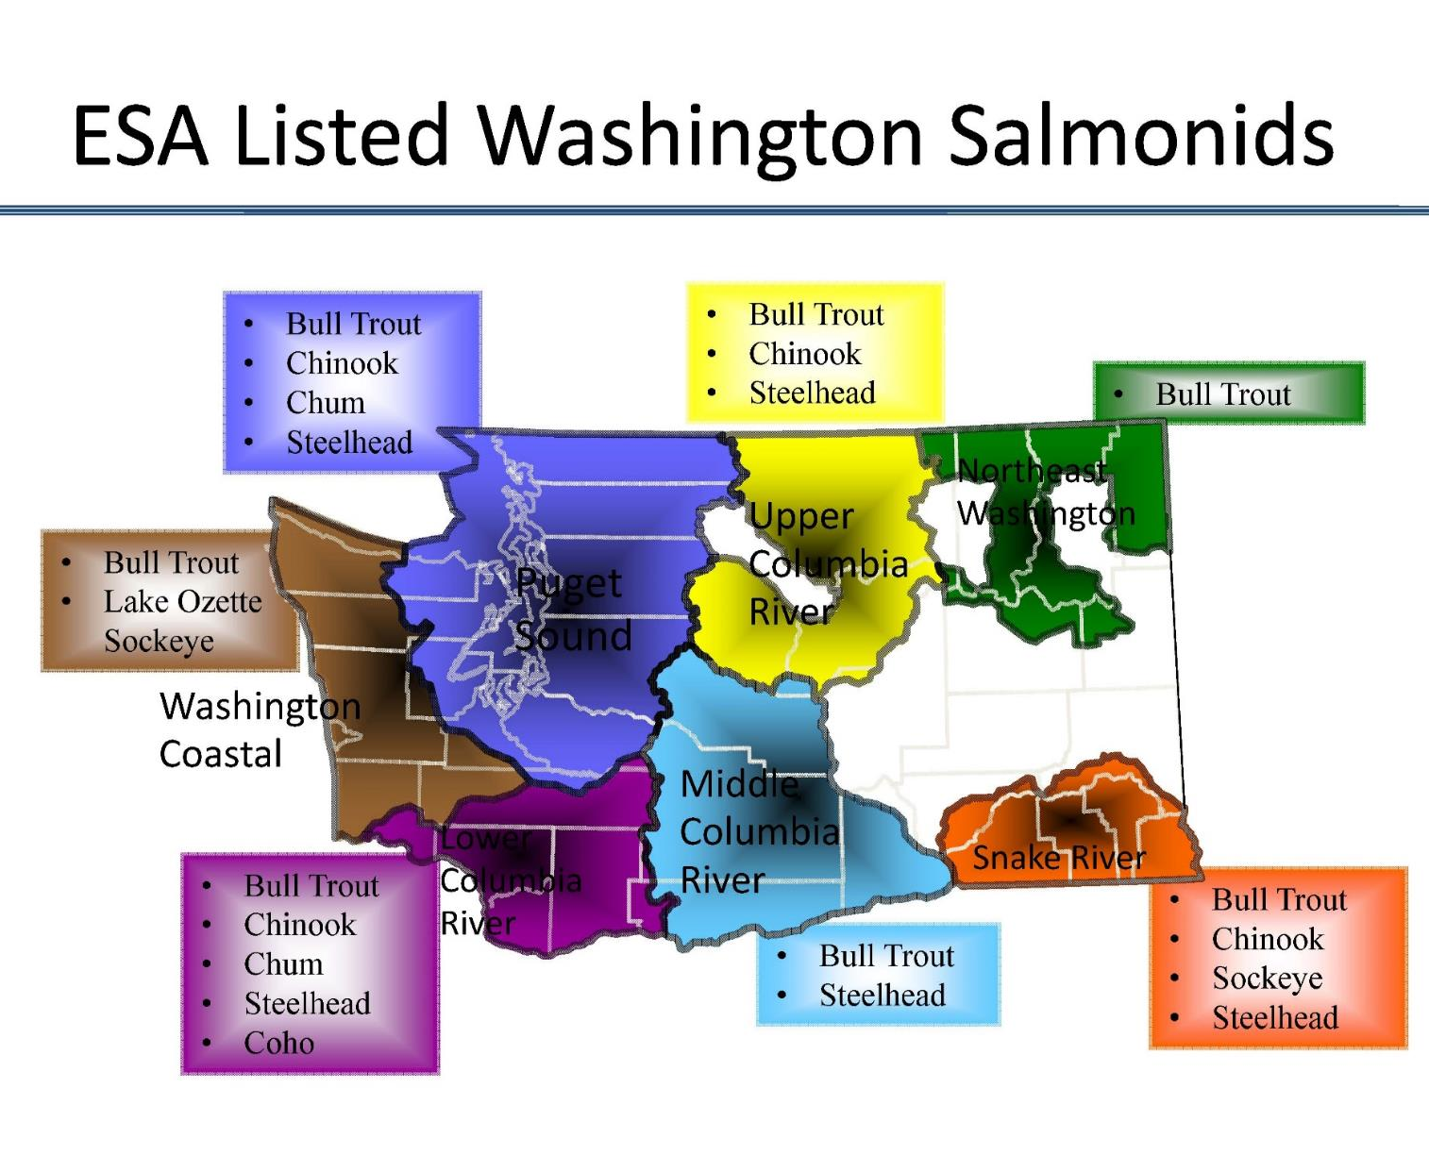
Why we need Instream Flows
About 75% of the state has at least one endangered or threatened salmon or trout species.
Low streamflows are just one of the reasons for this decline.
In the early 1970’s, Ecology started developing Instream Flow rules.
Notes:
It’s a sad fact, but around 75% of the state has at least one endangered or threatened salmonid.
There are many factors contributing to this decline, commonly grouped into the four H’s; Habitat, Hatcheries, Harvest, and Hydro.
Low streamflows are just one of the habitat factors.
Because of these many factors, It’s taking a comprehensive approach to address this decline.
In the early 70’s Ecology began developing ISF rules to address the low flow factor and to protect and preserve instream resources.
Instream Resources are the are the animals, activities and social values that benefit from having enough water in the stream.
These include:

Slide 7
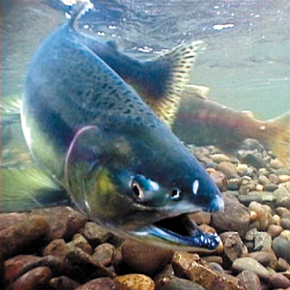
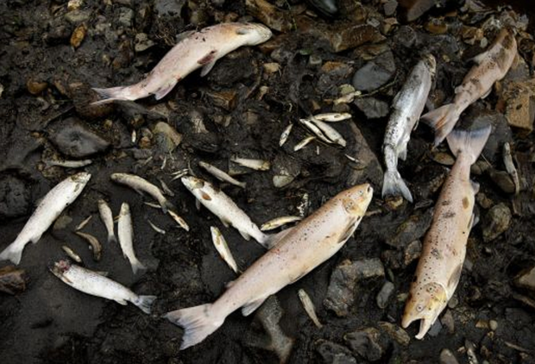
Instream Resources:
Fish & Wildlife
Notes:
Fish and wildlife: It’s sad to say, but we have had to point out that fish do indeed need water and that dry streams or increasing the dry period in intermittent streams does not protect the resource<CR>
Boating, Fishing, and other recreational activities : I don’t think dragging a kayak through the shallows is the experience most boaters are looking for <CR>.
Scenic or Aesthetic values, These are pictures of Shoshone Falls in Idaho and for many years, it was dry during the summer as all the water was diverted for power generation.
Now it has a 300 cfs instream flow;
During daylight hours;
Between April 1 and Labor Day.
I know it sounds funny, but it protects and preserves aesthetic qualities when people are most likely to see it.
Other instream resources include Water Quality and Navigation<CR>

Slide 8
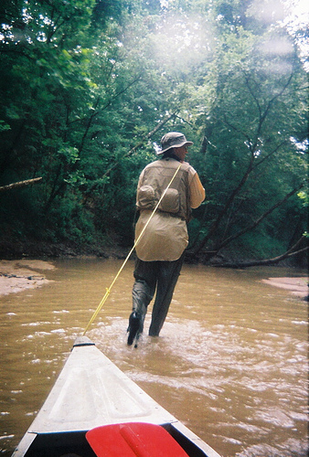
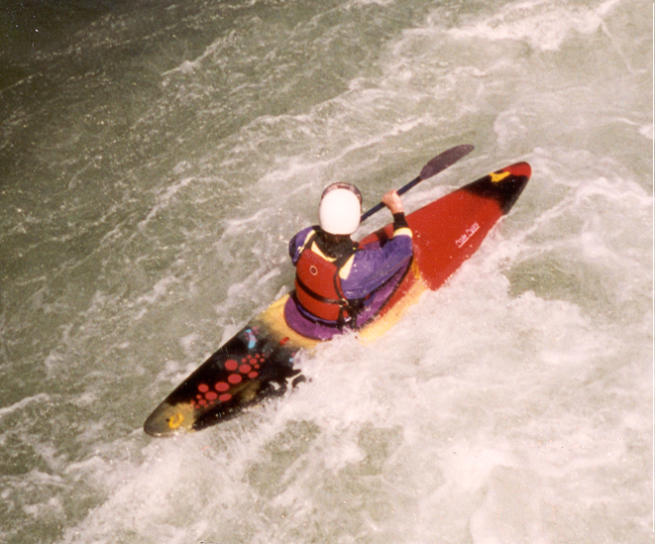
Instream Resources: Recreation such as Boating and Fishing
Notes:
Recreation: Boating and Fishing

Slide 9
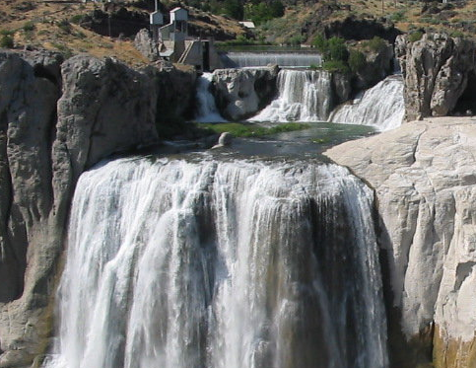
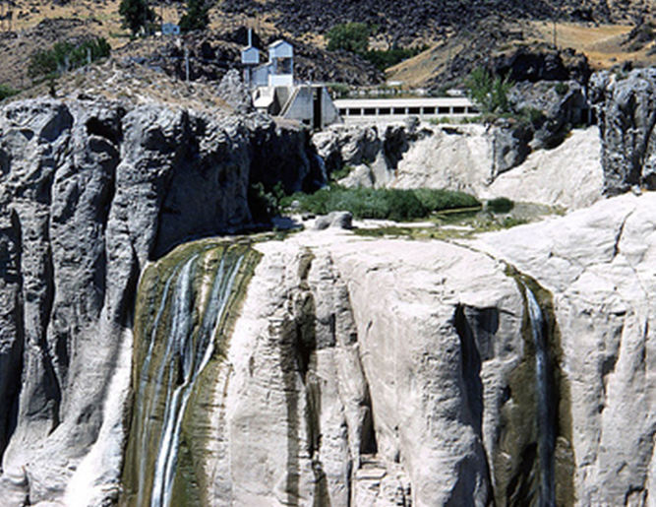
Instream Resources: Scenic or Aesthetic Values
Notes:
Scenic or Aesthetic Values

Slide 10
Hydrology 101
Hydrology 101
Streamflows Vary
Daily
Yearly
Seasonally
Notes:
To help understand instream flows, we should have an understanding of stream hydrology and streamflow statistics.
Here is a hydrograph showing two different years of daily stream flow data on Clover Creek. What was the Highest flow? 381cfs
This graph uses a normal or linear scale graph where each gridline represents the same interval, in this case the vertical interval is 25 cubic feet per second or cfs.
As you can see, streamflows vary…a lot.
They vary daily: In 1997, the December 29 streamflow was 205 cfs. On December 30 the streamflow increased to 291 cfs.
They vary yearly: In 1997, the January 3rd streamflow was 381 cfs. In 2014 on the same day, flows were only 23 cfs.
And they vary seasonally: This system has wet winters and dry summers
With linear graphs it’s easy to see the large difference between stream flows, but low flow can get lost in the width of the line.
For example, can anyone tell me the lowest flow?

Slide 11
Logarithmic Scale 1
Hydrology 101
Logarithmic Scale
This is the same data shown in a different way
Log scales are used to show data with widely ranging values
Notes:
This hydrograph shows the same two years of data, but it uses a logarithmic or Log scale where the major vertical intervals represents increasing orders of magnitude or factors of 10.
So from 1 to 10 cfs, the scale is 1 cfs.
From 10 to 100, the scale is 10 cfs
And from 100 to 1000, the scale is 100 cfs
With this scale we can see that the lowest flow was in 2016 flow was about 2.1 cfs.
Log scales are useful for showing data with widely ranging data, so I commonly use a log scale to show streamflows

Slide 12
Logarithmic Scale 2
Hydrology 101
Logarithmic Scale
32 years of data
Daily flows can vary by 2 orders of magnitude
Seasonal flows can vary by 3
Notes:
This graph shows the same stream with all the daily stream flow data for 32 years of daily streamflow data
It is quite messy, but it shows us that with any given day, streamflo commonly varies by an order of magnitude. In other watersheds, this is commonly 2 orders of magnitude.
Seasonally flows can vary by up to 3 orders of magnitude

Slide 13
Exceedance Curves
Hydrology 101
Exceedance Curves
Show the yearly and seasonal variability
Without the mess
Notes:
Here is the same graph overlaid with a streamflow statistic called exceedance curves
The upper blue line represents the 10% exceedance flow.
Streamflows at this level are only exceeded 10% of the time.
Think of it as a rare wet day where it has been raining for a while, or when its raining really hard.
The bottom red line is the 90% exceedance flow.
Streamflows at this level are exceeded 90% of the time.
When streamflows reach this level, it has been dry for a while.
In the summer, these would be drought conditions.
The dark blue line in the middle is the 50% exceedance flow. This is the same as the median.
<CR> By using 10-50-and 90% exceedance curves we can see most of the variability in a stream along with its seasonal pattern.

Slide 14
Streamflow Patterns: Rain Dominated
Hydrology 101
Streamflow
Patterns
A Rain dominated streamflow pattern tends to have the lowest summer flows and the longest low flow season
Notes:
Which is why I usually display stream flows using these exceedance curves.
In Washington, streams tend to follow one of three flow patterns
Chambers Creek is a little strange, but shows a Rain dominated pattern where streamflows are highest from winter rains and decline rapidly as the rains stops.
Rain dominated systems tend to have the longest period of low flows and the highest seasonal flow differences.
Chambers looked strange because the while the average precipitation rate is similar November through January, streamflows don’t peak until January. The summer flows are also higher than I expect from a rain-fed system-Lake influence
I’m not sure why all this is happening, but it could be caused by a combination of a large GW recharge component and a stormwater management that directs runoff away from the stream.

Slide 15
Streamflow Patterns: Snow dominated
Hydrology 101
Streamflow
Patterns
A Snow dominated streamflow pattern
Note the lack of large November and December rain events
Notes:
This is The Wenatchee River shows a snow dominated pattern.
With a Snow dominated streamflow pattern there can be some rain in the winter, but most of the precipitation is stored as snow.
Streamflows greatly increase during the summer as the snow melts.

Slide 16
Streamflow Patterns: Mixed
Hydrology 101
Streamflow
Patterns
A Mixed (Rain with Snow or Glacial melt) streamflow pattern have two bumps
Notes:
The Puyallup River has a mixed pattern, with high streamflows from winter rain in the low lands and another high in the spring and summer from melting snow and ice in the mountains.
Stream hydrographs will be an important tool for you to determine critical flow periods and
the months where water could be available for storage or recharge projects so have them available for your discussions.
Now back to instream flows.

Slide 17
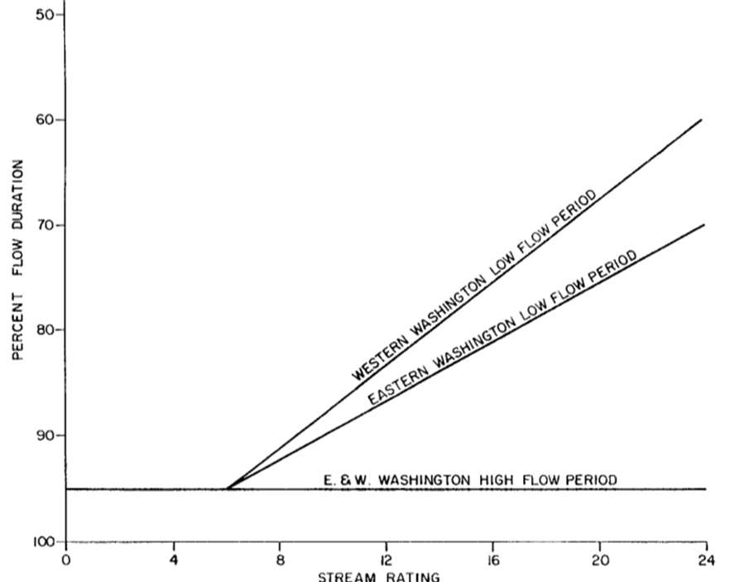
Instream Resource Rules 1973-1980
Wildlife
Fish
Scenic and
Aesthetic values
Navigation
Other
Environmental values
Water Quality
Notes:
Washington has had roughly three phases of ISF development.
From 1973-1980, ISFs were determined with a hydrology based definition and lead to an ISF methodology that was loosely called the hydrologic or stream rating method,
where a stream was managed by its high and a low flow period
The high flow period had the ISFs set at the 95% exceedance
The low flow period had an ISF that varied between the 95 and 60% exceedance depending upon the stream’s rating score of six factors.
The final score, ranging from 6 to 24 was converted to an exceedance level using the figure shown on the right. For example, a score of 19 <CR> would lead to an ISF at the 70% exceedance

Slide 18
Instream Resource Rule WRIA 22-1976
Dec 1-April 15: 95% Exceedance
Aug 15-Sept 15: 70% Exceedance
Notes:
Ecology published the rule for Water Resource Inventory Areas or WRIA # 22, the Chehalis River, in 1976.
Here they defined the a high flow period from December 1 to April 15, and the ISF, shown by the green line, was set at the 95% exceedance or 1300 cfs.
The low flow period was August 15 to September 15 and with a score of 19/24, had the ISF set at the 70% exceedance or 165 cfs
Then a straight line connected the two periods.
It was that simple…and was our least protective standard

Slide 19
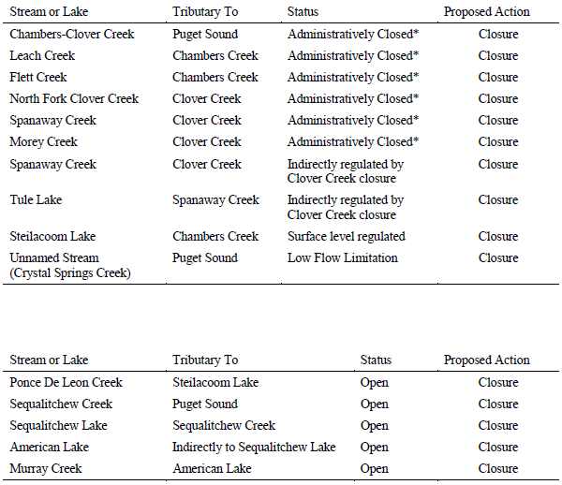
Instream Resource Rule
WRIA 12 -1979
Instream Resource Rule
WRIA 12 -1979
No instream flows were set in WRIA 12
The rule listed existing SWSLs from WDFW and proposed new year-round closures
Notes:
The WRIA 12 rule occurred during this first phase, but it did not set any instream flows.
Instead it only confirmed previous administrative closures and closed all remaining streams in the watershed.
Year-round closures are official declarations the that new water is not available for consumptive appropriations at any time.
In the rule, closures referred to surface water, but based on court rulings,
this could prohibit water retiming projects designed to use winter water and benefit streamflow in the summer.

Slide 20
All Year Stream Closures in the WRIA 12 Rule
Are they justified, or can they be seasonal?
WRIA 12 Streams with a long-term hydrograph
Chambers Creek
Clover Creek
Flett Creek
Leach Creek
Notes:
Are year-round closures needed ? Are they justified?
For Chambers Creek, could we take a cfs or two during the winter and retime it to improve summer flows…without impairing instream resources?
We would need to negotiate an agreement with all the interested parties and possibly conduct a habitat study,
but this group could recommend an exemption to the year-round closures for habitat projects or develop the data to support changing specific streams to a seasonal closure.

Slide 21
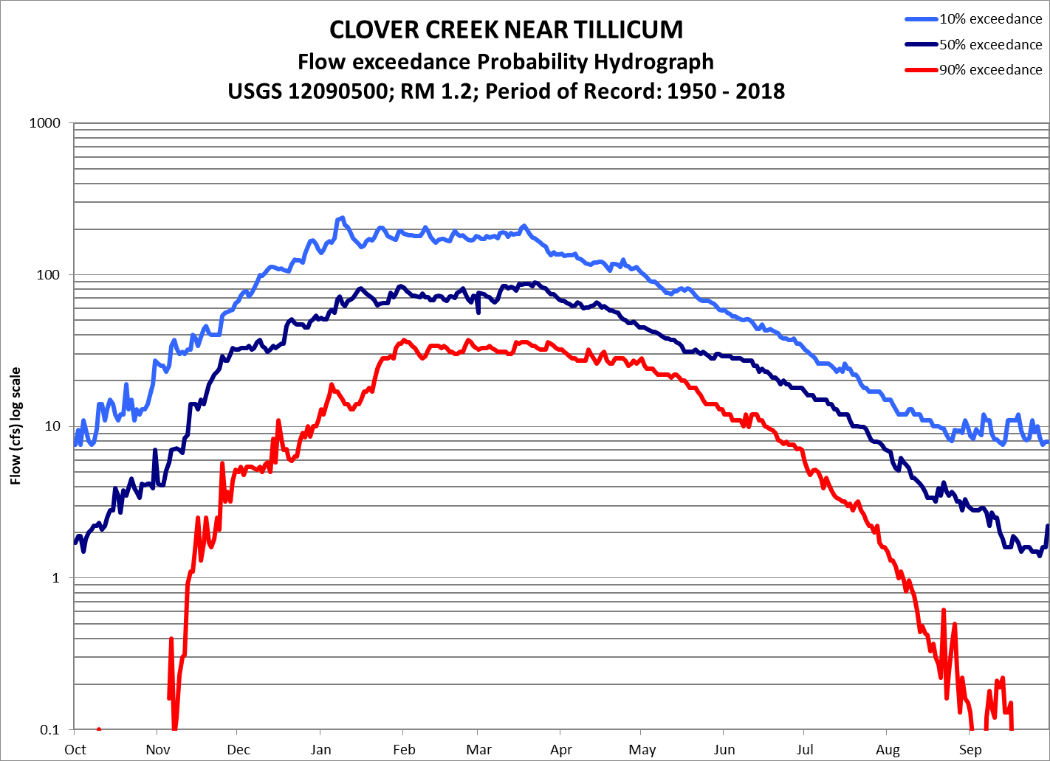
All Year Stream Closures in the WRIA 12 Rule
Are they justified, or can they be seasonal?
WRIA 12 Streams with a long-term hydrograph
Chambers Creek
Clover Creek
Flett Creek
Leach Creek
Notes:
Clover is smaller, but still may have high winter flows available.
And it looks like it could really benefit from increased summer flows.

Slide 22
All Year Stream Closures in the WRIA 12 Rule
Are they justified, or can they be seasonal?
WRIA 12 Streams with a long-term hydrograph
Chambers Creek
Clover Creek
Flett Creek
Leach Creek
Notes:
Flett Creek is even smaller, and even though it has better summer flows than Clover, it could still benefit from increased summer flows.
Again, we would need a negotiated agreement with all the interested parties and possibly a habitat study,
but changes to the year-round closures rule is needed to allow the option of winter water retiming projects.

Slide 23
“Base Flow”, “Minimum Flow”
What does it mean?
Definitions and consequences
Hydrology: streamflow from groundwater discharge
This hydrologic minimum is similar to drought conditions and does not provide much protection for the instream resource
Resource-Focused: streamflow needed to protect or preserve the resource
This usually leads to flows higher than the hydrologic minimum, but it provided a better level of protection
Notes:
The legislature directed Ecology to develop instream flows in 1971, but did not define several key terms such as
Base flow and minimum flow
The definition you use is important because it could lead to very different ways of determining an instream flow.
For example, a base flow defined by hydrology would use the level of streamflow coming solely from groundwater.
This is relatively easy to measure, but since this hydrologic minimum can be similar to drought conditions, it does not provide much protection
On the other hand, A Resource-Focused definition would look at a streamflow that protects and preserves the instream resource.
This is harder to measure and it usually leads to ISFs higher than the hydrologic base, but it provided a better level of protection.

Slide 24
Forrest Olson (1983) found that higher summer flows resulted in more coho adults returning two years later
Hydrology vs. Resource Focused Definition
Notes:
In this period, the fishery community also published additional studies confirming the fish to stream flow relationship.
For example, Forrest Olson (1983) found that higher summer flows resulted in more Coho adults returning two years later
Considering all the impacts that could affect coho returns, such as hatchery, harvest, habitat, and hydro, the fact that we see any kind of signal shows that the low flow index is important.
All this work built a defensible case to use a more resource focused definition for ISFs.

Slide 25
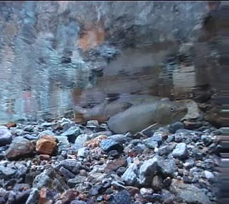
Instream Resource Rules 1980-1985
Instream Resource Rules 1980-1985
Several models/methods were developed in the 1970s, but were not factors until this second phase.
The most common for ISF rules were the Toe-Width Method and the PHABSIM model (Physical HABitat SIMulation)
Notes:
In the second phase of ISF development, biologists from WDFW and Ecology pushed for a more resource focused definition for ISFs.
There were several habitat based instream flow models/methods developed in the 1970s and used in Washington, but they were not used for ISFs until this second phase.
These include the Toe-Width which was the most commonly used method, and
PHABSIM which stands for Physical HABitat SIMulation.
This was typically used on the larger streams.

Slide 26
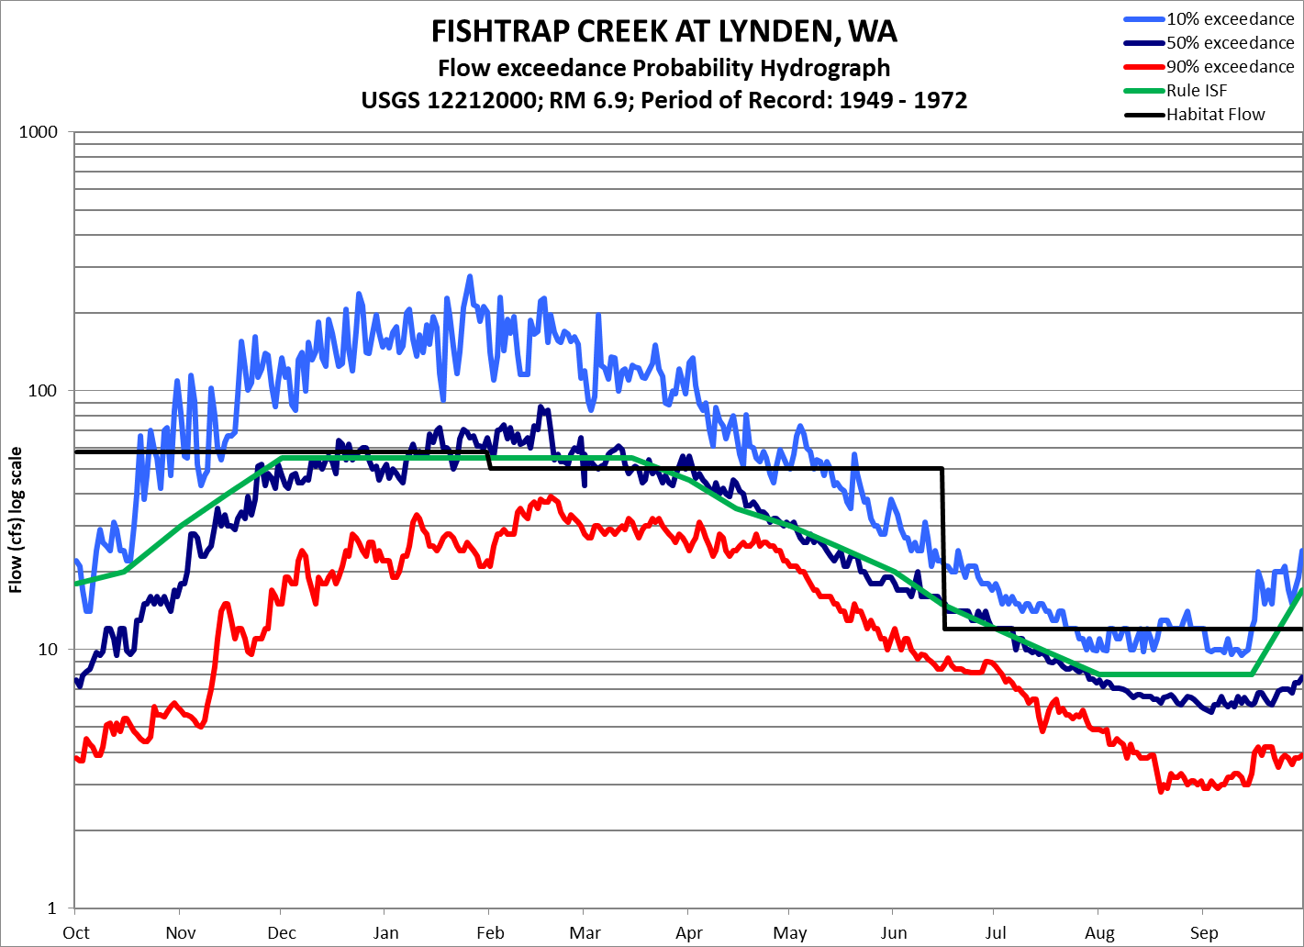
Instream Resource Rules 1980-1985 continued
Instream Flow Rules 1980-1985
A hybrid between habitat based ISFs and the hydrologic method
Notes:
Fishtrap Creek in WRIA 1 is an example of ISFs from this second phase.
Here the black line shows the recommend flows based on a Toe-Width study:
October-January: 58 cfs was preferred for Chinook spawning,
February-June 15: 52 cfs for Steelhead spawning, and
June 16-Septeptember: 12 cfs for Steelhead rearing.
The green line shows the negotiated instream flow.
They didn’t published rationale for this difference, but, ISFs in this phase were commonly limited to the 50% exceedance flow during the wet season and up to the 40% exceedance during the dry season suggesting an unwritten hydrologic limit.
ISFs set during this period were usually higher and more protective than those set in the first phase

Slide 27
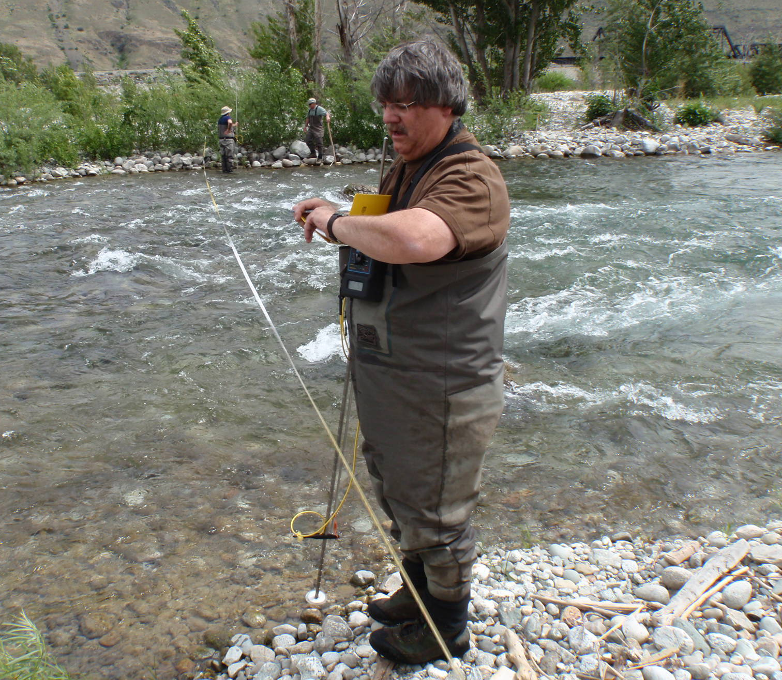
Instream Resource Rules 1986-2000:
The Dark Ages
Instream Resource Rules 1986-2000:
The Dark Ages
Instream flow rule making moratorium for 15 years
Instream flow studies and fish habitat research continued
Many hydropower projects were conditioned with instream flows
Notes:
Then the dark ages fell and we has an ISF moratorium for 15 years
During this time, WDFW and Ecology continued to conducted Phabsim and toe-width studies all over the state.
They also continued their fish habitat research to improve the accuracy of the models
Even though we didn’t develop any ISF rules, we were able to set ISFs at hydroelectric projects through the State’s 401 water quality certificate.

Slide 28
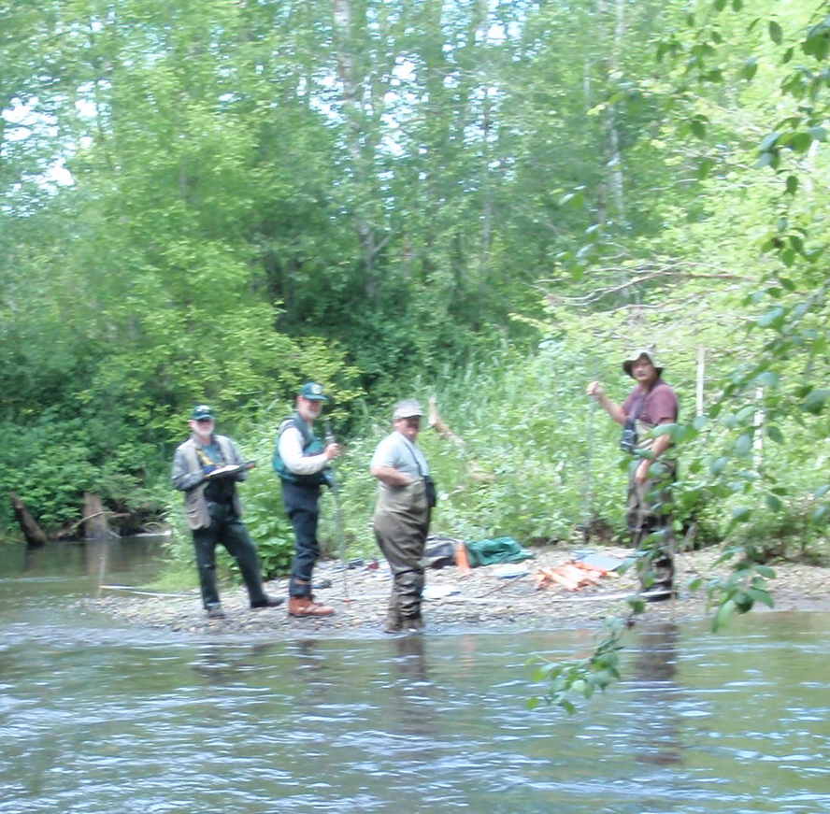
Instream Resource Rules 2000-2015
Instream Resource Rules 2000-2015
Ecology hired a second biologist and increased the size of WDFWs water team to implement RCW 90.82
Watershed plans were adopted resulting in 11 new instream flow rules
Continued to improve our modeling
Notes:
During the third phase of ISF protection we hired a second biologist, increased the size of WDFWs water team, and started implementing RCW 90.82
During this time, we used the adopted watershed plans to develop or update 11 ISF rules with a strong resource focus
We continued our fish habitat preference studies and analysis and published updates to our state-wide fish preference curves leading to more accurate modeling
So let’s look at how we develop a modern ISFs

Slide 29
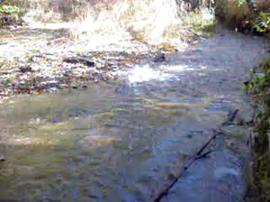

Key Instream Resources
Fish habitat is a key instream resource. The goal is to protect flows needed for:
Migration
Spawning
Rearing
Notes:
ISFs are designed to protect instream resources. They all need to be considered when developing an ISF,
but we have the best quantitative tools for measuring fish habitat so we generally use fish as the key instream resource.
We have also found that if we protect fish habitat, the other instream resources are protected as well.
All Fish lifestages need adequate depth and velocity. For example, these migrating chum could use more water to aid their migration.
But Spawning adults also need suitable gravel for building their redds (or nests),
And Rearing juveniles also need cover or places to hide from high velocities and/or predators.

Slide 30
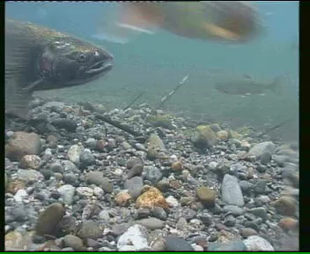
How Do We Develop an Instream Flow?
1) Habitat Study
2) Fish Periodicity
3) Stream Hydrology
Notes:
To develop an ISF, we first need a study that relates fish habitat to stream flow.
Second, we need a Periodicity Chart. This comes from local biologists and tells us what fish species and lifestage are in the stream month by month, and
Third, we would like to have a long-term hydrograph of the stream.
For the Habitat Study, we continue to prefer either the Toe-Width method or a PHABSIM study.

Slide 31
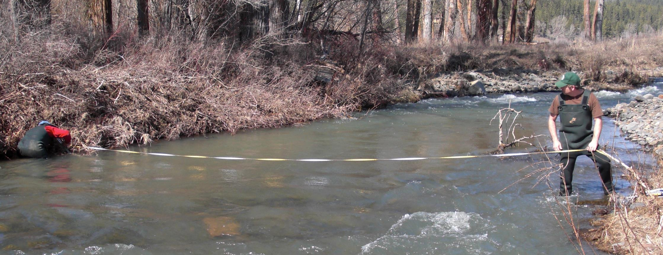
The Toe-Width Method
Measuring stream width at the toe of the bank - the point where the stream bed meets the stream bank.
Notes:
The toe-width method uses the width of the river measured at the toe of the bank, which is the point where the stream bed meets the stream bank.
When measured at pool tail-outs and riffles, and using the new protocols we published,
the widths are quite consistent and give an accurate estimate the ISF recommended by a PHABSIM study, but with much less effort.
This type of study is easy enough that all the key streams in an entire watershed can be measured in 1 to 3 days.
In fact, most of Washington’s ISF rules were developed using the Toe-Width method.

Slide 32
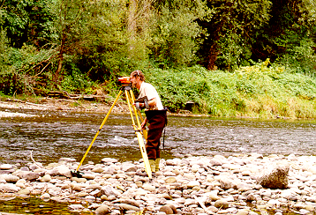
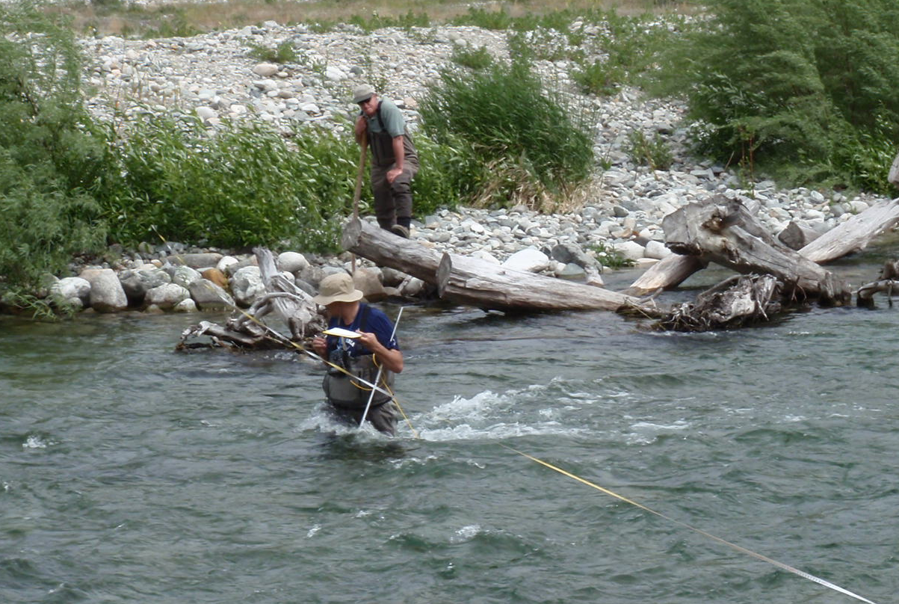
IFIM / PHABSIM
We measure around a thousand points of data - Our most detailed and site-specific instream flow method
The model predicts how depth and velocity changes with different stream flows
The model then compares these changes to the depth, velocity, and substrate or cover preferred by different fish species.
Notes:
PHABSIM is currently our gold standard for setting ISFs.
To conduct a Phabsim study, we first take hundreds of depth and velocity and other measurements at several different stream flows giving us a thousand points of data.
This is our most detailed and site specific ISF method and is much more time intensive.
The model takes all this data and predicts how depth and velocity conditions change over a wide range of stream flows.
Then it compares the conditions at different flows and compares it to the depth and velocity preferred by different fish species and lifestages.

Slide 33
Results from a PHABSIM model
These curves show the amount of habitat available at each of the modeled stream flows.
Notes:
Here are the results from a PHABSIM model from the EF Lewis showing the fish habitat to streamflow relationship.
In general, low flows are shallow and slow and fish don’t like it.
High flows are too deep and fast and fish don’t like it.
At some varied stream flow, the stream produces the most fish habitat for each of the modeled species and life histories.
The highlighted portion of the table are the peak habitat values and the associated streamflows are used to develop a draft recommendations.
This type of model is considered reliable and defensible because it is quantitative and based on biological principals.
It is also quite popular. PHABSIM is used in 13 of the 17 western states and is the preferred method in 11 of them.

Slide 34
Instream Resource Rule
WRIA 27 - 2009
Instream Resource Rule
WRIA 27 - 2009
Periodicity tells us what to protect
The habitat study tells where to set the ISF
Hydrology truth check the results.
Notes:
Here is an example from a 2007 rule of the Lewis River.
Periodicity tells us when the various fish species are in the system and helps us focus on what to protect. For Example, Chinook Salmon spawn from October through February.
The Habitat Study tells us 500 cfs provided the preferred spawning flow.
Steelhead spawn March 1 through May and 460 cfs protects spawning.
SH juveniles rear year-round so all other months got a rearing flow of 420 cfs.
Modern rules also use a hydrologic limit because the ISF should be “achievable”, but that was another undefined word.
Rare flow events can provide benefits to rearing fish populations, so we use the 10% exceedance as our hydrologic limit to habitat flows.
This has been our most protective ISF standard.
Under this ISF regime, new water users would have a reasonable chance of obtaining water from November through May
But how do ISFs affect uninterruptable water needed for new homes?

Slide 35
WRIA 27/28 Availability-2009 rule
Stream No. of years the Avg. days per year
name ISF was not met ISF was not met
Kalama River 20/20 183
E Fork Lewis River 8/8 169
Washougal River 11/11 177
Burnt Bridge Creek 4/4 251
Notes:
To answer this question, I looked at how often the ISF was not met in a watershed from a recent ISF rule using up to 20 years of daily streamflow data and a continuous 7-day not met threshold.
This means that the streamflow had to be below the ISF for at least 7 consecutive days before the ISF was considered “not met” for that year.
With today’s high standard, all the gaged streams in the WRIA had at least one 7 day event every year where the ISF was “not met” meaning that new uninterruptable water would not be available.
And then the polite and civil disagreements began

Slide 36
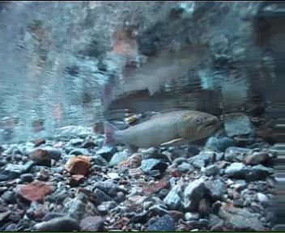
SEE!!!
I told you the Instream Flow is Too High!!!
Fish don’t need that much water!
Notes:
Mark Twain’s old adage that “whiskey's for drinking and water’s for fighting over”, is alive and well when dealing with instream flows.
We are frequently challenged with the claim that the ISF is too high,
And, that fish don’t need that much water!
HOWEVER, since 1935 research studies have consistently found a strong relationship between salmon abundance and streamflow.

Slide 37
Fish vs Flow Research
Dave Seiler’s studies on Bingham Creek for 1980-1997 found more summer flow equals more coho smolts outmigrating the following spring.
Notes:
The strongest relationship I’ve seen comes from Dave Seiler’s studies on Bingham Creek. He found that a higher summer flow resulted in more coho smolts out-migrating the following spring
The R^2 was 0.96. You don’t often see 0.96 as a biological response!
In general the research is showing that more flow means more fish.
However, if our critics are correct, simply using a lower ISF standard would solve the rural water problem, right?

Slide 38
WRIA 1 Availability-1985 rule
Stream No. of years the Avg. days per year
name ISF was not met ISF was not met
Fishtrap Creek (RM 6.9) 20/20 209
Nooksack (RM 36.6) 19/20 154
Nooksack (RM 5.8) 20/20 142
MF Nooksack (RM5.0) 20/20 144
SF Nooksack (RM 14.8) 20/20 204
Skookum Creek 20/20 181
Notes:
Here I used the same 7-day threshold analysis looking at availability under ISFs set during our 2nd phase of rule development .
Under this standard, we started using a resource focus for ISFs, but had hydrologic limits of 50% during the winter and about 40% during the summer.
Using this lower protective standard, ISFs were met on one stream in one year.
So even with a lower standard, new uninterruptable would not be available.

Slide 39
WRIA 22 Availability-1976 rule
Stream No. of years the Avg. days per year
name ISF was not met ISF was not met
Chehalis (RM 59.9) 15/20 43
Cloquallum Creek 11/20 58
Humptulips River 16/20 71
Satsop River 17/20 72
Skookumchuck 9/20 66
Wishkah River 7/8 41
Wynoochee River 17/20 68
Notes:
Finally, let look at availability on one of our first ISF rules.
This phase used our least protective standard that based ISFs on the 95% exceedance during high flow periods and between the 95 and 60% exceedance during the low flow period.
The results were quite stunning.
Even using our lowest standard, the WRIA 22 ISFs were not met over half the time

Slide 40
Instream Resource Rules
1973-1980
Dec 1-April 15: 95% Exceedance
Aug 15-Sept 15: 70% Exceedance
Notes:
As a reminder, here is what the ISF looked like on the Chehalis
It was not very protective
Lower standards may make water available more often, but even they would not allow for new uninterruptable use.
This has been used as a legal wedge in the efforts to limit residential development resulting in several landmark WA supreme court decisions

Slide 41
Instream Resource Rules 2016-20??
The Dark Ages Return
Swinomish v. Ecology (2013)-No impairment
Foster v. Ecology (2015)-No out of kind mitigation
Hirst v. Whatcom County (2016)-No building permit without water offset
Began another rule moratorium, but science marches on
Notes:
Swinomish v. Ecology (2013) - No impairment even from reservations of water Ecology thought were in the public interest to provide
Foster v. Ecology (2015) - No out of kind mitigaion – even it resulted in an improvement to instream resources
Hirst v. Whatcom County (2016)- No building permit without in-time in-place water offsets…
This effectively created a pseudo-building moratorium in some counties and others seemed just an easy lawsuit away from a similar condition
These cases also brought another ISF rule moratorium, but science marches on, even in the dark ages.
Last December, I teamed up with WDFW and we published an update to the toe-width method

Slide 42
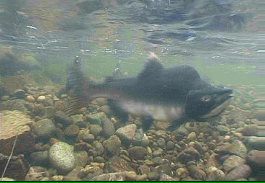
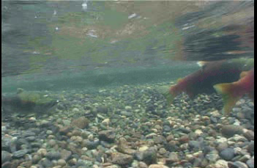
In a Nutshell
Stream Flows vary; daily, yearly and seasonally, by 2-3 orders of magnitude
If we want to protect rare but productive stream flows, higher ISFs are needed, but even low standards would limit new homes
A 100 cfs withdrawal affect streams differently than a 0.00004 cfs in-house use, but water law treats them the same
Flexibility is clearly needed
Notes:
Stream Flows vary – on a given day, average streamflow can vary by two orders of magnitude but the instream flow is a single number.
If we want to protect the rare, but productive high flow years, a high level of protection is needed, reducing water availability.
But uninterruptable water wasn’t available even with a low levels of protection so reducing standards aren't the answer.
Large water uses such as municipal, industrial, and agriculture can have a measureable impact on streams, but in-house domestic use only has about a 25 gpd consumptive impact or .00004 cfs
With rare exceptions, this use would not would not affect the stream, but water law treats them the same.
Flexibility within water law is needed

Slide 43
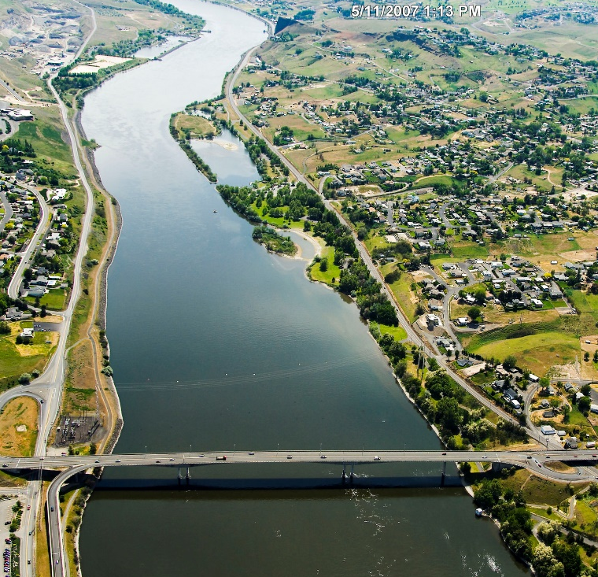
Streamflow Restoration
Authorized new domestic wells in closed and impaired basins
Must offset 20 years of projected water use from new development
  In-time, in-subbasin is a priority, out-of-time & subbasin is allowed
    May include non-water projects.
  The water offset and non-water projects must result in a Net Ecological Benefit
Notes:
There were many proposals, but after a two long years, Washington adopted RCW 9094, the Streamflow Restoration Act in January of 2018.
It gave us flexibility by authorizing new domestic wells in closed and impaired basins, but has 2 requirements.
First, the projected water use from 20 years of development must be offset somewhere in the basin.
In-time, in-subbasin are a priority, but out-of-time and out of subbasin projects are allowed
In addition to the offset projects, the plan may include non-water projects that improve instream resources
Second, the projected water use and the combination of water offset and non-water or habitat projects must result in a Net Ecological Benefit
Another undefined term we are struggling with

Slide 44
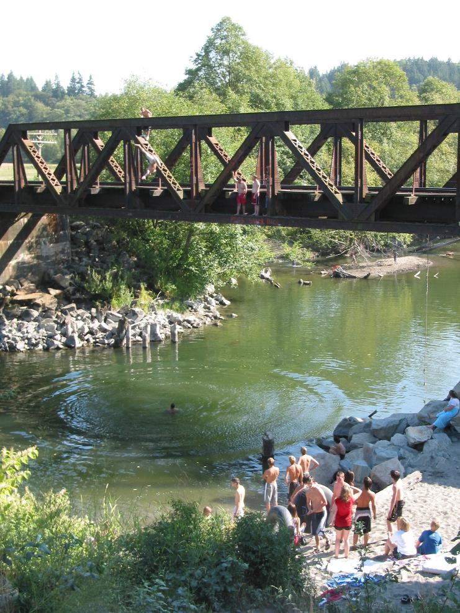
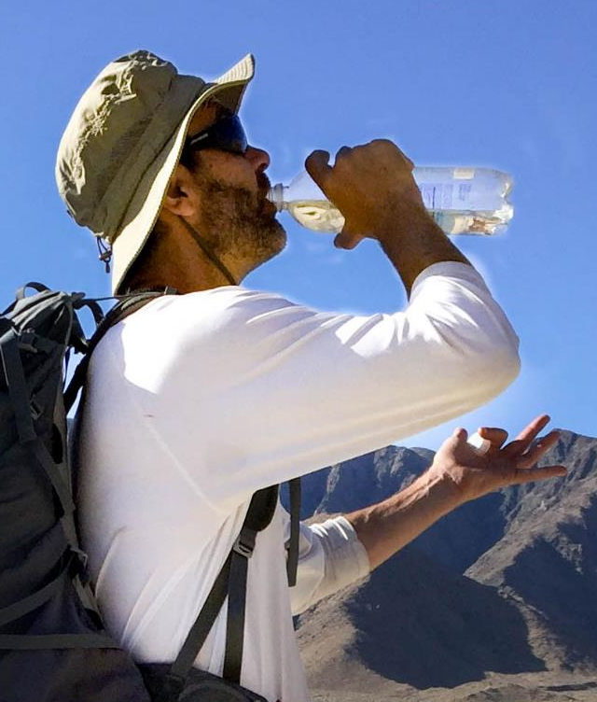
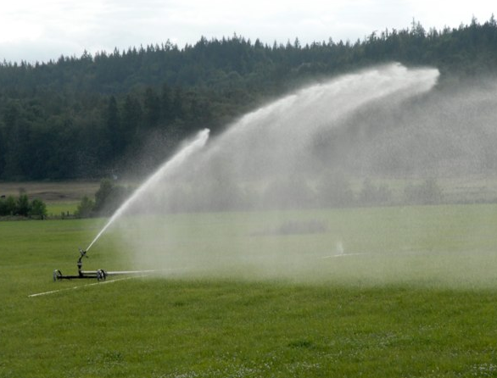
There are many competing uses for water.
RCW 90.94 lets us have strong ISF protection and the ability to provide water for new homes.
Calculating all the impacts and offsets will be difficult and require cooperation.
Our role is to provide technical assistance to help you be successful.
Notes:
There are many competing uses for water and conflicts are not always polite.
Ecology has tried to find ways to allow small uses within an ISF rule, but these have invalidated, or declared are too risky.
RCW 9094, the Streamflow Restoration Act is the new tool we have been given. It let us have strong ISF protection and the flexibility of building new homes in the rural areas
Calculating all the impacts and offsets, and determining Net Ecological Benefit is going to be a difficult task.
You may not do the happy dance over all the pieces of your plan, but the goal is not perfection. You’re just trying to get good things done in the watershed and move in a healthier direction.
Our role is to provide watershed groups with the technical assistance you need to be successful…
for the benefit of People, Farms and Fish

Slide 45
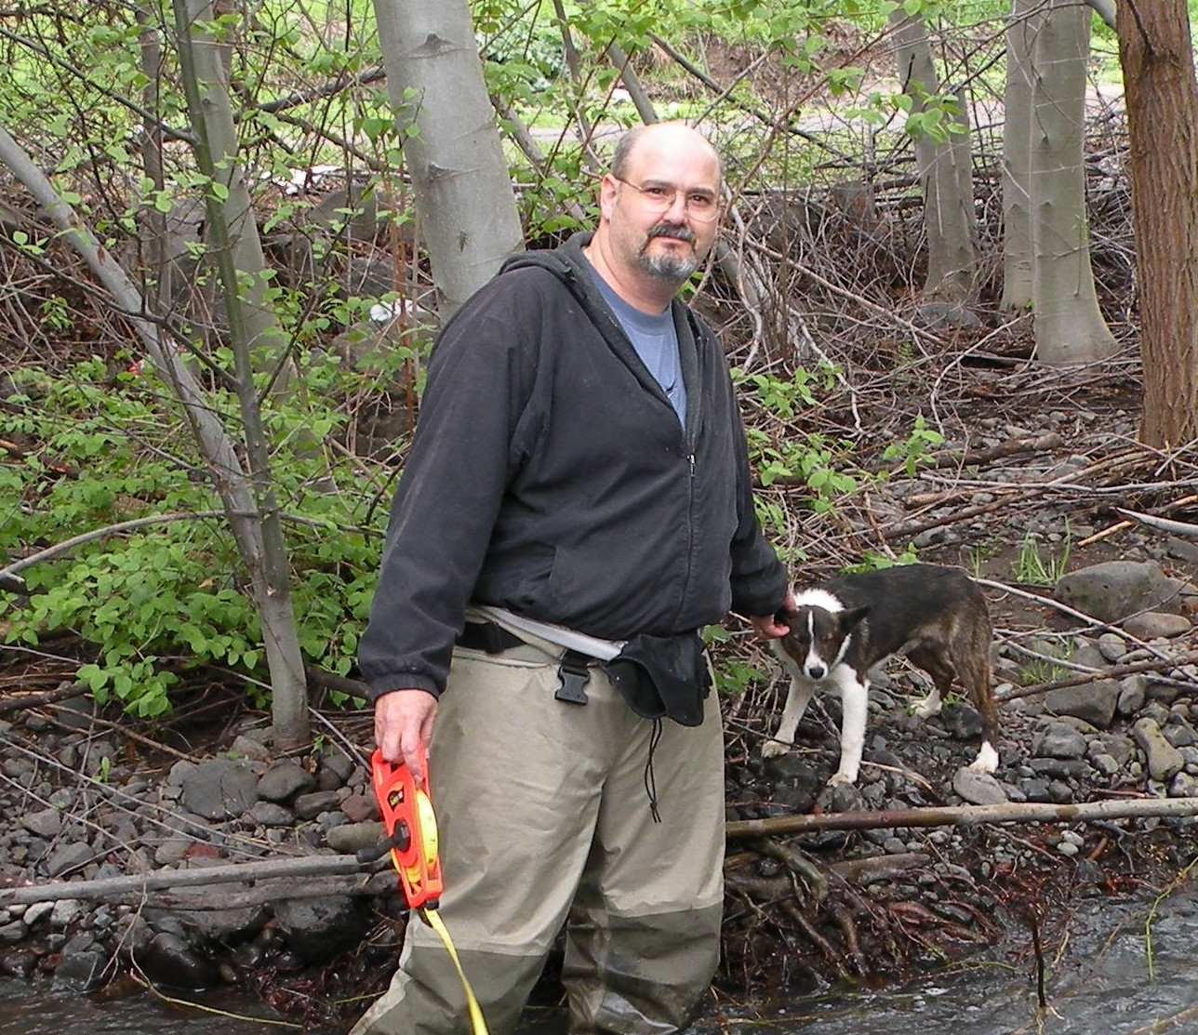
Thanks for listening
Questions?
Jim Pacheco
Instream Flow Biologist
Water Resources Program
James.Pacheco@ecy.wa.gov
360-407-7458

