Slide 1
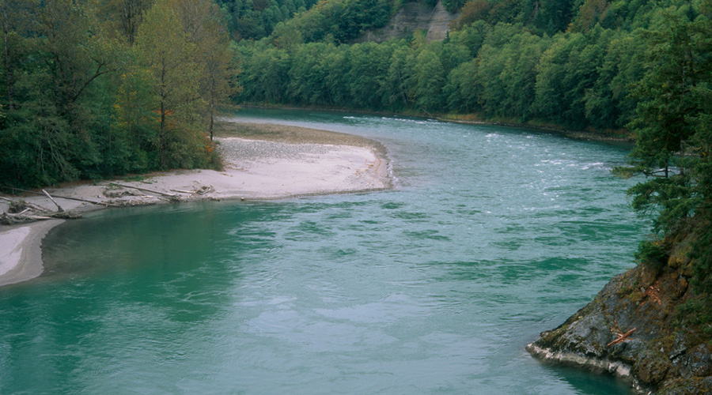
PE Well Projections
May 2019
Rebecca Brown
Washington State Department of Ecology
Rebecca.Brown@ecy.wa.gov
Notes:
This presentation will go into more detail about methods for projecting future permit exempt wells, with a focus on the direction the technical workgroup is heading. Our objective is to provide you the context of why we need to project future PE wells, and allow you to understand the workgroup’s recommended method. We would like to direct the technical consultants on how to proceed with projections based on the workgroup’s recommendation and feedback from this discussion.

Slide 2
Committee Task
Project number of new domestic permit exempt wells in the next 20 years.
Estimate the amount of indoor and outdoor water used by the domestic permit-exempt wells.
Calculate consumptive water use.
Develop projects and actions to offset the amount of water calculated in #3 and meet NEB.
Notes:
These are the steps that the committee, technical workgroup, and technical consultant will be working on over the next year.
Over the next few months we will focus on what we need to do to determine how much water we will need to offset, steps 1-3.
Each of these steps requires us to make a number of assumptions.
No one can accurately predict the future, we don’t where homes will be built, we don’t know how much water each individual well user will actually use, and we don’t have the actual plant and soil conditions on each parcel to know how much water actually ends up being consumptive rather than returned to the ground or to a stream. We’ll have to be comfortable with the unknowns, but also make assumptions that are defensible and justifiable.
The technical workgroup will develop methods or options for each step, based on different assumptions, and provide the committee the options and their assumptions, benefits, and drawbacks. The committee will decide which direction to take.
Lessons learned from WRIAs 1 and 11: if they did this again, would spent less time on steps 1-3 so they could focus more on project identification and development.
We have limited time and resources for this process. The more Committee meeting time, technical workgroup time, and consultant time we spend on the earlier steps, means less time and resources to use later.

Slide 3
Water Accounting
TCWU=Total annual consumptive water use per new home.
# PE Wells
TCWU
Offset Goal
Notes:
To get our offset goal, we need the projected number of PE wells and the estimated total consumptive water use. We’ll talk more about total consumptive use next month, today I just wanted to highlight where we are in the process and why. What we would like to do today is discuss where the technical workgroup landed as their recommendation for the PE well projections.

Slide 4
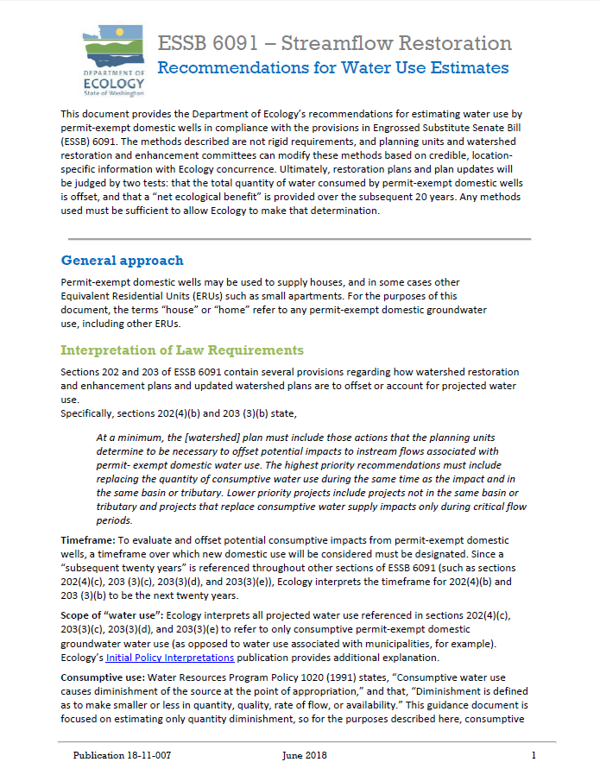
Recommendation Document
Ecology published recommendations for estimating water use by permit-exempt domestic wells in compliance with RCW 90.94.
This document is in your binders for reference, and is included as an appendix to the NEB guidance.
Notes:
Ecology published recommendations for estimating water use. It breaks down the steps into the 3 I mentioned above, and it provides assumptions and drawbacks for each recommended method. The document also points out assumptions that we need to make through the process, and the reasonable, Ecology-approved assumptions for water use and consumptive water. We will get into that more next month. This document is available on our website, and also in your binder.

Slide 5
Methods for Estimating Number of Future Permit-Exempt Domestic Wells
Building permits: Conduct GIS analysis of county building permits over time, zoning, and parcel information.
Population forecasts: Use population data available from counties and/or WA Office of Financial Management (OFM).
Wells: Use well data (Ecology or Tacoma-Pierce County Health Department).
Developable land: Conduct GIS analysis of parcels available for future development.
Notes:
The recommendations include 3 methods for estimating the number of future PE wells. Possible to use a combination of methods, or different methods for different parts of the basin based on county boundaries.
I added the method used in the King County Water Availability and Permitting study that you heard about at the March meeting.

Slide 6
Recommended PE Well Projection Method
# PE Wells
Historical Well Data
Developable Land
Notes:
The technical workgroup met on April 19 and has recommended a method using a combination of methods. The method includes using historical well data from the Tacoma Pierce County Health Department to have an understanding of past trends in the watershed. TPCHD permits PE wells in the county, so has a data set of all PE wells by parcel. We can use the past historical well data to project future trends.
WRIA 12 is unique in its size and its level of urbanization, and the fact that it is fully contained within one county. The technical workgroup thinks we can cross-check the PE well trend data with a review of developable parcels in the area outside of a Group A system.
Let’s go into each piece of the puzzle to better understand.

Slide 7
Projecting Future Exempt Wells using Historical Permit Data
Tacoma-Pierce County Health Dept
Review 20 year Trend Data
Moderate Approach
Eliminates Assumptions
Subarea (WRIA) Population/Housing Projections
Person Per Household (pphh)
Exempt Wells within Group A water systems
Notes:
No Sub-area projections for 2040
Vision 2050 Growth Allocation
Rural = 22,000 = 242 HUs per year
Unrealistically Low
Full Build-out
Beyond 20 years
Won’t be realized
Notes:
Ask Dan to talk about this slide.

Slide 8
PE Wells 1998-2007
Notes:
Please note that these are all the water wells at a certain depth and with a certain diameter that were constructed during the time-period. While we used the diameter and depth as a proxy for PE wells, these wells are not necessarily domestic PE wells. They could be associated with a water right, or they could be a PE well for stock watering or industrial or commercial purposes. We will have better data from the health department.

Slide 9
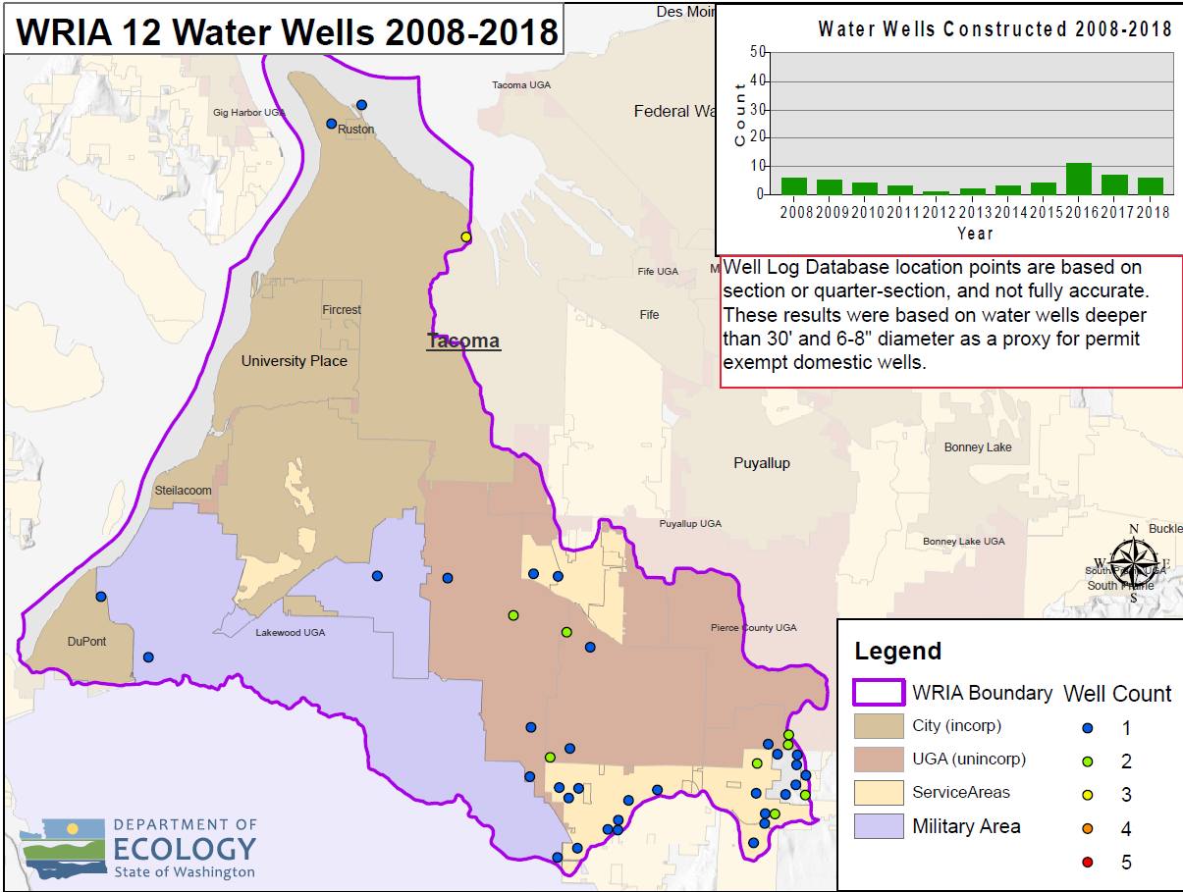
Water Wells 2008-2018
Notes:
Same data, more recent timeframe.

Slide 10
Developable Lands
Use GIS data to identify buildable/developable land.
Overlay zoning information to capture residential density potential.
Remove areas with municipal/community water systems.
Use as a check against the PE well historical data.
Assumptions: Parcels to exclude, connections in water service areas, etc.
Notes:
Here are the basic steps for the developable land review. This review would basically put an upper limit on our PE well projections, because homes will not go in that exceed the density standards.

Slide 11
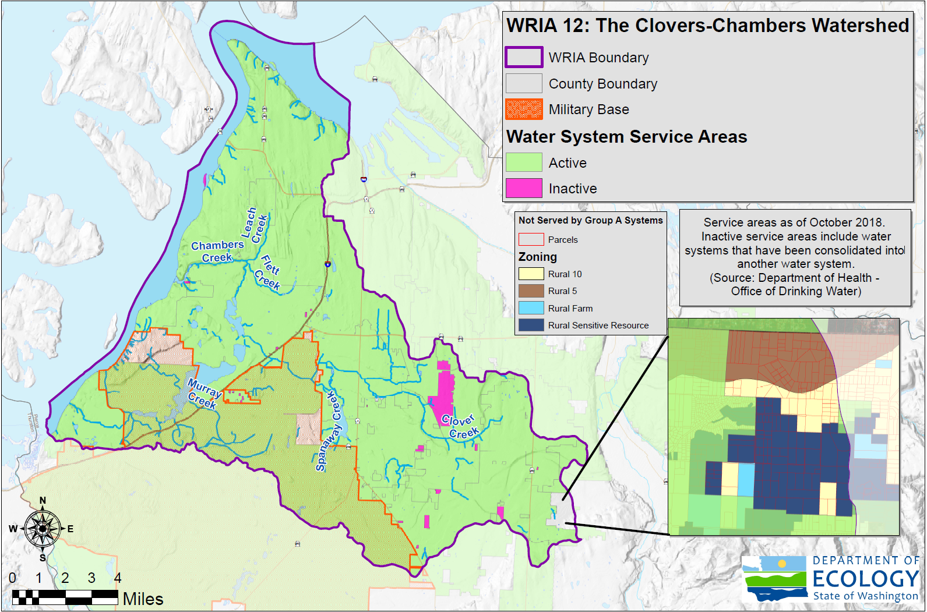
WRIA 12 Zoning
Notes:
Since we know that most domestic PE wells will go in the areas not served by water systems, this map shows the parcels and zoning on that part of the watershed.
The zones here are Rural 10 (density of 1 home per 10 acres), Rural 5 (density of 1 home per 5 acres, Rural Farm (1 per 20) and Rural Sensitive Resources (1 per 10). In total, that area is about 655 acres.
I did a back of the napkin calculations, taking into account zoning densities and approximate total area in each zone, and came up with 88 homes. My calculations included parcels with existing homes on them, so the actual number from the analysis will be smaller.
Are there questions you have on this proposed method? What are your concerns?

Slide 12
Recommended PE Well Projection Method
# PE Wells
Historical Well Data
Developable Land
Notes:
We will put forth this method for the technical workgroup to get started on. Do we need another option or method to pursue as well? We have time today to discuss other options, or we can discuss something at the next meeting.

