Slide 1
Nisqually Watershed
Successful Implementation of RCW 90.94.020
Process Considerations
June 12, 2019
Lisa Dally Wilson, PE
WRIA 12 WRE Committee
Notes:
Focus on coordinating on decision points with Tech consultants

Slide 2
Contents
CONTENTS
The Nisqually Watershed – Overview
RCW 90.94.020 Planning Process in WRIA 11
Sub-basin Delineations
Consumptive Use Estimates
Offsets – Micro and Macro (NEB) Approach
Offset Projects and Policies
Next Steps
Notes:
I’ll be discussing the Nisqually Watershed Hirst process as an example with a focus on the RCW 90.94 process and key decision points throughout. Basically Provide a road map – what to expect.
Nisqually Watershed different: 202 watershed, existing watershed plan, lead by local entity (only Tribal lead in WA state), For 203a Ecology is writing a new plan, informed by Committee.
All watersheds are different, but the Hirst process is fairly straightforward.
When we began this process in July of 2018 we were already sprinting toward the finish line. Given the timeframe, there are things I’d do differently and the WRIA 11 PU would do differently, if we had 2-3 years to complete the process.

Slide 3
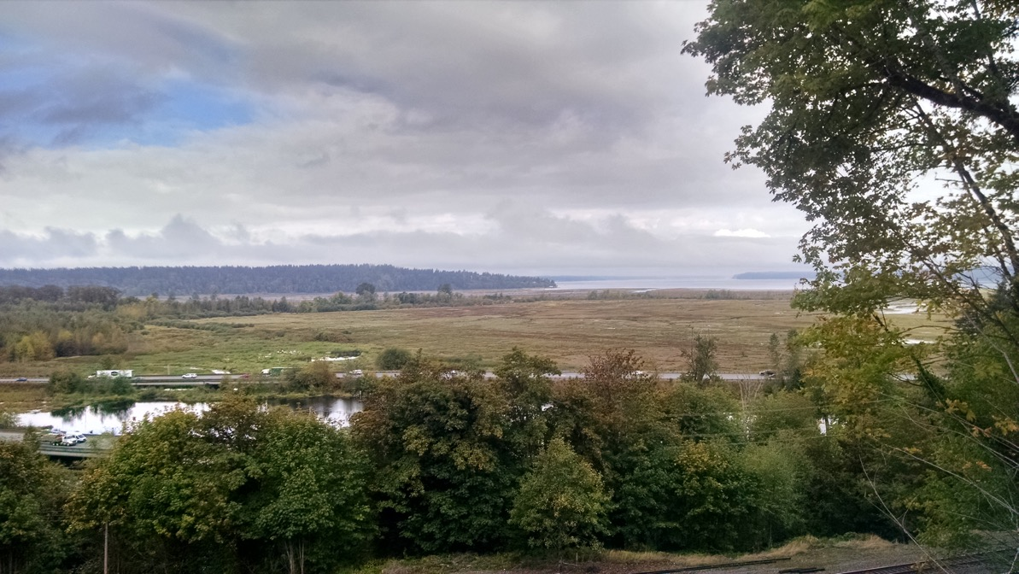

Slide 4
Nisqually watershed
Notes:
All watersheds are different

Slide 5
WRIA 11 Overview
WRIA 11 OVERVIEW
History of Collaboration
Nisqually River Council – 1987
2003 Nisqually Watershed Plan
Plan Addendum in Response to RCW90.94.020
Nisqually Tribe – Planning Unit Lead
RCW90.94.020 - 3000 gpd – maximum daily consumption per connection
Adopted by Ecology – February 1, 2019
Notes:
Although we started this planning process in July of 2018, and had 6 months to complete it, the stakeholders in the Nisqually had already developed trust and dealt with relationships and positions. We’ve been working together for 30 years.
1974 Boldt decision recognized Treaty Rights. Billy Frank. Commissioner Karen Fraiser and Bily Frank and others formed Nisqually River Council in 1987 – Oldest Water Council west of Missis
Developed amazing relationships and trust and the ability to work together on difficult issues. Issue of Water, Nexus between Growth management and water – very difficult issue, but the Nisqually was in a good position.
How did we do it – focus on legislation, micro and macro mitigation concepts

Slide 6
Planning Unit Members
PLANNING UNIT MEMBERS
IMPLEMENTING GOVERNMENTS
Nisqually Indian Tribe - LEAD
Thurston, Pierce and Lewis Counties
OTHER PARTICIPANTS
Cities of Lacey, Olympia, Yelm
Town of Eatonville
Thurston PUD
WDFW, WA Dept of Ag, Ecology
Nisqually River Council Citizens Advisory Committee

Slide 7
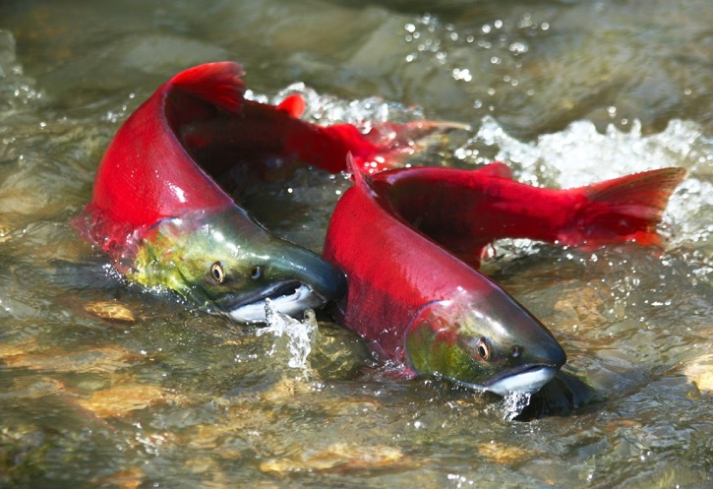
Interim Guidance for Determining Net Ecological Benefit Dept of Ecology June 2018
WRIA 11 – Basic Steps to Implementing RCW 90.94.020
“Characterize and quantify potential impacts to instream resources from the proposed 20-year new domestic permit-exempt water use at a scale that allows meaningful determinations of whether proposed offsets will be in-time and/or in the same sub-basin.”
“Suitably sized sub-basins”
If available, estimates of:
-Timing of impacts
-Proportion of flow impacted
“Anticipated benefits to instream resources from actions [projects and policies] designed to restore streamflow will offset and exceed projected impacts from new water use”
Notes:
Reminder – WRIA 11 used interim NEB guidance, 203 watersheds will use final NEB guidance

Slide 8
Basic Steps to Implementing RCW 90.94.020
Basic Steps to Implementing RCW 90.94.020
Define and Delineate Appropriately Sized Sub-basins
Estimate 20-Year Population Growth and New Dwelling Units
Calculate New Domestic Permit-Exempt Connections
Estimate Consumptive Use (3 methods)
Identify Projects and Actions to Offset 20 years of Consumptive Use
Quantify/Develop Projects and Actions as Offsets
Notes:
Each of these may comprises a Committee decision.

Slide 9
Basic Steps to Implementing RCW 90.94.020
Basic Steps to Implementing RCW 90.94.020
Define and Delineate Appropriately Sized Sub-basins
Estimate 20-Year Population Growth and New Dwelling Units
Calculate New Domestic Permit-Exempt Connections
Estimate Consumptive Use (3 methods)
Identify Projects and Actions to Offset 20 years of Consumptive Use
Quantify/Develop Projects and Actions as Offsets
Notes:
.LESSON LEARNED
Looking back – should have focused on #5 and #6 – very small quantity of water
To give you perspective: show LSR slide here

Slide 10
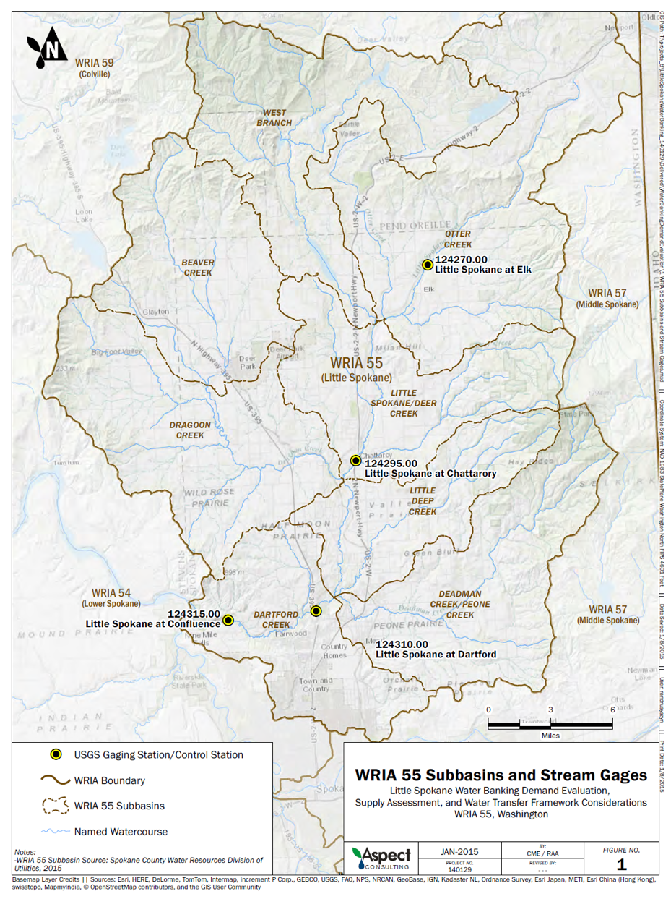
Impacts of permit-exempt use on streamflow – Little Spokane River Watershed
Modeled average reduction in flow (cfs) during July, August, September at Dartford Gage
Year | 2040 Permit Exempt Demand | 2040 Climate Change No Additional Demand
2005 | -0.26 | -14.5
2006 | -1.42 | -13.4
2007 | -0.44 | -14.4
2008 | -1.72 | -21.8
2009 | -2.35 | -24.6
2010 | -1.08 | -19.6
2011 | -1.01 | -30.7
2012 | -0.56 | -27.3
2013 | -0.58 | -29.4
Notes:
Perspective – don’t get caught up in the consumptive use estimates.

Slide 11
Basic Steps to Implementing RCW 90.94.020
Basic Steps to Implementing RCW 90.94.020
Define and Delineate Appropriately Sized Sub-basins
Estimate 20-Year Population Growth and New Dwelling Units
Calculate New Domestic Permit-Exempt Connections
Estimate Consumptive Use (3 methods)
Identify Projects and Actions to Offset 20 years of Consumptive Use
Quantify/Develop Projects and Actions as Offsets
Notes:
Each of these may comprises a Committee decision.

Slide 12
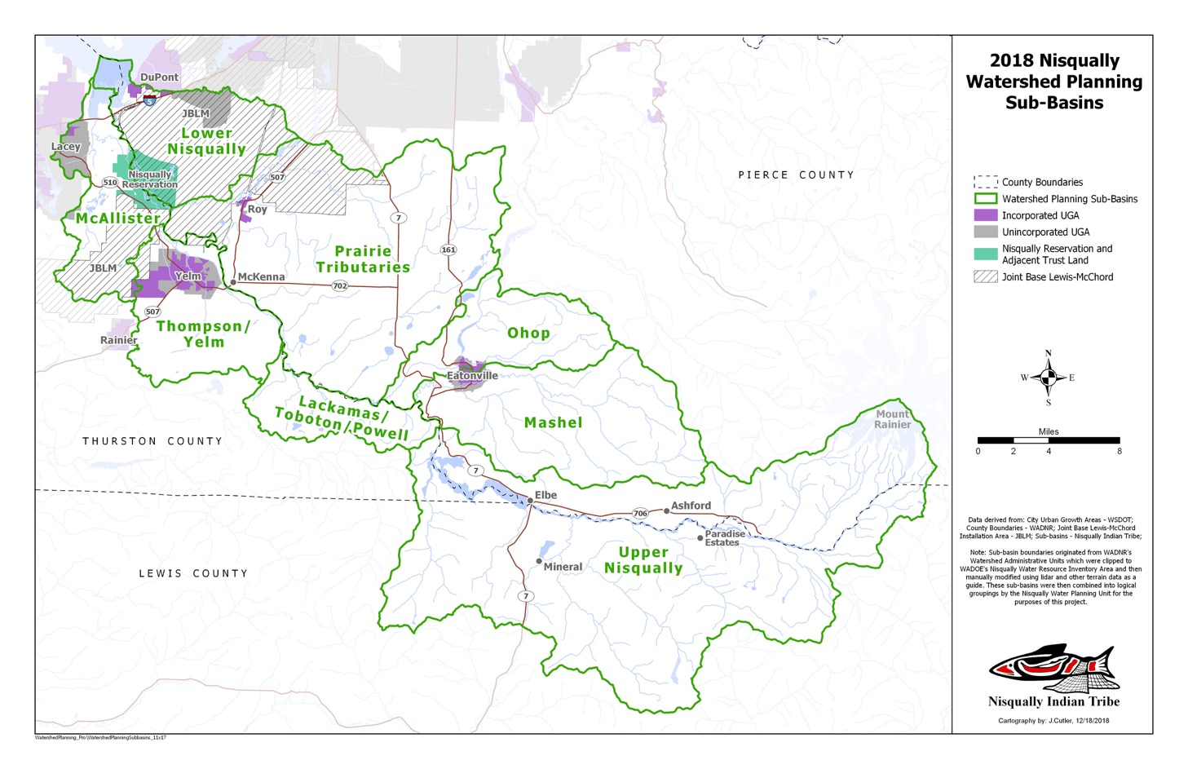
Step 1 Define appropriate sub-basins
WRIA 11: Sub-basin Delineation
8 Basins
Notes:
3 counties, 8 sub-basins
Sub-basins based on previous Watershed Plan, changes made to sync up with Salmon Recovery efforts and initiatives. Consider County boundaries, hydrogeologic characteristics, growth patterns, land use and salmon recovery considerations. Not too big, but not too small. Should be large enough to have space or options for potential projects. Consider whether you want to have viable projects in most sub-basins.

Slide 13
Subbasins
Notes:
2 differing hydrogeologic/development regimes in the watershed – Prairies (alternating sand and gravel and till with considerable hydraulic continuity between tributaries and the near-surface aquifer where rural wells are known to be completed) (in yellow outline) and the upper part of the watershed - Mt Rainier, bedrock dominated, snowmelt driven system(so far), , primarily timberland with very little development.

Slide 14
Committee Process Consideration
Committee Process Consideration
✓ Approve Proposed Sub-basins
Estimate 20-Year Population Growth and New Dwelling Units
Calculate New Domestic Permit-Exempt Connections
Estimate Consumptive Use (3 methods)
Identify Projects and Actions to Offset 20 years of Consumptive Use
Quantify/Develop Projects and Actions as Offsets

Slide 15
Step 2 22 Year Population Growth and New Dwelling Units (2018-2040)
WRIA 11: Estimate Growth
3 Counties, 3 methods
Thurston – TRPC growth projections
Pierce – Historical percentages of permit-exempt well growth by sub-basin
Lewis – growth projections
22 Year Projection (through 2040)
Not a PU decision point in WRIA 11
Notes:
Layout that each County did their own growth projections – 3 different methods for three different counties. County’s GMA responsibility.
Thurston

Slide 16
Committee Process Consideration
Committee Process Consideration
✓ Approve Proposed Sub-basins
Estimate 20-Year Population Growth and New Dwelling Units (Optional for Committee)
A. Counties provide using their chosen growth forecasting methods (Nisqually: 2018-2040)
OR
B. Committee Oversight of methodology and assumptions inherent in the method
Notes:
Counties – GMA responsibility
Option B – Need to factor this into Technical workplans

Slide 17
Committee Process Consideration
Committee Process Consideration
✓ Approve Proposed Sub-basins
✓ Estimate 20-Year Population Growth and New Dwelling Units (Optional)
Calculate New Domestic Permit-Exempt Connections
Estimate Consumptive Use (3 methods)
Identify Projects and Actions to Offset 20 years of Consumptive Use
Quantify/Develop Projects and Actions as Offsets

Slide 18
Step 3 Calculate New Domestic Permit-Exempt Well Connections
WRIA 11: New Connections
By County, by sub-basin
Cities, Towns to weigh in on PE well policies within their jurisdictions and UGAs
PUDs – provide information on available connections
Dept of Health Sentry database, other options to ID available connections in existing Group A and B systems
Notes:
Doesn’t need to be an explicit decision point by committee - More of a collaborative effort to pool information (Cities, Towns, PUDs, Counties, Health Depts).
Committee may choose to weigh in on assumptions for hookup to other water systems – not really necessary. May want to discuss current city or town policies for allowing PE wells within city limits or UGA areas, special considerations (eg., Bainbridge Island), Water Right concerns for Large Group A Systems.
Important for the committee to understand what was done. This may be of more importance when you are evaluating projects and ACTIONS. An action might be a policy or regulatory change in requirements of a Water System for hookup.

Slide 19
Step 3 Calculate new domestic permit-exempt connections, 2018-2040
Total Estimated New Permit-Exempt Connections Aggregated by Sub-basin
Sub-basin | UGA Connections | Rural Connections | Total Connections
McAllister | 39 | 116 | 155
Thompson/Yelm | 1,036 | 526 | 1,562
Lackamas/Toboton/Powell | - | 430 | 430
Lower Nisqually |  | 2 | 2
Mashel River |  | 20 | 20
Prairie Tributaries |  | 596 | 596
Ohop Creek |  | 27 | 27
Upper Nisqually (Lewis, Pierce, Thurston) |  | 195 | 195
Total | 1,075 | 1,912 | 2,987
Notes:
A lot of assumptions with respect to available connections (existing Group A and B systems), PE’s within urban areas, etc.

Slide 20
Committee Process Consideration
Committee Process Consideration
✓ Approve Proposed Sub-basins
✓ Estimate 20-Year Population Growth and New Dwelling Units(Optional)
✓ Calculate New Domestic Permit-Exempt Connections (Optional Decision Point)
Estimate Consumptive Use (3 methods)
Identify Projects and Actions to Offset 20 years of Consumptive Use
Quantify/Develop Projects and Actions as Offsets

Slide 21
Step 4 Estimate Consumptive Use
Estimate Consumptive Water Use by PE Connections
 | Annual Average Consumptive Use per connection (gpd) Total Outdoor
Actual Water Use – Thurston PUD Method | 95 gpd | 80 gpd outdoor
Ecology Method | 223 gpd | 208 gpd outdoor
Legal Method | 1,644 gpd | 1,536 gpd outdoor
Ecology guidance:
10% indoor use is consumptive
80% outdoor use is consumptive
Notes:
3 METHODs – provide context. First decision – what method??
Indoor total for Thurston and Ecology is 150 gpd, of which 15 gpd (10%) is consumptive.
Indoor Legal1080 of which 108gpd (10%) is consumptive
Outdoor total Thurston – (doubled) 100, of which 80 gpd is consumptive
Outdoor total Ecology – 261 gpd total, of which 208 is consumptive
Outdoor legal -1920 of which 1536 is consumptive

Slide 22
Possible Committee Process Considerations
Possible Committee Process Considerations
Estimate Consumptive Use
Methodology (Actual, Ecology, Legal, other)
Average Annual Basis or other (consider how you will compare to streamflow)
Indoor per person water use (Ecology Guidance - 60 per person per day)
Outdoor irrigable land (assume 1/2 acre or determine specific average area with GIS analysis)
Crop type and irrigation requirements
Irrigation efficiency percentage
Assumed consumptive portion of total use (Ecology Guidance -10% indoor, 80% outdoor)

Slide 23
Estimate New Domestic Permit-exempt Well Connections and Associated Consumptive Use 2018 – 2040 ECOLOGY METHOD
WRIA 11 – Consumptive Use Results
Sub-Basin | Total PE Connections | Annual Consumptive Use (AFY) | Cubic feet/second | cfs per connection
McAllister | 155 | 39 | 0.054
Thompson/Yelm | 1,562 | 390 | 0.539
Lackamas/Toboton/ Powell | 430 | 107 | 0.148
Lower Nisqually River | 2 | 0 | 0.001
Mashel River | 20 | 5 | 0.007
Prairie Tributaries | 596 | 149 | 0.206
Ohop Creek | 27 | 7 | 0.009
Upper Nisqually (all counties) | 195 | 49 | 0.067
Total | 2,987 | 747 | 1.032 | 0.0003453

Slide 24
Step 4 3 METHODS to Calculate Consumptive Water Use
WRIA 11 – Micro and Macro Approach to Offsets Based on Consumptive Use Methodology
 | Nisqually Watershed: Projected Annual Average Consumptive Use
 | (AFY) | (CFS)
Actual Water Use – Thurston PUD | 318 | 0.439
Ecology Method | 747 | 1.032
Legal Method | 5,501 | 7.598
Micro
Macro
Notes:
Micro – 1.03 cfs. Viewed this as specific offsets in each sub-basin
Macro – 7.6 cfs. Viewed this as a watershed-wide goal that would achieved in priority sub-basins for salmon recovery

Slide 25
USGS – McKenna Gage on Nisqually River August Mean Discharge, 2000- 2010
469 cfs
Watershed Offset Requirement
1.03 cfs

Slide 26
Committee Process Consideration
Committee Process Consideration
✓ Approve Proposed Sub-basins
✓ Estimate 20-Year Population Growth and New Dwelling Units(Optional)
✓ Calculate New Domestic Permit-Exempt Connections (Optional)
✓ Consumptive Use (3 methods)
Identify Projects and Actions to Offset 20 years of Consumptive Use
Quantify/Develop Projects and Actions as Offsets
Notes:
Projects and Actions – different for every WRIA
Reference May 30th Webinar that provides an overview of project types
Technical staff will provide more detailed discussion and ideas of local projects
NEB Guidance recommends tiering or prioritizing projects

Slide 27
Step 5 Identify Offset Projects and Actions Micro Mitigation (Offsets)
WRIA 11 – Micro and Macro Approach to Offsets
City of Yelm – Water Right Offset (future + current)
Water System Improvements (Group A and B)
Water Right Acquisition
Reclaimed Water Infiltration
Local Stream Restoration – Lower Sub-basins
Managed Aquifer Recharge (MAR)
Update County permitting processes - policies for Implementation – bank, credit system
Projects had varying levels of development: some conceptual, some quantitative
Notes:
Nisqually Approach – Micro = sub-basin specific offset
Committee members bring projects to the table. Committee “decision” is vetting projects and eventually prioritizing them for further development.
No Technical Support team – as offered to the WREC. Key decision of Committee will be which projects move forward with initial feasibility study.

Slide 28
Step 5 Watershed Scale Offsets Macro Mitigation (Offsets)
WRIA 11 – Micro and Macro Approach to Offsets
Address Major Barriers to Salmon Recovery
Community Managed Forests (VELMA Model)
Large Scale Floodplain and Riparian Restoration & Protection Projects (Ohop Creek)
Mashel River Baseflow Strategies – Eatonville Infrastructure Improvements
Projects had varying levels of development: some conceptual, some quantitative
Notes:
Change the way we manage forests. Manage forests to result in more mature forest stands. VELMA model has been used in the Nisqually to show this has water quantity benefits. Market currently works with 40 year rotation. Ecosystem based rotations are 60-80 years.
Ohop Creek – piezometer data since 2009 shows there are streamflow benefits from large scale floodplain and riparian restoration projects
Macro Mitigation (or NEB) focused on the Mashel River – high priority for salmon recovery. 95% of the flow benefits, but very little expected growth.

Slide 29
Coordinating with Ongoing Recovery Priorities
Coordinating with Ongoing Recovery Priorities
It is very important to coordinate Salmon Recovery efforts and Water Resource/ISF efforts!
Start the Conversation Early!
Notes:
Lesson Learned - Start the conversation early in the process – we found that the salmon recovery folks and the water resource engineers speak VERY DIFFERENT LANGUAGES
Example in Nisqually – Salmon Recovery – strategic initiatives – don’t look simply at streamflow. PU requested a list of their priority projects ranked by greatest benefit for instream flow. Salmon Recovery Projects aren’t scoped at a level of detail required for this effort until they are funded.
*** Understand your planners are already coordinating with Lead Entities. Ask chair to speak about how they are coordinating with LEs.

Slide 30
Salmon Recovery Habitat Initiatives as Offsets
Salmon Recovery Initiative | Priority | Sub-Basin | Key Actions
Mashel Watershed Recovery/ Community Forest | 1 | Mashel | Acquire commercial forestland to place in conservation management for streamflow enhancement
Ohop Watershed Recovery/ Community Forest | 7 | Ohop | Acquire commercial forestland to place in conservation management for streamflow enhancement
Bald Hills Watershed Recovery/ Community Forest | 8 | Lack/Tob/Powell | Acquire commercial forestland to place in conservation management for streamflow enhancement
Mashel Base Flow | 2 | Mashel | Implement Town of Eatonville stormwater and infrastructure improvements
Ohop Valley Floodplain Restoration | 3 | Ohop | Restore 3.1 miles of channelized stream and 710 acres of riparian and floodplain habitat
Mashel River Riparian Corridor Protection and Restoration | 4 | Mashel | Protect riparian corridor and restore habitat complexity through log jams and riparian plantings
Muck Creek Recovery* | 5 | Prairie Tributaries | Restore up to 60 miles of impaired streams and surrounding floodplain/wetland habitat; maintain hydrologic function of prairie ecosystem through prescribed burns
Prairie Tributaries Recovery* | 6 | Prairie Tributaries, Thom/Yelm, Lack/Tob/Powell | Restore up to 20 miles of impaired streams and surrounding floodplain/wetland habitat; maintain hydrologic function of prairie ecosystem through prescribed burns
Barrier Removal* | 9 | Multiple | Remove fish passage barriers
Notes:
Salmon recovery projects that are part of a strategic initiative typically wait until project funding is available before the project is fully developed and designed. Therefore, the requirements for specific project evaluation were not met.

Slide 31
Ohop Creek Restoration

Slide 32
Consumptive Use (Ecology Method) Compared to Minimum and Maximum Estimated Offsets (See Table 7-2)
Sub-basin | ECY Method Annual PE Consumptive Use (cfs) | Offset Actions (cfs) MIN | Offset Actions (cfs) MAX
McAllister | 0.054 | TBD | TBD
Thompson/Yelm | 0.539 | 0.479 | 1.050
Lackamas/Toboton/Powell | 0.148 | 0.116 | 0.697
Lower Nisqually | 0.001 | 0 | 0.552
Mashel River | 0.007 | 3.48 | 7.27
Prairie Tributaries | 0.206 | 0.058 | 2.058
Ohop Creek | 0.009 | 0.017 | 2.105
Upper Nisqually (Pierce, Lewis, Thurston) | 0.067 | 0.067 | 0.619
TOTAL | 1.03 | 4.22 | 14.35

Slide 33
Step 5: Projects and Actions
Step 5: Projects and Actions
Don’t forget the Actions
Track Potential Actions throughout the process
Consider PE well connection policies (cities, towns, PUDs)
Consider PE well replacement opportunities
Tracking system
Track PE wells development vs. Offsets
Track credits (eg., well abandonment, other)
Ensure that offsets keeps up with well development

Slide 34
Net Ecological Benefit (NEB)
Net Ecological Benefit (NEB)
Nisqually Plan Addendum did not provide full analysis of all projects or their probability of occurring per interim NEB guidance
Nisqually Planning Unit Core Strategy
Micro-offset projects provide sub-basin specific offsets
In coordination with the Nisqually Salmon Recovery Strategy, macro-offset projects recommended will, in combination with ‘micro projects’ and actions, provide NEB
Notes:
Interim NEB guiance

Slide 35
Net Ecological Benefit (NEB)
Net Ecological Benefit (NEB)
“This addendum to the Nisqually Watershed Plan identifies specific mitigation strategies and policy recommendations designed to offset the impacts that new PE wells may have on streamflows or other senior water rights. It also, in coordination with the Nisqually Salmon Recovery Strategy, makes recommendations for habitat projects that will, in combination with mitigation strategies, provide NEB for streamflows in the Nisqually Watershed” (Nisqually PU, 2019).
“While the WRIA 11 watershed plan Addendum does not adhere to Ecology’s guidance documents…. Taken as a whole, the results indicate that relative to the detriments created by future permit-exempt domestic wells anticipated in WRIA 11 over the next 20 years, the offset strategies proposed would result in a NEB for the watershed.”
- Ecology Technical Review, January 29, 2019
Notes:
In Ecology’s Technical Review of the Nisqually Hirst Response, they cite this WRIA 11 PU statement and a Dec 3, 2018 conversation with Ecology that provided some deference regarding the thoroughness of projects in the Plan Addendum, and suggested it would be acceptable that mitigation strategy elements require additional development after plan adoption..

Slide 36
Ecology Review
WRIA 11 – Ecology Determination of NEB
“The Plan Addendum provides varying levels of details and analyses (for the 22 strategies presented) . . . In light of the conceptual nature of much of the plan’s description of strategies, Ecology’s technical review segregated the strategies into 3 tiers.”
Adoption with Conditions
Annual Reporting
Five Year Self Assessment
Ongoing Compliance with RCW 90.94.020 (recording and reporting requirements)
Ecology Technical Review, January 29, 2019
Notes:
Annual reporting:
Implementation actions to date
Changes in approach
Implementation challenges resulting in a change to the approach
Specific Information regarding Tier 1 Actions.
Yelm Offset Action 1 – YELM WR and connecting new development in UGA to city water
Water Right Acquisition
Yelm Offset Action 2 (connect exiting PE wells in service area to city water)
MAR
Ohop Phase IV Floodplain Restoration and Protection

Slide 37
Committee Process Consideration
Committee Process Consideration
✓ Approve Proposed Sub-basins
✓ Estimate 20-Year Population Growth and New Dwelling Units(Optional)
✓ Calculate New Domestic Permit-Exempt Connections (Optional)
✓ Estimate Consumptive Use (method and assumptions)
✓ Identify Projects and Actions to Offset 20 years of Consumptive Use
Quantify/Develop Projects and Actions as Offsets
Notes:
We were running out of time – these were not well developed, and we did not have a technical team to assist. Each County, Tribe’s salmon recovery people, some cities identified projects in which they had interest. Many were multiple benefit projects and the Nisqually PU feels strongly that multiple benefit projects provide the greatest NEB
Still needed quantification/development to be Grant Ready

Slide 38
Step 6 Quantify/Develop Projects & Actions as Offsets Next Steps
WRIA 11 – Basic Steps to Implementing RCW 90.94.020
Planning Unit is doing this now through December, moving toward implementation
Re-evaluating priorities from Tiers determined by Ecology in their NEB evaluation
Considering implementation barriers, multiple benefits, concerns regarding MAR effectiveness, and unintended consequences of water purchase on Ag.
Find Funding: Good Plan, Needs Action/investment
Accounting System??: How do we ensure offsets keep pace with growth? 3 Counties, one watershed, multiple implementers.
Notes:
This WRE Committee will have the time to evaluate projects prior to adoption. A major decision point for the committee will be in prioritizing projects for further evaluation by the Technical Team.

Slide 39
Lessons Learned
Lessons Learned
Focus time and effort on developing robust offset actions providing multiple benefits – Offset Projects
20 years of domestic PE Consumptive Use is a relatively small impact to streamflow – conservatively estimate and move on to the important part
Work collaboratively with local salmon groups – overcome the language barrier between Water Resource and Salmon Recovery Scientists
QUANTIFY your offsets
Aim for multiple benefits, multiple goals, and consider reaching big
TRUST and PARTNERSHIPS and HISTORY of collaboration MATTER

Slide 40
Thank You!
Lisa Dally Wilson, PE
lisa@dallyenvironmental.com
www.dallyenvironmental.com
(206) 915-9551

