Slide 1
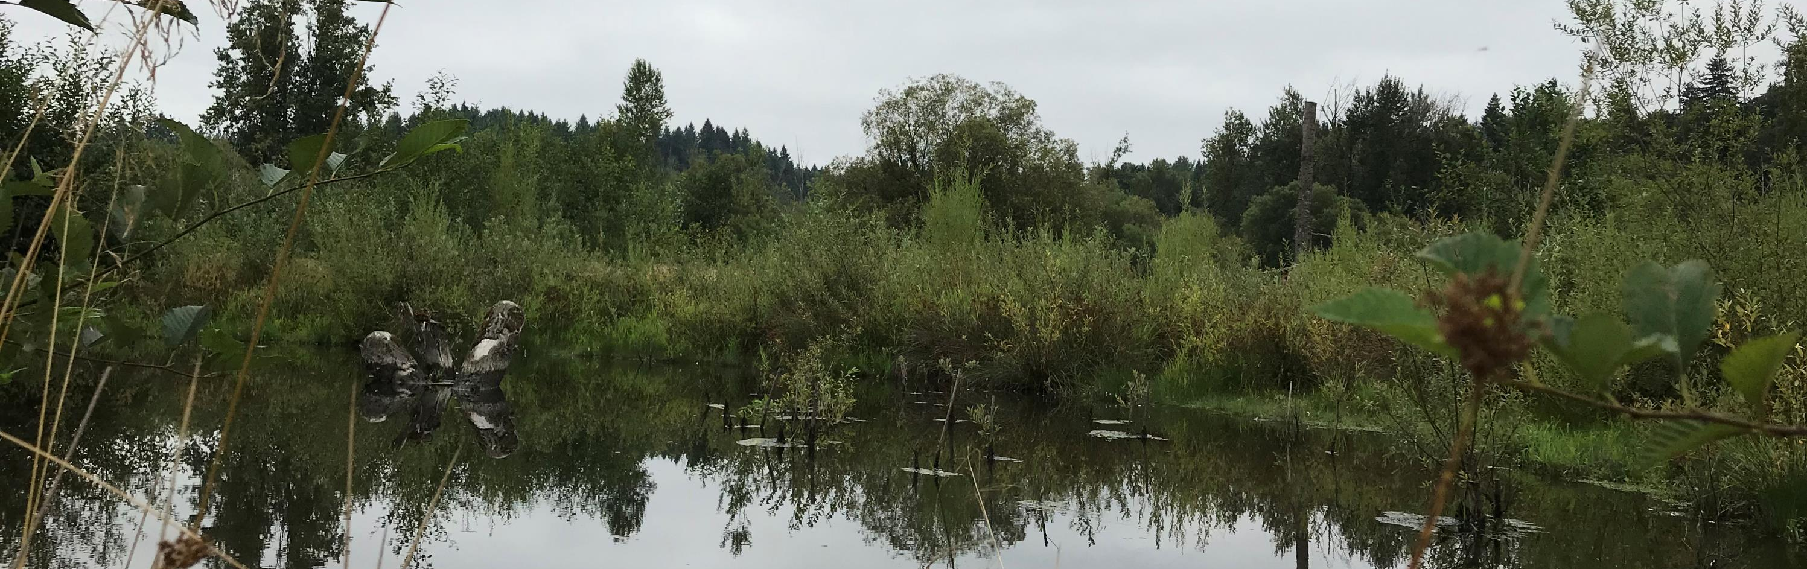
Final Guidance for Determining Net Ecological Benefit
Puyallup-White (WRIA 10) Watershed Restoration and Enhancement Committee
September 24, 2019
Notes:
This presentation will review the key components of the final NEB guidance, which was released on July 31st. I will also provide a very brief overview of the components we anticipate including in the plan and will bring forward a more detailed plan outline for your input in the next couple of months.
The final policy interpretations document was also released on July 31st – I will not discuss that document in detail but am happy to take questions.
Please save your questions/comments for the end.

Slide 2

What is the Net Ecological Benefit guidance and why does it matter?
Ecology’s interpretation of the term “Net Ecological Benefit” used in RCW 90.94.
The standards Ecology will apply when reviewing watershed plans submitted to Ecology under RCW 90.94.020 and RCW 90.94.030.
Notes:
The Streamflow Restoration law requires Ecology to determine whether a Net Ecological Benefit will result from the implementation of watershed restoration and enhancement plans before Ecology can adopt them.
We published this Net Ecological Benefit guidance to provide Ecology’s interpretation of the term and notify committees of the standards Ecology will apply when reviewing watershed restoration and enhancement plans submitted to Ecology.
Ecology’s definition from the final NEB Guidance is “The outcome that is anticipated to occur through implementation of projects and actions in a plan to yield offsets that exceed impacts within: a) the planning horizon; and, b) the relevant WRIA boundary.”
Ecology believes that clarity and consistency are important parts of implementing the streamflow restoration law. This document provide transparency for how Ecology interprets Net Ecological Benefit. It is intended to help those participating in the streamflow restoration planning processes
The final guidance replaces the Interim guidance as well as the Recommendations for Water Use Estimates.

Slide 3
How did Ecology develop the NEB guidance?
Workshops
June 2018
Interim Guidance for Determining Net Ecological Benefit
Fall 2018
Public Meetings and comment period
Spring 2018
Public Comment Period
July 2019
Final Guidance for Determining Net Ecological Benefit
Draft Final Guidance
Spring 2018
Notes:
There were several opportunities for partners and the public to provide comments on the development of these documents.
In the spring of 2018, we held workshop with key partners to inform the development of interim guidance
We issued Interim Guidance for Determining NEB for the planning groups with early deadlines for completing their plans. We wanted to take additional time to consider the subject and solicit public feedback before issuing the Final Guidance.
We received feedback during public comment periods and statewide workshops.
We appreciate the feedback that we received and have considered all input as we finalized the NEB guidance.

Slide 4
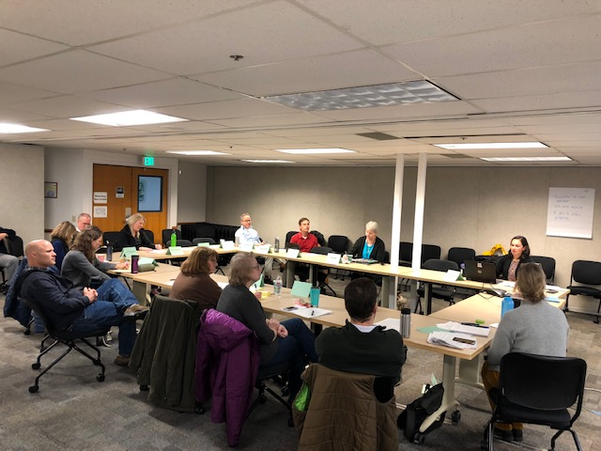
Who should use it?
Notes:
Applies to watershed restoration and enhancement plans (including our plan), the watershed plan updates submitted after December 2019, and the Foster Pilot Projects.
This document does not apply to any of Ecology’s decisions relating to competitive grants applications or any regulatory matter.

Slide 5
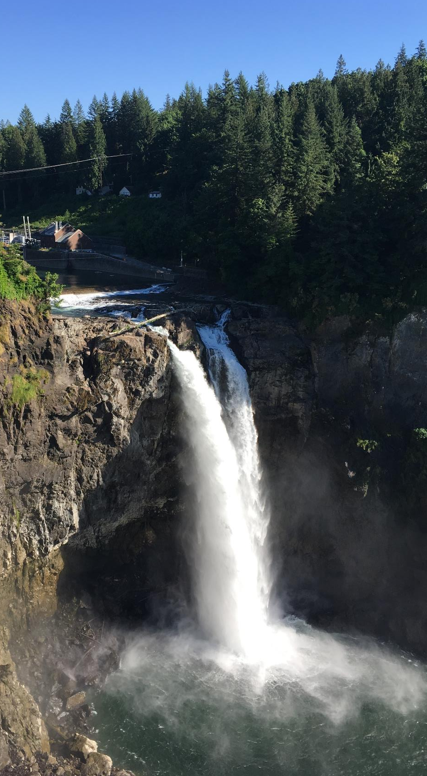
NEB for Watershed Planning
From the final NEB guidance:
“…local planning groups are best situated, and will therefore determine the appropriate amount of benefits beyond the offsetting of projected impacts …”
Notes:
Ecology gives considerable deference to the planning groups to decide what NEB means for our watershed. This committee knows this watershed best; Ecology is depending on our local expertise to put together a plan that meets the requirements of the law and enhances our watershed.
The guidance sets the minimum threshold: do more than offset the consumptive use from new permit-exempt domestic groundwater withdrawals over the planning horizon.
Planning groups can decide to do more; however, we need to balance the desire in doing more with the ability to meet all of the needs and interests around this table and the ability to meet our deadline of having an adopted plan by June 2021.

Slide 6
How do we use the final NEB guidance?
Notes:
The NEB guidance is our roadmap for developing the plan. It explains the scope of the planning process, information on the minimum requirements of the plan, and helps our committee prepare a NEB evaluation
The Appendices provide recommendations on how to estimate consumptive use and evaluate hydrologic impacts. There is an additional technical supplement prepared by WSU for our consideration, which I didn’t include in the version I printed for you.

Slide 7
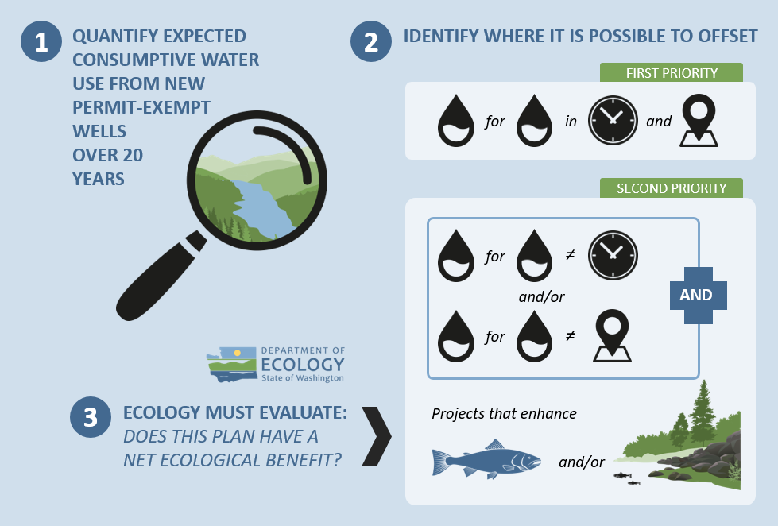
Required Plan Elements –
Legislation
Notes:
The plan must address Indoor and outdoor household water use from new permit-exempt domestic groundwater withdrawals over the 20 year horizon: January 19, 2018 – January 18, 2038
The plan must include projects and actions to offset new consumptive water use and the offsets must continue as long as well pumping continues.
NEB is evaluated at the WRIA scale
The plan must include an evaluation or estimation of the costs of offsetting the new PE domestic consumptive use.

Slide 8
Required Plan Elements –
NEB Guidance
Document assumptions and methods
Delineate subbasins
Estimate new consumptive water use
Evaluate impacts from new consumptive water use
Describe and evaluate offsets from projects and actions
Notes:
Planning groups must include the following information in the plans:
­Document assumptions and explain our methods for reaching our conclusions
­Discuss coordination with existing planning efforts like salmon recovery planning and ecosystem recovery planning
­Delineate subbasins to explain the relationship between consumptive use and offset projects, and whether the offsets are “in place”
­Estimate consumptive water use by subbasin. Recommended methods are in Appendix A.
­Evaluate impacts. We do not have time or resources for the detailed hydrogeologic modeling needed to identify consumptive use impacts to streamflow, so the guidance allows us to use consumptive use as a proxy for impact. We can assume the impacts from new permit-exempt domestic withdrawals over the planning horizon will be steady-state.
Appendix B provides more detail on evaluating impacts and offset projects and concludes domestic well pumping is likely to be small, dispersed, and nearly steady-state with impact on streams.
Ecology encourages planning groups to focus their efforts on identifying water offset and habitat projects that are most beneficial for fish.
[note if pressed: if Committees want to conduct a more detailed analysis in certain locations, ECY will consider resources available. E.g. existing contract, data needs funding.]
[note if pressed : The Streamflow Restoration Policy and Interpretive Statement (POL-2094), states: “Though the statute requires the offset of “consumptive impacts to instream flows associated with permit-exempt domestic water use” (RCW 90.94.020(4)(b)) and 90.94.030(3)(b)), watershed plans should address the consumptive use of new permit-exempt domestic withdrawals. Ecology recommends consumptive use as a surrogate for consumptive impact to eliminate the need for detailed hydrogeologic modeling, which is costly and unlikely feasible to complete within the limited planning timeframes provided in chapter 90.94 RCW.”]

Slide 9
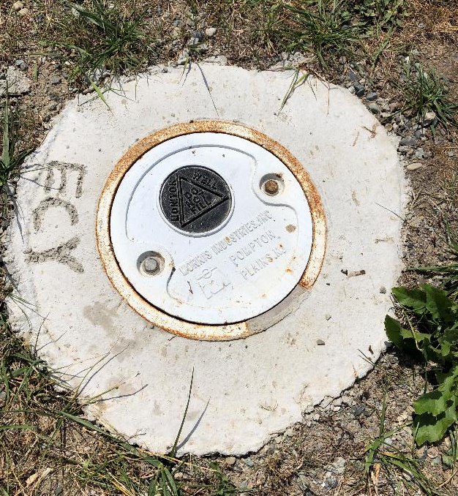
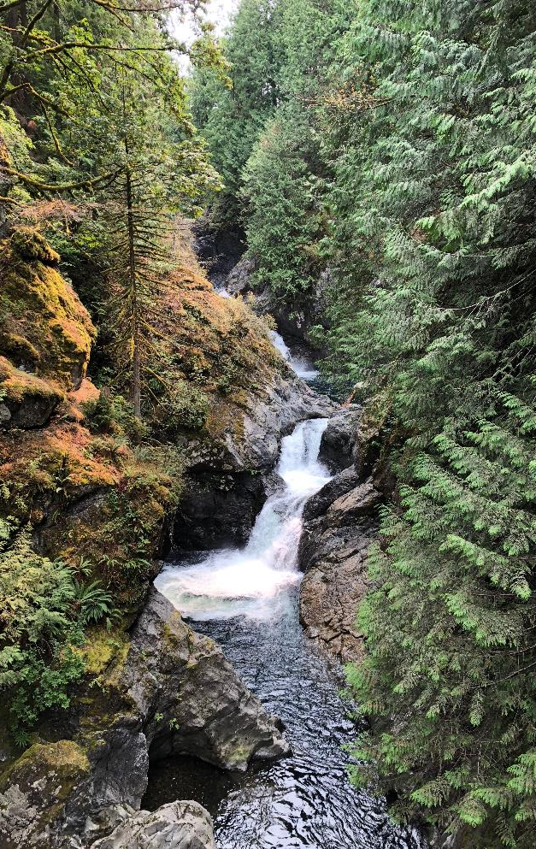
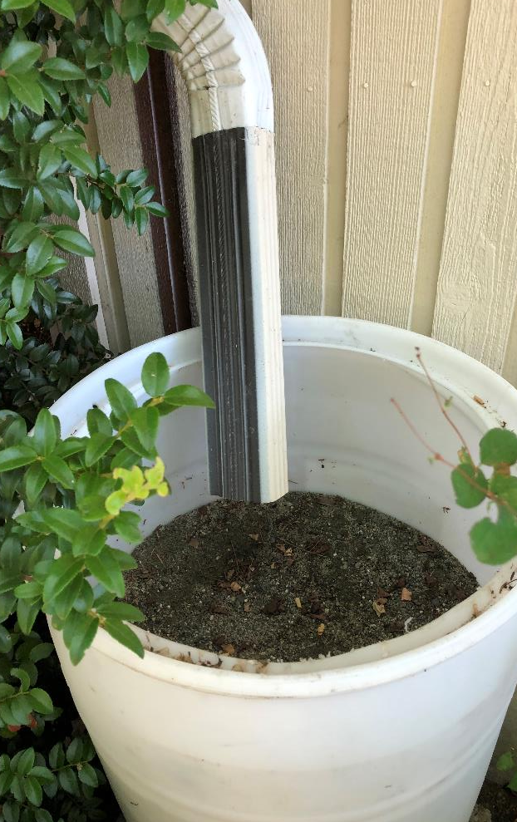
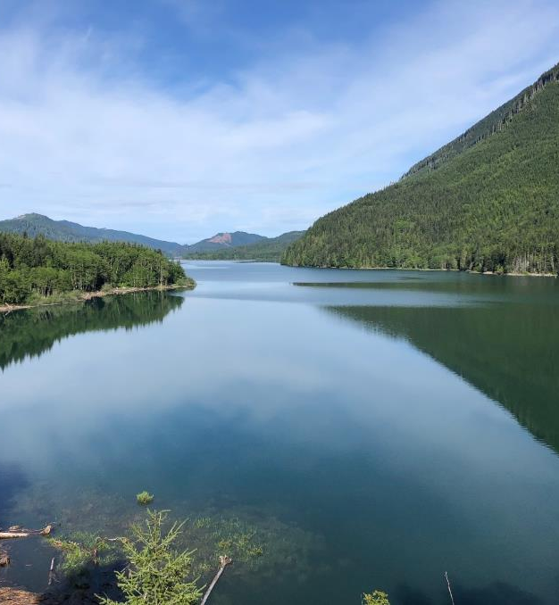
Evaluate Offsets
Project and action description
Offset estimates
Benefit summary
NEB evaluation
Adaptive management
Notes:
The NEB requires or suggests to include a number elements to describe each project, its streamflow benefits and/or instream resource enhancements, and its likelihood of being implemented.
­Project and Action description: the plan should include a narrative description, quantitative or qualitative assessment of impacts, likely benefits, performance measures, etc.
Plans should describe how the project will offset new consumptive use, if applicable, as well as how it will improve “instream resources” such as fish.
Offset estimates: Projects that contribute toward the offset should quantify the amount of water going back to the stream.
There is no requirement that offsets are in the same time and place as impacts. Plans need to meet NEB at the WRIA scale. Committees can decide where to direct offset projects based on the needs of the watershed.
Plans must offset consumptive water use from new permit-exempt domestic groundwater withdrawals in the planning horizon of 2019-2038
The NEB guidance talks about 3 ways to for committees to consider organizing project lists. None of these are required nor even recommended, but are put forward in case it helps the committee in thinking about how to organize the list.
Benefit summary and NEB evaluation: the plan must include a well-organized and transparent evaluation of the benefits from projects and actions to demonstrate that we’ve met our offset and achieved NEB. Plans must also include an assessment of the likelihood the project and action benefits will occur, including local support and barriers to implementation. The committee can choose to complete their own NEB evaluation (and our consultants have budget to do so) which can help put forward our own justification on why we – the local watershed experts - believe we meet NEB to the Ecology reviewers as they work on the NEB determination. The NEB guidance provide detailed steps on how to complete the NEB evaluation [note hidden slide if pressed on this topic]
Adaptive management (not required): an adaptive management component provides greater assurance that the plan will be implemented, however Ecology cannot obligate the planning group to keep meeting. We will discuss this more in the coming months.
Note if pressed: “offsets” for our plans are fundamentally different than “mitigation” for water right permits (or other regulatory purposes) where “mitigation” is typically required to be in-time and in-place.
[note on the below – use if pressed for more information on the different ways to organize the list or share if you think interest by the committee]
Priority. The law talks about high priority and lower priority offsets, with high priority being in-time and in-place. The law does not require committees to use these labels or include high priority projects (i.e. We are not required to include projects that are in the same subbasin as our projected impacts). Plan development should be focused on developing projects that provide the most benefits to fish regardless of how they align with priority labels.
Sequencing: The NEB guidance recommends planning groups “sequence” projects in order of most to least benefit, to inform the streamflow restoration grant funding scoring ONLY.
Tiering: planning groups can organize projects into tiers based on likelihood of implementation or certainty of benefits. This could be useful if the Committee finds a lot more projects than what we think is needed to achieve NEB. Allows us to focus the more detailed project descriptions and analysis on those projects needed for NEB. We have limited consultant capacity for this type of detailed analysis.

Slide 10
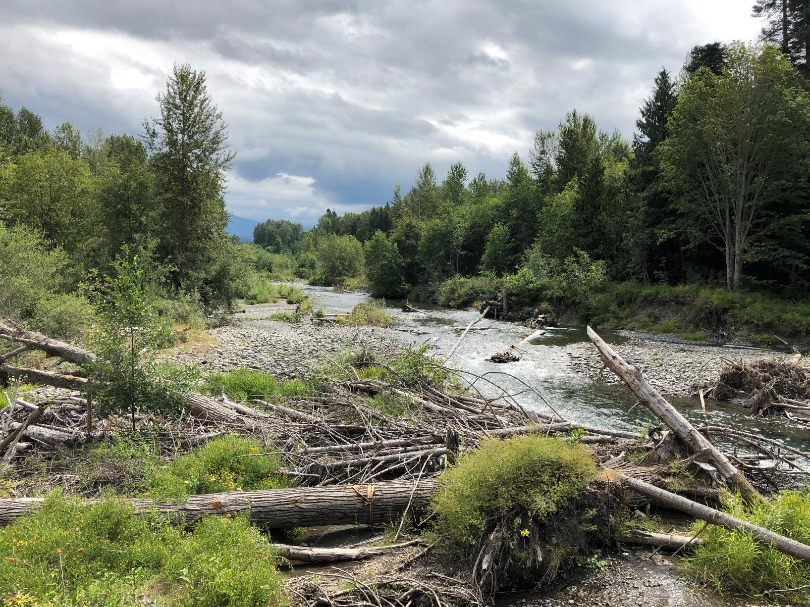
Examples of Projects & Actions
Water rights acquisition offset projects
Non-acquisition water offset projects
Habitat and other related projects
Regulatory actions
Notes:
There are many different types of projects and actions that could address the new consumptive water use and achievement of a net ecological benefit. The examples provided in the NEB guidance are some suggestions. The Committee can come up with new ideas for projects and actions that don’t fit into these categories. Some of the projects in our plan will likely be eligible to apply for streamflow restoration grant funding.
Notes if pressed about certain project types:
­Acquisitions are where Ecology acquires water rights and holds the rights in the Trust Water Rights Program. These trust water rights are managed by Ecology for the benefit of instream and out-of-stream uses. Water rights that Ecology acquires at the recommendation of the Committees must be permanently and legally held by Ecology in the Trust Water Rights program.
Non-acquisition water offset projects typically focus on retiming high flow season surface waters
Offset benefits for some of these projects will be straightforward to analyze but for others may be more difficult.
Examples are: Managed Aquifer Recharge, off-channel storage, source switches for water rights from surface water to groundwater, and streamflow augmentation.
Habitat projects may increase streamflow, but by design they prioritize habitat benefits.
Examples of habitat projects include floodplain restoration, instream habitat restoration, beaver reintroduction, land conservation, forest management, and fish barrier removal
It may be difficult to quantify offset benefits for these projects. If our Committee finds the needed offsets from other projects then we don’t need to provide a quantitative estimate of offset benefits from these types of projects.
If we do use these types of projects to contribute to our needed offsets, Ecology will apply a conservative approach in assessing the estimated water offset quantity relying on the substantial technical analysis provided by planning group.
Plans can also include recommended actions, such as change to state regulations or local ordinances
Ecology will consider “actions” that go into effect after the legislation was passed (January 19, 2018) and that were adopted for the purpose of streamflow restoration
The legislation specifically called out changes to the fee and water usage limits for new homes that rely on wells
Ecology and WDFW staff provided an overview of these project types during the May webinar. The [WRIA XX] Committees will spend time in the coming months talking in more detail about projects types appropriate for the [watershed name] watershed.

Slide 11
What is the Committee’s role?
Committee
Evaluates NEB
Approves Plan
Ecology
Determines NEB
Adopts Plan
Notes:
The committee includes an NEB evaluation in the plan, and then we vote to approve the plan. Assuming the plan is approved, then Ecology will determine NEB and adopt the plan.

Slide 12
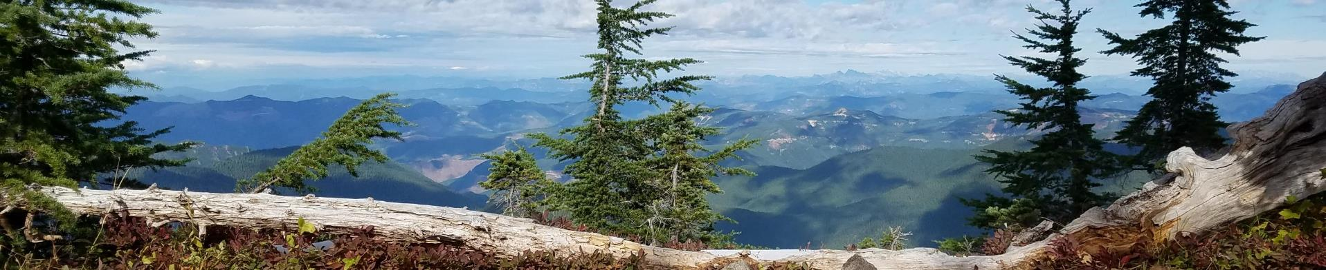
What will the plans look like?
Notes:
For the 203 Committees, Ecology will work with the Committee to write the WRE plan. Ecology will lead the process for writing the plans. We anticipate the plans will be brief (~30 pages) with several detailed technical appendices developed by our technical support consultants that will be summarized to include in the main body of the plan.
Ecology is building from the NEB guidance and the statute to develop a detailed template outline which will be a launching point for committees to provide input on the content, structure and flow of the plan. The following slide provides a high level overview of the required sections (per statute and NEB guidance), recommended sections, and other areas for consideration. We will provide a more detailed template outline for your written feedback in the coming months
This coming winter and spring, the committee will start reviewing and providing input on the draft sections of the plan.
[note if pressed- each committee can then tailor the outline but the master template will be the minimum requirements across all 203 plans].

Slide 13
Plan Outline
Purpose of the plan
Overview of the planning process and committee structure
Overview of the WRIA and Subbasin Delineation
Anticipated Growth in the WRIA
Consumptive Use Estimates for Indoor and Outdoor Use
Projects and Actions, including cost evaluation
Benefit Summary
Detailed Appendices
NEB Evaluation
Adaptive Management/Plan Implementation
Required
Notes:
Required:
Most of these sections will include a summary of the technical memos that you all will review and provide input on throughout this process, particularly over the next few months. The detailed appendices will include technical memos, various versions of maps that we don’t want to include in the main body of the plan, variations on the project and action list, etc.
Regarding projects and actions, beyond the dirt/water moving projects, we need to talk about policy and regulatory measures that may want to be considered. I encourage you all to consider ideas you may want to bring forward that could gain traction with the committee. The legislation refers to changing the building permit fee and water use amounts as options that the plan can change – both of which would trigger rulemaking. However, there may be other considerations, for instance I’ve heard ideas like metering new wells, and developing a system to track permanently de-commissioned wells. Reminder that we’ll need to get approval from around the table on all items.

Slide 14
Plan Outline
Purpose of the plan
Overview of the planning process and committee structure
Overview of the WRIA and Subbasin Delineation
Anticipated Growth in the WRIA
Consumptive Use Estimates for Indoor and Outdoor Use
Projects and Actions, including cost evaluation
Benefit Summary
Detailed Appendices
NEB Evaluation
Adaptive Management/ Plan Implementation
Required
Recommended
Notes:
Recommended:
Both of these items are strongly recommended in the NEB guidance and will help increase certainty around our plan meeting NEB and being implemented in the future. We have consultant support for the NEB evaluation. I’ve heard a lot of interest in ensuring the plan is implemented, and adaptive management measures area n opportunity to address that interest. We’ll will have time to discuss how we want to approach adaptive management – be thinking about if/how you or this committee should engage in monitoring plan implementation and in implementation itself after June 2021.

Slide 15
Plan Outline
Purpose of the plan
Overview of the planning process and committee structure
Overview of the WRIA and Subbasin Delineation
Anticipated Growth in the WRIA
Consumptive Use Estimates for Indoor and Outdoor Use
Projects and Actions, including cost evaluation
Benefit Summary
Detailed Appendices
NEB Evaluation
Adaptive Management/ Plan Implementation
Required
Climate change
History of water use and anticipated future water use, beyond permit-exempt wells
Detailed funding strategy
Others
Recommended
Other Considerations
Notes:
This committee may – time dependent- want to consider other elements to include in the plan. We’ve heard a lot of interest in climate change considerations, and we can decide our committee wants to approach climate change considerations in our plan—as its own section, or included throughout. We will have balance what else we want to see in the plan with our interested in streamlining the process.

Slide 16
Inspirational quote
Questions
Rebecca Brown
Chair, Puyallup-White (WRIA 10)
Watershed Restoration and Enhancement Committee
Notes:
Additional notes:
The law does not create an obligation that the plans are implemented. Additionally, the law does not prohibit issuing building permits, regardless of the plan’s implementation status
Q: My feedback wasn’t addressed. Why not? A: Thank you for providing feedback. All comments were reviewed throughout a rigorous and multi-stage public comment process. We believe the final document describes Ecology’s interpretation of the law in clear terms and in detail.
it is crucial to keep in mind that the purpose, meaning, and operation of “offsets” for planning under chapter 90.94 RCW are fundamentally different than “mitigation” for water right permits (or other regulatory purposes) authorized by other water law statutes such as Chapter 90.03 RCW, where “mitigation” is typically required to be in-time and in-place.

Slide 18
EXTRA SLIDES

Slide 19
Net Ecological Benefit evaluation
Steps to complete a Net Ecological Benefit evaluation
Consumptive water use vs water offsets in WRIA
Consumptive water use vs water offsets in subbasins
Additional benefits beyond offsetting new consumptive use
Finding that the plan achieves a Net Ecological Benefit
Ecology must complete NEB review before plan adoption deadline of June 30, 2021
Notes:
­In this section of the NEB guidance, Ecology recommends a process for planning groups to use to complete a NEB evaluation.
The Steps are:
Compare consumptive water use to water offsets at the WRIA scale
Compare consumptive water use to offsets within each subbasin
Identify the projects and actions that go beyond the needed offset in order to achieve NEB
The degree to which the plan must exceed this minimum offset is a matter for the planning group to decide, along with any margin of error or safety factor they choose to include in the plan. Plans should include the planning group’s reasoning for the “safety factor/margin of error”
The NEB evaluation should include a clear statement that the planning group finds that the combined components of the plan do or do not achieve a net ecological benefit
Can talk about adaptive management
We encourage planning groups to include an NEB evaluation based on guidance in Section 3.2.4.
Ecology will review those plan with considerable deference in light of the knowledge, insights, and expertise of the partners and stakeholders who influenced the preparation of their plan.
A watershed plan that includes a NEB evaluation based on this guidance significantly contributes to the reasonable assurances that the offsets and NEB within the plan will occur.
Ecology is more likely to adopt watershed plans that include rigorous science and reasonable assurances that the projects and actions will achieve the desired outcomes.
Planning groups may choose not to include a NEB evaluation. Ecology will review plans that do not include a NEB evaluation, as well as any plans that include a NEB evaluation that does not meet the standards described in this guidance. However, without this information and technical foundation, Ecology will not have benefit of the knowledge, insights, and expertise of partners and stakeholders. Consequently, Ecology will review any such plan with considerably less deference than plans that include NEB evaluations that meet the standards described in the guidance.
Ecology must complete the NEB review before the plan adoption deadline of June 30, 2021. In order for Ecology to have time to review the 8 plans coming in from the WRECs, our Committee needs to get the plan completed and approved by January or February 2021

Slide 20
How did Ecology develop the NEB guidance?
Workshops
June 2018
Interim Guidance for Determining Net Ecological Benefit
Fall 2018
Public Meetings and comment period
Spring 2018
Public Comment Period
July 2019
Final Guidance for Determining Net Ecological Benefit
Draft Final Guidance
Spring 2018
Notes:
In the spring of 2018, we held workshop with key partners to inform the development of interim guidance
We issued Interim Guidance for Determining NEB in June 2018 for the planning groups with deadlines in early 2019 for completing their plans. We wanted to take additional time to consider the subject and solicit public feedback before issuing the Final Guidance.
We asked for feedback on the Interim Guidance in October 2018 and held several workshops around the state to take input
We released the draft final Guidance and held a public comment period in May-June 2019.
There were several opportunities for partners and the public to provide comments on the development of these documents. We appreciate the feedback that we received and have considered all input as we finalized the NEB guidance.

