Slide 1
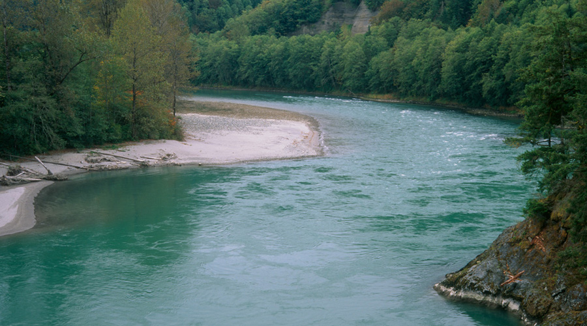

WRIA 12 Consumptive Use Methods
WRIA 12 Consumptive Use Methods
September, 2019
Chad Wiseman/Dan Graves
HDR Inc.
Adapted from a presentation by Rebecca Brown (Ecology)

Slide 2
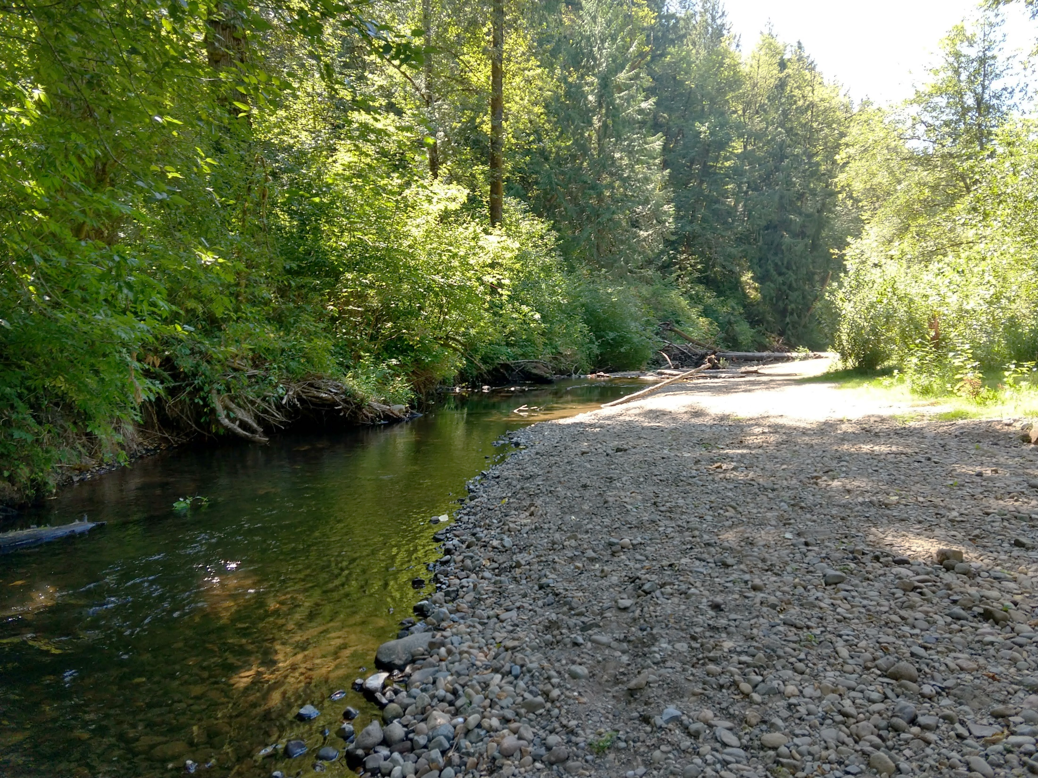
Consumptive Use Definition
Consumptive Water:
Water that is evaporated, transpired, consumed by humans, or otherwise removed from an immediate water environment.

Slide 3

Why Estimate Consumptive Water Use?
Under RCW 90.94 permit-exempt domestic well water use must be estimated to establish amount of water use that watershed restoration plans and plan updates must address.
Plans must estimate consumptive use associated with new domestic permit-exempt wells and connections anticipated between January 19, 2018 and January 18, 2038.
Ultimately, watershed plans will be judged by two tests:
  total potential impacts of new permit-exempt domestic wells are offset
  “net ecological benefit” (NEB) is provided by plan.

Slide 4
Average Indoor Use and Irrigated Area Method (Ecology Guidance)
Indoor use estimated using average from guidance and research
Outdoor use estimated by measuring lawn areas on selection of parcels

Slide 5
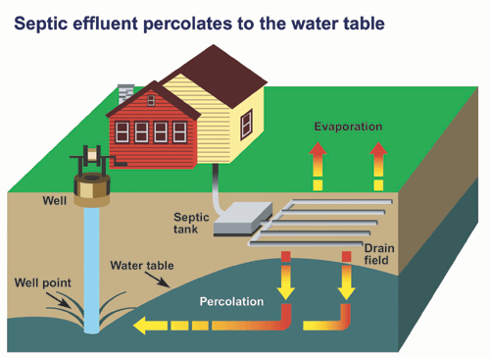
Indoor Water Use and Consumptive Portion
Average about 50-60 gallons per day (gpd) per person.
  Homes on municipal water generally use less water.
  Assumption of 60 gpd per person is reasonable for indoor water use.
10%
90%
Notes:
Numbers from a Water Research Foundation (DeOreo, et al., 2016) study that evaluated water use in homes provided municipal water in 23 areas across U.S. and Canada used an average of 59 gpd.
Tacoma Water study found an average of 51 gpd.

Slide 6
Household Consumptive Indoor Water Use
Assumptions:
2.5 people per household.
60 gpd per person water use.
10% of indoor water use is consumptive.
Example:
60 gpd * 2.5 people/house * 365 days * 0.00000307 AF/gal *10% CU = 0.017 AF/YR
Assumptions can be adjusted if supported by data in WRIA 12
Notes:
Example from the recommended methods document.
Average household size estimates are available from OFM and local planning agencies.

Slide 7
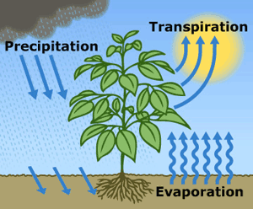
Outdoor Water Use and Consumptive Portion
Outdoor water use depends on…
The irrigated area size
The type of plants being irrigated, and
Local irrigation requirements (WAIG) (USDA 1997)
80%
Assumptions:
75% irrigation efficiency.
80% consumptive use.
20%
Assumptions can be adjusted if supported by data in WRIA 12
Notes:
Outdoor water use is highly variable. It depends on the size of the property, the amount of the property that is irrigated, and the type of plants being irrigated.
Irrigation requirements are available in Appendix A of the Washington Irrigation Guide (WAIG) (USDA, 1997).

Slide 8
Outdoor Water Use and Consumptive Portion
Example:
Irrigation Requirements (in) = 11.11 in ÷ 12 in per ft * 0.4 acres = 0.37 AF/YR
0.37 AF/YR ÷ 75% Irrigation Efficiency = 0.49 AF/YR
0.49 acre-feet * 80% Consumed (20% return flow) = 0.39 acre-feet
Assumptions can be adjusted if supported by data in WRIA 12
Notes:
Outdoor water use is highly variable. It depends on the size of the property, the amount of the property that is irrigated, and the type of plants being irrigated.
Irrigation requirements are available in Appendix A of the Washington Irrigation Guide (WAIG) (USDA, 1997).

Slide 9
Method to Estimate Irrigated Lawn Size
Define “pool” of parcels with existing PE connections (TPCHD data)
Select sample (80 parcels) with a stratified random draw (i.e. stratify by property value)
  Analyze parcels (one technician; August aerial imagery; corroborate among years or seasons; interpolate around trees and shading)
  Corroborate with Group B parcels (one Group B system, all parcels)

Slide 10
Water System Data Method
  Consumptive use of permit exempt wells and connections may also be estimated using metered connections from water systems.
  Obtain Group A or B water system meter data; ideally with flat rate (Spanaway Water Company)
  Separate average household indoor use and outdoor use
  Average monthly indoor use best defined as consumption in Dec, Jan, and Feb
  Multiply average monthly indoor use by 12 months to estimate total annual indoor water use.
  Subtract indoor use from total use to determine outdoor water use (ideally by month, then annualize).
  Apply respective consumptive factors to indoor and outdoor use
  Add indoor and outdoor consumptive use to determine total consumptive use per connection

Slide 11
Total Consumptive Water Use
Total annual consumptive water use per PE connection
Amount of water to offset in the plan.
Projected PE connections
*
=

Slide 12
Related Considerations

Slide 13


When & Where Consumptive Use
Impacts Will Occur
ESSB 6091 requires high priority offset projects to replace 20-year water use in-time and in same subbasin.
Estimating timing of groundwater impacts on streams is complicated due to lags between when a well is pumped and when those impacts propagate to a stream.
If shallow well pumps an unconfined aquifer adjacent to a stream, pumping effects can be almost instantaneous. However, if well pumps aquifer further from stream, smaller effects can occur over longer periods.

Slide 14
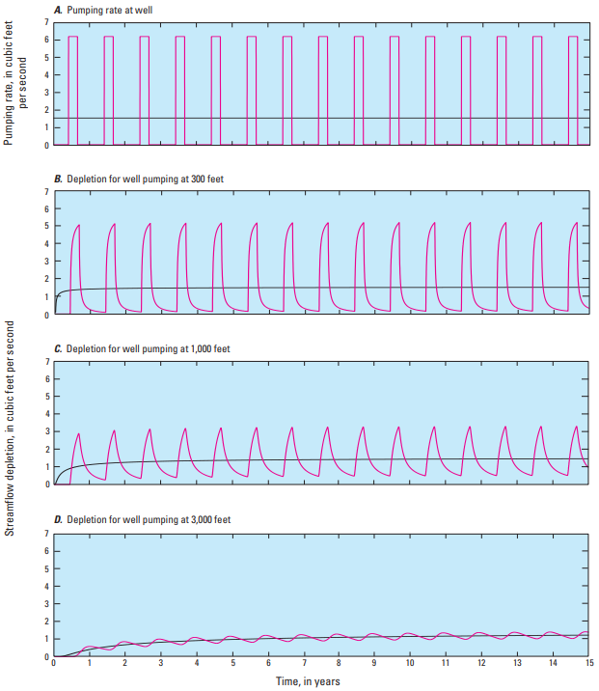
Seasonal vs. Steady State
Magnitudes of aquifer pumping pulses decay over distance and time as effects spread out.
In this example water-level changes range from a distinct pump-on – pump-off pattern, to a relatively constant impact.
In most instances in western Washington it is reasonable to assume streamflow depletion will essentially be steady state - especially beyond distance of few thousand feet.
USGS Circular 1376

Slide 15
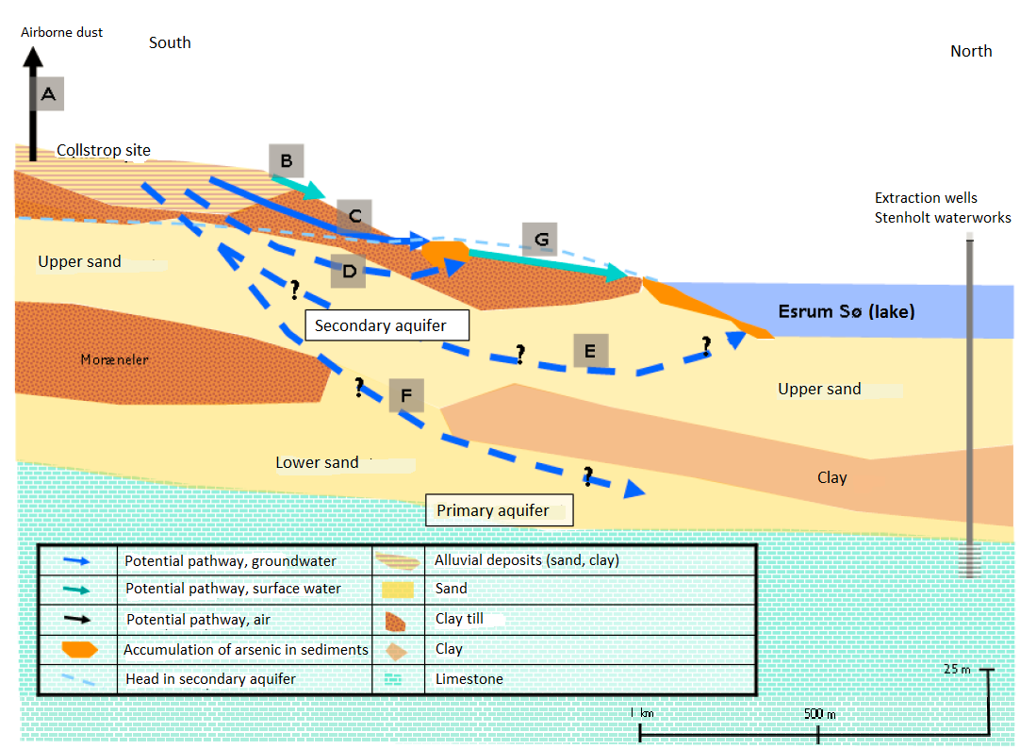
Conceptual Groundwater Understanding
Conceptual groundwater models provide overall hydrogeologic understanding.
In water resources terms this generally considers:
spatial delineations of recharge and discharge areas
identification of pathways from unsaturated zones through saturated zones to groundwater receptors
analyses and estimates of time scales of flow and effects of groundwater pumping

Slide 16
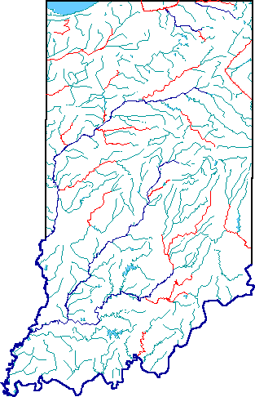
Spatial Considerations
Even when planning groups assume steady state conditions, they will need to consider how pumping effects are distributed spatially.
Conceptually, one option is to assume all pumping effects will remain within a subbasin and be distributed evenly to all surface water bodies.
In those instances where most future wells are likely to be shallow and congregated near an important fish-bearing stream, another option is to conservatively assume depletion impacts are entirely attributed to streams closest to pumping. However, this likely would be a rare instance.

Slide 17
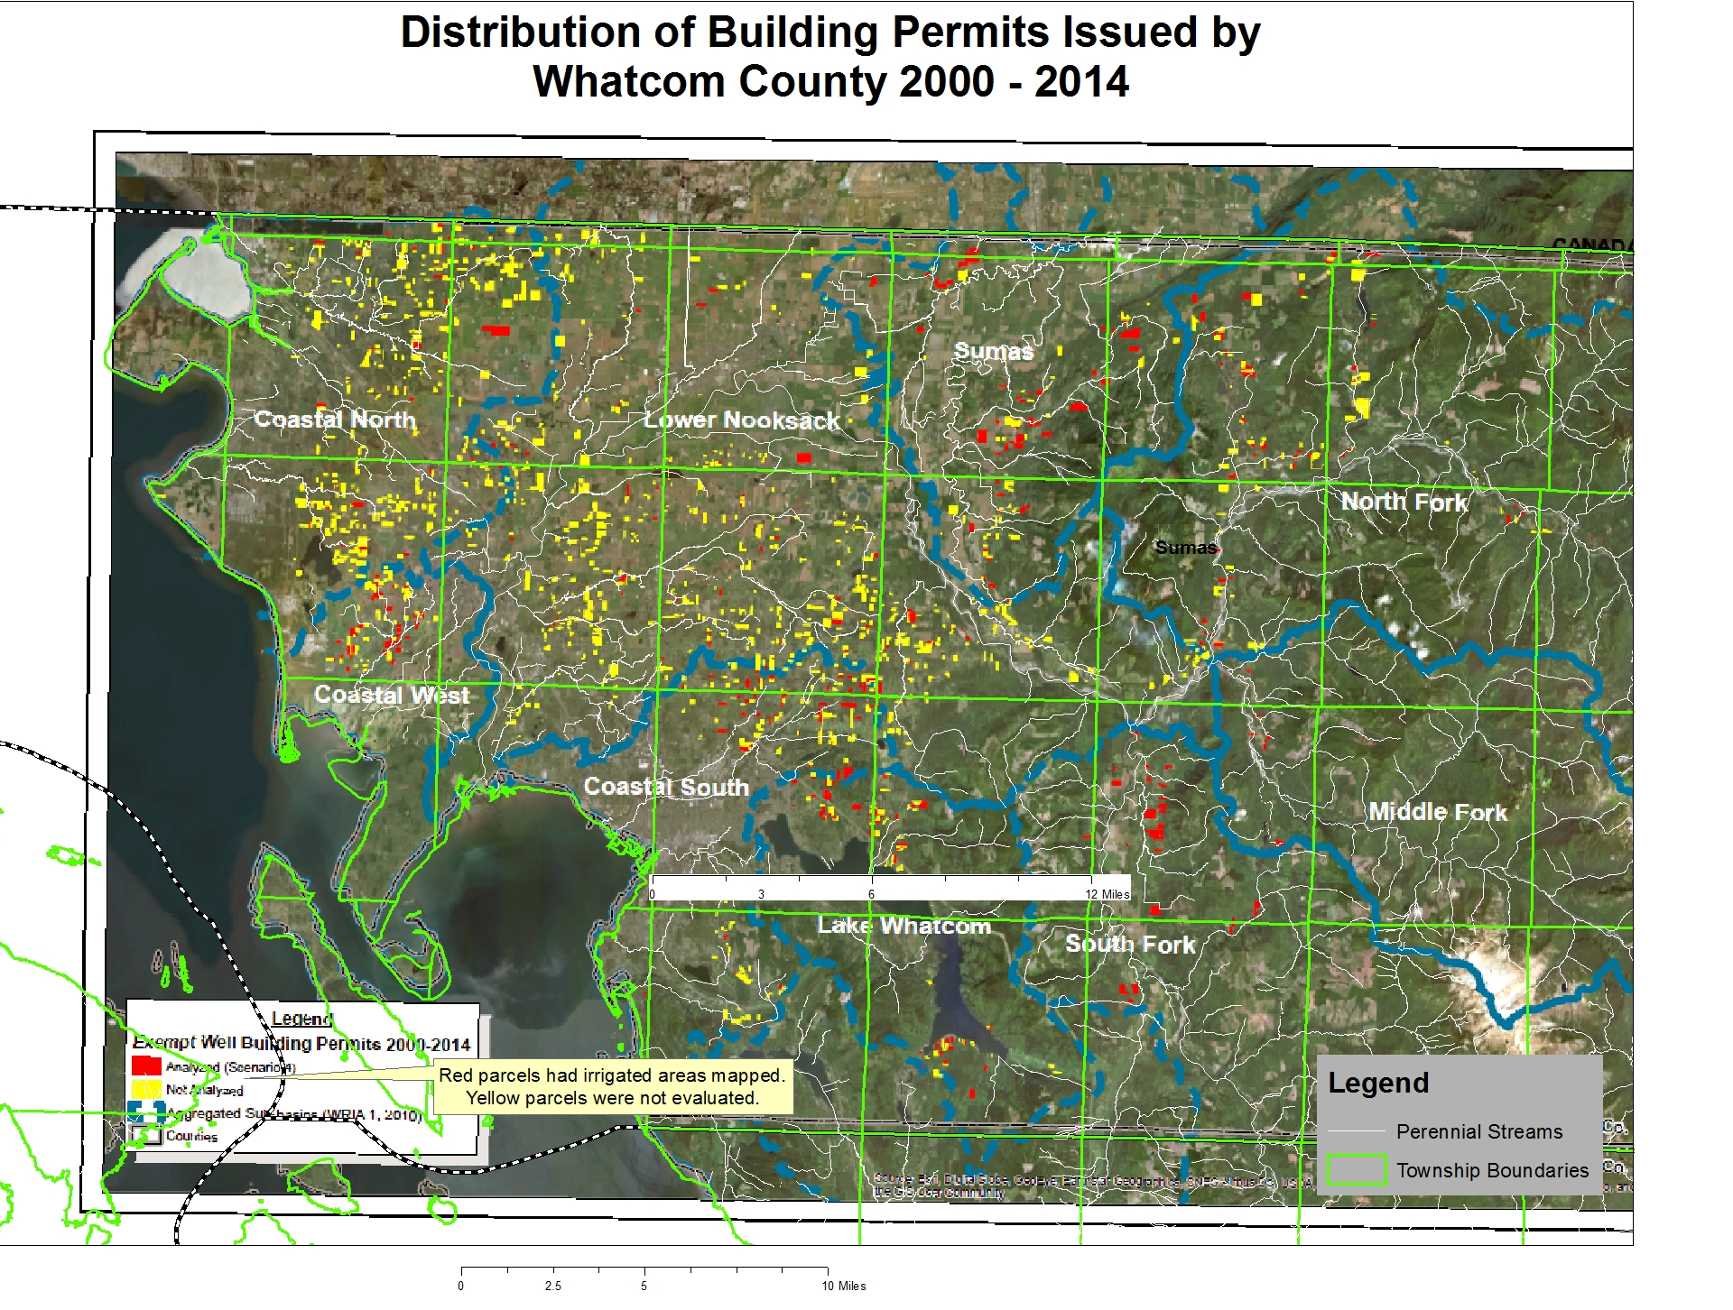
WRIA 1 Example
Most of permit exempt wells drilled in WRIA 1 2000-2014 were not located adjacent to perennial streams (both yellow and red parcels).
Steady-state depletion impacts are reasonable.

Slide 18
Context of RCW 90.94
Structure of mitigation under RCW 90.94 is fundamentally different then mitigation for groundwater permits.
Typically water right permits require offsetting impacts of groundwater pumping in-time and in place.
RCW 90.94 allows mitigation for permit-exempt domestic wells to occur anywhere within a WRIA, provided watershed plans achieve a Net Ecological Benefit (NEB).
Per RCW 90.94 when Ecology reviews plan addendums it will be looking for:
  “actions that the planning unit determines to be necessary to offset potential consumptive impacts to instream flows associated with permit-exempt domestic water use.”
  actions that “will result in a net ecological benefit to instream resources within the water resource inventory area.”
This means placing offset projects in places most beneficial to fish is probably more important than understanding specific impacts from permit-exempt domestic well pumping.

Slide 19
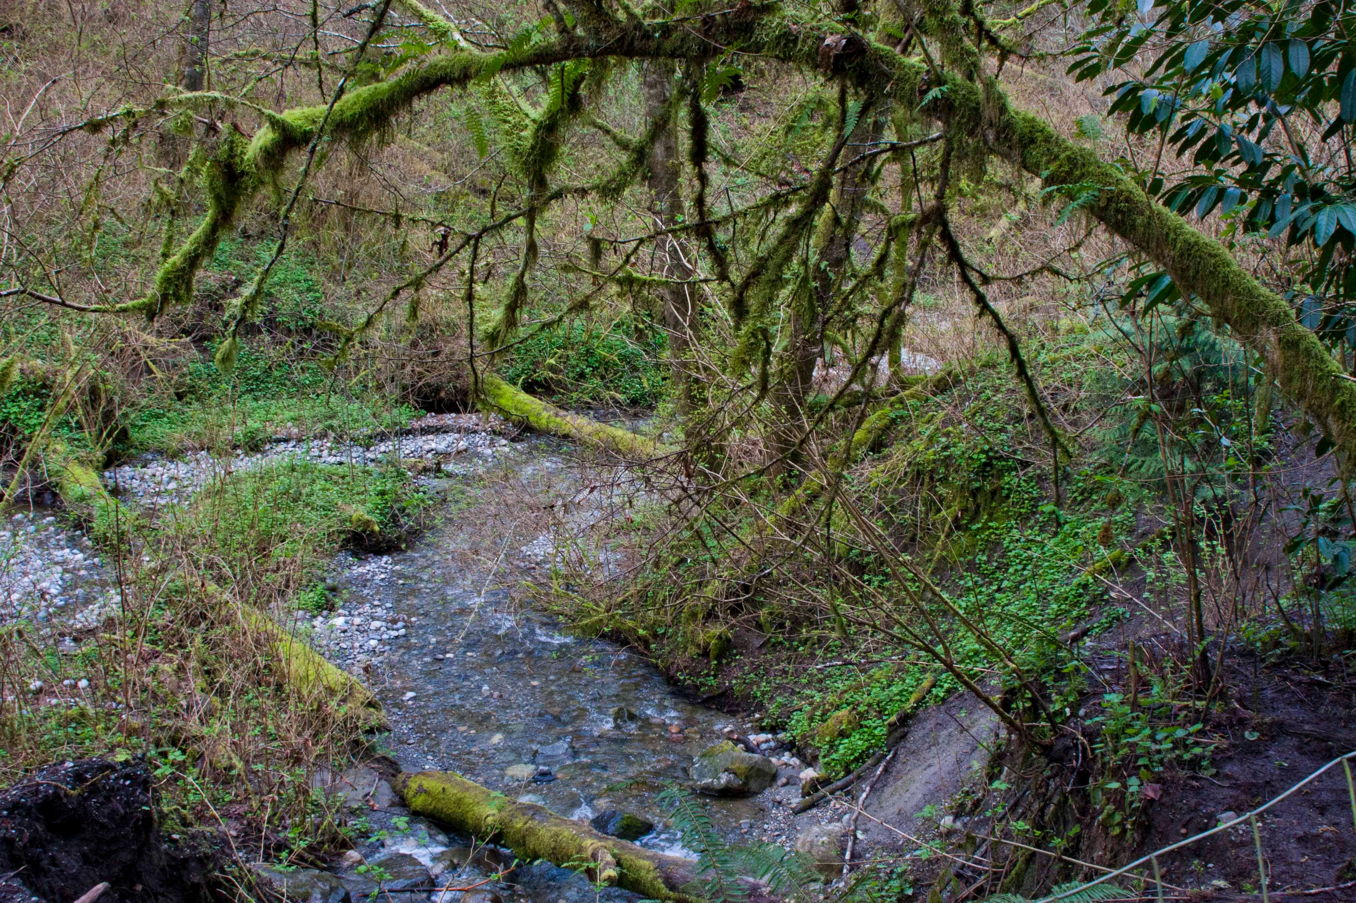
Questions?
Questions
and
Discussion
Chad Wiseman/Dan Graves
HDR Inc.

