Slide 1
PE Wells and Consumptive Use
Review on assumptions and remaining questions

Slide 2
Growth Projection Methods
Develop historical growth rates of permit-exempt wells for each subbasin using the TPCHD well database (1999 – 2018).
Forecast growth of future permit-exempt well connections for the 20 year planning horizon, based on the subbasin-specific historical growth rate.

Slide 3
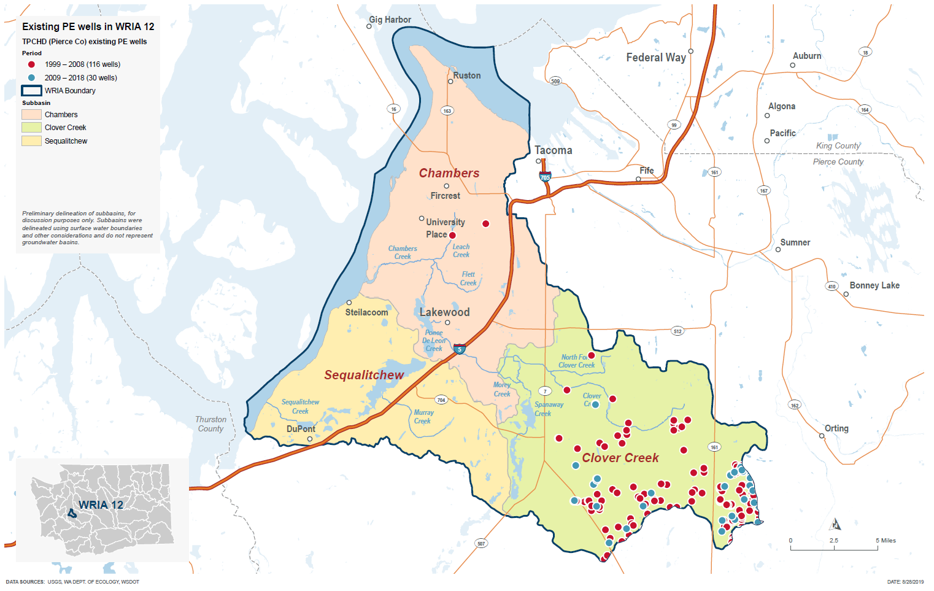
PE Wells from 1999-2018

Slide 4
PE Well Projections: High/Low/Moderate
 | Projected 2038 Total Wells Added Since 2018
Subbasins | Based on 1999-2008 Growth Rates (high) | Based on 2009-2018 Growth Rates (low) | Based on 1999-2018 Growth Rates (moderate)
All Subbasins | 227 | 78 | 145
Clover Creek | 220 | 76 | 141
Sequalitchew | -- | -- | --
Chambers Creek | 7 | 2 | 4

Slide 5
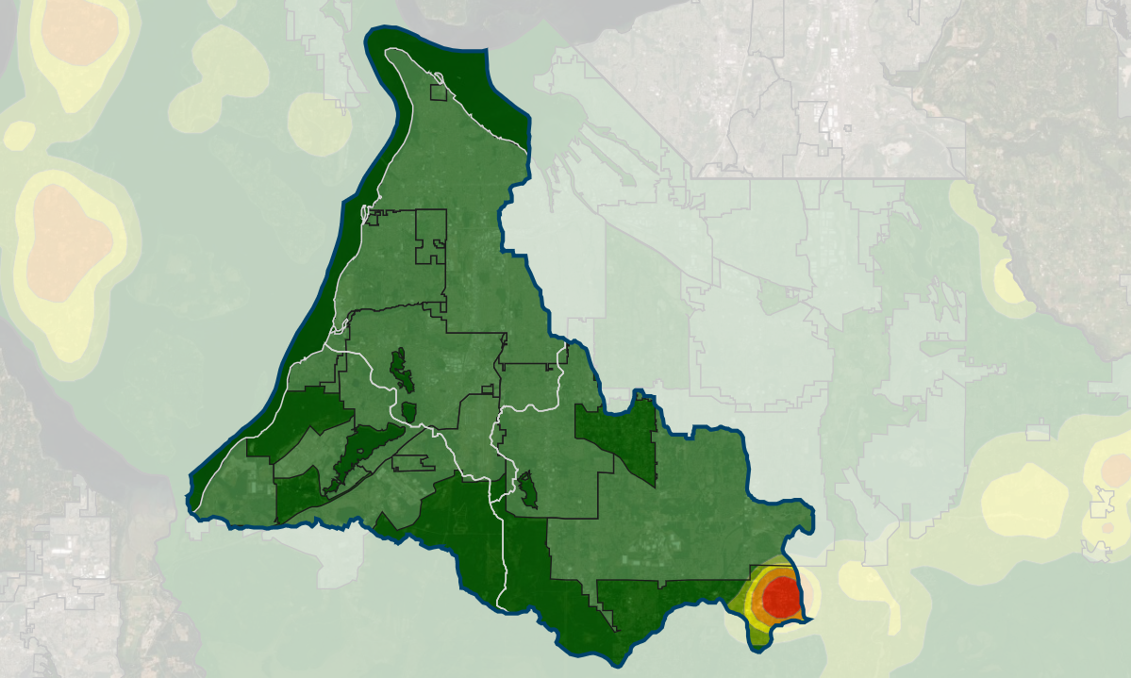
Heat Map of anticipated growth
Allocate growth within each subbasin spatially, based upon buildable lands analysis (i.e. parcel must be outside of UGA, not in a water & wastewater system boundary, not already build upon, or must have zoning category that allows for domestic dwelling unit use).
Notes:
Allocate growth within each subbasin spatially, based upon buildable lands analysis (i.e. parcel must be outside of UGA, not in a water & wastewater system boundary, not already build upon, or must have zoning category that allows for domestic dwelling unit use).

Slide 6
Baseline Consumptive Use Assumptions
Indoor:
60 gal/day/pp
2.5 people per household
10% consumptive
Outdoor:
20.3 inches/year (Washington Irrigation Guide)
75% irrigation efficiency
80% consumptive
?? Average landscape area

Slide 7
Average Landscape Area Analysis
Parcel pool: 137 (from well permits between 1999-2018)
Selected 80 parcels in stratified random draw by property value (<$350, $350-$600, >$600)
80 parcels was based on time, budget, and the contract, not a scientifically-based sample size.
One GIS analyst reviewed the August 2018 aerial photos for signs of outdoor irrigation, and measured the irrigated area.
When 2018 aerial photos were inconclusive, the analysts used other years’ aerial photo as noted on the CU Calculator Irrigated Area tab.
Analysis yielded an average outdoor irrigation area of 0.15 acres.

Slide 8
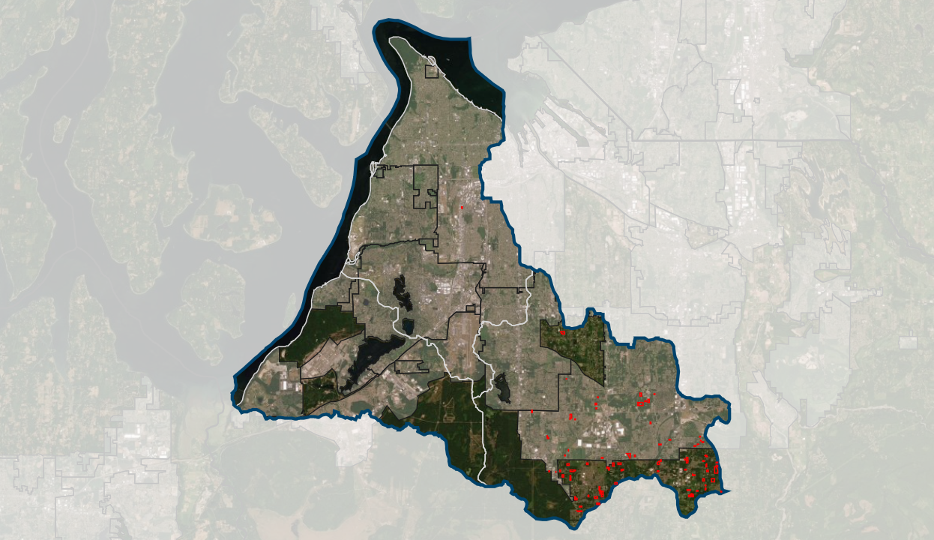
Parcels selected for outdoor irrigation analysis

Slide 9
Annual Consumptive Use Estimates Preliminary—based on 0.15 average acres.
Growth Projection Scenario/Subbasin | Projected PE Wells | Water System Estimate |  |  | Outdoor Irrigation Area
 |  | Ac-ft | gpm | cfs | Ac-ft | gpm | cfs
Based on 1999-2008 - Higher Growth Projection
Clover Creek | 220 | 13.1 | 8.1 | 0.02 | 63.2 | 39.2 | 0.09
Sequalitchew |  | 0.0 | 0.0 | 0.00 | 0.0 | 0.0 | 0.00
Chambers | 7 | 0.4 | 0.3 | 0.00 | 2.0 | 1.2 | 0.00
Total based on 1999-2008 | 227 | 13.5 ac-ft | 8.4 gpm | 0.02 cfs | 65.2 ac-ft | 40.4 gpm | 0.09 cfs
Based on 2009-2018 - Lower Growth Projection
Clover Creek | 76 | 4.5 | 2.8 | 0.01 | 21.8 | 13.5 | 0.03
Sequalitchew |  | 0.0 | 0.0 | 0.00 | 0.0 | 0.0 | 0.00
Chambers | 2 | 0.1 | 0.1 | 0.00 | 0.6 | 0.4 | 0.00
Total based on 1999-2008 | 78 | 4.6 ac-ft | 2.9 gpm | 0.01 cfs | 22.4 ac-ft | 13.9 gpm | 0.03 cfs
Based on 1999-2018 - Growth Projection
Clover Creek | 141 | 8.4 | 5.2 | 0.01 | 40.5 | 25.1 | 0.06
Sequalitchew |  | 0.0 | 0.0 | 0.00 | 0.0 | 0.0 | 0.00
Chambers | 4 | 0.2 | 0.1 | 0.00 | 1.1 | 0.7 | 0.00
Total based on 1999-2008 | 145 | 8.6 ac-ft | 5.3 gpm | 0.01 cfs | 41.7 ac-ft | 25.8 gpm | 0.06 cfs

Slide 10
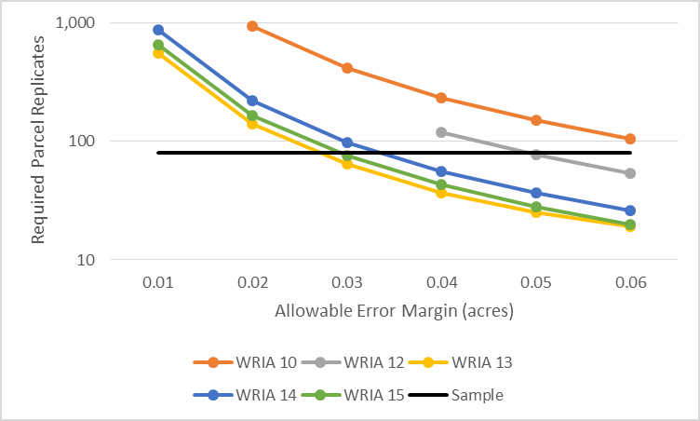
Outdoor Irrigation Analysis Statistics
Statistic | WRIA 10 | WRIA 12 | WRIA 13 | WRIA 14 | WRIA 15
PE Parcel Sample Pool | 978 | 137 | 7,271 | 5,091 | 8,987
Sample Size | 80 | 80 | 80 | 80 | 80
Mean with 0's | 0.17 | 0.15 | 0.06 | 0.07 | 0.08
SD with zero's | 0.31 | 0.22 | 0.12 | 0.15 | 0.13
Mean with 0.05 acre substitution | 0.20 | 0.17 | 0.10 | 0.10 | 0.11
SD with 0.05 acre substitution | 0.30 | 0.21 | 0.10 | 0.14 | 0.11
No Non-detects, Non-parametric Distribution
95% UCL (Chebyshev) | 0.34 | 0.27 | 0.12 | 0.14 | 0.14
Assume 0's are non-detects, replaced with 0.05 acres; Parameteric (Gamma or Lognormal)
95% UCL | 0.27 | 0.21 | 0.11 | 0.13 | 0.12
Sample Size Required to Estimate Mean at a specified allowable error margin (with given SD)
0.01 acres | 3,694 | 1,862 | 556 | 867 | 652
0.02 acres | 925 | 467 | 141 | 219 | 165
0.03 acres | 413 | 209 | 64 | 98 | 75
0.04 acres | 233 | 119 | 37 | 56 | 43
0.05 acres | 150 | 77 | 25 | 37 | 28
0.06 acres | 105 | 54 | 19 | 26 | 20

Slide 11
Questions/Concerns: Sample Size
The 80 parcel sample was selected based on budget and time considerations, not necessarily statistical significance. Options to address:
Document assumptions in the technical memo and plan.
Compare sample size to power analysis results.
Use the 95% Upper Confidence Level or add the allowable error margin (0.05) to the 0.15 acre average.

Slide 12
Questions/Concerns: Non-Detects
The average landscape area analysis yielded many “non-detects” or zero irrigated areas. This does not mean that these homes do not use outdoor water. Options to address include:
Assume the zeros are correct.
Make changes on results from cross-WRIA analysis.
Assume that there is undetectable amount of outdoor water use, and assign a value to reflect outdoor watering.
Could use the high-end of the error margin (0.05 acres).
Could assume “average” outdoor water use based on water system data. Calculate area based on the acres the average outdoor water could irrigate to WAIG standards.
Notes:
We don’t have to solve all these questions now.

Slide 13
Outstanding Concerns
Climate change could increase evapotranspiration and irrigation requirements.
Look at seasonality of water use or month by month instead of by full year.
Quality control.

